Slide 1
Code Table changes
2019-2020 School Year
July 31, 2019 – August 1, 2019

Slide 2
aGENDA
INDUSTRY-CERTIFICATION-LICENSURE-CODE (C214)
PROGRAM-OF-STUDY-CODE (C220)
SERVICE-ID (C022)

Slide 3
INDUSTRY-CERTIFICATION-LICENSURE-CODE
Since the March 2019 publication of TEDS v2020.1.0, translations for 9 codes have been revised and many industry certification licensure codes have been added.
There are currently 245 industry certification licensure options in the code table.
Click to view the INDUSTRY-CERTIFICATION-LICENSURE-CODE (C214) code table.

Slide 4
aGENDA
INDUSTRY-CERTIFICATION-LICENSURE-CODE (C214)
PROGRAM-OF-STUDY-CODE (C220)
SERVICE-ID (C022)

Slide 5
PROGRAM-OF-STUDY-CODE
Since the March 2019 publication of TEDS v2020.1.0, these changes have been made to the PROGRAM-OF-STUDY-CODE (C220) code table:
Code 008 translation revised from “Aviation” to “Aviation Maintenance”,
Code 010 “Building Code and Inspection” retired, and
8 new program of study codes added.

Slide 6
PROGRAM-OF-STUDY-CODE (C220)
Code | Translation | State | Region | New/Revised/Retire
008 | Aviation Maintenance | Y | N | Revised
010 | Building Code and Inspection | Y | N | Retire
053 | Barbering | Y | N | New
054 | Construction Management and Inspection | Y | N | New
055 | Fashion Design | Y | N | New
056 | Flight | Y | N | New
057 | Interior Design | Y | N | New
058 | Maritime | Y | N | New
059 | Medical Therapist | Y | N | New
060 | Welding | Y | N | New

Slide 7
aGENDA
INDUSTRY-CERTIFICATION-LICENSURE-CODE (C214)
PROGRAM-OF-STUDY-CODE (C220)
SERVICE-ID (C022)

Slide 8
SERVICE-ID (C022)
Since the March 2019 publication of TEDS v2020.1.0, the SERVICE-ID code table has additions, revisions and deletions.
Click to view the change log for the SERVICE-ID (C022) code table.
Click to view the SERVICE-ID (C022) code table.

Slide 9
SERVICE-ID (C022) - CYBERSECURITY
For the 2018-2019 school year, House Bill 3593 (85th Texas Legislature, 2017) permitted school districts to receive weighted Career and Technical Education funding for students enrolled in the following technology application courses on cybersecurity:
Fundamentals of Computer Science (03580140)
Computer Science I (03580200)
AP Computer Science Principles (A3580300)
To receive weighted funding, the district reports CTE attendance contact hours for students enrolled in these courses.

Slide 10
SERVICE-ID (C022) - CYBERSECURITY
For the 2019-2020 school year, the cybersecurity courses eligible for CTE weighted funding have changed.
August 2019 - HB 963 allows all Technology Applications courses to be eligible for weighted funding.
The following Service ID is no longer eligible for weighted funding:
Fundamentals of Computer Science (03580140)
The following Service IDs are newly eligible for weighted funding:
Digital Forensics (03580360)
AP Computer Science A – MATH (A3580110)
AP Computer Science A – LOTE (A3580120)
All Technology Applications courses
The following new Service IDs are eligible for weighted funding:
Foundations of Cybersecurity (03580850)
Cybersecurity Capstone (03580855)

Slide 11
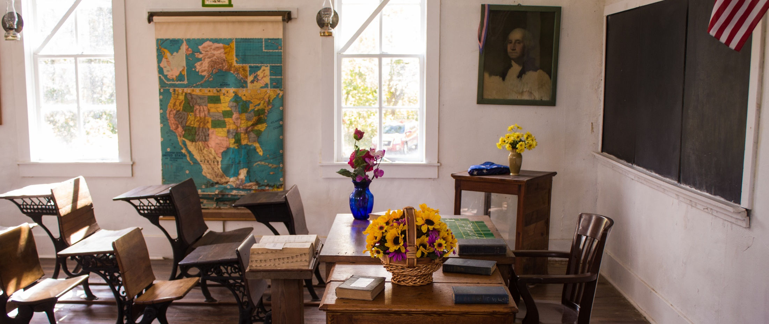
Questions?
www.texasstudentdatasystem.org

