Slide 1
OPEN CORE SUBMISSIONS
2024-2025
REACHING THE FINISH LINE

Slide 2
SESSION AGENDA
ECDS PK
SELA
RF TRACKER
CHILD FIND

Slide 3
Early Childhood Data System Prekindergarten
Reference Slides 28 - 44

Slide 4
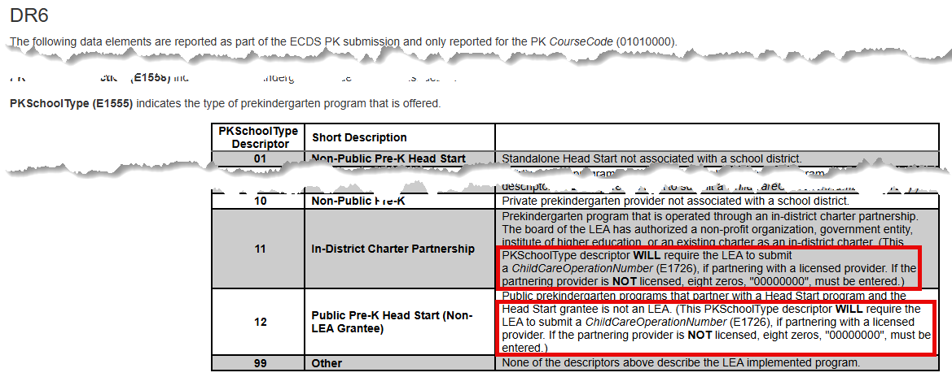
ECDS PK – Guidance Update
Guidance found in DR6 of Section Entity has been updated for the PKSchoolType (E1555) concerning descriptor codes ‘11’ and ‘12’.
This school type descriptor WILL require the LEA to submit a Child Care Operation Number, if partnering with a licensed provider. If the partnering provider is NOT licensed, eight zeros, "00000000", must be entered.
Section Entity - DR6

Slide 5
ECDS PK – Descriptor Table Updates
TitleOfAssessment
C312
Changes to the TitleOfAssessment descriptor table
PKTeacherRequirement
C207
Two new descriptors added to the PKTeacherRequirement descriptor table
Reference Slide 32
98 – PK teacher in a school district no additional HQPK Qualification
99 – Emp PK teacher in LEA no additional HQPK Qualification
Rules impacted by the change
30040-0049
30040-0057

Slide 6
ECDS PK – Report Updates
ECD0-000-006 Early Childhood PK Data Submission
Updated to include Teacher “Inst Strt” and “Inst End”
NEW Report logic updated to adjust calculations for “# Days in Class”, “Total Days in a PK Program”, and “Student in HQ Program” when the optional StudentSection.EndDate data element is not provided (reference slide 36)
ECD0-000-010 Early Childhood High-Quality PK Components Completion
New columns added to reflect the two new descriptor codes for PKTeacherRequirement

Slide 7
ECDS PK – Private Prekindergarten Reminder
For the 2024-2025 school year, TEA will no longer collect data from private prekindergarten schools.

Slide 8
Current Known Issues – ECDS PK1
No current known issues as of March 20, 2025.
Notes:
CTE AUTO-CALCULATION UPDATES

Slide 9
Question Quick Stop

Slide 10
Special Education Language Acquisition
Reference Slides 45 - 56

Slide 11
SELA Descriptor Updates
ToolOrAssessmentUsed
C320
Updates to the descriptor table
Descriptor Table Name Changes
C318 (was DC160) – HearingAmplificationAccess
Two new descriptors “RS” and “ES”
One descriptor deleted “AS”
C319 (was DC161) - HearingAmplificationDailyUse

Slide 12
Current Known Issues - SELA 1
No current known issues as of March 20, 2025.
Notes:
CTE AUTO-CALCULATION UPDATES

Slide 13
Residential Facility Tracker
Reference Slides 57 - 76

Slide 14
RF Tracker Mid-year Checkpoint2
Original mid-year checkpoint – December 13, 2024
Statewide extension – January 17, 2025
With a few additional extensions, 189 LEAs completed the checkpoint by January 21, 2025.

Slide 15
RF Tracker Rules Update 2
Reinstated rule: 10025-0001
ResidentialFacilityId must match an entry registered with the TEA as an active residential facility.
Added new rule: 40115-0013
ResidentialFacilityId must match an entry registered with TEA as an active residential facility.
Reasoning:
Ensures that the Residential Facility ID is active, and a valid number assigned by the Special Education Division. If there are no students reported residing in a residential facility during a school year, the residential facility will be inactivated for the next school year.

Slide 16
Current Known Issues – RF Tracker21
No current known issues as of March 20, 2025.

Slide 17
Question Quick Stop 2

Slide 18
Child Find
Reference Slides 77 - 90

Slide 19
Child Find Data Element Updates
EvaluationDelayDays (E1711)
TransitionNotificationDate (E1712)
TransitionConferenceDate (E1713)
EligibilityEvaluationDate (E1715)
was STUDENT-ABSENCES-WITHIN-TIMEFRAME
was ECI-NOTIFICATION-DATE
was ECI-TRANSITION-CONFERENCE-DATE
was INITIAL-EVALUATION-DATE
SpecialEducationOrganizationResponsibilityAssociation (SEORA)
School ref (where Responsibility (E3051) = ’03’)
was CAMPUS-ID-OF-EVALUATION

Slide 20
Child Find Descriptor Table Name Changes
EligibilityDelayReason (C347)
was DELAY-REASON-CODE (DC164)
EvaluationDelayReason (C348)
was DELAY-REASON-CODE (DC164)

Slide 21
Child Find CHANGE to Compliance Timeline
Change to SPPI-11 compliance calculation for holdover students.
The standard SPPI-11 Eligibility Determination compliance timeline for students evaluated less than 30 calendar days before the end of the prior school year has been updated.
OLD: EligibilityDeterminationDate had to be completed no later than the 1st instructional day of the next school year.
NEW: EligibilityDeterminationDate must be completed no later than the 15th instructional day of the next school year.

Slide 22
Child Find CHANGE to Compliance Timeline 2
This change was made in the February 28, 2025 software release.
LEAs that promoted data to Child Find prior to this date should re-promote their submission data to re-calculate the compliance in this scenario.
The Child Find compliance flowcharts have been updated to reflect this change:
TSDSKB-620: SPPI-11 Compliance Flowchart
TSDSKB-650: Child Find Interactive Flowchart

Slide 23
Reminder - OriginalECIServicesDate
OriginalECIServicesDate (E1737)
Only reported for children receiving early childhood intervention (ECI) services.
Date must come before the child’s 3rd birthday.​
Children reported with a date less than 90 days before their 3rd birthday will have their compliance calculated through the SPPI-11 timeline.​
CHF0-100-002 SPPI-12 Student Compliance Report
Review the ‘Calc Days Til 3rd Bday Count’ column on this report.​
These children will show up on both the:
SPPI-11 reports CHF0-100-001, CHF0-100-003 and CHF0-100-005.
and be counted in both the SPPI-12 reports CHF0-100-002 and CHF0-100-004.

Slide 24
Current Known Issues – Child Find5 1
CalendarCode (E0975) promotion logic issue when a student's latest enrollment campus does not match their evaluation campus.
CHF0-100-003 TSDS SPPI-11 Aggregate Report
Row (a) is counting the total number of students reported in all of Child Find and should only be counting those being reported for SPPI-11.
Notes:
CTE AUTO-CALCULATION UPDATES

Slide 25
Question Quick Stop 3

Slide 26
Promotion Logic Document Updates
Data Collection Documentation
RF Tracker
Available now!
Child Find, ECDS PK, SELA
2024-2025 updates coming soon!

Slide 27
QUESTIONS

Slide 28
ECDS PK Resource Slides #28 to #44
Return to slide 3

Slide 29
PROGRAM AREA UPDATES & GUIDANCE
Early Childhood Education Division
Tori Lee – Division Director
Sylina Valdez – Programs Director
Rebecca Matz – Program and Enrollment Specialist
Magali Farooqi – Early Childhood Assessment Specialist
Lauren Gomez – Curriculum and Instruction Specialist
Jennifer Bruning – Family Engagement Specialist
Program-related questions can be submitted to the Early Childhood Education Division Support Portal.

Slide 30
PROGRAM AREA UPDATES & GUIDANCE 2
ECDS Kindergarten Assessment Guidance
Ensure student information is loaded in a timely manner – Programs team will be pulling data on when an LEA begins promoting data to determine if extensions will be granted
There are no exemptions given for LEAs that do not use one of the two commissioner-approved kindergarten reading instruments (TX-KEA or mCLASS Texas)
ECDS Prekindergarten Assessment Update
New list will be implemented this school year – There are no exemptions given for LEAs that do not administer commissioner-approved pre-k instruments
There will be no collection of MOY prekindergarten data through ECDS for the 24-25 SY
High-Quality Prekindergarten ECDS Reporting Update
SY 24-25: PK Teacher Requirement code table add’l update to add a “does not meet” code and will generate a fatal error if left blank
Notes for PK School Type Code updated to address Child Care Operation Number (next slide)
June 2024- Commissioner's Rule 19 TAC 102.1003 updated to align with HB 2729 and create consistency with Texas Education Code Chapter 29 Subchapter E-1.

Slide 31
PROGRAM AREA UPDATES & GUIDANCE 3
DR6 (TSDS Web-Enabled Data Standards) from Notes for PK School Type Code Table have been updated.
For Codes 11 and 12:
This school type code WILL require the LEA to submit a Child Care Operation Number, if partnering with a licensed provider. If the partnering provider is NOT licensed, eight zeros, "00000000", must be entered.)

Slide 32
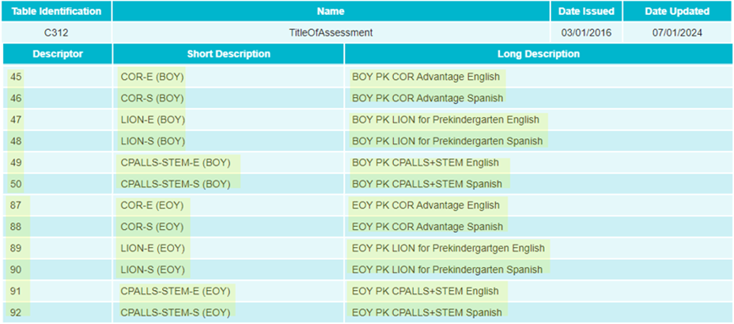
DATA GOVERNANCE UPDATES
SUMMER TRAINING 2024 Descriptor Table Updates:
C312 TitleOfAssessment:
New Prekindergarten Assessments for 2024-2025 School Year

Slide 33
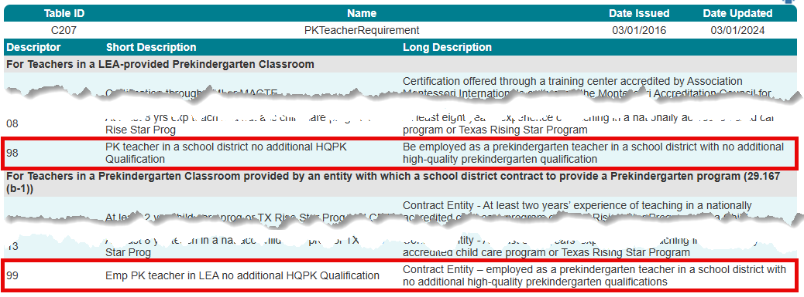
DESCRIPTOR TABLE UPDATES
The following C207 PKTeacherRequirement descriptor table values have been added:
98 – Be employed as a prekindergarten teacher in a school district with no additional high-quality prekindergarten qualification
99 – Contract Entity – employed as a prekindergarten teacher in a school district with no additional high-quality prekindergarten qualifications

Slide 34
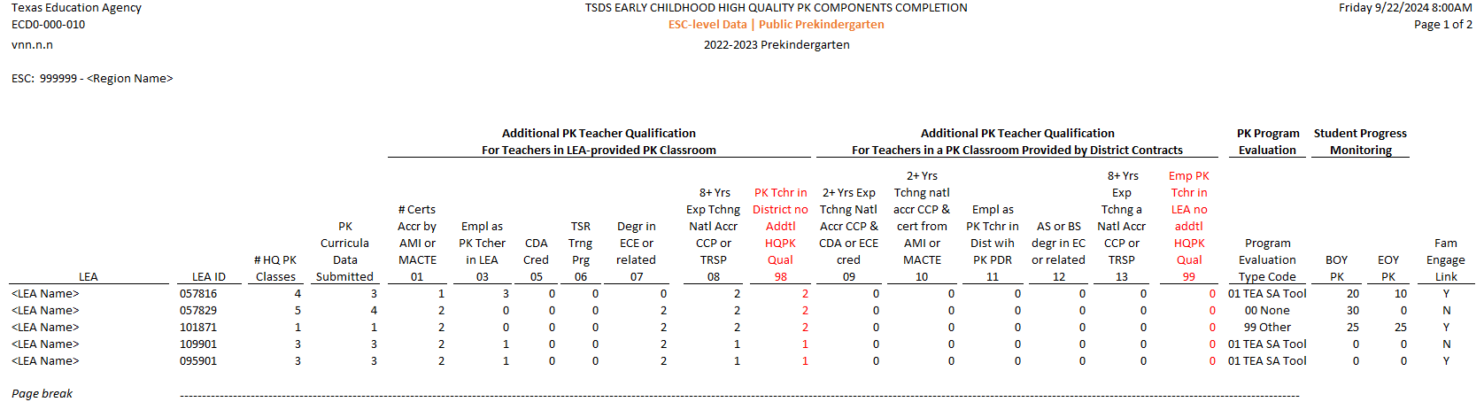
REPORT UPDATES 3
SUMMER TRAINING 2024 The following report was updated to accommodate the new values that were added to the PKTeacherRequirement descriptor table for the 2024-2025 school year.
ECD0-000-010 Early Childhood High-Quality PK Components Completion

Slide 35
REPORT UPDATES 23
SUMMER TRAINING 2024 The following report was updated to include the teacher “Inst Strt” and “Inst End” dates:
ECD0-000-006 Early Childhood PK Data Submission

Slide 36
REPORT UPDATES 3 3
NEW* The report logic calculating the number of days in class, number of days in PKSchoolType, and number of HighQualityPKProgram days will be updated to use a fixed date when the optional StudentSection.EndDate is not provided unless there is a withdrawal or schedule change.
ECD0-000-006 Early Childhood PK Data Submission
*New since Summer Training 2024

Slide 37
BUSINESS RULE UPDATES 2
The following business rules will be impacted by the C207 PKTeacherRequirement descriptor table values that will be added:
30040-0049
30040-0057

Slide 38
TSDS UPGRADE PROJECT UPDATES
Data Element Name Changes:
Data Element ID | XML Data Element Name | Upgrade Data Element Name
E1127 | ASSESSMENT TITLE | TitleofAssessment
E1359 | SCORE RESULT | Result
E1056 | CLASS-ID-NUMBER | SectionIdentifier
E3010 (was E1069) | STUDENT-BEGIN-DATE | BeginDate
E3020 (was E1070) | STUDENT-END-DATE | EndDate
E3010 (was E1065) | ASSIGNMENT-BEGIN-DATE | BeginDate
E3020 (was E1066) | ASSIGNMENT-END-DATE | EndDate
E0790 (was E1390) | EMERGENT-BILINGUAL | EmergentBilingualIndicator
E3044 (was E1079) | PRIMARY-PK-FUNDING-SOURCE | PKFundingSource
E3044 (was E1080) | SECONDARY-PK-FUNDING-SOURCE | PKFundingSource

Slide 39
TSDS UPGRADE PROJECT UPDATES 3
Descriptor Table Name Changes:
Descriptor Table ID | XML Code Table Name | Upgrade Descriptor Table Name
C061 (was DC079) | EMERGENT-BILINGUAL-TYPE | EmergentBilingualIndicator
C303 (was DC096) | PROGRAM-TYPE | ProgramType
C310 (was DC152) | PK-SCHOOL-TYPE | PKSchoolType
C311 (was DC153) | STUDENT-INSTRUCTION-TYPE | PKStudentInstruction
C312 (was DC154) | ASSESSMENT-TITLE-CODE | TitleOfAssessment

Slide 40
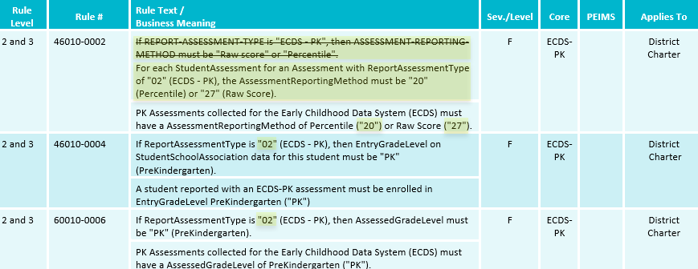
TSDS UPGRADE PROJECT UPDATES 2
Business Rule Changes:
Uses codes instead of descriptors to trigger validations:
“If ReportAssessmentType is "02" (ECDS - PK)…”

Slide 41
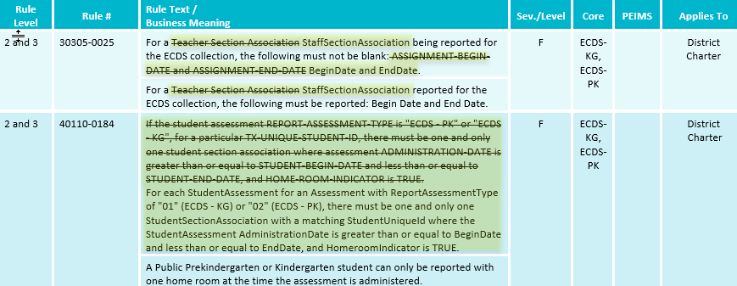
TSDS UPGRADE PROJECT UPDATES 4
Business Rule Changes:
Business validation logic requires that a BeginDate and EndDate must be populated:

Slide 42
TSDS UPGRADE PROJECT UPDATES 5 4
Business Rule Changes:
30305-0011
The rule logic was updated from “EndDate must be greater than BeginDate” to “EndDate must be greater than or equal to BeginDate.”

Slide 43
TIMELINE 3
Early Childhood Data System Collection (ECDS) - PK | Date
TSDS ready to load data to IODS | August 5, 2024
ECDS Prekindergarten ready for users to complete | May 1, 2025
ECDS Prekindergarten Submission due date for LEAs | June 26, 2025
ECDS Prekindergarten data available to customers | July 10, 2025

Slide 44
TECHNICAL RESOURCES
Technical Support
TSDSCustomerSupport@tea.texas.gov
Technical Specifications
2024-2025 TSDS Web-Enabled Data Standards (TWEDS)
Known Issues
TSDS Incident Management System (TIMS)
TSDS Incident Management System (TIMS) Support Application
TIMS Knowledge Base Article Repository
Early Childhood Education
Early Childhood Education Division Support Portal

Slide 45
SELA Resource Slides #45 to #56
Return to slide 10

Slide 46
PROGRAM AREA UPDATES & GUIDANCE 7
Special Education Programs Division​
Emily Heise – Director, Deaf & Hard of Hearing Program Admin. and State Director of Regional Day School Program for the Deaf
Program-related questions can be submitted to SELA@tea.texas.gov.

Slide 47
DATA GOVERNANCE UPDATES 8
Descriptor Table Updates:

Slide 48
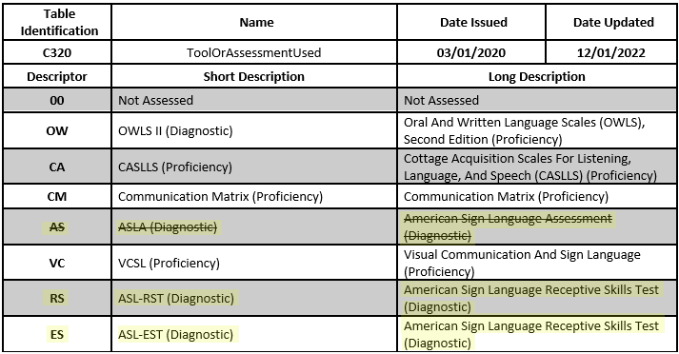
DATA GOVERNANCE UPDATES 9
Descriptor Table Updates:
Notes:
DC096 PROGRAM-TYPE->C303 ProgramType:
C303 now only includes the following values:
04 Bilingual
05 Career and Technical Education
12 English as a Second Language (ESL)
33 Special Education
38 Title I Part A
DC142 DISABILITY TYPE->C053 Disability
C053 descriptor value updates (description reassigned to new code values)
01-Orthopedic Impairment
02-Other Health Impairment
03-Deaf And Hard Of Hearing
04-Deaf And Hard Of Hearing
05-Deaf-Blindness
06-Intellectual Disability
07-Emotional Disturbance
08-Specific Learning Disability
09-Speech or Language Impairment
10-Autism
12-Developmental Delay
13-Traumatic Brain Injury
14-Noncategorical Early Childhood

Slide 49
TSDS UPGRADE PROJECT UPDATES 10
Data Element Name Changes:
Data Element ID | XML Data Element Name | Upgrade Data Element Name
E3010 | N/A | BeginDate
E3020 | N/A | EndDate
E3016 | N/A | DisabilitySetBeginDate
E3017 | N/A | DisabilitySetEndDate
E3025 | N/A | InstructionalSettingBeginDate
E3026 | N/A | InstructionalSettingEndDate
E0266 | CAMPUS-ID | EducationOrganization (Reference)

Slide 50
TSDS UPGRADE PROJECT UPDATES 8
Descriptor Table Name Changes:
Descriptor Table ID | XML Code Table Name | Upgrade Descriptor Table Name
C061 (was DC079) | EMERGENT-BILINGUAL-TYPE | EmergentBilingualIndicator
C318 (was DC160) | PERIOD-OF-TIME-ACCESS-CODE | HearingAmplificationAccess
C319 (was DC161) | AVERAGE-TIME-CODE | HearingAmplificationDailyUse
C303 (was DC096) | PROGRAM-TYPE | ProgramType
C053 (was DC142) | DISABILITY-TYPE | Disability
Notes:
DC096 PROGRAM-TYPE->C303 ProgramType:
C303 now only includes the following values:
04 Bilingual
05 Career and Technical Education
12 English as a Second Language (ESL)
33 Special Education
38 Title I Part A
DC142 DISABILITY TYPE->C053 Disability
C053 descriptor value updates (description reassigned to new code values)
01-Orthopedic Impairment
02-Other Health Impairment
03-Deaf And Hard Of Hearing
04-Deaf And Hard Of Hearing
05-Deaf-Blindness
06-Intellectual Disability
07-Emotional Disturbance
08-Specific Learning Disability
09-Speech or Language Impairment
10-Autism
12-Developmental Delay
13-Traumatic Brain Injury
14-Noncategorical Early Childhood

Slide 51
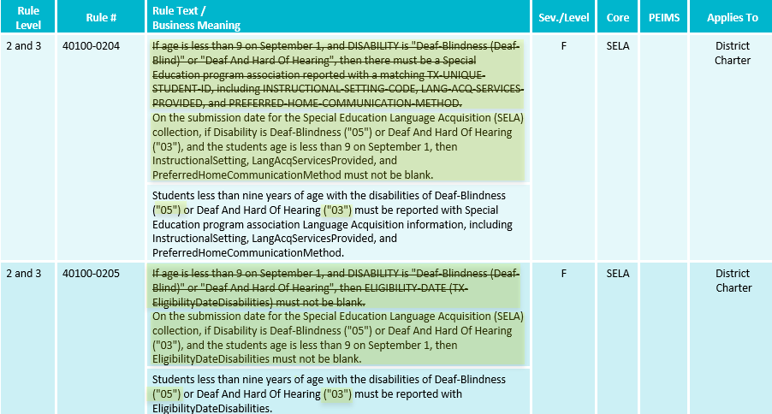
TSDS UPGRADE PROJECT UPDATES 2 1
Business Rule Changes:
Uses Disability ’05’ and ‘03’ descriptor values replacing ‘Deaf Blindness’ and ‘Deaf And Hard of Hearing’

Slide 52
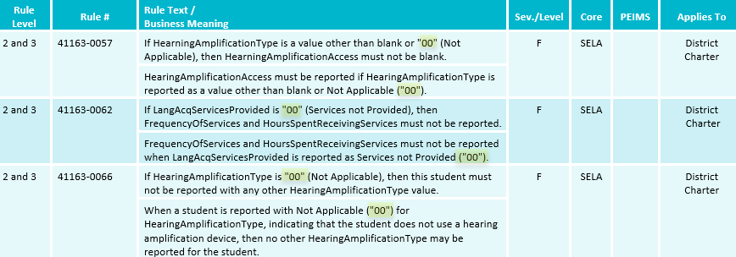
TSDS UPGRADE PROJECT UPDATES 7 3
Business Rule Changes:
Example of rules that use ‘00’ descriptor values instead of code value description:

Slide 53
TSDS UPGRADE PROJECT UPDATES 8 4
Business Rule Changes:
The following business rules have been added:

Slide 54
TSDS UPGRADE PROJECT UPDATES 9
SUMMER TRAINING 2024 Entity/Common Type Change:

Slide 55
TIMELINE 2
Special Education Language Acquisition (SELA) | Date
TSDS ready to load data to IODS | August 5, 2024
Special Education Language Acquisition ready for users to complete | May 19, 2025
Special Education Language Acquisition Submission due date for LEAs | June 26, 2025
Special Education Language Acquisition data available to customers | July 10, 2025

Slide 56
TECHNICAL RESOURCES 3
Technical Support
TSDSCustomerSupport@tea.texas.gov
Technical Specification
2024-2025 TSDS Web-Enabled Data Standards (TWEDS)
Known Issues
TSDS Incident Management System (TIMS)
TSDS Incident Management System (TIMS) Support Application
TIMS Knowledge Base Article Repository

Slide 57
RF Tracker Resource Slides #57 to #76
Return to slide 13

Slide 58
PROGRAM AREA UPDATES & GUIDANCE 11
Office of Special Populations and Monitoring
Department of Review and Support
ReviewandSupport@tea.texas.gov

Slide 59
TSDS UPGRADE PROJECT UPDATES 1
Data Element Name Changes:
Data Element ID | XML Data Element Name | Upgrade Data Element Name
E0041 | PRIMARY-DISABILITY-CODE | Disability
E0834 | SECONDARY-DISABILITY-CODE | Disability
E0835 | TERTIARY-DISABILITY-CODE | Disability

Slide 60
TSDS UPGRADE PROJECT UPDATES 11 2
Data Element Name Changes:
Data Element ID | XML Data Element Name | Upgrade Data Element Name
E0833 | REG-DAY-SCH-PROG-DEAF-CODE | SpecialEducationProgramService
E0838 | AUDIOLOGICAL-SERV-IND-CODE | SpecialEducationProgramService
E0840 | COUNSELING-SERVICES-IND-CODE | SpecialEducationProgramService
E0841 | MEDICAL-DIAGNOSTIC-SERV-IND-CODE | SpecialEducationProgramService
E0843 | OCCUPATIONAL-THERAPY-IND-CODE | SpecialEducationProgramService

Slide 61
TSDS UPGRADE PROJECT UPDATES 123
Data Element Name Changes:
Data Element ID | XML Data Element Name | Upgrade Data Element Name
E0844 | ORIENT-MOBILITY-TRNG-IND-CODE | SpecialEducationProgramService
E0845 | PHYSICAL-THERAPY-IND-CODE | SpecialEducationProgramService
E0846 | PSYCHOLOGICAL-SERVICES-IND-CODE | SpecialEducationProgramService
E0847 | RECREATION-IND-CODE | SpecialEducationProgramService

Slide 62
TSDS UPGRADE PROJECT UPDATES 134
Data Element Name Changes:
Data Element ID | XML Data Element Name | Upgrade Data Element Name
E0848 | SCHOOL-HEALTH-SERVICES-IND-CODE | SpecialEducationProgramService
E0849 | SOCIAL-WORK-SERVICES-IND-CODE | SpecialEducationProgramService
E0851 | TRANSPORTATION-INDICATOR-CODE | SpecialEducationProgramService
E0857 | SPEECH-THERAPY-INDICATOR-CODE | SpecialEducationProgramService

Slide 63
TSDS UPGRADE PROJECT UPDATES 5
Data Element Name Changes:
Data Element ID | XML Data Element Name | Upgrade Data Element Name
E0899 | PRESCHL-PROG-CHLDRN-WITH-DISAB-IND-CD | SpecialEducationProgramService
E0900 | EARLY-CHILDHOOD-INTERV-IND-CODE | SpecialEducationProgramService
E0997 | ASSISTIVE-TECH-INDICATOR-CODE | SpecialEducationProgramService
E1040 | INTERPRETING-SERVICES-TYPE-CODE | SpecialEducationProgramService

Slide 64
TSDS UPGRADE PROJECT UPDATES 6
Business Rule Changes:
If Disability is "14", then OrderOfDisability must be 1.
For 2023-2024 the disability data elements were primary, secondary, and tertiary.
For 2024-2025, the OrderOfDisability is used, 1=primary, 2=secondary, and 3=tertiary.

Slide 65
TSDS UPGRADE PROJECT UPDATES 7
Business Rule Changes:
On the PEIMS Fall snapshot date, or on the submission date for the Residential Facility Tracker (RFT) collection, if a Disability is reported with OrderOfDisability 3, then a Disability must be reported with OrderOfDisability of 2 for this student.
For 2023-2024 the disability data elements were primary, secondary, and tertiary.
For 2024-2025, the OrderOfDisability is used, 1=primary, 2=secondary, and 3=tertiary.

Slide 66
TSDS UPGRADE PROJECT UPDATES 14 8
Business Rule Changes:
On the submission date for the Residential Facility Tracker (RFT) submission, if a Disability is reported with OrderOfDisability of 2 or 3, then a Disability must be reported with OrderOfDisability of 1.
For 2023-2024 the disability data elements were primary, secondary, and tertiary.
For 2024-2025, the OrderOfDisability is used, 1=primary, 2=secondary, and 3=tertiary.

Slide 67
TSDS UPGRADE PROJECT UPDATES 18
SUMMER TRAINING 2024 Business Rule Changes:
Reinstated Data Validation Rule 10025-0001:

Slide 68
TSDS UPGRADE PROJECT UPDATES 82
SUMMER TRAINING 2024 Business Rule Changes:
Added Data Validation Rule 40115-0013:

Slide 69
TSDS UPGRADE PROJECT UPDATES 83
SUMMER TRAINING 2024 Business Rule Changes:
Revised Data Validation Rule 41163-0010:

Slide 70
TSDS UPGRADE PROJECT UPDATES 84
SUMMER TRAINING 2024 Business Rule Changes:
Added Data Validation Rule 41163-0103:

Slide 71
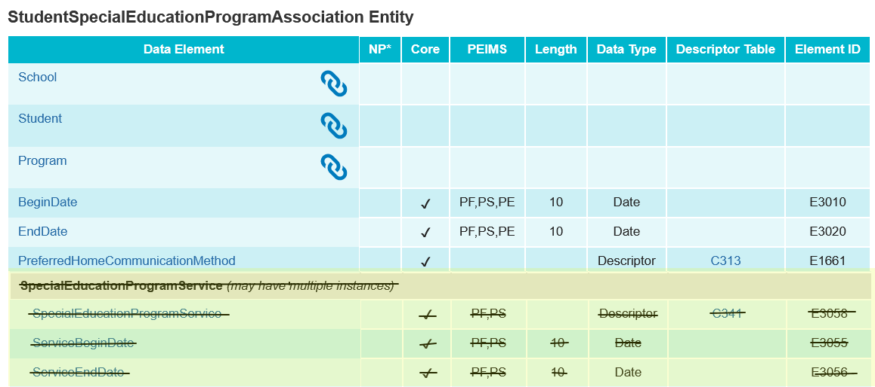
TSDS UPGRADE PROJECT UPDATES 86
SUMMER TRAINING 2024 Entity/Common Type Change:
Removed SpecialEducationProgramService common type

Slide 72
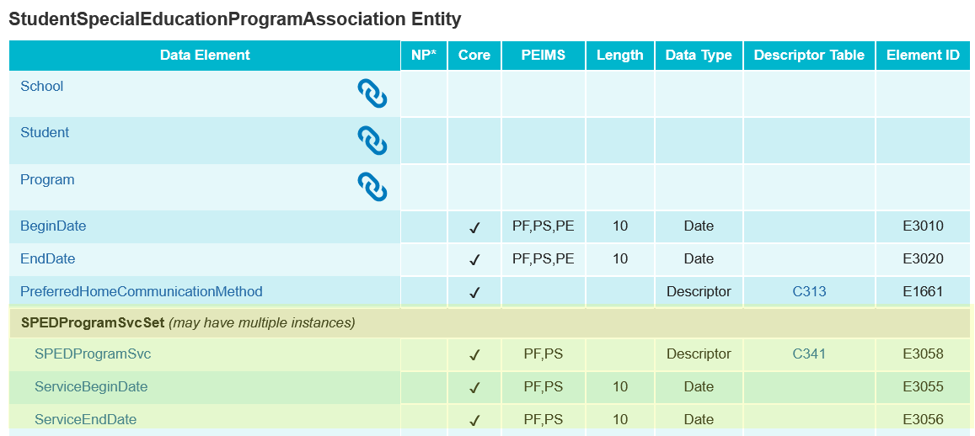
TSDS UPGRADE PROJECT UPDATES 87
SUMMER TRAINING 2024 Entity/Common Type Change:
StudentSpecialEducationProgramAssociation.SPEDProgramSvcSet

Slide 73
TSDS UPGRADE PROJECT UPDATES 15 9
Additional Changes:
XML Legacy Data Element | XML Legacy Complex Type | Upgrade Data Element | Upgrade Student Entity
CAMPUS-ID-OF-ENROLLMENT (E0782) | StudentResidentialFacilityAssociationExtension Complex Type | School | StudentSchoolAssociation
ENTRY-GRADE-LEVEL-TYPE (E1517) | StudentResidentialFacilityAssociationExtension Complex Type | EntryGradeLevel | StudentSchoolAssociation

Slide 74
TIMELINE 2 2
RF Tracker | Date
TSDS Ready to load data to the IODS | August 5, 2024
All RF Tracker data up to this point must be promoted, validated, and fatal free. LEA will continue to report RF Tracker data as students enter and exit residential facilities or on a monthly basis throughout the school year. | December 13, 2024
RF Tracker ready for users to complete | May 19, 2025
RF Tracker Submission due date for LEAs | July 17, 2025
RF Tracker data available to customers | July 31, 2025

Slide 75
TECHNICAL RESOURCES 1
Knowledge Based Articles:
TSDSKB-586 RFT: Residential Facility Tracker (RF Tracker – FAQ)
TSDSKB-589 RFT: Residential Facility Tracker (RF Tracker) process for adding or updating the Residential Facilities IDs
Program Area Support
ReviewandSupport@tea.texas.gov
Residential Facility Download
AskTED

Slide 76
TECHNICAL RESOURCES 2
Technical Support
TSDSCustomerSupport@tea.Texas.gov
Technical Specifications
2024-2025 TSDS Web-Enabled Data Standards (TWEDS)
Known Issues
TSDS Incident Management System (TIMS)
TSDS Incident Management System (TIMS) Support Application
TIMS Knowledge Base Article Repository

Slide 77
Child Find Resource Slides #77 to #90
Return to slide 18

Slide 78
PROGRAM AREA UPDATES & GUIDANCE 22
Special Populations Strategic Supports and Reporting Division
Donna Holmes – Program Specialist
Program-related questions can be submitted through TIMS and will be routed accordingly.
Monitoring, Review and Support
Lori Merrell, MS CCC/SLP – Director
For questions about the SPP clarifications process, please contact ReviewandSupport@tea.texas.gov

Slide 79
DATA GOVERNANCE UPDATES 1
SUMMER TRAINING 2024 Entity/Common Type Change:
ReportingPeriodExt
Reference CalendarDate
Removed may have multiple instances

Slide 80
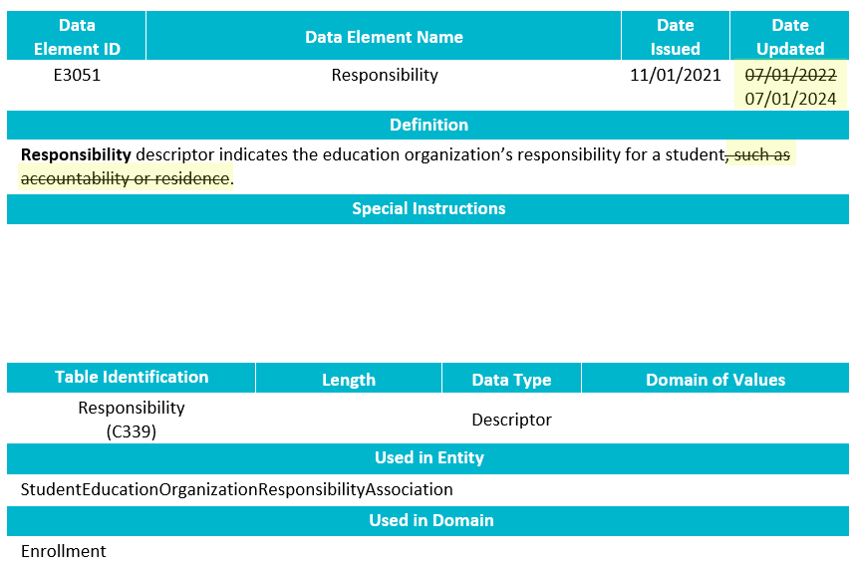
DATA GOVERNANCE UPDATES8
SUMMER TRAINING 2024 Data Element Change:
E3051 Responsibility
Revised the definition.

Slide 81
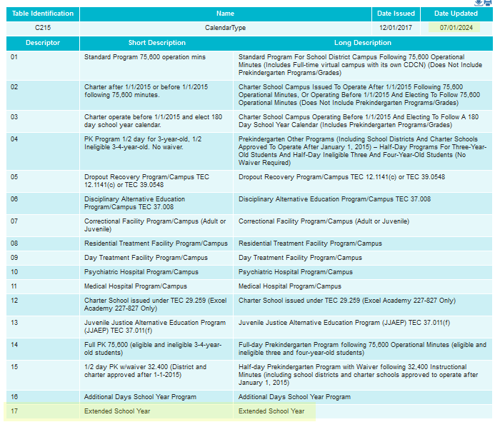
DATA GOVERNANCE UPDATES 22 2
SUMMER TRAINING 2024 Descriptor Table Updates:

Slide 82
DATA GOVERNANCE UPDATES 3
SUMMER TRAINING 2024 Business Rule Changes:
The following business rules have been added:

Slide 83
TSDS UPGRADE PROJECT UPDATES 22 1
Data Element Name Changes:
Data Element ID | XML Data Element Name | Upgrade Data Element Name
E0975 | INSTRUCTIONAL-TRACK-INDICATOR-CODE | CalendarCode
E1168 | CALENDAR-DATE | Date
E1582 | SCHOOL-DAY-EVENT-CODE | CalendarEvent
E1600 | INSTRUCTIONAL-PROGRAM-TYPE | CalendarType
E3051 (was E1710) | CAMPUS-ID-OF-EVALUATION | Responsibility (where descriptor = ’03’ Evaluation)

Slide 84
TSDS UPGRADE PROJECT UPDATES 23 2
Data Element Name Changes:
Data Element ID | XML Data Element Name | Upgrade Data Element Name
E1711 | STUDENT-ABSENCES-WITHIN-TIMEFRAME | EvaluationDelayDays
E1712 | ECI-NOTIFICATION-DATE | TransitionNotificationDate
E1713 | ECI-TRANSITION-CONFERENCE-DATE | TransitionConferenceDate
E1715 | INITIAL-EVALUATION-DATE | EligibilityEvaluationDate
E1716 | SPED-ELIGIBILITY-DETERMINATION-DATE | EligibilityDeterminationDate
E1717 | SPED-ELIGIBILITY-DETERMINATION-CODE | IDEAIndicator

Slide 85
TSDS UPGRADE PROJECT UPDATES 324
Descriptor Table Name Changes:
Descriptor Table ID | XML Code Table Name | Upgrade Descriptor Table Name
C208 | SCHOOL-DAY-EVENT-CODE | CalendarEvent
C215 | INSTRUCTIONAL-PROGRAM-TYPE | CalendarType
C339 | N/A | Responsibility
C347 (was DC164) | DELAY-REASON-CODE | EligibilityDelayReason
C348 (was DC164) | DELAY-REASON-CODE | EvaluationDelayReason

Slide 86
TSDS UPGRADE PROJECT UPDATES 25 4
Business Rule Changes:
The following business rule has been added to ensure all students reported for Child Find are also reported with an evaluation campus.
The evaluation campus is the EducationOrganization (reference) reported in the StudentEducationOrganizationResponsibilityAssociation where Responsibility (E3051) = ‘03’ (Evaluation).

Slide 87
TSDS UPGRADE PROJECT UPDATES 26 5
Business Rule Changes:
The following rule has been updated to reflect the terminology changes made to the collection of evaluation campus information.
41163-0078 states that the SchoolId reported with a Responsibility = ‘03’ (Evaluation) must match an entry registered with TEA.
In the XML submission, this rule stated that the CAMPUS-ID-OF-EVALUATION must be a valid campus.

Slide 88
TIMELINE 5 2
Child Find | Date
TSDS ready to load data to IODS | August 5, 2024
Child Find ready for users to complete | May 19, 2025
Child Find Submission due date for LEAs | July 31, 2025
Child Find data available to customers | August 14, 2025

Slide 89
TECHNICAL RESOURCES 1 2
TIMS Knowledge Base Articles
TSDSKB-620: SPPI-11 Compliance Flowchart
TSDSKB-621: SPPI-12 Compliance Flowchart
TSDSKB-622: Child Find Frequently Asked Questions
TSDSKB-645: SPPI-12 Frequently Asked Questions
TSDKSB-646: SPPI-11 Frequently Asked Questions
TSDSKB-650: Child Find Interactive Flowchart
Please Note – these KB articles are updated to account for the SPPI-11 Eligibility Determination compliance calculation change.

Slide 90
TECHNICAL RESOURCES 2 3
Technical Support
TSDSCustomerSupport@tea.texas.gov
Technical Specification
2024-2025 TSDS Web-Enabled Data Standards (TWEDS)
Known Issues
Program Area Documentation
SPPI-11 Guidance Documents
SPPI-12 Guidance Documents
TSDS Incident Management System (TIMS)
TSDS Incident Management System (TIMS) Support Application
TIMS Knowledge Base Article Repository

