Slide 1
Student Discipline Policy
Chapter 37
Presented by: Mary Scott
2019-2020 School Year
March 2019

Slide 2
Contents
Role as your Student Discipline Policy Analyst
Overview of the Guide to Student Discipline – Chapter 37
Trainings for Regional Service Centers and LEAs
Review of Presentation
Questions

Slide 3
My role as your Student Discipline Policy Analyst
Questions from Regional Service Centers and LEAs
I will be answering questions that specifically deal with student discipline policy from service centers and LEAs.
TIMS ticket system
Email: StudentDisciplineSupport@tea.texas.gov
Legislative Bill Analyst Regarding Student Discipline Policy
During the legislative sessions, I will be completing bill analysis on proposed bills that affect student discipline policies and procedures.
Guide to Student Discipline – Chapter 37
Currently, I am writing a guide to help interpret Chapter 37; Law and Order. Once this is completed and available, I will continually update the guide to keep it in compliance with the law and to provide a current resource for LEAs and Regional Service Centers.

Slide 4
Overview of Guide to Student Discipline – Chapter 37
Guide to Student Discipline - Chapter 37
Preface/Introduction – Code of Conduct 37. 001
Discipline Reasons
    Mandatory
    Discretionary
Discipline Actions
  In-School Suspensions (ISS)
  Out-of-School Suspensions (OSS)
  District Alternative Education Program (DAEP)
  Expulsions Without Placement
  With Placement to DAEP
  With Placement in JJAEP
  Court Ordered Placement

Slide 5
Overview of Guide to Student Discipline – Chapter 37
Discipline for Students with Disabilities
Parent/Guardian/Student Rights
  DAEP Placement Conference
  Expulsion Hearing
  Appeal Process Flow Chart
  Students with Disabilities
LEA Responsibilities and Best Practices
Open-Enrollment Charter Schools
Data Reporting – TSDS
Glossary
Common Q/A
Appendix
  DAEP Placement Order
  Expulsion Placement Order
  Appeal Process Flow Chart
  LEA/Parent Resources beyond Chapter 37
  Appendix E

Slide 6
Trainings Can Be Conducted
Trainings for Regional Service Centers and LEAs
  Request a training through the student discipline support email including the following information:
1. What is your desired outcome for the training?
2. How long do you want the training to last?
(half a day, full day, 2 half days, 3 hours)
3. Who will the attending audience be?
4. Desired Dates of the training?
5. Where do you want the training held?
(Regional Service Center, LEAs, TEA - Combined with more than 1 Regional Service Center or LEAs)

Slide 7
Review
Mary Scott – TEA Student Discipline Specialist
Role: Questions, Bill Analysis for Student Conduct Policy and Procedures , Guide to Student Discipline – Chapter 37, Trainings for service centers and LEAs.
Contact:
StudentDisciplineSupport@tea.texas.gov
*After examining the overview of Guide to Student Discipline – Chapter 37, please submit questions or suggestions to the student discipline support email. Your thoughts and ideas are welcome to help improve this resource.

Slide 8
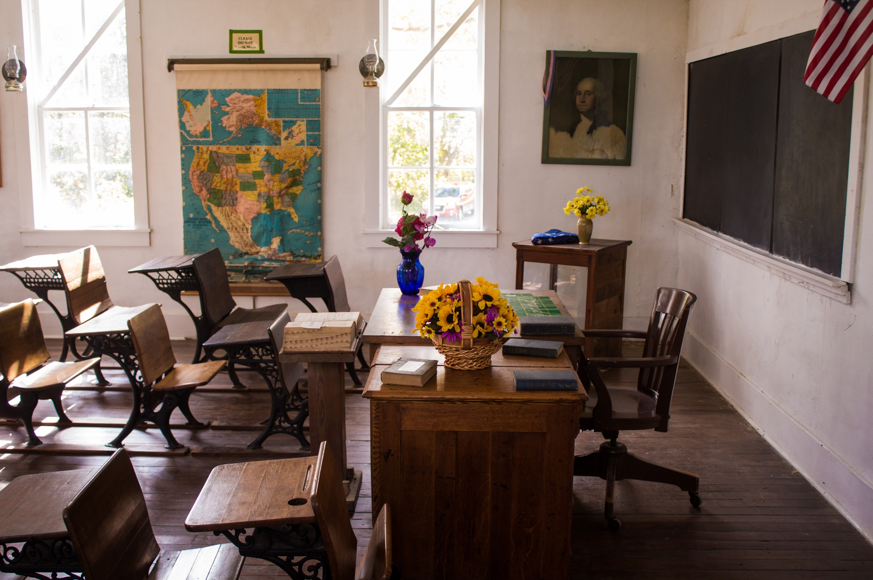
Questions?
StudentDisciplineSupport@tea.texas.gov

