Slide 1
Code Table changes
Presented by: Melissa Lemons
2019-2020 School Year
March 2019

Slide 2
CONTENTS
New Expenditure Code
Disciplinary Action Reason Code Changes
Campus ID of Residence

Slide 3
New expenditure code - Background
Senate Bill 622, passed during the 85th legislative session, requires that political subdivisions (including school districts) reflect in their proposed budget, a line item specifically for expenditures incurred to publish all statutorily required public notices in the newspaper by the political subdivision or their representatives.
Examples include: items related to school board elections, specific test administration dates, or notices of budget and tax rate meetings.

Slide 4
New expenditure code
In order to comply with Senate Bill 622, the Texas Education Agency, has added the following code to the OBJECT-CODE (C159) code table that applies to Actual Financial data reporting for the 2019-2020 school year:
  6491 – Statutorily Required Public Notices

Slide 5
New expenditure code - rules
Rule # | Rule Change | Collection / Submission & Error Level | Applies to
20032-0149 New | There should be Actual Financial data where OBJECT-CODE is "6491" | Special Warning Sub 2 | Districts
20032-0150 New | OBJECT-CODE must not be "6491" | Fatal Sub 2 | Charters

Slide 6
New expenditure code
For budget reporting, 6491 and all codes under 6400 (Operating Costs) are reported as OBJECT-CODE 6400. Code 6491 (Statutorily Required Public Notices) is part of a subset of codes that exist in the OBJECT-CODE (C159) code table.

Slide 7
New expenditure code
Additionally, the To The Administrator (TAA) notice New Expenditure Code (Object 6491) for all Statutorily Required Public Notices states that expenses related to the new OBJECT-CODE 6491 (Statutorily Required Public Notices) should be tracked for the 2018-2019 school year so that LEAs can report these expenditures in the 2019-2020 TSDS PEIMS collection of Actual Financial data.

Slide 8
CONTENTS
New Expenditure Code
Disciplinary Action Reason Code Changes
Campus ID of Residence

Slide 9
Disciplinary action reason code changes
Federal reporting requirement changes have been made to no longer require states to report data related to tobacco and school related gang violence. This information is currently collected through the DISCIPLINARY-ACTION-REASON-CODEs 33 (tobacco) and 34 (school related gang violence).

Slide 10
Disciplinary action reason code changes
In order to comply with the updated federal reporting requirements, the following changes have been made to the DISCIPLINARY-ACTION-REASON-CODE (C165) code table for the 2019-2020 school year:
  Delete code 33 (tobacco)
  Delete code 34 (school related gang violence)
  Update code 21 (take out reference of codes 33 and 34)

Slide 11
Disciplinary action reason code changes – Code Table
Code Table ID | Name | XML Name | Date Issued | Date Updated
C165 | DISCIPLINARY-ACTION-REASON-CODE | TX-DisciplinaryActionReasonType | 3/2/1998 | 3/1/2019
Code | Translation
21 | Violation Of Student Code Of Conduct Not Included Under TEC §§37.002(b), 37.006, or 37.007 (does not include student code of conduct violations covered in reason codes 33 and 34)
33 | Possessed, Purchased, Used, or Accepted a Cigarette Or Tobacco Product As defined in the Health and Safety Code, Section 3.01, Chapter 161.252
34 | School-Related Gang Violence Action by three or more persons having a common identifying sign or symbol or an identifiable sign or symbol or an identifiable leadership who associate in the commission of criminal activities under Penal Code §71.01

Slide 12
Disciplinary action reason code changes - Rules
Rule # | Rule Change | Collection / Submission & Error Level | Applies to
44425-0037 | If DISCIPLINARY-ACTION-REASON-CODE is "01", "02", "07", "21", "28", "33", "34", "41", "42", "44", "45", or "56" then DISCIPLINARY-ACTION-CODE should not be "01"-"04", "09", "11", "12", "15", "50"-"53", "56", "58", "59" or "61". | Special Warning Sub 3 | Districts and Campuses
44425-0050 | If DISCIPLINARY-ACTION-REASON-CODE is "21"-"23", "33", "34", "41", "42", "44", "45", "55", or "56", then BEHAVIOR-LOCATION-CODE must be "00" | Fatal Sub 3 | Districts, Campuses, and Charters

Slide 13
Disciplinary action reason code changes - Rules
Rule # | Rule Change | Collection / Submission & Error Level | Applies to
44425-0055 | If DISCIPLINARY-ACTION-REASON-CODE is not "21"-"23", "33", "34", "41", "42", "44", "45", "55", or "56", then BEHAVIOR-LOCATION-CODE must not be "00". | Fatal Sub 3 | Districts, Campuses, and Charters

Slide 14
CONTENTS
New Expenditure Code
Disciplinary Action Reason Code Changes
Campus ID of Residence

Slide 15
campus id of residence – background
The Texas Education Agency administers an annual grant (refer to: eGrants SC5050) in order to collect serving and residing local education agency (LEA) student enrollment and demographic data for open-enrollment charter schools and three special state LEAs
  Texas School for the Blind and Visually Impaired (TSBVI)
  Texas School for the Deaf (TSD)
  South Texas ISD (STISD)

Slide 16
campus id of residence – background
LEAs currently must enter student enrollment data via the eGrants collection, at which time the Resident Public School District (CAMPUS-ID-OF-RESIDENCE) must be entered. This information is then used in the federal statutory based allocation formulas to account for and allocate federal funds to LEAs.
By using data reported in the PEIMS Fall Submission for CAMPUS-ID-OF-RESIDENCE (E0903), the annual eGrants SC5050 data collection for special state LEAs will be eliminated with a few exceptions.
Notes:
Exceptions include new charters opening for the first time and those that are wishing to apply for significant expansions in the September/October timeframe.

Slide 17
campus id of residence – CODE TABLE Changes
In order to use the CAMPUS-ID-OF-RESIDENCE (E903) for the special state schools, the following changes have been made to the STUDENT-ATTRIBUTION-CODE (C161) code table:
  Code 29 – South Texas ISD [For South Texas ISD use only]

Slide 18
CAMPUS ID OF RESIDENCE – CODE TABLE CHANGES
Code Table ID | Name | XML Name | Date Issued | Date Updated
C161 | STUDENT-ATTRIBUTION-CODE | TX-AttributionType | 3/3/1997 | 12/1/2018
Code | Translation
29 | South Texas ISD [For South Texas ISD Use Only]

Slide 19
campus id of residence – GUIDANCE
Additionally, guidance has been updated in 2.4 in order to address when the CAMPUS-ID-OF-RESIDENCE should be reported. The guidance now includes the TSD, TSBVI, and STISD.

Slide 20
campus id of residence - Rules
Rule # | Rule Change | Collection / Submission & Error Level | Applies to
40110-0097 | If CAMPUS-ID-OF-RESIDENCE is not blank, then CAMPUS-IDOF-RESIDENCE must be "255000000" or match an entry registered with the TEA as an active instructional campus ending in "001"-"698", but must not be a charter, a JJAEP, Texas School for the Deaf (227906), Texas School for the Blind and Visually Impaired (227905), Texas Juvenile Justice Department (227622), or South Texas ISD (031916). | Fatal Sub 1, 3, and 4 | Districts, Campuses, and Charters

Slide 21
campus id of residence - Rules
Rule # | Rule Change | Collection / Submission & Error Level | Applies to
40110-0099 | If DISTRICT-ID matches the Texas School for the Deaf (227906), the Texas School for the Blind and Visually Impaired (227905), or South Texas ISD (031916), then CAMPUS-ID-OF-RESIDENCE must not be blank. | Fatal Sub 1, 3, and 4 | Districts

Slide 22
campus id of residence - Rules
Rule # | Rule Change | Collection / Submission & Error Level | Applies to
40110-0193 (NEW) | If STUDENT-ATTRIBUTION-CODE is "10", then CAMPUS-ID must be in the Texas School for the Deaf (227906). | Fatal 1, 3, and 4 | Districts, Campuses, and Charters
40110-0194 (NEW) | If STUDENT-ATTRIBUTION-CODE is "29", then CAMPUS-ID must be in South Texas ISD (031916) | Fatal 1, 3, and 4 | Districts, Campuses, and Charters

Slide 23
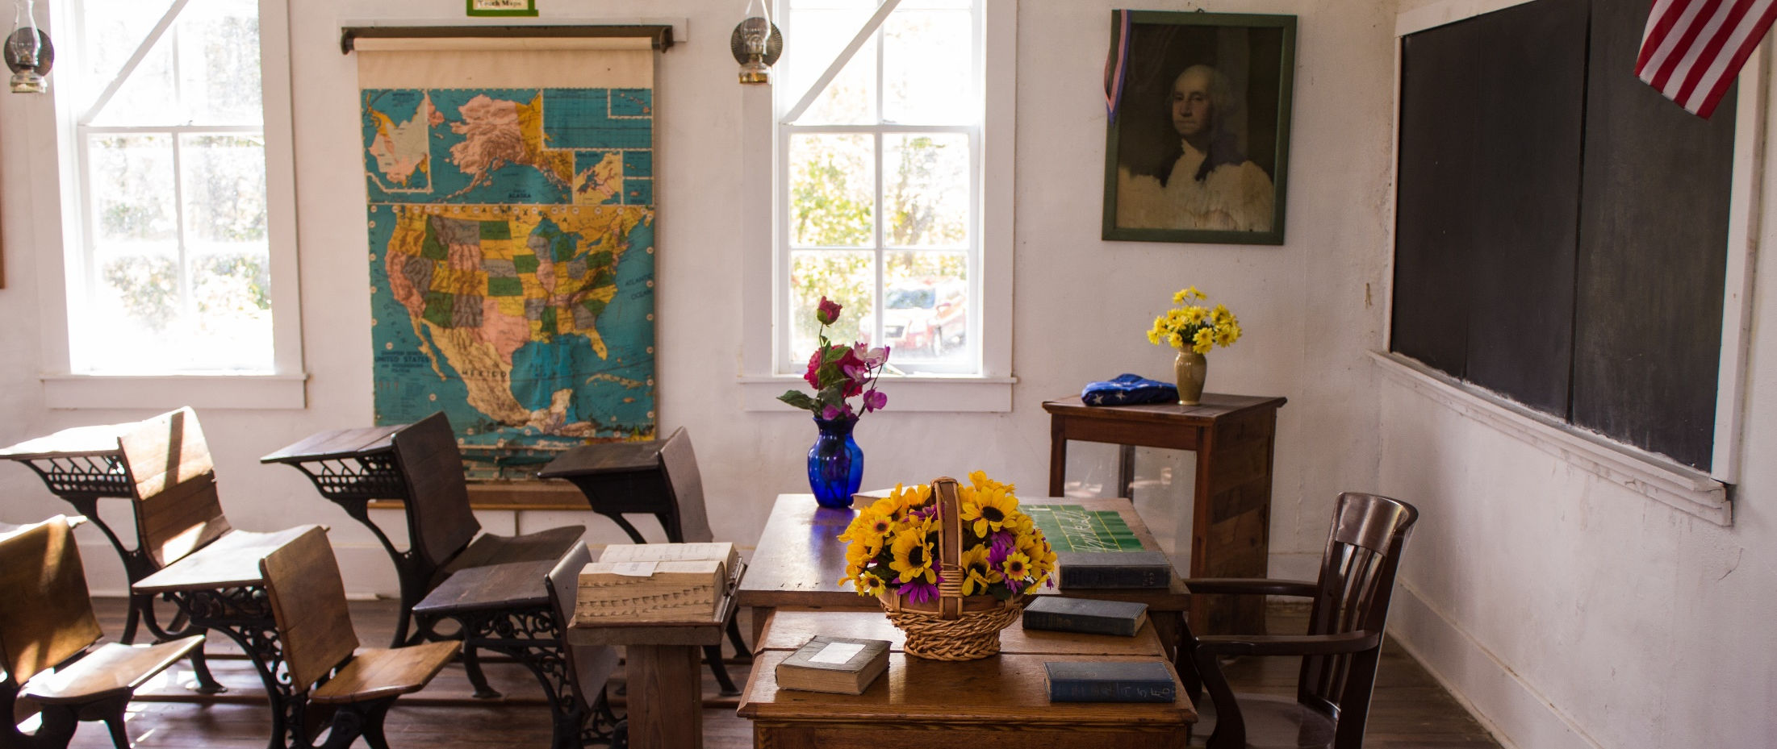
Questions?
www.texasstudentdatasystem.org

