Slide 1
Residential facility tracker
Texas Education Agency
Kathy Adaky – Subject Matter Expert
July 30 - August 1, 2019

Slide 2
agenda
Residential Facility (RF) Tracker Timeline
  2019-2020 Submission Timeline
  RF Tracker TEAL Roles
  Residential Facility Legacy System
Residential Facility Information
  Residential Facility Migration
  Residential Facility Information in AskTED
  Adding/Updating Residential Facility Information
Residential Facility Tracker
  Residential Facility Tracker Interchanges
  TEDS Post Addendum Changes
  Technical Resources

Slide 3
RF Tracker Submission Timeline
2019-2020 School Year
Residential Facility Tracker (RF Tracker) Collection
TSDS ready to load data to eDM | August 5, 2019
RF Tracker ready for users to promote data | September 9, 2019
RF Tracker submission due date for LEAs | July 30, 2020
LEAs are expected to load RF Tracker data throughout the school year. The TEA Division of Special Education monitors this data throughout the school year.
It is recommended to load the data as the students enter and withdraw from the residential facility, or at the least monthly.

Slide 4
RF Tracker TEAL Roles
RF Tracker TEAL Roles are in production.
    The following are the LEA TEAL roles:
  The following is the ESC TEAL role:
ODS Data Loader | Loads the RF Tracker data into the ODS
RFT Promoter | Promotes and Validates the collection
RFT Completer | Verifies and Completes the collection
RFT Approver | Can request an extension for the collection
RFT ESC Data Viewer | Can view and monitor the RF Tracker submission.
Notes:
Reminder to request roles if they haven’t done so already.

Slide 5
Residential Facility Legacy System
All LEAs have completed their 2018-2019 Residential Facility submission in the Legacy Residential Monitoring system as of June 21, 2019. ​
The Single District Report for Student Details from the legacy system will be archived for the following years:
  2017
  2018
  2019
The archived reports can be accessed from the RF Tracker reports page within TSDS.

Slide 6
Residential Facility Tracker Timeline
  2019-2020 Submission Timeline
  RF Tracker TEAL Roles
  Residential Facility Legacy System
Residential Facility Information
  Residential Facility Migration
  Residential Facility Information in AskTED
  Adding/Updating Residential Facility Information
Residential Facility Tracker
  Residential Facility Tracker Interchanges
  TEDS Post Addendum Changes
  Technical Resources

Slide 7
Residential Facility migration
​
The 2018-2019 residential facility information will be migrated to AskTED for the 2019-2020 school year.
This includes any new residential facilities added and any updates to residential facility information in the 2018-2019 school year.​
​
A spreadsheet of all residential facilities may be downloaded from AskTED.​
​

Slide 8
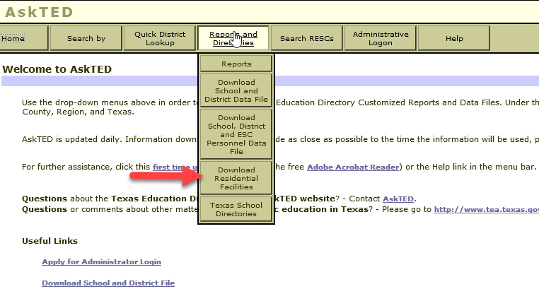
Residential Facilities in AskTED
Available under the Reports and Directories menu:
​

Slide 9
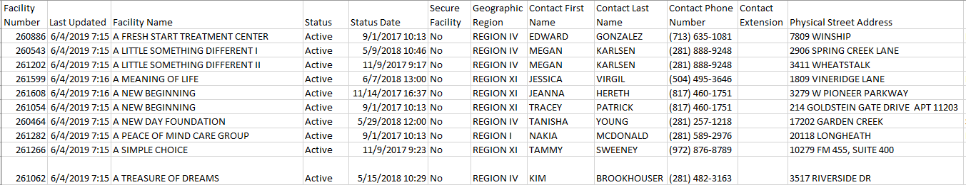
Residential facilities in AskTED
Other columns that will be included in the Residential Facility spreadsheet that are not displayed in the screen shot below:
  Contact Email Address
  Facility Physical State and Zip Code
  Facility Phone Number and Extension
  Facility Mailing address (same as Physical Address)
Additional information available (not currently shown):
  Contact Email Address
  Facility Physical State and Zip Code
  Facility Phone Number and Extension
  Facility Mailing address (same as Physical Address)

Slide 10
Adding/updating Residential facilities
The LEA’s Special Education contact person must submit a form to TEA in order to add/maintain Residential Facilities within their geographic boundaries where the LEA serves students with disabilities residing at the facility.
The completed form must be submitted via a TSDS Incident Management System (TIMS) ticket and follow the escalation process to the Division of Special Education.
TEA’s Special Education division will enter/update the Residential Facilities in the AskTED application and return the TIMS ticket with the new Residential Facility ID number (if added).
Notes:
Link for Form to maintain Residential Facilities in TAA letter dated April 18th 2019, also on special education division website. Both links are in the technical resources slide at end of this presentation.

Slide 11
Residential Facility Tracker Timeline
  2019-2020 Submission Timeline
  RF Tracker TEAL Roles
  Residential Facility Legacy System
Residential Facility Information
  Residential Facility Migration
  Residential Facility Information in AskTED
  Adding/Updating Residential Facility Information
Residential Facility Tracker
  Residential Facility Tracker Interchanges
  TEDS Post Addendum Changes
  Technical Resources

Slide 12
RF tracker interchanges
TSDS Collection
  InterchangeEducationOrganizationExtension
    Local Education Agency
    School
    Residential Facility Extension
  InterchangeStudentParentExtension
    Student Extension
  InterchangeStudentEnrollmentExtension
    Student Residential Facility Association Extension
Notes:
Have list of data elements for each complex type

Slide 13
RF tracker interchanges
TSDS PEIMS Summer Submission
  InterchangeEducationOrganizationExtension
    Local Education Agency
    School
  InterchangeStudentExtension
    Student Extension
  InterchangeStudentProgramExtension
    Student Program Extension
    Student Special Ed Program Association Extension
Notes:
Have list of data elements for each complex type
SJ: I would not go into tremendous effort in explaining the data breakdown (especially the elements) – just refer them back to TEDS for more information

Slide 14
RF tracker interchanges
TSDS PEIMS Summer Resubmission
The RF Tracker promotion process will use the latest data loaded into the ODS for PEIMS Summer.
  If an LEA has loaded Student Basic information for the PEIMS Summer 2 submission, then this data will be used for promotion.

Slide 15
TEDS Post Addendum Changes
TEDS Post Addendum Changes
The StudentProgramExtension complex type was added to InterchangeStudentProgramExtension for data element E0794 SPECIAL-ED-INDICATOR-CODE.
Notes:
You will be able to load this complex type 8/5/2019 and promote the data 9/9/2019.

Slide 16
Technical resources
Technical Specifications: ​
  Texas Education Data Standards (TEDS)​
Division of Special Education:
  Special Education in Residential Facilities
TAA Letter - Dated 4/18/2019
  Residential Facilities Tracker in the Texas Student Data System
Technical Support:​
  TSDSCustomerSupport@tea.texas.gov ​
Knowledge Base Articles:​
  TSDSKB-586 Residential Facility Tracker Frequently Asked Questions

Slide 17

Questions?
www.texasstudentdatasystem.org

