Slide 1
Charter school waitlist
Texas Education Agency
Ed Linden - Subject Matter Expert
April 2020

Slide 2
Background
Background
Timeline
TEAL Roles and Privileges
Data Collection
Core Application

Slide 3
Division of Charter School Administration
Division of Charter School Administration
  Heather Mauze Division Director
  CharterSchools@tea.texas.gov

Slide 4
background
Charter School Waitlist (CSW) was included in Senate Bill 2293.
Beginning with the 2020-2021 school year charter schools will be required to report CSW collection data as of the last Friday in September. The data will be due to the agency on the last Friday in October, per legislation. Students who have applied but are not enrolled in the charter school and who are on a waitlist, must be reported to the agency in addition to the number of students enrolled and the educational enrollment capacity.
The following information will be collected and reported for each campus operating under the charter holder's charter:
  The number of students enrolled
  The enrollment capacity
  If a charter’s campus uses a waiting list to grant admission
If a charter holder uses a waiting list for admission to a campus the following information will be reported:
  Student demographic and entry grade level information
  The total number of students on the waiting list
  The number of students on the waiting list disaggregated by grade level
  Note: TEA will collect this data at the student level
This data collection will be added to the Core application:
  It is brand new for LEAs. There is no legacy system or current collection.

Slide 5
timeline
Background
Timeline
TEAL Roles and Privileges
Data Collection
Core Application

Slide 6
TIMELINE
TAA Letter was sent on March 12, 2020 to Charter School administrators and ESCs.
Charter School Waitlist (CSW) Collection
TSDS ready to load data to eDM | August 3, 2020
CSW ready for users to promote data | September 14, 2020
CSW ready for users to complete | September 25, 2020
CSW submission due date for LEAs | October 30, 2020
CSW data available to customers | November 13, 2020
Notes:
Still need to verify dates.

Slide 7
Teal roles and privileges
Background
Timeline
TEAL Roles and Privileges
Data Collection
Core Application

Slide 8
Teal roles and privileges
Charter School Waitlist (CSW) will utilize the following existing TEAL roles:
  Core ESC Data Viewer
  Core LEA Data Approver
  Core LEA Data Completer
  Core LEA Data Promoter
  Core LEA Data Viewer
A new privilege, ‘CSW Access’, will be added to each of these roles.
Stay tuned to the upcoming FCN Webinars, Newsletters, and Training for more information regarding the TEAL Roles and Privileges.

Slide 9
Data collection
Background
Timeline
TEAL Roles and Privileges
Data Collection
Core Application

Slide 10
Data collection
CSW will collect data from the following TSDS interchanges.
  InterchangeEducationOrganizationExtension
  InterchangeStudentParentExtension
  InterchangeStudentEnrollmentExtension

Slide 11
tsds collection – complex types/elements
Education Organization
  LocalEducationAgency
    E0212 DISTRICT-ID
  SchoolExtension
    E0266 CAMPUS-ID
    *NEW E1674 NUMBER-CHARTER-STUDENTS-ENROLLED
    *NEW E1675 CHARTER-EDUCATIONAL-ENROLLMENT-CAPACITY
    *NEW E1676 CHARTER-ADMISSION-WAITLIST-INDICATOR-CODE
*Three new optional data elements above will be added to the TSDS collection to report Charter School Waitlist information in the SchoolExtension complex type for interchange EducationOrganizationExtension.

Slide 12
tsds collection – complex types/elements
Student Parent
  StudentExtension
    E1523 TX-UNIQUE-STUDENT-ID
    E1090 STUDENT-IDENTIFICATION-SYSTEM
    E0001 STUDENT-ID
    E0703 FIRST-NAME
    E0705 LAST-NAME
    E0006 DATE-OF-BIRTH
    E1325 SEX
    *NEW E1677 CHARTER-WAITLIST-INDICATOR-CODE
Student Enrollment
  SchoolSchoolAssociationExtension
    E1523 TX-UNIQUE-STUDENT-ID
    E0266 CAMPUS-ID
    E1517 ENTRY-GRADE-LEVEL-TYPE
*One new optional data element above will be added to the TSDS collection to report Charter School Waitlist information in the StudentExtension complex type for the interchange StudentParentExtension.

Slide 13
CODE TABLES
There are no new code tables being added for the Charter School Waitlist data collection.

Slide 14
Core application
Background
Timeline
TEAL Roles and Privileges
Data Collection
Core Application

Slide 15
CORE APPLICATION
CSW will be added to the Core application.
It will be District-level only, with no campus-level data submissions.
ESCs will be able to monitor Charter School data submissions but will not submit any of their own data.
Functionality will be similar to other Core collections. LEAs will be able to promote, validate, run reports, complete, and apply for extensions.

Slide 16
PROMOTION LOGIC
The following criteria logic will be applied when promoting campus level data:
  All Charter campuses will include the following data elements for the charter holder’s charter:
    E1674 NUMBER-CHARTER-STUDENTS-ENROLLED
    E1675 CHARTER-EDUCATIONAL-ENROLLMENT-CAPACITY
    E1676 CHARTER-ADMISSION-WAITLIST-INDICATOR-CODE
The following criteria logic will be applied when promoting student level data:
  Students coded with the following data element:
    E1677 CHARTER-WAITLIST-INDICATOR-CODE (C088):
      Code 1 – Participant In Program Or Service, Or Condition Or Situation Applicable To This Person Or Campus

Slide 17
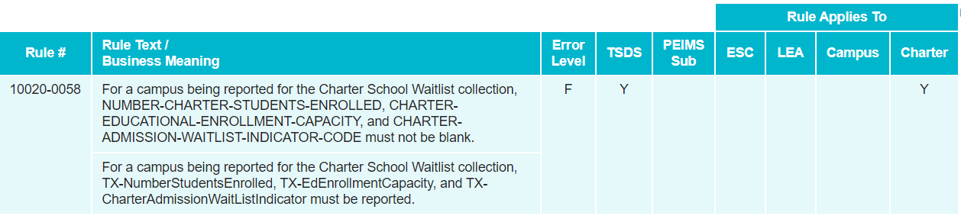
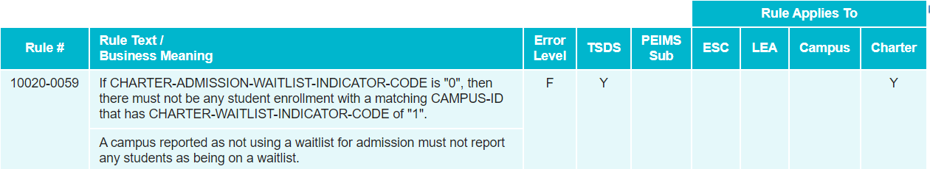
New Validation rules

Slide 18
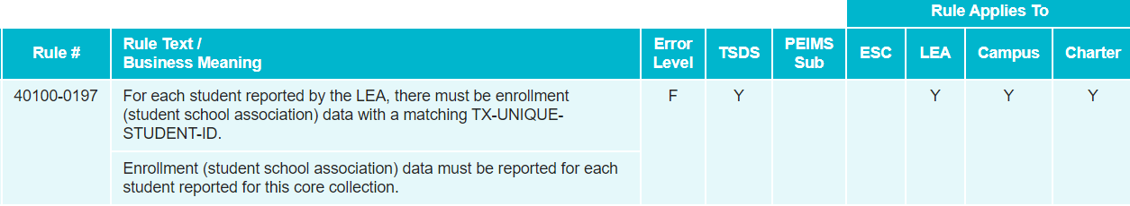
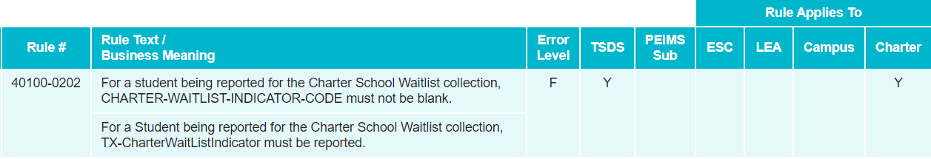
New Validation rules – cont'd

Slide 19
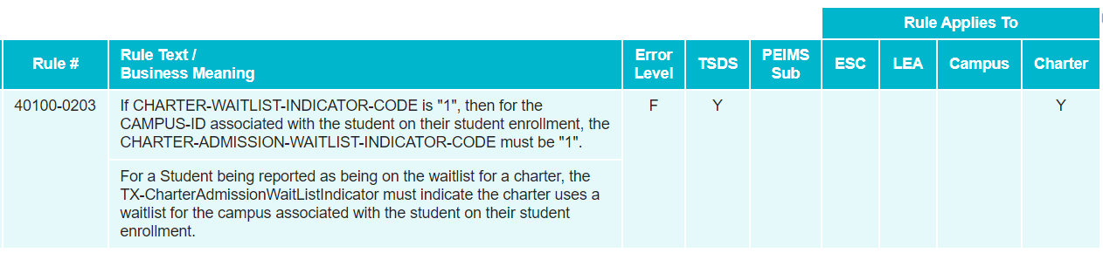
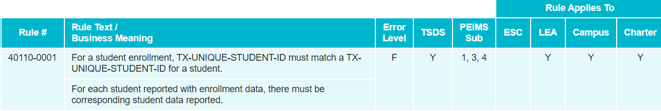
New Validation rules – cont'd

Slide 20
existing Validation rules
This collection will leverage existing validations as well. Examples:
  10010-000A: DISTRICT-ID must be unique for each Local Education Agency.
  40100-000A: The combination of the following fields must be unique for each student: DISTRICT-ID and TX-UNIQUE-STUDENT-ID.
  40100-0017: DATE-OF-BIRTH must be a valid date.
  41163-000D: The combination of the following fields must be unique for each Student Special Education Program Association: DISTRICT-ID and TX-UNIQUE-STUDENT-ID.

Slide 21
reports
Expecting only one report at both the LEA and ESC levels.
  Report will be similar in structure to “roster” style reports seen in other TSDS data collections.
  LEAs will use this report to verify all data submitted for the data collection.
  ESCs will be able to run this report for all of their LEAs to monitor their submissions.

Slide 22
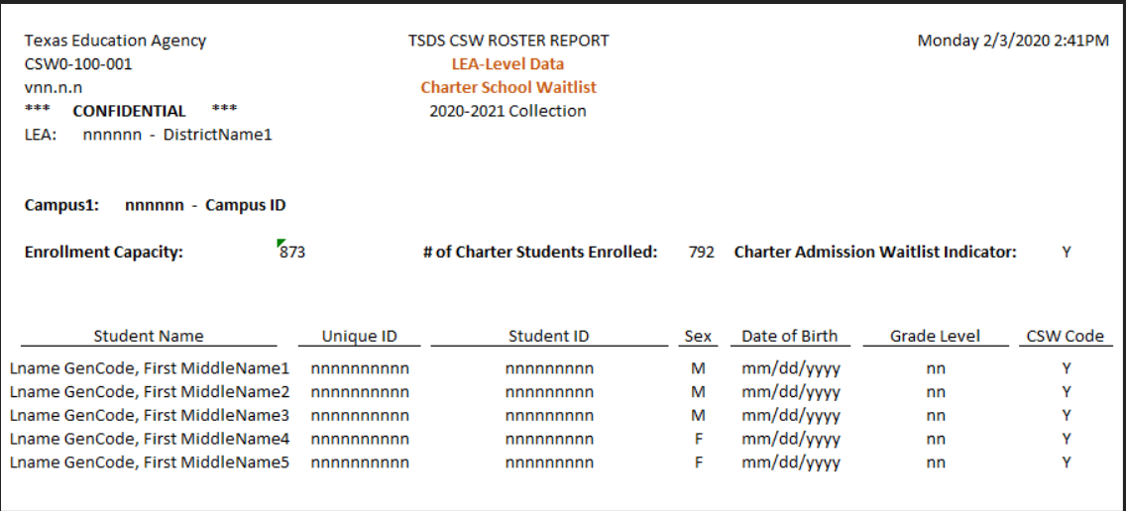
reports
CSW-100-001 CSW Roster Report

Slide 23
FREQUENTLY ASKED QUESTIONS
Why are the new Charter School data elements not collected in the Fall PEIMS collection?
  Due to the timeline for CSW data being due at the end of October as defined in legislation, this CSW data was unable to be included in the PEIMS FALL submission, which is due on December 3, 2020.

Slide 24
FREQUENTLY ASKED QUESTIONS
How will students apply to a Charter School?
  As part of SB 2293, TEA was required to develop a common application form for Charters to use as part of their application process.

Slide 25
FREQUENTLY ASKED QUESTIONS
Can students apply to more than one charter school or more than one charter school campus?
  Yes. Students can apply to multiple charter schools and multiple campuses at the same Charter.

Slide 26

Questions?
www.texasstudentdatasystem.org

