Slide 1
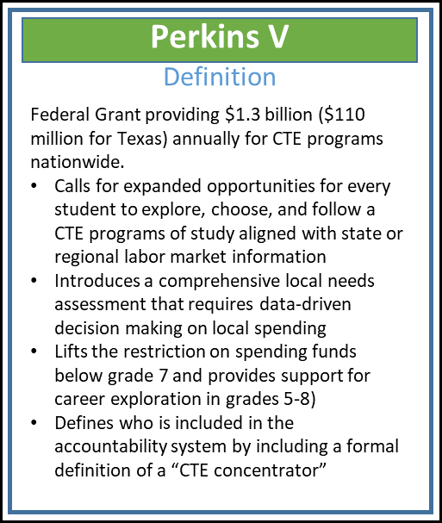
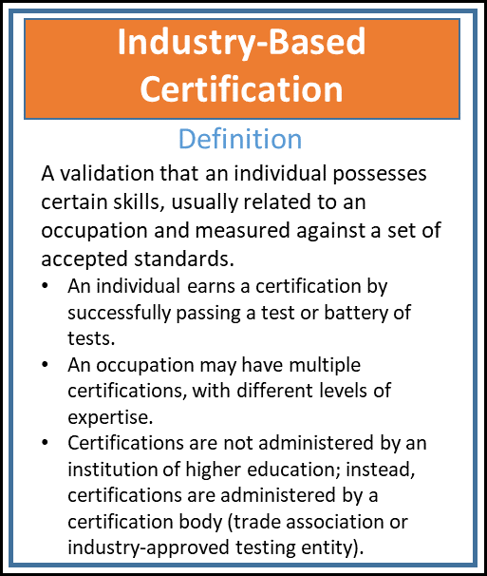
Definitions

Slide 2
CTE Data
Perkins IV | VS |  | Perkins V
District Self-Reported through PEIMS Using Locally Developed Programs of Study | Data Source |  | Auto-Calculated Using Existing Certified PEIMS Course Completion Records and Statewide or approved Regional Programs of Study
Greater District Workload Based on Student Intent Not Equitable Across the State | Problems | Benefits | District Workload Reduction Based on Course Completion Comparable Across Districts

Slide 3
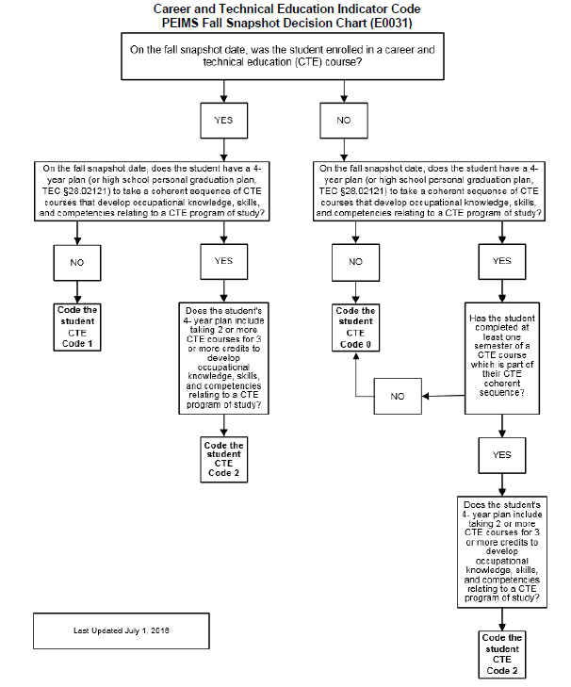
CTE Indicator Code Decision Chart (E0031)

Slide 4
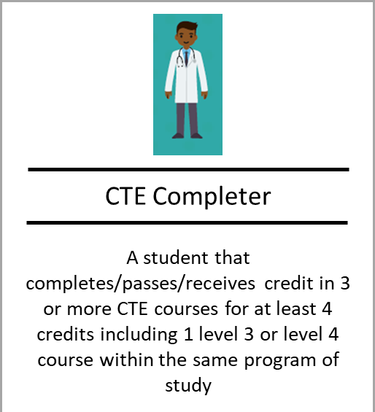
Career & Technical Education Indicator Definitions

