Slide 1
Code Table changes
Presented by: Leticia Ollervidez
2020-2021 School Year
March-April 2020

Slide 2
aGENDA
Overview
SERVICE-ID (C022)
LANGUAGE-CODE (C092)
LEAVER-REASON-CODE (C162 and C162-A)
SCHOOL-YEAR-TYPE (C193)
INDUSTRY-CERTIFICATION-LICENSURE-CODE (C214)

Slide 3
overview
The changes to the TSDS code tables were the result of legislative items or at the request of TEA Program Areas.

Slide 4
Service-id (C022)
Overview
SERVICE-ID (C022)
LANGUAGE-CODE (C092)
LEAVER-REASON-CODE (C162 and C162-A)
SCHOOL-YEAR-TYPE (C193)
INDUSTRY-CERTIFICATION-LICENSURE-CODE (C214)

Slide 5
Service-id (C022)
Each school year, the TEA Curriculum Division has changes to the SERVICE-ID table. For the 2020-2021 school year, two new codes were added, one subheading was updated, four translations were updated, and three codes were deleted.
Addition of Codes:
03200800 – English Language Development and Acquisition (First time taken)
03200810 – English Language Development and Acquisition (Second time taken)
Update to subheading, replaced “Minimum High School Program (MHSP) with “Foundation high school program”
Subchapter P. Transportation, Distribution, and Logistics Cluster
Notes:
Added 2 codes and translations
Update subheading
Updated 4 code translations
Deleted 3 codes and related translations

Slide 6
Service-id (C022) CONT’D
Updates to Code Translations for:
I3100500 - International Baccalaureate (IB) Mathematics: Analysis and Approaches Standard Level
I3100600 - International Baccalaureate (IB) Mathematics: Analysis and Approaches Higher Level
I3100700 - International Baccalaureate (IB) Mathematics: Applications and Interpretations Standard Level
I3100800 - International Baccalaureate (IB) Mathematics: Applications and Interpretations Higher Level
Deletion of Codes:
N1280040 - Foundations of Intensive Language Acquisition and Support
N1280042 - Newcomers' English Language Development A
N1280043 - Newcomers' English Language Development B
Notes:
Added 2 codes and translations
Update subheading
Updated 4 code translations
Deleted 3 codes and related translations

Slide 7
LANGUAGE-CODE (C092)
Overview
SERVICE-ID (C022)
LANGUAGE-CODE (C092)
LEAVER-REASON-CODE (C162 and C162-A)
SCHOOL-YEAR-TYPE (C193)
INDUSTRY-CERTIFICATION-LICENSURE-CODE (C214)

Slide 8
LANGUAGE-CODE (C092)
For the 2020-2021school year, per request from the English Learner Support Division a new code was added to C092 to properly identify ASL as a language option.
Added:
6B – American Sign Language (ASL)

Slide 9
LEAVER-REASON-CODE (C162 and C162-A)
Overview
SERVICE-ID (C022)
LANGUAGE-CODE (C092)
LEAVER-REASON-CODE (C162 and C162-A)
SCHOOL-YEAR-TYPE (C193)
INDUSTRY-CERTIFICATION-LICENSURE-CODE (C214)

Slide 10
Leaver-reason-code (c162 and C162-a)
Upon review of HB3 and HB330, it was determined the language was revised. GED terminology was replaced with ‘High School Equivalency Certificate’.
All translations in Code Table C162 (LEAVER-REASON-CODE) and LEAVER-REASON-CODE using ‘GED’ were updated to align with this change.
Updated Codes:
Header information
Code 86
Code 88
Code 89
Code 90

Slide 11
Leaver-reason-code BUSINESS RULES
The following Business Validation Rules were updated to match translation changes:
40203-0023
If LEAVER-REASON-CODE is "01", "24", "88", "90", or "98", then student address information must be provided (ADDRESS-TYPE, STREET-NUMBER-NAME, CITY, STATE-ABBREVIATION, POSTAL-CODE).
Student address information must be provided for any school leaver with the following TX-LeaverReasonCode: "Graduated From A Campus In This District Or Charter" (01), "College, Pursue Associate’s or Bachelor’s Degree" (24), "Court-Ordered To A High School Equivalency Program, Has Not Earned A Texas Certificate of High School Equivalency (TxCHSE)" (88), "Graduated From Another State Under Provisions Of The Interstate Compact On Educational Opportunity For Military Children" (90), or "Other" (98).
40203-0024
If LEAVER-REASON-CODE is "01", "24", "88", "90", or "98", then parent address information should be provided (ADDRESS-TYPE, STREET-NUMBER-NAME, CITY, STATE-ABBREVIATION, POSTAL-CODE).
Parent address information must be provided for any school leaver with the following TX-LeaverReasonCode: "Graduated From A Campus In This District Or Charter" (01), "College, Pursue Associate’s or Bachelor’s Degree" (24), "Court-Ordered To A High School Equivalency Program, Has Not Earned A Texas Certificate of High School Equivalency (TxCHSE)" (88), "Graduated From Another State Under Provisions Of The Interstate Compact On Educational Opportunity For Military Children" (90), or "Other" (98).

Slide 12
SCHOOL-YEAR-TYPE (C193)
Overview
SERVICE-ID (C022)
LANGUAGE-CODE (C092)
LEAVER-REASON-CODE (C162 and C162-A)
SCHOOL-YEAR-TYPE (C193)
INDUSTRY-CERTIFICATION-LICENSURE-CODE (C214)

Slide 13
SCHOOL-YEAR-TYPE (C193)
Per Quality Assurance initiatives, TEA added three new codes to C193 to support year ranges used by data element E1437 CLASS OF.
41 – 2036-2037
42 – 2037-2038
43 – 2038-2039

Slide 14
INDUSTRY-CERTIFICATION-LICENSURE-CODE (C214)
Overview
SERVICE-ID (C022)
LANGUAGE-CODE (C092)
LEAVER-REASON-CODE (C162 and C162-A)
SCHOOL-YEAR-TYPE (C193)
INDUSTRY-CERTIFICATION-LICENSURE-CODE (C214)

Slide 15
INDUSTRY-CERTIFICATION-LICENSURE-CODE (C214)
For the 2020-2021 school year, the TEA College, Career, and Military Preparation Division added one new code and deleted one code.
Added Code:
931 – Medical Laboratory Technician
Deleted Code:
400 – Certified Patient Care Technician (CPCT)
Duplicate of 786
Notes:
(C214)

Slide 16
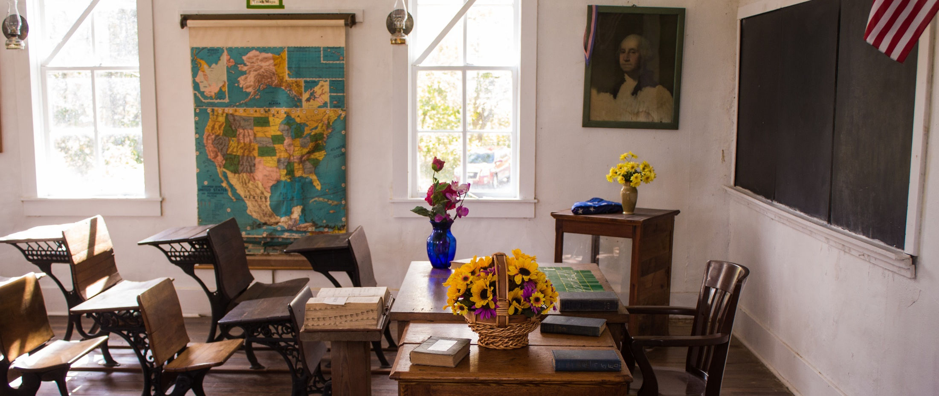
Questions?
www.texasstudentdatasystem.org

