Slide 1
Military Connected Student Identifier

Slide 2
Presenter
Abby Rodriguez, M.A.
State Coordinator, Military Connected Students
and
Pregnancy Related Services

Slide 3
Objectives
Participants will:
Increase knowledge and awareness of the Military Student Identifier
Receive data and demographics in Texas
Receive legislative highlights and updates
Increase knowledge and awareness of leaver codes and military connected students
Learn about resources, upcoming news, and agency communications

Slide 4
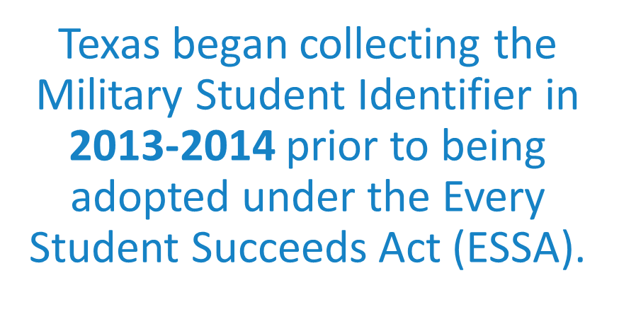
Did you know?

Slide 5
Military Student Identifier
Military Connected Active Duty
Military Connected Duty Part-Time
75th Innovation Command - Houston
Former member of the United States military, the Texas National Guard, or reserve force in the United States military.
A member of a military or reserve force in the United States fallen in the line of duty.

Slide 6
86th Texas Legislative Session Highlights

Slide 7
86th Texas Legislative Session Highlight
SB 1557- (TEC § 33.909, § 25.006) Purple Star Campus Designation
Two new PEIMS indicator codes allowing districts to identify:
Students with a parent or guardian who are veterans
Students dependents of a member in the military or reserve force who have fallen in the line of duty
Effective Date: April 2020

Slide 8
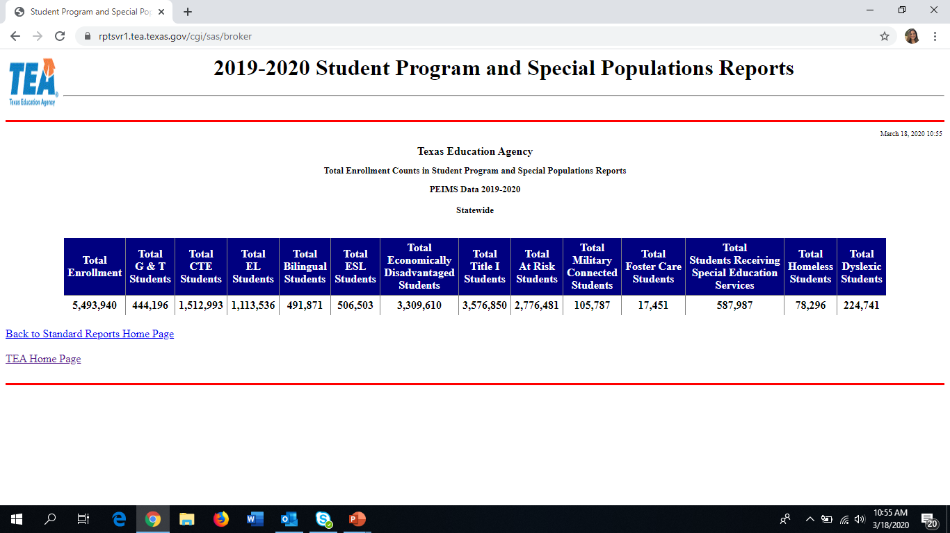
Military Connected Students 2018-2019
Source: Texas Education Agency, 2019-2020 PEIMS Standard Reports, Special Populations

Slide 9
Military Connected Student Program Data
2019-2020
105,787 Students
Source: Texas Education Agency, PEIMS Standard Reports Data 2019-2020

Slide 10
TSDS PEIMS
Coding

Slide 11
PEIMS Coding Information
http://castro.tea.state.tx.us/tsds/teds/2020A/teds-ds4.pdf

Slide 12
PEIMS Lever
Code

Slide 13
Interstate Compact on Educational Opportunity for Military Children
Compact removes barriers to educational success imposed upon children of military families because of frequent moves and deployment of parents.
In 2009, the 81st Texas Legislature adopted the Compact in the Texas Education Code, Chapter 162
Covered Under Graduation:
Allowing a student to receive a diploma from the sending school instead of receiving school.
All 50 states and the District of Columbia have signed the Interstate Compact for Military Children.

Slide 14
PEIMS Leaver Code Information
http://castro.tea.state.tx.us/tsds/teds/2020A/teds-ds4.pdf

Slide 15
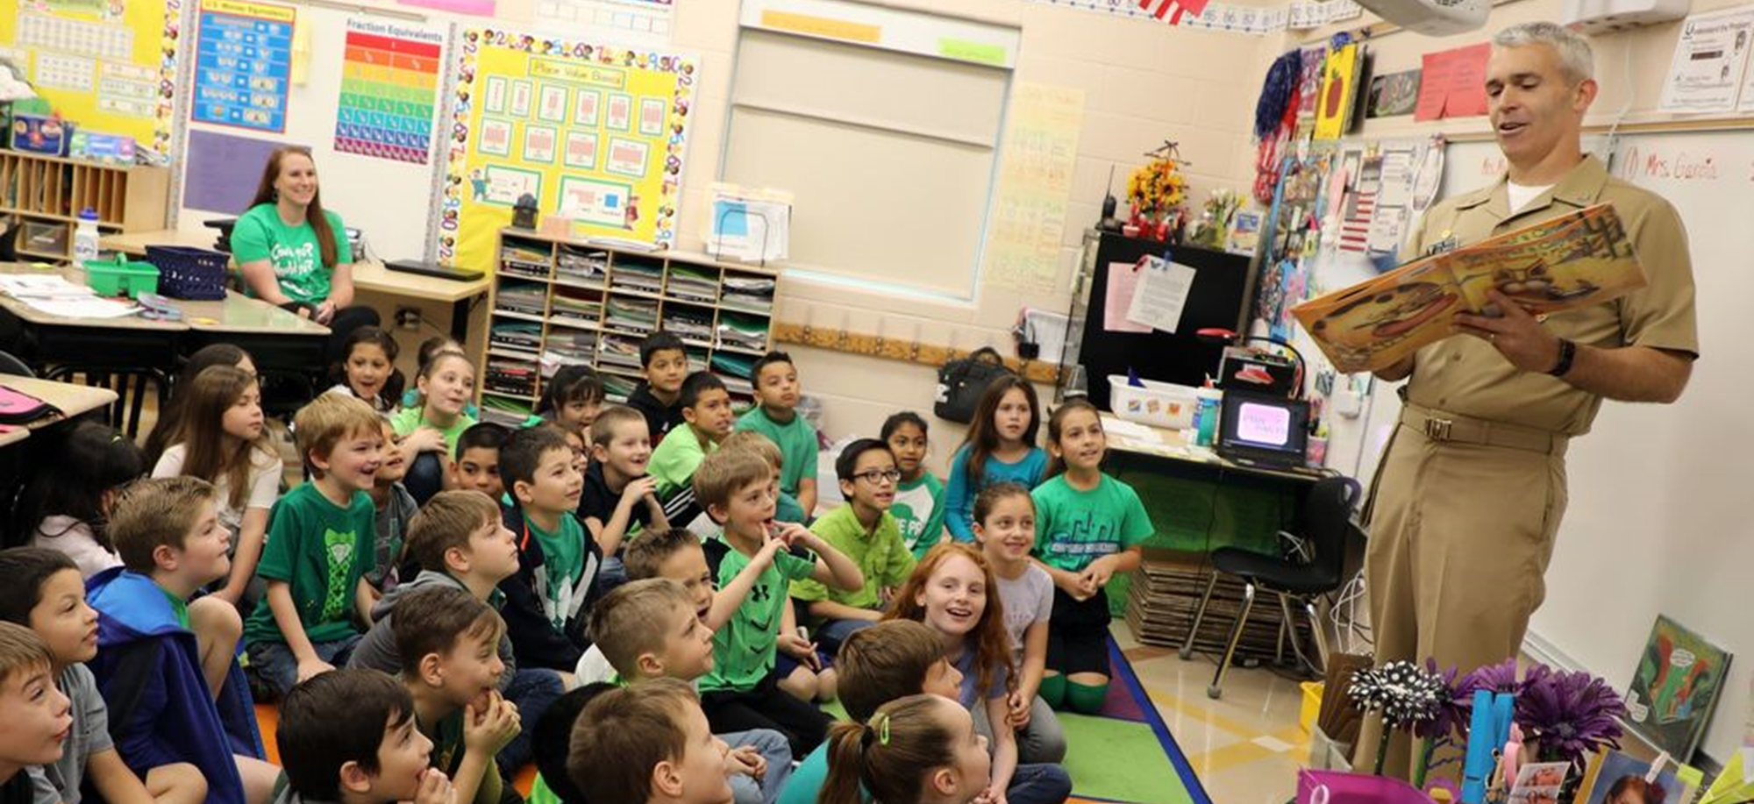
Challenges Related to
Under Identification

Slide 16
Challenges
Under identification hinders educators from informing all eligible students (and parents) of every right, resource, and law they have access to.
Advocates, families, and educators, may not fully understand eligibility requirements or the intricacies of implementing The Interstate Compact on Education Opportunity for Military Children (TEC Chapter 162), in relation to state law and local school district policy.
Ensuring that mobility does not interrupt student’s course and educational program placement.

Slide 17
Resources and Communications

Slide 18
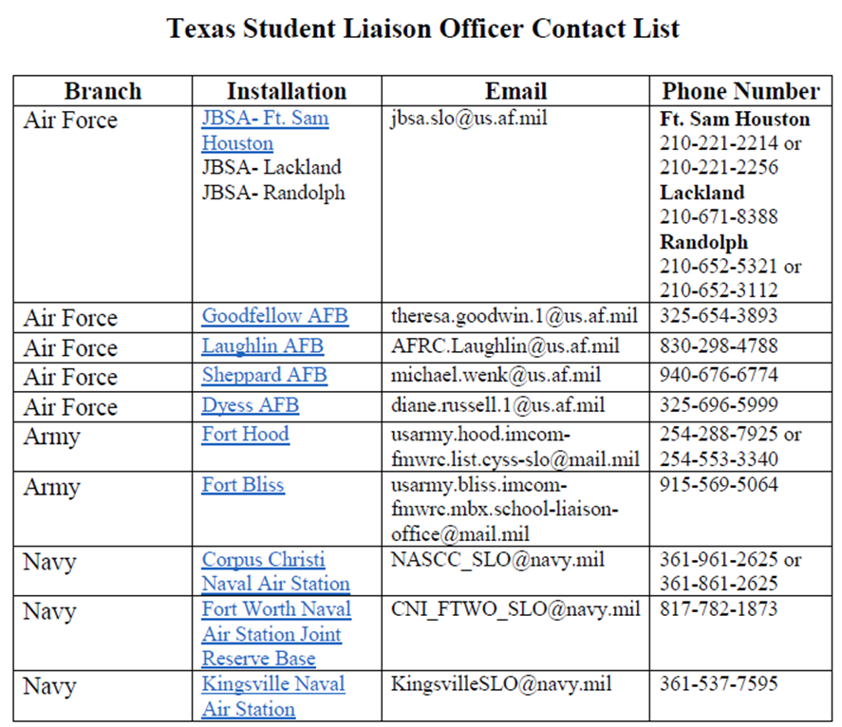
Who Do I Ask For Help?
https://tea.texas.gov/About_TEA/Other_Services/Military_Family_Resources

Slide 19
Military Family Resources Webpage
https://tea.texas.gov/mil/

Slide 21
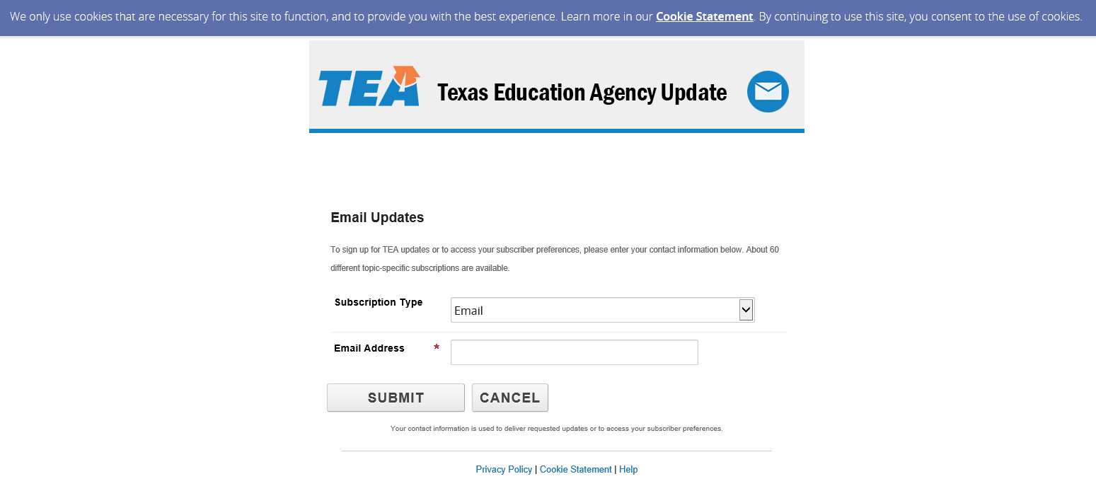
Sign-Up for Updates!

Slide 22
Sign-Up for Updates!

Slide 24
Military Connected Student Program Contact
Abby Rodriguez, M.A.
State Coordinator, Military Connected Students and Pregnancy Related Services
TEA Military Family Resources:
https://tea.texas.gov/mil/
Phone: 512-463-9502
Email: abby.rodriguez@tea.texas.gov

