Slide 1
2020-2021PEIMS DATA COLLECTIONS
Kathy Adaky, Candice DeSantis – Subject Matter Experts
April 2020

Slide 2
agenda
PEIMS DATA COLLECTIONS
Truancy (HB 548)
Additional Days (HB 3)
Expanded Learning Opportunity
CTE Auto-Calculation

Slide 3
TRUANCY (HB 548)
PEIMS DATA COLLECTIONS
Truancy (HB 548)
Additional Days (HB 3)
Expanded Learning Opportunity
CTE Auto-Calculation

Slide 4
background
TRUANCY (HB 548)
Background
Timeline
Data Collection
PEIMS Application

Slide 5
Background
House Bill (HB) 548, passed in the 86th Legislative Session, amends TEC 42.006 by adding Subsection (a-6) that requires local education agencies (LEAs) to report through PEIMS at a campus and grade level, the:
number of children who are required to attend school, but do not attend without excuse for 10 or more days or parts of days within a six-month period of a school year but fail to do so;
number of students for whom the district initiates a truancy prevention measure under TEC 25.0915 (a-4);
number of parents of students against whom an attendance officer or other school official has filed a complaint under TEC 25.093 (PARENT CONTRIBUTING TO NONATTENDANCE).

Slide 6
TIMELINE
TRUANCY (HB 548)
Background
Timeline
Data Collection
PEIMS Application

Slide 7
timeline
PEIMS
TSDS PEIMS ready to load data to eDM | August 3, 2020
PEIMS Summer submission ready for users to promote data | March 1, 2021
PEIMS Summer submission ready for users to complete | May 17, 2021
PEIMS Summer first submission due date for LEAs | June 17, 2021
PEIMS Summer resubmission due date for LEAs | July 15, 2021
PEIMS Summer data available to customers | September 16, 2021
List any additional information here.
Notes:
Still need to verify dates.

Slide 8
Data collection
TRUANCY (HB 548)
Background
Timeline
Data Collection
PEIMS Application

Slide 9
Data collection
Truancy will promote data from the following TSDS PEIMS interchange for the Summer submission:
InterchangeStudentAttendance

Slide 10
Data collection
InterchangeStudentAttendance
NEW StudentTruancyExtension complex type
E1523 TX-UNIQUE-STUDENT-ID
E0782 CAMPUS-ID-OF-ENROLLMENT
E0017 GRADE-LEVEL-CODE
NEW E1657 EXCESSIVE-UNEXCUSED-ABSENCE-INDICATOR-CODE
NEW E1658 TRUANCY-PREVENTION-MEASURE-INDICATOR-CODE
NEW E1659 TRUANCY-COMPLAINT-FILED-INDICATOR-CODE

Slide 11
HB 548 Truancy DATA ELEMENTS
CAMPUS-ID-OF-ENROLLMENT (E0782)
For StudentTruancyExtension, the CAMPUS-ID-OF-ENROLLMENT is the campus at which the student was enrolled when the student met the threshold of 10 or more unexcused absences for a day or parts of a day. When calculating the number of unexcused absences, include absences that have accumulated at other campuses within the LEA.
GRADE-LEVEL-CODE (E0017)
For StudentTruancyExtension, the GRADE-LEVEL-CODE indicates the grade level of the student at the time the student met the threshold of 10 or more unexcused absences for a day or parts of a day.
EXCESSIVE-UNEXCUSED-ABSENCE-INDICATOR-CODE (E1657)
Indicates a student who is required to attend school (age 6 to 18 years under TEC 25.086), but did not attend without excuse for 10 or more days or parts of days within a six month period of a school year. An unexcused absence is defined as any absence that is not excused by state law or LEA local policy. A partial day is defined in accordance with LEA local policy.

Slide 12
HB 548 Truancy DATA ELEMENTS CONT’d
TRUANCY-PREVENTION-MEASURE-INDICATOR-CODE (E1658)
Indicates the LEA initiated a truancy prevention measure under TEC 25.0915 (a-4) for the student.
TRUANCY-COMPLAINT-FILED-INDICATOR-CODE (E1659)
Indicates whether an attendance officer or other school official has filed a complaint against a student’s parent or legal guardian, under TEC 25.093.

Slide 13
REPORTING REQUIREMENTS
Only report the student the first time the student reaches the threshold of 10 or more unexcused absences for a day or parts of days.

Slide 14
CODE TABLES
There are no new code tables being added for Truancy. Existing PEIMS code tables will be used.

Slide 15
PEIMS APPLICATION
TRUANCY (HB 548)
Background
Timeline
Data Collection
PEIMS Application

Slide 16
PEIMS APPLICATION
StudentTruancyExtension will be added to the PEIMS Summer data submission.
Data will be provided at the student level by campus, and grade level.
No additional functionality is expected in the PEIMS application for Truancy.

Slide 17
Validation rules
New Business Validation Rules:

Slide 18
Validation rules
New Field Validation Rules:

Slide 19
reports
There will be a new report at the LEA and Campus level that will provide data for those students who are indicated as having Excessive Unexcused Absences, Truancy Prevention Measures, and/or a Truancy Complaint Filed.
The report will include the following information:
Student Name
Unique ID
Local ID
Student ID
Campus ID of Enrollment
Grade Level
Excessive Unexcused Absence Indicator Code
Truancy Prevention Measure Indicator Code
Truancy Complaint Filed Indicator Code

Slide 20
Additional Days (HB 3)
PEIMS DATA COLLECTIONS
Truancy (HB 548)
Additional Days (HB 3)
Expanded Learning Opportunity
CTE Auto-Calculation

Slide 21
background
Additional Days (HB 3)
Background
Timeline
Data Collection
PEIMS Application

Slide 22
Background
From the 2019 legislative session, Section 1.014 of House Bill (HB) 3 requires the commissioner to adjust the average daily attendance of a school district or open-enrollment charter school under Section 48.005 that offers up to an additional 30 days of half-day instruction for students enrolled in prekindergarten through fifth grade. This will be done by increasing the average daily attendance of the qualifying district or school by the amount that results from the quotient of the sum of attendance by students for each of the 30 additional instructional days of half-day instruction that are provided divided by 180.
In addition to three (3) new data elements, regular attendance and staff data will also be included in the PEIMS Extended Year submission.

Slide 23
Additional Days Program area
Office of School Programs
Brian Doran Manager of Strategy & Operations

Slide 24
TIMELINE
Additional Days (HB 3)
Background
Timeline
Data Collection
PEIMS Application

Slide 25
Timeline
PEIMS
TSDS PEIMS ready to load data to eDM | August 3, 2020
Extended Year submission ready for users to promote data | March 22, 2021
Extended Year submission ready for users to complete | August 4, 2021
Extended Year resubmission due date for LEAs | August 26, 2021
Extended Year resubmission due date for LEAs | September 16, 2021
Extended Year data available to customers | October 14, 2021

Slide 26
Data collection
Additional Days (HB 3)
Background
Timeline
Data Collection
PEIMS Application

Slide 27
Data collection
Additional Days will promote data from the following TSDS PEIMS interchanges for the Extended Year submission:
InterchangeEducationOrganization
InterchangeEducationOrgCalendar
InterchangeStudentProgram
InterchangeStudentAttendance
InterchangeStaffAssociationExtension

Slide 28
Data collection
InterchangeEducationOrganization
SchoolExtension complex type
*NEW* E1671 ADDITIONAL-DAYS-PROGRAM-INDICATOR-CODE
InterchangeEducationOrgCalendar
ReportingPeriodExtension complex type
E0266 CAMPUS-ID
E1093 SCHOOL-YEAR
E0934 REPORTING-PERIOD-INDICATOR-CODE
E1568 REPORTING-PERIOD-BEGIN-DATE
E1569 REPORTING-PERIOD-END-DATE
E0975 INSTRUCTIONAL-TRACK-INDICATOR-CODE
E1600 INSTRUCTIONAL-PROGRAM-TYPE
E0935 NUMBER-DAYS-TAUGHT
E1168 CALENDAR-DATE
CalendarDateExtension complex type
E1582 SCHOOL-DAY-EVENT-CODE
E1571 SCHOOL-DAY-OPERATIONAL-MINUTES
E1599 SCHOOL-DAY-INSTRUCATIONAL-MINUTES

Slide 29
Data collection
InterchangeStudentProgram
StudentProgramExtension
*NEW* E1672 ADDITIONAL-DAYS-PROGRAM-PARTICIPATION-INDICATOR-CODE
InterchangeStudentAttendance
BasicReportingPeriodATtendanceExtension complex type
SpecialProgramsReportingPeriodAttendanceExtension complex type

Slide 30
Data collection
InterchangeStaffAssociationExtension
StaffExtension complex type
E1524 TX-UNIQUE-STAFF-ID
E0505 STAFF-ID
E0703 FIRST-NAME
E0705 LAST-NAME
E0006 DATE-OF-BIRTH
E0212 DISTRICT-IDE
E0706 GENERATION-CODE
E0004 SEX-CODE
E1064 HISPANIC-LATINO-CODE
E1059 AMERICAN-INDIAN-ALASKA-NATIVE-CODE
E1060 ASIAN-CODE
E1061 BLACK-AFRICAN-AMERICAN-CODE
E1062 NATIVE-HAWAIIAN-PACIFIC-ISLANDER-CODE
E1063 WHITE-CODE
E1073 STAFF-TYPE-CODE
E0730 HIGHEST-DEGREE-LEVEL-CODE
E0161 YEARS-EXPERIENCE-IN-DISTRICT
E0130 TOTAL-YEARS-PROF-EXPERIENCE

Slide 31
DATA COLLECTION
StaffResponsibilitiesExtension complex type
E0212 DISTRICT-ID
E1524 TX-UNIQUE-STAFF-ID
E0266 CAMPUS-ID
E0721 ROLE-ID
E0724 SERVICE-ID
E1056 CLASS-ID-NUMBER
E0747 POPULATION-SERVED-CODE
E0170 NUMBER-STUDENTS-IN-CLASS
E1015 ESC-SSA-STAFF-INDICATOR-CODE
E1055 CLASS-TYPE-CODE
*NEW* E1673 ADDITIONAL-DAYS-PROGRAM-TEACHER-INDICATOR-CODE

Slide 32
NEW DATA ELEMENTS
ADDITIONAL-DAYS-PROGRAM-INDICATOR-CODE (E1671)
ADDITIONAL-DAYS-PROGRAM-INDICATOR-CODE indicates whether the campus offers an Additional Days School Year program to any students in prekindergarten through fifth grades as described in TEC Sec. 48.0051
ADDITIONAL-DAYS-PROGRAM-PARTICIPATION-INDICATOR-CODE (E1672)
ADDITIONAL-DAYS-PROGRAM-PARTICIPATION-INDICATOR-CODE indicates if an ADA eligible prekindergarten through fifth grade student participates in the additional days school year program as described in TEC Sec. 48.0051
ADDITIONAL-DAYS-PROGRAM-TEACHER-INDICATOR-CODE (E1673)
ADDITIONAL-DAYS-PROGRAM-TEACHER-INDICATOR-CODE indicates if a teacher is teaching students eligible for the additional days school year program as described in TEC Sec. 48.0051.

Slide 33
Code tables
C130 REPORTING-PERIOD-INDICATOR-CODE
*New* Code "9" – Additional Days School Year Program Reporting Period
C215 INSTRUCTIONAL-PROGRAM-TYPE
*New* Code 16 – Additional Days School Year Program

Slide 34
Data Collection
BasicReportingPeriodAttendanceExtension Complex Type
Special Reporting Requirements
When reporting attendance data for the Additional Days School Year Program, use REPORTING-PERIOD-INDICATOR-CODE ‘9’. Only report absences and days present for students that are ADA eligible. Report the total days present and days absent for when the student was in the program. The program may include days of instruction during the school year and the summer. Report the CAMPUS-ID-OF-ENROLLMENT as the campus on which the student attended the Additional Day School Year Program. Report days absent and days present in half day increments. This data is reported in the PEIMS Extended Year submission.

Slide 35
Data collection
ReportingPeriodExtension Complex Type
Special Reporting Requirements
When reporting data for the Additional Days School Year Program, use REPORTING-PERIOD-INDICATOR-CODE of ‘9’. The reporting period begin date will be the first instructional day of the program and the end date will be the last instructional day of the program. Instructional days for this program can be any combination of days during the regular school year and the summer. Also, use INSTRUCTIONAL-PROGRAM-TYPE code “16” – Additional Day School Year Program. This data is reported in the PEIMS Extended Year submission.
CalendarDateExtension Complex Type
Special Reporting Requirements:
When reporting the calendar dates for the Additional Days School Year Program, use School Day Event Code 01 - Student Instructional Day (whole or partial day). Waivers do not apply to this program.

Slide 36
Data collection
BasicReportingPeriodAttendanceExtension Complex Type
Data Element Reporting Requirements
CAMPUS-ID-OF-ENROLLMENT (E0782) indicates the unique campus identification number of the campus in which the student is enrolled. For PEIMS Extended Year, this is the campus in which the student is attending the Additional Days School Year Program.
REPORTING-PERIOD-INDICATOR-CODE (E0934) indicates the period for which the attendance data is being reported. REPORTING-PERIOD-INDICATOR-CODE identifies the six-week reporting period.
The instructional calendar(s) for each campus must be divided into six approximately equal reporting periods.
Warning: School calendar tracks exceeding 180 days will result in less ADA funding per day for the school district/campus.
For PEIMS Extended Year, the REPORTING-PERIOD-INDICATOR-CODE must be ‘9’.
NUMBER-DAYS-TAUGHT (E0935) indicates the number of days of instruction offered, as shown on the school calendar, during a particular reporting period.
Instructional days do not include days of teacher in-service or preparation, or holidays. All students assigned to a particular instructional track will have the same NUMBER-DAYS-TAUGHT. Warning: School calendar tracks exceeding 180 days will result in less ADA funding per day for the school district/campus.
The instructional calendar(s) for each campus must be divided into six approximately equal reporting periods. Regardless of the structure of the actual instructional calendar, a LEA must report the full school year (usually 180 days) for each instructional track offered by the LEA in six approximately equal reporting periods.
For PEIMS Extended Year, NUMBER-DAYS-TAUGHT must be the number of days in the Additional Day School Year Program. Report as full days.

Slide 37
Data collection
BasicReportingPeriodAttendanceExtension Complex Type Cont’d
TOTAL-DAYS-ABSENT (E0036) indicates the total number of days the student was absent during a particular reporting period. For PEIMS Extended Year, TOTAL-DAYS-ABSENT should be reported as half-day absences in the Additional Day School Year Program.
For additional rules concerning the reporting of days absent for a particular student, please refer to the Student Attendance Accounting Handbook.
TOTAL-ELIGIBLE-DAYS-PRESENT (E0937) indicates the total number of days the student was present and eligible for Foundation School Program funding during a particular reporting period. For PEIMS Extended Year, TOTAL-ELIGIBLE-DAYS-PRESENT should be reported as half-day present in the Additional Day School Year Program.
For additional rules concerning the reporting of Eligible Days Present for a particular student, please refer to the Student Attendance Accounting Handbook.
SpecialProgramsReportingPeriodAttendanceExtension Complex Type
Special Reporting Requirements
When reporting special program attendance data for the Additional Days School Year Program, use REPORTING-PERIOD-INDICATOR-CODE ‘9’. Report special program data based on whether the students received services during the Additional Days School Year Program. Flexible attendance is not reported for the Additional Days School Year Program. Days should be reported as half-days. This data is reported in the PEIMS Extended Year submission.

Slide 38
Data collection
SpecialProgramsReportingPeriodAttendanceExtension Complex Type
Special Reporting Requirements
When reporting special program attendance data for the Additional Days School Year Program, use REPORTING-PERIOD-INDICATOR-CODE ‘9’. Report special program data based on whether the students received services during the Additional Days School Year Program. Flexible attendance is not reported for the Additional Days School Year Program. Days should be reported as half-days. This data is reported in the PEIMS Extended Year submission.

Slide 39
Data collection
StaffExtension Complex Type
General Reporting Requirements
PEIMS Extended Year Submission
Report teachers teaching students in the Additional Days School Year Program. Only staff with teaching responsibilities (Role IDs 047 and 087) should be reported.
StaffResponsibilitiesExtension Complex Type
General Reporting Requirements
PEIMS Extended Year Submission
For teachers teaching in the Additional Days School Year Program, report the Service ID, Population Served and Number of Students in Class for this particular program in the PEIMS Extended Year Submission.
Data Element Reporting Requirements
ADDITIONAL-DAYS-PROGRAM-TEACHER-INDICATOR-CODE (E16X3) indicates if a teacher is teaching prekindergarten through fifth grade students in the Additional Days School Year Program as described in TEC Sec. 48.0051.

Slide 40
PEIMS APPLICATION
Additional Days (HB 3)
Background
Timeline
Data Collection
PEIMS Application

Slide 41
PEIMS APPLICATION
Additional Days will be added to the PEIMS Extended Year data submission.
Data will be collected at the Student-level, Staff-level, Campus-level, LEA-level.
No additional functionality is expected in the PEIMS application for Additional Days.

Slide 42
New Validation rules

Slide 43
New Validation rules CONT'D

Slide 44
New Validation rules CONT'D

Slide 45
New Validation rules CONT'D

Slide 46
existing Validation rules
This collection will leverage existing validations as well. Examples:
10010-000A: DISTRICT-ID must be unique for each Local Education Agency.
40100-000A: The combination of the following fields must be unique for each student: DISTRICT-ID and TX-UNIQUE-STUDENT-ID.
40100-0017: DATE-OF-BIRTH must be a valid date.
41163-000D: The combination of the following fields must be unique for each Student Special Education Program Association: DISTRICT-ID and TX-UNIQUE-STUDENT-ID.

Slide 47
reports
Existing PEIMS reports will be modified.
New reports for Extended Year submission will be added for data validations.
Reports will be added at the Student-level, Staff-level, Campus-level and LEA-level.
Requirements are still underway. Stay tuned for more information.

Slide 48
Expanded Learning Opportunity
PEIMS DATA COLLECTIONS
Truancy (HB 548)
Additional Days (HB 3)
Expanded Learning Opportunity
CTE Auto-Calculation

Slide 49
Expanded Learning opportunity Program area
Innovative Instructional Models
Christine McCormick Education Specialist

Slide 50
CTE AUTO-CALCULATION
PEIMS DATA COLLECTIONS
Truancy (HB 548)
Additional Days (HB 3)
Expanded Learning Opportunity
CTE Auto-Calculation

Slide 51
background
CTE Auto-Calculation
Background
Data Collection
PEIMS Application

Slide 52
background
Federal Perkins legislation that governs state and local CTE programs using federal funds was reauthorized and signed into federal law on July 31, 2018.
The current method Texas uses to meet previous Perkins IV reporting requirements is insufficient to meet Perkins V reporting requirements.
Perkins V requires State Education Agencies to report specific CTE indicators that are defined differently than what was previously outlined in Perkins IV.

Slide 53
CTE Auto-Calculation Program area
College, Career, and Military Preparation
Ryan Merritt State Director, Career and Technical Education
Steve Smith Project Manager, College, Career, and Military Preparation Division

Slide 54
CTE Process
CTE information is currently reported in the PEIMS Fall Submission.
In order to meet the legislation requirements, the StudentProgramExtension complex type was modified to remove the following data element:
E0031 CAREER-AND-TECHNICAL-ED-IND-CD (TX-CareerAndTechnologyEd)
The StudentCTEProgramAssociationExtension Complex Type was removed from the PEIMS Fall Submission and instead will be reported in the PEIMS Summer Submission.
Sunset of the CareerAndTechnicalEducationCourseExtension complex type from TEDS.

Slide 55
CTE Process
Beginning in the 2020-2021school year, TEA will calculate the appropriate Career and Technical (CTE) Indicator code(s) to assign to each student that does or does not participate in a CTE program. The data used for this calculation will include:
course completion records from the PEIMS Summer submission.
where the student’s Course Sequence Code is 0, 2, 5, or 9 and Pass/Fail Indicator is 1 or 0.
The data will be stored to a table in TEA’s main database that includes
the calculated CTE Indicator
Program of Study Indicator (as defined by CCMP division)
Statewide or Regional Program of Study Indicator
State Career Cluster ID and
Federal Career Cluster ID.
**Information regarding Programs of Study or Career cluster can be found on the Career and Technical Education webpage https://tea.texas.gov/academics/college-career-and-military-prep/career-and-technical-education.

Slide 56
CTE Indicators
CTE Auto-Calculation
Background
Data Collection
PEIMS Application

Slide 57
Data collection
StudentProgramExtension Complex Type
Data Element Reporting Requirements
CAREER-AND-TECHNICAL-ED-IND-CD (E0031)
The CAREER-AND-TECHNICAL-ED-IND-CD is a calculated value based on the student’s course completion data for all years in which the student could have taken a CTE course. The CAREER-AND-TECHNICAL-ED-IND-CD will be calculated for all students in grades 06-12.
The CAREER-AND-TECHNICAL-ED-IND-CD is calculated once the PEIMS Summer Submission is in the Accepted status for all LEAs. Reports that display the calculated value will be available approximately two weeks after each submission closes.
State and Federal Clusters are assigned to each program of study and are used for reporting purposes.

Slide 58
Data collection
CTE Codes 6 and 7:
Course completion records must have a Course Sequence Code of 0, 2, 5, or 9 and a Pass/Fail Indicator of 1 to be considered in the calculation. Additionally, only certain CTE courses are considered when determining Concentrators (Code 6) and Completers (Code 7). The list of valid service ids can be found on the following link: https://tea.texas.gov/academics/college-career-and-military-prep/career-and-technical-education/approved-cte-programs-study..
CTE Program Concentrator (Code 6) are students completing and passing two or more high-school CTE program courses as defined by 19 TAC Chapter 126 (C), 127 (B) or 130, for at least two credits within the same program of study and not a completer.
CTE Program Completer (Code 7) are students completing and passing three or more high-school CTE program courses as defined by 19 TAC Chapter 126 (C), 127 (B) or 130, for four or more credits within a program of study, including one level 3 or level 4 course from within the same program of study.
Note: One student may be a concentrator or completer in more than one program of study. One student may be a concentrator in one or more programs of study and also a completer in one or more programs of study.

Slide 59
Data collection
CTE Codes 5 and E:
Course completion records must have a Course Sequence Code of 0, 2, 5, or 9 to be considered in the calculation. Pass/Fail Indicators are not considered in the calculation.
CTE Program Participant (Code 5) are students completing one, but not two or more high-school CTE program courses as defined by 19 TAC Chapter 126 (C), 127 (B) or 130, for two or more credits (the student does not have to pass or receive credit).
CTE Program Explorer (Code E) are students completing two or more high-school CTE program courses as defined by 19 TAC Chapter 126 (C), 127 (B) or 130, for at least two credits, and not a participant, concentrator or completer (the student does not have to pass or receive credit).

Slide 60
Data Collection
CTE Code 4:
All students not coded a 5, E, 6 or 7 will be coded as a 4. This includes students that have never been enrolled in a CTE course, students that take middle-school CTE courses and students that only complete the first parts of multiple part CTE courses.
Not CTE (Code 4) are students who never enrolled or who did not complete any high-school CTE course as defined by 19 TAC Chapter 126 (C), 127 (B) or 130.

Slide 61
scenarios
Scenario | Calculated CTE Indicator | Notes
Student never enrolls in a CTE course. | 4
Student only completes the course College and Career Readiness (12700300). This is a middle-school CTE course. | 4
Student only completes the first part of any two-part CTE course. | 4 | The student is a code 4 because they did not complete the last part of a multi-part course.
Student completes and passes all parts of the course Principles of Applied Engineering (13036200) and all parts of the course Introduction to Aircraft Technology (13039350). | E | Principles of Applied Engineering and Introduction to Aircraft are not in the same Program of Study.
Student completes all parts of the course Principles of Applied Engineering (13036200) but does not pass the course. | 5 | The student completed one CTE course, so they are not coded a 4. The student only completed one course and did not complete and pass two CTE courses, so they are not a code E or code 6 (if within the same program of study, passed both and received at least 2 credits).

Slide 62
Scenarios cont’d
Scenario | Calculated CTE Indicator | Notes
Student completes and passes all parts of Foundations of Cybersecurity (03580850) and Computer Programming I (13027600). | 6 | Student is a code 6 because both courses are in the same program of study.
Student completes and passes all parts of Principles of Biosciences (13036300), Biotechnology I (13036400) and Biotechnology II (13036450). | 6 | Student is a code 6 because all courses are in the same program of study.
Student completes and passes all parts of Principles of Applied Engineering (13036200), Manufacturing Engineering Technology I (13032900), Aerospace Engineering (PLTW) (N1303745) and Scientific Research and Design (13037200). | 7 | Student is a code 7 because both courses are in the same program of study.
Student completes and passes all parts of Principles of Manufacturing (13032200), Principles of Applied Engineering (13036200), Robotics I (13037000), and Robotics II (13037050). | 7 | Student is a code 7 because three or more courses are in the same program of study, and one of them is a level 3 or 4 course.

Slide 63
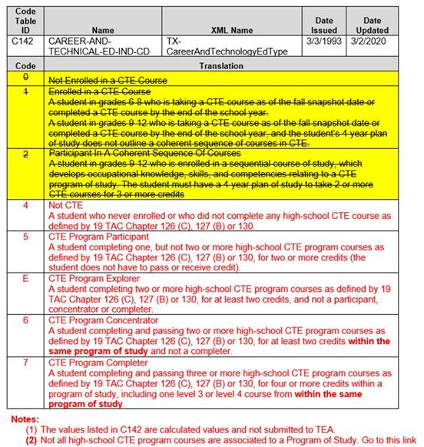
Code tables

Slide 64
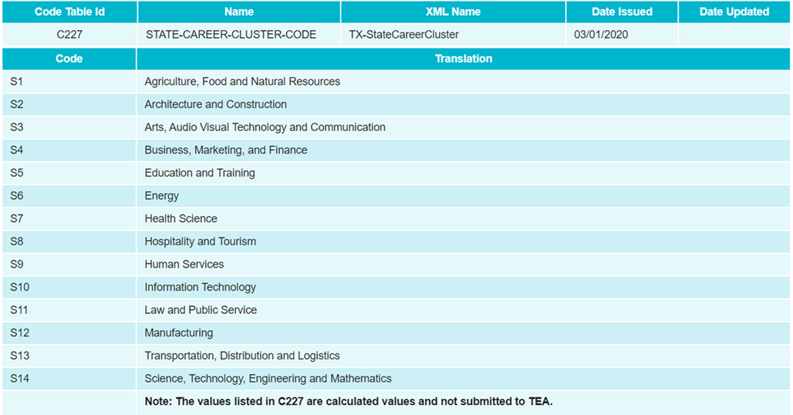
Code tables

Slide 65
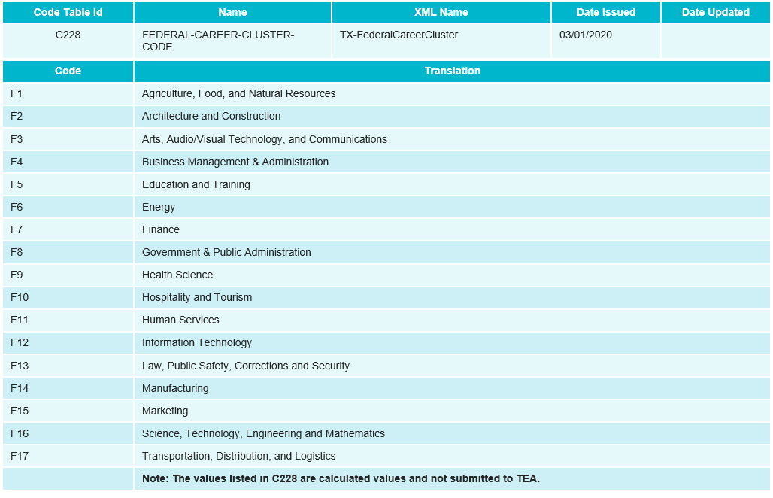
Code tables

Slide 66
CTE Indicators
CTE Auto-Calculation
Background
Timeline
Data Collection
PEIMS Application

Slide 67
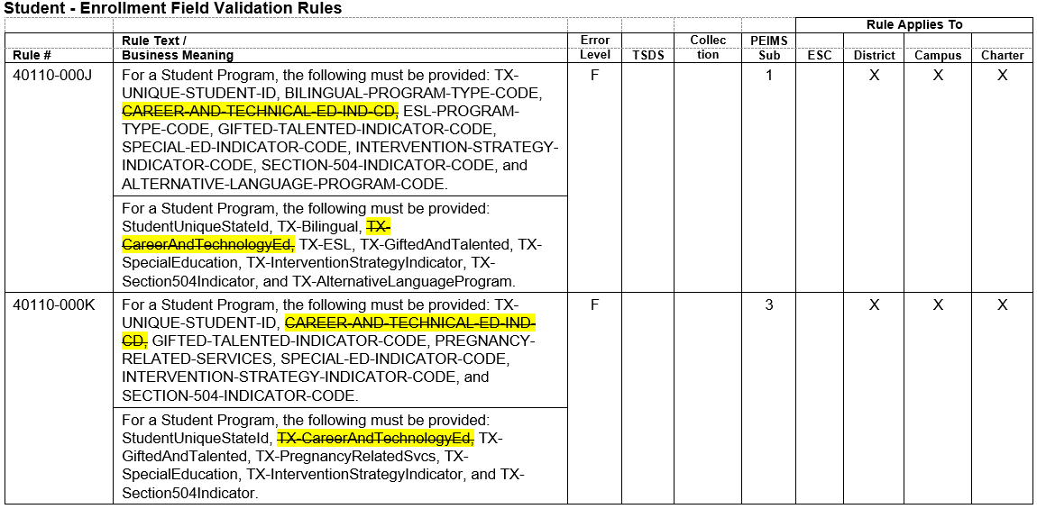
Rule uPDATES
The following rules will be updated to remove references to the CAREER-AND-TECHNICAL-ED-IND-CD:

Slide 68
Rule Updates – cont’d

Slide 69
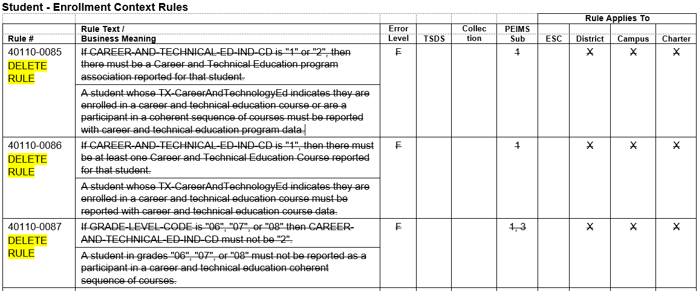
Rule Deletions
The following rules will be deleted from TEDS:

Slide 70
Rule deletions – cont’d

Slide 71
Rule deletions – cont’d

Slide 72
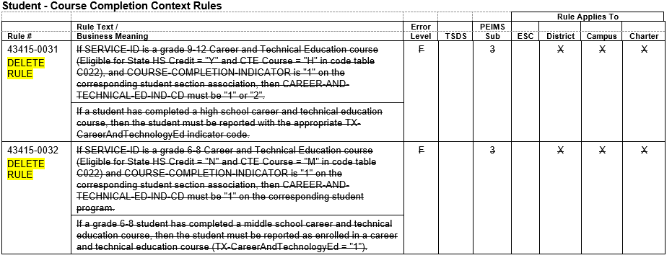
Rule deletions – cont’d

Slide 73
reports
New report will be created for the PEIMS Summer collection which includes the following CTE data:
Student Name
Unique ID
Local ID
Student ID
Program of Study
State or Regional Program
Calculated CTE Indicator
State Cluster
Federal Cluster
This report will be a campus level and LEA level report.
The user will be able to export the output in CSV format
Note: Once LEAs are in Accepted status, TEA will process the calculation that will create data for the reports where CTE data is located.

Slide 74
reports
The listed existing PEIMS Summer reports will display blank CTE Indicator data (including counts) until the calculation process is completed after all LEAs are in Accepted status.
PDM3-120-004 Disaggregation of PEIMS Summer Attendance Data
PDM3-120-007 Student Indicator Report by Grade

Slide 75
Questions?
www.texasstudentdatasystem.org

