Slide 1
Special education language acquisition
Texas Education Agency
Connor Briggs – Subject Matter Expert
April 2020

Slide 2
background
Background
Timeline
TEAL Roles and Privileges
Data Collection
Core Application

Slide 3
Department of special education
Department of Special Education
Tammy Pearcy | Deputy State Director, Special Education
sped@tea.texas.gov

Slide 4
background
Special Education Language Acquisition (SELA) was included in House Bill 548.
Requires TEA to ensure that the language acquisition of children 8 years of age or younger who are deaf or hard of hearing is regularly assessed using a tool or assessment.
For eligible students, the following will be collected:
Student demographic information
Type of disability
Type of language acquisition services provided
Time spent receiving services
Type of hearing amplification device used
Time spent using the device
Type of assessment used
Results of assessment
This data collection will be added to the Core application.
It is brand new for LEAs. There is no legacy system or current collection.

Slide 5
timeline
Background
Timeline
TEAL Roles and Privileges
Data Collection
Core Application

Slide 6
timeline
Special Education Language Acquisition (SELA) Collection
TSDS ready to load data to eDM | August 3, 2020
SELA ready for users to promote data | September 14, 2020
SELA ready for users to complete | May 17, 2021
SELA submission due date for LEAs | June 24, 2021
SELA data available to customers | July 8, 2021

Slide 7
Teal roles and privileges
Background
Timeline
TEAL Roles and Privileges
Data Collection
Core Application

Slide 8
Teal roles and privileges
SELA will utilize the following existing TEAL roles:
Core ESC Data Viewer
Core LEA Data Approver
Core LEA Data Completer
Core LEA Data Promoter
Core LEA Data Viewer
A new privilege, ‘SELA Access’, will be added to each of these roles.
Stay tuned to the upcoming FCN Webinars, Newsletters, and Training for more information regarding the TEAL Roles and Privileges.

Slide 9
Data collection
Background
Timeline
TEAL Roles and Privileges
Data Collection
Core Application

Slide 10
Data collection - Interchanges
SELA will promote data from the following TSDS interchanges.
InterchangeEducationOrganizationExtension
InterchangeStudentParentExtension
InterchangeStudentProgramExtension

Slide 11
tsds collection – complex types/elements
Education Organization
LocalEducationAgency
E0212 DISTRICT-ID
School
E0266 CAMPUS-ID
E0212 DISTRICT-ID
Student Parent
StudentExtension
E1523 TX-UNIQUE-STUDENT-ID
E1090 STUDENT-IDENTIFICATION-SYSTEM
E0923 LOCAL-STUDENT-ID *
E0001 STUDENT-ID
E0703 FIRST-NAME
E0704 MIDDLE-NAME *
E0705 LAST-NAME
E1303 GENERATION-CODE-SUFFIX *
E0006 DATE-OF-BIRTH
E1325 SEX
E1375 HISPANIC-LATINO-ETHNICITY
E1343 RACIAL-CATEGORY
E1390 LIMITED-ENGLISH-PROFICIENT
E1220 DISABILITY
E1632 EFFECTIVE-DATE (TX-EffectiveDateDisabilities)
E0212 DISTRICT-ID
* denotes elements not identified in TEDS 2021.1.0 as being collected in SELA. This will be corrected in an upcoming TEDS publication.

Slide 12
tsds collection – complex types/elements
Student Program
StudentSpecialEdProgramAssociationExtension
E1523 TX-UNIQUE-STUDENT-ID
E1337 PROGRAM-TYPE
E0212 DISTRICT-ID
E0173 INSTRUCTIONAL-SETTING-CODE (using PEIMS data element in TSDS)
NEW sub-complex types and elements
TX-SpecialEducationLanguageAcquisition
SchoolReference *
E0266 CAMPUS-ID *
E1661 PREFERRED-HOME-COMMUNICATION-METHOD
TX-LanguageAcquisitionServicesProvided
E1662 LANGUAGE-ACQUISITION-SERVICES-PROVIDED
E1663 FREQUENCY-OF-SERVICES
E1664 HOURS-SPENT-RECEIVING-SERVICES
TX-HearingAmplificifation
E1665 HEARING-AMPLIFICATION-TYPE
E1666 HEARING-AMPLIFICATION-ACCESS
E1667 HEARING-AMPLIFICATION-AVERAGE-DAILY-USE
TX-LanguageAcquisitionAssessmentReportingCategory
E1668 TOOL-OR-ASSESSMENT-USED
E1669 ASSESSMENT-RESULTS-OBTAINED
* denotes elements not identified in TEDS 2021.1.0 as being collected in SELA. This will be corrected in an upcoming TEDS publication.

Slide 13
NEW CODE TABLES
PREFERRED-HOME-COMMUNICATION-CODE (DC155)
01 Visual
02 Auditory
03 Tactile
04 Multiple or Total
LANGUAGE-ACQUISITION-SERVICES-PROVIDED-CODE (DC156)
01 Direct
02 Indirect
03 Consultative
FREQUENCY-OF-SERVICES-CODE (DC157)
01 Daily
02 Weekly
03 Monthly
04 Less Than Monthly

Slide 14
NEW CODE TABLES CONT’D
HOURS-SPENT-SERVICES-CODE (DC158)
01 Less Than 1 Hour
02 1 to 3 Hours
03 More Than 3 Hours up to 5 Hours
04 More Than 5 Hours
HEARING-AMPLIFICATION-CODE (DC159)
00 Not Applicable
01 Hearing Aids
02 Bone Anchored Hearing Aids (BAHA)
03 Implants (Includes Cochlear and Middle Ear Implants)
04 Supplementals (includes examples such as FM systems, Infrared systems, Induction Loop systems)
PERIOD-OF-TIME-ACCESS-CODE (DC160)
01 Full Day
02 Partial Day

Slide 15
NEW CODE TABLES CONT’D
AVERAGE-TIME-CODE (DC161)
01 Less Than 1 Hour
02 1 to 3 Hours
03 More Than 3 Hours
TOOL-ASSESSMENT-CODE (DC162)
00 Not Assessed
01 Proficiency
02 Diagnostic
03 Achievement
04 Rubric
05 Other
ASSESSMENT-RESULTS-OBTAINED-CODE (DC163)
01 Far Below Expectations
02 Below Expectations
03 Meets Expectations
04 Above Expectations
05 Far Above Expectations
06 No Results Obtained

Slide 16
Core application
Background
Timeline
TEAL Roles and Privileges
Data Collection
Core Application

Slide 17
Core application
SELA will be added to the Core application.
Data submission will be LEA-level only, with no campus-level data submissions.
ESCs will be able to monitor LEA data submissions but will not submit any of their own data.
Functionality will be similar to other Core collections. LEAs will be able to promote, validate, run reports, complete, and apply for extensions.

Slide 18
PROMOTION LOGIC
The following criteria logic will be applied when promoting students:
Students 8 years of age or younger on September 1st of current school year
Students coded with the following E1220 DISABILITY:
02 – Deaf-Blindness (Deaf-Blind)
06 – Hearing/Auditory Impairment (Auditory Impairment)

Slide 19
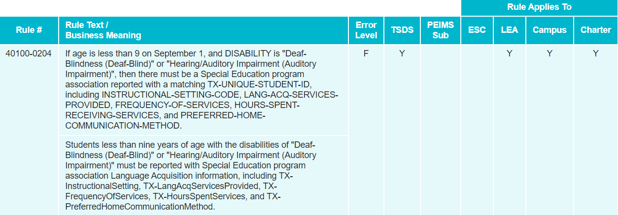
New Validation rules
New validation rules:

Slide 20
New Validation rules

Slide 21
New Validation rules – cont'd

Slide 22
New Validation rules – cont'd

Slide 23
New Validation rules – cont'd

Slide 24
Existing Validation rules
This collection will leverage existing validations as well. Examples:
10010-000A: DISTRICT-ID must be unique for each Local Education Agency.
40100-000A: The combination of the following fields must be unique for each student: DISTRICT-ID and TX-UNIQUE-STUDENT-ID.
40100-0017: DATE-OF-BIRTH must be a valid date.
41163-000D: The combination of the following fields must be unique for each Student Special Education Program Association: DISTRICT-ID and TX-UNIQUE-STUDENT-ID.

Slide 25
reports
Expecting only one report at both the LEA and ESC levels
Report will be similar in structure to “roster” style reports seen in other TSDS data collections.
LEAs will use this report to verify all data submitted for the data collection.
ESCs will be able to run this report for all of their LEAs to monitor their submissions.

Slide 26
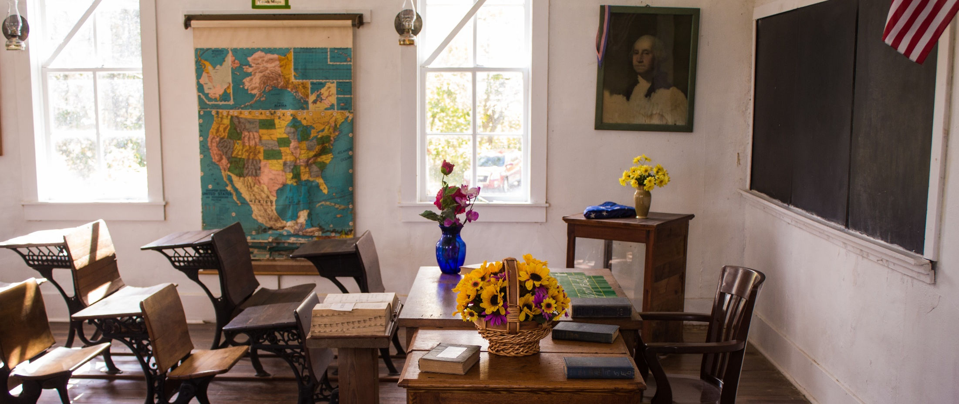
Questions?
www.texasstudentdatasystem.org

