Slide 1
Student Discipline Data Reporting Changes
Presented by
Mary Scott
Rhonda Williams
2020-2021 School Year
March 31, 2020 – April 2, 2020

Slide 2
Agenda
Disciplinary Action Code Table C164 Updates
HB 446 – Clubs and Knuckles
HB 65 – Out of School Suspension, DAEP, and Expulsion Reporting

Slide 3
Disciplinary Action Code Table C164 Updates
Disciplinary Action Code Table C164 Updates
HB 446 – Clubs and Knuckles
HB 65 – Out of School Suspension, DAEP, and Expulsion Reporting

Slide 4
Disciplinary Action Code Table C164 Updates
Code Table DISCIPLINARY-ACTION-CODE (C164)
Translations were updated to remove unnecessary references to statute and eliminate inaccurate and misinterpreted constraints on action code use as well as decrease the likelihood of future modifications. Other minor edits were made to ensure accuracy, consistency, and clarity.
There are no reports or data validation rule impacts from these updates.

Slide 5
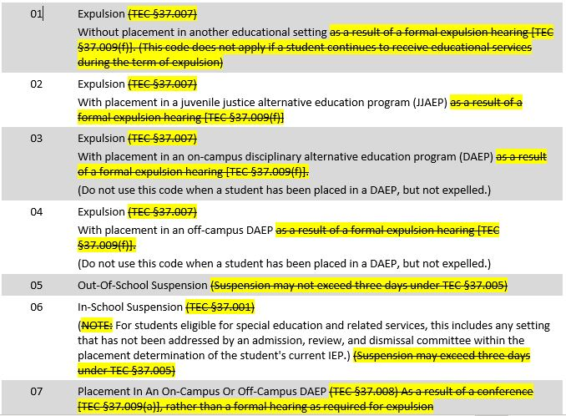
Disciplinary-Action-Code Table C164 Updates (cont’d)

Slide 6
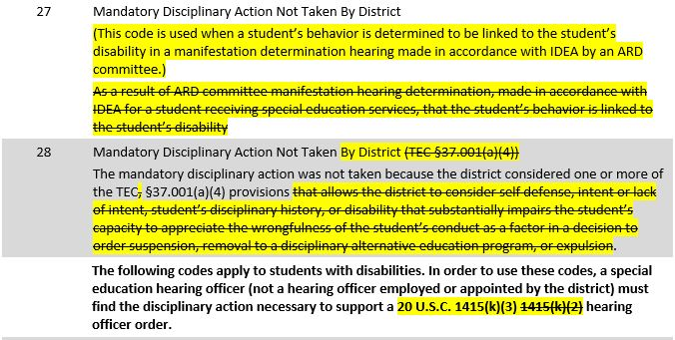
Disciplinary-Action-Code Table C164 Updates (cont’d)

Slide 7
HB 446 - Clubs and knuckles
Disciplinary Action Code Table C164 Updates
HB 446 – Clubs and Knuckles
HB 65 – Out of School Suspension, DAEP, and Expulsion Reporting

Slide 8
House Bill 446 - Clubs and Knuckles
Code Table DISCIPLINARY-ACTION-REASON-CODE (C165)
House Bill (HB) 446, 86th Texas Legislature amended certain sections of the Texas Penal Code effective September 1, 2019:
It is no longer an offense under Section 46.02 to carry a club as defined by Section 46.01(1) in unrestricted areas. However, Section 46.03 still prohibits clubs being brought on to any property of a school or educational institution and is a third-degree felony.
Knuckles, as defined by Section 46.01(8), are no longer listed as one of the prohibited weapons defined in Section 46.05.
These changes impacted disciplinary reason codes ‘13’ and ‘14’ of Code Table C165.

Slide 9
House Bill 446 - Clubs and Knuckles (CONT’D)
Code Table C165: Reason Code ’13’
Local education agencies (LEAs) should no longer report students with disciplinary reason code 13. This reason code has been eliminated from C165.
Students now found in possession of a club should be reported using disciplinary reason code ‘02’ (Conduct Punishable as a Felony).
Students using a club may also be reported with other disciplinary reason codes, such as assault, defined in Appendix E of the 2020-2021 Texas Education Data Standards (TEDS) as applicable.

Slide 10
House Bill 446 - Clubs and Knuckles (CONT’D)
Code Table C165: Reason Code ’14’
LEAs should no longer report students found with knuckles with disciplinary reason code 14.
Based on an LEA’s student code of conduct, students found with knuckles may be reported using disciplinary reason code ‘21’ (Violation of Student Code of Conduct).
Students using knuckles may be reported with other disciplinary reason codes, such as assault, defined in Appendix E of the 2020-2021 TEDS as applicable.

Slide 11
House Bill 446 - Clubs and Knuckles (CONT’D)

Slide 12
HB 65 – Out of School Suspension, DAEP, and Expulsion Reporting
Disciplinary Action Code Table C164 Updates
HB 446 – Clubs and Knuckles
HB 65 – Out of School Suspension, DAEP, and Expulsion Reporting

Slide 13
HB 65 – Out of School Suspension, DAEP, and Expulsion Reporting
Previous Process:
Prior to the 86th Legislative Session, Texas Education Code (TEC) Section 37.020 required LEAs to report:
Each placement in a disciplinary alternative education program established under TEC Section 37.008; and
Each expulsion under TEC Section 37.007, whether mandatory or discretionary
that were inconsistent with guidelines included in the student code of conduct under TEC Section 37.001(a)(5) to set the length of term for disciplinary alternative education program (DAEP) placements and expulsions. To date, the Texas Education Agency has not collected this information.

Slide 14
HB 65 – Out of School Suspension, DAEP, and Expulsion Reporting (cont’d)
New Process:
HB 65, 86th Texas Legislature, passed and added Subsection (f) to TEC Section 37.020.
TEC Section 37.020(f) includes a requirement for LEAs to report the number of out-of-school suspensions inconsistent with the guidelines included in the student code of conduct under TEC Section 37.001(a)(3) which states a student code of conduct must outline conditions under which a student may be suspended as provided by TEC Section 37.005.

Slide 15
HB 65 – Out of School Suspension, DAEP, and Expulsion Reporting (cont’d)
*NEW* E1656 INCONSISTENT-CODE-OF-CONDUCT-INDICATOR-CODE (TX-InconsistentCodeOfConductIndicator) was added to the DisciplineActionExtension complex type to be reported in the PEIMS Summer Submission.
This new element provides LEAs a mechanism to report if any disciplinary alternative education program (DAEP) placement, expulsion, or out-of-school suspension (OSS) is inconsistent with an LEA’s student code of conduct guidelines:
DAEP and Expulsion: length of term inconsistent with the student code of conduct guidelines;
OSS: all student code of conduct guidelines required by TEC Section 37.005.
Data reporting examples follow on the next slide:

Slide 16
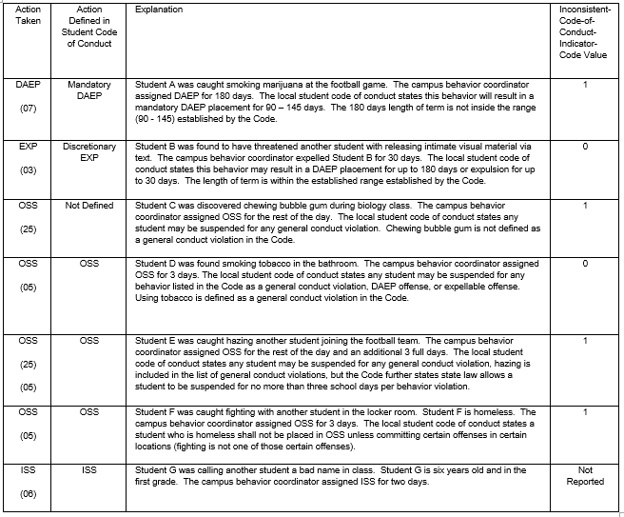
HB 65 – Out of School Suspension, DAEP, and Expulsion Reporting (cont’d)

Slide 17
HB 65 – Out of School Suspension, DAEP, and Expulsion Reporting (cont’d)
Validation Rules:
44425-0074
If DISCIPLINARY-ACTION-CODE is "01", "02", "03", "04", "05", "07", "08", "09", "10", "11", "12", "15", "25", "50", "51", "52", "53", "55", "56", "57", "58", "59", or "61", then INCONSISTENT-CODE-OF-CONDUCT-INDICATOR-CODE must not be blank.
44425-0075
If DISCIPLINARY-ACTION-CODE is not "01", "02", "03", "04", "05", "07", "08", "09", "10", "11", "12", "15", "25", "50", "51", "52", "53", "55", "56", "57", "58", "59", or "61", then INCONSISTENT-CODE-OF-CONDUCT-INDICATOR-CODE must be blank/not reported.

Slide 18
HB 65 – Out of School Suspension, DAEP, and Expulsion reporting (cont’d)
The following reports will include the *NEW* E1656 INCONSISTENT-CODE-OF-CONDUCT-INDICATOR-CODE data element:
PDM3-132-001 Student Disciplinary Action Roster

Slide 19
HB 65 – Out of School Suspension, DAEP, and Expulsion reporting (cont’d)
PDM3-132-002 Student Disciplinary Action Detail by Reason

Slide 20
HB 65 – Out of School Suspension, DAEP, and Expulsion reporting (cont’d)
PDM3-132-004 Student Disciplinary Action Detail by Incident Number

Slide 21
Questions?
StudentDisciplineSupport@tea.texas.gov

