Slide 1
Texas Records Exchange (TREX) update
Presented by: Leticia Ollervidez
2020 - 2021 School Year
March-April 2020

Slide 2
Trex v4.9 aGENDA
New Data Elements
New Code Tables
Changes to Existing Code Tables
Other Changes
Notes:
These changes were the result of two legislative bills: SB 1679 and HB3 Section 2.031 (TEC 29.172)

Slide 3
New Data elements
New Data Elements
New Code Tables
Changes to Existing Code Tables
Other Changes
Notes:
These changes were the result of two legislative bills: SB 1679 and HB3 Section 2.031 (TEC 29.172)

Slide 4
LEGISLATION – SENATE BILL 1679
SECTION 1. Section 29.153
Education Code, is amended by
adding Subsection (g) to read as follows:
(g) A child who is eligible for enrollment in a prekindergarten class under Subsection (b) at the age of three and
enrolls in a prekindergarten class at the age of three remains
eligible for enrollment in a prekindergarten class for the following school year.

Slide 5
Trex - New Data elements
PK-ELIGIBILE-PREVIOUS-YEAR-INDICATOR-CODE (TE136)
POST-SECONDARY-CERTIFICATION-LICENSURE-EARNED (TE133)
IBC-REIMBURSEMENT-INDICATOR (TE132)
SAT-ACT-REIMBURSEMENT-INDICATOR (TE134)

Slide 6
Trex - new data element
PK-ELIGIBILE-PREVIOUS-YEAR-INDICATOR-CODE (TE136)
Indicates whether a four-year-old student is eligible for enrollment in a prekindergarten class only because they were eligible for enrollment at the age of three in the previous school year.
Notes:
SB1679

Slide 7
Trex - new data element
POST-SECONDARY-CERTIFICATION-LICENSURE-EARNED (TE133)
Indicates the nationally or internationally recognized business or industry certification or license earned by a student.
Industry certifications earned between:
  September 1 and May 31 are reported in PEIMS SUMR(3) Submission
  June 1 and August 31 are reported in PEIMS FALL(1) Submission
Notes:
HB3 Section 2.031 (TEC 29.172)

Slide 8
Legislation – House Bill 3
SECTION 2.031. Section 29.190
Education Code, is amended by amending Subsection (a) and adding Subsection (a-1)
(a-1) A student may not receive more than one subsidy under this section.
  Sec.48.155 COLLEGE PREPARATION ASSESSMENT REIMBURSEMENT
  Sec. 48.156. CERTIFICATION EXAMINATION REIMBURSEMENT
Notes:
SB1679
HB3
(LEAs) are entitled to a reimbursement to help defray the cost of industry certification exams and college preparation assessments. Each LEA cannot receive more than one industry certification exam reimbursement per student and a student may not receive more than one subsidy.

Slide 9
Trex - new data element
IBC-REIMBURSEMENT-INDICATOR (TE132)
Indicates an LEA has received reimbursement for an industry certification exam fee for the student. LEAs enrolling students for whom another LEA has received reimbursement will not receive reimbursement.
A student/LEA can only be reimbursed once.
Notes:
HB3 Section 2.031 (TEC 29.172)

Slide 10
Trex - new data element
SAT-ACT-REIMBURSEMENT-INDICATOR (TE134)
Indicates an LEA has received reimbursement for a college preparation assessment for the student. LEAs enrolling students for whom another LEA has received reimbursement will not receive reimbursement.
A student/LEA can only be reimbursed once.
Notes:
HB3 Section 2.031 (TEC 29.172)

Slide 11
New Code Tables
New Data Elements
Changes to Existing Code Tables
Other Changes
II. New Code Tables
Notes:
These changes were the result of two legislative bills: SB 1679 and HB3 Section 2.031 (TEC 29.172)

Slide 12
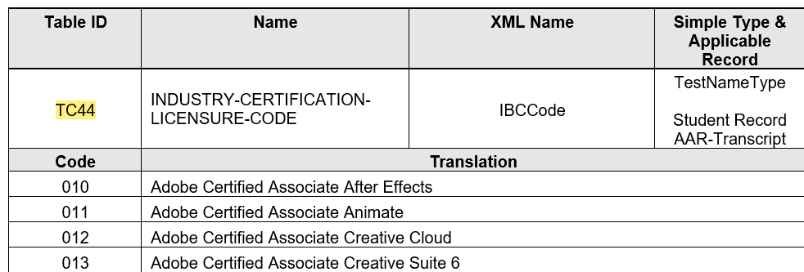
Trex - New code table
INDUSTRY-CERTIFICATION-LICENSURE-CODE (TC44)
931 code values

Slide 13
Changes to existing code tables
New Data Elements
New Code Tables
IV. Other Changes
III. Changes to Existing Code Tables
Notes:
These changes were the result of two legislative bills: SB 1679 and HB3 Section 2.031 (TEC 29.172)

Slide 14
Trex – CHANGES TO EXISTING code tables
TEA program areas have requested the addition of a new code for American Sign Language (ASL) to properly identify ASL as a language option. This new option will allow for proper tracking of the ASL population and will assist the agency and local education agencies (LEAs) with targeting support for deaf/hard of hearing English learners.
LANGUAGE-CODE-TABLE (TC14)
NEW CODE: 6B – American Sign Language (ASL)

Slide 15
Other changes
New Data Elements
New Code Tables
Changes to Existing Code Tables
IV. Other Changes

Slide 16
Trex – other changes
Published TREx v4.8.1New Feature List for 19-20
Added TC-01ASSESSMENT-NAME code table back into TREx Data Standards
Correct TAC reference in LEP-INDICATOR-CODE Definition from 19 TAC §89.12256 to 19 TAC §89.1226

Slide 17
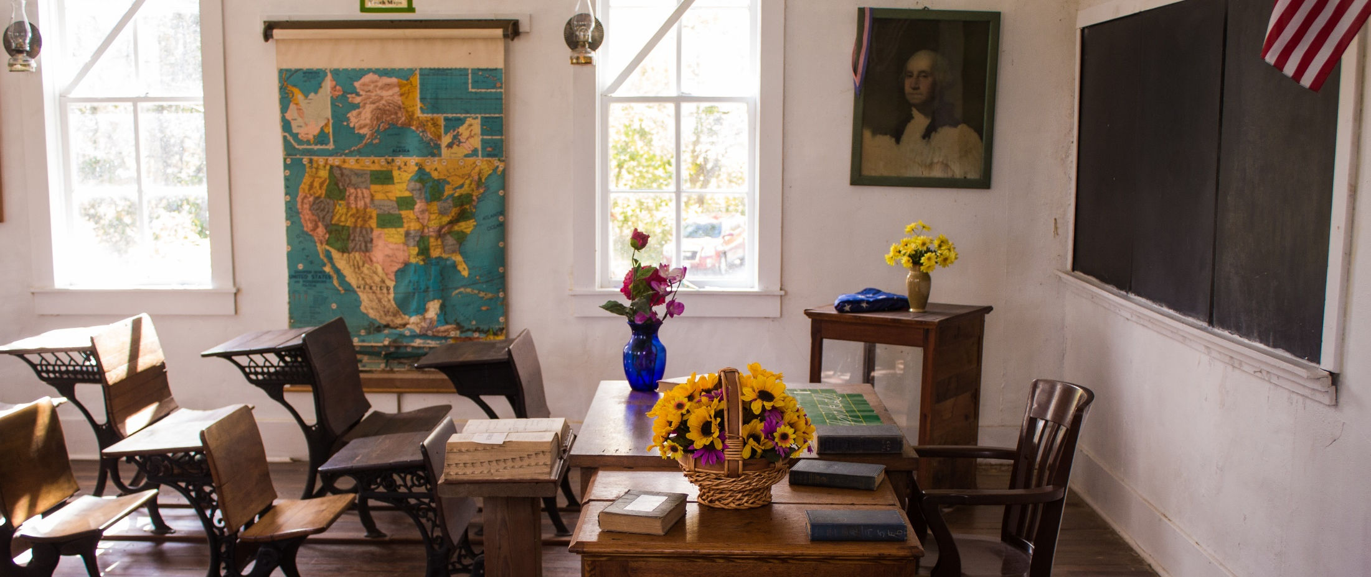
Questions?
www.texasstudentdatasystem.org

