Slide 1
Single Sign On Introduction
Accountability Policy Advisory Committee Meeting
Performance Reporting Division| April 2, 2020
Texas Education Agency Governance & Accountability Performance Reporting

Slide 2
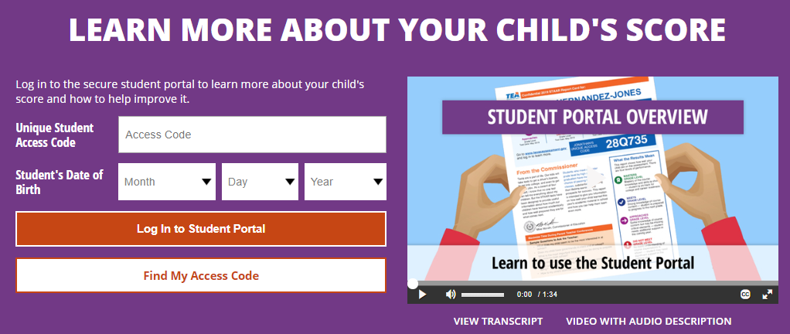
What is Single Sign On?
Single Sign On (SSO) is an exciting new feature Student Information System (SIS) vendors can offer their clients.
This feature uses a simple HTTP post request allowing SIS vendors to provide districts with the ability to give their parent-facing portals direct access to their child’s STAAR scores via the Student Portal with one click.
Parents would be taken directly into the Student Portal without needing their child’s Unique Access Code.

Slide 3
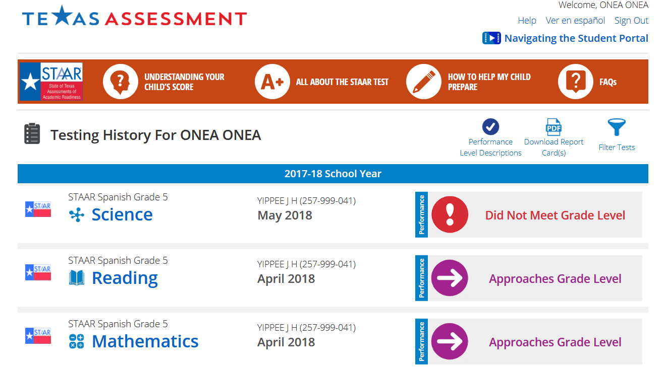
What Advantages does the Student Portal Offer?
The Student Portal offers parents and students
a history of their STAAR scores for each assessment taken in the past 10 years;
detailed results for each assessment taken;
ability to view all released test questions and how they performed;
custom resources tailored to each child (May 2020); and
resources to assist parents in understanding their child’s score, understanding the STAAR test, how to help their child prepare, and FAQs.
Student Portal Tour

Slide 4
Benefits of Single Sign On
Single Sign On benefits include
providing districts an easy way to make student STAAR scores available to parents;
providing parents easy access to all the features and resources inside the Student Portal; and
providing parents Student Portal access without their child’s Unique ID or Social Security Number.

Slide 5
Single Sign On Technical Guidance
Single Sign On
SIS Vendor Technical Guidance
(provided in separate PDF document)

Slide 6
Additional Guidance
There would be no anticipated site downtime during high traffic seasons.
Timeout is not an issue for the SIS vendor platform.
TEA guidance is to only implement Single Sign On for parent-facing portals at this time.

Slide 7
District and ESC Feedback
TEA provided district and ESC staff a preview of Single Sign On during all spring roadshow trainings across the state.
Districts were excited to begin offering their parents easy access to the Student Portal.
ESCs were excited to be able to use Single Sign On with their campuses to assist parents in improving their child’s academic outcomes.

Slide 8
District Feedback from Parents about Student Portal
“Parents love that they can see their child’s results so easily as well as all the unique features inside the Student Portal.”
“Parents love seeing all their child’s test history in one place as well as the test question details.”
“Parents find the Student Portal very user friendly.”
“The Student Portal mobile experience is great for parents.”
“Parents are more comfortable accessing their child’s scores electronically versus traditional paper.”
Notes:
In January, TEA called and spoke to district DTCs across the state. One of the purposes of our call was to gather feedback about the student portal that these districts had received from parents directly. The responses were overwhelming positive. This slide provides just a few of the responses we received from districts. Implementation of SSO would give districts the ability for their parents to access this resource that they already love with one easy click through their secure SIS.

Slide 9
Performance Reporting and ETS Contacts
General Questions
Technical Guidance Questions
Performance Reporting Email performance.reporting@tea.texas.gov
Performance Reporting Telephone (512) 463-9704
ETS Email STAAR3-8@ets.org
TexasAssessment.gov Support Center (888) 333-7770

Slide 10
Thank you!

