Slide 1
2020-2021Attendance
Amy Copeland
Justin Jons
David Marx
Jamie Muffoletto
JULY 2020

Slide 2
agenda
2020-2021 School Year Attendance
2020-2021 New Data Elements
2020-2021 Report Changes
2020-2021 Rule Changes
2020-2021 Pending Changes
New Sub-Complex Type
2019-2020 Extended Year – Service IDs

Slide 3
agenda
2020-2021 School Year Attendance
2020-2021 New Data Elements
2020-2021 Report Changes
2020-2021 Rule Changes
2020-2021 Pending Changes
New Sub-Complex Type
2019-2020 Extended Year – Service IDs

Slide 4
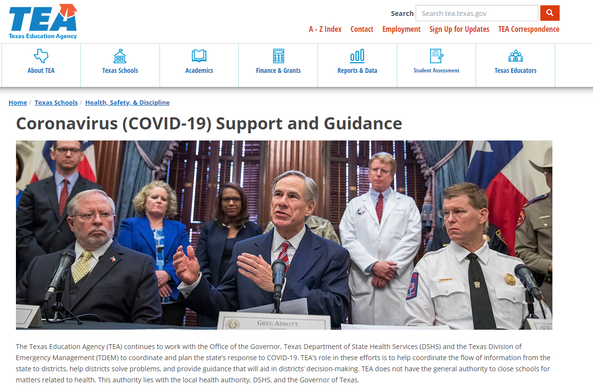
2020-2021 school year attendance
TEA COVID-19 Support and Guidance Page

Slide 5
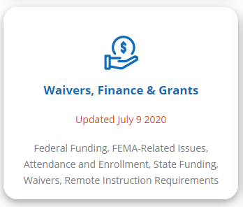
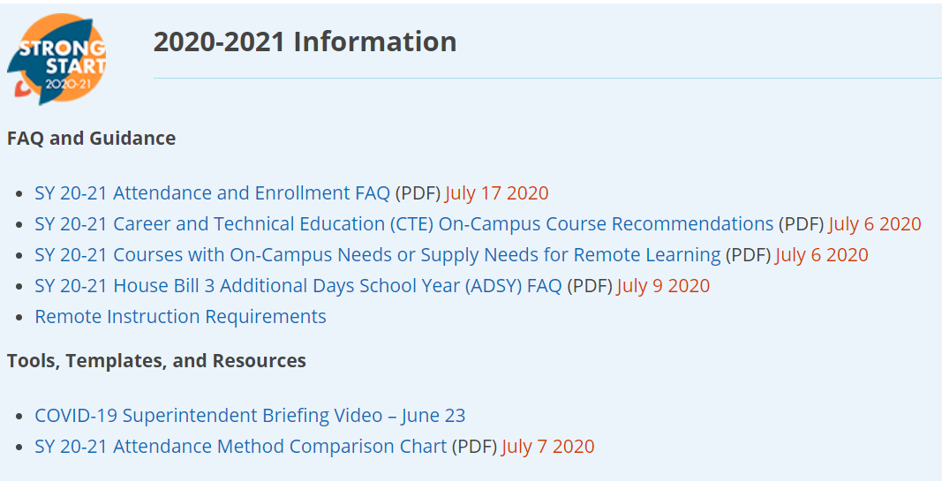
2020-2021 school year attendance
Note: May need to clear your cache memory on this site by holding down CTRL, Shift, and Delete. You will then have the option to clear the cache memory.
Waivers, Finance & Grants
FAQ

Slide 6
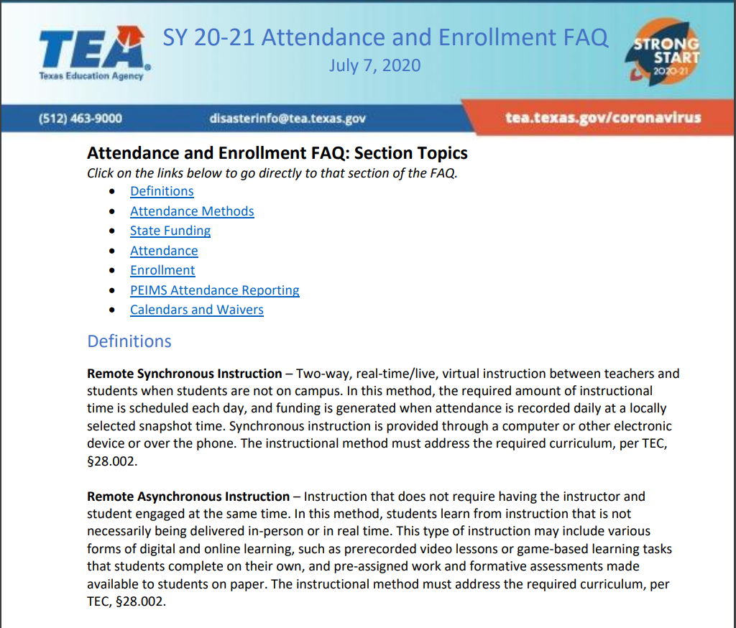
2020-2021 school year attendance
Section Topics

Slide 7
2020-2021 definitions
Remote Synchronous Instruction
Remote Asynchronous Instruction
Two-way, real-time/live, virtual instruction between teachers and students when students are not on campus.
Required amount of instructional time is scheduled each day.
Attendance recorded daily at locally selected snapshot time.
Instruction provided through computer or other electronic device or over the phone.
Must address required curriculum, per TEC, §28.002.
Are not required to be engaged at the same time.
Instruction is not necessarily delivered in-person or in real time.
Instructional plan determines the daily engagement, instructional materials, progress monitoring, and teacher supports the student receive in order to earn daily attendance.
Instruction may include various forms of digital and online learning, prerecorded video lessons or game-based learning tasks that students complete on their own, and pre-assigned work and formative assessments made available to students on paper.
Must address required curriculum, per TEC, §28.002.

Slide 8
agenda
2020-2021 School Year Attendance
2020-2021 New Data Elements
2020-2021 Report Changes
2020-2021 Rule Changes
2020-2021 Pending Changes
New Sub-Complex Type
2019-2020 Extended Year – Service IDs

Slide 9
2020-2021 New Data Elements
30 New Data Elements Added to Texas Education Data Standards (TEDS) to Address Remote Synchronous and Remote Asynchronous Instruction
All New Data Elements Reported in Submission 3
Selected New Data Elements Reported in Submission 4 if LEA is participating in Additional Day School Year (ADSY)
Optional Flexible School Day Program (OFSDP) students cannot be served in Remote Synchronous or Remote Asynchronous
Two (2) New Data Elements to Texas Records Exchange (TREx)

Slide 10
2020-2021 New Data Elements
In Person
RS-TOTAL-ELIGIBLE-DAYS-PRESENT (E16XX)
TOTAL-ELIGIBLE-DAYS-PRESENT (E0937)
RA-TOTAL-ELIGIBLE-DAYS-PRESENT (E16XX)
RS
RA
Eligible (In-Person), Remote Synchronous, and Remote Asynchronous are reported separately in the BasicReportingPeriodAttendanceExtension.
BasicReportingPeriodAttendanceExtension

Slide 11
2020-2021 data elements
On Campus | Remote Synchronous Instruction |  | Remote Asynchronous Instruction
TOTAL-ELIGIBLE-DAYS-PRESENT (E0937) (Sub 3 & 4) | RS-TOTAL-ELIGIBLE-DAYS-PRESENT (Sub 3 & 4) | Total number of days the student was remote synchronous and eligible for FSP funding during a reporting period. | RA-TOTAL-ELIGIBLE-DAYS-PRESENT (Sub 3 & 4) | Total number of days the student was remote asynchronous and eligible for FSP funding during a reporting period.
BILINGUAL/ESL-FUNDING-CODE (E1651) (Sub 3 & 4) | RS-BILINGUAL/ESL-FUNDING-CODE (Sub 3 & 4) | The remote synchronous language program in which the student participates during the reporting period. | RA-BILINGUAL/ESL-FUNDING-CODE (Sub 3 & 4) | The remote asynchronous language program in which the student participates during the reporting period.
TOTAL-ELIG-BILINGUAL/ESL-DAYS-PRESENT (E0938) (Sub 3 & 4) | RS-TOTAL-ELIG-BILINGUAL/ESL-DAYS-PRESENT (Sub 3 & 4) | Total number of days the student was remote synchronous and an eligible participant in the state-approved bilingual/ESL program during a reporting period. | RA-TOTAL-ELIG-BILINGUAL/ESL-DAYS-PRESENT (Sub 3 & 4) | Total number of days the student was remote asynchronous and an eligible participant in the state-approved bilingual/ESL program during a reporting period.
TOTAL-ELIG-RESIDENTIAL-FACILITY-DAYS-PRESENT (E1652) (Sub 3) | RS-TOTAL-ELIG-RESIDENTIAL-FACILITY-DAYS-PRESENT (Sub 3) | Total number of days the student was remote synchronous and eligible for LEA services in a residential facility during a reporting period. | RA-TOTAL-ELIG-RESIDENTIAL-FACILITY-DAYS-PRESENT (Sub 3) | Total number of days the student was remote asynchronous and eligible for LEA services in a residential facility during a reporting period.
TOTAL-ELIG-PREG-REL-SVCS-DAYS-PRESENT (E0939)(Sub 3 & 4) | RS-TOTAL-ELIG-PREG-REL-SVCS-DAYS-PRESENT (Sub 3 & 4) | Total number of days a female student was remote synchronous and eligible recipient of PRS services during a reporting period. | RA-TOTAL-ELIG-PREG-REL-SVCS-DAYS-PRESENT (Sub 3 & 4) | Total number of days a female student was remote asynchronous and eligible recipient of PRS services during a reporting period.

Slide 12
2020-2021 data elements
On Campus | Remote Synchronous Instruction |  | Remote Asynchronous Instruction
TOTAL-ELIG-SP-ED-MAINSTREAM-DAYS-PRESENT (E0940) (Sub 3 & 4) | RS-TOTAL-ELIG-SP-ED-MAINSTREAM-DAYS-PRESENT (Sub 3 & 4) | Total number of days a student with a SPED IEP which provided mainstream instructional arrangement was remote synchronous during a reporting period. | RA-TOTAL-ELIG-SP-ED-MAINSTREAM-DAYS-PRESENT (Sub 3 & 4) | Total number of days a student with a SPED IEP which provided mainstream instructional arrangement was remote asynchronous during a reporting period.
ELIGIBLE-DAYS-PRESENT-IN-INSTR-SETTING (E0944)(Sub 3 & 4) | RS-ELIGIBLE-DAYS-PRESENT-IN-INSTR-SETTING (Sub 3 & 4) | Total number of days the student was eligible and remote synchronous in a designated instructional setting during a reporting period. | RA-ELIGIBLE-DAYS-PRESENT-IN-INSTR-SETTING (Sub 3 & 4) | Total number of days the student was eligible and remote asynchronous in a designated instructional setting during a reporting period.
INSTRUCTIONAL-SETTING-CODE (E0173) (Sub 3 & 4) | RS-INSTRUCTIONAL-SETTING-CODE (Sub 3 & 4) | Identifies the setting used to provide remote synchronous instruction. | RA-INSTRUCTIONAL-SETTING-CODE (Sub 3 & 4) | Identifies the setting used to provide remote asynchronous instruction.
EXCESS-HOURS-IN-INSTRUCTIONAL-SETTING (Sub 3) | RS-EXCESS-HOURS-IN-INSTRUCTIONAL-SETTING (Sub 3) | Total hours above the allowable six hours per day of remote synchronous combined career and technical and special education and related services in a designated instructional setting in a reporting period. | RA-EXCESS-HOURS-IN-INSTRUCTIONAL-SETTING (Sub 3) | Total hours above the allowable six hours per day of remote asynchronous combined career and technical and special education and related services in a designated instructional setting in a reporting period.

Slide 13
2020-2021 data elements
On Campus | Remote Synchronous Instruction |  | Remote Asynchronous Instruction
ELIGIBLE-DAYS-PRESENT-V1 (E0950) (Sub 3) | RS-ELIGIBLE-DAYS-PRESENT-V1 (Sub 3) | Total number of days eligible and remote synchronous present and enrolled in an approved career and technical course that generated one contact hour during a reporting period. | RA-ELIGIBLE-DAYS-PRESENT-V1 (Sub 3) | Total number of days eligible and remote asynchronous present and enrolled in an approved career and technical course that generated one contact hour during a reporting period.
ELIGIBLE-DAYS-PRESENT-V2 (E0951) (Sub 3) | RS-ELIGIBLE-DAYS-PRESENT-V2 (Sub 3) | Total number of days eligible and remote synchronous present and enrolled in an approved career and technical course that generated two contact hours during a reporting period. | RA-ELIGIBLE-DAYS-PRESENT-V2 (Sub 3) | Total number of days eligible and remote asynchronous present and enrolled in an approved career and technical course that generated two contact hours during a reporting period.
ELIGIBLE-DAYS-PRESENT-V3 (E0952) (Sub 3) | RS-ELIGIBLE-DAYS-PRESENT-V3 (Sub 3) | Total number of days eligible and remote synchronous present and enrolled in an approved career and technical course that generated three contact hours during a reporting period. | RA-ELIGIBLE-DAYS-PRESENT-V3 (Sub 3) | Total number of days eligible and remote asynchronous present and enrolled in an approved career and technical course that generated three contact hours during a reporting period.

Slide 14
2020-2021 data elements
On Campus | Remote Synchronous Instruction |  | Remote Asynchronous Instruction
ELIGIBLE-DAYS-PRESENT-V4 (E0953) (Sub 3) | RS-ELIGIBLE-DAYS-PRESENT-V4 (Sub 3) | Total number of days eligible and remote synchronous present and enrolled in an approved career and technical course that generated four contact hours during a reporting period. | RA-ELIGIBLE-DAYS-PRESENT-V4 (Sub 3) | Total number of days eligible and remote asynchronous present and enrolled in an approved career and technical course that generated four contact hours during a reporting period.
ELIGIBLE-DAYS-PRESENT-V5 (E0954) (Sub 3) | RS-ELIGIBLE-DAYS-PRESENT-V5 (Sub 3) | Total number of days eligible and remote synchronous present and enrolled in an approved career and technical course that generated five contact hours during a reporting period. | RA-ELIGIBLE-DAYS-PRESENT-V5 (Sub 3) | Total number of days eligible and remote asynchronous present and enrolled in an approved career and technical course that generated five contact hours during a reporting period.
ELIGIBLE-DAYS-PRESENT-V6 (E0955) (Sub 3) | RS-ELIGIBLE-DAYS-PRESENT-V6 (Sub 3) | Total number of days eligible and remote synchronous present and enrolled in an approved career and technical course that generated six contact hours during a reporting period. | RA-ELIGIBLE-DAYS-PRESENT-V6 (Sub 3) | Total number of days eligible and remote asynchronous present and enrolled in an approved career and technical course that generated six contact hours during a reporting period.
CTE

Slide 15
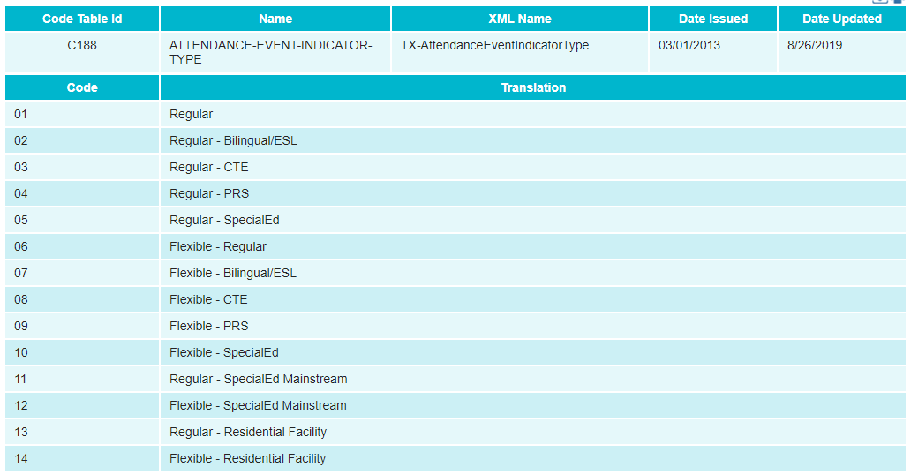
2020-2021 peims attendance reporting
How will an LEA report E1085 ATTENDANCE-EVENT-INDICATOR?
LEAs will use the “regular” ATTENDANCE-EVENT-INDICATOR-TYPE

Slide 16
2020-2021 example
Question: How will my LEA report eligible days present for in person, remote synchronous and remote asynchronous instruction methods?
Date |  | Date |  | Date
8/17/2020 | Present | 8/31/2020 | Present | 9/14/2020 | RS
8/18/2020 | Present | 9/1/2020 | Absent | 9/15/2020 | RS
8/19/2020 | Present | 9/2/2020 | Present | 9/16/2020 | RS
8/20/2020 | Present | 9/3/2020 | Present | 9/17/2020 | RS
8/21/2020 | Present | 9/4/2020 | RS | 9/18/2020 | RS
8/24/2020 | Absent | 9/7/2020 | School Holiday | 9/21/2020 | RA
8/25/2020 | Present | 9/8/2020 | RS | 9/22/2020 | RA
8/26/2020 | Present | 9/9/2020 | RS | 9/23/2020 | RA
8/27/2020 | Present | 9/10/2020 | RS | 9/24/2020 | RA
8/28/2020 | Present | 9/11/2020 | RS | 9/25/2020 | RA
RS – Remote Synchronous
Present
RA –Remote Asynchronous
Present
Present – On Campus
Number of Days Taught = 29

Slide 17
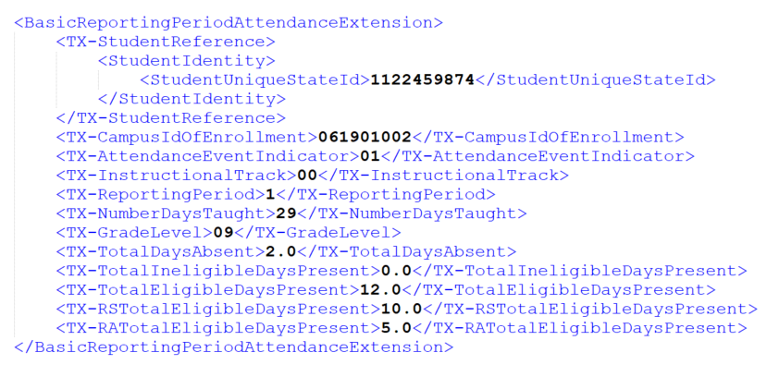
2020-2021 Example (BasicReportingPeriodAttendanceExtension)

Slide 18
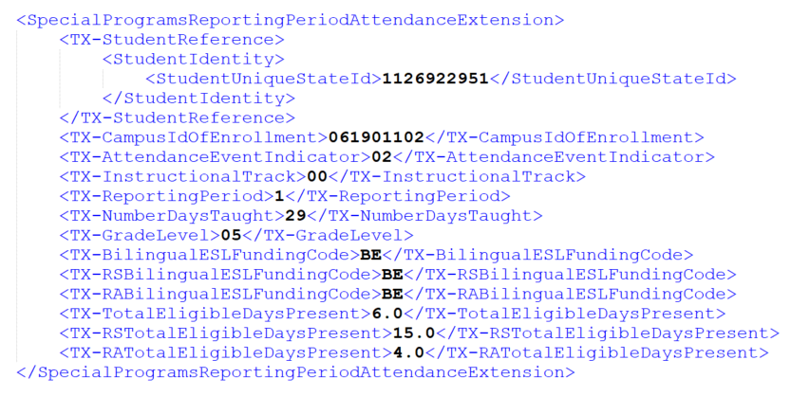
2020-2021 example (SpecialProgramReportingPeriodAttendanceExtension)

Slide 19
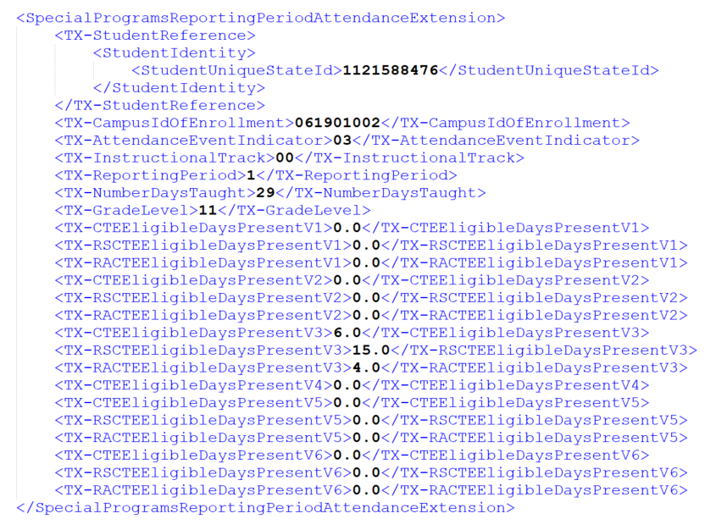
2020-2021 example (SpecialProgramReportingPeriodAttendanceExtension)

Slide 20
2020-2021 peims attendance reporting
How do we submit attendance for EE and PK students?
Prekindergarten (PK) eligible days present will be reported using the data element for RA-TOTAL-ELIGIBLE-DAYS-PRESENT. PK students should be coded as half-day students.
Early Education (EE) students' eligible days present will be reported using the data element for RA-TOTAL-ELIGIBLE-DAYS-PRESENT. EE students should be coded as full-day or half-day based on their individual education program.

Slide 21
2020-2021 peims attendance reporting
How should I code OFSDP students who are served through the remote synchronous or asynchronous instructional methods?
SY 20-21 Attendance and Enrollment FAQ (Question Number from August 4, 2020)
PEIMS Attendance Reporting
Question: 5

Slide 22
2020-2021 peims attendance reporting
Can my LEA decide to only offer remote instruction for a campus, or for all of my campuses?
Can districts develop a hybrid instructional model that intentionally blends on campus, remote asynchronous, and remote synchronous experiences?
SY 20-21 Attendance and Enrollment FAQ (Question Number from August 4, 2020)
Attendance
Question: 37 & 38

Slide 23
2020-2021 school year attendance
How will LEAs take attendance for students who are receiving instruction at home?
Chart

Slide 24
2020-2021 peims attendance reporting
How will LEAs take attendance for students who are receiving instruction at home?
SY 20-21 Attendance and Enrollment FAQ (Question Number from August 4, 2020)
Attendance
Question: 11

Slide 25
2020-2021 peims attendance reporting
If a student who is originally scheduled to receive instruction through the synchronous instructional method is not present at the designated official attendance time, could the student still be marked present for the day by engaging through the remote asynchronous method?
If students make academic progress at night, are we able to adjust the attendance for that day if they were initially marked absent?
SY 20-21 Attendance and Enrollment FAQ (Question Number from August 4, 2020)
Attendance
Question: 27 & 28

Slide 26
2020-2021 peims attendance reporting
Will the 90/10 minimum student attendance for class credit rule be in effect for the 2020-2021 school year?
SY 20-21 Attendance and Enrollment FAQ (Question Number from August 4, 2020)
Attendance
Question: 22
How are high school teachers supposed to track daily student engagement as required for asynchronous instruction when they have 150+ students every day?
SY 20-21 Attendance and Enrollment FAQ (Question Number from August 4, 2020)
Attendance
Question: 50

Slide 27
2020-2021 peims attendance reporting
Will there be an ADA hold harmless for the 2020-2021 school year?
SY 20-21 Attendance and Enrollment FAQ (Question Number from August 4, 2020)
State Funding
Question: 1

Slide 28
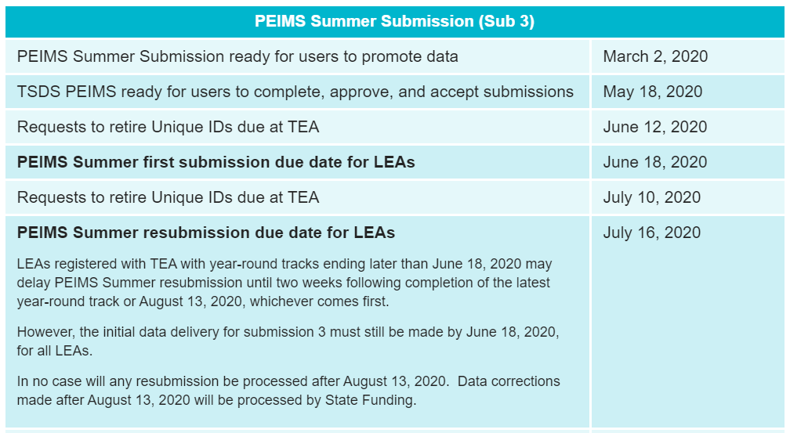
2020-2021 PEIMS Due Dates
Will the Summer PEIMS due date be changed (pushed back) for LEAs who choose to run an intersessional calendar, even though they may not be designated as a year-round LEA?
PEIMS Summer Submission (Sub 3)
SY 20-21 Attendance and Enrollment FAQ​ (Question Number from August 4, 2020)
PEIMS Attendance Reporting
Question: 7

Slide 29
agenda
2020-2021 School Year Attendance
2020-2021 New Data Elements
2020-2021 Report Changes
2020-2021 Rule Changes
2020-2021 Pending Changes
New Sub-Complex Type
2019-2020 Extended Year – Service IDs

Slide 30
2020-2021 Report changes
Existing PEIMS Attendance reports will be analyzed for impacts related to the changes for the 2020-2021 new attendance elements.
New reports may be added.
Some TSDS attendance reports will combine the elements while others will keep them separate. TEA will provide additional report information as it becomes available prior to Submission 3.

Slide 31
agenda
2020-2021 School Year Attendance
2020-2021 New Data Elements
2020-2021 Report Changes
2020-2021 Rule Changes
2020-2021 Pending Changes
New Sub-Complex Type
2019-2020 Extended Year – Service IDs

Slide 32
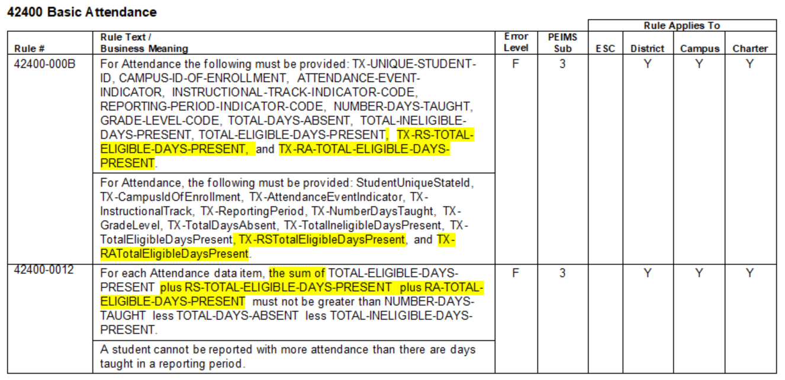
2020-2021 Rule Changes
New RS and RA data elements are being added to existing rules.
For example:

Slide 33
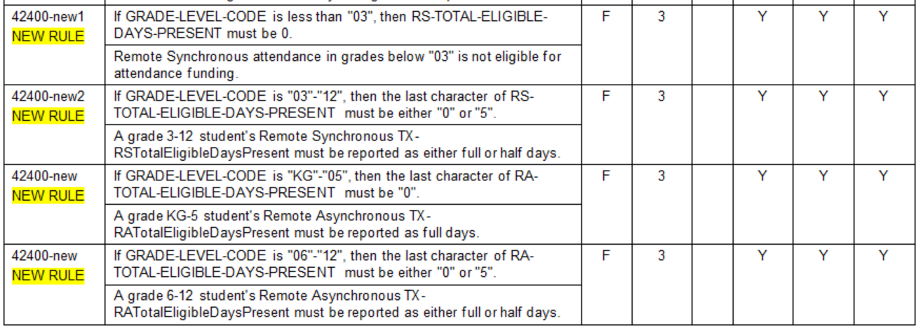
2020-2021 Rule Changes
New rules are being added for RS and RA specific checks.
Remote Synchronous attendance:
Funding for grade 3 and higher
Half day funding is available
Remote Asynchronous attendance:
Funding for grades KG-5 is full-day
Funding for middle school and high school students can be half-day or full-day

Slide 34
2020-2021 Rule Changes
Why is synchronous instruction for PK – 2 prohibited?
SY 20-21 Attendance and Enrollment FAQ (Question Numbers from August 4, 2020)
State Funding
Question: 7

Slide 35
agenda
2020-2021 School Year Attendance
2020-2021 New Data Elements
2020-2021 Report Changes
2020-2021 Rule Changes
2020-2021 Pending Changes
New Sub-Complex Type
2019-2020 Extended Year – Service IDs

Slide 36
2020-2021 pending changes
New Attribution Code(s)
SY 20-21 Attendance and Enrollment FAQ (Question Numbers from August 4, 2020)
Enrollment
Question: 3
New Crisis Code(s)

Slide 37
agenda
2020-2021 School Year Attendance
2020-2021 New Data Elements
2020-2021 Report Changes
2020-2021 Rule Changes
2020-2021 Pending Changes
New Sub-Complex Type
2019-2020 Extended Year – Service IDs

Slide 38
New sub-complex type
A student should be reported with each CRISIS-CODE (E1054) that applies to them during the school year.
New sub-complex type TX-CrisisImpacts contains existing CRISIS-CODE (E1054) element. E1054 can be repeated within the new sub-complex so more than one Crisis Code can be reported for each student.
40100/49010 StudentExtension

Slide 39
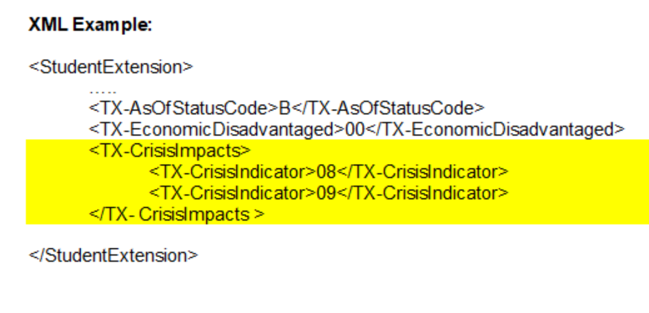
new sub-complex type

Slide 40
new sub-complex type

Slide 41
agenda
2020-2021 School Year Attendance
2020-2021 New Data Elements
2020-2021 Report Changes
2020-2021 Rule Changes
2020-2021 Pending Changes
New Sub-Complex Type
2019-2020 Extended Year – Service IDs

Slide 42
2019-2020 extended year – service ids
CP110100 – College Preparatory Course English Language Arts
CP111200 – College Preparatory Course Mathematics
Beginning 2019-2020, course completion for the college preparatory service IDs are included in the TSDS PEIMS Extended Year collection.
No end date expected in collecting course completion data for these service IDs.

Slide 43
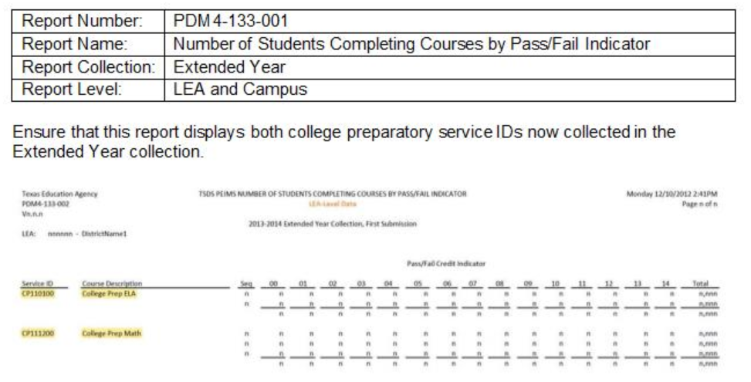
2019-2020 extended year – service ids

Slide 44
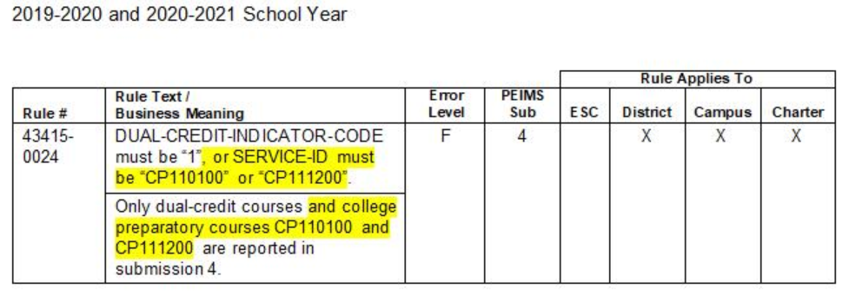
2019-2020 extended year – service ids
Updates during the July 31, 2020 Software Release
Rule will begin with 2019-2020 Extended Year Submission

Slide 45
Questions?
www.texasstudentdatasystem.org

