Slide 1
Code Table changes
Leticia Ollervidez
July 2020
2020-2021 School Year

Slide 2
aGENDA - Spring
SERVICE-ID (C022)
LANGUAGE-CODE (C092)
LEAVER-REASON-CODE (C162 and C162-A)
SCHOOL-YEAR-TYPE (C193)
INDUSTRY-CERTIFICATION-LICENSURE-CODE (C214)

Slide 3
aGENDA - summer
SERVICE-ID (C022) - UPDATED
FUND-CODE (C145) - NEW
PROGRAM-INTENT-CODE (C147) - NEW
CRISIS-CODE (C178) - NEW
PROGRAM-OF-STUDY-CODE (C220) – NEW
ASSESSMENT-TITLE-CODE (DC154) – NEW
Reinstated Code Table(s) - NEW
Deleted Code Table(s) - NEW

Slide 4
Legislation
The changes to TSDS code tables were the result of House Bill 3 (HB3) and House Bill 330 (HB330) or the request of TEA Program Areas.

Slide 5
SPRING
Training Content

Slide 6
Service-id (C022)
Each school year, the TEA Curriculum Division has changes to the SERVICE-ID table. For 2020-2021 school year, two new codes were added, an update to one subheading, update to four translations, and the deletion of three codes.
Addition of Codes:
03200800 – English Language Development and Acquisition (First time taken)
03200810 – English Language Development and Acquisition (Second time taken)
Update to subheading, replaced “Minimum High School Program (MHSP) with “Foundation high school program”
Subchapter P. Transportation, Distribution, and Logistics Cluster
Notes:
Added 2 codes and translations
Update subheading
Updated 4 code translations
Deleted 3 codes and related translations

Slide 7
Service-id (C022) CONT’D
Updates to Code Translations for:
I3100500 - International Baccalaureate (IB) Mathematics: Analysis and Approaches Standard Level
I3100600 - International Baccalaureate (IB) Mathematics: Analysis and Approaches Higher Level
I3100700 - International Baccalaureate (IB) Mathematics: Applications and Interpretations Standard Level
I3100800 - International Baccalaureate (IB) Mathematics: Applications and Interpretations Higher Level
Deletion of Codes
N1280040 - Foundations of Intensive Language Acquisition and Support
N1280042 - Newcomers' English Language Development A
N1280043 - Newcomers' English Language Development B
Notes:
Added 2 codes and translations
Update subheading
Updated 4 code translations
Deleted 3 codes and related translations

Slide 8
LANGUAGE-CODE (C092)
For 2020-2021school year, per request from the English Learner Support Division a new code was added to C092 to properly identify ASL as a language option.
Added:
6B – American Sign Language (ASL)

Slide 9
Leaver-reason-code (c162 and C162-a)
Upon review of HB3 and HB330, it was determined that Legislature replaced GED terminology with High School Equivalency Certificate.
All translations in Code Table C162 (LEAVER-REASON-CODE) and LEAVER-REASON-CODE using GED were updated to align with this change.
Updated Codes:
Header information
Code 86
Code 88
Code 89
Code 90

Slide 10
Leaver-reason-code BUSINESS RULES
The following Business Validation Rules were updated to match translation changes:
40203-0023
If LEAVER-REASON-CODE is "01", "24", "88", "90", or "98", then student address information must be provided (ADDRESS-TYPE, STREET-NUMBER-NAME, CITY, STATE-ABBREVIATION, POSTAL-CODE).
Student address information must be provided for any school leaver with the following TX-LeaverReasonCode: "Graduated From A Campus In This District Or Charter" (01), "College, Pursue Associate’s or Bachelor’s Degree" (24), "Court-Ordered To A High School Equivalency Program, Has Not Earned A Texas Certificate of High School Equivalency (TxCHSE)" (88), "Graduated From Another State Under Provisions Of The Interstate Compact On Educational Opportunity For Military Children" (90), or "Other" (98).
40203-0024
If LEAVER-REASON-CODE is "01", "24", "88", "90", or "98", then parent address information should be provided (ADDRESS-TYPE, STREET-NUMBER-NAME, CITY, STATE-ABBREVIATION, POSTAL-CODE).
Parent address information must be provided for any school leaver with the following TX-LeaverReasonCode: "Graduated From A Campus In This District Or Charter" (01), "College, Pursue Associate’s or Bachelor’s Degree" (24), "Court-Ordered To A High School Equivalency Program, Has Not Earned A Texas Certificate of High School Equivalency (TxCHSE)" (88), "Graduated From Another State Under Provisions Of The Interstate Compact On Educational Opportunity For Military Children" (90), or "Other" (98).

Slide 11
SCHOOL-YEAR-TYPE (C193)
Per Quality Assurance initiatives, TEA added three new codes to table C193 to support year ranges used by data element E1093 SCHOOL YEAR.
41 – 2036-2037
42 – 2037-2038
43 – 2038-2039

Slide 12
INDUSTRY-CERTIFICATION-LICENSURE-CODE (C214)
For the 2020 - 2021 school year, the TEA College, Career, and Military Preparation Division added one new and deleted one code.
Added Code:
931 – Medical Laboratory Technician
Delete Code:
400 – Certified Patient Care Technician (CPCT)
Duplicate of 786
Notes:
(C214)

Slide 13
SUMMER
Training Content

Slide 14
aGENDA - summer
SERVICE-ID (C022) - UPDATED
FUND-CODE (C145) - NEW
PROGRAM-INTENT-CODE (C147) - NEW
CRISIS-CODE (C178) - NEW
PROGRAM-OF-STUDY-CODE (C220) – NEW
ASSESSMENT-TITLE-CODE (DC154) – NEW
Reinstated Code Table(s) - NEW
Deleted Code Table(s) - NEW

Slide 15
Service-id (C022)
For 2020-2021 school year, the TEA Curriculum Division has additional changes to the SERVICE-ID table as follows:
40 Additional Codes
28 Revised Codes
12 Deleted Codes
Refer to C022 – SERVICE ID code table for details
Notes:
Added 2 codes and translations
Update subheading
Updated 4 code translations
Deleted 3 codes and related translations

Slide 16
Fund-code (c145)
Added:
Code 266 CARES ACT – Coronavirus Aid, Relief, and Economic Security (CARES) Act
Payroll Eligible: Y
Actual Eligible: Y
Notes:
Added 2 codes and translations
Update subheading
Updated 4 code translations
Deleted 3 codes and related translations

Slide 17
Program-intent-code (c147)
Added:
Code 43: Dyslexia – Special Education
Budget Eligible: Y
Payroll Eligible: Y
CI Staff Eligible: Y
Notes:
Added 2 codes and translations
Update subheading
Updated 4 code translations
Deleted 3 codes and related translations

Slide 18
Crisis-codes (C178)
Deleted Codes
NOTE: Codes 7A – 7I added for use in 19-20 PEIMS Summer Submission only are not valid for 20-21
Code | TRANSLATION
07 | Reserved For Future Health Or Weather Related Crisis
7A | COVID-19: Engaged For The Majority Of The Time Period
7B | COVID-19: Not Contactable For The Entire Time Period
7C | COVID-19: Not Contactable Prior To May 1st; Contact Made May 1st Or After But Not Engaged Through End Of The School Year
7D | COVID-19: Not Contactable Prior To May 1st; Contact Made May 1st Or After And Engaged Through End Of The School Year
7E | COVID-19: Contactable But Not Engaged For The Majority Of The Time Period
7F | COVID-19: Contactable But Not Engaged Prior To May 1st; Not Contactable May 1st Or After
7G | COVID-19: Contactable But Not Engaged Prior To May 1st; Engaged May 1st Or After Through End Of The School Year
7H | COVID-19: Engaged Prior To May 1st; Not Contactable May 1st Through End Of The School Year
7I | COVID-19: Engaged Prior To May 1st; Not Engaged May 1st Through End Of The School Year
Notes:
Added 2 codes and translations
Update subheading
Updated 4 code translations
Deleted 3 codes and related translations

Slide 19
Program-of-study-code (c220)
New
061-Drone (Unmanned Flight)
062-Geospatial Engineering and Land Surveying
063-Industrial Maintenance
064-Printing and Imaging
065-Retail Management
Revised
013-Cosmetology and Personal Care Services
State/Region: Region
036-Law Enforcement
043-Nursing Science
056-Aviation (Flight)
State/Region: Region
058-Maritime
State/Region: Region
059-Medical Therapy
Deleted
053 –Barbering
055-Fashion Design
057-Interior Design

Slide 20
Assessment-title-code (dc154)
New Codes
1A - BOY KG mCLASS TX Assessment
1B - BOY KG mCLASS TX Assessment Espanol
Revised Codes
01-BOY KG TX-KEA English
61-BOY PK GOLD English
62-BOY PK GOLD Spanish
79-EOY PK GOLD English
80-EOY PK GOLD Spanish
Deleted Codes
57-BOY PK Work Sampling System English
58-BOY PK Work Sampling System Spanish
75-EOY PK Work Sampling System English
76-EOY PK Work Sampling System Spanish

Slide 21
Reinstated code table(s)
Code Table ID | Code Table Name
DC002 | ACADEMIC-SUBJECT-TYPE
DC014 | ASSESSMENT-REPORTING-METHOD-TYPE
DC063 | GRADE-LEVEL-TYPE
DC124 | STATE-ABBREVIATION-TYPE
DC033 | COUNTRY-CODE-TYPE
Code tables deleted in error during TSDS Dashboard review.
Notes:
These were deleted in error and now being reinstated.

Slide 22
Deleted code table(s)
Code Table ID | Code Table Name
C180 | CLASS-ROLE
DC001 | ACADEMIC-HONORS-TYPE
DC004 | ADDITIONAL-CREDIT-TYPE
DC009 | ADMINISTRATIVE-FUNDING-CONTROL-TYPE
DC022 | CAREER-PATHWAY-TYPE
DC027 | CHARTER-STATUS-TYPE
DC028 | COHORT-SCOPE-TYPE
DC029 | COHORT-TYPE
DC030 | COHORT-YEAR-TYPE
DC032 | CONTENT-STANDARD-TYPE
DC039 | COURSE-GPA-APPLICABILITY-TYPE
DC041 | COURSE-LEVEL-TYPE
DC044 | CREDIT-TYPE
DC046 | DIPLOMA-LEVEL-TYPE
DC047 | DIPLOMA TYPE
DC053 | EDUCATIONAL-ENVIRONMENT-TYPE
DC055 | EDUCATION-ORGANIZATION-CATEGORY-TYPE
DC056 | EDUCATION-ORG-IDENTIFICATION-SYSTEM-TYPE
DC062 | GPA-WEIGHTED-TYPE
DC067 | IDEA-ELIGIBILITY-TYPE
Code Table ID | Code Table Name
DC068 | INCIDENT-BEHAVIOR-TYPE
DC071 | INSTITUTION-TELEPHONE-NUMBER-TYPE
DC074 | LANGUAGE-ITEM-TYPE
DC075 | LEA-CATEGORY-TYPE
DC081 | MAGNET-SPECIAL-PROGRAM-EMPHASIS-SCHOOL-TYPE
DC083 | MEETING-DAY-ITEM-TYPE
DC086 | OPERATIONAL-STATUS-TYPE
DC087 | OTHER-NAME-TYPE
DC089 | PERSONAL-INFORMATION-TYPE
DC090 | PERSONAL-TITLE-PREFIX-TYPE
DC092 | POSTING-RESULT-TYPE
DC093 | POST-SECONDARY-EVENT-CATEGORY-TYPE
DC095 | PROGRAM-SPONSOR-TYPE
DC104 | RECOGNITION-TYPE
DC111 | SCHOOL-CATEGORY-ITEM-TYPE
DC114 | SCHOOL-TYPE
DC134 | TERM-TYPE
DC140 | WEAPON-ITEM-TYPE
DC147 | RESTRAINT-EVENT-REASON-ITEM-TYPE
DC149 | ETHNICITY-CODE
Notes:
These code tables were used by the dashboards and are not utilized by any active data elements.

Slide 23
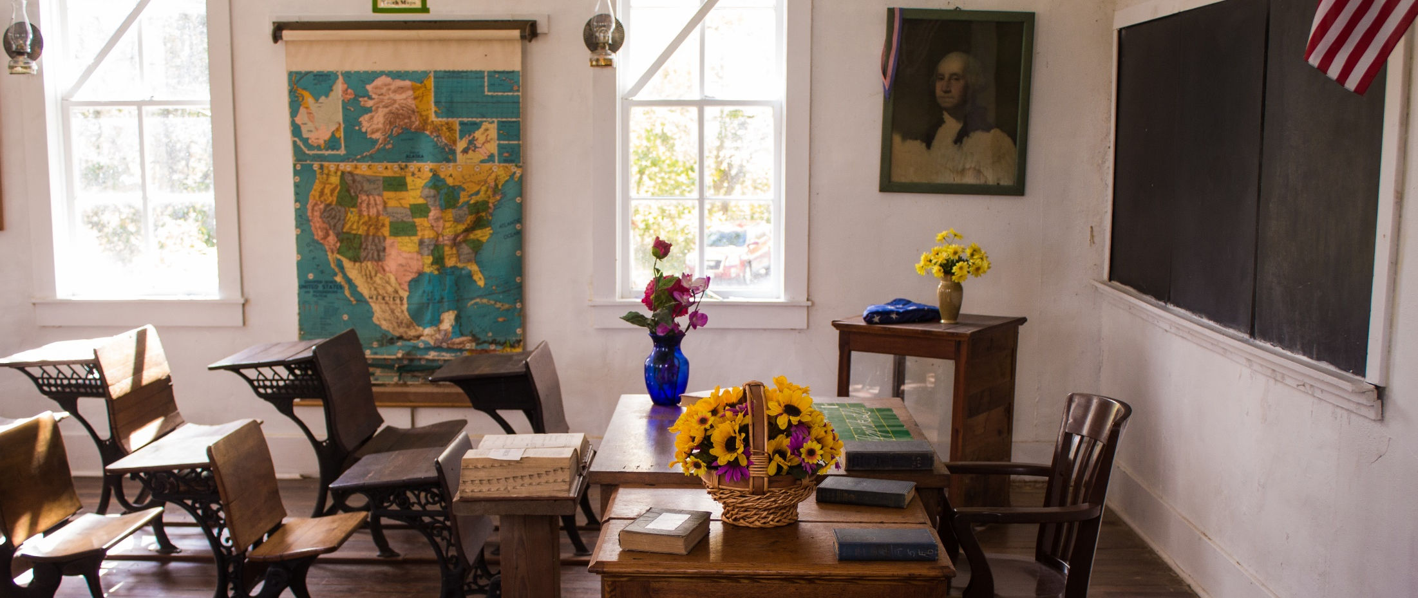
Questions?
www.texasstudentdatasystem.org

