Slide 1
Charter school waitlist
Texas Education Agency
Ed Linden - Subject Matter Expert
July 2020

Slide 2
Agenda
Timeline
TEAL Roles and Privileges
Data Collection
Core Application
Frequently Asked Questions
Technical Resources

Slide 3
timeline
Timeline
TEAL Roles and Privileges
Data Collection
Core Application
Frequently Asked Questions
Technical Resources

Slide 4
timeline
Submission Due: October 30, 2020
Charter School Waitlist (CSW) Collection
TSDS ready to load data to eDM | August 3, 2020
CSW ready for users to promote data | September 14, 2020
CSW ready for users to complete | September 25, 2020
CSW submission due date for LEAs | October 30, 2020
CSW data available to customers | November 13, 2020

Slide 5
Teal roles and privileges
Timeline
TEAL Roles and Privileges
Data Collection
Core Application
Frequently Asked Questions
Technical Resources

Slide 6
Teal roles and privileges
CSW will utilize the following existing TEAL roles:​
Core ESC Data Viewer​
Core LEA Data Approver​
Core LEA Data Completer​
Core LEA Data Promoter​
Core LEA Data Viewer​
A new privilege, ‘CSW Access’, can now be requested for each of these roles.

Slide 7
Data collection
Timeline
TEAL Roles and Privileges
Data Collection
Core Application
Frequently Asked Questions

Slide 8
Data collection
CSW will promote data from the following TSDS interchanges.
InterchangeEducationOrganizationExtension
InterchangeStudentParentExtension
InterchangeStudentEnrollmentExtension
Notes:
There were no changes since the March TEDS publication in regard to the interchanges required for CSW reporting.

Slide 9
tsds collection – complex types/elements
Education Organization
LocalEducationAgency
E0212 DISTRICT-ID
SchoolExtension
E0266 CAMPUS-ID
E1674 NUMBER-CHARTER-STUDENTS-ENROLLED
E1675 CHARTER-EDUCATIONAL-ENROLLMENT-CAPACITY
E1676 CHARTER-ADMISSION-WAITLIST-INDICATOR-CODE
Notes:
There were no changes since the March TEDS publication in regard to the interchanges required for CSW reporting.

Slide 10
tsds collection – complex types/elements updates
Student Parent
StudentExtension
E1523 TX-UNIQUE-STUDENT-ID
E1090 STUDENT-IDENTIFICATION-SYSTEM
E0001 STUDENT-ID
E0703 FIRST-NAME
*E0704 MIDDLE-NAME
E0705 LAST-NAME
*E1303 GENERATION-CODE-SUFFIX
E0006 DATE-OF-BIRTH
E1325 SEX
E1677 CHARTER-WAITLIST-INDICATOR-CODE
Student Enrollment
StudentSchoolAssociationExtension
E1523 TX-UNIQUE-STUDENT-ID
E0266 CAMPUS-ID
E1517 ENTRY-GRADE-LEVEL-TYPE
*Middle-Name and Generation-Code-Suffix were added to the TEDS 2021.2.0 publication on July 1, 2020 and are included on the Common Charter application form.

Slide 11
Core application
Timeline
TEAL Roles and Privileges
Data Collection
Core Application
Frequently Asked Questions
Technical Resources

Slide 12
CORE APPLICATION
CSW will be added to the Core application.
Data submission will be LEA-level only, with no campus-level data submissions.
ESCs will be able to monitor Charter School data submissions but will not submit any of their own data.
Functionality will be similar to other Core collections. LEAs will be able to promote, validate, run reports, complete, and apply for extensions.

Slide 13
PROMOTION LOGIC
The following criteria logic will be applied when promoting campus level data:
All Charter campuses will include the following data elements for the charter holder’s charter:
E1674 NUMBER-CHARTER-STUDENTS-ENROLLED
E1675 CHARTER-EDUCATIONAL-ENROLLMENT-CAPACITY
E1676 CHARTER-ADMISSION-WAITLIST-INDICATOR-CODE
The following criteria logic will be applied when promoting student level data:
Students coded with the following data element:
E1677 CHARTER-WAITLIST-INDICATOR-CODE (C088):
Code 1 – Participant In Program Or Service, Or Condition Or Situation Applicable To This Person Or Campus
There were no changes in the above promotion logic since the last ESC/Vendor training.

Slide 14
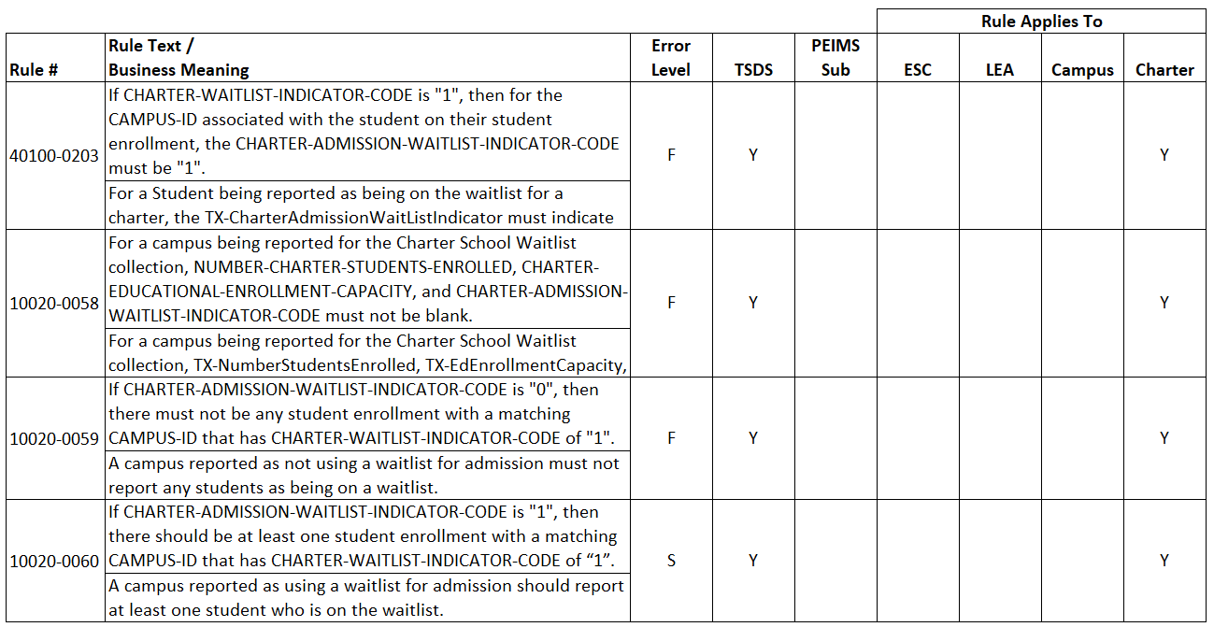
Validation rules-updates
The following validation rules were updated with the TEDS 2021.2.0 publication on July 1, 2020.

Slide 15
Validation rules-updates
The following validation rule was deleted with the TEDS 2021.2.0 publication on July 1, 2020.

Slide 16
reports
CSW0-100-001 – CSW Roster Report
Roster style report, similar to reports seen in other TSDS data collections.
Available at LEA and ESC levels.
LEAs will use this report to verify all data submitted for the data collection.
ESCs will be able to run this report for all of their LEAs to monitor their submissions.

Slide 17
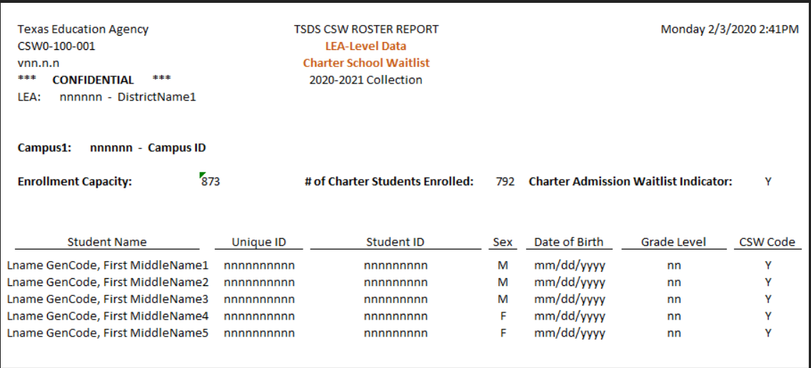
reports
CSW Roster Report example for:
Charters who maintain a waitlist
Student information will display on the waitlist

Slide 18
reports
CSW Roster Report example for:
Charters who do not maintain a waitlist
Students information will NOT display on the waitlist

Slide 19
Frequently Asked Questions
Timeline
TEAL Roles and Privileges
Data Collection
Core Application
Frequently Asked Questions
Technical Resources

Slide 20
FREQUENTLY ASKED QUESTIONS
Does this data collection apply to In-District Charters?
The Charter School Waitlist data collection only applies to open-enrollment charter schools.

Slide 21
FREQUENTLY ASKED QUESTIONS
Does the charter school need to complete this data collection if they do not have a waitlist and they are not at capacity?
Yes. All open-enrollment charter schools must complete the CSW collection. If they are not at capacity and do not have a waitlist, they still must submit the following Education Organization data:
E1674 NUMBER-CHARTER-STUDENTS-ENROLLED
E1675 CHARTER-EDUCATIONAL-ENROLLMENT-CAPACITY
E1676 CHARTER-ADMISSION-WAITLIST-INDICATOR-CODE

Slide 22
FREQUENTLY ASKED QUESTIONS
What needs to be reported if a charter school uses a waitlist but has no students on it as of September 25th?
If there are no students on the waitlist on the last Friday in September, then the charter school would not report any students in the CSW collection. However, the charter school would still need to report the required Education Organization data.
If the charter school campus had a least one student on a waitlist on or before the last Friday in September, the campus would report that they did maintain a waitlist which would be indicated with the data element CHARTER-WAITLIST-ADMISSION-INDICATOR=1.

Slide 23
FREQUENTLY ASKED QUESTIONS
Does the charter school need to continue maintaining the data for the CHARTER-ADMISSION-WAITLIST-INDICATOR-CODE throughout the school year, or is this only needed through the last Friday in September?
TEA will only collect data for the CSW collection for students who are placed on a waitlist in the current school year as of the last Friday in September. Each charter school should manage their campus wait lists according to the guidelines outlined in their admission and enrollment policy, as stated in their charter.

Slide 24
FREQUENTLY ASKED QUESTIONS
What if a student is on a charter school waitlist and does not have a Unique ID? Is this required even if the student never enrolls in the charter school?
The charter school should make every effort to determine the student’s Unique ID or get one assigned if the student does not currently have one.
The SSN and birth certificates are not required to apply for admission to a Texas Charter School. If the student on the waitlist does not provide an SSN, then the charter may assign a state-assigned ID (S-number) to obtain a Unique ID. Even if the student never enrolls, a Unique ID should be assigned for reporting.

Slide 25
FREQUENTLY ASKED QUESTIONS
Which charter school will assign and own the Unique ID if a student is on two waitlists?
The master record LEA assignment controls who can edit the student's demographic information. The last LEA that submitted the Unique ID through the file upload will be listed on the master record.
Multiple LEAs can report the same student, but only one has the ability to edit the student’s demographics at a time.

Slide 26
FREQUENTLY ASKED QUESTIONS
If students are allowed to appear on multiple charter school waitlists, is there is a concern of students having duplicate Unique IDs?
Charter schools must search the Unique ID system to determine if a waitlist student has already been assigned a Unique ID. The charter school can utilize the file upload and assignment option in the Unique ID system or manually search for a specific student.
If the student is found with an existing Unique ID, there is no need for a charter to create a new or duplicate one.

Slide 27
Technical resources
Timeline
TEAL Roles and Privileges
Data Collection
Core Application
Frequently Asked Questions
Technical Resources

Slide 28
Technical Resources
To the Administrator (TAA) Letter
The TAA Letter was sent to Charter School administrators and ESCs on July 27, 2020.
Charter School (TEA Website):
The Common Charter Application Form was posted on July 1, 2020.
For program area questions related to the Charter School Waitlist, please email charterschools@tea.texas.gov.

Slide 29
Questions?
www.texasstudentdatasystem.org

