Slide 1
Special education language acquisition
Texas Education Agency
Connor Briggs – Subject Matter Expert
July 2020

Slide 2
Agenda
Timeline
TEAL Roles and Privileges
Data Collection
Core Application
Frequently Asked Questions
Technical Resources

Slide 3
Timeline
Timeline
TEAL Roles and Privileges
Data Collection
Core Application
Frequently Asked Questions
Technical Resources

Slide 4
timeline
Submission Due: June 24, 2021
Special Education Language Acquisition (SELA) Collection
TSDS ready to load data to eDM | August 3, 2020
SELA ready for users to promote data | September 14, 2020
SELA ready for users to complete | May 17, 2021
SELA submission due date for LEAs | June 24, 2021
SELA data available to customers | July 8, 2021

Slide 5
Teal roles and privileges
Timeline
TEAL Roles and Privileges
Data Collection
Core Application
Frequently Asked Questions
Technical Resources

Slide 6
Teal roles and privileges
SELA will utilize the following existing TEAL roles:
Core ESC Data Viewer
Core LEA Data Approver
Core LEA Data Completer
Core LEA Data Promoter
Core LEA Data Viewer
A new privilege, ‘SELA Access’, can now be requested for each of these roles.

Slide 7
Data collection
Timeline
TEAL Roles and Privileges
Data Collection
Core Application
Frequently Asked Questions
Technical Resources

Slide 8
Data collection - Interchanges
SELA will promote data from the following TSDS interchanges.
InterchangeEducationOrganizationExtension
InterchangeStudentParentExtension
InterchangeStudentProgramExtension
Notes:
There were no changes since the March TEDS publication in regard to the interchanges required for SELA reporting.

Slide 9
tsds collection – complex types/elements
Education Organization
LocalEducationAgency
E0212 DISTRICT-ID
School
E0266 CAMPUS-ID
E0212 DISTRICT-ID
Student Parent
StudentExtension
E1523 TX-UNIQUE-STUDENT-ID
E1090 STUDENT-IDENTIFICATION-SYSTEM
E0923 LOCAL-STUDENT-ID
E0001 STUDENT-ID
E0703 FIRST-NAME
E0704 MIDDLE-NAME
E0705 LAST-NAME
E1303 GENERATION-CODE-SUFFIX
E0006 DATE-OF-BIRTH
E1325 SEX
E1375 HISPANIC-LATINO-ETHNICITY
E1343 RACIAL-CATEGORY
E1390 LIMITED-ENGLISH-PROFICIENT
E1220 DISABILITY
E1632 EFFECTIVE-DATE (TX-EffectiveDateDisabilities)
E0212 DISTRICT-ID
Notes:
There were no changes since the March TEDS publication in regard to the data elements required for SELA reporting.

Slide 10
tsds collection – complex types/elements
Student Program
StudentSpecialEdProgramAssociationExtension
E1523 TX-UNIQUE-STUDENT-ID
E1337 PROGRAM-TYPE
E0212 DISTRICT-ID
E0173 INSTRUCTIONAL-SETTING-CODE
TX-SpecialEducationLanguageAcquisition
SchoolReference
E0266 CAMPUS-ID
E1661 PREFERRED-HOME-COMMUNICATION-METHOD
TX-LanguageAcquisitionServicesProvided
E1662 LANGUAGE-ACQUISITION-SERVICES-PROVIDED
E1663 FREQUENCY-OF-SERVICES
E1664 HOURS-SPENT-RECEIVING-SERVICES
TX-HearingAmplificifation
E1665 HEARING-AMPLIFICATION-TYPE
E1666 HEARING-AMPLIFICATION-ACCESS
E1667 HEARING-AMPLIFICATION-AVERAGE-DAILY-USE
TX-LanguageAcquisitionAssessmentReportingCategory
E1668 TOOL-OR-ASSESSMENT-USED
E1669 ASSESSMENT-RESULTS-OBTAINED
Notes:
There were no changes since the March TEDS publication in regard to the data elements required for SELA reporting.

Slide 11
NEW CODE values
New values were added to the following code tables with the TEDS 2021.2.0 publication on July 1, 2020.
PREFERRED-HOME-COMMUNICATION-CODE (DC155)
98 – Parent or Guardian did not Respond
99 – Parent or Guardian was not able to be Reached
LANGUAGE-ACQUISITION-SERVICES-PROVIDED-CODE (DC156)
00 – Services not Provided
FREQUENCY-OF-SERVICES-CODE (DC157)
00 – None
HOURS-SPENT-SERVICES-CODE (DC158)
00 – 0 Hours

Slide 12
Core application
Timeline
TEAL Roles and Privileges
Data Collection
Core Application
Frequently Asked Questions
Technical Resources

Slide 13
Core application
SELA will be added to the Core application.
Data submission will be LEA-level only, with no campus-level data submissions.
ESCs will be able to monitor LEA data submissions but will not submit any of their own data.
Functionality will be similar to other Core collections. LEAs will be able to promote, validate, run reports, complete, and apply for extensions.

Slide 14
PROMOTION LOGIC
The following criteria logic will be applied when promoting students:
Students 8 years of age or younger on September 1st of the current school year
Students coded with the following E1220 DISABILITY:
02 – Deaf-Blindness (Deaf-Blind)
06 – Hearing/Auditory Impairment (Auditory Impairment)
In addition, the following criteria will be applied when promoting student special education program data:
Special Education Program data where E1337 PROGRAM-TYPE = ‘Special Education’

Slide 15
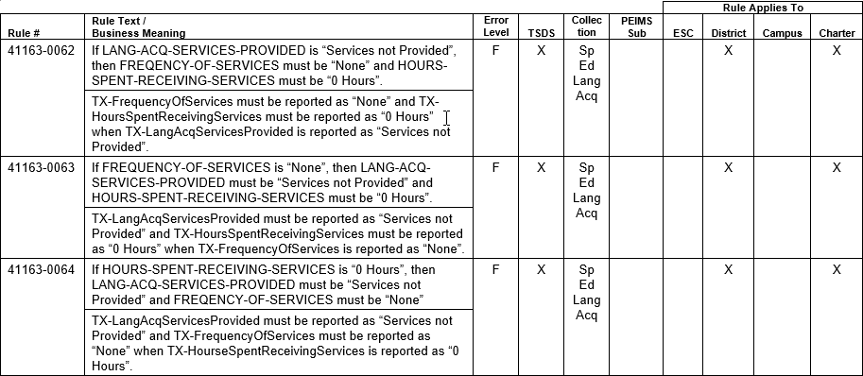
New validation rules
The following validation rules were added with the TEDS 2021.2.0 publication on July 1, 2020.

Slide 16
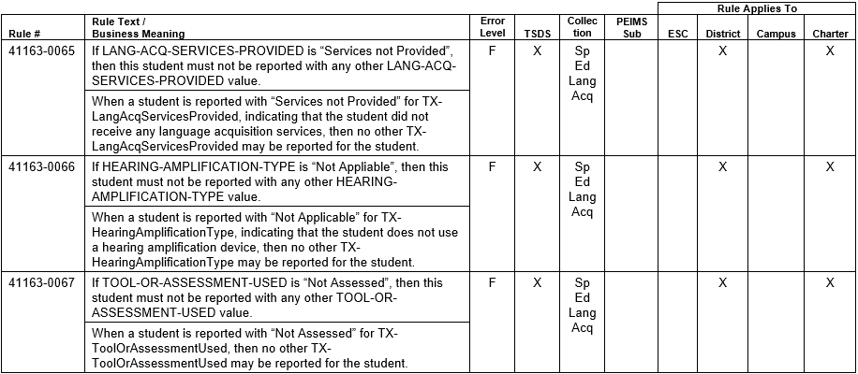
New validation rules

Slide 17
reports
SEL0-100-001 – Special Education Language Acquisition Roster
Roster style report, similar to reports seen in other TSDS data collections.
Available at LEA and ESC levels.
LEAs will use this report to verify all data submitted for the data collection.
ESCs will be able to run this report for all of their LEAs to monitor their submissions.

Slide 18
reports

Slide 19
Frequently asked questions
Timeline
TEAL Roles and Privileges
Data Collection
Core Application
Frequently Asked Questions
Technical Resources

Slide 20
Frequently asked questions
Which students are reported in the SELA data collection?
All students who are 8 years of age or younger on September 1st of the school year and are reported with a disability of either ‘Hearing/Auditory Impairment (Auditory Impairment)’ or ‘Deaf-Blindness (Deaf-Blind)’ will be promoted to the SELA data mart, regardless of how the rest of their data is reported.

Slide 21
Frequently asked questions
If a student turns 9 years old during the middle of the school year, should they still be included in the SELA data collection?
Yes. All students who are age 8 or younger on September 1st of the school year should be included in the SELA data collection.

Slide 22
Frequently asked questions
If a user has one of the Core roles already for SPPI-14 access, will they still need to apply for the SELA access privilege?
Yes. Users with one of the Core roles will not automatically receive SELA access. They must apply for the privilege. It will go through the standard TEAL approval process.

Slide 23
Frequently asked questions
Is there an ‘as of’ or ‘snapshot’ date for the SELA data collection?
No. The SELA data collection does not have an ‘as of’ or ‘snapshot’ date. LEAs are expected to submit the required data throughout the school year.

Slide 24
Frequently asked questions
Can disabilities other than ‘Hearing/Auditory Impairment’ and ‘Deaf-Blindness’ be reported for a student?
Yes. Students may be reported with multiple disabilities. However, they must be reported with ‘Hearing/Auditory Impairment’ or ‘Deaf-Blindness’ in order to promote into the SELA data mart.

Slide 25
Frequently asked questions
If a student receives more than one language acquisition service, can multiple records be reported?
Yes. Reporting TX-LanguageAcquisitionServicesProvided, along with the following complex types allow for multiple records to be submitted for each student.
TX-HearingAmplification
TX-LanguageAcquisitionAssessmentReportingCategory

Slide 26
Frequently asked questions
If a student does not meet the criteria for the SELA data collection, should they be included in the vendor’s SELA data extract?
The Operational Data Store (ODS) is a data warehouse that was designed to be collection agnostic and receive data for all TSDS collections. When a user promotes data to the SELA data mart, all data in the ODS is considered but only that which meets the promotion logic criteria will be promoted.

Slide 27
Technical resources
Timeline
TEAL Roles and Privileges
Data Collection
Core Application
Frequently Asked Questions
Technical Resources

Slide 28
Technical resources
To the Administrator Addressed (TAA) Letter​
A TAA letter from the Special Education department was posted on July 9, 2020.
Knowledge Base (KB) Articles
TSDSKB-612 SELA: Frequently Asked Questions (FAQ)
​​
For program area questions related to SELA, please email sped@tea.texas.gov.

Slide 29
Questions?
www.texasstudentdatasystem.org

