Slide 1
Texas Records Exchange (TREX) update
Presented by:
Leticia Ollervidez
2020 - 2021 School Year
July 2020

Slide 2
Trex v4.9 aGENDA
New Data Elements
New Code Tables
Changes to Existing Code Tables
Other Changes
V. Q&A
Notes:
These changes were the result of two legislative bills: SB 1679 and HB3 Section 2.031 (TEC 29.172)

Slide 3
New Data elements
New Data Elements
New Code Tables
Changes to Existing Code Tables
Other Changes
V. Q&A
Notes:
These changes were the result of two legislative bills: SB 1679 and HB3 Section 2.031 (TEC 29.172)

Slide 4
Trex - New Data elements
IBC-REIMBURSEMENT-INDICATOR (TE132)
POST-SECONDARY-CERTIFICATION-LICENSURE-EARNED (TE133)
SAT-ACT-REIMBURSEMENT-INDICATOR (TE134)
CRISIS-CODE (TE135)
RS-TOTAL-DAYS-PRESENT (TE136)
RA-TOTAL-DAYS-PRESENT (TE137)

Slide 5
Trex - Data element
PK-ELIGIBILE-PREVIOUS-YEAR-INDICATOR-CODE (TE136)
PK-ELIGIBLE-PREVIOUS-YEAR-INDICATOR-CODE (TE136) was presented in the Spring training. TE136 will not be added at this time. The element will be added with additional guidance, at a later date.

Slide 6
Legislation – House Bill 3
SECTION 2.031. Section 29.190
Education Code, is amended by amending Subsection (a) and adding Subsection (a-1)
(a-1) A student may not receive more than one subsidy under this section.
Sec.48.155 COLLEGE PREPARATION ASSESSMENT REIMBURSEMENT
Notes:
SB1679
HB3
(LEAs) are entitled to a reimbursement to help defray the cost of industry certification exams and college preparation assessments. Each LEA cannot receive more than one industry certification exam reimbursement per student and a student may not receive more than one subsidy.

Slide 7
Trex - new data element
IBC-REIMBURSEMENT-INDICATOR (TE132)
Indicates an LEA has received reimbursement for an industry certification exam fee for the student. LEAs enrolling students for whom another LEA has received reimbursement will not receive reimbursement.
A student/LEA can only be reimbursed once.
Notes:
HB3 Section 2.031 (TEC 29.172)

Slide 8
Trex - new data element
POST-SECONDARY-CERTIFICATION-LICENSURE-EARNED (TE133)
Indicates the nationally or internationally recognized business or industry certification or license earned by a student.
Notes:
HB3 Section 2.031 (TEC 29.172)

Slide 9
Trex - new data element
SAT-ACT-REIMBURSEMENT-INDICATOR (TE134)
Indicates an LEA has received reimbursement for a college preparation assessment for the student. LEAs enrolling students for whom another LEA has received reimbursement will not receive reimbursement.
A student/LEA can only be reimbursed once.
Notes:
HB3 Section 2.031 (TEC 29.172)

Slide 10
Trex - new data element
CRISIS-CODE (TE135)
Indicates a state health or weather-related event that impacts a group of students, and may require additional funding, educational, or social services. The event may or may not cause the student to leave the district or campus of residence. A crisis event is designated by the Commissioner of Education. Crisis codes may not be year-specific.
Special Instructions
The data transmitted is based on the code table, which is populated as events occur that will require state reporting. After the commissioner of education declares a crisis, the data may be transmitted via TREx for the affected students based on the guidance from TEA. TREx is designed to allow more than one crisis code to be sent for a student. Otherwise, if a student is not affected by a declared crisis, then this field may be left blank.
Notes:
SB1679

Slide 11
Trex - new data element
RS-TOTAL-DAYS-PRESENT (TE136)
Indicates the total number of days the student was remote synchronous present during the current academic year.
Notes:
SB1679

Slide 12
Trex - new data element
RA-TOTAL-DAYS-PRESENT (TE137)
Indicates the total number of days the student was remote asynchronous present during the current academic year.
Notes:
SB1679

Slide 13
New Code Tables
New Data Elements
Changes to Existing Code Tables
Other Changes
V. Q&A
II. New Code Tables
Notes:
These changes were the result of two legislative bills: SB 1679 and HB3 Section 2.031 (TEC 29.172)

Slide 14
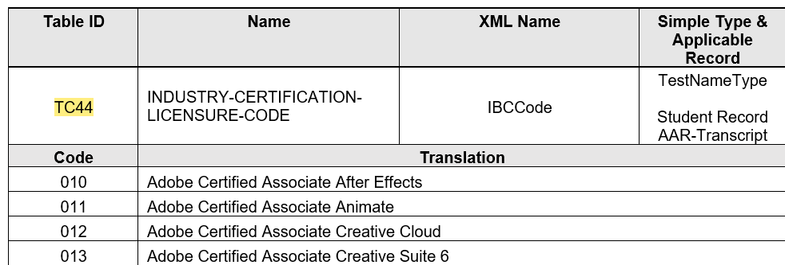
Trex - New code table
INDUSTRY-CERTIFICATION-LICENSURE-CODE (TC44)
931 code values

Slide 15
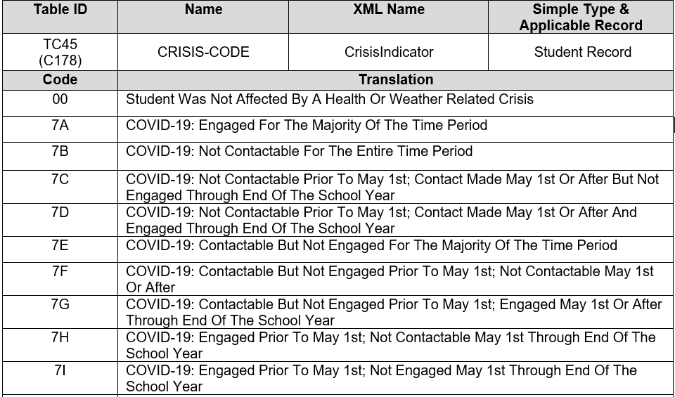
Trex - New code table
CRISIS-CODE (TC45)
10 New Codes

Slide 16
Changes to existing code tables
New Data Elements
New Code Tables
IV. Other Changes
V. Q&A
III. Changes to Existing Code Tables
Notes:
These changes were the result of two legislative bills: SB 1679 and HB3 Section 2.031 (TEC 29.172)

Slide 17
Trex – CHANGES TO EXISTING code tables
TEA program areas have requested the addition of a new code for American Sign Language (ASL) to properly identify ASL as a language option. This new option will allow for proper tracking of the ASL population and will assist the agency and local education agencies (LEAs) with targeting support for deaf/hard of hearing English learners.
LANGUAGE-CODE-TABLE (TC14)
NEW CODE: 6B – American Sign Language (ASL)

Slide 18
Other changes
New Data Elements
New Code Tables
Changes to Existing Code Tables
V. Q&A
IV. Other Changes

Slide 19
Trex – other changes
Published TREx v4.8.1New Feature List for 19-20
Added TC-01ASSESSMENT-NAME code table back into TREx Data Standards
Corrected TAC reference in LEP-INDICATOR-CODE Definition from 19 TAC §89.12256 to 19 TAC §89.1226

Slide 20
Other changes
New Data Elements
New Code Tables
Changes to Existing Code Tables
IV. Other Changes
V. Q & A

Slide 21
TREx – Q & A
Question:
In TREx, districts will be receiving whether a student earned an Industry Certification. They are to just be made aware that they were submitted by another District with an industry certification. They won't enter it into their SIS correct?
Districts monitor for Accountability/A-F if their students have met CCMR points. If they know a student already earned an industry certification from another district, yet they cannot enter it into their SIS, they are going to have to maintain this on a separate screen.
Response:
Because the IBCs need to be transmitted via TREx, each LEA needs to have a way to transmit this information. It is the decision of the receiving LEA on how to maintain this information going forward.

Slide 22
TREX – Q & A
Question:
Can you please address the overlap of the new POST-SECONDARY-CERTIFICATION-LICENSURE-EARNED that will be reported vs. the existing records we send for Certification Licensures Performance Acknowledgements?
Response:
The performance acknowledgement is just one of five acknowledgements that can go on the high school transcript. (There is an element for each one). It is solely used as a distinction for students. There are guidelines for the performance acknowledgement in section 19 TAC §74.14 of the graduation requirements. It’s the district’s responsibility to review any license or certification earned by a student and determine whether the student has earned a performance acknowledgement, based on whether the licenses or certification meets the guidelines in 19 TAC §74.13(e). This means a school district could potentially award an acknowledgement for a license or certification that is not on the list of certifications that the College, Career, and Military Preparation Division is working on. Because the eligibility for the performance acknowledgement is determined at the local level, the field for the acknowledgement is free form.

Slide 23
Questions?
www.texasstudentdatasystem.org

