Slide 1
Child Find

Slide 2
AGENDA
Program Area
Background
Timeline
TEAL Roles and Privileges
Data Collection
Core Application
Technical Resources

Slide 3
AGENDA
Program Area
Background
Timeline
TEAL Roles and Privileges
Data Collection
Core Application
Technical Resources

Slide 4
PROGRAM AREA
Division of Special Education Program Reporting
Tammy Pearcy Director; Department of Monitoring, Reporting, and Support
Zane Wubbena Data Analyst; Department of Monitoring, Reporting, and Support

Slide 5
AGENDA
Program Area
Background
Timeline
TEAL Roles and Privileges
Data Collection
Core Application
Technical Resources

Slide 6
BACKGROUND
Child Find will combine the following two State Performance Plan (SPP) Indicators in TSDS:
SPPI-11
Refers to the timely evaluation of students, ages 3-21, for special education services under Part B of IDEA.
SPPI-12
Refers to children who are referred from Part C of IDEA prior to age 3, found eligible for Part B of IDEA, and have an individualized education plan (IEP) developed and implemented by their third birthday to receive early childhood special education (ECSE) services from a local education agency (LEA).
Issues with current collection:
Aggregate data collected in State Performance Plan (SPP) application.
More non-compliance reported than other federally required compliance indicators.

Slide 7
AGENDA
Program Area
Background
Timeline
TEAL Roles and Privileges
Data Collection
Core Application
Technical Resources

Slide 8
TIMELINE
Submission Due: July 28, 2022
Child Find Collection
TSDS ready to load data to eDM | August 2, 2021
Child Find ready for users to promote data | September 13, 2021
Child Find ready for users to complete | June 6, 2022
Child Find submission due date for LEAs | July 28, 2022
Child Find data available to customers | August 11, 2022

Slide 9
AGENDA
Program Area
Background
Timeline
TEAL Roles and Privileges
Data Collection
Core Application
Technical Resources

Slide 10
TEAL ROLES AND PRIVILEGES
Child Find will utilize the following existing TEAL roles:
Core ESC Data Viewer
Core LEA Data Approver
Core LEA Data Completer
Core LEA Data Promoter
Core LEA Data Viewer
A new privilege, ‘Child Find Access’, will be added to each of these roles.
Users will need to apply for this new privilege even if they already have one of the roles above.

Slide 11
AGENDA
Program Area
Background
Timeline
TEAL Roles and Privileges
Data Collection
Core Application
Technical Resources

Slide 12
DATA COLLECTION: OVERVIEW
The collection will include students for whom the special education evaluation process was completed.
In some cases, this may include non-enrolled students such as homeschooled students, private school students, or children who received Early Childhood Intervention services through another state agency.
The completed evaluation/eligibility process is based on an eligibility determination date on or between July 1st – June 30th of a given school year.
This includes “holdover students”, whose parental consent was obtained in the prior school year and the evaluation/eligibility process was completed in the current school year.

Slide 13
DATA COLLECTION: INTERCHANGES
Child Find will promote data from the following TSDS interchanges:
InterchangeEducationOrganizationExtension
InterchangeEducationOrgCalendar
InterchangeStudentParentExtension
InterchangeStudentEnrollmentExtension
InterchangeStudentProgramExtension

Slide 14
DATA COLLECTION: COMPLEX TYPES & ELEMENTS
Education Organization
LocalEducationAgencyExtension
E0212 DISTRICT-ID
SchoolExtension
E0266 CAMPUS-ID
LocalEducationAgencyReference

Slide 15
DATA COLLECTION: COMPLEX TYPES & ELEMENTS
Education Organization Calendar
ReportingPeriodExtension
E0266 CAMPUS-ID
E1093 SCHOOL-YEAR
E0934 REPORTING-PERIOD-INDICATOR-CODE
E1568 REPORTING-PERIOD-BEGIN-DATE
E1569 REPORTING-PERIOD-END-DATE
E0975 INSTRUCTIONAL-TRACK-INDICATOR-CODE
E1600 INSTRUCTIONAL-PROGRAM-TYPE*
E0935 NUMBER-DAYS-TAUGHT*
CalendarReference
*These will be required to load into the ODS but will not be promoted for the collection.

Slide 16
DATA COLLECTION: COMPLEX TYPES & ELEMENTS
Education Organization Calendar
CalendarDateExtension
E1168 CALENDAR-DATE
E1582 SCHOOL-DAY-EVENT-CODE
E1570 CALENDAR-WAIVER-EVENT-TYPE
E1571 SCHOOL-DAY-OPERATIONAL-MINUTES
E1599 SCHOOL-DAY-INSTRUCTIONAL-MINUTES
E1572 SCHOOL-DAY-WAIVER-MINUTES*
*These will be required to load into the ODS but will not be promoted for the collection.

Slide 17
DATA COLLECTION: COMPLEX TYPES & ELEMENTS
Student Parent
StudentExtension
E1523 TX-UNIQUE-STUDENT-ID
E1090 STUDENT-IDENTIFICATION-SYSTEM
E0001 STUDENT-ID
E0703 FIRST-NAME
E0704 MIDDLE-NAME
E0705 LAST-NAME
E1303 GENERATION-CODE-SUFFIX
E1325 SEX
E0006 DATE-OF-BIRTH
E1375 HISPANIC-LATINO-ETHNICITY
E1343 RACIAL-CATEGORY
E0212 DISTRICT-ID

Slide 18
DATA COLLECTION: COMPLEX TYPES & ELEMENTS
Student Enrollment
StudentSchoolAssociationExtension
E1523 TX-UNIQUE-STUDENT-ID
E0266 CAMPUS-ID
E1517 ENTRY-GRADE-LEVEL-TYPE
Student Program
StudentSpecialEdProgramAssociationExtension
E1523 TX-UNIQUE-STUDENT-ID
ProgramReference
EducationOrganizationReference
E1632 EFFECTIVE-DATE (TX-EffectiveDateServices)
E0900 EARLY-CHILDHOOD-INTERV-IND-CODE

Slide 19
DATA COLLECTION: COMPLEX TYPES & ELEMENTS
**New complex types and data elements**
StudentChildFindAssociationExtension
TX-ChildFind
E1710 CAMPUS-ID-EVALUATION
E0975 INSTRUCTIONAL-TRACK-INDICATOR-CODE (existing data element)
E1711 STUDENT-ABSENCES-WITHIN-TIMEFRAME
TX-EarlyChildhoodTransition
E1712 ECI-NOTIFICATION-DATE
E1713 ECI-TRANSITION-CONFERENCE-DATE
TX-ChildFindInitialEvaluation
E1714 PARENTAL-CONSENT-DATE
E1715 INITIAL-EVALUATION-DATE
TX-ChildFindEligibilityDetermination
E1716 SPED-ELIGIBILITY-DETERMINATION-DATE
E1717 SPED-DETERMINATION-CODE
TX-EvaluationDelay
E1718 EVALUATION-DELAY-REASON

Slide 20
DATA COLLECTION: PRIOR YEAR PEIMS DATA
For students where E1714 PARENTAL-CONSENT-DATE is in the prior school year – “holdover students” – Child Find will also use the following calendar data from the prior year’s PEIMS Summer Accepted data:
CalendarDateExtension
ReportingPeriodExtension

Slide 21
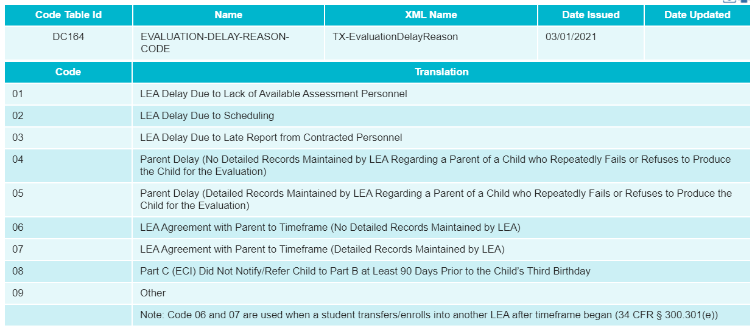
DATA COLLECTION: NEW CODE TABLE

Slide 22
DATA COLLECTION: EXISTING CODE TABLES
Child Find will also utilize the following existing code tables:
C088 – PARTICIPATION-INDICATOR-CODE
C130 – REPORTING-PERIOD-INDICATOR-CODE
C193 – SCHOOL-YEAR-TYPE
C204 – CALENDAR-WAIVER-EVENT-TYPE-CODE
C208 – SCHOOL-DAY-EVENT-CODE
C215 – INSTRUCTIONAL-PROGRAM-TYPE
DC063 – GRADE-LEVEL-TYPE
DC096 – PROGRAM-TYPE
DC097 – RACE-ITEM-TYPE
DC119 – SEX-TYPE
DC126 – STUDENT-IDENTIFICATION-SYSTEM-TYPE
DC148 – GENERATION-CODE-SUFFIX-TYPE

Slide 23
AGENDA
Program Area
Background
Timeline
TEAL Roles and Privileges
Data Collection
Core Application
Technical Resources

Slide 24
CORE APPLICATION: OVERVIEW
Child Find will be added to the Core application.
Functionality will be the same as other Core collections:
LEAs will be able to promote and validate data, run reports, complete/reset submissions, and apply for extensions.
ESCs will be able to monitor LEA data submissions and run reports.

Slide 25
CORE APPLICATION: PROMOTION LOGIC
The following criteria logic will be applied when promoting students to the Child Find data mart:
21 years of age or younger on September 1st of the current school year
Reported with a value for element E1716 SPED-ELIGIBILITY-DETERMINATION-DATE

Slide 26
CORE APPLICATION: REPORTS
Currently expecting four reports at the LEA and ESC levels; two each for SPPI-11 and SPPI-12 compliance.
Student-level compliance report
Aggregate-level compliance report
More information will be provided when available.

Slide 27
CORE APPLICATION: VALIDATION RULES
Child Find will utilize both new and existing data validations.

Slide 28
CORE APPLICATION: VALIDATION RULES

Slide 29
AGENDA
Program Area
Background
Timeline
TEAL Roles and Privileges
Data Collection
Core Application
Technical Resources

Slide 30
TECHNICAL RESOURCES
Child Find Program Area Support:
SpecialEducation@tea.texas.gov
Technical Support:
TIMS ticket
TSDSCustomerSupport@tea.texas.gov
TAA letter and TIMS knowledge base articles coming later this summer.

Slide 31
Questions

