Slide 1
PEIMS

Slide 2
AGENDA
PEIMS
2020-2021​
Truancy
Additional Days School Year Program
Industry Based Certification
CTE Auto-Calculation
Submission Reminders
Submission Updates​
Current Known Issues
2021-2022
Expanded Learning Opportunities
Crisis Codes
Industry Based Certification
Leaver Definition Update
2022-2023
Financial Aid Application Early Notice
Timeline​
Technical Resources

Slide 3
AGENDA
PEIMS
2020-2021​
Truancy
Additional Days School Year Program
Industry Based Certification
CTE Auto-Calculation
Submission Reminders
Submission Updates​
Current Known Issues
2021-2022
Expanded Learning Opportunities
Crisis Codes
Industry Based Certification
Leaver Definition Update
2022-2023
Financial Aid Application Early Notice
Timeline​
Technical Resources

Slide 4
Truancy: Data Elements
CAMPUS-ID-OF-ENROLLMENT (E0782)
If a student has excessive unexcused absences, the CAMPUS-ID-OF-ENROLLMENT is the campus at which the student was enrolled when the student met the threshold of 10 or more unexcused absences for a day or parts of a day. When calculating the number of unexcused absences, include absences that have accumulated at other campuses within the LEA.
If a student does not have excessive unexcused absences, but truancy prevention measures have been initiated, the CAMPUS-ID-OF-ENROLLMENT is the campus at which the student was enrolled when the truancy prevention measures were initiated.
​
GRADE-LEVEL-CODE (E0017)
If a student has excessive unexcused absences, the GRADE-LEVEL-CODE indicates the grade level of the student at the time the student met the threshold of 10 or more unexcused absences for a day or parts of a day. ​
If a student does not have excessive unexcused absences, but truancy prevention measures have been initiated, the GRADE-LEVEL-CODE is the grade level of the student when the truancy prevention measures were initiated.
​
Notes:
Will mention new complex type StudentTruancyExtension reported in the InterchangeStudentAttendanceExtension

Slide 5
Truancy: Data Elements
EXCESSIVE-UNEXCUSED-ABSENCE-INDICATOR-CODE (E1657)
Indicates a student who is required to attend school (age 6 to 18 years under TEC 25.086) but did not attend without excuse for 10 or more days or parts of days within a six-month period of a school year. An unexcused absence is defined as any absence that is not excused by state law or LEA local policy. A partial day is defined in accordance with LEA local policy. ​
TRUANCY-PREVENTION-MEASURE-INDICATOR-CODE (E1658)
Indicates the LEA initiated a truancy prevention measure under TEC 25.0915 (a-4) for the student.
TRUANCY-COMPLAINT-FILED-INDICATOR-CODE (E1659)
Indicates whether an attendance officer or other school official has filed a complaint against a student’s parent or legal guardian, under TEC 25.093.

Slide 6
Truancy: Frequently Asked Questions
Are open-enrollment charter schools required to report truancy data?
​
Yes, open-enrollment charter schools are required to report truancy data.
If the truancy prevention measure is reported, is the measure applied before the student meets the 10-absence threshold?
An LEA may implement a prevention measure before the student fails to attend school without excuse on 10 or more days or parts of days within a six-month period in the same school year. The LEA would report the data for (E1658) TRUANCY-PREVENTION-MEASURE-INDICATOR-CODE for the student.

Slide 7
Truancy: Frequently Asked Questions
If an LEA filed a complaint on a parent for a student, but did not file a complaint related to the siblings of the student, is the TRUANCY-COMPLAINT-FILED-INDICATOR-CODE or TRUANCY-PREVENTION-MEASURE-INDICATOR-CODE reported for the siblings even though the LEA didn't formally file on them?​
Each student and their associated data is reported separately. If a complaint or truancy prevention measure only relates to one student, it should only be reported for that student.
Truancy prevention measures should be reported for a student regardless if a complaint is filed or a student has 10 or more unexcused absences.

Slide 8
Truancy: Frequently Asked Questions
TRUANCY-COMPLAINT-FILED-INDICATOR-CODE (E1659) is reported if the LEA files against a parent or legal guardian. What does the LEA report if a complaint is filed against only the student?
If the complaint is filed against the student, this does not need to be reported in E1659 TRUANCY-COMPLAINT-FILED-INDICATOR-CODE. The intent of this data element is to get the number of truancy complaints filed against parents/legal guardians.
Do you report the StudentTruancyExtension when the school official files, regardless of what the court does?
If your school official files a complaint against the parent, regardless of the outcome of the filing, it should be reported.
Notes:
These questions along with others will be published in a KB article

Slide 9
AGENDA
PEIMS
2020-2021​
Truancy
Additional Days School Year Program
Industry Based Certification
CTE Auto-Calculation
Submission Reminders
Submission Updates​
Current Known Issues
2021-2022
Expanded Learning Opportunities
Crisis Codes
Industry Based Certification
Leaver Definition Update
2022-2023
Financial Aid Application Early Notice
Timeline​
Technical Resources

Slide 10
Additional Days School Year Program: Data Elements
SchoolExtension complex type
*NEW* E1671 ADDITIONAL-DAYS-PROGRAM-INDICATOR-CODE
ReportingPeriodExtension complex type
E0266 CAMPUS-ID
E1093 SCHOOL-YEAR
E0934 REPORTING-PERIOD-INDICATOR-CODE
E1568 REPORTING-PERIOD-BEGIN-DATE
E1569 REPORTING-PERIOD-END-DATE
E0975 INSTRUCTIONAL-TRACK-INDICATOR-CODE
E1600 INSTRUCTIONAL-PROGRAM-TYPE
E0935 NUMBER-DAYS-TAUGHT
E1168 CALENDAR-DATE
CalendarDateExtension complex type
E1582 SCHOOL-DAY-EVENT-CODE
E1571 SCHOOL-DAY-OPERATIONAL-MINUTES
E1599 SCHOOL-DAY-INSTRUCTIONAL-MINUTES

Slide 11
Additional Days School Year Program: Data Elements
StudentProgramExtension
*NEW* E1672 ADDITIONAL-DAYS-PROGRAM-PARTICIPATION-INDICATOR-CODE
BasicReportingPeriodAttendanceExtension complex type
E1523 TX-UNIQUE-STUDENT-ID
E0782 CAMPUS-ID-OF-ENROLLMENT
E1085 ATTENDANCE-EVENT-INDICATOR
E0975 INSTRUCTIONAL-TRACK-INDICATOR-CODE
E0934 REPORTING-PERIOD-INDICATOR-CODE
E0935 NUMBER-DAYS-TAUGHT
E0017 GRADE-LEVEL-CODE
E0036 TOTAL-DAYS-ABSENT
E0936 TOTAL-INELIGIBLE-DAYS-PRESENT
E0937 TOTAL-ELIGIBLE-DAYS-PRESENT
E1678 RS-TOTAL-ELIGIBLE-DAYS-PRESENT
E1679 RA-TOTAL-ELIGIBLE-DAYS-PRESENT
E1079 PRIMARY-PK-FUNDING-SOURCE
E1080 SECONDARY-PK-FUNDING-SOURCE
E1078 PK-PROGRAM-TYPE-CODE

Slide 12
Additional Days School Year Program: Data Elements
SpecialProgramsReportingPeriodAttedanceExtension complex type
E1523 TX-UNIQUE-STUDENT-ID
E0782 CAMPUS-ID-OF-ENROLLMENT
E1085 ATTENDANCE-EVENT-INDICATOR
E0975 INSTRUCTIONAL-TRACK-INDICATOR-CODE
E0934 REPORTING-PERIOD-INDICATOR-CODE
E0935 NUMBER-DAYS-TAUGHT
E0017 GRADE-LEVEL-CODE
E1651 BILINGUAL/ESL-FUNDING-CODE
E1680 RS-BILINGUAL/ESL-FUNDING-CODE
E1681 RA-BILINGUAL/ESL-FUNDING-CODE
E0938 TOTAL-ELIG-BILINGUAL/ESL-DAYS-PRESENT
E1682 RS-TOTAL-ELIG-BILINGUAL/ESL-DAYS-PRESENT
E1683 RA-TOTAL-ELIG-BILINGUAL/ESL-DAYS-PRESENT
E0939 TOTAL-ELIG-PREG-REL-SVCS-DAYS-PRESENT
E1686 RS-TOTAL-ELIG-PREG-REL-SVCS-DAYS-PRESENT
E1687 RA-TOTAL-ELIG-PREG-REL-SVCS-DAYS-PRESENT

Slide 13
Additional Days School Year Program: Data Elements
SpecialProgramsReportingPeriodAttedanceExtension complex type - Cont’d
E1688 RS-TOTAL-ELIG-SP-ED-MAINSTREAM-DAYS-PRESENT
E1689 RA-TOTAL-ELIG-SP-ED-MAINSTREAM-DAYS-PRESENT
E0944 ELIGIBLE-DAYS-PRESENT-IN-INSTR-SETTING
E1690 RS-ELIGIBLE-DAYS-PRESENT-IN-INSTR-SETTING
E1691 RA-ELIGIBLE-DAYS-PRESENT-IN-INSTR-SETTING
E0833 REG-DAY-SCH-PROG-DEAF-CODE
E0173 INSTRUCTIONAL-SETTING-CODE
E1692 RS-INSTRUCTIONAL-SETTING-CODE
E1693 RA-INSTRUCTIONAL-SETTING-CODE

Slide 14
Additional Days School Year Program: Data Elements
StaffExtension complex type
E1524 TX-UNIQUE-STAFF-ID
E0505 STAFF-ID
E0703 FIRST-NAME
E0705 LAST-NAME
E0006 DATE-OF-BIRTH
E0212 DISTRICT-ID
E0706 GENERATION-CODE
E0004 SEX-CODE
E1064 HISPANIC-LATINO-CODE
E1059 AMERICAN-INDIAN-ALASKA-NATIVE-CODE
E1060 ASIAN-CODE
E1061 BLACK-AFRICAN-AMERICAN-CODE
E1062 NATIVE-HAWAIIAN-PACIFIC-ISLANDER-CODE
E1063 WHITE-CODE
E1073 STAFF-TYPE-CODE
E0730 HIGHEST-DEGREE-LEVEL-CODE
E0161 YEARS-EXPERIENCE-IN-DISTRICT
E0130 TOTAL-YEARS-PROF-EXPERIENCE

Slide 15
Additional Days School Year Program: Data Elements
StaffResponsibilitiesExtension complex type
E0212 DISTRICT-ID
E1524 TX-UNIQUE-STAFF-ID
E0266 CAMPUS-ID
E0721 ROLE-ID
E0724 SERVICE-ID
E1056 CLASS-ID-NUMBER
E0747 POPULATION-SERVED-CODE
E0170 NUMBER-STUDENTS-IN-CLASS
E1015 ESC-SSA-STAFF-INDICATOR-CODE
E1055 CLASS-TYPE-CODE
*NEW* E1673 ADDITIONAL-DAYS-PROGRAM-TEACHER-INDICATOR-CODE
​

Slide 16
Additional Days School Year Program: Code Tables
C130 REPORTING-PERIOD-INDICATOR-CODE​
*New* Code 9 – Additional Days School Year Program Reporting Period​
C215 INSTRUCTIONAL-PROGRAM-TYPE​
*New* Code 16 – Additional Days School Year Program​

Slide 17
Additional Days School Year Program: Reporting Guidance
BasicReportingPeriodAttendanceExtension Complex Type​
​
Special Reporting Requirements​
When reporting attendance data for the Additional Days School Year Program, use REPORTING-PERIOD-INDICATOR-CODE ‘9’. Only report absences and days present for students that are ADA eligible. Report the total days present and days absent for when the student was in the program. The program may include days of instruction during the school year and the summer. Report the CAMPUS-ID-OF-ENROLLMENT as the campus on which the student attended the Additional Days School Year Program. Report days absent and days present in half day increments. This data is reported in the PEIMS Extended Year submission. ​
​

Slide 18
Additional Days School Year Program: Reporting Guidance
ReportingPeriodExtension Complex Type​
Special Reporting Requirements ​
When reporting data for the Additional Days School Year Program, use REPORTING-PERIOD-INDICATOR-CODE of ‘9’. The reporting period begin date will be the first instructional day of the program and the end date will be the last instructional day of the program. Instructional days for this program can be any combination of days during the regular school year and the summer. Also, use INSTRUCTIONAL-PROGRAM-TYPE code “16” – Additional Days School Year Program. This data is reported in the PEIMS Extended Year submission. ​
CalendarDateExtension Complex Type​
Special Reporting Requirements:​
When reporting the calendar dates for the Additional Days School Year Program, use School Day Event Code 01 - Student Instructional Day (whole or partial day). Waivers do not apply to this program.​

Slide 19
Additional Days School Year Program: Reporting Guidance
BasicReportingPeriodAttendanceExtension Complex Type​
Data Element Reporting Requirements​
CAMPUS-ID-OF-ENROLLMENT (E0782) indicates the unique campus identification number of the campus in which the student is enrolled. For PEIMS Extended Year, this is the campus in which the student is attending the Additional Days School Year Program.​
​REPORTING-PERIOD-INDICATOR-CODE (E0934) indicates the period for which the attendance data is being reported. REPORTING-PERIOD-INDICATOR-CODE identifies the six-week reporting period. ​
The instructional calendar(s) for each campus must be divided into six approximately equal reporting periods. ​
Warning: School calendar tracks exceeding 180 days will result in less ADA funding per day for the school district/campus. ​
For PEIMS Extended Year, the REPORTING-PERIOD-INDICATOR-CODE must be ‘9’.​
NUMBER-DAYS-TAUGHT (E0935) indicates the number of days of instruction offered, as shown on the school calendar, during a particular reporting period.​
Instructional days do not include days of teacher in-service or preparation, or holidays. All students assigned to a particular instructional track will have the same NUMBER-DAYS-TAUGHT. Warning: School calendar tracks exceeding 180 days will result in less ADA funding per day for the school district/campus. ​
The instructional calendar(s) for each campus must be divided into six approximately equal reporting periods. Regardless of the structure of the actual instructional calendar, a LEA must report the full school year (usually 180 days) for each instructional track offered by the LEA in six approximately equal reporting periods.​
​For PEIMS Extended Year, NUMBER-DAYS-TAUGHT must be the number of days in the Additional Days School Year Program. Report as full days.​
​

Slide 20
Additional Days School Year Program: Reporting Guidance
BasicReportingPeriodAttendanceExtension Complex Type Cont’d​
​TOTAL-DAYS-ABSENT (E0036) indicates the total number of days the student was absent during a particular reporting period. For PEIMS Extended Year, TOTAL-DAYS-ABSENT should be reported as half-day absences in the Additional Days School Year Program.​
For additional rules concerning the reporting of days absent for a particular student, please refer to the Student Attendance Accounting Handbook. ​
​TOTAL-ELIGIBLE-DAYS-PRESENT (E0937) indicates the total number of days the student was present and eligible for Foundation School Program funding during a particular reporting period. For PEIMS Extended Year, TOTAL-ELIGIBLE-DAYS-PRESENT should be reported as half-day present in the Additional Days School Year Program.​
​For additional rules concerning the reporting of Eligible Days Present for a particular student, please refer to the Student Attendance Accounting Handbook.​
SpecialProgramsReportingPeriodAttendanceExtension Complex Type​
Special Reporting Requirements​
When reporting special program attendance data for the Additional Days School Year Program, use REPORTING-PERIOD-INDICATOR-CODE ‘9’. Report special program data based on whether the students received services during the Additional Days School Year Program. Flexible attendance is not reported for the Additional Days School Year Program. Days should be reported as half-days. This data is reported in the PEIMS Extended Year submission.​

Slide 21
Additional Days School Year Program: Reporting Guidance
StaffExtension Complex Type​
General Reporting Requirements​
PEIMS Extended Year Submission​
Report teachers teaching students in the Additional Days School Year Program. Only staff with teaching responsibilities (Role IDs 047 and 087) should be reported.​
​
StaffResponsibilitiesExtension Complex Type​
General Reporting Requirements​
PEIMS Extended Year Submission​
For teachers teaching in the Additional Days School Year Program, report the Service ID, Population Served and Number of Students in Class for this particular program in the PEIMS Extended Year Submission. ​
​
Data Element Reporting Requirements​
ADDITIONAL-DAYS-PROGRAM-TEACHER-INDICATOR-CODE (E1673) indicates if a teacher is teaching prekindergarten through fifth grade students in the Additional Days School Year Program as described in TEC Sec. 48.0051.​
​

Slide 22
Additional Days School Year Program: Reports
Existing Reports added to PEIMS Extended Year submission:
PDM4-111-001 Individual Staff Profiles
PDM4-116-003 Campus Calendar Minutes Detail
PDM4-120-003 Student Indicator Report by Grade
New Report added to PEIMS Extended Year submission: ​
​
PDM4-130-003 Superintendent’s Report of ADSY Attendance

Slide 23
AGENDA
PEIMS
2020-2021​
Truancy
Additional Days School Year Program
Industry Based Certification
CTE Auto-Calculation
Submission Reminders
Submission Updates​
Current Known Issues
2021-2022
Expanded Learning Opportunities
Crisis Codes
Industry Based Certification
Leaver Definition Update
2022-2023
Financial Aid Application Early Notice
Timeline​
Technical Resources

Slide 24
Industry Based Certification: Exam Fee Guidance
StudentExtension complex type – Data Element Reporting Requirements
**TX-IndustryCertifications
The TX-IndustryCertifications Complex Type represents the industry-based certification(s) as student has received. This information is used by Performance Reporting for use in the College, Career, and Military Readiness components of the academic accountability system.
**TX-IndustryCertification
The TX-IndustryCertification Complex Type represents a single industry-based certification (IBC) a student has received.
More than one industry certification may be reported for each student. For each unique industry certification earned by a student while enrolled in a particular LEA, the complex type TX-IndustryCertification will be reported. In the XML reporting, this is known as “unbounded” and allows an XML item or set of items to be repeated as many times as needed.

Slide 25
Industry Based Certification: Exam Fee Guidance
Effective dating is a method of tracking data changes over time. A new instance of the TX-IndustryCertification Complex Type will be reported each time a student earns a post-secondary industry certification or license. With each new instance of the complex type a new date should be reported in the EFFECTIVE-DATE (TX-DateCertEarned).
EFFECTIVE-DATE (TX-DateCertEarned) (E1632) indicates the date upon which the associated data values(s) is/are considered to take effect, or the associated data value(s) change(s).
For the TX-IndustryCertification Complex Type, the EFFECTIVE-DATE reflects the date the student received the industry certification.

Slide 26
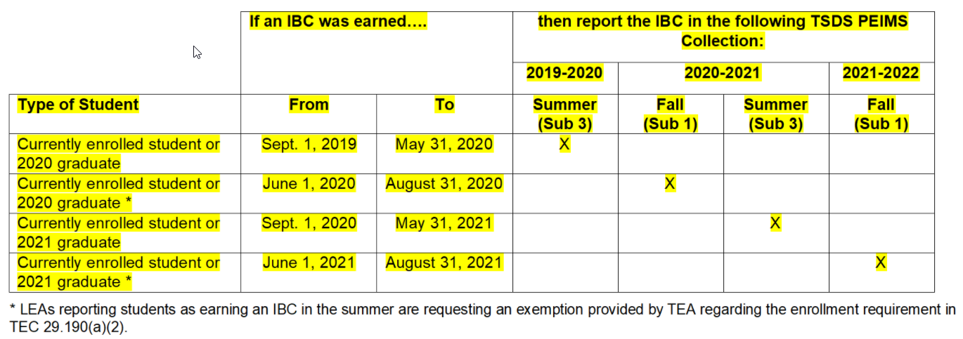
Industry Based Certification: Exam Fee Guidance
The following table illustrates when an earned Industry-Based Certification (IBC) should be reported for a given school year.

Slide 27
Industry Based Certification: Exam Fee Guidance
POST-SECONDARY-CERTIFICATION-LICENSURE-CODE (E1640) indicates a nationally or internationally recognized business or industry certification or license earned by a student. The industry certifications are limited to the choices in code table C214.
IBC-EXAM-FEE-AMOUNT (E1654) identifies the amount of money that was paid for a student’s industry certification exam by the local education agency or the student.
For an industry certification or licensure, this is the amount paid by or for the student to take the industry certification exam. An exam fee will be reported for each certification exam taken. The LEA will be reimbursed for the highest exam fee. Each student is entitled to one passed certification examination at state cost in grades 9-12, of which the LEA is entitled to a reimbursement from TEA for up to $700. LEAs cannot receive more than one reimbursement per student for a passed exam. If the student pays for the exam fee, the LEA will reimburse the student.

Slide 28
Industry Based Certification: Exam Fee Guidance
TEA will reimburse the first reported IBC exam in PEIMS with an associated cost greater than $0. Since only one reimbursement per student in grades 9-12 will be provided, LEAs should only report an IBC-EXAM-FEE-AMOUNT greater than $0 for the certification for which they wish to be reimbursed. If an LEA reports more than one IBC-EXAM-FEE-AMOUNT for a student, the first certification earned with an amount greater than $0 will be reimbursed. If there is more than one certification earned on the same day that is reported with an amount greater than $0, the higher amount will be reimbursed.
If multiple LEAs report an IBC-EXAM-FEE-AMOUNT for the same student, the first LEA will be considered for reimbursement (the LEA in which the student was enrolled at the time of examination and the LEA that paid for the certification examination). LEAs should utilize the TREx platform to minimize duplicate reporting.
For more information, refer to House Bill 3: Industry-Based Certification Reimbursements.

Slide 29
Industry Based Certification: Exam Fee Guidance
IBC-VENDOR-CODE (E1655) identifies the organization or company that offered the service.
For an industry certification or licensure, this is the vendor or organization that administered the certification exam. The vendor code must be reported for each certification exam taken.
The College, Career, and Military Preparation (CCMP) Division of TEA maintains the following list of Industry Certification exams cross walked to the approved vendors providing the exam:
Industry-Based Certification Approved Vendor Crosswalk.

Slide 30
AGENDA
PEIMS
2020-2021​
Truancy
Additional Days School Year Program
Industry Based Certification
CTE Auto-Calculation
Submission Reminders
Submission Updates​
Current Known Issues
2021-2022
Expanded Learning Opportunities
Crisis Codes
Industry Based Certification
Leaver Definition Update
2022-2023
Financial Aid Application Early Notice
Timeline​
Technical Resources

Slide 31
CTE Auto-Calculation
Beginning with the 2020-2021 PEIMS Summer submission, TEA will calculate the appropriate Career and Technical (CTE) Indicator code(s) to assign to each student that does or does not participate in a CTE program. The data used for this calculation will include:
course completion records from the PEIMS Summer submission.
where the student’s Course Sequence Code is 0, 2, 5, or 9 and Pass/Fail Indicator is 1 or 0.
The data will be stored to a table in TEA’s main database that includes
the calculated CTE Indicator
Program of Study Indicator (as defined by CCMP division)
Statewide or Regional Program of Study Indicator
State Career Cluster ID and
Federal Career Cluster ID.
**Information regarding Programs of Study or Career cluster can be found on the Career and Technical Education webpage https://tea.texas.gov/academics/college-career-and-military-prep/career-and-technical-education.

Slide 32
CTE Auto-Calculation: Data Elements
StudentProgramExtension Complex Type
Data Element Reporting Requirements
CAREER-AND-TECHNICAL-ED-IND-CD (E0031)
The CAREER-AND-TECHNICAL-ED-IND-CD is a calculated value based on the student’s course completion data for all years in which the student could have taken a CTE course. The CAREER-AND-TECHNICAL-ED-IND-CD will be calculated for all students in grades 06-12.
The CAREER-AND-TECHNICAL-ED-IND-CD is calculated once the PEIMS Summer Submission is in the Accepted status for all LEAs. Reports that display the calculated value will be available approximately two weeks after each submission closes.
State and Federal Clusters are assigned to each program of study and are used for reporting purposes.
Note: The LEA will no longer report the CAREER-AND-TECHNICAL-ED-IND-CD (E0031)

Slide 33
CTE Auto-Calculation: Code Table
CTE Codes 6 and 7:
Course completion records must have a Course Sequence Code of 0, 2, 5, or 9 and a Pass/Fail Indicator of 1 to be considered in the calculation. Additionally, only certain CTE courses are considered when determining Concentrators (Code 6) and Completers (Code 7). The list of valid service ids can be found on the following link: https://tea.texas.gov/academics/college-career-and-military-prep/career-and-technical-education/approved-cte-programs-study..
CTE Program Concentrator (Code 6) A student completing and passing two or more 19 TAC Chapter 126 (C), 127 (B) or 130 CTE courses for at least two credits within the same program of study and not a completer.
CTE Program Completer (Code 7) A student completing and passing three or more 19 TAC Chapter 126 (C), 127 (B) or 130 CTE courses for four or more credits within a program of study, including one level three or level four course from within the same program of study.
Note: One student may be a concentrator or completer in more than one program of study. One student may be a concentrator in one or more programs of study and also a completer in one or more programs of study.

Slide 34
CTE Auto-Calculation: Code Table
CTE Codes 5 and E:
Course completion records must have a Course Sequence Code of 0, 2, 5, or 9 to be considered in the calculation. Pass/Fail Indicators are not considered in the calculation.
CTE Program Participant (Code 5) A student completing one or more courses for less than two credits defined by 19 TAC Chapter 126 (C), 127 (B) or 130 (the student does not have to pass or receive credit).
CTE Program Explorer (Code E) A student completing two or more high school CTE courses for two or more credits defined by 19 TAC Chapter 126 (C), 127 (B) or 130 and not a participant, concentrator or completer (the student does not have to pass or receive credit).

Slide 35
CTE Auto-Calculation: Code Table
CTE Code 4:
All students not coded a 5, E, 6 or 7 will be coded as a 4. This includes students that have never been enrolled in a CTE course, students that take middle-school CTE courses and students that only complete the first parts of multiple part CTE courses.
Not CTE (Code 4) A student who never enrolled or who did not complete any high-school CTE course as defined by 19 TAC Chapter 126 (C), 127 (B) or 130.

Slide 36
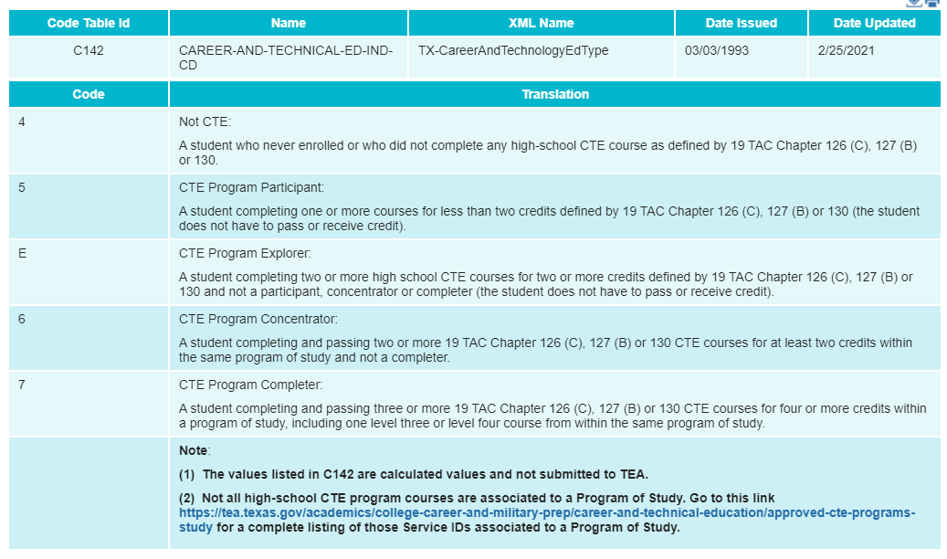
CTE Auto-Calculation: Code Tables
CAREER-AND-TECHNICAL-ED-IND-CD (C142)
CTE Technical Resources

Slide 37
CTE Auto-Calculation: Reports
New report will be created for the PEIMS Summer submission which includes the following CTE data:
Student Name
Unique ID
Local ID
Student ID
Program of Study
State or Regional Program
Calculated CTE Indicator
State Cluster
Federal Cluster
This report will be a campus level and LEA level report.
The user will be able to export the output in CSV format
Note: Once LEAs are in Accepted status, TEA will process the calculation that will create data for the reports where CTE data is located.

Slide 38
CTE Auto-Calculation: Reports
The following existing PEIMS Summer reports will display blank CTE Indicator data (including counts) until the calculation process is completed after all LEAs are in Accepted status.
PDM3-120-004 Disaggregation of PEIMS Summer Attendance Data
PDM3-120-007 Student Indicator Report by Grade

Slide 39
AGENDA
PEIMS
2020-2021​
Truancy
Additional Days School Year Program
Industry Based Certification
CTE Auto-Calculation
Submission Reminders
Submission Updates​
Current Known Issues
2021-2022
Expanded Learning Opportunities
Crisis Codes
Industry Based Certification
Leaver Definition Update
2022-2023
Financial Aid Application Early Notice
Timeline​
Technical Resources

Slide 40
PEIMS: 2020-2021 SUBMISSION REMINDERS
Verify Student’s DYSLEXIA-SERVICES-CODE (E1650)
PDM3-120-018 Student Dyslexia or Related Services Roster
Data Element Summary
Search Submission Data

Slide 41
PEIMS: 2020-2021 SUBMISSION UPDATES
A reports advisory committee was formed to help determine which reports to update with the RS/RA attendance data. During the meeting, how to update the reports was also discussed. The following reports were modified based on the feedback which include the updates on each report.
PDM3-120-004 Disaggregation of PEIMS Summer Attendance Data
Aggregated ADA for all instructional methods
PDM3-130-001 Superintendent’s Report of Student Attendance
IP, RS and RA calculations includes parameters
Summary page with aggregated ADA for all instructional methods

Slide 42
PEIMS: 2020-2021 SUBMISSION UPDATES
PDM3-130-004 Superintendent’s Report of Special Education Eligible Days & Excess Hours
Aggregated ADA for all instructional methods
PDM3-130-005 Comparison of Current and Prior Year Attendance
Aggregated ADA for all instructional methods
PDM3-130-006 Campus Attendance Diagnostic Messages
Aggregated ADA for all instructional methods

Slide 43
PEIMS: 2020-2021 SUBMISSION UPDATES
PDM3-130-007 Student with Zero Days Absent
Aggregated ADA for all instructional methods
PDM3-130-008 Superintendent’s Summary Report of Student Attendance
IP, RS and RA calculations includes parameters
Summary page with aggregated ADA for all instructional methods

Slide 44
PEIMS: 2020-2021 SUBMISSION UPDATES
PDM3-130-009 Attendance by District of Residence
Aggregated ADA for all instructional methods
PDM3-130-010 Attendance Rates Comparison by Ethnicity, Gender, and Special Population
IP, RS and RA calculations includes parameters
Summary page with aggregated ADA for all instructional methods
PDM3-130-020 Special Education FTEs by District of Residence and Instructional Setting
Aggregated ADA for all instructional methods

Slide 45
PEIMS: 2020-2021 CURRENT KNOWN ISSUES
PDM3-120-004 Disaggregation of PEIMS Summer Attendance Data
The report is displaying incorrect Homeless/Unaccompanied Youth, LEP, and Military Connected counts.
PDM3-120-007 Student Indicator Report by Grade
The report is displaying only Dyslexia Risk 02 indicator when selecting parameter 'Dyslexia Risk' for the Student Program Indicator Code.
PDM3-131-006 Roster of Early Education Students with Speech Therapy only or No Special Education
The report is returning students that are not speech therapy only.

Slide 46
AGENDA
PEIMS
2020-2021​
Truancy
Additional Days School Year Program
Industry Based Certification
CTE Auto-Calculation
Submission Reminders
Submission Updates​
Current Known Issues
2021-2022
Expanded Learning Opportunities
Crisis Codes
Industry Based Certification
Leaver Definition Update
2022-2023
Financial Aid Application Early Notice
Timeline​
Technical Resources

Slide 47
Expanded Learning Opportunities
Background:
Senate Bill (SB) 1404, passed in the 85th legislative session, requires that each school district and open-enrollment charter school report through PEIMS the following:
Availability of expanded learning opportunities (ELOs) as descripted in TEC §33.252.
Number of students participating in each of the categories of expanded learning opportunities listed under TEC §33.252(b).
ELOs were reported beginning in the 2019-2020 school year.
Additional data is needed to meet the requirements of SB 1404.

Slide 48
Expanded Learning Opportunities: Data Elements
For the 2021-2022 school year, the following elements were DELETED from the TX-SchoolELO sub-complex:

Slide 49
Expanded Learning Opportunities: Data Elements
For the 2021-2022 school year, the following new elements were ADDED to the new sub-complex type TX-SchoolELOActivity:

Slide 50
Expanded Learning Opportunities: Code Tables
2020-2021 ELO-TYPE (C218)
2021-2022 ELO-TYPE (C218)

Slide 51
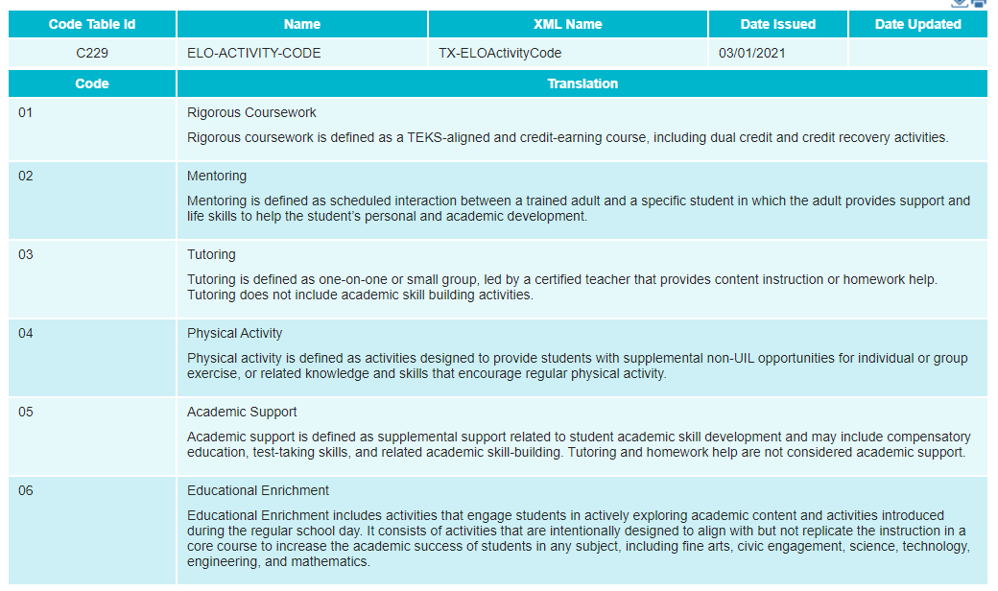
Expanded Learning Opportunities: Code Tables
New: ELO-ACTIVITY-CODE (C229)

Slide 52
Expanded Learning Opportunities: Reporting Guidance
EXPANDED-LEARNING-OPPORTUNITY-INDICATOR-CODE (E1613) indicates the is used to
identify if a campus offers any expanded learning opportunity (ELO) as listed in TEC 33.252.
In the SchoolExtension Complex Type, the EXPANDED-LEARNING-OPPORTUNITYINDICATOR-CODE data element only refers to the campus offerings of an expanded learning
opportunity. An expanded learning opportunity is an activity that is not required, but is
supplemental.
The EXPANDED-LEARNING-OPPORTUNITY-INDICATOR-CODE is reported only for PEIMS
Submissions 3 and 4.
If the school offers an expanded learning opportunity program, then the following elements
(E1615-E1621) must be reported for each ELO activity offered:
E1614 ELO-TYPE-CODE
E17X1 ELO-ACTIVITY-CODE
E17X2 ELO-DAYS-SCHEDULED-PER-YEAR
E1621 ELO-MINUTES-SCHEDULED-PER-DAY

Slide 53
Expanded Learning Opportunities: Reporting Guidance
** TX-SchoolELOS Complex Type **
The TX-SchoolELOS Complex Type captures data for school participation in expanded learning
opportunities.
The TX-SchoolELOS Complex Type is reported only for PEIMS Submissions 3 and 4.
** TX-SchoolELO Complex Type **
TX-SchoolELO Complex Type represents a single expanded learning opportunity a school
offers.
For each expanded learning opportunity type offered by a school, the entire complex type
TX-SchoolELO will be reported. In the XML reporting, this is known as “unbounded” and
allows an XML item or set of items to be repeated as many times as needed. Therefore there
can be more than one TX-SchoolELO within TX-SchoolELOS.
For example, if a school offers both a Non-Voluntary Extended School Year and a Voluntary
Expanded Learning – Before School and After School, two sets of data will be reported in the
TX-SchoolELO complex type instance.

Slide 54
Expanded Learning Opportunities: Reporting Guidance
ELO-TYPE-CODE (E1614) indicates the type of expanded learning opportunity (ELO)
program offered at the campus.
In the TX-SchoolELOS Complex Type the ELO-TYPE-CODE data element only refers to the campus offerings of an expanded learning opportunity program.
** TX-SchoolELOActivity Complex Type **
For each expanded learning opportunity offered by a school, more than one ELO act. For each expanded learning opportunity offered by a school, more than one ELO activity can be reported. In the XML reporting, this is known as “unbounded” and allows an XML item or set of items to be repeated as many times as needed. Therefore, there can be more than one TX-SchoolELOActivity within TX-SchoolELO complex type.
For example, if a school offers both Physical Activity and Tutoring after school, report two sets of data in their own TX-SchoolELOActivity complex type instance.

Slide 55
Expanded Learning Opportunities: Reporting Guidance
ELO-ACTIVITY-CODE (E17X1) indicates the specific Expanded Learning Opportunity
(ELO) activity offered at the campus.
• RIGOROUS-COURSEWORK
Rigorous coursework is defined as a TEKS-aligned and credit-earning course, including dual credit and credit recovery activities.
• MENTORING
Mentoring is defined as scheduled interaction between a trained adult and a specific student in which the adult provides support and life skills to help the student’s personal and academic development.
• TUTORING
Tutoring is defined as one-on-one or small group, led by a certified teacher that provides content instruction or homework help. Tutoring does not include academic skill building activities.
• PHYSICAL ACTIVITY
Physical activity is defined as activities designed to provide students with supplemental non-UIL opportunities for individual or group exercise, or related knowledge and skills that encourage regular physical activity.
• ACADEMIC SUPPORT
Academic support is defined as supplemental support related to student academic skill development and may include compensatory education, test-taking skills, and related academic skill-building. Tutoring and homework help are not considered academic support.
• EDUCATIONAL ENRICHMENT
Educational enrichment includes activities that engage students in actively exploring academic content and activities introduced during the regular school day. It consists of Expand ELO Data Elements activities that are intentionally designed to align with but not replicate the instruction in a core course to increase the academic success of students in any subject, including fine arts, civic engagement, science, technology, engineering, and mathematics.

Slide 56
Expanded Learning Opportunities: Reporting Guidance
ELO-DAYS-SCHEDULED-PER-YEAR (E17X2) indicates the number of days the Expanded Learning Opportunity (ELO) activity is offered during the school year.
To compute the ELO-DAYS-SCHEDULED-PER-YEAR, the school should consider the beginning point in time of the ELO-ACTIVITY-CODE to the ending point in time for the ELO-ACTIVITY-CODE.
ELO-MINUTES-SCHEDULED-PER-DAY (E1621) indicates the number of minutes scheduled each day for a given ELO-ACTIVITY-CODE.
If a school offers two instances of the same ELO program, such as Tutoring, for English and Math, both before school, the minutes will need to be added together and reported as one total for both subjects since they are the same ELO Activity Code and are offered under the same ELO-TYPE.
Additionally, if a school offers the same ELO program throughout the year, but changes the length of minutes scheduled per day, the minutes will need to be averaged.
For example, a school offers Academic Support (ELO Activity Code ‘05’) for 60 minutes on Mondays and 90 minutes on Wednesdays, the minutes will need to be averaged to 75 minutes/day for reporting.
To compute the ELO-MINUTES-SCHEDULED-PER-DAY, the school should consider the beginning point in time of the ELO-ACTVITIY-CODE program to the ending point in time for the ELO-ACTIVITY-CODE program.

Slide 57
Expanded Learning Opportunities: Reporting Guidance
Refer to Example #N in the examples section below.
ELO-RIGOROUS-COURSEWORK-INDICATOR-CODE (E1615) indicates the campus offers an expanded learning opportunity (ELO) identified as rigorous coursework. Rigorous coursework is defined as a TEKS-aligned and credit-earning course, including dual credit and credit recovery activities.
In the TX-SchoolELOS Complex Type the ELO-RIGOROUS-COURSEWORK-INDICATORCODE data element only refers to the campus offerings of an expanded learning opportunity program.
ELO-MENTORING-INDICATOR-CODE (E1616) indicates the campus offers an expanded learning opportunity (ELO) identified as mentoring. Mentoring is defined as scheduled interaction between a trained adult and a specific student in which the adult provides support and life skills to help the student’s personal and academic development.
In the TX-SchoolELOS Complex Type the ELO-MENTORING-INDICATOR-CODE data element only refers to the campus offerings of an expanded learning opportunity program.
ELO-TUTORING-INDICATOR-CODE (E1617) indicates the campus offers an expanded learning opportunity (ELO) identified as tutoring. “Tutoring” is defined as one-on-one or small group, led by a certified teacher that provides content instruction or homework help. Tutoring does not include academic skill building activities.
In the TX-SchoolELOS Complex Type the ELO-TUTORING-INDICATOR-CODE data element only refers to the campus offerings of an expanded learning opportunity program.

Slide 58
Expanded Learning Opportunities: Reporting Guidance
ELO-PHYSICAL-ACTIVITY-INDICATOR-CODE (E1618) indicates the campus offers an expanded learning opportunity (ELO) identified as physical activity. “Physical activity” is defined as activities designed to provide students with supplemental non-UIL opportunities for individual or group exercise, or related knowledge and skills that encourage regular physical activity.
In the TX-SchoolELOS Complex Type the ELO-PHYSICAL-ACTIVITY-INDICATOR-CODE data element only refers to the campus offerings of an expanded learning opportunity program.
ELO-ACADEMIC-SUPPORT-INDICATOR-CODE (E1619) indicates the campus offers an expanded learning opportunity (ELO) identified as academic support. “Academic” support is defined as supplemental support related to student academic skill development and may include compensatory education, test-taking skills, and related academic skill-building. Tutoring and homework help are not considered academic support.
In the TX-SchoolELOS Complex Type the ELO-ACADEMIC-SUPPORT-INDICATOR-CODE data element only refers to the campus offerings of an expanded learning opportunity program.
ELO-EDUCATIONAL-ENRICHMENT-INDICATOR-CODE (E1620) indicates the campus offers an expanded learning opportunity (ELO) identified as educational enrichment. Educational enrichment includes activities that engage students in actively exploring academic content and activities introduced during the regular school day. It consists of activities that are intentionally designed to align with but not replicate the instruction in a core course to increase the academic
success of students in any subject, including fine arts, civic engagement, science, technology, engineering, and mathematics.
In the TX-SchoolELOS Complex Type the ELO-EDUCATIONAL-ENRICHMENT-INDICATORCODE data element only refers to the campus offerings of an expanded learning opportunity program.

Slide 59
Expanded Learning Opportunities: Rules
2021-2022 Deleted Rule:
2021-2022 New Rule:

Slide 60
Expanded Learning Opportunities: Rules
2021-2022 Revised Rules:

Slide 61
Expanded Learning Opportunities: Reports
TSDS PEIMS Reports Updates:
PDM3-116-008 – Organization Expanded Learning Opportunities
PDM4-116-008 – Organization Expanded Learning Opportunities

Slide 62
AGENDA
PEIMS
2020-2021​
Truancy
Additional Days School Year Program
Industry Based Certification
CTE Auto-Calculation
Submission Reminders
Submission Updates​
Current Known Issues
2021-2022
Expanded Learning Opportunities
Crisis Codes
Industry Based Certification
Leaver Definition Update
2022-2023
Financial Aid Application Early Notice
Timeline​
Technical Resources

Slide 63
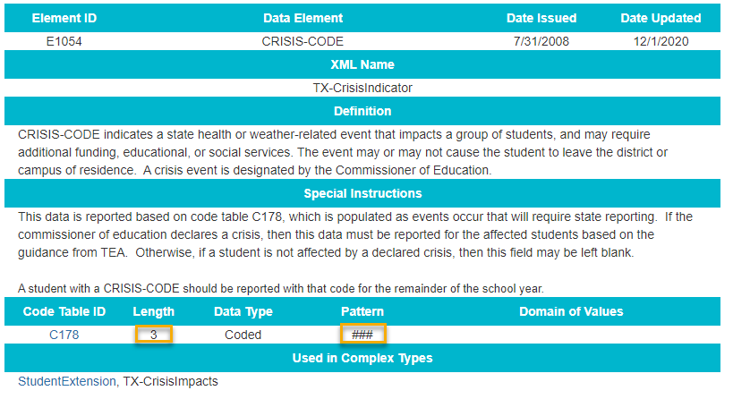
Crisis Codes: Data Elements
Expand the length of CRISIS-CODE element (E1054) from two to three in the Texas Education Data Standards.

Slide 64
Crisis Codes: Reports
Updating the following TSDS PEIMS reports:
PEIMS Fall Reports:
PDM1-120-011 – Student Crisis Code Roster
Expanded crisis code column to allow up to 3 characters.
PDM1-123-001 – STAAR Precoding Report
Expanded crisis code column to allow up to 3 characters.
PEIMS Summer Reports:
PDM3-120-005 – Student Crisis Code Roster
Expanded crisis code column to allow up to 3 characters.
PDM3-120-012 – Attendance Data
Expanded crisis code column to allow up to 3 characters.
PDM3-120-014 – Flexible Attendance Data
Expanded crisis code column to allow up to 3 characters.

Slide 65
Crisis Codes: Reports
Updating the following TSDS PEIMS reports:
PEIMS Extended Year Reports:
PDM4-120-002 – Student Crisis Code Roster
Expanded crisis code column to allow up to 3 characters.
PDM4-130-002 – Flexible Attendance Data
Expanded crisis code column to allow up to 3 characters

Slide 66
AGENDA
PEIMS
2020-2021​
Truancy
Additional Days School Year Program
Industry Based Certification
CTE Auto-Calculation
Submission Reminders
Submission Updates​
Current Known Issues
2021-2022
Expanded Learning Opportunities
Crisis Codes
Industry Based Certification
Leaver Definition Update
2022-2023
Financial Aid Application Early Notice
Timeline​
Technical Resources

Slide 67
Industry Based Certification: Data Elements
Modify TX-IndustryCertifications sub-complex type reported with StudentExtension complex type in the PEIMS Fall and Summer Submissions
Change IBC-EXAM-FEE-AMOUNT from Conditionally Mandatory (C) to Optional (Y)

Slide 68
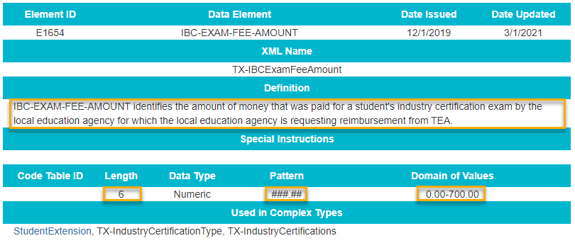
Industry Based Certification: Data Elements
Modify Data Element IBC-EXAM-FEE-AMOUNT (E1654) definition, length, pattern, and domain of values.
The adjustments to length, pattern, and domain of values will allow for the reporting of fees with cents.

Slide 69
Industry Based Certifications: Reporting Guidance
Update Data Element reporting guidance
IBC-EXAM-FEE-AMOUNT (E1654) identifies the amount of money that was paid for a student’s industry certification exam by the local education agency for which the local education agency is requesting reimbursement from TEA.
Each student is entitled to one passed certification examination at state cost in grades 9-12, of which the LEA is entitled to a reimbursement from TEA for up to $700.
TEA will reimburse the first reported IBC exam in PEIMS with an associated cost greater than $0. Since only one reimbursement per student in grades 9-12 will be provided, LEAs should only report an IBC-EXAM-FEE-AMOUNT greater than $0.00 for the certification for which they wish to be reimbursed. For any certification for which an LEA is not requesting reimbursement (for example, if they have already requested a reimbursement for this student), the IBC-EXAM-FEE-AMOUNT either does not need to be reported or may be reported as $0.00.
If an LEA reports more than one IBC-EXAM-FEE-AMOUNT for a student, the first certification earned with an amount greater than $0.00 will be reimbursed. If there is more than one certification earned on the same day that is reported with an amount greater than $0.00, the higher amount will be reimbursed.
If multiple LEAs report an IBC-EXAM-FEE-AMOUNT for the same student, the first LEA will be considered for reimbursement (the LEA in which the student was enrolled at the time of examination and the LEA that paid for the certification examination). LEAs should utilize the TREx platform to minimize duplicate reporting.

Slide 70
Industry Based Certification: Reports
Updating the following TSDS PEIMS report:
PEIMS Fall Reports:
PDM1-120-021 – Industry Based Certification Roster
Allow Exam Fee column to display 6 characters in the numerical format, “nnn.nn”.
PEIMS Summer Reports:
PDM3-120-XXX – Industry Based Certification Roster
New report

Slide 71
AGENDA
PEIMS
2020-2021​
Truancy
Additional Days School Year Program
Industry Based Certification
CTE Auto-Calculation
Submission Reminders
Submission Updates​
Current Known Issues
2021-2022
Expanded Learning Opportunities
Crisis Codes
Industry Based Certification
Leaver Definition Update
2022-2023
Financial Aid Application Early Notice
Timeline​
Technical Resources

Slide 72
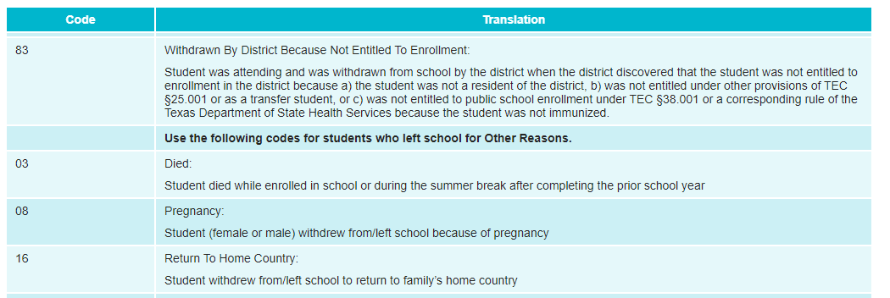
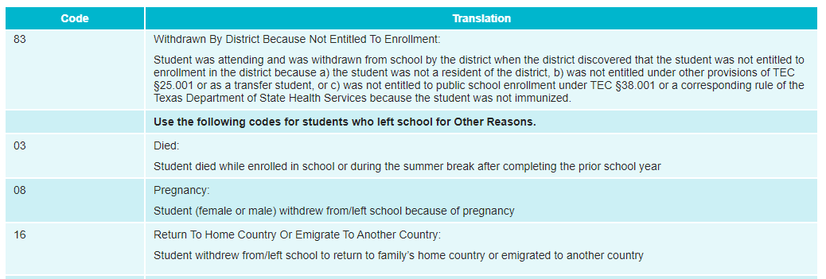
Leaver Definition Update: Code Tables
The Research and Analysis Division requested a modification to the wording on LEAVER-REASON-CODE 16:
2020-2021 LEAVER-REASON-CODE (C162)
2021-2022 LEAVER-REASON-CODE (C162)

Slide 73
AGENDA
PEIMS
2020-2021​
Truancy
Additional Days School Year Program
Industry Based Certification
CTE Auto-Calculation
Submission Reminders
Submission Updates​
Current Known Issues
2021-2022
Expanded Learning Opportunities
Crisis Codes
Industry Based Certification
Leaver Definition Update
2022-2023
Financial Aid Application Early Notice
Timeline​
Technical Resources

Slide 74
Graduate Financial Aid Application: 2022-2023 Early Notice
Background:
The Texas Commission on Public School Finance identified that many Texas students are not applying for financial aid and as a result there has been a drop in college enrollment. House Bill 3 (HB3) added to Texas Education Code (TEC §28.0256) the requirement that prior to graduating from high school, all students must complete and submit either a free application for federal student aid (FAFSA), a Texas application for state financial aid (TASFA) or opt out of the requirement.
To align with this legislative mandate, the Standards and Support Division in collaboration with the Curriculum Division and Beyond Grad Support team requested the addition of new data elements and code tables in both the PEIMS Fall submission and the Texas Records Exchange (TREx) to support this reporting requirement.
Beginning in the 2022-2023 school year, TSDS PEIMS will collect a new mandatory data element labeled FINANCIAL-AID-APPLICATION-CODE on all 2021-2022 graduates.

Slide 75
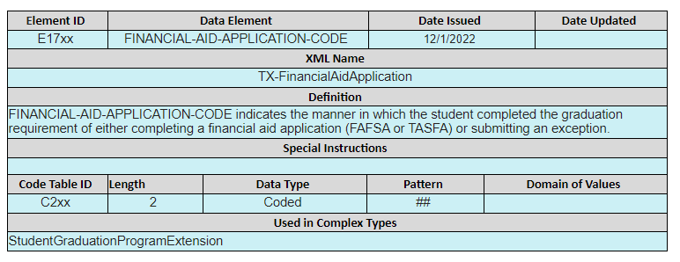
Graduate Financial Aid Application: Data Elements
2022-2023 Student Graduate Data Collection:
FINANCIAL-AID-APPLICATION-CODE (E17XX)

Slide 76
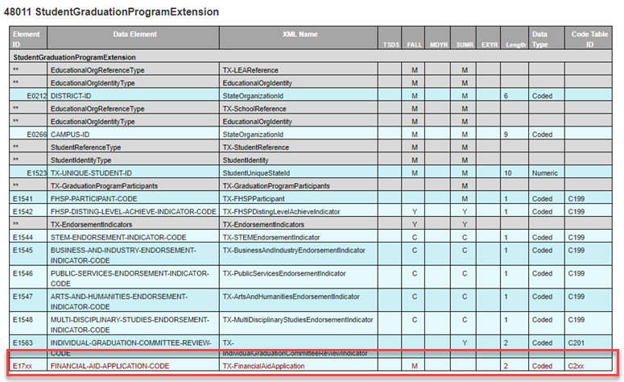
Graduate Financial Aid Application: Data Elements
2022-2023 Student Graduate Data Collection:
StudentGraduationProgramExtension complex type:

Slide 77
Graduate Financial Aid Application: Data Elements
2022-2023 Student Graduate Data Collection:
FINANCIAL-AID-APPLICATION-CODE table:

Slide 78
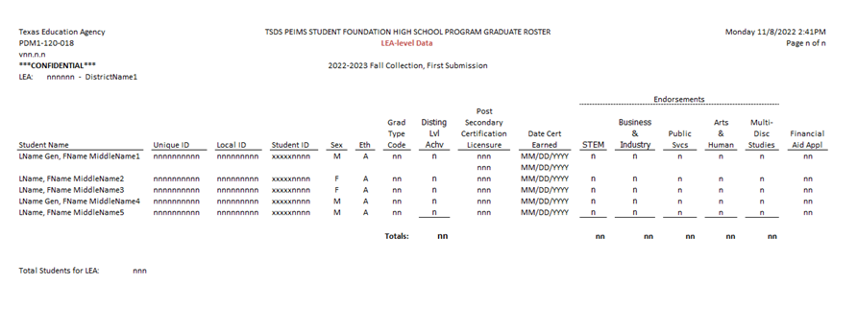
Graduate Financial Aid Application: Reports
TSDS PEIMS Reports Updates:
PDM1-120-018 - Foundation High School Program Graduate Roster

Slide 79
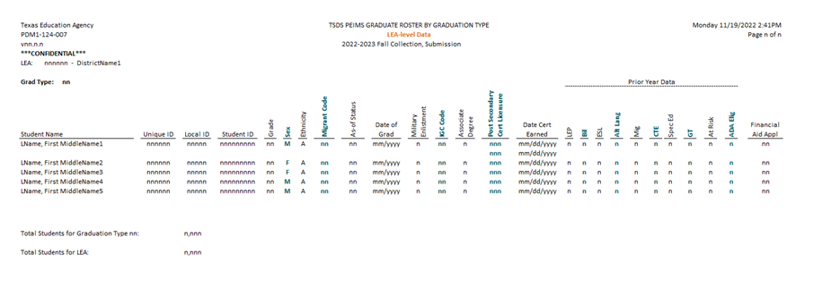
Graduate Financial Aid Application: Reports
TSDS PEIMS Reports Updates:
PDM1-124-007 - Graduate Roster by Graduation Type

Slide 80
AGENDA
PEIMS
2020-2021​
Truancy
Additional Days School Year Program
Industry Based Certification
CTE Auto-Calculation
Submission Reminders
Submission Updates​
Current Known Issues
2021-2022
Expanded Learning Opportunities
Crisis Codes
Industry Based Certification
Leaver Definition Update
2022-2023
Financial Aid Application Early Notice
Timeline​
Technical Resources

Slide 81
TIMELINE: 2020-2021 PEIMS SUMMER
PEIMS Summer Submission (Sub 3)
TSDS PEIMS ready for users to complete, approve, and accept submissions | May 17, 2021
Requests to retire Unique IDs due at TEA | June 11, 2021
PEIMS Summer first submission due date for LEAs | June 17, 2021
Requests to retire Unique IDs due at TEA | July 9, 2021
PEIMS Summer resubmission due date for LEAs | July 15, 2021
PEIMS Summer data available to customers | September 16, 2021
**Refer to Release Schedule presentation for the 2021-2022 timeline

Slide 82
TIMELINE: 2020-2021 PEIMS EXTENDED YEAR
PEIMS Extended Year Submission (Sub 4)
TSDS PEIMS ready for users to complete, approve, and accept submissions | July 26, 2021
Requests to retire Unique IDs due at TEA | August 20, 2021
PEIMS Extended Year first submission due date for LEAs | August 26, 2021
Requests to retire Unique IDs due at TEA | September 10, 2021
PEIMS Extended Year resubmission due date for LEAs | September 16, 2021
PEIMS Extended Year data available to customers | October 14, 2021
**Refer to Release Schedule presentation for the 2021-2022 timeline

Slide 83
AGENDA
PEIMS
2020-2021​
Truancy
Additional Days School Year Program
Industry Based Certification
CTE Auto-Calculation
Submission Reminders
Submission Updates​
Current Known Issues
2021-2022
Expanded Learning Opportunities
Crisis Codes
Industry Based Certification
Leaver Definition Update
2022-2023
Financial Aid Application Early Notice
Timeline​
Technical Resources

Slide 84
PEIMS: TECHNICAL RESOURCES
Technical Specifications:
Texas Education Data Standards (TEDS)
Technical Support:
TSDSCustomerSupport@tea.texas.gov

Slide 85
Questions

