Slide 1
Special Education Language Acquisition (SELA)

Slide 2
AGENDA
SELA
  2020-2021
    Submission Updates
    Reminders
    Current Known Issues
  2021-2022
    Data Element Updates
    Business Rule Updates
    Code Table Updates
  Timeline
  Frequently Asked Questions
  Technical Resources

Slide 3
AGENDA
SELA
  2020-2021
    Submission Updates
    Reminders
    Current Known Issues
  2021-2022
    Data Element Updates
    Business Rule Updates
    Code Table Updates
  Timeline
  Frequently Asked Questions
  Technical Resources

Slide 4
2020-2021: SUBMISSION UPDATES
The 2020-2021 SELA yearly submission is due June 24, 2021.
  Current Status Counts: ​
  Initiated – 4
  Promoted – 0
  Validated – 1

Slide 5
2020-2021: REMINDERS
SELA promotes data from the following TSDS interchanges.
  InterchangeEducationOrganizationExtension
  InterchangeStudentParentExtension
  InterchangeStudentProgramExtension

Slide 6
2020-2021: REMINDERS
The following criteria logic is applied when promoting students:
  8 years of age or younger on September 1st of the current school year
  Coded with the following E1220 DISABILITY:
    02 – Deaf-Blindness (Deaf-Blind)
    06 – Hearing/Auditory Impairment (Auditory Impairment)
In addition, the following criteria is applied when promoting student special education program data:
  Special Education Program data where E1337 PROGRAM-TYPE = ‘Special Education’

Slide 7
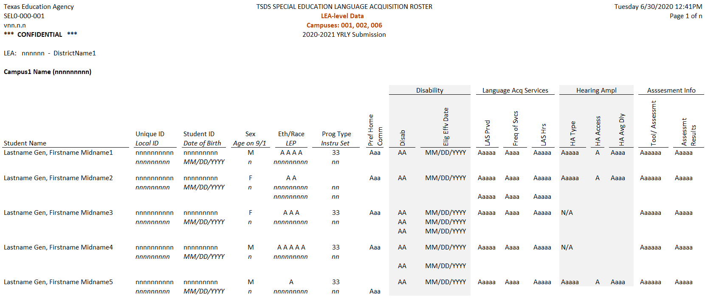
2020-2021: REMINDERS
SEL0-100-001 – Special Education Language Acquisition Roster – available at LEA and ESC level.

Slide 8
CURRENT KNOWN ISSUES
DAEP Instructional campuses do not appear in the parameters for the SEL0-100-001 report.
  Students reported at these campuses will not be displayed on the report.
  This is scheduled to be resolved in the May 7, 2021 release.

Slide 9
AGENDA
SELA
  2020-2021
    Submission Updates
    Reminders
    Current Known Issues
  2021-2022
    Data Element Updates
    Business Rule Updates
    Code Table Updates
  Timeline
  Frequently Asked Questions
  Technical Resources

Slide 10
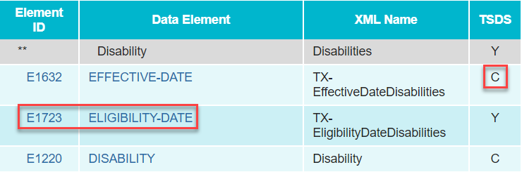
2021-2022: DATA ELEMENT UPDATES
Disability complex type:
  Added data element E1723 ELIGIBILITY-DATE.
    Indicates the date upon which a student who is deaf or hard of hearing is eligible for services.
    This data is currently being collected using element E1632 EFFECTIVE-DATE.
  Changed E1632 EFFECTIVE-DATE from ‘Optional’ to ‘Conditionally Mandatory’.
    Indicates the date upon which the disability is considered to take effect.

Slide 11
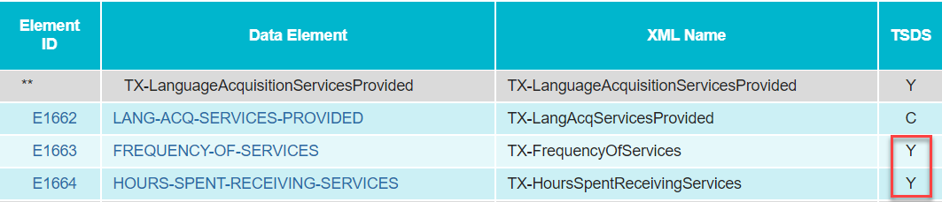
2021-2022: DATA ELEMENT UPDATES
TX-LanguageAcquisitionServicesProvided complex type:
  Changed E1663 FREQUENCY-OF-SERVICES and E1664 HOURS-SPENT-RECEIVING-SERVICES from ‘Mandatory’ to ‘Optional’.
    This will no longer require an LEA to report these elements for students that do not receive services.

Slide 12
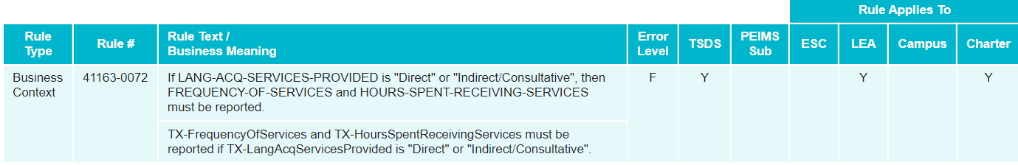
2021-2022: BUSINESS RULE UPDATES
2021-2022 New Validation Rules

Slide 13
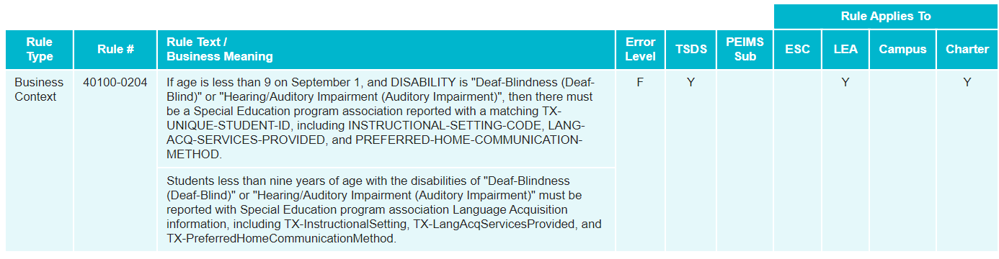
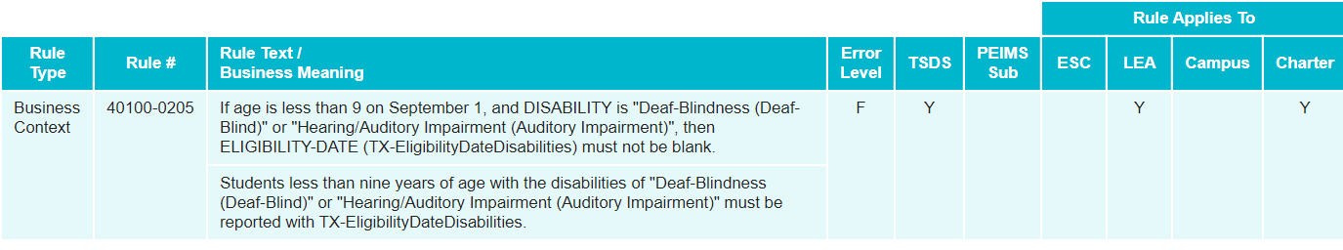
2021-2022: BUSINESS RULE UPDATES
2021-2022 Updated Validation Rules

Slide 14
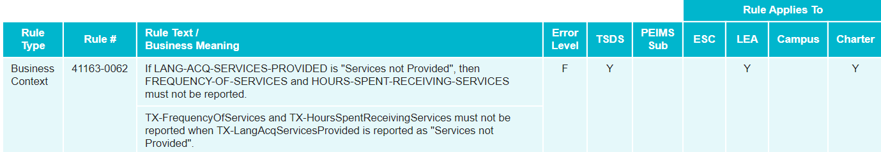
2021-2022: BUSINESS RULE UPDATES
2021-2022 Updated Validation Rules

Slide 15
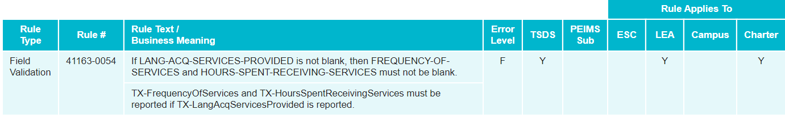
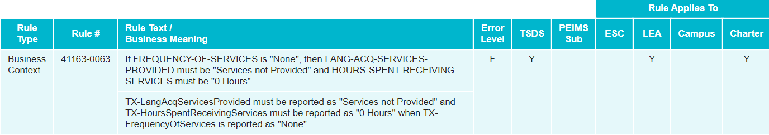
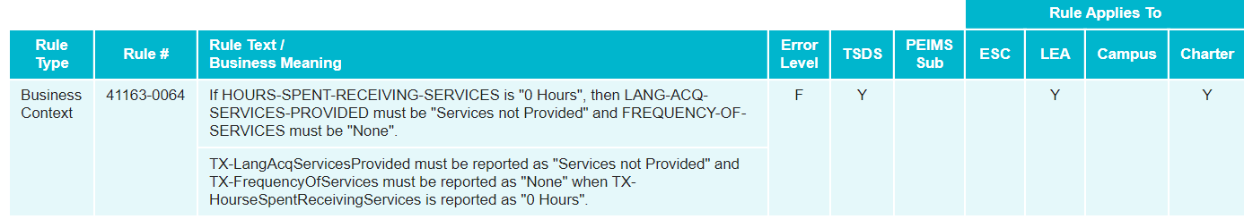
2021-2022: BUSINESS RULE UPDATES
2021-2022 Deleted Validation Rules

Slide 16
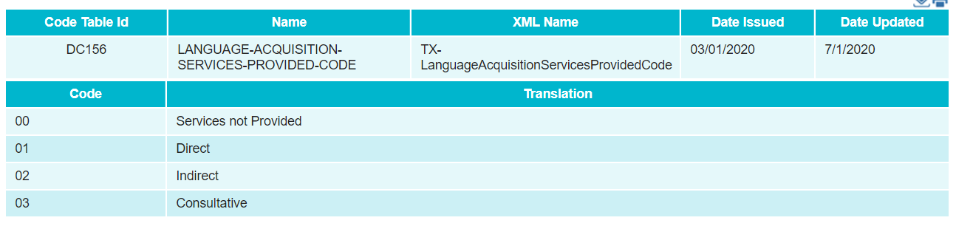
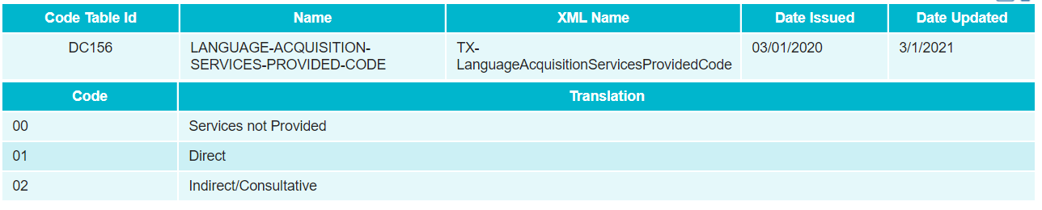
2021-2022: CODE TABLE UPDATES
DC 156 – LANGUAGE-ACQUISITION-SERVICES-PROVIDED-CODE
2020-2021
2021-2022

Slide 17
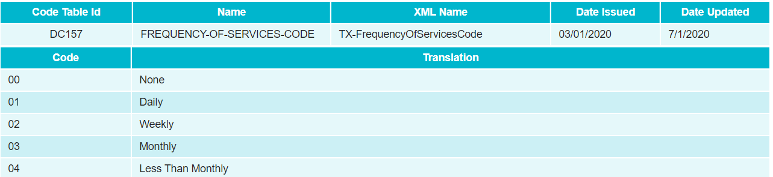
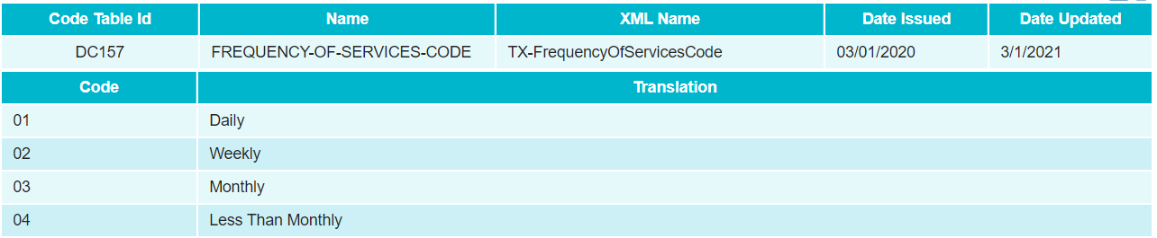
2021-2022: CODE TABLE UPDATES
DC 157 – FREQUENCY-OF-SERVICES-CODE
2020-2021
2021-2022

Slide 18
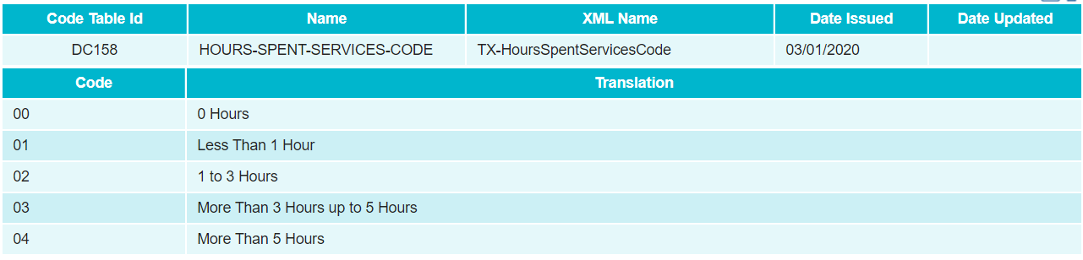
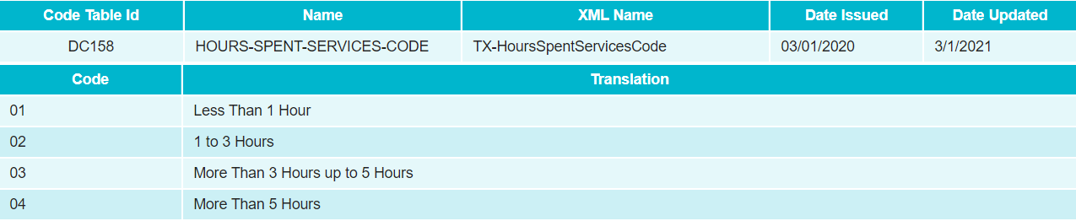
2021-2022: CODE TABLE UPDATES
DC 158 – HOURS-SPENT-SERVICES-CODE
2020-2021
2021-2022

Slide 19
AGENDA
SELA
  2020-2021
    Submission Updates
    Reminders
    Current Known Issues
  2021-2022
    Data Element Updates
    Business Rule Updates
    Code Table Updates
  Timeline
  Frequently Asked Questions
  Technical Resources

Slide 20
TIMELINE
Submission Due: June 23, 2022
Special Education Language Acquisition Collection
TSDS ready to load data to eDM | August 2, 2021
SELA ready for users to promote data | September 13, 2021
SELA ready for users to complete | May 16, 2022
SELA submission due date for LEAs | June 23, 2022
SELA data available to customers | July 7, 2022

Slide 21
AGENDA
SELA
  2020-2021
    Submission Updates
    Reminders
    Current Known Issues
  2021-2022
    Data Element Updates
    Business Rule Updates
    Code Table Updates
  Timeline
  Frequently Asked Questions
  Technical Resources

Slide 22
FREQUENTLY ASKED QUESTIONS
Which students are reported in the SELA data collection?
  All students who are 8 years of age or younger on September 1st of the current school year and are reported with a disability of either ‘Hearing/Auditory Impairment (Auditory Impairment)’ or ‘Deaf-Blindness (Deaf-Blind)’ are promoted to the SELA data mart, regardless of how the rest of their data is reported.

Slide 23
FREQUENTLY ASKED QUESTIONS
If a student turns 9 years old during the middle of the school year, should they still be included in the SELA data collection?
  Yes. All students who are age 8 or younger on September 1st of the current school year should be included in the SELA data collection.

Slide 24
FREQUENTLY ASKED QUESTIONS
Can disabilities other than ‘Hearing/Auditory Impairment (Auditory Impairment)’ and ‘Deaf-Blindness (Deaf-Blind)’ be reported for a student?
  Yes. Students may be reported with multiple disabilities. However, they must be reported with ‘Hearing/Auditory Impairment (Auditory Impairment)’ or ‘Deaf-Blindness (Deaf-Blind)’ in order to be promoted into the SELA data mart.

Slide 25
FREQUENTLY ASKED QUESTIONS
If a student switches campuses during the middle of the year, which campus should be reported in the TX-SpecialEducationLanguageAcquisition complex type?
If a student switches campuses, the LEA should report the most recent campus where the student received services.

Slide 26
AGENDA
SELA
  2020-2021
    Submission Updates
    Reminders
    Current Known Issues
  2021-2022
    Data Element Updates
    Business Rule Updates
    Code Table Updates
  Timeline
  Frequently Asked Questions
  Technical Resources

Slide 27
TECHNICAL RESOURCES
Technical Specifications:
  Texas Education Data Standards (TEDS)
Technical Support:
  TSDSCustomerSupport@tea.texas.gov
SELA Program Area:
  FAQ and other state guidance resources for AI students
  TAA – HB 548
Knowledge Base Articles:
  TSDSKB-612 SELA: Frequently Asked Questions (FAQ)
  TSDSKB-615 SELA: Definition of Learning Acquisition Services
  TSDSKB-616 SELA: Definition of Assessment Types

Slide 28
Questions

