Slide 1
TEXAS RECORDS EXCHANGE (TREx) UPDATE

Slide 2
AGENDA
Texas Records Exchange (TREx) Updates
2021-2022 Changes
Financial Aid Application
Legislation
Data Elements
Code Table
CAREER-TECH-ED-INDICATOR (CTE)
Legislation
Data Elements
Code Table
TREx Publication Format Changes

Slide 3
AGENDA
Texas Records Exchange (TREx) Updates
2021-2022 Changes
Financial Aid Application
Legislation
Data Elements
Code Table
CAREER-TECH-ED-INDICATOR (CTE)
Legislation
Data Elements
Code Table
TREx Publication Format Changes

Slide 4
FINANCIAL AID APPLICATION: LEGISLATION
House Bill 3
TEC §28.0256
Before graduating from high school, each student must complete and submit a free application for federal student aid (FAFSA) or a Texas application for state financial aid (TASFA) or opt out of the requirement.

Slide 5
AGENDA
Texas Records Exchange (TREx) Updates
2021-2022 Changes
Financial Aid Application
Legislation
Data Elements
Code Table
CAREER-TECH-ED-INDICATOR (CTE)
Legislation
Data Elements
Code Table
TREx Publication Format Changes

Slide 6
FINANCIAL AID APPLICATION: DATA ELEMENTS
Beginning in the 2022-2023 school year, TSDS PEIMS will collect a new mandatory data element labeled FINANCIAL-AID-APPLICATION-CODE on all 2021-2022 graduates.
TREx is adding the new element for LEAs to transmit the information during the 2021-2022 school year.

Slide 7
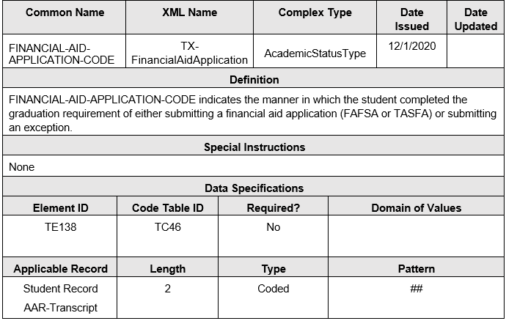
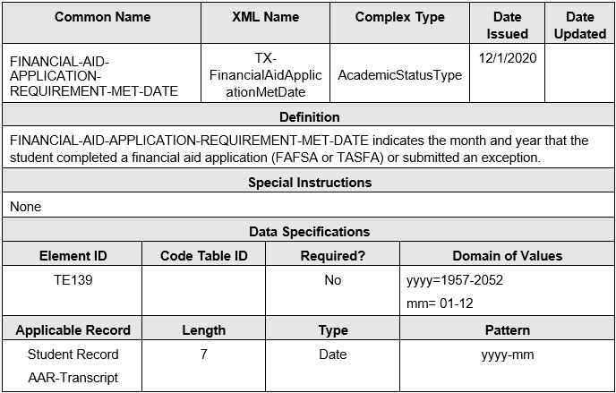
FINANCIAL AID APPLICATION: DATA ELEMENTS
FINANCIAL-AID-APPLICATION-CODE (TE138)
FINANCIAL-AID-APPLICATION-REQUIREMENT-MET-DATE (TE139)

Slide 8
AGENDA
Texas Records Exchange (TREx) Updates
2021-2022 Changes
Financial Aid Application
Legislation
Data Elements
Code Table
CAREER-TECH-ED-INDICATOR (CTE)
Legislation
Data Elements
Code Table
TREx Publication Format Changes

Slide 9
FINANCIAL AID APPLICATION: CODE TABLE
FINANCIAL-AID-APPLICATION-CODE (TC46)

Slide 10
AGENDA
Texas Records Exchange (TREx) Updates
2021-2022 Changes
Financial Aid Application
Legislation
Data Elements
Code Table
CAREER-TECH-ED-INDICATOR (CTE)
Legislation
Data Elements
Code Table
TREx Publication Format Changes

Slide 11
CAREER-TECH-ED-INDICATOR: LEGISLATION
Career and Technical Education
Public Law 115-224, Perkins V, the Act, or statute
Sections 113. [20 U.S.C. 2323] ACCOUNTABILITY (B)STATE DETERMINED PERFORMANCE MEASURES
The Federal Perkins legislation that was signed into federal law on July 21, 2018 updated Perkins V reporting requirements. This updated piece of legislation required State Education Agencies to report specific CTE indicators defined differently than what was previously outlined in Perkins IV.

Slide 12
AGENDA
Texas Records Exchange (TREx) Updates
2021-2022 Changes
Financial Aid Application
Legislation
Data Elements
Code Table
CAREER-TECH-ED-INDICATOR (CTE)
Legislation
Data Elements
Code Table
TREx Publication Format Changes

Slide 13
CAREER-TECH-ED-INDICATOR: DATA ELEMENTS
No Data Element Changes:
CAREER-TECH-ED-INDICATOR (TE014)

Slide 14
AGENDA
Texas Records Exchange (TREx) Updates
2021-2022 Changes
Financial Aid Application
Legislation
Data Elements
Code Table
CAREER-TECH-ED-INDICATOR (CTE)
Legislation
Data Elements
Code Table
TREx Publication Format Changes

Slide 15
CAREER-TECH-ED-INDICATOR: CODE TABLE
Due to the implementation of the auto-calculation, the CAREER-TECH-ED-INDICATOR (TE014) and corresponding code table TC03 will be updated to reflect the auto calculation codes for the LEA to transfer a student’s code to a new LEA beginning in the 2021-2022 school year.

Slide 16
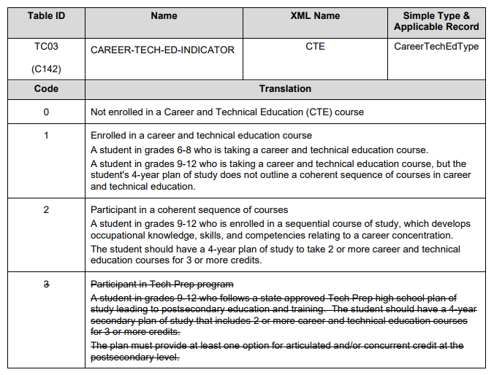
CAREER-TECH-ED-INDICATOR: CODE TABLE
CAREER-TECH-ED-INDICATOR (TC03)
2020-2021
2021-2022
Code 4 - Not CTE
A student who never enrolled or who did not complete any high-school CTE course as defined by 19 TAC Chapter 126 (C), 127 (B) or 130.
Code 5 - CTE Program Participant
A student completing at least one course but not two or more high school CTE courses for two or more credits defined by 19 TAC Chapter 126 (C), 127 (B), or 130 (the student does not have to pass or receive credit).
Code E – CTE Program Explorer
A student completing two or more high school CTE courses for two or more credits defined by 19 TAC Chapter 126 (C), 127 (B) or 130 and not a participant, concentrator or completer (the student does not have to pass or receive credit).
Code 6 – CTE Program Concentrator
A student completing and passing two or more 19 TAC Chapter 126 (C), 127 (B) or 130 CTE courses for at least two credits within the same program of study and not a completer.
Code 7 – CTE Program Completer
A student completing and passing three or more 19 TAC Chapter 126 (C), 127 (B) or 130 CTE courses for four or more credits within a program of study, including one level three or level four course from within the same program of study.
Note:
(1) The values listed are calculated values and not submitted to TEA.
(2) Not all high-school CTE program courses are associated to a Program of Study. Go to this link https://tea.texas.gov/academics/college-career-and-military-prep/career-and-technical-education/approved-cte-programs-study for a complete listing of those Service IDs associated to a Program of Study.

Slide 17
AGENDA
Texas Records Exchange (TREx) Updates
2021-2022 Changes
Financial Aid Application
Legislation
Data Elements
Code Table
CAREER-TECH-ED-INDICATOR (CTE)
Legislation
Data Elements
Code Table
TREx Publication Format Changes

Slide 18
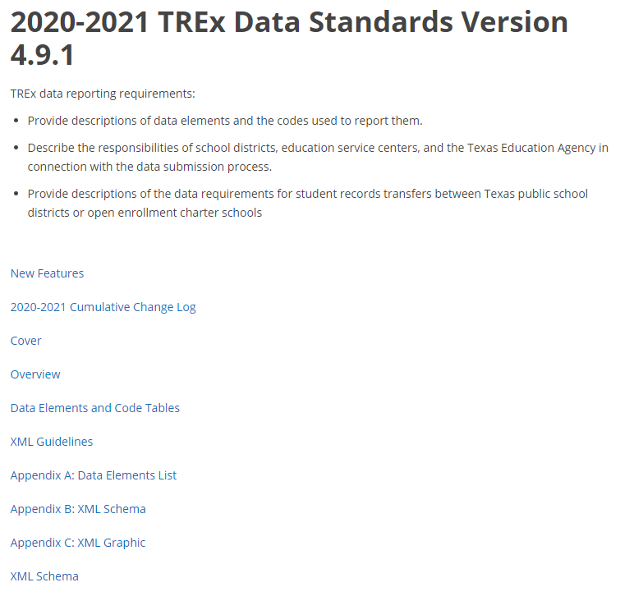
TREx PUBLICATION CURRENT FORMAT

Slide 19
TREx PUBLICATION FORMAT CHANGES

Slide 20
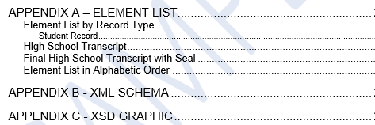
TREx PUBLICATION TABLE OF CONTENTS

Slide 21
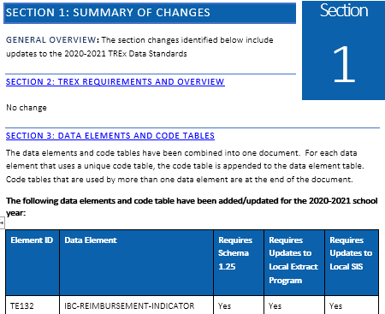
TREx PUBLICATION NEW FEATURES

Slide 22
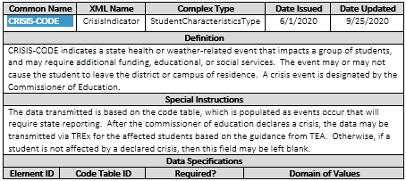
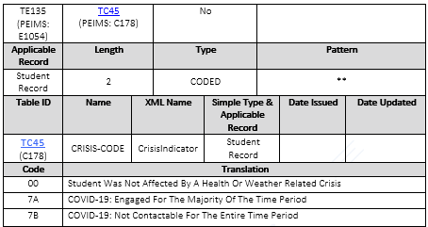
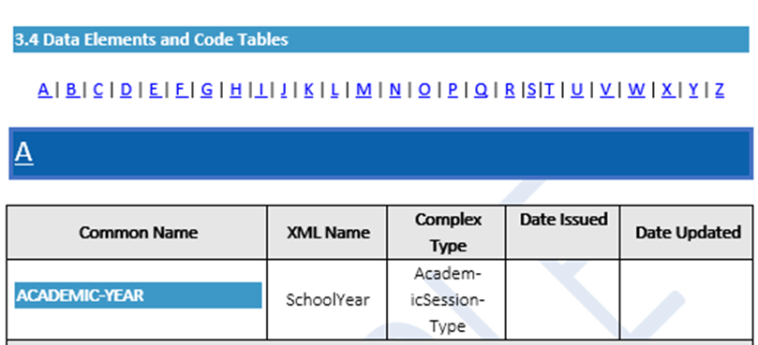
TREx PUBLICATION NEW FEATURES

Slide 23
Questions

