Slide 1
Financial Aid Application Graduation Requirement
Summer 2021

Slide 2
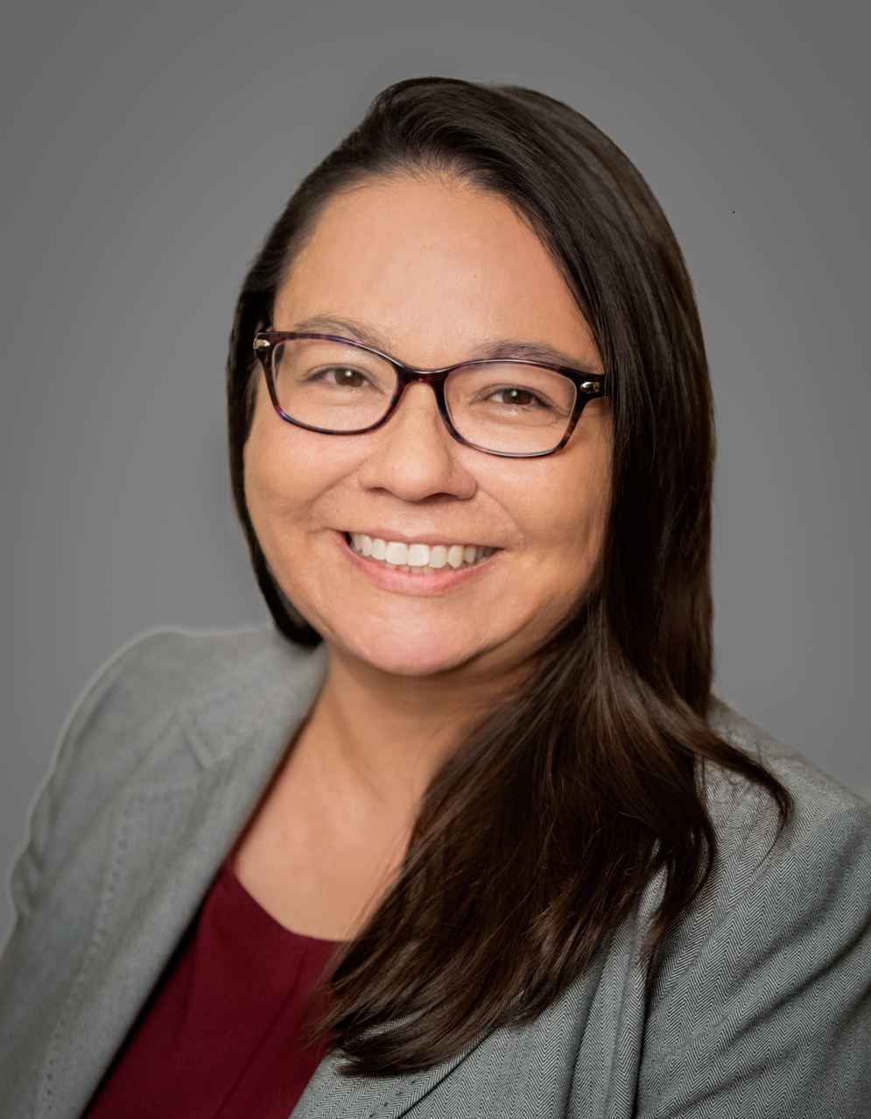
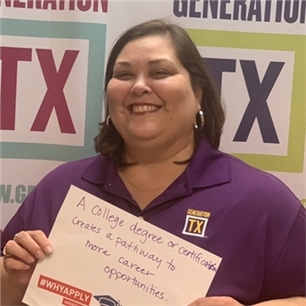
Speaker Introductions
Josie Brunner
Data Strategist
College, Career, and Military Preparation Division
Texas Education Agency
Josie.Brunner@tea.texas.gov
Claudette Jenks
Director, College Access
Texas Higher Education Coordinating Board
Claudette.Jenks@highered.Texas.gov

Slide 3
HB 3 Changes – Financial Aid Application Requirement
New Graduation Requirement
Beginning in 2021-2022, each student must do one of the following in order to graduate:
complete and submit a free application for federal student aid (FAFSA)
complete and submit a Texas application for state financial aid (TASFA)
submit a signed opt-out form
TEA must establish and convene an advisory committee to develop recommendations for adoption of rules including implementation of the new requirement and related timelines.
Key Takeaway
This requirement applies beginning with students enrolled in 12th grade during the 2021-2022 school year.

Slide 4
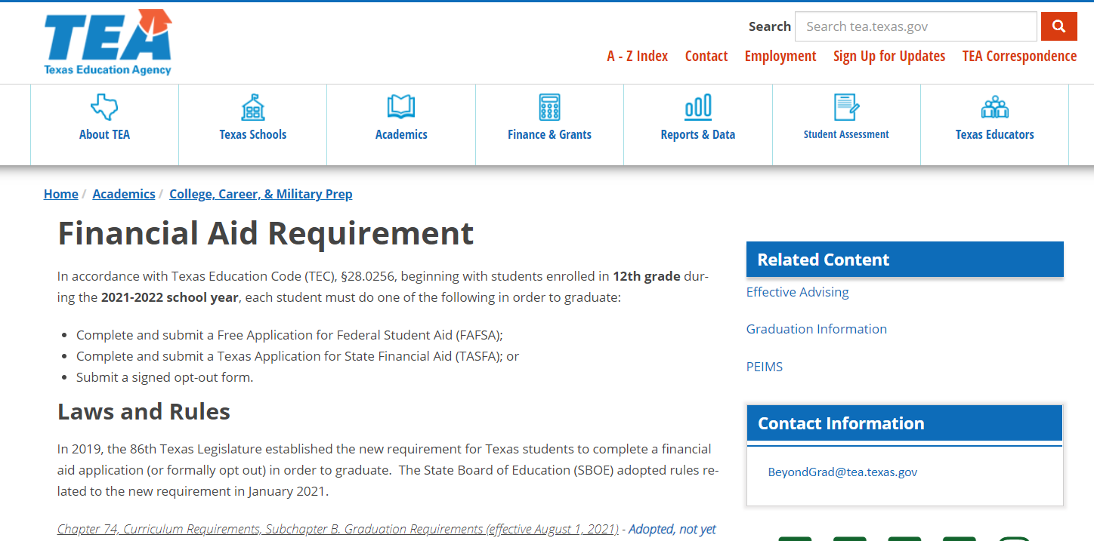
TEA Financial Aid Requirement Website
Laws and Rules
Commissioner’s Rules
SBOE Rules
Opting Out
Reporting
Training and Resources
Additional Guidance
https://tea.texas.gov/academics/college-career-and-military-prep/financial-aid-requirement

Slide 5
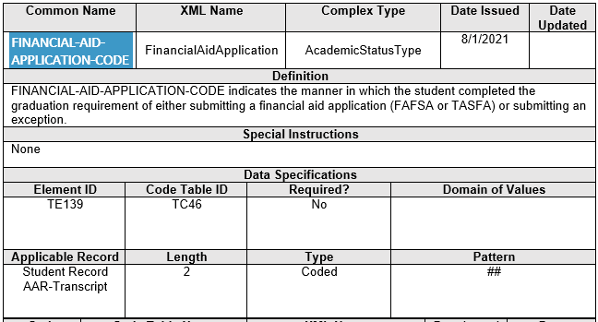
Reporting Requirements – TREx Financial-Aid-Application-Code (TE139)
Beginning in school year 2021-22, new data elements will be entered in the Texas Records Exchange (TREx) System to track students' completion of the graduation requirement for the student record.

Slide 6
Reporting Requirements – TREx Financial-Aid-Application-Code (TC46)
Opt-Out Form
Note: These codes will be the same as the codes used for TSDS PEIMS.

Slide 7
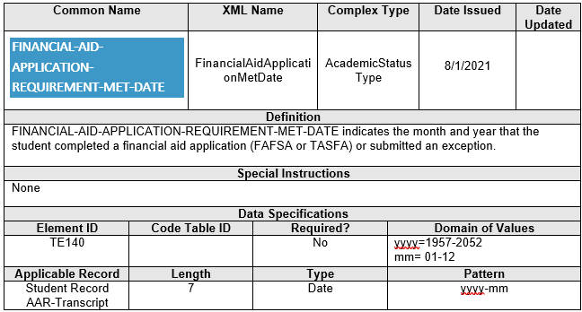
Reporting Requirements – TREx Financial-Aid-Application-Met-Date (TE140)
Note: The FAFSA and TASFA application does not open until October 1 in a school year.

Slide 8
Reporting Requirements - TSDS PEIMS Financial Aid Application Code (E1724)
Beginning in fall of school year 2022-23 for Submission 1, districts will be required to report the financial aid application graduation requirement in TSDS PEIMS for 2021-22 graduates.
Data standards will be published December 2021
FINANCIAL-AID-APPLICATION-CODE indicates the manner in which the student completed the graduation requirement by either completing a financial aid application (FAFSA or TASFA) or submitting an exception.
Note: Districts are not asked what financial aid application form (i.e., the FAFSA or TASFA) was completed.
Financial-Aid-Application-Indicator
01 Financial application form completed
02 Exception filed

Slide 9
Reporting Timeline for 2021-22 Graduates
School Year (SY) 2021-22
School Year 2022-23
Fall 2021
Districts begin entering
TREx data
Spring 2022
Class of 2022 graduates
Fall 2022
TSDS PEIMS reporting for 2022 graduates
FAFSA Opens for New Applications
October 1
FAFSA Closes for New Application
June 30
Last Day for FAFSA Corrections
September 10
FAFSA reports available in ApplyTX Counselor Suite
Late-October
SY 2021-22 FAFSA Data No Longer Available in ApplyTX CS
September 30
TASFA encouraged window
October 1 – Mid-January

Slide 10
Method of proof of completion and submission of FAFSA
FAFSA completion and submission may be confirmed through:
Date represented in the “FAFSA Process date” field in ApplyTexas Counselor Suite FAFSA data; or
Notification from USDE that demonstrates a student has completed and submitted a FAFSA, such as an email confirmation of submission; or
Alternate proof of FAFSA completion that may be provided by a student based on the local policy developed by a district. Some examples may include:
Screenshot of FAFSA submission acknowledgement page
Financial aid award letter from an IHE
Other, as established by local policy

Slide 11
Method of proof of completion and submission of TASFA
School districts must develop a local policy for the method of proof that the student has completed a TASFA. Some examples may include:
Acknowledgement of receipt from an IHE
Copy of signature page
Screenshot of TASFA submission acknowledgement page (from those institutions that offer an electronic form)
Other, as established by local policy
Note: The process for TASFA submission is not standard for all Texas institutions. There is currently no centralized source to verify submission and completion of a TASFA electronically.

Slide 12
APPLYTEXAS
Counselor Suite
The
Updated June 2021

Slide 13
What is the Counselor Suite?
The Counselor Suite is a tool used by high school counselors to track student progress in completing ApplyTexas and FAFSA.
Counselors use the site to:
View a list of students at their school who have started or completed admissions applications
Link to individual student admission application details to review application progress
View a list of students at their school who have started or completed a FAFSA
Create reports on student applications

Slide 14
How does a counselor receive authorization?
ApplyTX team authorizes Education Service Center (ESC) representatives for each TEA region who manage authorizations for high school counselors in their region
***All data is password-protected.***
District completes Memorandum of Understanding with the Texas Higher Education Coordinating Board
District sends counselor names/emails to ESC rep
ESC rep enters counselor data into system
System sends counselor temporary password/instructions
Counselor logs in, signs FERPA* certification, gains access (Step 1 is done once; Steps 2-5 are repeated annually)
Counselor Login: https://admin.applytexas.org
*Family Educational Rights and Privacy Act

Slide 15
Viewing FAFSA Applications

Slide 16
About ApplyTexas FAFSA Information
FAFSA filing status data for Texas students is sent from the Department of Education to the Texas Higher Education Coordinating Board per agreement under the FAFSA Completion Initiative
The Coordinating Board then forwards the student FAFSA filing status data to ApplyTexas to post on the Counselor Suite site.
From late October-June, data is released daily. The first report is usually added to the Counselor Suite by late October and is updated on ApplyTexas every morning from Monday through Friday.
Previous year’s information remains on the Counselor Suite site until the first report of the new year arrives.

Slide 17
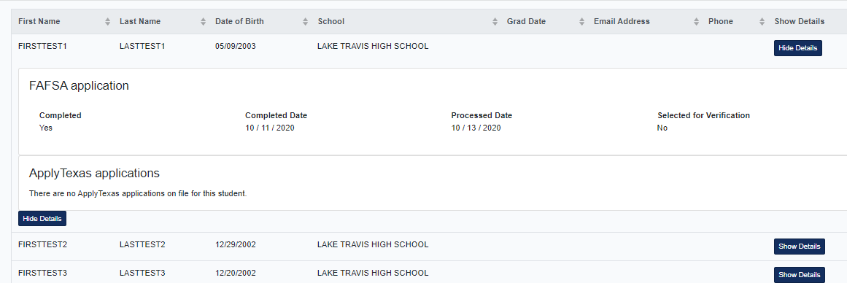
How do I find FAFSA Information?
Clicking on Show Details also displays the progress of the student’s FAFSA filing status: filing status, completion date, process date and selected for verification.

Slide 18
Counselor Suite Reports

Slide 19
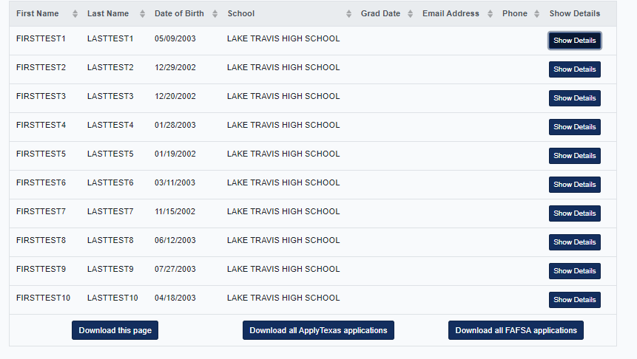
Creating a FAFSA Report
The student listing page of the FAFSA screen may be downloaded using the Download all FASFA applications button.

Slide 20
Creating FAFSA Reports
The status report of FAFSA applications will show the following data:
Student name
Date of birth
HS district
HS name
FAFSA submission date
FAFSA process date
Was student selected for verification
Number of FAFSA applications

Slide 21
Helpful Information
Why aren’t some students showing up on my FAFSA application list?
For students to be shown on the Counselor Suite:
Allow 1 ½ -2 weeks of processing time
The correct high school name must be entered on the FAFSA
Student must use the correct application type
If school name changed within in the last year, student must select the high school listed on the search and select feature of the FAFSA
Student and parent must use FSA ID to sign the FAFSA
Frequently Asked Questions pertaining to ApplyTX Counselor Suite FAFSA Data can be found here: FAQ ApplyTX FAFSA Data.pdf. Please follow the instructions listed at this Federal Student Aid website to make corrections: https://studentaid.gov/apply-for-aid/fafsa/review-and-correct

Slide 22
TASFA Update
Overview House Bill 2140
Establishes the Texas Application for State Financial Aid (TASFA) electronically through the ApplyTexas system
Establishes an advisory committee of financial aid personnel and other stakeholders
Requires Texas Higher Education Board adopt procedures for TASFA and develop recommendations
Update
Development is fully underway for the online TASFA.
The online TASFA launch has been extended from 2022-23 to 2023-24 academic year to align with the recently adopted federal FAFSA simplification changes.
THECB is working on TASFA data collection capability in Counselor Suite

Slide 23
Questions? CASSTeam@tea.Texas.gov

