Slide 1
PEIMS

Slide 2
AGENDA
PEIMS
2020-2021​
English Learner Summer School
Additional Days School Year Program
PEIMS Performance
CTE Updates
2021-2022
Expanded Learning Opportunities
Crisis Codes
Industry Based Certification
Leaver Definition Update
Non-Membership Special Education Student Discipline and Restraint Reporting
CTE Data Element Changes
SERVICE-ID Code Changes
Fund Code Table Changes
Excessive Unexcused Absence Data Element Change
September 1, 2021 Post-Addendum Non-Legislative Updates
2022-2023
Financial Aid Application Early Notice
Timeline​
Technical Resources

Slide 3
AGENDA
PEIMS
2020-2021​
English Learner Summer School
Additional Days School Year Program
PEIMS Performance
CTE Updates
2021-2022
Expanded Learning Opportunities
Crisis Codes
Industry Based Certification
Leaver Definition Update
Non-Membership Special Education Student Discipline and Restraint Reporting
CTE Data Element Changes
SERVICE-ID Code Changes
Fund Code Table Changes
Excessive Unexcused Absence Data Element Change
September 1, 2021 Post-Addendum Non-Legislative Updates
2022-2023
Financial Aid Application Early Notice
Timeline​
Technical Resources

Slide 4
English Learner Summer School
Overview:
TEA is adding back the PRIOR-YEAR-BILINGUAL/ESL-SUMMER-SCHOOL-INDICATOR-CODE (E1708) data element for the 2021-2022 school year.
This will allow an LEA completing the English Learner (EL) summer school program through one of the approved options to report the participation data in the 2021-2022 PEIMS Extended Year submission due to TEA on August 25, 2022.

Slide 5
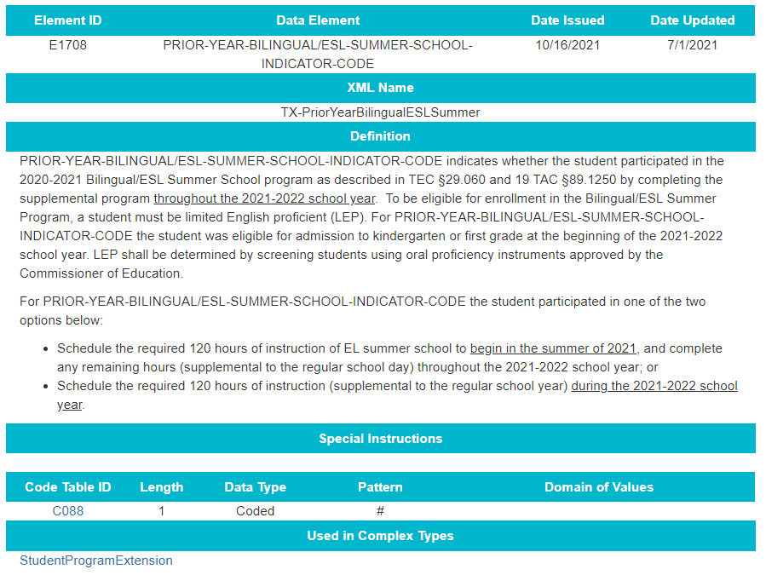
English Learner Summer School: Data Elements

Slide 6
AGENDA
PEIMS
2020-2021​
English Learner Summer School
Additional Days School Year Program
PEIMS Performance
CTE Updates
2021-2022
Expanded Learning Opportunities
Crisis Codes
Industry Based Certification
Leaver Definition Update
Non-Membership Special Education Student Discipline and Restraint Reporting
CTE Data Element Changes
SERVICE-ID Code Changes
Fund Code Table Changes
Excessive Unexcused Absence Data Element Change
September 1, 2021 Post-Addendum Non-Legislative Updates
2022-2023
Financial Aid Application Early Notice
Timeline​
Technical Resources

Slide 7
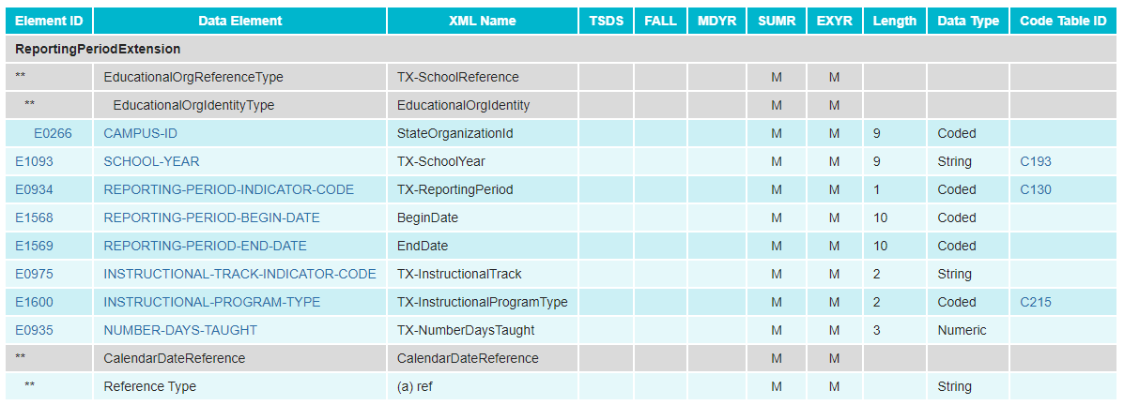
Additional Days School Year Program: Data Elements
CalendarDateExtension complex type
ReportingPeriodExtension complex type

Slide 8
Additional Days School Year Program: Reporting Guidance
CalendarDateExtension complex type​
ReportingPeriodExtension complex type​

Slide 9
Additional Days School Year Program: Data Elements
SchoolExtension complex type
StudentProgramExtension complex type

Slide 10
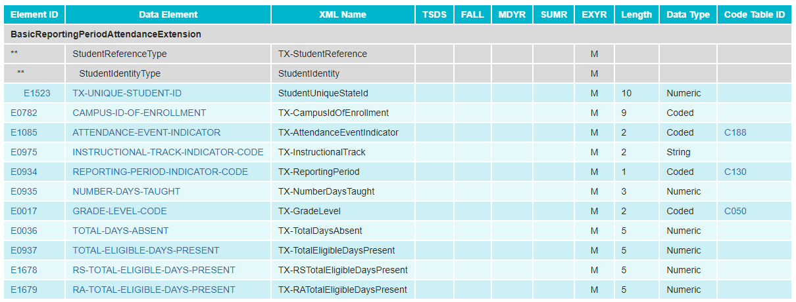
Additional Days School Year Program: Data Elements
BasicReportingPeriodAttendanceExtension complex type

Slide 11
Additional Days School Year Program: Reporting Guidance
BasicReportingPeriodAttendanceExtension complex type​
​

Slide 12
Additional Days School Year Program: Reporting Guidance
BasicReportingPeriodAttendanceExtension complex type (continued​)
​

Slide 13
Additional Days School Year Program: Reporting Guidance
BasicReportingPeriodAttendanceExtension complex type (continued​) ​
​

Slide 14
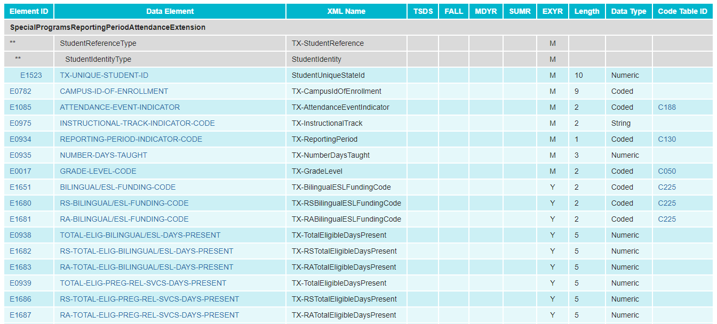
Additional Days School Year Program: Data Elements
SpecialProgramsReportingPeriodAttedanceExtension complex type

Slide 15
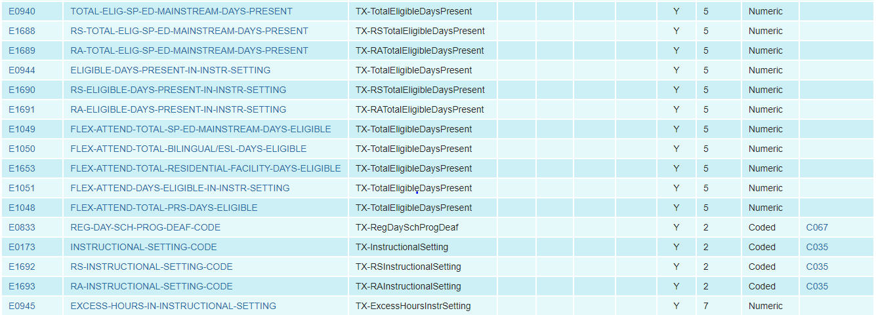
Additional Days School Year Program: Data Elements
SpecialProgramsReportingPeriodAttedanceExtension complex type (continued​)

Slide 16
Additional Days School Year Program: Reporting Guidance
SpecialProgramsReportingPeriodAttendanceExtension complex type​
​

Slide 17
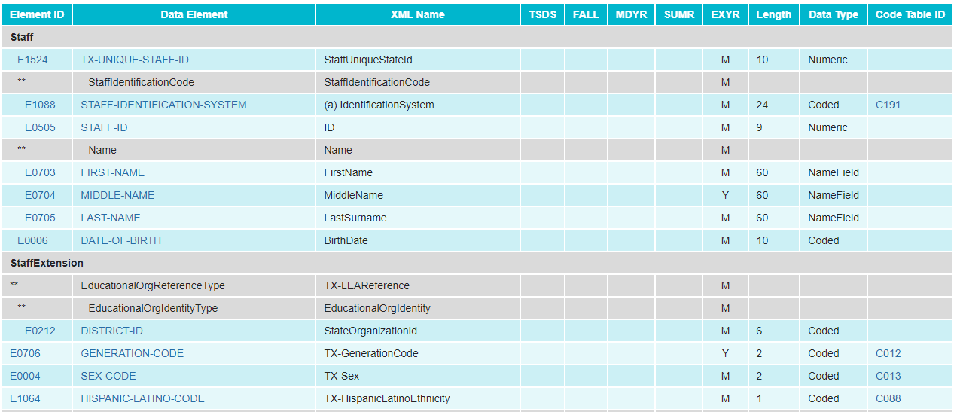
Additional Days School Year Program: Data Elements
StaffExtension complex type

Slide 18
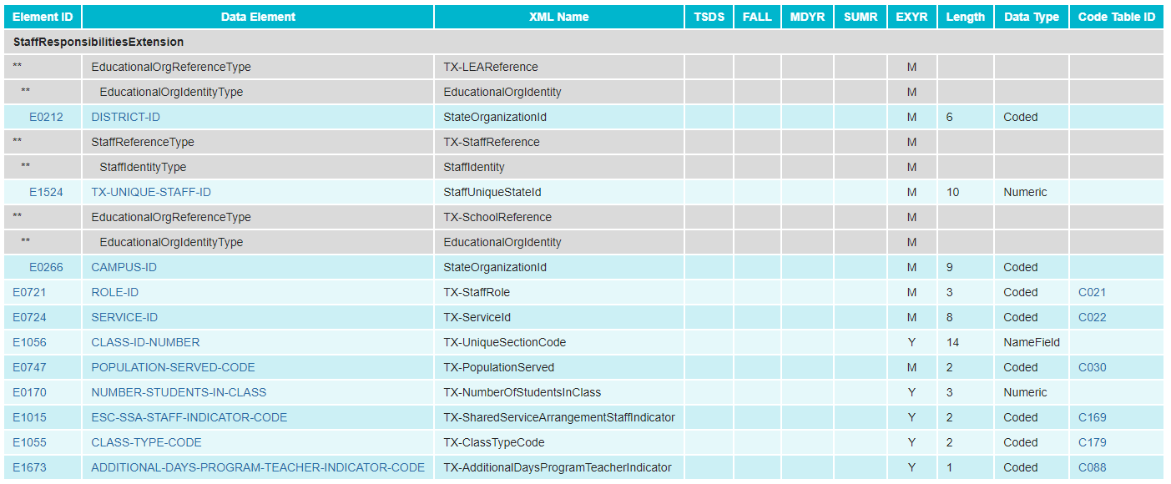
Additional Days School Year Program: Data Elements
StaffResponsibilitiesExtension complex type
​

Slide 19
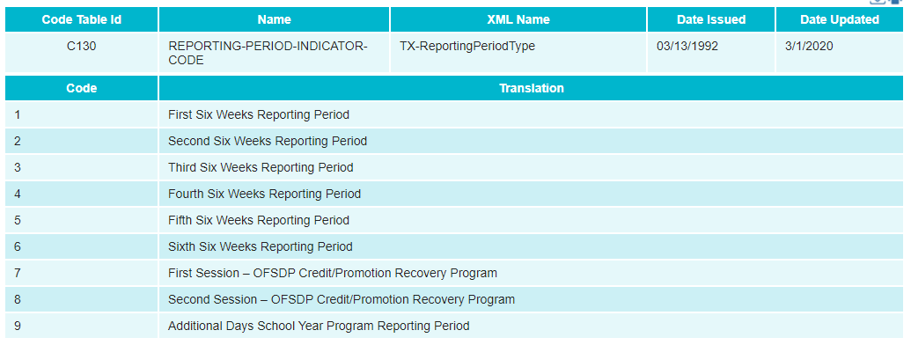
Additional Days School Year Program: Code Tables
C130 REPORTING-PERIOD-INDICATOR-CODE​
C215 INSTRUCTIONAL-PROGRAM-TYPE

Slide 20
Additional Days School Year Program: Reports
Existing Reports added to PEIMS Extended Year submission:
PDM4-111-001 Individual Staff Profiles
PDM4-116-003 Campus Calendar Minutes Detail
PDM4-120-003 Student Indicator Report by Grade

Slide 21
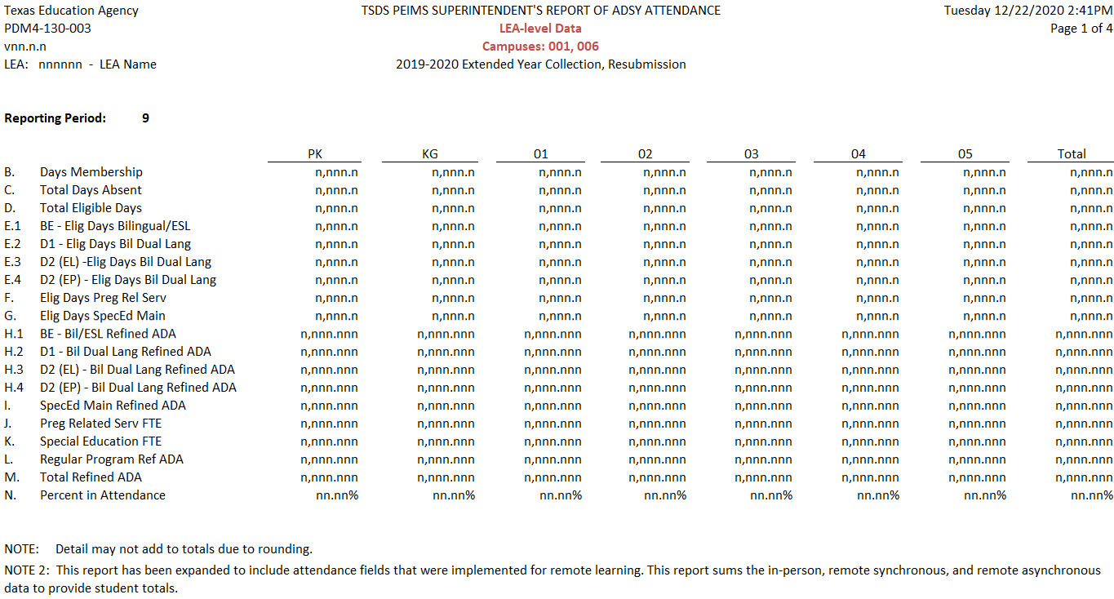
Additional Days School Year Program: Reports
New Report added to PEIMS Extended Year submission: ​
​
PDM4-130-003 Superintendent’s Report of ADSY Attendance

Slide 22
AGENDA
PEIMS
2020-2021​
English Learner Summer School
Additional Days School Year Program
PEIMS Performance
CTE Updates
2021-2022
Expanded Learning Opportunities
Crisis Codes
Industry Based Certification
Leaver Definition Update
Non-Membership Special Education Student Discipline and Restraint Reporting
CTE Data Element Changes
SERVICE-ID Code Changes
Fund Code Table Changes
Excessive Unexcused Absence Data Element Change
September 1, 2021 Post-Addendum Non-Legislative Updates
2022-2023
Financial Aid Application Early Notice
Timeline​
Technical Resources

Slide 23
PROCESS SUMMARY – PEIMS Summer 1
TSDS
Collection
Promotion
Validation
Reports
2020
Total numbers processed
8,564 | 4,834 | 4,827 | 164,334
7.1 | 4 | 4 | 108
Avg numbers processed per district
Max numbers processed
58 | 14 | 15 | 885
Total hours processed
16,175 | 1,712 | 1,436 | 21,461
1.9 | 0.24 (14.4 minutes) | 0.19 (11.4 minutes) | 18.14
Avg hours processed per district
2021
Total numbers processed
7,661 | 4,311 | 4,304 | 189,562
6.3 | 3.6 | 3.6 | 159
Avg numbers processed per district
Max numbers processed
43 | 12 | 15 | 797
Total hours processed
12,745 | 159 | 156 | 1,818
1.7 | 0.024 (1.44 minutes) | 0.022 (1.32 minutes) | 1.53
Avg hours processed per district

Slide 24
AGENDA
PEIMS
2020-2021​
English Learner Summer School
Additional Days School Year Program
PEIMS Performance
CTE Updates
2021-2022
Expanded Learning Opportunities
Crisis Codes
Industry Based Certification
Leaver Definition Update
Non-Membership Special Education Student Discipline and Restraint Reporting
CTE Data Element Changes
SERVICE-ID Code Changes
Fund Code Table Changes
Excessive Unexcused Absence Data Element Change
September 1, 2021 Post-Addendum Non-Legislative Updates
2022-2023
Financial Aid Application Early Notice
Timeline​
Technical Resources

Slide 25
CTE Updates
During the CTE calculation process completed after PEIMS Summer 1st submission, an issue was identified where some students were coded with a "CTE Indicator 4 – Not CTE" that should have been coded a "5 – CTE Participant."
If a student had completed one course for 2 or more credits, the process assigned the student a CTE indicator of 4. The student should have been assigned a CTE indicator of 5.
The CTE Calculation process will be corrected for the PEIMS Summer Resubmission using an updated definition.
TEA will be reaching out to ESCs who have LEAs with students who met this condition.

Slide 26
CTE Updates
Previous definition:
5 CTE Participant:
A student completing one or more courses for less than two credits, defined by 19 TAC 126 (C), Chapter 127 (B) or 130 (the student does not have to pass or receive credit).
Updated definition:
5 – CTE Participant
A student completing EITHER:
Only one CTE course for any number of credits
OR
More than one course for less than two credits
where a CTE course is defined by 19 TAC 126 (C), Chapter 127 (B) or 130 (the student does not have to pass or receive credit).

Slide 27
AGENDA
PEIMS
2020-2021​
English Learner Summer School
Additional Days School Year Program
PEIMS Performance
CTE Updates
2021-2022
Expanded Learning Opportunities
Crisis Codes
Industry Based Certification
Leaver Definition Update
Non-Membership Special Education Student Discipline and Restraint Reporting
CTE Data Element Changes
SERVICE-ID Code Changes
Fund Code Table Changes
Excessive Unexcused Absence Data Element Change
September 1, 2021 Post-Addendum Non-Legislative Updates
2022-2023
Financial Aid Application Early Notice
Timeline​
Technical Resources

Slide 28
Expanded Learning Opportunities
Background:
Senate Bill (SB) 1404, passed in the 85th legislative session, requires that each school district and open-enrollment charter school report through PEIMS the following:
Availability of expanded learning opportunities (ELOs) as descripted in TEC §33.252.
Number of students participating in each of the categories of expanded learning opportunities listed under TEC §33.252(b).
ELOs were reported beginning in the 2019-2020 school year.
Additional data is needed to meet the requirements of SB 1404.

Slide 29
Expanded Learning Opportunities: Data Elements
For the 2021-2022 school year, the following new elements were ADDED to the new sub-complex type TX-SchoolELOActivity:

Slide 30
Expanded Learning Opportunities: Code Tables
2021-2022 ELO-TYPE (C218)

Slide 31
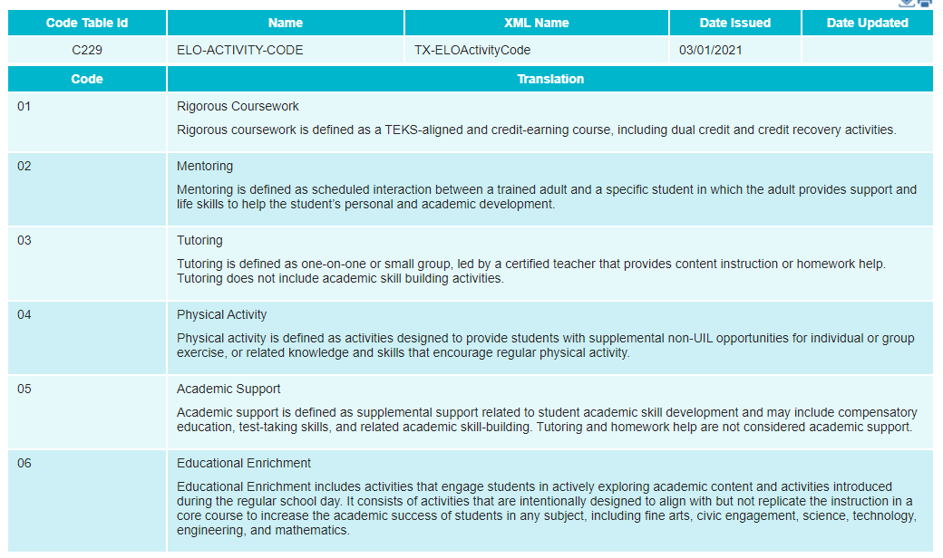
Expanded Learning Opportunities: Code Tables
New: ELO-ACTIVITY-CODE (C229)

Slide 32
Expanded Learning Opportunities: Reporting Guidance

Slide 33
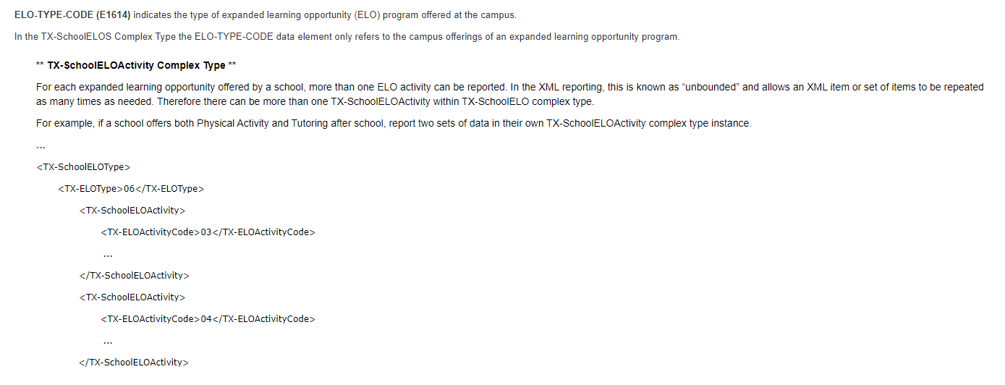
Expanded Learning Opportunities: Reporting Guidance

Slide 34
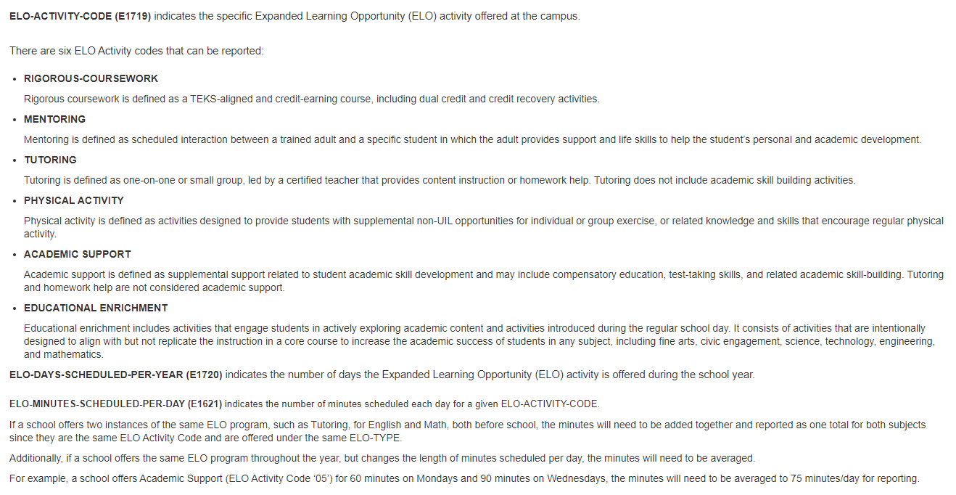
Expanded Learning Opportunities: Reporting Guidance

Slide 35
Expanded Learning Opportunities: Rules
2021-2022 Deleted Rule:
2021-2022 New Rule:

Slide 36
Expanded Learning Opportunities: Rules
2021-2022 Revised Rules:

Slide 37
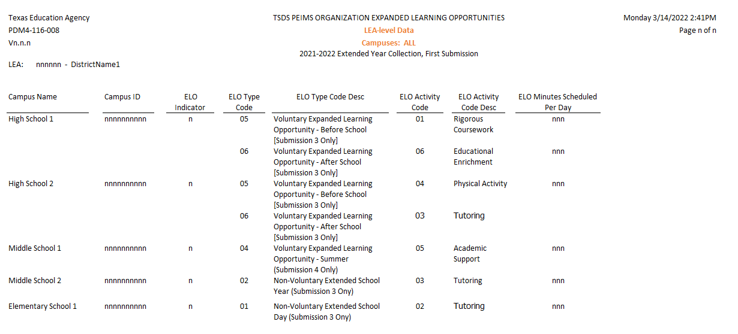
Expanded Learning Opportunities: Reports
TSDS PEIMS Reports Updates:
PDM3-116-008 – Organization Expanded Learning Opportunities
PDM4-116-008 – Organization Expanded Learning Opportunities

Slide 38
AGENDA
PEIMS
2020-2021​
English Learner Summer School
Additional Days School Year Program
PEIMS Performance
CTE Updates
2021-2022
Expanded Learning Opportunities
Crisis Codes
Industry Based Certification
Leaver Definition Update
Non-Membership Special Education Student Discipline and Restraint Reporting
CTE Data Element Changes
SERVICE-ID Code Changes
Fund Code Table Changes
Excessive Unexcused Absence Data Element Change
September 1, 2021 Post-Addendum Non-Legislative Updates
2022-2023
Financial Aid Application Early Notice
Timeline​
Technical Resources

Slide 39
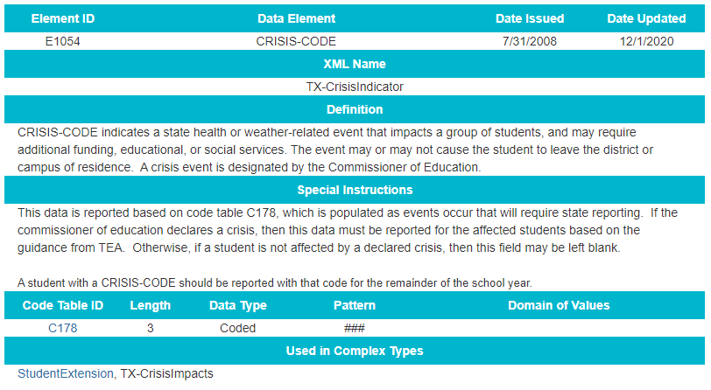
Crisis Codes: Data Elements
Expanded the length of CRISIS-CODE element (E1054) from two to three in the Texas Education Data Standards.

Slide 40
Crisis Codes: Reports
Updating the following TSDS PEIMS reports:
PEIMS Fall Reports:
PDM1-120-011 – Student Crisis Code Roster
Expanded crisis code column to allow up to 3 characters.
PDM1-123-001 – STAAR Precoding Report
Expanded crisis code column to allow up to 3 characters.
PEIMS Extended Year Reports:
PDM4-120-002 – Student Crisis Code Roster
Expanded crisis code column to allow up to 3 characters.
PDM4-130-002 – Flexible Attendance Data
Expanded crisis code column to allow up to 3 characters.

Slide 41
AGENDA
PEIMS
2020-2021​
English Learner Summer School
Additional Days School Year Program
PEIMS Performance
CTE Updates
2021-2022
Expanded Learning Opportunities
Crisis Codes
Industry Based Certification
Leaver Definition Update
Non-Membership Special Education Student Discipline and Restraint Reporting
CTE Data Element Changes
SERVICE-ID Code Changes
Fund Code Table Changes
Excessive Unexcused Absence Data Element Change
September 1, 2021 Post-Addendum Non-Legislative Updates
2022-2023
Financial Aid Application Early Notice
Timeline​
Technical Resources

Slide 42
Industry Based Certification: Data Elements
1. Modified TX-IndustryCertifications sub-complex type reported with StudentExtension complex type in the PEIMS Fall and Summer Submissions.
Changed IBC-EXAM-FEE-AMOUNT from Conditionally Mandatory (C) to Optional (Y).

Slide 43
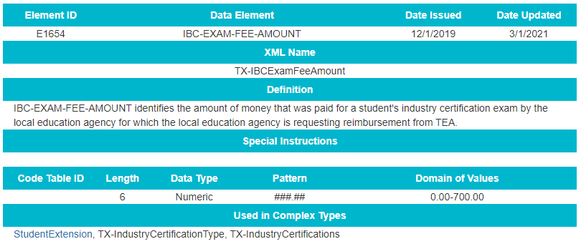
Industry Based Certification: Data Elements
2. Modified Data Element IBC-EXAM-FEE-AMOUNT (E1654) definition, length, pattern, and domain of values.
The adjustments to length, pattern, and domain of values allow for the reporting of fees with cents.

Slide 44
Industry Based Certifications: Reporting Guidance
Updated Data Element reporting guidance

Slide 45
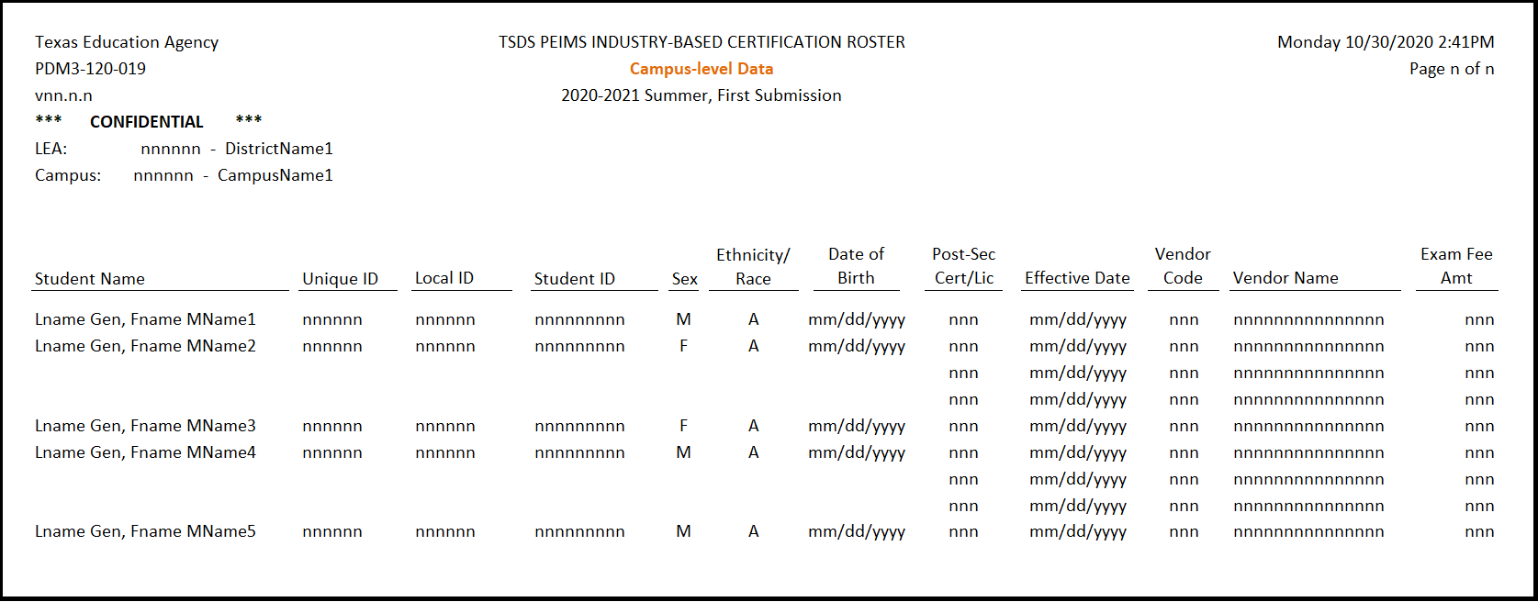
Industry Based Certification: Reports
Updating the following TSDS PEIMS report:
PEIMS Fall Reports:
PDM1-120-021 – Industry Based Certification Roster
Allow Exam Fee column to display 6 characters in the numerical format, “nnn.nn”.
PEIMS Summer Reports:
PDM3-120-019 – Industry Based Certification Roster

Slide 46
Industry Based Certification: Code Table Changes
Deleted Codes From the Following Code Tables:
C214 – INDUSTRY-CERTIFICATION-LICENSURE-CODE
Code 832 – Google Cloud Certified Professional – G Suite
C226 – VENDOR-CODE
Code 460 - ProctorU

Slide 47
AGENDA
PEIMS
2020-2021​
English Learner Summer School
Additional Days School Year Program
PEIMS Performance
CTE Updates
2021-2022
Expanded Learning Opportunities
Crisis Codes
Industry Based Certification
Leaver Definition Update
Non-Membership Special Education Student Discipline and Restraint Reporting
CTE Data Element Changes
SERVICE-ID Code Changes
Fund Code Table Changes
Excessive Unexcused Absence Data Element Change
September 1, 2021 Post-Addendum Non-Legislative Updates
2022-2023
Financial Aid Application Early Notice
Timeline​
Technical Resources

Slide 48
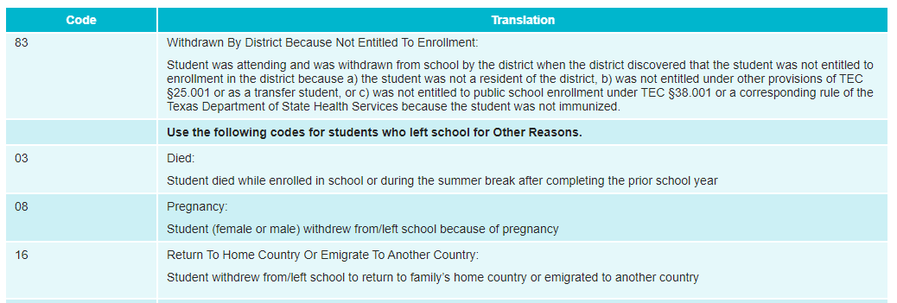
Leaver Definition Update: Code Tables
The Research and Analysis Division requested a modification to the wording on LEAVER-REASON-CODE 16:
2021-2022 LEAVER-REASON-CODE (C162)

Slide 49
AGENDA
PEIMS
2020-2021​
English Learner Summer School
Additional Days School Year Program
PEIMS Performance
CTE Updates
2021-2022
Expanded Learning Opportunities
Crisis Codes
Industry Based Certification
Leaver Definition Update
Non-Membership Special Education Student Discipline and Restraint Reporting
CTE Data Element Changes
SERVICE-ID Code Changes
Fund Code Table Changes
Excessive Unexcused Absence Data Element Change
September 1, 2021 Post-Addendum Non-Legislative Updates
2022-2023
Financial Aid Application Early Notice
Timeline​
Technical Resources

Slide 50
Non-Membership SPED Discipline and Restraint
Overview:
TEA is adding NON-MEMBERSHIP-DISCIPLINE-RESTRAINT-INDICATOR-CODE (E1725) to the DisciplineActionExtension and RestraintEventExtension collected in the PEIMS Summer submission. The new indicator will enable an LEA to report any discipline and restraint information on special education students who are enrolled, not in membership (ADA-ELIGIBILITY-CODE “0”).

Slide 51
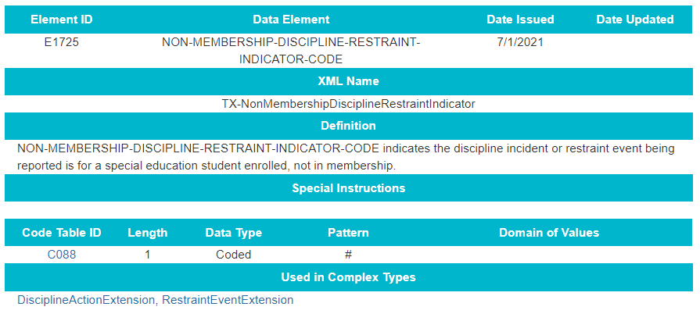
Non-Membership SPED Discipline and Restraint: Data Elements
E1725 – NON-MEMBERSHIP-DISCIPLINE-RESTRAINT-INDICATOR-CODE
2021-2022 New Data Element
Notes:
Added to CR Presentation

Slide 52
Non-Membership SPED Discipline and Restraint: Reporting Guidance
Update to DisciplineActionExtension:
Notes:
Added to CR Presentation

Slide 53
Non-Membership SPED Discipline and Restraint: Reporting Guidance
Update to RestraintEventExtension:
Notes:
Added to CR Presentation

Slide 54
Non-Membership SPED Discipline and Restraint: Reporting Guidance
Update to StudentExtension:
Notes:
Added to CR Presentation

Slide 55
Non-Membership SPED Discipline and Restraint: Reporting Guidance
Update to StudentSpecialEdProgramAssociationExtension:
Notes:
Added to CR Presentation

Slide 56
Non-Membership SPED Discipline and Restraint: Reporting Guidance
Update to StudentSchoolAssociationExtension:
Notes:
Added to CR Presentation

Slide 57
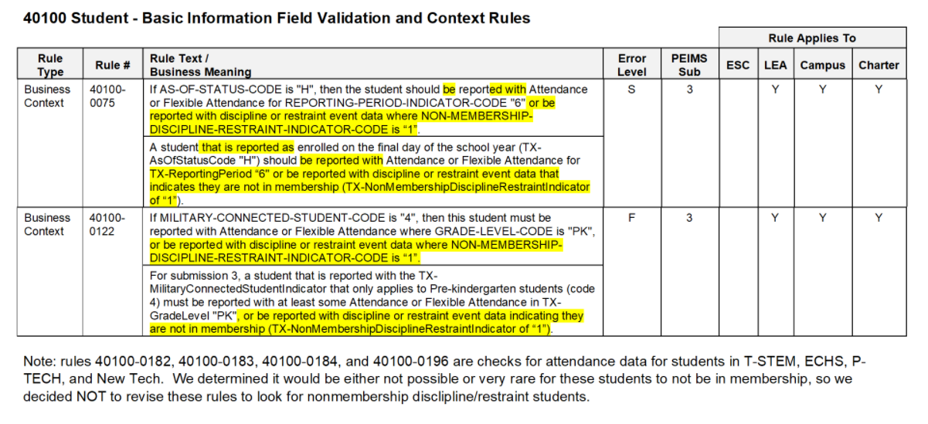
Non-Membership SPED Discipline and Restraint: Rules
2021-2022 Business Context Rule Changes
Notes:
Added to CR Presentation

Slide 58
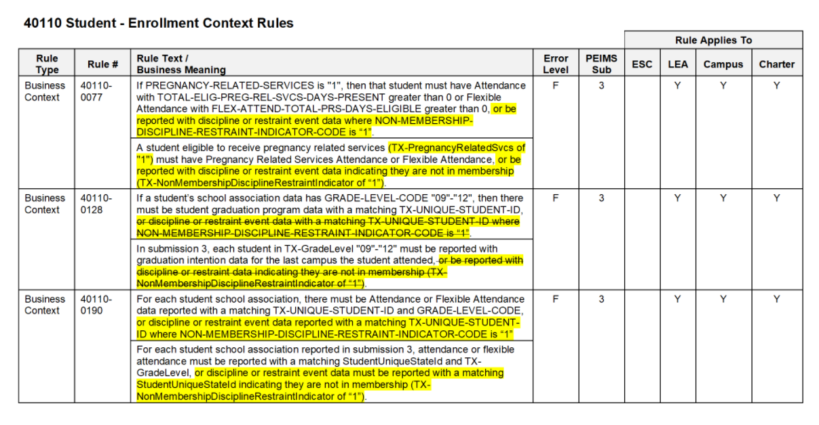
Non-Membership SPED Discipline and Restraint: Rules
2021-2022 Business Context Rule Changes
Notes:
Added to CR Presentation

Slide 59
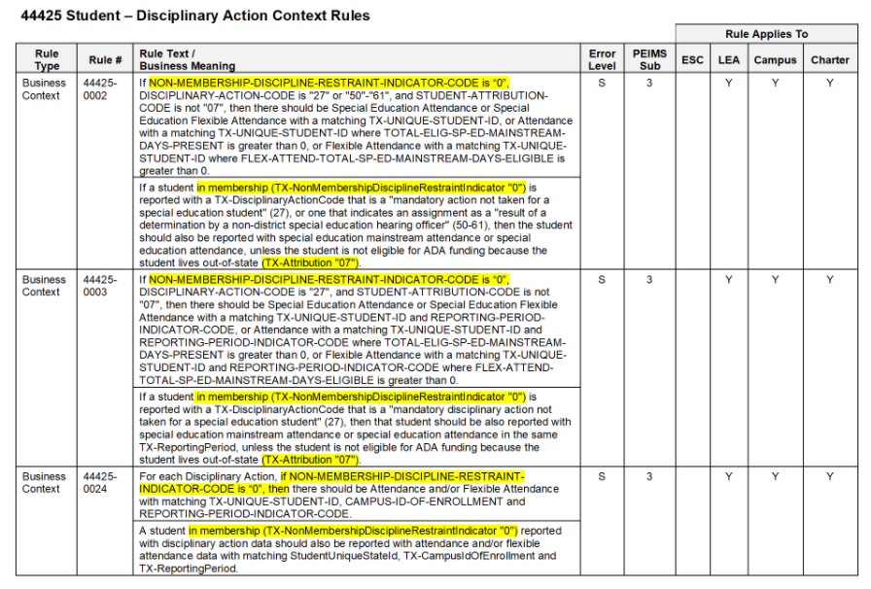
Non-Membership SPED Discipline and Restraint: Rules
2021-2022 Business Context Rule Changes
Notes:
Added to CR Presentation

Slide 60
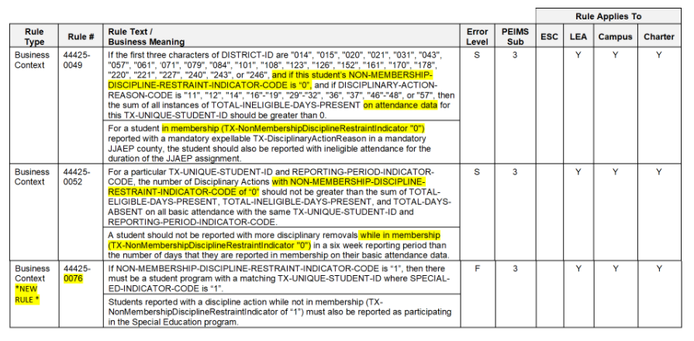
Non-Membership SPED Discipline and Restraint: Rules
2021-2022 Business Context Rule Updates and New Rule
Notes:
Added to CR Presentation

Slide 61
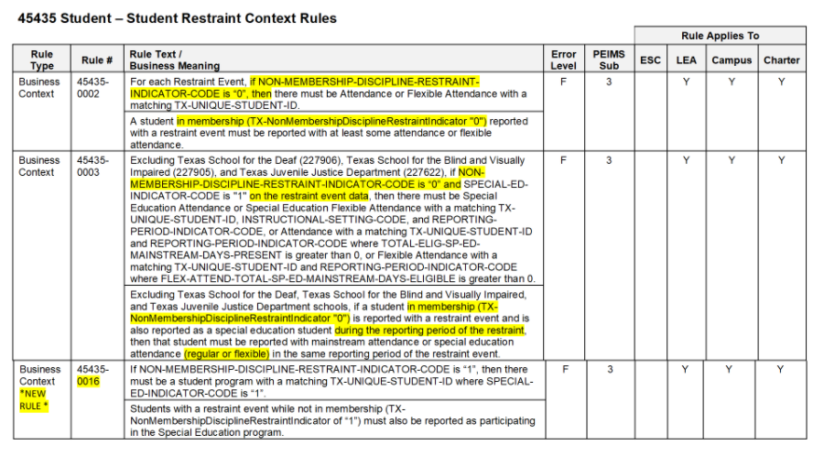
Non-Membership SPED Discipline and Restraint: Rules
2021-2022 Business Context Rule Updates and New Rule
Notes:
Added to CR Presentation

Slide 62
AGENDA
PEIMS
2020-2021​
English Learner Summer School
Additional Days School Year Program
PEIMS Performance
CTE Updates
2021-2022
Expanded Learning Opportunities
Crisis Codes
Industry Based Certification
Leaver Definition Update
Non-Membership Special Education Student Discipline and Restraint Reporting
CTE Data Element Changes
SERVICE-ID Code Changes
Fund Code Table Changes
Excessive Unexcused Absence Data Element Change
September 1, 2021 Post-Addendum Non-Legislative Updates
2022-2023
Financial Aid Application Early Notice
Timeline​
Technical Resources

Slide 63
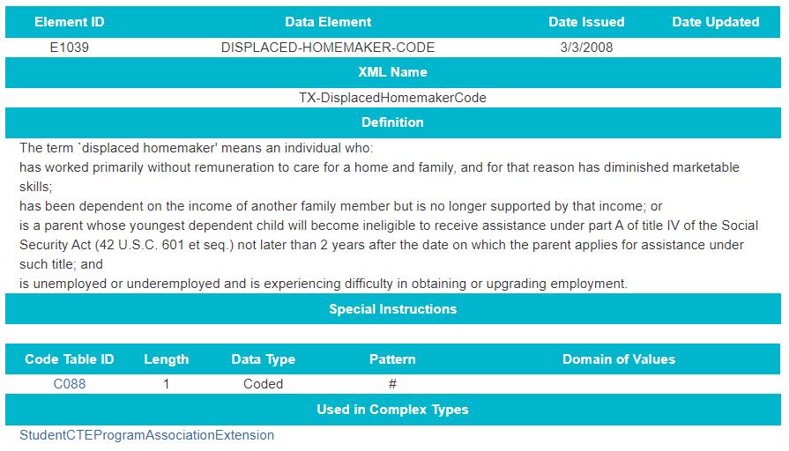
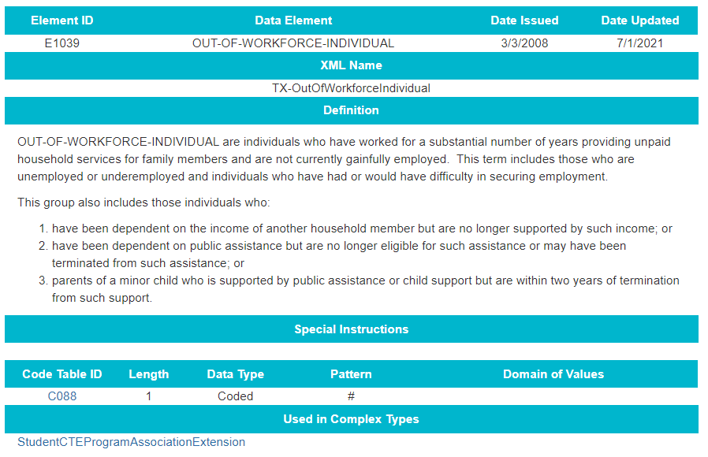
CTE Data Element Changes
E1039 DISPLACED-HOMEMAKER-CODE change to OUT-OF-WORKFORCE-INDIVIDUAL.

Slide 64
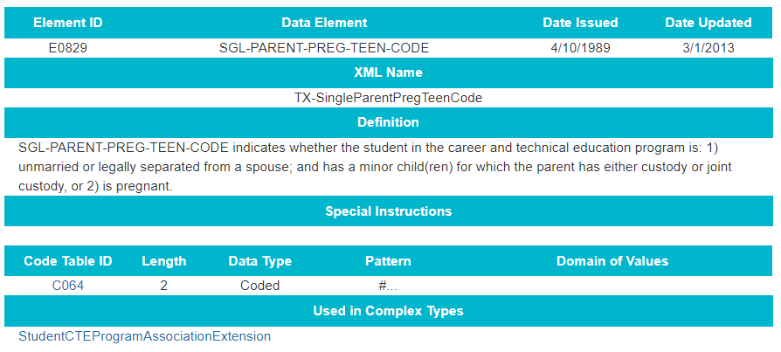
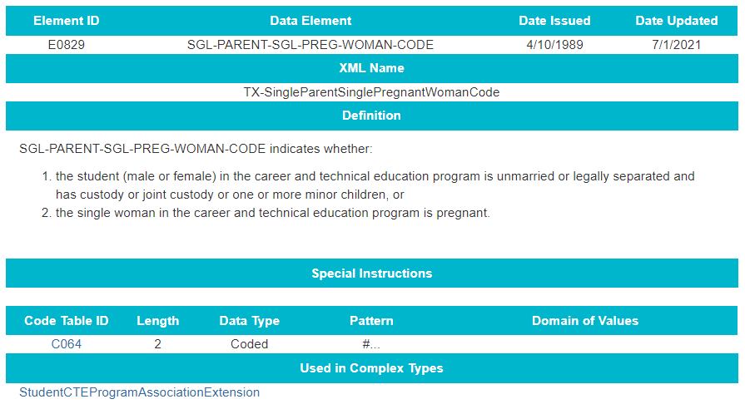
CTE Data Element Changes
E0829 SGL-PARENT-PREG-TEEN-CODE change to SGL-PARENT-SGL-PREG-WOMAN-CODE.

Slide 65
AGENDA
PEIMS
2020-2021​
English Learner Summer School
Additional Days School Year Program
PEIMS Performance
CTE Updates
2021-2022
Expanded Learning Opportunities
Crisis Codes
Industry Based Certification
Leaver Definition Update
Non-Membership Special Education Student Discipline and Restraint Reporting
CTE Data Element Changes
SERVICE-ID Code Changes
Fund Code Table Changes
Excessive Unexcused Absence Data Element Change
September 1, 2021 Post-Addendum Non-Legislative Updates
2022-2023
Financial Aid Application Early Notice
Timeline​
Technical Resources

Slide 66
SERVICE-ID Code Table Changes
Code Table Updates:
SERVICE-ID C022 Deletions
SERVICE-ID | Course | SERVICE-ID | Course
I3100100 | IB Mathemathical Studies Standard Level | I3100200 | IB Mathematics Standard Level
I3100300 | IB Mathematics Higher Level | I3100400 | IB Further Mathematics Higher Level
02810000 | Reading, Grade 6 | 03273440 | Reading, Grade 7
03273450 | Reading, Grade 8 | 02800000 | English Language Arts, Grade 6
03200540 | English Language Arts, Grade 7 | 03200550 | English Language Arts, Grade 8
03210520 | Spanish Language Arts, Grade 6
02561005 | Spanish Language Arts, Kindergarten | 02561010 | Spanish Language Arts, Grade 1
02561020 | Spanish Language Arts, Grade 2 | 02561030 | Spanish Language Arts, Grade 3
02561040 | Spanish Language Arts, Grade 4 | 02561050 | Spanish Language Arts, Grade 5

Slide 67
SERVICE-ID Code Table Changes
Code Table Updates:
SERVICE-ID C022 Deletions
SERVICE-ID | Course | SERVICE-ID | Course
02620001 | Reading, Kindergarten | 02620010 | Reading, Grade 1
02620020 | Reading, Grade 2 | 02620030 | Reading, Grade 3
02620040 | Reading, Grade 4 | 02620050 | Reading, Grade 5
02630001 | English Language Arts, Kindergarten | 02630010 | English Language Arts, Grade 1
02630020 | English Language Arts, Grade 2 | 02630030 | English Language Arts, Grade 3
02630040 | English Language Arts, Grade 4 | 02630050 | English Language Arts, Grade 5

Slide 68
SERVICE-ID Code Table Changes
Code Table Updates:
SERVICE-ID C022 Additions
SERVICE-ID | Course | SERVICE-ID | Course
N1300272 | Geographic Information Systems (GIS) for Agriculture | N1302125 | Medical Intervention Evaluation and Research
N1303425 | Practicum in Entrepreneurship | N1302120 | Allied Health Therapeutic Services
N1302121 | Clinical Ethics | N1302122 | Dental Anatomy and Physiology
N1302123 | Imaging Technology I | N1302124 | Kinesiology II
N1302126 | Optical Technician | N1300996 | Practicum in Digital Audio Technology
N1302127 | Pharmacy I | N1302128 | Physical Therapy I
N1302129 | Science of Nursing | N1302543 | Social and Community Services
N1302275 | Practicum in Event and Meeting Planning | N1303690 | Programmable Logic Controller II
N1170195 | Dance Appreciation | N1170196 | Instrument Repair Technician
N1170197 | Piano Technician I | N1170198 | Piano Technician II

Slide 69
SERVICE-ID Code Table Changes
Code Table Updates:
SERVICE-ID C022 Additions
SERVICE-ID | Course | SERVICE-ID | Course
N1170199 | Piano Technician III | N1170200 | Piano Technician IV
02625001 | English Language Arts and Reading, Kindergarten | 02625010 | English Language Arts and Reading, Grade 1
02625020 | English Language Arts and Reading, Grade 2 | 02625030 | English Language Arts and Reading, Grade 3
02625040 | English Language Arts and Reading, Grade 4 | 02625050 | English Language Arts and Reading, Grade 5
02562005 | Spanish Language Arts and Reading, Kindergarten | 02562010 | Spanish Language Arts and Reading, Grade 1
02562020 | Spanish Language Arts and Reading, Grade 2 | 02562030 | Spanish Language Arts and Reading, Grade 3
02562040 | Spanish Language Arts and Reading, Grade 4 | 02562050 | Spanish Language Arts and Reading, Grade 5
03210525 | Spanish Language Arts and Reading, Grade 6

Slide 70
AGENDA
PEIMS
2020-2021​
English Learner Summer School
Additional Days School Year Program
PEIMS Performance
CTE Updates
2021-2022
Expanded Learning Opportunities
Crisis Codes
Industry Based Certification
Leaver Definition Update
Non-Membership Special Education Student Discipline and Restraint Reporting
CTE Data Element Changes
SERVICE-ID Code Changes
Fund Code Table Changes
Excessive Unexcused Absence Data Element Change
September 1, 2021 Post-Addendum Non-Legislative Updates
2022-2023
Financial Aid Application Early Notice
Timeline​
Technical Resources

Slide 71
FUND-CODE Table Changes
Code Table Updates:
FUND-CODE C145 Additions

Slide 72
AGENDA
PEIMS
2020-2021​
English Learner Summer School
Additional Days School Year Program
PEIMS Performance
CTE Updates
2021-2022
Expanded Learning Opportunities
Crisis Codes
Industry Based Certification
Leaver Definition Update
Non-Membership Special Education Student Discipline and Restraint Reporting
CTE Data Element Changes
SERVICE-ID Code Changes
Fund Code Table Changes
Excessive Unexcused Absence Data Element Change
September 1, 2021 Post-Addendum Non-Legislative Updates
2022-2023
Financial Aid Application Early Notice
Timeline​
Technical Resources

Slide 73
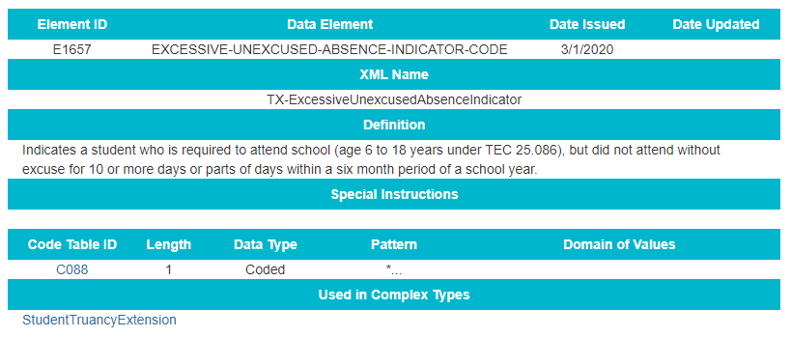
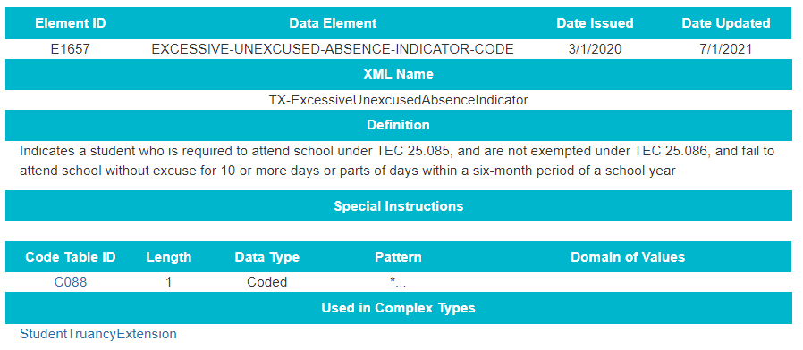
Excessive Unexcused Absence Data Element Change
E1657 EXCESSIVE-UNEXCUSED-ABSENCE-INDICATOR-CODE

Slide 74
AGENDA
PEIMS
2020-2021​
English Learner Summer School
Additional Days School Year Program
PEIMS Performance
CTE Updates
2021-2022
Expanded Learning Opportunities
Crisis Codes
Industry Based Certification
Leaver Definition Update
Non-Membership Special Education Student Discipline and Restraint Reporting
CTE Data Element Changes
SERVICE-ID Code Changes
Fund Code Table Changes
Excessive Unexcused Absence Data Element Change
September 1, 2021 Post-Addendum Non-Legislative Updates
2022-2023
Financial Aid Application Early Notice
Timeline​
Technical Resources

Slide 75
Post-Addendum Non-Legislative Updates
On September 1, 2021, TEA will release a Post-Addendum to the Texas Education Data Standards. In addition to legislative changes there are two non-legislative changes that will be reviewed by ITF and PCPEI in August 2021.
High School Career and Technical Education (CTE) courses completed in the summer months will be reported in the PEIMS Extended Year submission beginning with the 2021-2022 school year.

Slide 76
Post-Addendum Non-Legislative Updates
Special education students who have a RESIDENTIAL-FACILITY-INDICATOR (E1629) of “1”, and ADA-ELIGIBILITY-CODE “0” (enrolled, not in membership) will be reported in the PEIMS Summer submission. The RF Tracker core collection will use the data reported for these students.
Guidance changes will be made in the StudentExtension, StudentProgramExtension, and StudentSpecialEdProgramAssociationExtension complex types.

Slide 77
AGENDA
PEIMS
2020-2021​
English Learner Summer School
Additional Days School Year Program
PEIMS Performance
CTE Updates
2021-2022
Expanded Learning Opportunities
Crisis Codes
Industry Based Certification
Leaver Definition Update
Non-Membership Special Education Student Discipline and Restraint Reporting
CTE Data Element Changes
SERVICE-ID Code Changes
Fund Code Table Changes
Excessive Unexcused Absence Data Element Change
September 1, 2021 Post-Addendum Non-Legislative Updates
2022-2023
Financial Aid Application Early Notice
Timeline​
Technical Resources

Slide 78
Graduate Financial Aid Application: 2022-2023 Early Notice
Background:
The Texas Commission on Public School Finance identified that many Texas students are not applying for financial aid and as a result there has been a drop in college enrollment. House Bill 3 (HB3) added to Texas Education Code (TEC §28.0256) the requirement that prior to graduating from high school, all students must complete and submit either a free application for federal student aid (FAFSA), a Texas application for state financial aid (TASFA) or opt out of the requirement.
To align with this legislative mandate, the Standards and Support Division in collaboration with the Curriculum Division and Beyond Grad Support team requested the addition of new data elements and code tables in both the PEIMS Fall submission and the Texas Records Exchange (TREx) to support this reporting requirement.
Beginning in the 2022-2023 school year, TSDS PEIMS will collect a new mandatory data element labeled FINANCIAL-AID-APPLICATION-CODE on all 2021-2022 graduates.

Slide 79
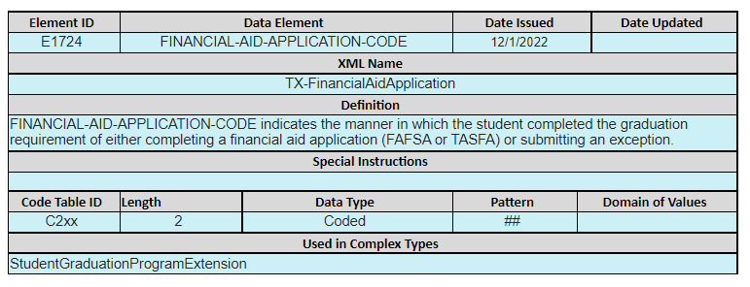
Graduate Financial Aid Application: Data Elements
2022-2023 Student Graduate Data Collection:
FINANCIAL-AID-APPLICATION-CODE (E1724)

Slide 80
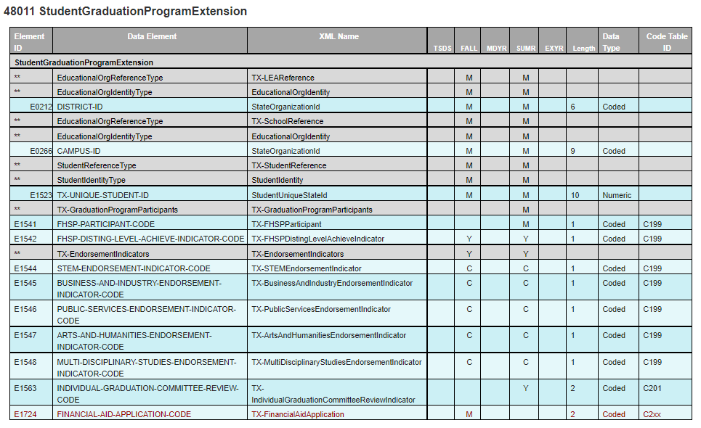
Graduate Financial Aid Application: Data Elements
2022-2023 Student Graduate Data Collection:
StudentGraduationProgramExtension complex type:

Slide 81
Graduate Financial Aid Application: Data Elements
2022-2023 Student Graduate Data Collection:
FINANCIAL-AID-APPLICATION-CODE table:

Slide 82
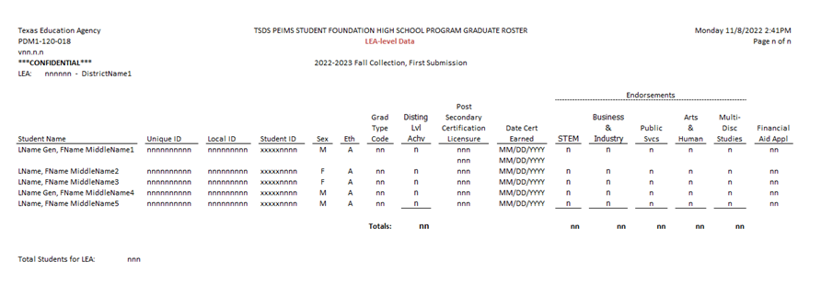
Graduate Financial Aid Application: Reports
TSDS PEIMS Reports Updates:
PDM1-120-018 - Foundation High School Program Graduate Roster

Slide 83
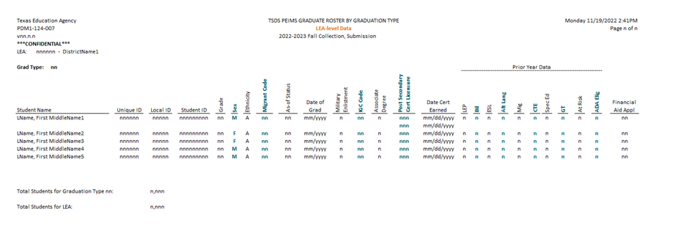
Graduate Financial Aid Application: Reports
TSDS PEIMS Reports Updates:
PDM1-124-007 - Graduate Roster by Graduation Type

Slide 84
AGENDA
PEIMS
2020-2021​
English Learner Summer School
Additional Days School Year Program
PEIMS Performance
CTE Updates
2021-2022
Expanded Learning Opportunities
Crisis Codes
Industry Based Certification
Leaver Definition Update
Non-Membership Special Education Student Discipline and Restraint Reporting
CTE Data Element Changes
SERVICE-ID Code Changes
Fund Code Table Changes
Excessive Unexcused Absence Data Element Change
September 1, 2021 Post-Addendum Non-Legislative Updates
2022-2023
Financial Aid Application Early Notice
Timeline​
Technical Resources

Slide 85
TIMELINE: 2021-2022 PEIMS FALL
PEIMS Fall Submission (Sub 1)
PEIMS Fall submission ready to promote data | September 13, 2021
Close of school-start window – Last Friday in September | September 24, 2021
PEIMS Fall snapshot date | October 29, 2021
TSDS PEIMS ready for users to complete, approve, and accept submissions | November 1, 2021
Requests to retire Unique IDs due to TEA | November 26, 2021
PEIMS Fall first submission due date for LEAs and ESCs | December 2, 2021
Requests to retire Unique IDs due to TEA | January 14, 2022
PEIMS Fall resubmission due date for LEAs and ESCs | January 20, 2022
PEIMS Fall data available to customers | February 17, 2022
**Refer to Release Schedule presentation for the 2021-2022 timeline

Slide 86
TIMELINE: 2021-2022 PEIMS MID-YEAR
PEIMS Mid-Year Submission (Sub 2)
PEIMS Mid-Year submission ready for users to promote data | November 8, 2021
TSDS PEIMS ready for users to complete, approve, and accept submissions | December 20, 2021
PEIMS Mid-Year first submission due date for LEAs and ESCs | January 27, 2022
PEIMS Mid-Year resubmission due date for LEAs and ESCs | February 10, 2022
PEIMS Mid-Year data available to customers | March 3, 2022
**Refer to Release Schedule presentation for the 2021-2022 timeline

Slide 87
TIMELINE: 2021-2022 PEIMS SUMMER
PEIMS Summer Submission (Sub 3)
PEIMS Summer submission ready for users to promote data | February 28, 2022
TSDS PEIMS ready for users to complete, approve, and accept submissions | May 16, 2022
Requests to retire Unique IDs due at TEA | June 10, 2022
PEIMS Summer first submission due date for LEAs | June 16, 2022
Requests to retire Unique IDs due at TEA | July 15, 2022
PEIMS Summer resubmission due date for LEAs | July 21, 2022
PEIMS Summer data available to customers | September 15, 2022
**Refer to Release Schedule presentation for the 2021-2022 timeline

Slide 88
TIMELINE: 2021-2022 PEIMS EXTENDED YEAR
PEIMS Extended Year Submission (Sub 4)
PEIMS Extended Year submission ready for users to promote data | March 28, 2022
TSDS PEIMS ready for users to complete, approve, and accept submissions | July 25, 2022
Requests to retire Unique IDs due at TEA | August 19, 2022
PEIMS Extended Year first submission due date for LEAs | August 25, 2022
Requests to retire Unique IDs due at TEA | September 9, 2022
PEIMS Extended Year resubmission due date for LEAs | September 15, 2022
PEIMS Extended Year data available to customers | October 13, 2022
**Refer to Release Schedule presentation for the 2021-2022 timeline

Slide 89
AGENDA
PEIMS
2020-2021​
English Learner Summer School
Additional Days School Year Program
PEIMS Performance
CTE Updates
2021-2022
Expanded Learning Opportunities
Crisis Codes
Industry Based Certification
Leaver Definition Update
Non-Membership Special Education Student Discipline and Restraint Reporting
CTE Data Element Changes
SERVICE-ID Code Changes
Fund Code Table Changes
Excessive Unexcused Absence Data Element Change
September 1, 2021 Post-Addendum Non-Legislative Updates
2022-2023
Financial Aid Application Early Notice
Timeline​
Technical Resources

Slide 90
PEIMS: TECHNICAL RESOURCES
Technical Specifications:
TSDS Web-Enabled Data Standards (TWEDS)​
Technical Support:
TSDSCustomerSupport@tea.texas.gov

Slide 91
Questions

