Slide 1
Child Find

Slide 2
AGENDA
CHILD FIND ​
Program Area Updates & Guidance​
Timeline
TEAL Roles and Privileges
Data Collection
Core Application
Frequently Asked Questions​
Technical Resources

Slide 3
AGENDA
CHILD FIND ​
Program Area Updates & Guidance​
Timeline
TEAL Roles and Privileges
Data Collection
Core Application
Frequently Asked Questions​
Technical Resources

Slide 4
PROGRAM AREA UPDATES & GUIDANCE
Division of Special Education Program Reporting
Tammy Pearcy Director; Department of Monitoring, Reporting, and Support
Zane Wubbena Data Analyst; Department of Monitoring, Reporting, and Support

Slide 5
PROGRAM AREA UPDATES & GUIDANCE
Child Find will combine the following two State Performance Plan (SPP) Indicators in TSDS:
SPPI-11
Refers to the timely evaluation of students, ages 3-21, for special education services under Part B of IDEA.
SPPI-12
Refers to children who are referred from Part C of IDEA prior to age 3, found eligible for Part B of IDEA, and have an individualized education plan (IEP) developed and implemented by their third birthday to receive early childhood special education (ECSE) services from a local education agency (LEA).
Issues with current collection:
Aggregate data collected in State Performance Plan (SPP) application.
More non-compliance reported than other federally required compliance indicators.

Slide 6
AGENDA
CHILD FIND ​
Program Area Updates & Guidance​
Timeline
TEAL Roles and Privileges
Data Collection
Core Application
Frequently Asked Questions​
Technical Resources

Slide 7
TIMELINE: 2021-2022
Submission Due: July 28, 2022
Child Find Collection
TSDS ready to load data to eDM | August 2, 2021
Child Find ready for users to promote data | September 13, 2021
Child Find ready for users to complete | June 6, 2022
Child Find submission due date for LEAs | July 28, 2022

Slide 8
AGENDA
CHILD FIND ​
Program Area Updates & Guidance​
Timeline
TEAL Roles and Privileges
Data Collection
Core Application
Frequently Asked Questions​
Technical Resources

Slide 9
TEAL ROLES AND PRIVILEGES
Child Find will utilize the following existing TEAL roles:
Core ESC Data Viewer
Core LEA Data Approver
Core LEA Data Completer
Core LEA Data Promoter
Core LEA Data Viewer
A new privilege, ‘Child Find Access’, will be added to each of these roles.
Users will need to apply for this new privilege even if they already have one of the roles above.
These privileges are tentatively scheduled to be available for request around August 2, 2021.

Slide 10
AGENDA
CHILD FIND ​
Program Area Updates & Guidance​
Timeline
TEAL Roles and Privileges
Data Collection
Core Application
Frequently Asked Questions​
Technical Resources

Slide 11
DATA COLLECTION: OVERVIEW
The collection will include students for whom the special education evaluation process was completed.
In some cases, this may include non-enrolled students such as homeschooled students, private school students, or children who received Early Childhood Intervention services through another state agency.
The completed evaluation/eligibility process is based on an eligibility determination date on or between July 1, 20XY – June 30, 20XX of a given school year.
This includes “holdover students”, whose parental consent was obtained in the prior school year and the evaluation/eligibility process was completed in the current school year.

Slide 12
DATA COLLECTION: INTERCHANGES
Child Find will promote data from the following TSDS interchanges:
InterchangeEducationOrganizationExtension
InterchangeEducationOrgCalendar
InterchangeStudentParentExtension
InterchangeStudentEnrollmentExtension
InterchangeStudentProgramExtension

Slide 13
DATA COLLECTION: COMPLEX TYPES & ELEMENTS
Education Organization
LocalEducationAgencyExtension
E0212 DISTRICT-ID
ProgramReference*
SchoolExtension
E0266 CAMPUS-ID
LocalEducationAgencyReference
Program
E1337 PROGRAM-TYPE*
*These will be required to load into the ODS but will not be promoted for the collection.

Slide 14
DATA COLLECTION: COMPLEX TYPES & ELEMENTS
Education Organization Calendar
ReportingPeriodExtension
E0266 CAMPUS-ID
E1093 SCHOOL-YEAR*
E0934 REPORTING-PERIOD-INDICATOR-CODE*
E1568 REPORTING-PERIOD-BEGIN-DATE*
E1569 REPORTING-PERIOD-END-DATE*
E0975 INSTRUCTIONAL-TRACK-INDICATOR-CODE
E1600 INSTRUCTIONAL-PROGRAM-TYPE*
E0935 NUMBER-DAYS-TAUGHT*
CalendarReference
*These will be required to load into the ODS but will not be promoted for the collection.

Slide 15
DATA COLLECTION: COMPLEX TYPES & ELEMENTS
Education Organization Calendar
CalendarDateExtension
E1168 CALENDAR-DATE
E1582 SCHOOL-DAY-EVENT-CODE
E1570 CALENDAR-WAIVER-EVENT-TYPE*
E1571 SCHOOL-DAY-OPERATIONAL-MINUTES*
E1599 SCHOOL-DAY-INSTRUCTIONAL-MINUTES*
E1572 SCHOOL-DAY-WAIVER-MINUTES*
*These will be required to load into the ODS but will not be promoted for the collection.

Slide 16
DATA COLLECTION: COMPLEX TYPES & ELEMENTS
Student Parent
StudentExtension
E1523 TX-UNIQUE-STUDENT-ID
E1090 STUDENT-IDENTIFICATION-SYSTEM
E0001 STUDENT-ID
E0703 FIRST-NAME
E0704 MIDDLE-NAME
E0705 LAST-NAME
E1303 GENERATION-CODE-SUFFIX
E1325 SEX
E0006 DATE-OF-BIRTH
E1375 HISPANIC-LATINO-ETHNICITY
E1343 RACIAL-CATEGORY
E0212 DISTRICT-ID

Slide 17
DATA COLLECTION: COMPLEX TYPES & ELEMENTS
Student Enrollment
StudentSchoolAssociationExtension
E1523 TX-UNIQUE-STUDENT-ID
E0266 CAMPUS-ID
E1517 ENTRY-GRADE-LEVEL-TYPE
Student Program
StudentSpecialEdProgramAssociationExtension
E1523 TX-UNIQUE-STUDENT-ID
ProgramReference
EducationOrganizationReference
E1632 EFFECTIVE-DATE (TX-EffectiveDateServices)
E0900 EARLY-CHILDHOOD-INTERV-IND-CODE

Slide 18
DATA COLLECTION: COMPLEX TYPES & ELEMENTS
**New complex types and data elements**
StudentChildFindAssociationExtension
TX-ChildFind
E1710 CAMPUS-ID-EVALUATION
E0975 INSTRUCTIONAL-TRACK-INDICATOR-CODE (existing data element)
E1711 STUDENT-ABSENCES-WITHIN-TIMEFRAME
TX-EarlyChildhoodTransition
E1712 ECI-NOTIFICATION-DATE
E1713 ECI-TRANSITION-CONFERENCE-DATE
TX-ChildFindInitialEvaluation
E1714 PARENTAL-CONSENT-DATE
E1715 INITIAL-EVALUATION-DATE
TX-ChildFindEligibilityDetermination
E1716 SPED-ELIGIBILITY-DETERMINATION-DATE
E1717 SPED-ELIGIBILITY-DETERMINATION-CODE
TX-EvaluationDelay
E1718 EVALUATION-DELAY-REASON

Slide 19
DATA COLLECTION: PRIOR YEAR PEIMS DATA
For students where E1714 PARENTAL-CONSENT-DATE is in the prior school year – “holdover students” – Child Find will also use the following calendar data from the prior year’s PEIMS Summer Accepted data:
CalendarDateExtension
ReportingPeriodExtension
The Core application will retrieve this certified data automatically. LEAs do not need to reload any of this PEIMS data for the Child Find data collection.

Slide 20
DATA COLLECTION: CALCULATIONS
The Core application will also perform calculations based on the data elements being reported.
The calculated data will include:
The Initial Evaluation and SPED Eligibility Determination compliance for each student.
The overall SPPI-11 and SPPI-12 compliance for each student, based on which indicator applies to them.
The number of days beyond timeframe to complete the initial evaluation/eligibility determination process for non-compliance students.
These calculations will display on reports and appear in data validation rules.

Slide 21
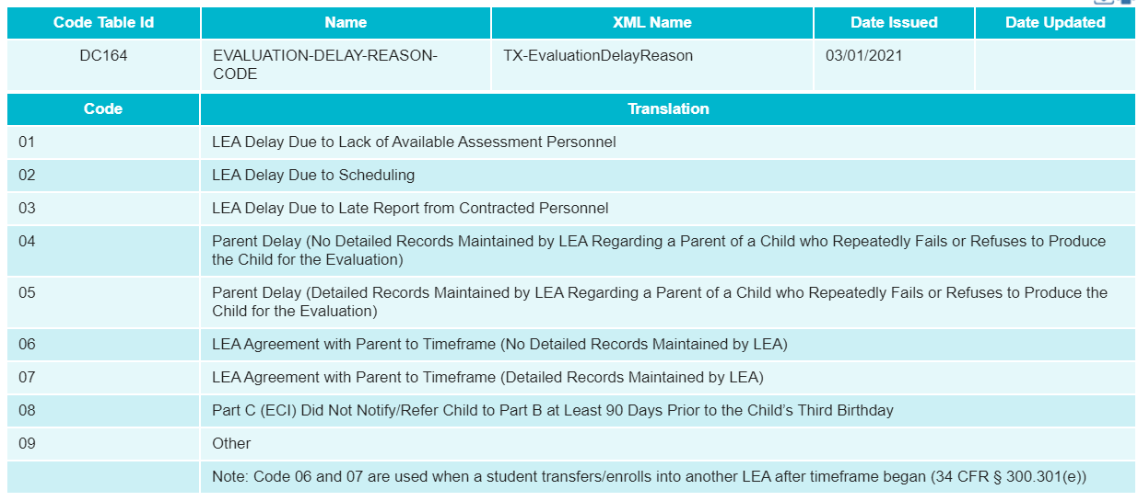
DATA COLLECTION: DC164 CODE TABLE

Slide 22
DATA COLLECTION: ADDITIONAL CODE TABLES
Child Find will also utilize the following existing code tables:
C088 – PARTICIPATION-INDICATOR-CODE
C130 – REPORTING-PERIOD-INDICATOR-CODE
C193 – SCHOOL-YEAR-TYPE
C204 – CALENDAR-WAIVER-EVENT-TYPE-CODE
C208 – SCHOOL-DAY-EVENT-CODE
C215 – INSTRUCTIONAL-PROGRAM-TYPE
DC063 – GRADE-LEVEL-TYPE
DC096 – PROGRAM-TYPE
DC097 – RACE-ITEM-TYPE
DC119 – SEX-TYPE
DC126 – STUDENT-IDENTIFICATION-SYSTEM-TYPE
DC148 – GENERATION-CODE-SUFFIX-TYPE

Slide 23
AGENDA
CHILD FIND ​
Program Area Updates & Guidance​
Timeline
TEAL Roles and Privileges
Data Collection
Core Application
Frequently Asked Questions​
Technical Resources

Slide 24
CORE APPLICATION: OVERVIEW
Child Find will be added to the Core application.
Functionality will be the same as other Core collections:
LEAs will be able to promote and validate data, run reports, complete/reset submissions, and apply for extensions.
ESCs will be able to monitor LEA data submissions and run reports.

Slide 25
CORE APPLICATION: SUBCATEGORIES
The following subcategories of data will be used in Child Find:
Education Organization
Local Education Agency
Campus
Calendar
Student
Student Basic Information
Enrollment (School Association)
Special Education Program
Due to the interdependency and complexity of the calculations being performed, users will only be able to promote data by ALL CATEGORIES.

Slide 26
CORE APPLICATION: PROMOTION LOGIC
The following criteria logic will be applied when promoting students to the Child Find data mart:
21 years of age or younger on September 1st of the current school year
Reported with a value for data element E1716 SPED-ELIGIBILITY-DETERMINATION-DATE

Slide 27
CORE APPLICATION: REPORTS
Four reports at the LEA and ESC levels; two each for SPPI-11 and SPPI-12.
CHF0-100-001: TSDS SPPI-11 Student Compliance Report
CHF0-100-002: TSDS SPPI-12 Student Compliance Report
CHF0-100-003: TSDS SPPI-11 Aggregate Report
CHF0-100-004: TSDS SPPI-12 Aggregate Report

Slide 28
CHF0-100-001: TSDS SPPI-11 STUDENT COMPLIANCE REPORT

Slide 29
CHF0-100-002: TSDS SPPI-12 STUDENT COMPLIANCE REPORT

Slide 30
CHF0-100-003: TSDS SPPI-11 AGGREGATE REPORT

Slide 31
CHF0-100-004: TSDS SPPI-12 AGGREGATE REPORT

Slide 32
CORE APPLICATION: New Validation Rules– Student Category
New rules added for Child Find – 40100 Student Category
The following additional existing rules will be added for the Student Category:
40100-0102
40100-0103
40100-0104
40100-0105
Note:
The following rules added in March TEDS v2022.1.0 have been renumbered and moved from the Student Enrollment subcategory to the Special Education Program subcategory.
40110-000W is now 41163-000F
40110-0227 is now 41163-0074

Slide 33
CORE APPLICATION: New Validation Rules– Special Education Category
Ten new rules have been created in the 41163 –Special Education Program category related to the Child Find collection.
Note: not all rules are listed, please refer to TWEDS for a complete list of the rules.
The following rules relate to the dates required for the Child Find Collection:

Slide 34
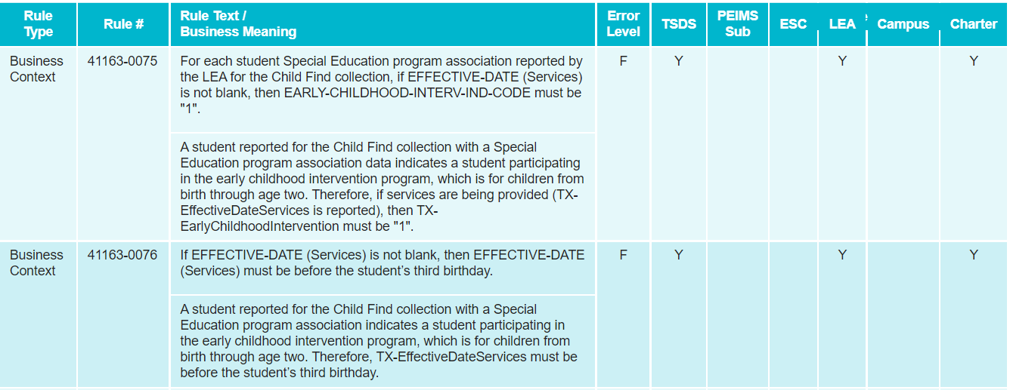
CORE APPLICATION: New Validation Rules– Special Education Category
Additional New rules added for Child Find to 41163 - Special Education Program Category:

Slide 35
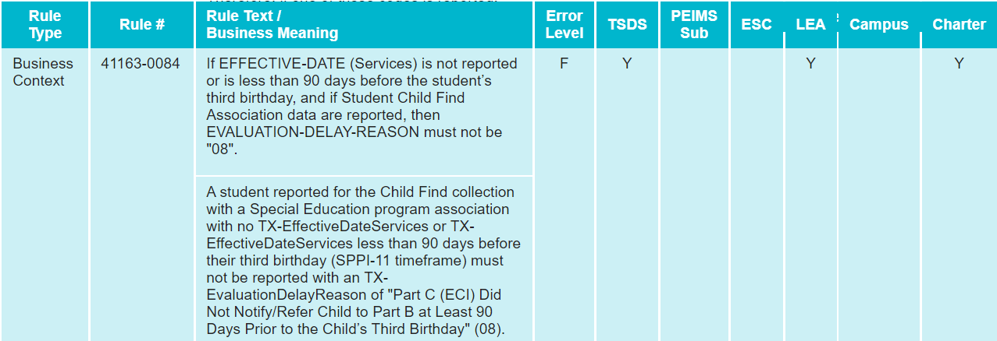
CORE APPLICATION: New Validation Rules– Special Education Category
The following rules relate the EVALUATION-DELAY-REASON (E1718) to the Child Find collection:

Slide 36
CORE APPLICATION: New Validation Rules– Special Education Category
The following Special Warning rules relate EVALUATION-DELAY-REASON to the Child Find Compliance calculation for SPPI-11 and SPPI-12:
41163-0085 & 41163-0087
If the Compliance (calculated value) is “Y”, then EVALUATION-DELAY-REASON should either not be reported, “05”, or “07”.
41163-0086 & 41163-0088
If the Compliance (calculated value) is “N”, then EVALUATION-DELAY-REASON should be reported and should not be “05” or “07”.
Please refer to TWEDS for a complete list of the rules.

Slide 37
AGENDA
CHILD FIND ​
Program Area Updates & Guidance​
Timeline
TEAL Roles and Privileges
Data Collection
Core Application
Frequently Asked Questions​
Technical Resources

Slide 38
FREQUENTLY ASKED QUESTIONS
Why are SPPI-11 and SPPI-12 being changed to collect information at the student level rather than in aggregation?
Texas is currently under a corrective action requirement from the federal government. As part of the corrective action response and acceptance by the federal government, the inclusion of student level data is to ensure Texas is tracking every student who is potentially eligible for special education services and the outcome, as part of the compliance standards.
The aggregate data did not provide specific details needed related to the timeline in terms of when the parental consent form was signed, when the student was evaluated, etc.

Slide 39
FREQUENTLY ASKED QUESTIONS
Which students will be reported for Child Find?
Only students for whom the special education evaluation/eligibility process has been completed should be reported. This is indicated by data element E1716 SPED-ELGIBILITY-DETERMINATION-DATE.
If this data element is not reported for a student, they will not be promoted to Child Find.

Slide 40
FREQUENTLY ASKED QUESTIONS
Are LEAs required to report non-enrolled students?
The LEA of residence is required to find and serve children with disabilities. Per federal requirements, private and homeschooled children that are not enrolled in an LEA are required to be evaluated and served by the LEA.

Slide 41
FREQUENTLY ASKED QUESTIONS
How will the data be reported for non-enrolled students?
Both enrolled and non-enrolled students will be reported the same in Child Find.
However, the StudentSchoolAssociation data in the InterchangeStudentEnrollmentExtension would not be reported for non-enrolled students.

Slide 42
FREQUENTLY ASKED QUESTIONS
Will LEAs be required to load Child Find data periodically throughout the school year?
LEAs are encouraged to load and promote data throughout the school year as it becomes available. However, there will be no formal mid-year checkpoints like the RF Tracker collection.

Slide 43
AGENDA
CHILD FIND ​
Program Area Updates & Guidance​
Timeline
TEAL Roles and Privileges
Data Collection
Core Application
Frequently Asked Questions​
Technical Resources

Slide 44
TECHNICAL RESOURCES
Technical Specifications:
TSDS Web-Enabled Data Standards (TWEDS)
Child Find Program Area Support:
spp@tea.texas.gov
Technical Support:
TSDSCustomerSupport@tea.texas.gov
TAA letter
TIMS knowledge base (kb) articles will be available by go-live date.

Slide 45
Questions

