Slide 1
Early Childhood Data System (ECDS)

Slide 2
AGENDA
Early Childhood Data System
Program Area Updates & Guidance
2020-2021
Submission Counts
2021-2022
Reminders
Business Rule Updates
Code Table Updates
Report Updates
Current Known Issues
Timeline
Technical Resources

Slide 3
PROGRAM AREA UPDATES & GUIDANCE
Early Learning Partnerships
Early learning partnerships are formal collaborations between local education agencies (LEAs) such as school districts or open-enrollment charters, and private early learning centers (ELCs) or Head Start centers.
The resulting partnership allows an LEA to dual enroll children and provide prekindergarten and/or additional comprehensive, wrap-around services.
Partnerships benefit a wide range of stakeholders including, families and children, LEAs, ELCs, and the Early Childhood community.

Slide 4
PROGRAM AREA UPDATES & GUIDANCE
Reporting Public Pre-K Partnerships in ECDS Pre-K submission:
PK-SCHOOL-TYPE (E1555) indicates the PK program offered at the campus.
PK-SCHOOL-TYPE is reported as part of the ECDS collection and applies to a campus/course/section and is only reported for course sections that utilize the Pre-Kindergarten SERVICE-ID “01010000” (Pre-Kindergarten).
LEAs that administer a partnership with a Head Start program or licensed child care provider would report one of the highlighted codes:
Code Table Id | Name | XML Name | Date Issued | Date Updated
DC152 | PK-SCHOOL-TYPE | TX-PKSchoolType | 03/03/2014 | 3/1/2020
Code | Translation
01 | Non-Public Pre-K Head Start
02 | Public Pre-K
05 | Non-Public Pre-K Licensed Child Care
07 | Public Pre-K Head Start
08 | Public Pre-K Licensed Child Care
10 | Non-Public Pre-K
11 | In-District Charter Partnership
99 | Other

Slide 5
AGENDA
Early Childhood Data System
Program Area Updates & Guidance
2020-2021
Submission Counts
2021-2022
Reminders
Business Rule Updates
Code Table Updates
Report Updates
Current Known Issues
Timeline
Frequently Asked Questions
Technical Resources

Slide 6
2020-2021: SUBMISSION COUNTS
The 2020-2021 ECDS Prekindergarten submission closed on June 24, 2021.
Final Status Count: ​
Public Pre-K Completed: | 1,068
Private Pre-K Completed: | 2

Slide 7
AGENDA
Early Childhood Data System
Program Area Updates & Guidance
2020-2021
Submission Counts
2021-2022
Reminders
Business Rule Updates
Code Table Updates
Report Updates
Current Known Issues
Timeline
Technical Resources

Slide 8
2021-2022: REMINDERS
ECDS Kindergarten Assessments:
TEA is continuing to work with the kindergarten assessment vendors for TX-KEA and mCLASS Texas Edition to improve the process for providing the results directly to TEA in 2021-2022.
Stay tuned for further information and guidance in upcoming FCN communications.
ECDS Prekindergarten Assessments:​
The prekindergarten process will remain the same for 2021-2022 as it was for 2020-2021.
LEAs are expected to obtain their assessment results directly from their ECDS vendor and are responsible for loading their assessment data into the ODS.
Prekindergarten assessment results will NOT be provided directly to TEA.

Slide 9
2021-2022: REMINDERS
-999 (Not Assessed) Score result:
Due to analysis and feedback received from LEAs and ECDS assessment vendors regarding difficulties associated with the -999 (Not Assessed) score and the associated assessment administration date, it was decided by the Early Childhood Program area that the -999 score will no longer be required for LEAs to submit in the 2021-2022 school year.

Slide 10
2021-2022: BUSINESS RULE UPDATES
2021-2022 New Validation Rule
 |  |  |  |  |  | Rule Applies To
Rule Type | Rule # | Rule Text / Business Meaning | Error Level | TSDS | PEIMS Sub | ESC | LEA | Campus | Charter
Business Context | 30040-0057 | If PK-TEACHER-REQUIREMENT is not blank, then this staff person must/should have a Teacher Section Association with a CLASSROOM-POSITION of “Teacher of Record” for a Course Section where HIGH-QUALITY-PK-PROGRAM-INDICATOR is “1”. | SW | Y |  |  | Y |  | Y
 |  | A staff person with a TX-PKTeacherRequirement must/should be reported as Teacher of Record for a High Quality PK program course.

Slide 11
2021-2022: BUSINESS RULE UPDATES
2021-2022 Updated Validation Rule
 |  |  |  |  |  | Rule Applies To
Rule Type | Rule # | Rule Text / Business Meaning | Error Level | TSDS | PEIMS Sub | ESC | LEA | Campus | Charter
Business Context | 46010-0005 | If REPORT-ASSESSMENT-TYPE is "ECDS - PK" or "ECDS - KG', then for the reported ASSESSMENT-TITLE and ACADEMIC-SUBJECT, if there is a minimum score and maximum score defined in TEDS DC154 Code Table Assessment Specifications, then the SCORE-RESULT must be either -999, or greater than or equal to the score minimum and less than or equal to the score maximum. | F | Y |  |  | Y |  | Y
 |  | For a PK or KG Student Assessment collected for the ECDS, the Result must be either not assessed (-999), or within the allowed score range for the AssessmentTitle and AcademicSubject.

Slide 12
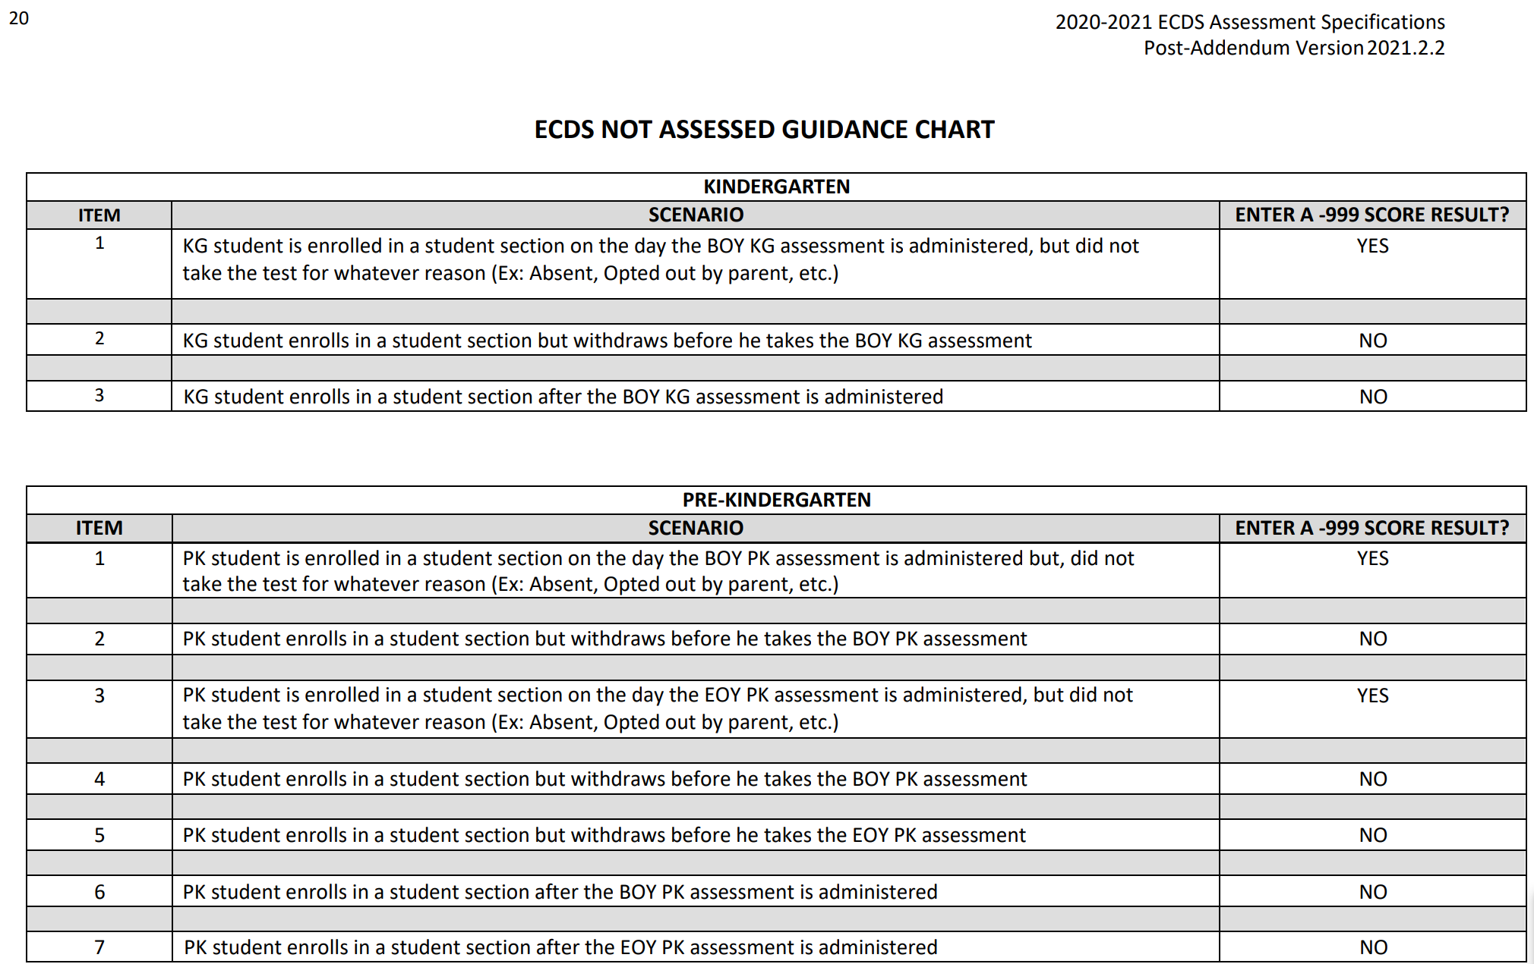
2021-2022: CODE TABLE UPDATES
DC 154 – ASSESSMENT-TITLE-CODE
2021-2022
The ‘ECDS NOT ASSESSED GUIDANCE CHART’ will be removed from the 2021-2022 Assessment Specifications since LEAs will no longer be required to report a -999 score value to indicate a student that was ‘Not Assessed’.

Slide 13
2021-2022: REPORT UPDATES
ECD0-000-010: The ‘# HQ PK Classes’ column has been added to the report to allow ESCs to compare against the High-Quality PK components that are reported by LEAs in their region.

Slide 14
2021-2022: REPORT UPDATES
The following reports have been impacted by the -999 score result no longer being classified as ‘Not Assessed’:
-999 assessment score value will no longer display as ‘Not Assessed’:
ECD0-000-004 Early Childhood KG Data Submission
ECD0-000-006 Early Childhood PK Data Submission
-999 assessment score will no longer be excluded from the KG Readiness calculations:
ECD0-000-001 Early Childhood Assessment Completion
ECD0-000-002 Early Childhood Assessment Summary
ECD0-000-003 Early Childhood Assessment With PK Sources
If a -999-assessment score value is submitted for a student, the above reports will now include the score in the KG Readiness calculations based on the proficiency ranges in the Assessment Specifications.
-999 assessment score value will no longer be excluded from the Assessment Totals:
ECD0-000-007 Early Childhood PRE-K Completion
ECD0-000-008 Early Childhood PK Proficiency Summary
ECD0-000-009 Early Childhood Public PK Missing Assessment Data

Slide 15
2021-2022: REPORT UPDATES
2020-2021 Example:
2021-2022 Example:

Slide 16
AGENDA
Early Childhood Data System
Program Area Updates & Guidance
2020-2021
Submission Counts
2021-2022
Reminders
Business Rule Updates
Code Table Updates
Report Updates
Current Known Issues
Timeline
Technical Resources

Slide 17
CURRENT KNOWN ISSUES
The following report issues will be resolved in the November 5, 2021 release:​​
ECDS Kindergarten Reports:​
ECD0-000-001​
Classroom positions, other than the Teacher of Record, are displaying on the report.​
Campus ID and campus name are not matching in the report details section.
ECD0-000-005:
The report is listing students as missing assessments, even though those subject areas are not part of the required domain for KG readiness.
ECD0-000-006​
The PDF and CSV version of this report for prior years is failing after running for an extended amount of time.​
ECDS Prekindergarten Reports:​
ECD0-000-003​
The report is incorrectly displaying the number of High-Quality PK students for those students that have exited and re-entered the same course/section.

Slide 18
CURRENT KNOWN ISSUES
The following rule issues will be resolved in the November 5, 2021 release:​​
The rule text is incorrectly displaying extra symbols and characters for the following ECDS rules:
10010-0015
10010-0016
46010-0005

Slide 19
AGENDA
Early Childhood Data System
Program Area Updates & Guidance
2020-2021
Submission Counts
2021-2022
Reminders
Business Rule Updates
Code Table Updates
Report Updates
Current Known Issues
Timeline
Technical Resources

Slide 20
TIMELINE: 2021-2022 KINDERGARTEN
Submission Due: January 27, 2022
Early Childhood Data System Collection (ECDS) - KG
TSDS ready to load data to eDM | August 2, 2021
ECDS Kindergarten ready for users to promote data | November 8, 2021
ECDS Kindergarten submission due date for LEAs | January 27, 2022

Slide 21
TIMELINE: 2021-2022 PREKINDERGARTEN
Submission Due: June 23, 2022
Early Childhood Data System Collection (ECDS) - KG
TSDS ready to load data to eDM | August 2, 2021
ECDS Prekindergarten ready for users to promote data | November 8, 2021
Private Prekindergarten application deadline for BPD (Business Partner Directory) Org number | May 26, 2022
ECDS Prekindergarten submission due date for LEAs and Private Prekindergarten Organizations | June 23, 2022

Slide 22
AGENDA
Early Childhood Data System
Program Area Updates & Guidance
2020-2021
Submission Counts
2021-2022
Reminders
Business Rule Updates
Code Table Updates
Report Updates
Current Known Issues
Timeline
Technical Resources

Slide 23
TECHNICAL RESOURCES
Technical Specifications:
Texas Education Data Standards (TEDS)
Technical Support:
TSDSCustomerSupport@tea.texas.gov
ECDS Program Area:
Early Childhood Education Website
ECDS Quick Support Guide
Knowledge Base Articles:
TSDSKB-249 ECDS: General FAQs
TSDSKB-508 ECDS: Assessment Specifications

Slide 24
TECHNICAL RESOURCES
2021-2022 School Year Commissioner’s List of Assessments:
Prekindergarten:
The Commissioner's List of Approved Prekindergarten Assessment Instruments is extended through the 2021-2022 school year.
Kindergarten:
Local Education Agencies (LEAs) must conduct a beginning of year (BOY) literacy assessment using either TX-KEA or mCLASS Texas Edition.
The ECDS kindergarten submission will only accept BOY Kindergarten data from these two vendors.
Commissioner-selected literacy screening tools for kindergarten is through July 2023.
Districts and open enrollment charters can use either of these tools to conduct the required beginning-of-year literacy screening for the 2021-2022 and 2022-2023 school years.

Slide 25
Questions

