Slide 1
Statewide Longitudinal Data Systems (SLDS) School-Level Poverty Metrics (SLPM) Project

Slide 2
School-Level Poverty Metrics (SLPM) Project
The SLDS grant team has requested states to assist them in testing their newly developed software application that takes the latitude and longitudinal coordinates of a student’s address and produces a Geolocated Ratio of Income-to-Poverty (GRIP) Score.
This score would then be compared to the Economic-Disadvantaged Indicator assigned to students.
The name of the application is BlindSIDE Poverty Assignment Tool.
TEA is facilitating the test of the application and analysis of the results with five to seven LEAs that are of different sizes and geographical locations.

Slide 3
SLPM Project - Timeline
October 2021
TEA Identifies five to seven LEAs to participate in the tool analysis project.
February – March 2022
Partner LEAs use the tool to produce the results.
April – June 2022
Partner LEAs analyze and compare the results to the Economic-Disadvantage data submitted in the PEIMS Fall, 2021-2022 submission.

Slide 4
SLPM - Process
SLDS team provides training on the tool to LEAs.
LEA produces input file and submits through the application.
Application produces output file.
LEA analyzes output file.
LEA provides feedback on tool and analysis of data.

Slide 5
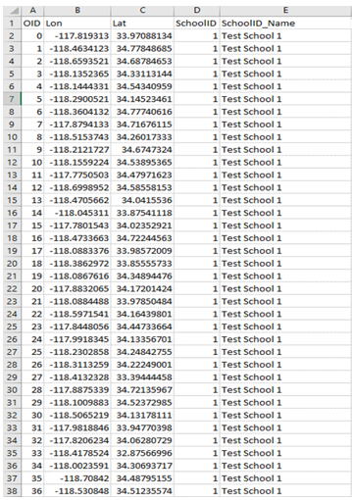
Initial Input – Student File

Slide 6
SLPM Project – Next Steps
Please contact LEAs in your area to find interested participants.
Contact Dave Erichson (dave.erichson@tea.texas.gov) with volunteer LEA information by October 1, 2021.

