Slide 1
Special Education Language Acquisition (SELA)

Slide 2
AGENDA
SELA
2020-2021
Submission Counts
2021-2022
Data Element Updates
Business Rule Updates
Code Table Updates
Report Updates
Current Known Issues
Timeline
Technical Resources

Slide 3
AGENDA
SELA
2020-2021
Submission Counts
2021-2022
Data Element Updates
Business Rule Updates
Code Table Updates
Report Updates
Current Known Issues
Timeline
Technical Resources

Slide 4
2020-2021: SUBMISSION COUNTS
The 2020-2021 SELA submission closed on June 24, 2021.
Final Status Count: ​
Completed: 454

Slide 5
AGENDA
SELA
2020-2021
Submission Counts
2021-2022
Data Element Updates
Business Rule Updates
Code Table Updates
Report Updates
Current Known Issues
Timeline
Technical Resources

Slide 6
2021-2022: DATA ELEMENT UPDATES
Disability complex type:
Added data element E1723 ELIGIBILITY-DATE.
Indicates the date upon which a student who is deaf or hard of hearing is eligible for services.
This data was collected in the 2020-2021 collection using element E1632 EFFECTIVE-DATE.
Changed E1632 EFFECTIVE-DATE from ‘Optional’ to ‘Conditionally Mandatory’.
Indicates the date upon which the disability is considered to take effect.
This data element will NOT be promoted to the SELA data mart.

Slide 7
2021-2022: DATA ELEMENT UPDATES
TX-LanguageAcquisitionServicesProvided complex type:
Changed E1663 FREQUENCY-OF-SERVICES and E1664 HOURS-SPENT-RECEIVING-SERVICES from ‘Mandatory’ to ‘Optional’.
This will no longer require an LEA to report these elements for students that do not receive services.

Slide 8
2021-2022: BUSINESS RULE UPDATES
2021-2022 New Validation Rule

Slide 9
2021-2022: BUSINESS RULE UPDATES
2021-2022 Updated Validation Rules
FREQUENCY-OF-SERVICES and HOURS-SPENT-RECEIVING-SERVICES are removed from rule 40100-0204 since data elements have been changed from mandatory to optional.
EFFECTIVE-DATE (E1632) has been removed from rule 40100-0205 and replaced with ELIGIBILITY-DATE (E1723).

Slide 10
2021-2022: BUSINESS RULE UPDATES
2021-2022 Updated Validation Rules

Slide 11
2021-2022: BUSINESS RULE UPDATES
2021-2022 Deleted Validation Rules

Slide 12
2021-2022: CODE TABLE UPDATES
DC156 – LANGUAGE-ACQUISITION-SERVICES-PROVIDED-CODE
2020-2021
2021-2022

Slide 13
2021-2022: CODE TABLE UPDATES
DC157 – FREQUENCY-OF-SERVICES-CODE
2020-2021
2021-2022

Slide 14
2021-2022: CODE TABLE UPDATES
DC158 – HOURS-SPENT-SERVICES-CODE
2020-2021
2021-2022

Slide 15
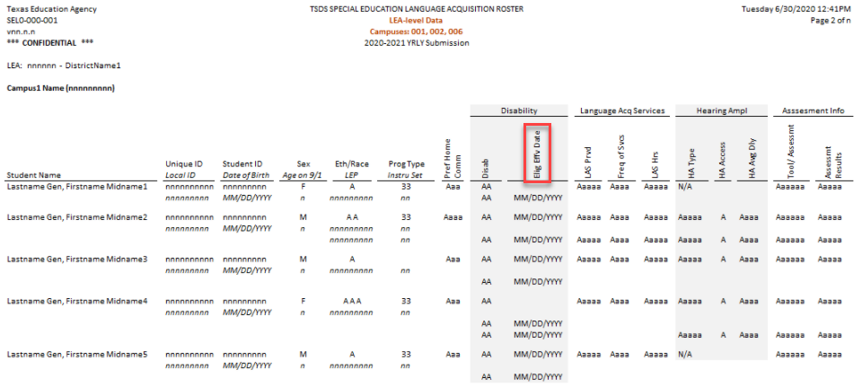
2021-2022: REPORT UPDATES
E1723 ELIGIBILITY-DATE will now populate the ‘Elig Eff Date’ column in the SEL0-000-001 report.

Slide 16
AGENDA
SELA
2020-2021
Submission Counts
2021-2022
Data Element Updates
Business Rule Updates
Code Table Updates
Report Updates
Current Known Issues
Timeline
Technical Resources

Slide 17
CURRENT KNOWN ISSUES
Report SEL0-100-001 Special Education Language Acquisition Roster is currently including inactive campuses when the ‘*All Campuses’ report parameter is selected.
This issue is tentatively scheduled to be resolved in the January 21, 2022 software release.

Slide 18
AGENDA
SELA
2020-2021
Submission Counts
2021-2022
Data Element Updates
Business Rule Updates
Code Table Updates
Report Updates
Current Known Issues
Timeline
Technical Resources

Slide 19
TIMELINE: 2021-2022
Submission Due: June 23, 2022
Special Education Language Acquisition Collection
TSDS ready to load data to eDM | August 2, 2021
SELA ready for users to promote data | September 13, 2021
SELA ready for users to complete | May 16, 2022
SELA submission due date for LEAs | June 23, 2022

Slide 20
AGENDA
SELA
2020-2021
Submission Counts
2021-2022
Data Element Updates
Business Rule Updates
Code Table Updates
Report Updates
Current Known Issues
Timeline
Technical Resources

Slide 21
TECHNICAL RESOURCES
Technical Specifications:
TSDS Web-Enabled Data Standards (TWEDS)
Technical Support:
TSDSCustomerSupport@tea.texas.gov
SELA Program Area:
FAQ and other state guidance resources for AI students
TAA – HB 548
Knowledge Base Articles:
TSDSKB-612 SELA: Frequently Asked Questions (FAQ)
TSDSKB-615 SELA: Definition of Learning Acquisition Services
TSDSKB-616 SELA: Definition of Assessment Types

Slide 22
Questions

