Slide 1
TEXAS RECORDS EXCHANGE (TREx) UPDATE

Slide 2
AGENDA
Texas Records Exchange (TREx) Updates
2021-2022 Changes
Financial Aid Application - No Changes
Legislation
Data Elements
Code Table
CAREER-TECH-ED-INDICATOR (CTE) - Updated
Legislation
Data Elements
Code Table
DYSLEXIA-RISK-CODE – New
Data Element
Code Table

Slide 3
AGENDA
Texas Records Exchange (TREx) Updates
2021-2022 Changes
Financial Aid Application – No Updates
Legislation
Data Elements
Code Table
CAREER-TECH-ED-INDICATOR (CTE) - Updated
Legislation
Data Elements
Code Table
DYSLEXIA-RISK-CODE – New
Data Element
Code Table

Slide 4
FINANCIAL AID APPLICATION: LEGISLATION
86th Legislature House Bill 3
TEC §28.0256
Before graduating from high school, each student must complete and submit a free application for federal student aid (FAFSA) or a Texas application for state financial aid (TASFA) or opt out of the requirement.

Slide 5
FINANCIAL AID APPLICATION: DATA ELEMENTS
Beginning with the 2022-2023 school year, a new mandatory data element, FINANCIAL-AID-APPLICATION-CODE will need to be reported for all graduates in the PEIMS Fall submission.
New data elements are being added to TREx for LEAs to transmit the information during the 2021-2022 school year.

Slide 6
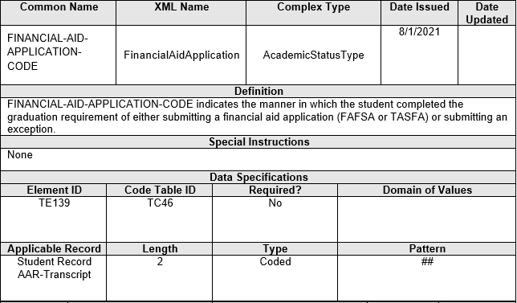
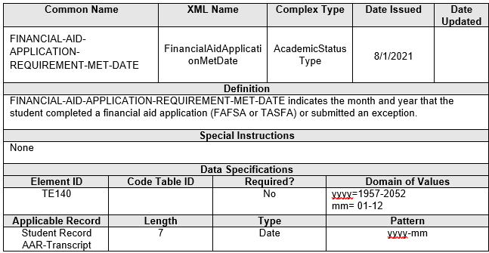
FINANCIAL AID APPLICATION: DATA ELEMENTS
FINANCIAL-AID-APPLICATION-CODE (TE139)
FINANCIAL-AID-APPLICATION-REQUIREMENT-MET-DATE (TE140)

Slide 7
FINANCIAL AID APPLICATION: CODE TABLE
FINANCIAL-AID-APPLICATION-CODE (TC46)

Slide 8
AGENDA
Texas Records Exchange (TREx) Updates
2021-2022 Changes
Financial Aid Application – No Updates
Legislation
Data Elements
Code Table
CAREER-TECH-ED-INDICATOR (CTE) - Updated
Legislation
Data Elements
Code Table
DYSLEXIA-RISK-CODE – New
Data Element
Code Table

Slide 9
CAREER-TECH-ED-INDICATOR: LEGISLATION
Career and Technical Education
Public Law 115-224, Perkins V, the Act, or statute
Sections 113. [20 U.S.C. 2323] ACCOUNTABILITY (B)STATE DETERMINED PERFORMANCE MEASURES
The Federal Perkins legislation that was signed into federal law on July 21, 2018 updated Perkins V reporting requirements. This updated piece of legislation requires State Education Agencies to report specific CTE indicators defined differently than what was previously outlined in Perkins IV.

Slide 10
CAREER-TECH-ED-INDICATOR: DATA ELEMENTS
No Data Element Changes:
CAREER-TECH-ED-INDICATOR (TE014)

Slide 11
CAREER-TECH-ED-INDICATOR: CODE TABLE
Due to the implementation of the auto-calculation, the CAREER-TECH-ED-INDICATOR (TE014) and corresponding code table TC03 will be updated to reflect the auto calculation codes for the LEA to transfer a student’s code to a new LEA beginning in the 2021-2022 school year.

Slide 12
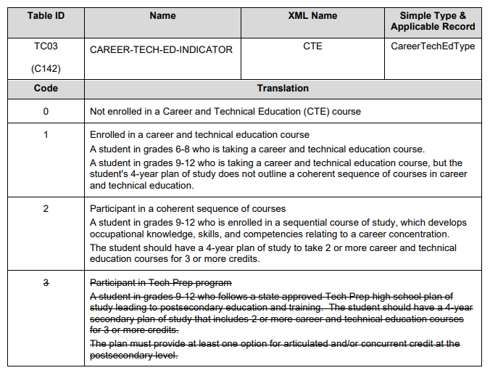
CAREER-TECH-ED-INDICATOR: CODE TABLE
CAREER-TECH-ED-INDICATOR (TC03)
2020-2021
2021-2022
Code 4 - Not CTE
A student who never enrolled or who did not complete any high-school CTE course as defined by 19 TAC Chapter 126 (C), 127 (B) or 130.
Code 5 - CTE Program Participant
A student completing at least one course but not two or more high school CTE courses for two or more credits defined by 19 TAC Chapter 126 (C), 127 (B), or 130 (the student does not have to pass or receive credit).
Code E – CTE Program Explorer
A student completing two or more high school CTE courses for a total of two or more credits defined by 19 TAC Chapter 126 (C), 127 (B) or 130 and not a participant, concentrator or completer (the student does not have to pass or receive credit).
Code 6 – CTE Program Concentrator
A student completing and passing two or more 19 TAC Chapter 126 (C), 127 (B) or 130 CTE courses for a total of at least two credits within the same program of study and not a completer.
Code 7 – CTE Program Completer
A student completing and passing three or more 19 TAC Chapter 126 (C), 127 (B) or 130 CTE courses for a total of four or more credits within a program of study, including one level three or level four course from within the same program of study.
Note:
(1) The values listed are calculated values and not submitted to TEA.
(2) Not all high-school CTE program courses are associated to a Program of Study. Go to this link https://tea.texas.gov/academics/college-career-and-military-prep/career-and-technical-education/approved-cte-programs-study for a complete listing of those Service IDs associated to a Program of Study.

Slide 13
AGENDA
Texas Records Exchange (TREx) Updates
2021-2022 Changes
Financial Aid Application – No Updates
Legislation
Data Elements
Code Table
CAREER-TECH-ED-INDICATOR (CTE) - Updated
Legislation
Data Elements
Code Table
DYSLEXIA-RISK-CODE – New
Data Element
Code Table

Slide 14
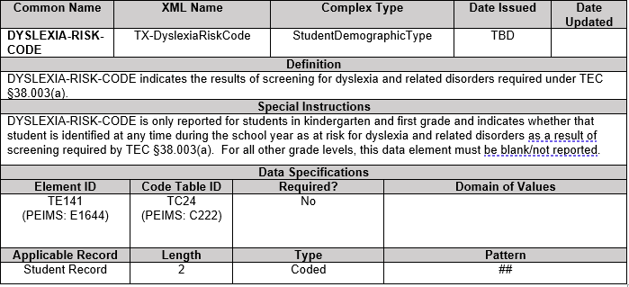
DYSLEXIA-RISK-CODE: DATA ELEMENT
DYSLEXIA-RISK-CODE (TE141)

Slide 15
DYSLEXIA-RISK-CODE: CODE TABLE
DYSLEXIA-RISK-CODE (TC24)

Slide 16
Questions

