Slide 1
ODS 3.x

Slide 2
AGENDA
ODS 3.x
Overview and Background
Current Process vs Planned Process
High Level Architecture & User Process Flow
Key Changes & Expected Benefits
Phased Implementation
Pilot Program
Parallel Submission
LEA Partnerships
Training and Support
Training for ESC Champions
Supporting Parallel Submission
Resources
Frequently Asked Questions
To the Administrator Addressed (TAA)

Slide 3
OFFICE OF INFORMATION TECHNOLOGY
Customer Relationship Management & Data Standards Department
Information Technology
A multi-year initiative to upgrade the Operational Data Store (ODS) and Texas Education Data Standards (TEDS) to a current version of Ed-FI.

Slide 4
CURRENT PROCESS
DATA LOADING
LEAs extract data from their source systems in eXtensible Markup Language (XML) format
LEAs manually load the XML files for each data collection into the Operation Data Store (ODS).
DATA PROMOTION
LEAs promote data from the ODS to the TSDS data marts for a specific collection
LEAs resolve any issues preventing data from being promoted and ensure data completeness
DATA VALIDATION
LEAs run validation checks and resolve issues by updating their source system data and reloading
LEAs run validation reports to ensure data accuracy and verify the data collection

Slide 5
WHAT IS EXPECTED TO CHANGE?
CURRENT TSDS
Data extracted with XML files from source systems and submitted by LEAs
Vendors provide calculated values, such as Eligible Days Present for a six-weeks period
Based upon Ed-Fi 1.0 Data Standards
Separate collections in the ODS (PEIMS & TSDS CORE)
Most validations downstream
TSDS ODS 3.x
Data submitted with Application Program Interface (API) transactions
TEA calculates values based on the transactional data from the LEA’s ODS
Based upon Ed-Fi 3.x Data Standards
Effective dating for TEA submissions
More validations at local level
MANUAL DATA LOADS
AUTOMATED API LOADS

Slide 6
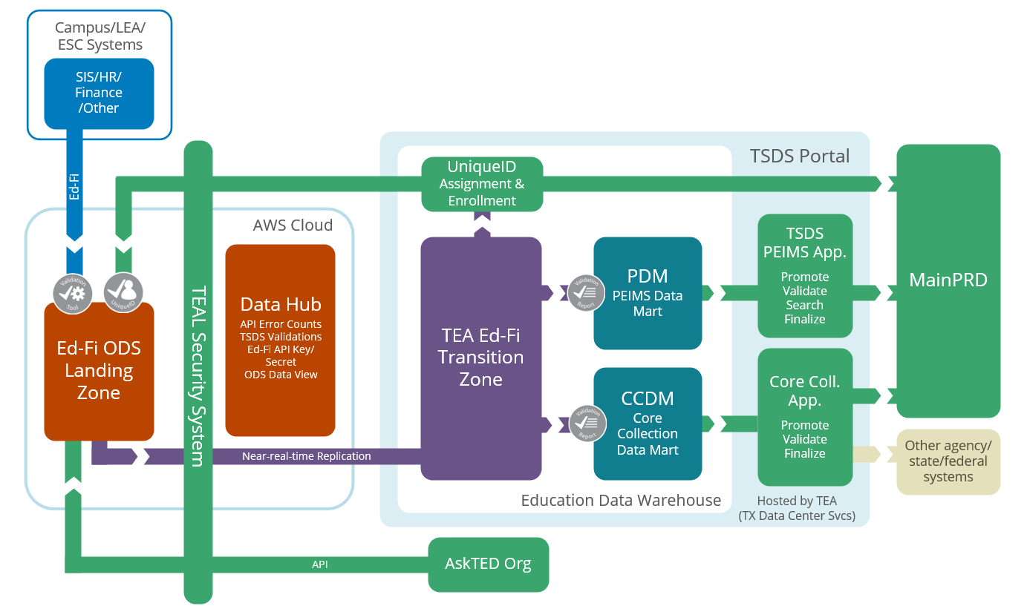
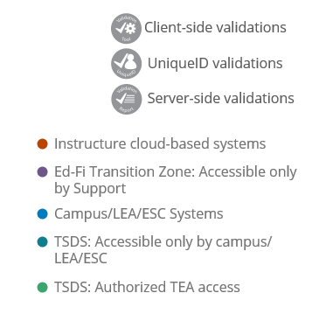
ODS 3.x ARCHITECTURE

Slide 7
ODS 3.x ARCHITECTURE: LANDING ZONE
Data
Landing Zone
Local Ed-Fi ODS per LEA
Source system vendors will publish data via APIs
LEAs will be able to run validations & view data through local application

Slide 8
ODS 3.x ARCHITECTURE: TRANSITION ZONE
Data
Transition Zone
Near real-time data pulls from Landing Zone
Landing Zone will filter and allow only TSDS mandated data to be pulled
LEAs promote and complete data submissions as they do now

Slide 9
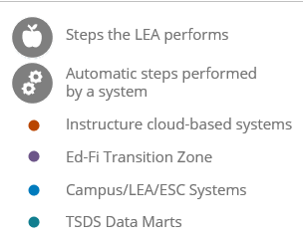
ODS 3.x USER PROCESS FLOW

Slide 10
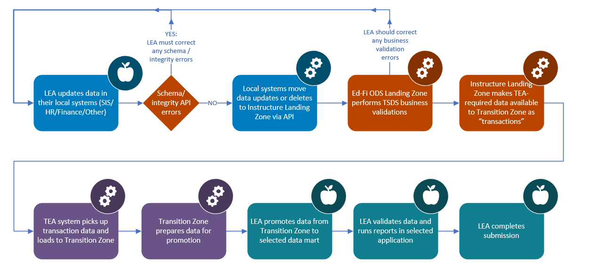
LEVELS OF VALIDATIONS
LEVEL 2
LEVEL 1
LEVEL 1.5
LEVEL 3

Slide 11
ATTENDANCE AND ENROLLMENT
Attendance
1. Granular negative attendance by student which will eliminate the requirement for SIS vendors to calculate attendance by six-weeks.
2. Cumulative attendance by six-weeks by student. (no change from the way attendance is currently collected)
Enrollment
TEA plans to collect attendance data two ways in the 2023-2024 school year:
Enrollment and withdrawal data will be collected at the student level in the ODS.
This data will be sent to the UID Enrollment Tracking application so LEAs will no longer have to load this data in the UID system.
Note: TEA will discontinue collecting cumulative attendance after confirming attendance calculations.

Slide 12
WHAT IS REMAINING THE SAME?
All processes that occur from the ODS to the data mart will remain as-is
Reports will remain available in downstream applications
Existing business rule validations
TEAL authentication for TSDS applications
TSDS Unique ID assignment for staff and students
TSDS Web-Enabled Data Standards (TWEDS) will continue to provide specifications and guidance

Slide 13
WHAT BENEFITS WILL THE UPGRADE PROVIDE?
Better alignment to existing Ed-Fi vendor products by being on the current version of the Ed-Fi standard.
More robust validation process earlier in the data loading process.
Eliminates bulk load processes and requirement for vendors to implement logic for data extraction. Data will be loaded to ODS transactionally with APIs.
Elimination of bulk loading will resolve current ODS performance issues.
Each LEA will have a Local ODS that can be used for purposes other than state reporting.

Slide 14
LOCAL USE OF ODS
The TSDS ODS 3.x project will provide an Ed-Fi Operational Data Store (ODS) for each LEA to utilize for state reporting and local use.
This project will allow source system vendors the ability to publish transactional data to an LEA’s Landing Zone (ODS) beyond the reporting requirements of TSDS.
Logic will be implemented in the LEA’s Landing Zone to ensure only the state mandated data is reported to TEA’s Transition Zone (ODS) and utilized for TSDS data submissions.

Slide 15
PHASED IMPLEMENTATION
Pilot
Parallel
Go Live
July 2021 – August 2022
Pilot program for TSDS vendors
Consists of a series of mini-pilots
August 2022 – August 2023
Parallel submission for participating LEAs
LEAs validate API transactions against XML
August 2023 – August 2024
Go-Live for 2023-2024 school year
XML submissions no longer accepted for TSDS

Slide 16
PILOT PROGRAM: 2021-2022
PURPOSE: Optional opportunity for vendors to develop and test their product solution through the integration, data out, and end-to-end testing phases in preparation for the 2022-2023 parallel submission year.
FOCUS: For the 2021-2022 Pilot Program, vendors will develop and test against the following TSDS data submission requirements:
PEIMS FALL
CLASS ROSTER FALL
CLASS ROSTER WINTER
CHILD FIND

Slide 17
PILOT PROGRAM: TIMELINE
JULY 2021 –
OCTOBER 2021
Pilot Vendor 1: PowerSchool
SDK & Hosted Sandboxes
NOVEMBER 2021 –
MARCH 2022
Pilot Vendor Cohort – 6 vendors
Level 1 Validations & UID Validation
MAY 2022 –
AUGUST 2022
Partner LEA Testing (TBD)
User Interfaces & Validations
INTEGRATION
TEDS PUBLICATION
DATA OUTPUT
TEDS PUBLICATION
END-TO-END
MAY 2021
Statewide Vendor Kickoff
OCTOBER 2021 -
NOVEMBER 2021
Pilot ODS 3.x Data Standards
Pilot Vendor 2: Ascender
MARCH 2022 – APRIL 2022
Updated ODS 3.x Data Standards

Slide 18
PARTICIPATING PILOT VENDORS
PILOT PROGRAM: The following vendors have committed to the pilot program. TEA continues to communicate and provide guidance to all source system vendors through frequent webinars.
Aeries
February 2022
Skyward
February 2022
PowerSchool
August 2021
Frontline
February 2022
Tyler Technologies
February 2022
Ascender
November 2021

Slide 19
VENDOR COMMUNICATIONS
WEBINARS: TEA has conducted the following statewide webinars for sources system vendors to attend and receive information and guidance on this project.
May 25, 2021
June 1, 2021
Ed-Fi Certification
August 30, 2021
September 29, 2021
February 7, 2022
Pilot Vendor Cohort
Project Kickoff
Architecture and Design
Texas Education Data Standards
December 8, 2021
Software Development Kit
April 6, 2022
Next Scheduled Webinar

Slide 20
PARALLEL SUBMISSION
2022-2023: Parallel Year
LEAs will submit both XML and API data
LEAs will validate against reports and validations
Obtain TSDS compatible designation
2023-2024: Go-Live Year
Only API transactions will be accepted for TSDS
XML data loads will not be available
Complete vendor readiness
For the 2022-2023 parallel submission year, TEA would expect
to have 250 LEAs participating to ensure system readiness.

Slide 21
LEA PARTNERSHIPS
Parallel Submission (2022-2023)
Each vendor will partner with at least one LEA to submit API data based upon the TEDS 3.x specifications, along with their current XML data submissions.
LEAs will verify the ODS 3.x data against their official 2022-2023 TSDS submissions to ensure vendor readiness for the go-live year in 2023-2024.
TEA will be coordinating with source system vendors and ESCs to solicit parallel LEAs in the coming months. LEAs should contact their vendor(s) if interested.
Source System Vendors
Parallel LEAs
ODS 3.x Readiness
ESC
Training & Support

Slide 22
KEY TAKEAWAYS
LEAs submit TSDS data through API transactions, rather than XML and review business validations locally.
LEAs will be provided their own Ed-Fi ODS (Landing Zone) for local validations and reporting.
LEAs should contact their vendors to participate in the parallel submission year and ensure vendor readiness.
2021-2022 Pilot Program
2022-2023 Parallel Year
2023-2024 Go-Live
DATA COLLECTION
TSDS snapshot and collection due dates will not change. Effective dating will be utilized to promote data to respective TSDS data submissions.
Negative attendance will be collected at granular student and cumulative levels for initial rollout.
LEAs will no longer need to load student enrollment and withdrawal data into Unique ID application. This will be collected via ODS 3.x transactions.

Slide 23
TRAINING FOR ESC CHAMPIONS
New Certification Designations
TSDS Technical 3.x Champion
TSDS Data Hub Administration and Security Champion
TSDS ODS 3.x Technical Training
September 7, 2022 / September 13, 2022 / September 20, 2022
Audience: currently certified Technical Champions
Dates currently reserved for CETs will be used for new 3.x certification training. Hold those days.
TSDS ODS 3.x Program Area Training
September 8, 2022 (new)
Audience: currently certified in any Program Area
Child Find, Class Roster, CSW, ECDS, PEIMS, RFT, SELA, or SPPI-14
New User Training
October 3-14, 2022
Focused on submitting data in new ODS 3.x format only.

Slide 24
TSDS TRAINING ADVISORY GROUP (TTAG)
Purpose:
Review one or more of the ten training course decks for the TSDS ODS 3.X project and provide feedback.
Ensure that the content provided is relevant, effective, and at the right level of detail.
Identify any gaps in training materials that need to be addressed to ensure LEA and/or ESC staff have a complete understanding of the new TSDS ODS 3.X system.
Give TTAG members an opportunity to collaborate and provide input on the proposed changes shared by other TTAG members.
Time commitment:
Minimum of 4 hours per month (April – September 2022) per training course deck reviewed

Slide 25
VOLUNTEERS NEEDED
Text:
@TTAG to (833)756-0874
Email:
TSDS_Training@TEA.Texas.gov

Slide 26
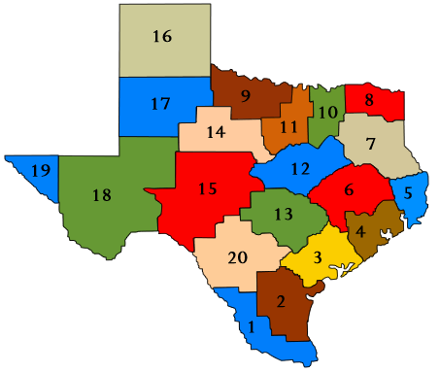
SUPPORTING PARALLEL SUBMISSION
Technical Support: ESCs will be expected to support any LEA(s) participating in the 2022-2023 parallel submission.
Parallel LEAs |  | TEA will coordinate with vendors to ensure at least one LEA for each ESC region.
Parallel Portal |  | There will be a dedicated TSDS ODS 3.x parallel portal for participating LEAs.
TEAL Access |  | TEA will use TEAL for the parallel portal and Data Hub application access.
TIMS Support |  | LEAs will submit any issues and data discrepancies through the TIMS system.

Slide 27
FREQUENTLY ASKED QUESTIONS
How can interested LEAs participate in the parallel submission?
TEA is encouraging LEAs interested in participating in the parallel submission to contact their source system vendor(s) directly to ensure their product is ready and available for ODS 3.x API transactions.
TEA will be coordinating with source system vendors and ESCs prior to the start of the 2022-2023 parallel submission to ensure proper diversity in terms of LEA enrollment size and regional location.
For any assistance with vendor coordination, LEAs can email TSDSDeployment@tea.texas.gov with their vendor and product information.

Slide 28
FREQUENTLY ASKED QUESTIONS
How will ESC Champions be informed of LEAs participating in the parallel submission year?
TEA will be directly communicating and coordinating with ESC Champions to inform them of any LEA(s) committed to participating in the 2022-2023 parallel submission.
ESCs will be provided training, guidance, and materials by TEA to conduct their own trainings with participating LEAs.

Slide 29
FREQUENTLY ASKED QUESTIONS
How will participating LEAs conduct testing and verification of their parallel submission to ensure vendor readiness?
LEAs will submit their official XML data submissions along with the ODS 3.x API transactions provided by their vendor. Prior to the TSDS collection due dates, LEAs will compare and verify the XML data against the ODS 3.x data through promotions, validations, and reports available in the TSDS parallel portal.
LEAs are strongly encouraged to conduct this comparison while validating their official XML data submissions to ensure the ODS 3.x local validations and downstream data mart validations are working as expected.

Slide 30
FREQUENTLY ASKED QUESTIONS
Will there be bulk load functionality available for vendors and/or LEAs in ODS 3.x?
Currently TEA is not expecting to implement bulk load functionality to allow LEAs to load their data into ODS 3.x.
All data submissions into the ODS will utilize the Ed-Fi APIs.

Slide 31
FREQUENTLY ASKED QUESTIONS
Will there be delete functionality available for vendors and/or LEAs in ODS 3.x?
The ODS 3.x upgrade will eliminate the requirement for a Delete Utility. Data deletes will be submitted through the API just as add and change transactions are submitted. LEAs will have transparency into what data has been loaded in the Landing Zone and what data was loaded into to the Transition Zone.

Slide 32
FREQUENTLY ASKED QUESTIONS
Will TSDS still require individual TSDS PEIMS and CORE submissions?
The ODS 3.x upgrade will eliminate the requirement for data to be designated as "PEIMS" or "Core" data. All data submitted through the APIs will be stored in the ODS.
Data will be promoted from the ODS for specific collections based on "effective dating" by using begin and end dates as delivered by the Ed-Fi model.
Data elements that require begin and end dates are identified in the data standards.

Slide 33
FREQUENTLY ASKED QUESTIONS
How will TEA ensure vendor readiness for the 2023-2024 Go-Live year?
TEA is requiring all TSDS source vendors to participate in the 2022-2023 parallel submission year with at least one LEA.
Vendors will be required to obtain Ed-Fi certification for their products prior to the 2023-2024 Go-Live year. In addition, TEA will be providing a TSDS Compatible Designation to vendors that successfully complete the parallel submission requirements and have been confirmed by their participating LEA(s).
TEA will continue to provide frequent communications, guidance, and support to vendors throughout the process.

Slide 34
TAA LETTER
Published To the Administrator Addressed (TAA) on September 30, 2021

Slide 35
Questions

Slide 36
ODS 3.x ARCHITECTURE

Slide 37
LEVELS OF VALIDATIONS
LEVEL 2
LEVEL 1
LEVEL 1.5
LEVEL 3

