Slide 1
Agenda
Welcome
Statewide Programs of Study
Innovative Courses
Industry-Based Certifications
CCMR Accountability
CTE Indicator Autocoding
New CTE Calculations
Tiered CTE Funding
CTE Funding Requirements

Slide 2
CTE Statewide Programs of Study

Slide 3
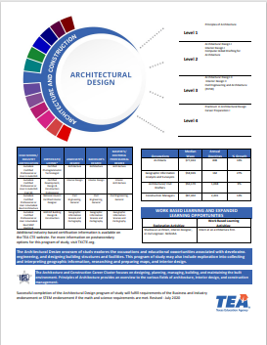
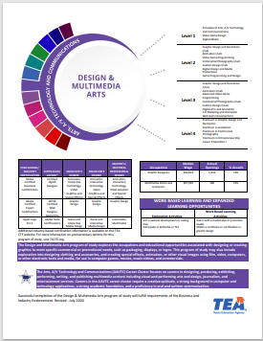
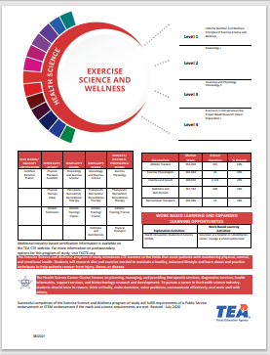
CTE Programs of Study
Texas has 53 statewide programs of study in 14 career clusters
  High wage
  In-demand
  High skill
Texas currently has 8 regional programs study
  Includes all LEAs in the Education Service Center
  Region.
  Based on regional Labor Market Information
  Applications for regional programs of study open
  every year.
  Approved applications are good for four years

Slide 4
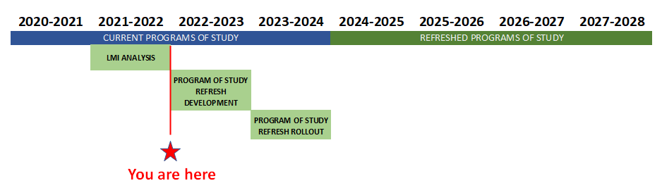
Programs of Study Refresh Timeline

Slide 5
Innovative Courses

Slide 6
Innovative Courses to Support Programs of Study - 2020
Year 2 - Implemented 2021
Year 3 – TBD In Review for 2022 Implementation
Advanced Court Systems
Applied Nutrition and Dietetics
Child Development Associate Preparation
Communication and Technology in Education
Computer Aided Drafting for Architecture
Concepts of Distribution & Logistics Technology
Entrepreneurship II
Foundations of Restaurant Management
Introduction to Dental Science
Introduction to Event and Meeting Planning
Introduction to Imaging Technology
Introduction to Pharmacy Science
Kinesiology I
Logistics Engineering
Marketing
Principles of Allied Health
Principles of Cloud Computing
Principles of Community Services
Principles of Diagnostic Healthcare
Principles of Exercise and Wellness
Principles of Health Informatics
Principles of Nursing
Principles of Therapeutic HealthCare
Programmable Logic Controller I
Sheet Metal
Tourism Marketing Concepts and Applications

Slide 7
Innovative Courses to Support Programs of Study - 2021
Year 1 – Implemented 2020
Year 2 - Implemented 2021
Geographic Information Systems for Agriculture
Practicum in Entrepreneurship
Medical Intervention Evaluation and Research
Kinesiology II
Physical Therapy I
Pharmacy I
Practicum in Digital Audio Technology
Programmable Logic controller II
Science of Nursing
Dental Anatomy and Physiology
Clinical Ethics
Allied Health Therapeutic services
Practicum in Event and Meeting Planning
Social and Community Services
Imaging Technology I
Programable Logic Controller II
Introduction to Renewable Energy
Introduction to Instrumentation and Electrical
Optical Technician

Slide 8
Innovative Courses to Support Programs of Study - 2022
Physical Therapy II
Occupational Therapy I
Occupational Therapy II
IT Troubleshooting
Imaging Technology II
Dental Equipment and Procedures
Practicum in Energy
Advanced Instrumentation and Electrical

Slide 9
Industry-Based Certifications

Slide 10
IBC Reporting: Earned, Passed, and Attempted
Earned: Requires the state to account for high school students who earn an IBC as one indicator within the public school accountability system. HB22 (2017)
Passed: Reimbursement is provided once per high school student for any of the IBCs on the approved list if the student passed the exam. HB3 (2019)
Attempted: Perkins V – Texas must report progress toward indicators and any disparities, examine root causes.
*Beginning September 1, 2022.

Slide 11
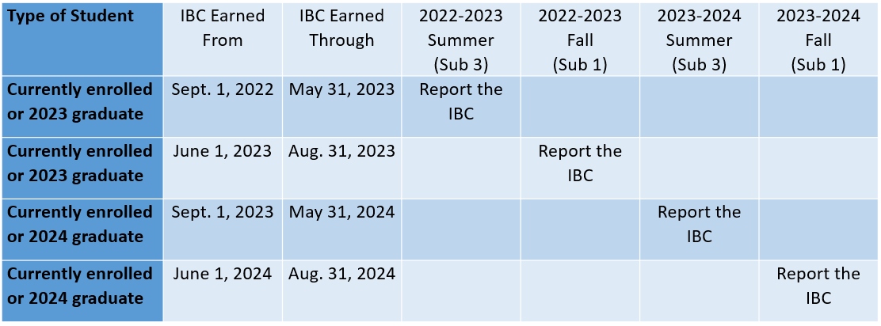
IBC Reporting Timeline
Data Element | Used by PEIMS Sub 1 | Used by PEIMS Sub 3
EFFECTIVE-DATE (TX-DateCertEarned) | Yes | Yes
POST-SECONDARY-CERTIFICATION- LICENSURE-CODE | Yes | Yes
POST-SECONDARY-CERTIFICATION-LICENSURE-RESULT | Yes | Yes
IBC-EXAM-FEE-AMOUNT | Yes | Yes
IBC-VENDOR-CODE | Yes | Yes

Slide 12
Release of 2022-2024 TEA Approved IBC List
The IBC list will be announced via listserv and placed on the TEA's CTE IBC webpage in the fall,
alongside a suite of guidance and supports.
The release of the new list will be accompanied by a sunsetting policy for the current list.
The new list is additive during the sunsetting period.
LEAs will be able to report IBCs from the previous list for both CCMR and reimbursement during
the sunsetting period.
IBC List Evaluation
873 unique IBCs sent to the Ray Marshall Center
8,830 responses to the surveys
579 IBCs determined to be industry recognized and valued, recommended for further evaluation
of remaining criteria

Slide 13
Changes to the IBC Vendor Crosswalk
Names of IBCs | • IBC names have been updated to match the certifying entity’s listings • IBCs will retain the unique identifier if they were previously on the list • New IBCs may be assigned a 3-digit or 4-digit unique identifier
Vendors | • For IBCs that have a set examination, certifying entities are listed rather than vendors​ • This allows greater flexibility for LEAs to select the vendor, approved by the certifying entity, that meets students’ needs​ • Certifying entities will receive a unique identifier

Slide 14
Changes to the IBC Vendor Crosswalk (cont.)
Additional Information | • The date the IBC will be sunset (if applicable) will be listed on each line • Certifying entity website addresses will be linked to the IBC name on the IBC Vendor Crosswalk so LEAs will have up-to-date information regarding qualifications to sit for an exam, cost, approved vendors, etc. • It is the LEA's responsibility to review the IBC Certifying Entity Crosswalk and certifying entities' websites to ensure compliance annually

Slide 15
CCMR Accountability

Slide 16
Updated CTE CCMR Indicators
Updated Indicators
Incorporate programs of study as required by statute, in alignment with industry-based certifications.
• Refreshed IBC list will be available Fall of 2022.
• Phase-in for aligned programs of study course Completers requirements is necessary to give schools time to adjust.

Slide 17
CTE Indicator Autocoding

Slide 18
What is CTE Indicator Autocoding?
In 2020-2021 TEA began autocoding CTE indicators
  Replaced district self-reported CTE indicator data
  Created new set of codes
  Utilized existing course completion data
  Created look-up tables and logic
  Used CTE indicators in state accountability and federal Perkins reporting
PEIMS data
Programs of Study Course Sequences
CTE Indicators
Auto-calculated
Look-up Tables
Summer Submission 3
Autocode Logic
Computer System

Slide 19

What are the Benefits of CTE Autocoding?
Workload reduction
  Reduced local staff time (local course completion documentation, student plans, course enrollment information)
  Shifted work from estimating CTE indicators to verifying CTE course completion data
Equitable calculations
  Created uniformity for coding student status within districts and the state
Portability
  Followed students that transferred within the state

Slide 20
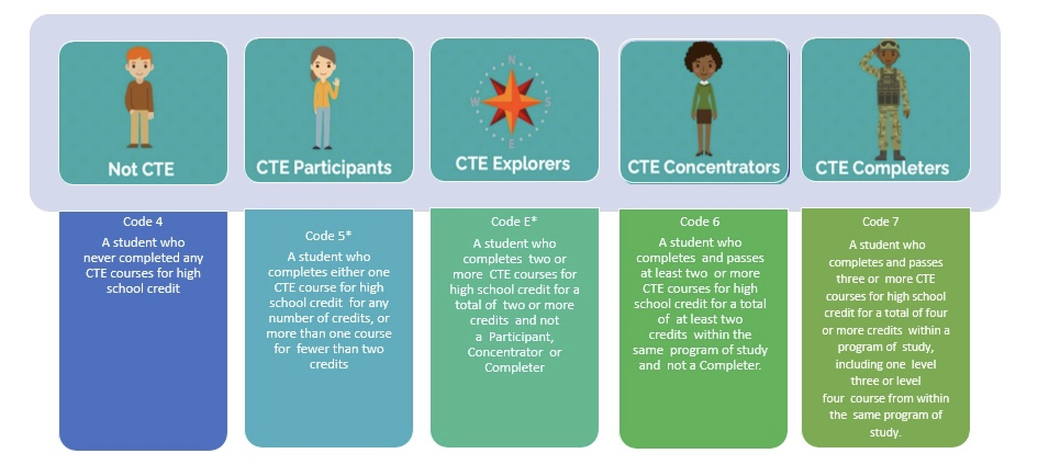
What are the CTE Indicator Codes?
*Students do not have to pass courses to be coded as a Participant or Explorer

Slide 21
Sample of TSDS PEIMS Data Elements Used
C022 SERVICE-ID
Provides eight-digit codes and names to identify courses.
C220 PROGRAM-OF-STUDY- CODE
Provides code set and names for statewide and regional programs of study.
C227 STATE-CAREER- CLUSTER-CODE
Provides code set and names of state programs of study.
C135 COURSE-SEQUENCE-CODE
C136 PASS/FAIL-CREDIT- INDICATOR-CODE
In order for the course to count in calculations, it must be the last course in a sequence.
To count toward Concentrator/Completer status, students must complete, pass, and receive credit.

Slide 22
C135 COURSE-SEQUENCE-CODE
C135 COURSE-SEQUENCE-
CODE
C136 PASS/FAIL-CREDIT- INDICATOR-CODE
C220 PROGRAM-OF-STUDY- COD
C227 STATE-CAREER- CLUSTER-CODE

Slide 23
C136 PASS/FAIL-CREDIT-INDICATOR-CODE
C135 COURSE-SEQUENCE-
CODE
C136 PASS/FAIL-CREDIT- INDICATOR-CODE
C220 PROGRAM-OF-STUDY- COD
C227 STATE-CAREER- CLUSTER-CODE
C228 FEDERAL-CREER- CLUSTER-CODE

Slide 24
New CTE Calculations

Slide 25
CTE Weighted Funding Survey
The first step in calculating CTE FTEs is adding up each student’s V-codes.
True
False

Slide 26
Why is this important?
House Bill 1525 changed the calculations for Career and Technical Education funding.
  What has not changed?
  What has changed?
  Updates to TSDS PEIMS reports

Slide 27
CTE Funding Calculations Update
The 87th Texas Legislature passed House Bill (HB) 1525, which amends state law related to weighted funding for students who take career and technical education (CTE) courses for high school credit.
The legislation established that a district is entitled to weighted funding for each full-time equivalent student in average daily attendance in an approved CTE course in grades 7-12, beginning in the 2021-22 school year.
This weighted tier funding for high school credit CTE courses will be calculated by the State Funding Division at TEA after the submission/resubmission closes and all aggregated data has moved to TEA’s main database.
A TAA Letter was sent on August 5, 2021, outlining this update: August 5, 2021, TAA Letter

Slide 28
Calculating CTE Funding
What has NOT Changed for PEIMS | What has NOT Changed for the State Funding Division
TSDS PEIMS will calculate CTE Contact Hours and FTEs during the promotion process. | The State Funding Division at TEA will perform funding calculations after the PEIMS Summer submission and/or resubmission closes, and aggregated data has moved to TEA's main database.
What Has Changed for PEIMS | What Has Changed for the State Funding Division
TSDS PEIMS will perform the Contact Hour and FTE calculations on Tier 1, Tier 2, and Tier 3 CTE Service ID courses separately. | The State Funding Division will calculate the funding on Tier 1, Tier 2, and Tier 3 FTEs separately with the specified Tier Weight for each Tier.

Slide 29
Tiered CTE Funding
House Bill 1525 (87th Texas Legislature) amended state law related to weighted funding for students enrolled in career and technical education (CTE) courses for high school credit.
Began 2021-2022 SY
Earned for each FTE in average daily attendance; V-Codes 1-3
Applies to grades 7 through 12
Weighted Funding | Definition
1.1 | High school CTE courses not in an approved Program of Study
1.28 | Levels one and two CTE courses in an approved Program of Study, as identified by TEA
1.47 | Levels three and four CTE courses in an approved Program of Study, as identified by TEA

Slide 30
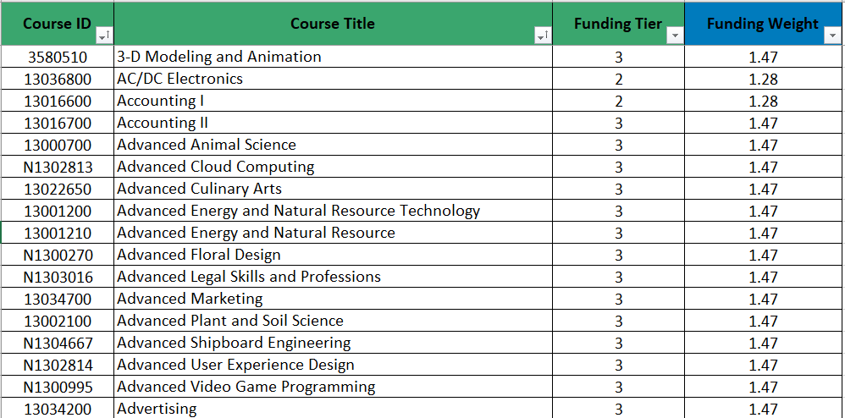
Alpha Listing of All CTE Courses
Alphabetic Listing of CTE Courses with Weights

Slide 31
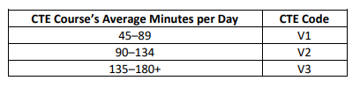
CTE Funding Requirements
Student Attendance Accountability Handbook
Section 5.5 CTE (Contact Hour) Codes
Each CTE course must be reviewed separately to determine the average minutes per day students attend that course in a 10-school day period.
V1= 45 minutes minimum per class period and at least 450 minutes over two weeks.

Slide 32
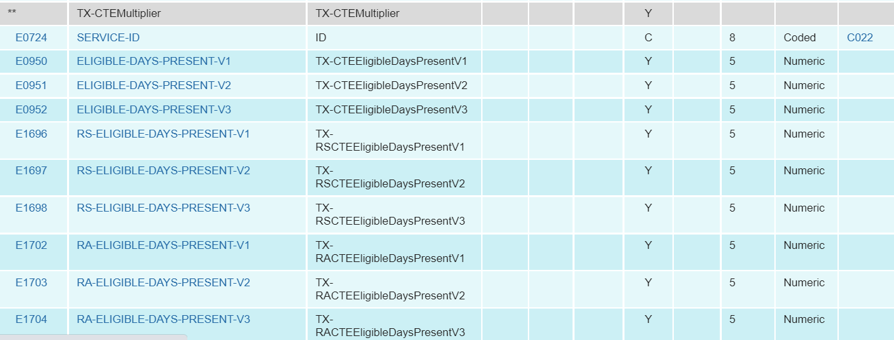
New Sub-Complex Type
Added new sub-complex type to collect CTE attendance data:
SpecialProgramsReportingPeriodAttendanceExtension
  TX-CTEMultiplier with the existing data elements:
            SERVICE-ID
            ELIGIBLE-DAYS-PRESENT V1-V3

Slide 33
Tier Weighted Funding Calculations
  TSDS PEIMS will categorize the FTE totals by tier so that the State Funding Division will know which tier weight to apply to the district-level data that is received from PEIMS.
  TEA’s State Funding Division will calculate the weighted tier funding for CTE courses after the submission/resubmission closes and aggregated data has moved to TEA's main database.

Slide 34
Sample CTE FTE Calculations

Slide 35
PEIMS Contact Hour Calculations
Contact Hour Calculations
V1 Eligible Days Present in Tier 1 CTE Service IDs × Contact Hour Multiplier = V1 Tier 1 Contact Hours
V2 Eligible Days Present in Tier 1 CTE Service IDs × Contact Hour Multiplier = V2 Tier 1 Contact Hours
V3 Eligible Days Present in Tier 1 CTE Service IDs × Contact Hour Multiplier = V3 Tier 1 Contact Hours
Add V1 Tier 1 + V2 Tier 1 + V3 Tier 1 for total Tier 1 Contact Hours.
*This calculation is repeated for Tier 2 and Tier 3 and is the same for In Person, RS, and RA. The three CTE FTE calculations are calculated by campus, track and reporting period.

Slide 36
PEIMS CTE FTE Calculations
CTE FTE Calculations
Total Tier 1 Contact Hours ÷ (Days Taught × 6 hours) = Tier 1 CTE FTEs
Total Tier 2 Contact Hours ÷ (Days Taught × 6 hours) = Tier 2 CTE FTEs
Total Tier 3 Contact Hours ÷ (Days Taught × 6 hours) = Tier 3 CTE FTEs
*The calculations are the same for In Person, RS, and RA. The three CTE FTE calculations are calculated by campus, track, and reporting period.

Slide 37
Service ID 13022650
Remember, funding is based on the Service ID for each CTE course. Course Levels and Tier Weights are assigned according to the Service ID.
Service ID 13022650 is in a POS and the CTE Funding Tier is 3.
The PEIMS calculation outputs CTE FTE totals by tier and are performed during promotion.
This example is for one student participating in this course in 1st sixweeks.

Slide 38
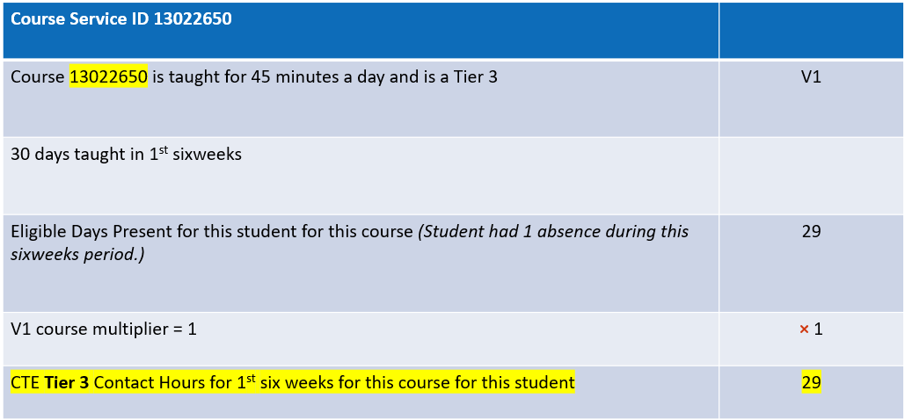
Calculating CTE Contact Hours

Slide 39
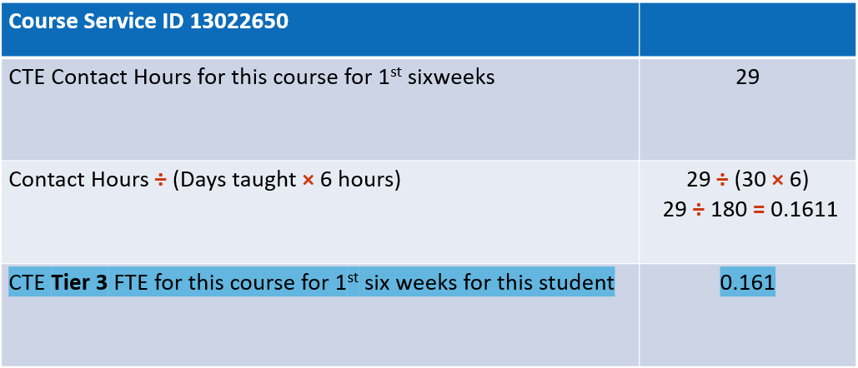
Calculating CTE FTE

Slide 40
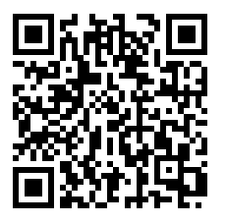
Webinar Evaluation
  Please use this QR code to access and complete a short webinar evaluation.

Slide 41

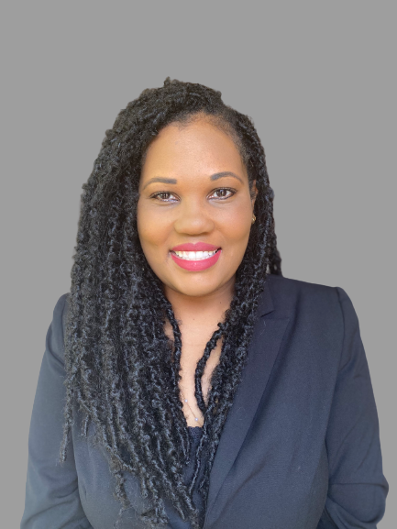


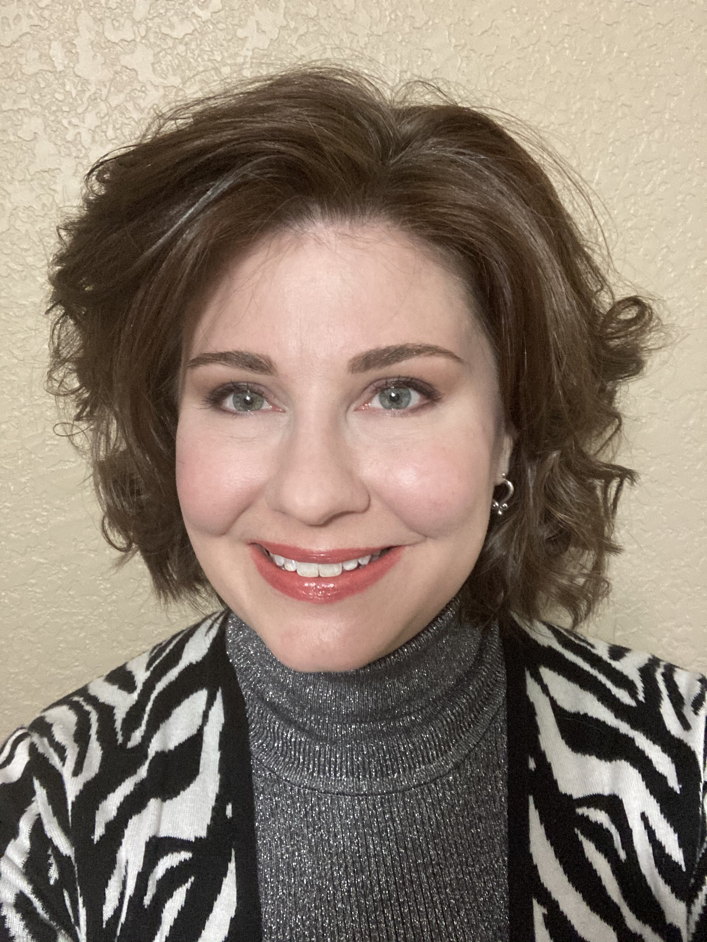


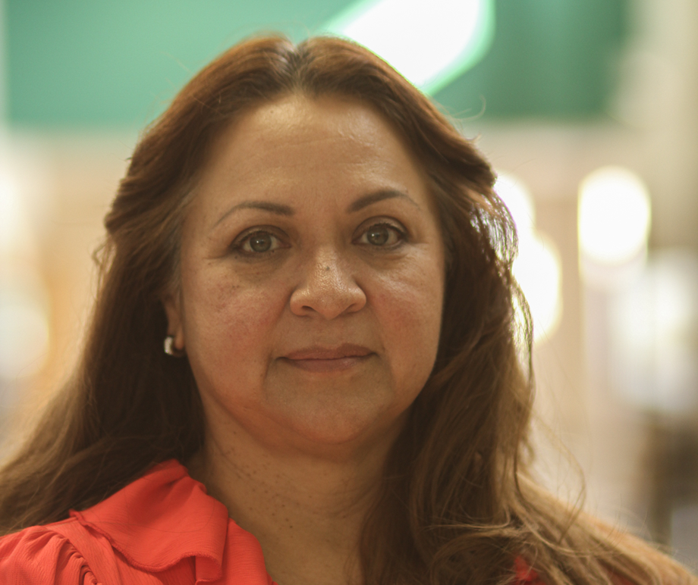
TEA Career and Technical Education Team
Marcette Kilgore
Statewide CTE Director
Erica Bates
CTE Coordinator
Career Clusters
--Education and Training
-Hospitality and Tourism
-Human Services
Jennifer Bullock
CTE Coordinator
Career Clusters
-Information
Technology
-STEM
-Manufacturing
Dale Fowler
CTE Coordinator
Career Clusters
-Business, Marketing and Finance
-Law and Public Service
Lacy Freeman
CTE Coordinator
Career Clusters
-Arts, AV
Technology and
Communications
-Autocoding
-IBCs
Les Hudson
CTE Coordinator
Career Clusters
-Agriculture, Food
& Natural Resources
-Architecture and
Construction
-Energy
Steve Smith
Project Management
Juanita Soto
CTE Coordinator
Career Clusters
-Health Science
-Transportation, Distribution and Logistics

Slide 42
TEA CTE Team – For Questions
TEA CTE Team | Email Address | ESC Regions Assigned
Erica Bates, CTE Coordinator | erica.bates@tea.texas.gov | ESC Regions 2, 3, and 20
Jennifer Bullock, CTE Coordinator | jennifer.bullock@tea.texas.gov | ESC Regions 7, 8, and 9
Dale Fowler, CTE Coordinator | dale.fowler@tea.texas.gov | ESC Regions 16, 17, 18, and 19
Lacy Freeman, CTE Coordinator | lacy.freeman@tea.texas.gov | ESC Regions 6, 12, 14, and 15
Les Hudson, CTE Coordinator | les.hudson@tea.texas.gov | ESC Regions 1, 10, and 11
Marcette Kilgore, CTE Director | marcette.Kilgore@tea.texas.gov | Statewide Director
Juanita Soto, CTE Coordinator | juanita.soto@tea.Texas.gov | ESC Regions 4, 5, and 13
TEA CTE Website

