Slide 1
Child Find

Slide 2
PLEASE NOTE:
The focus of this presentation is on the changes for the official XML data submissions during the 2022-2023 school year.

Slide 3
AGENDA
Child Find
  Program Area Updates & Guidance
  2021-2022
    Submission Updates
  2022-2023 Changes
    Application Updates
    Data Element Updates
    Report Updates
    Business Rule Updates
    Code Table Updates
    Guidance & Reminders
  Timeline
  Frequently Asked Questions
  Technical Resources
  Questions

Slide 4
PROGRAM AREA UPDATES & GUIDANCE
Special Education Program, Policy, Engagement, and Reporting
  Zane Wubbena Data Analyst; Department of Monitoring, Reporting, and Support
  Tammy Pearcy Director; Department of Monitoring, Reporting, and Support

Slide 5
2021-2022: SUBMISSION UPDATES
The 2021-2022 Child Find data collection closed on July 28, 2022.
  Completed Count: 1162

Slide 6
2022-2023

Slide 7
2022-2023: APPLICATION UPDATES
The Child Find data collection will be updated to collect the following new element:
  ELIGIBILITY-DELAY-REASON (E1731)
This optional data element will be collected in the TX-DelayReason sub-complex type in the InterchangeStudentProgramExtension.

Slide 8
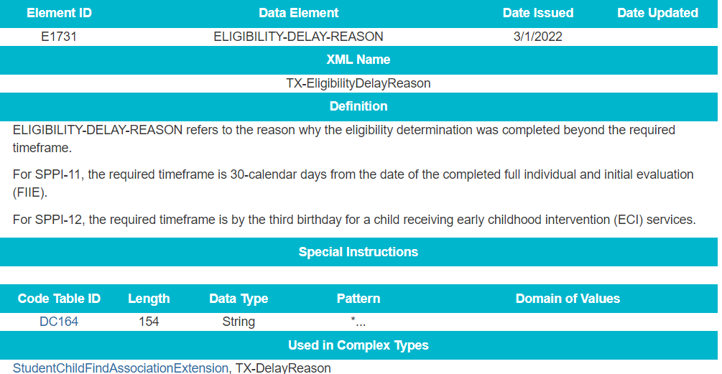
2022-2023: DATA ELEMENT UPDATES

Slide 9
2022-2023: DATA ELEMENT UPDATES

Slide 10
2022-2023: REPORT UPDATES
The following reports will be updated to add a column for the new element ELIGIBILITY-DELAY-REASON (E1731).
  CHF0-000-001: TSDS SPPI-11 Student Compliance Report
  CHF0-000-002: TSDS SPPI-12 Student Compliance Report

Slide 11
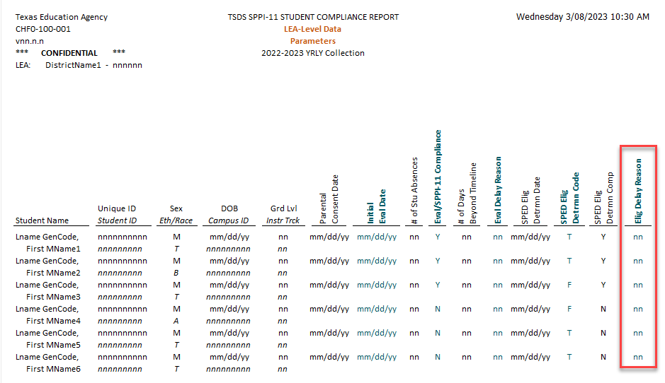
2022-2023: REPORT UPDATES
CHF0-100-001 Report Mockup

Slide 12
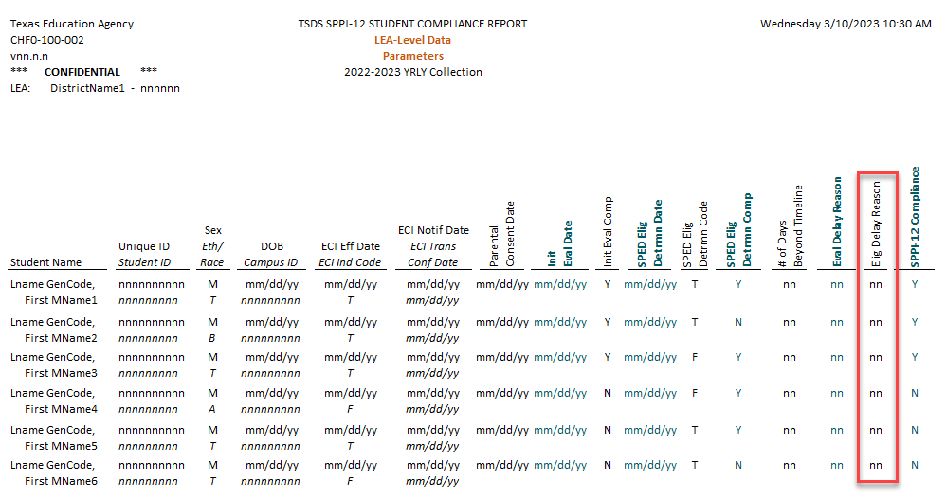
2022-2023: REPORT UPDATES
CHF0-100-002 Report Mockup

Slide 13
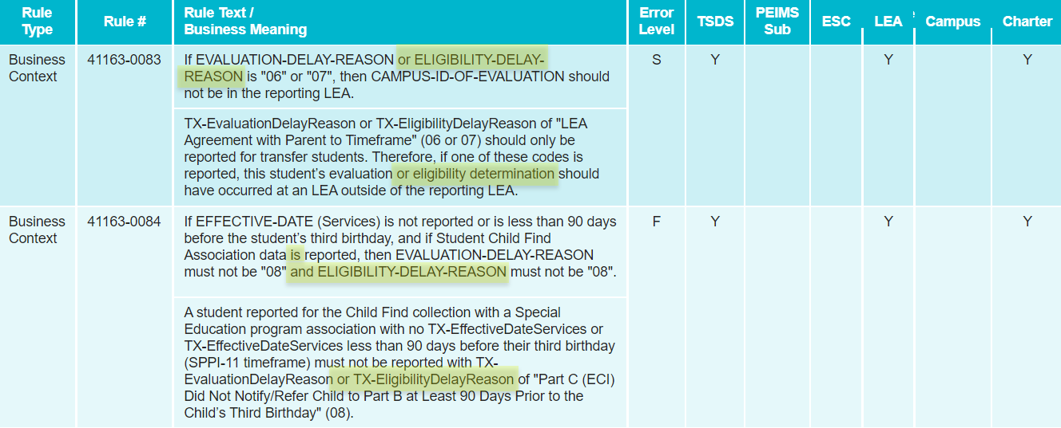
2022-2023: BUSINESS RULE UPDATES
Updated Business Rules

Slide 14
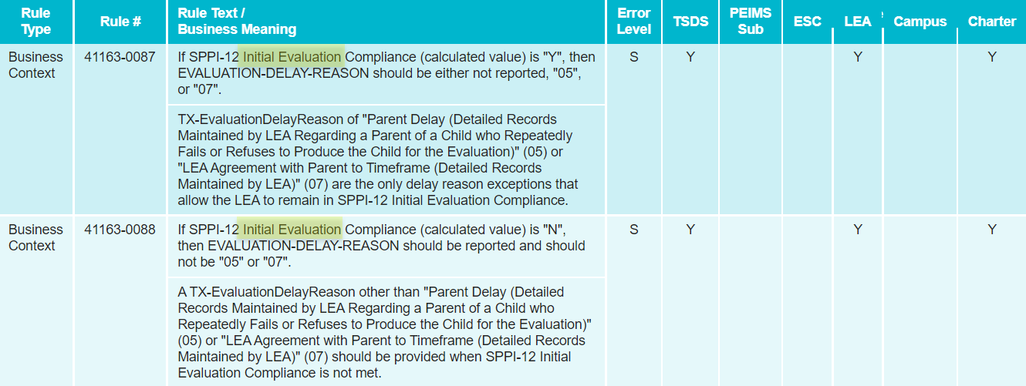
2022-2023: BUSINESS RULE UPDATES

Slide 15
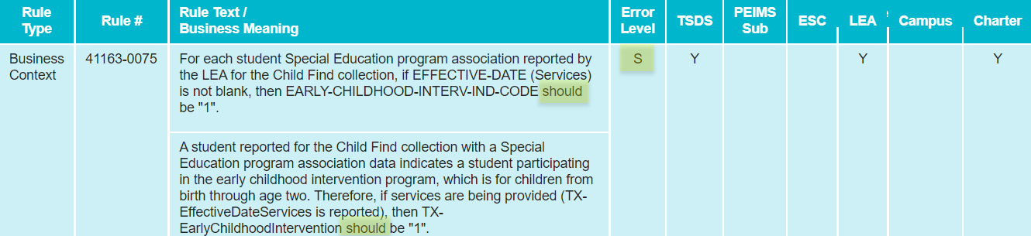
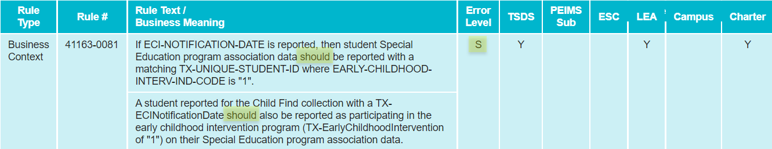
2022-2023: BUSINESS RULE UPDATES

Slide 16
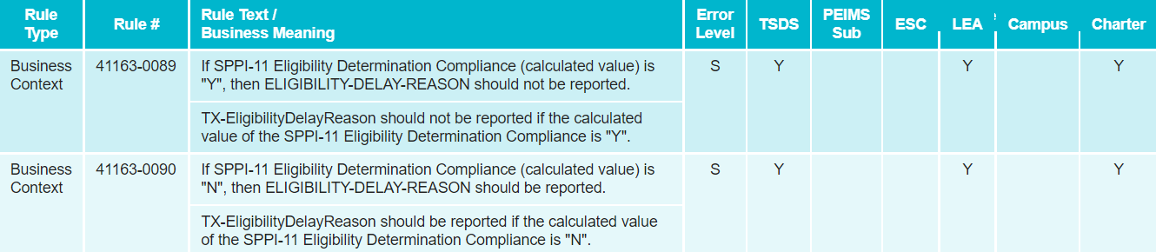
2022-2023: BUSINESS RULE UPDATES
New Business Rules

Slide 17
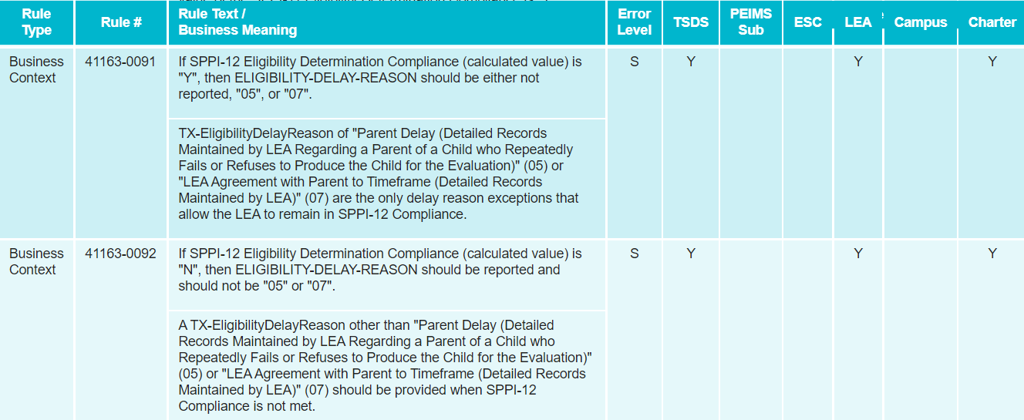
2022-2023: BUSINESS RULE UPDATES

Slide 18
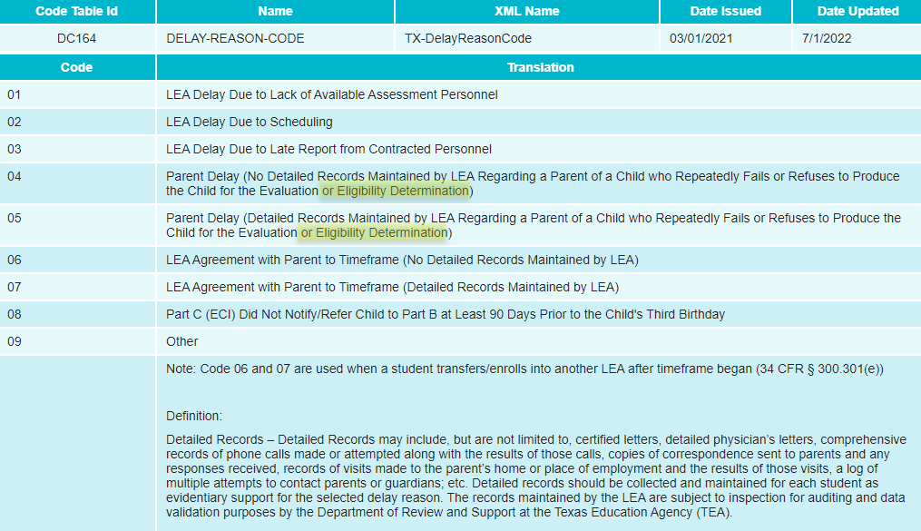
2022-2023: CODE TABLE UPDATES
Renamed EVALUATION-DELAY-REASON-CODE (DC164) to DELAY-REASON-CODE (DC164)

Slide 19
2022-2023: GUIDANCE & REMINDERS
Validation rules:
  41163-0085 and 41163-0086 (SPPI-11)
  41163-0088 and 41163-0089 (SPPI-12)
  LEAs should be closely reviewing these rules as they indicate that the system has calculated non-compliance for a student.
  Run student-level reports CHF0-100-001 (SPPI-11) and CHF0-100-002 (SPPI-12) to review all data elements for non-compliance students.
    Pay extra attention to E1711 STUDENT-ABSENCES-WITHIN-TIMEFRAME and all date-related data elements as they directly impact the compliance calculation performed by the system.
    Verify data elements are being reported according to TEDS and program area guidance.
    In addition to the student-level data, LEAs may also need to verify the calendar data being reported as it is used to determine the compliance timeframe.
Notes:
Mention compliance calculation issues fixed in deployments and that all fixes will remain in place for 2022-2023 school year.

Slide 20
2022-2023: GUIDANCE & REMINDERS
Data element E1632 EFFECTIVE-DATE
  Reported along with E0900 EARLY-CHILDHOOD-INTERV-IND-CODE for SPPI-12 children only.
  Used to report the date that the child began receiving services in the early childhood intervention program.
  Several LEAs were misreporting this as the date the child began receiving special education services.
REMINDER:
  If E1632 EFFECTIVE-DATE is not at least 90 calendar days before the child’s 3rd birthday the compliance is calculated based on SPPI-11 logic.

Slide 21
2022-2023: GUIDANCE & REMINDERS
Examples – E1632 EFFECTIVE-DATE
Student A
  E0006 DATE-OF-BIRTH = 01/10/2020
  E1632 EFFECTIVE-DATE = 09/15/2022
  Child’s 3rd birthday = 01/10/2023
  Child began receiving ECI services 118 days before their 3rd birthday, therefore their compliance is determined via the SPPI-12 timeframe.
Student B
  E0006 DATE-OF-BIRTH = 01/10/2020
  E1632 EFFECTIVE-DATE = 10/24/2022
  Child’s 3rd birthday = 01/10/2023
  Child began receiving ECI services 79 days before their 3rd birthday, therefore their compliance is determined via the SPPI-11 timeframe.

Slide 22
2022-2023: GUIDANCE & REMINDERS
Examples – E1632 EFFECTIVE-DATE
Student C
  E0006 DATE-OF-BIRTH = 01/10/2020
  E1632 EFFECTIVE-DATE = 01/11/2023
  Child’s 3rd birthday = 01/10/2023
  Invalid data entry – indicates the child began receiving ECI services after their 3rd birthday.
    Because the EFFECTIVE-DATE is still less than 90 days before the child’s 3rd birthday, the system uses the SPPI-11 timeframe to determine compliance.

Slide 23
2022-2023: GUIDANCE & REMINDERS
Data element E1714 PARENTAL-CONSENT-DATE
  This date should be reported as the first instructional date following the date on which the LEA received written consent for the full individual and initial evaluation (FIIE) from the student’s parent.
  Many LEAs misreported this as the date the parent provided written consent, not the following instructional date.
Reporting PARENTAL-CONSENT-DATE obtained during the Summer
  When the child’s PARENTAL-CONSENT-DATE and the INITIAL-EVALUATION-DATE occur over the Summer, data element E1714 PARENTAL-CONSENT-DATE should be backdated to the last day of school in the prior school year.
  If the PARENTAL-CONSENT-DATE occurs during the Summer, but the INITIAL-EVALUATION-DATE doesn’t occur until after the start of the new school year, LEAs should report E1714 PARENTAL-CONSENT-DATE as the first instructional day of the new school year.

Slide 24
2022-2023: GUIDANCE & REMINDERS
REMINDER:
  For SPPI-11 Initial Evaluation compliance, the date reported for PARENTAL-CONSENT-DATE is counted as the first day of the compliance timeframe. Misreporting this date could cause the compliance calculation to be inaccurate.

Slide 25
2022-2023: GUIDANCE & REMINDERS
Fatal validation rules 41163-0075 and 41163-0081
  These two rules forced all SPPI-12 children to be reported with an EARLY-CHILDHOOD-INTERV-IND-CODE = ‘1’.
  These were downgraded to a Special Warning in the June 24, 2022, software deployment.
  These two validation rules will remain as a Special Warning for the 2022-2023 submission to allow LEAs to report children with an EARLY-CHILDHOOD-INTERV-IND-CODE = ‘0’, when applicable.
REMINDER: LEAs reporting children with an EARLY-CHILDHOOD-INTERV-IND-CODE = ‘0’ will still need to report data element E1632 EFFECTIVE-DATE. This date indicates when the child began receiving ECI services.

Slide 26
2022-2023: GUIDANCE & REMINDERS
Reporting E1713 ECI-TRANSITION-CONFERENCE-DATE when no transition conference took place
  If there was no transition conference held between the agency providing ECI services, the family, and the LEA, then LEAs should be reporting data element E1713 ECI-TRANSITION-CONFERENCE-DATE with the same date reported for data element E1712 ECI-NOTIFICATION-DATE.
  If there was a transition conference held between the agency providing ECI services, the family, and the LEA, then LEAs should be reporting that date for data element E1713 ECI-TRANSITION-CONFERENCE-DATE.
REMINDER: Data elements E1712 ECI-NOTIFICATION-DATE and E1713 ECI-TRANSITION-CONFERENCE-DATE are both required to be reported for SPPI-12 children.

Slide 27
2022-2023: TIMELINE
Child Find Collection | Date
TSDS ready to load data to eDM | August 1, 2022
Child Find ready for users to promote data | September 12, 2022
Child Find ready for users to complete | May 15, 2023
Child Find submission due date for LEAs | July 27, 2023

Slide 28
FREQUENTLY ASKED QUESTIONS
What should be reported for data element E1714 PARENTAL-CONSENT-DATE if the parent provided consent during Summer and the student’s initial evaluation was completed in August before the new school year began?
When the student’s parent provides parental consent during the Summer months and the LEA completes the student’s initial evaluation before the new school year begins, the LEA should backdate data element E1714 PARENTAL-CONSENT-DATE to the last instructional day in the prior school year. LEAs should keep local detailed records of this date being used.

Slide 29
FREQUENTLY ASKED QUESTIONS
Should the actual day the parent provides consent for evaluation be reported for E1714 PARENTAL-CONSENT-DATE?
No. The data element E1714 PARENTAL-CONSENT-DATE represents the first instructional day following the day the LEA receives written consent for the full individual and initial evaluation (FIIE) from the student’s parent.

Slide 30
FREQUENTLY ASKED QUESTIONS
Should a delay reason for the eligibility determination be reported in the following scenario:
The student’s SPPI-11 initial evaluation was completed within the compliance timeframe but completing their eligibility determination was delayed. Report CHF0-100-001 is showing the student as in-compliance for SPPI-11, but non-compliance for the eligibility determination.
Yes, a delay reason should be reported for the eligibility determination. Beginning with the 2022-2023 school year, a new data element (E1731 ELIGIBILITY-DELAY-REASON) will be used to report delays related to the eligibility determination for both SPPI-11 and SPPI-12 students. The LEA should report a valid delay reason from the DC164 DELAY-REASON-CODE table for data element E1731.

Slide 31
FREQUENTLY ASKED QUESTIONS
Does E1713 ECI-TRANSITION-CONFERENCE-DATE need to be reported if the parent opted out of the ECI transition conference for one of the SPPI-12 children being reported. If so, what date should be reported?
Yes. E1713 ECI-TRANSITION-CONFERENCE-DATE is a required data element for all SPPI-12 children.
If the parent opted out of the ECI transition conference, the LEA should report data element E1713 ECI-TRANSITION-CONFERENCE-DATE as the same date reported for E1712 ECI-NOTIFICATION-DATE.

Slide 32
TECHNICAL RESOURCES
Technical Support:
  TIMS
  TSDSCustomerSupport@tea.texas.gov
  Tech Tips – Initial Evaluation and Eligibility Determination Compliance
Child Find Program Area
  spp@tea.texas.gov
  TIMS: Guidance questions will be routed to the program area
  SPPI-11 Guidance Documents
  SPPI-12 Guidance Documents
TIMS Knowledge Base Articles
  TSDSKB-620: SPPI-11 Compliance Flow Chart
  TSDSKB-621: SPPI-12 Compliance Flow Chart
  TSDSKB-622: Child Find Frequently Asked Questions

Slide 33
Questions

