Slide 1
TSDS ODS 3.x Data Standards

Slide 2
AGENDA
Texas Education Data Standards
Domain Review
Data Element Changes
Begin Date Guidance
Questions

Slide 3
TEXAS EDUCATION DATA STANDARDS
Pilot ODS 3.x Data Standards
TEA will maintain both the 3.x TEDS version and the current TEDS version (available in the TSDS Web-Enabled Data Standards (TWEDS)) throughout the ODS 3.x project. The 3.x TEDS version should be available in TWEDS in December 2022.

Slide 4
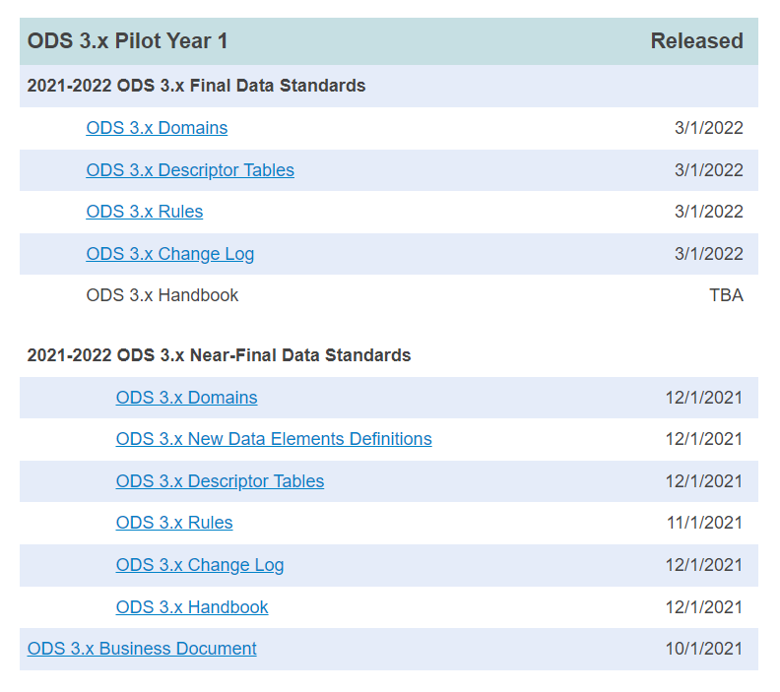
TEXAS EDUCATION DATA STANDARDS – PILOT YEAR 1
10/01/2021: ODS 3.x Business Document
12/01/2021: Near-Final Data Standards – ODS 3.x Domains, New Data Element Definitions, Descriptor Tables, Rules, Change Log and Handbook
03/01/2022: Final Data Standards – ODS 3.x Domains, Descriptor Tables, Rules, and Change Log
April, 2022: Final Data Standards – ODS 3.x Domains (any corrections needed after the 03/01/2022 publication).

Slide 5
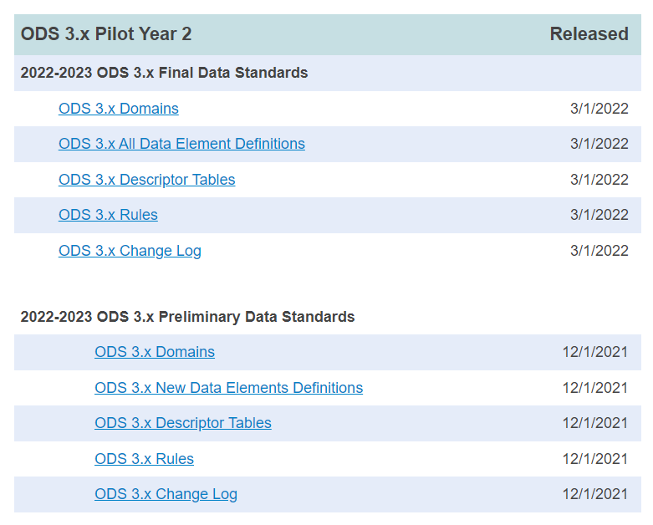
TEXAS EDUCATION DATA STANDARDS – PARALLEL YEAR
12/01/2021: Preliminary Data Standards – ODS 3.x Domains, New Data Element Definitions, Descriptor Tables, Rules, and Change Log
03/01/2022: Final Data Standards – ODS 3.x Domains, All Data Element Definitions, Descriptor Tables, Rules, and Change Log
April, 2022: Final Data Standards – ODS 3.x Domains (Including Attendance), All Data Element Definitions, Descriptor Tables, Rules, and Change Log

Slide 6
Domain Review

Slide 7
TERMINOLOGY REVIEW
Current TSDS Terminology | ODS 3.x Terminology
Interchanges | Domains/Domain Entities
Complex Type | Entity
Data Element | Data Element
Code Table | Descriptor Table

Slide 8
Data Standards Legend

Slide 9
DOMAIN OVERVIEW – Part 1
Based on Ed-Fi 3.2.0-c Version
Domains/Domain Entities Collected
Student Identification & Demographics Domain – provides the characteristics and demographics of a student and the education organization associated with the student.
Enrollment Domain – provides the enrollment and withdrawal information for a student and the relationship between a particular education organization.
School Calendar Domain – provides the specific calendar information for a particular school. A new entity Session is generally a unit of time into which courses are scheduled similar to a reporting period.
Staff Domain – provides the general staff information for a local education agency.

Slide 10
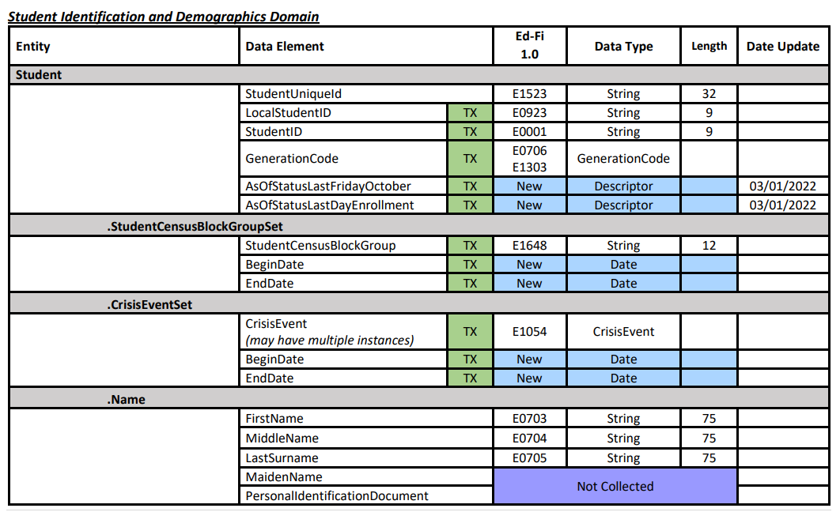
STUDENT IDENTIFICATION AND DEMOGRAPHICS DOMAIN

Slide 11
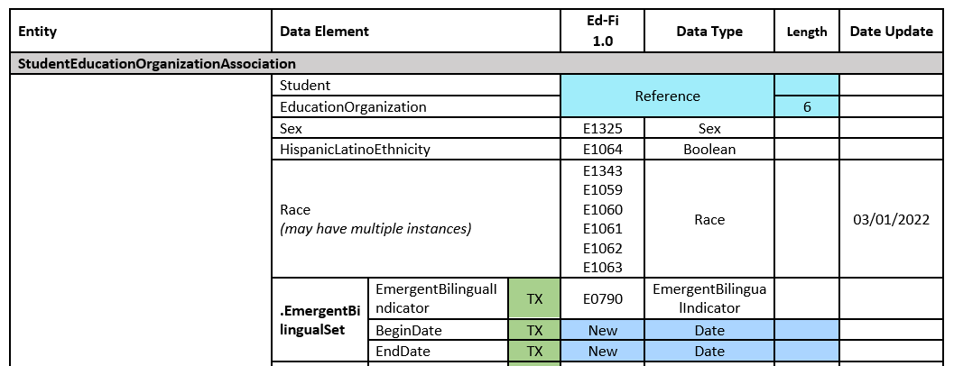
STUDENT IDENTIFICATION AND DEMOGRAPHICS EXTENSION CONT

Slide 12
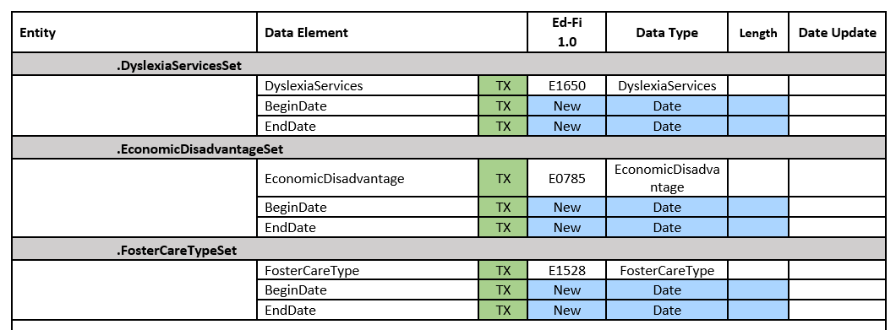
STUDENT IDENTIFICATION AND DEMOGRAPHICS EXTENSION CONT2

Slide 13
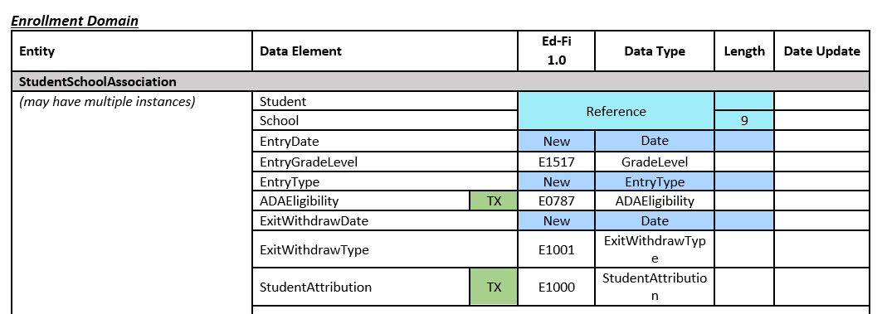
ENROLLMENT DOMAIN

Slide 14
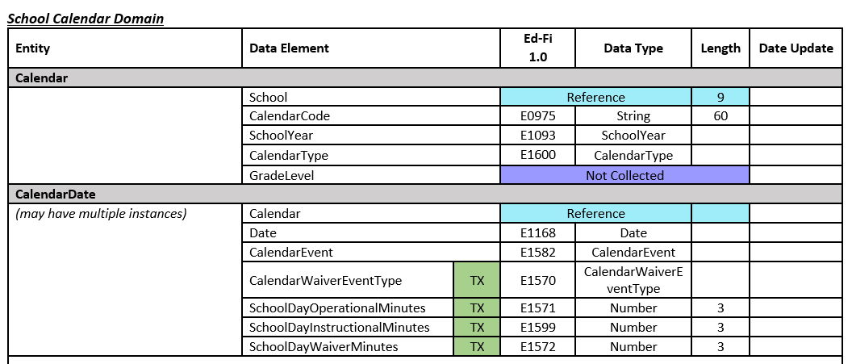
SCHOOL CALENDAR DOMAIN

Slide 15
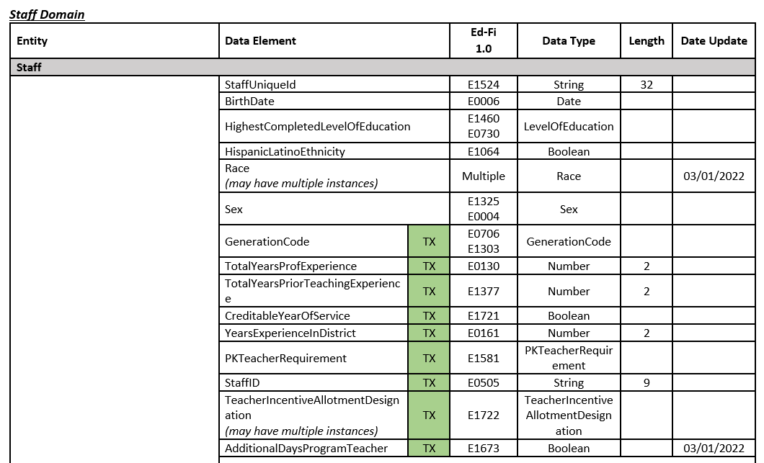
STAFF DOMAIN

Slide 16
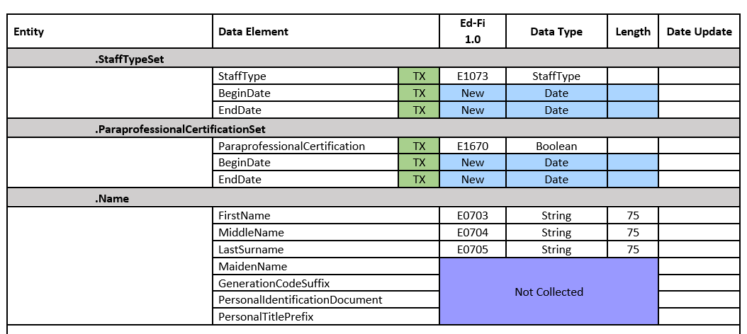
STAFF DOMAIN CONT

Slide 17
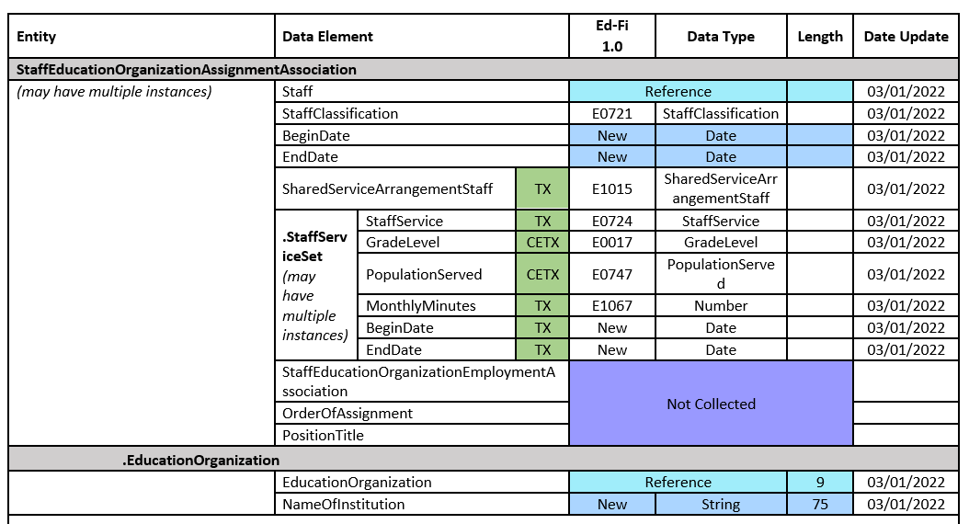
STAFF DOMAIN CONT3

Slide 18
DOMAIN OVERVIEW – Part 2
Based on Ed-Fi 3.2.0-c Version
Domains/Domain Entities Collected
Education Organization Domain – provides information about any public, charter, education service center, organization or agency.
Alternative & Supplemental Services Domain – provides program information such as Title I, Special Education, and Emergent Bilingual.
Discipline Domain – provides the discipline incidents, the student associated to the incident, and any actions that were taken against the student.
Restraint Event Domain Entity – provides the restraint information and the student associated to the restraint.
Teaching & Learning Domain – provides the course information, the students assigned to a course offered on a particular campus and the staff member that provides instruction for the course.

Slide 19
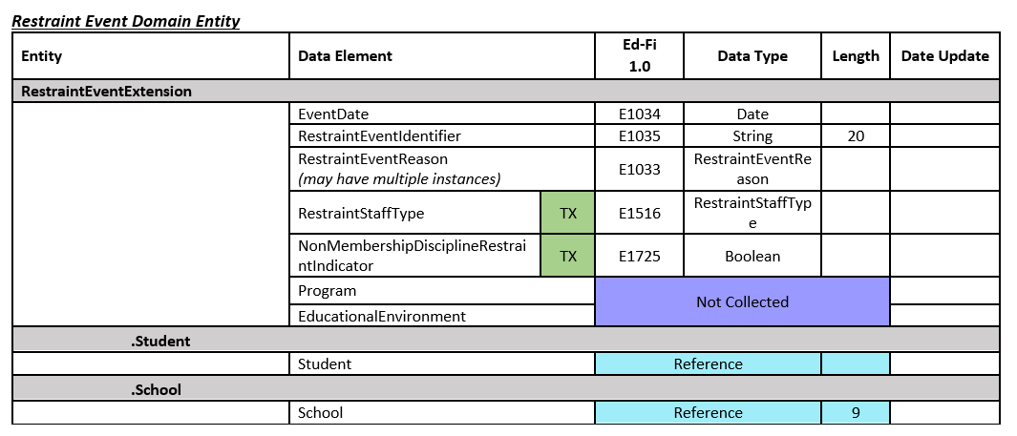
RESTRAINT EVENT DOMAIN ENTITY

Slide 20
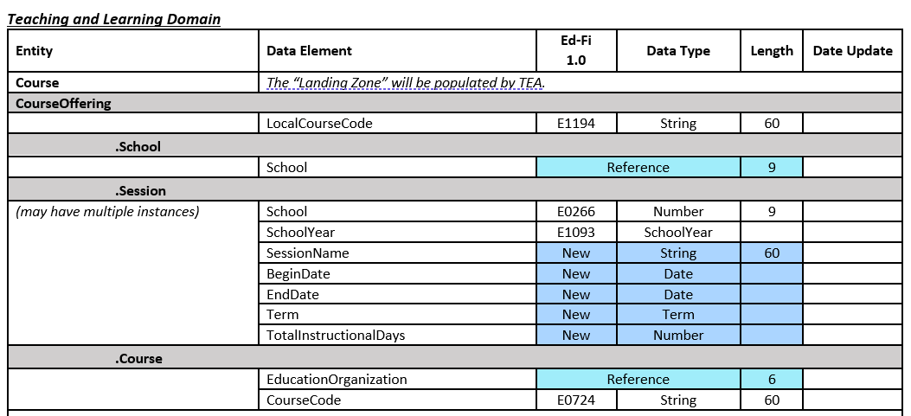
TEACHING AND LEARNING DOMAIN

Slide 21
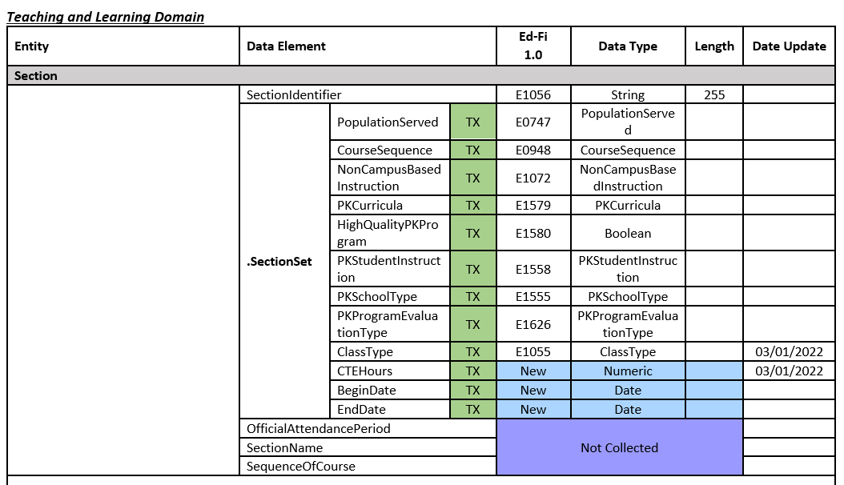
TEACHING AND LEARNING DOMAIN cont1

Slide 22
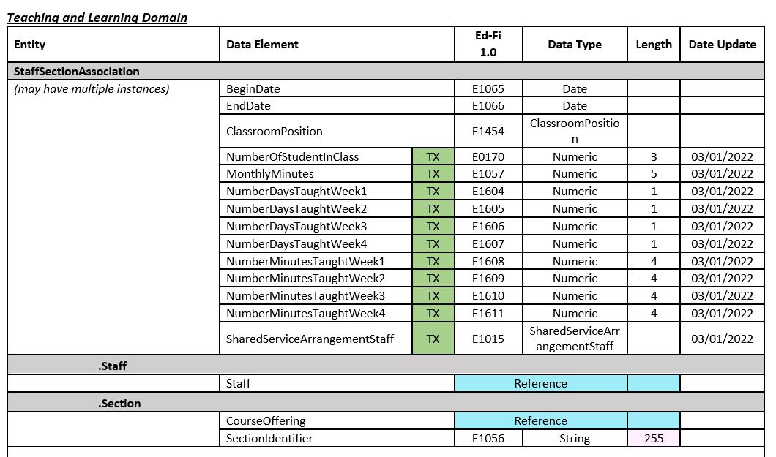
TEACHING AND LEARNING DOMAIN cont2

Slide 23
DOMAIN OVERVIEW – Part 4
Based on Ed-Fi 3.2.0-c Version
Domains/Domain Entities Collected
Student Academic Record Domain – provides the cumulative record of academic achievement for a student and the final record of a student’s performance in their course at the end of a semester or school year.
Finance Domain – provides the financial information captured in accounts (both actuals and budgeted).
Assessment Domain – provides the assessments given to students and the results.
Student Cohort Domain – provides the cohort information for which a student is designated.
Student Attendance Domain – provides the daily attendance information for students.

Slide 24
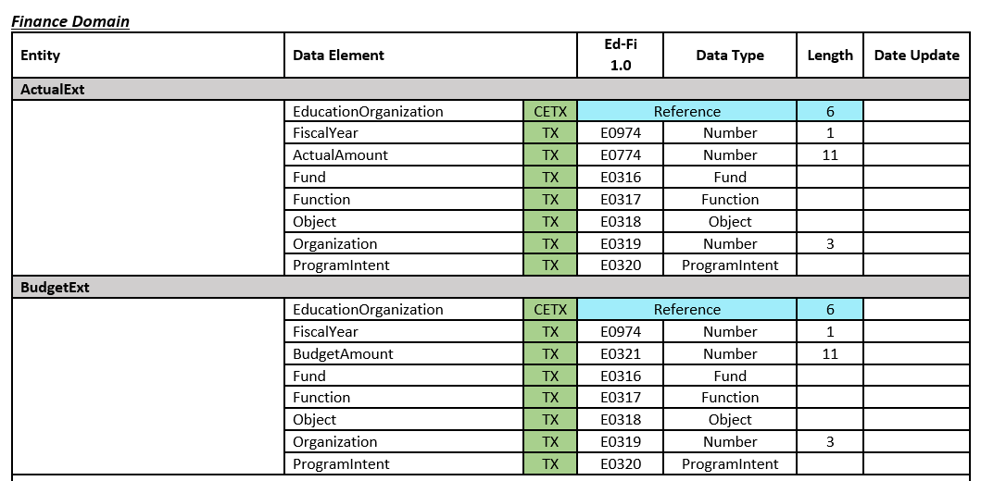
FINANCE DOMAIN

Slide 25
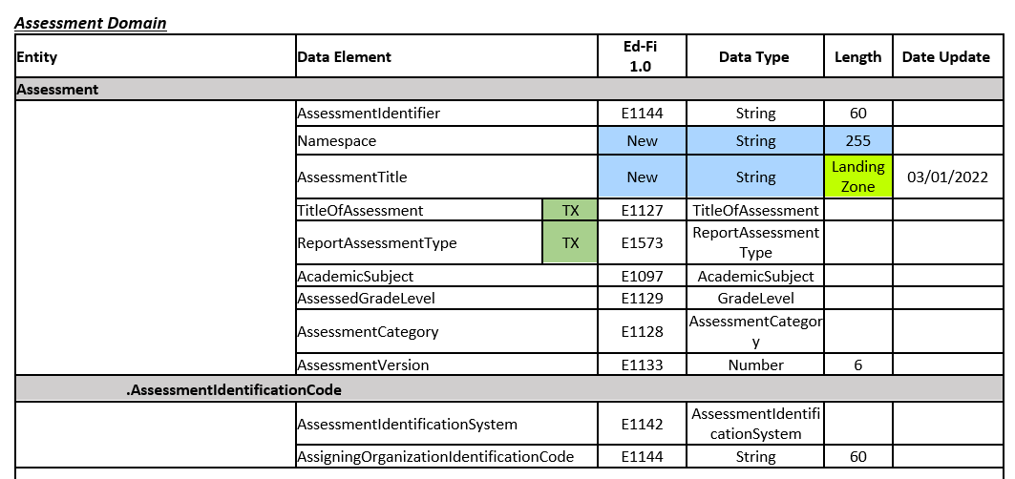
ASSESSMENT DOMAIN

Slide 26
DOMAIN OVERVIEW – Part 3
Based on Ed-Fi 3.2.0-c Version
Domains/Domain Entities Collected
As Of Status A Leavers Domain Entity – represents the leaver information for students enrolled in the LEA during the prior school year that have never enrolled in the LEA during the current school year.
Student Application Domain Entity – represents the data for students who have applied but are not enrolled in a charter school and who are on a waitlist for the current school year.
Student Special Education Program Eligibility Association Domain Entity – represents the data needed to meet federal compliance reporting requirements related to special education Child Find (SPPI-11 and SPPI-12) activities.

Slide 27
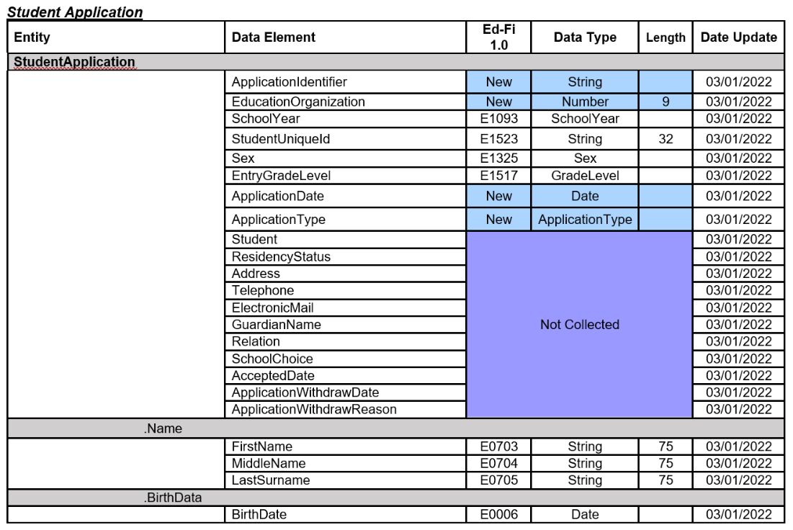
STUDENT APPLICATION – CHARTER SCHOOL WAITLIST

Slide 28
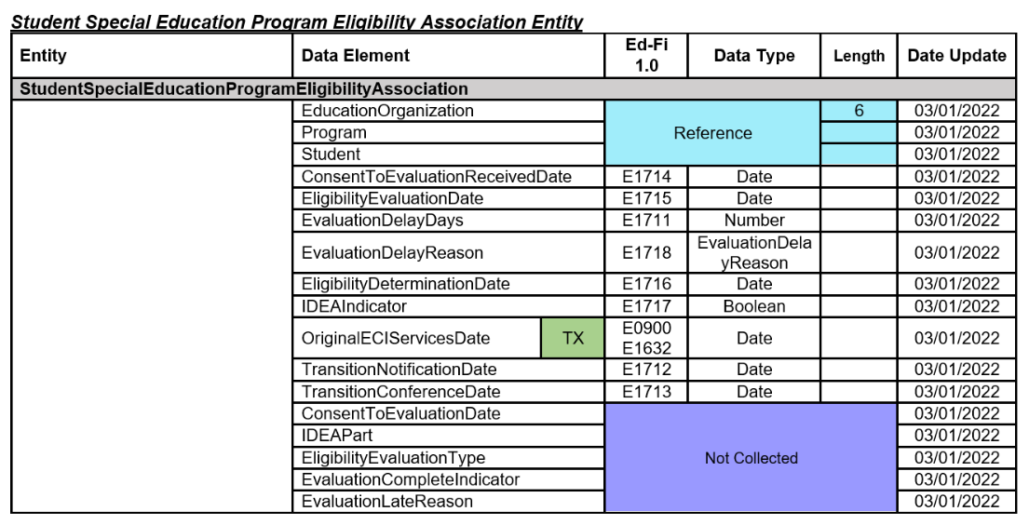
STUDENT SPECIAL EDUCATION PROGRAM ELIGIBLITY ASSOCIATION – CHILD FIND

Slide 29
STUDENT SPECIAL EDUCATION PROGRAM ELIGIBLITY ASSOCIATION – DATA ELEMENT NAME CHANGES
Date Element ID | Old Data Element Name | New Data Element Name
E1711 | STUDENT-ABSENCES-WITHIN-TIMEFRAME | EvaluationDelayDays
E1712 | ECI-NOTIFICATION-DATE | TransitionNotificationDate
E1713 | ECI-TRANSITION-CONFERENCE-DATE | TransitionConferenceDate
E1714 | PARENTAL-CONSENT-DATE | ConsentToEvaluationReceivedDate
E1715 | INITIAL-EVALUATION-DATE | EligibilityEvaluationDate
E1716 | SPED-ELIGIBILITY-DETERMINATION-DATE | EligibilityDeterminationDate
E1717 | SPED-ELIGIBILITY-DETERMINATION-CODE | IDEAIndicator

Slide 30
ODS 3.x DOMAINS/DOMAIN ENTITIES
Based on Ed-Fi 3.2.0-c Version
Domains NOT Collected
Bell Schedule – represents the start time and duration of one or more class periods in a day or over a course of days.
Graduation – captures the credits and coursework required for graduation, and references to required assessment. (TEA will capture this information in the As of Status A Leavers Domain Entity Extension.)
Intervention – captures educational interventions aimed at improving student’s understanding of concepts, materials or skills necessary for success in school.
Survey – captures the structure of surveys and survey results.

Slide 31
Data Element Changes

Slide 32
DATA ELEMENT “SET”
In order to “effective date” some data elements, TEA will begin collecting the data element combined with a begin and end date in a “set.” Some sets will have more than one data element that will be associated with the begin date.
Data Element “Sets”: StudentCensusBlockGroupSet, CrisisEventSet, EmergentBilingualSet, TruancySet, DyslexiaServicesSet, EconomicDisadvantageSet, FosterCareTypeSet, HomelessStatusSet, UnaccompaniedYouthSet, UnschooledAsyleeRefugeeSet, EarlyReadingIndicatorSet, MilitaryConnectedStudentSet, DyslexiaRiskSet, PKProgramTypeSet, PKFundingSourceSet, LanguageSet, StaffTypeSet, ParaprofessionalCertificationSet, StaffServiceSet, AuxiliaryRoleIdSet, CampusEnrollmentTypeSet, NSLPTypeSet, CharterWaitlistSet, ELOSet, ELOActivitySet, StudentTitleIPartAProgramAssociationSet, StudentSPEDProgramAssociationSet, SpecialEducationSettingSet, DisabilitySet, ParentalPermissionSet, SectionSet, and IndustryBasedCertificationSet

Slide 33
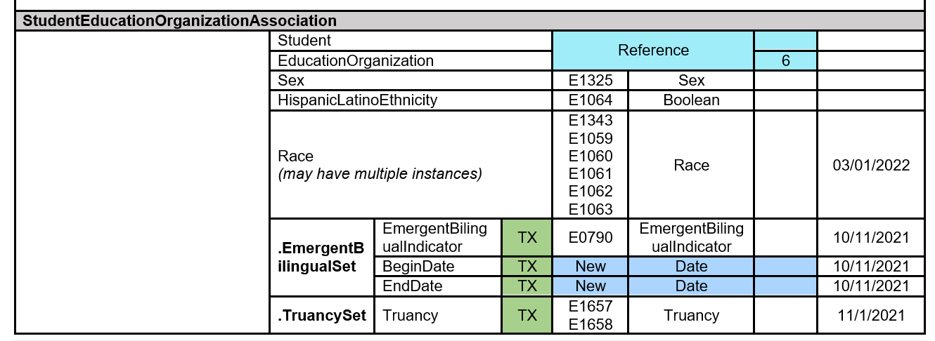
TRUANCY SET
Data Elements:
EXCESSIVE-UNEXCUSED-ABSENCE-INDICATOR-CODE (E1657),
TRUANCY-PREVENTION-MEASURE-INDICATOR-CODE (E1658), TRUANCY-COMPLAINT-FILED-INDICATOR-CODE (E1658)

Slide 34
LANGUAGE SET
Data Elements:
HOME-LANGUAGE-CODE (E0895),
STUDENT-LANGUAGE-CODE (E1590)

Slide 35
STUDENT EDUCATION ORGANIZATION RESPONSIBILITY ASSOCIATION
Data Elements:
CAMPUS-ID-OF-ACCOUNTABILITY (E1027),
CAMPUS-ID-OF-RESIDENCE (E0903), CAMPUS-ID-OF-EVALUATION (E1710)

Slide 36
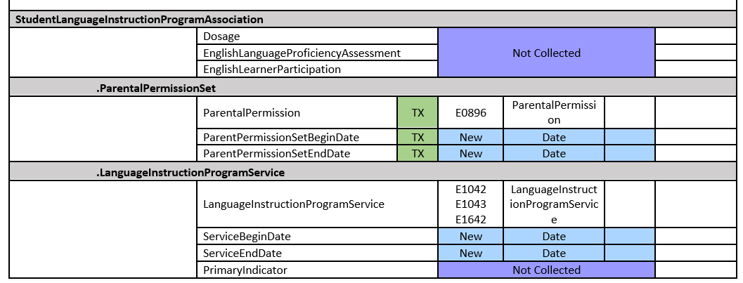
STUDENT LANGUAGE PROGRAM ASSOCIATION
Data Elements:
BILINGUAL-PROGRAM-TYPE-CODE (E1042),
ESL-PROGRAM-TYPE-CODE (E1043), ALTERNATIVE-LANGUAGE-PROGRAM-CODE (E1642)

Slide 37
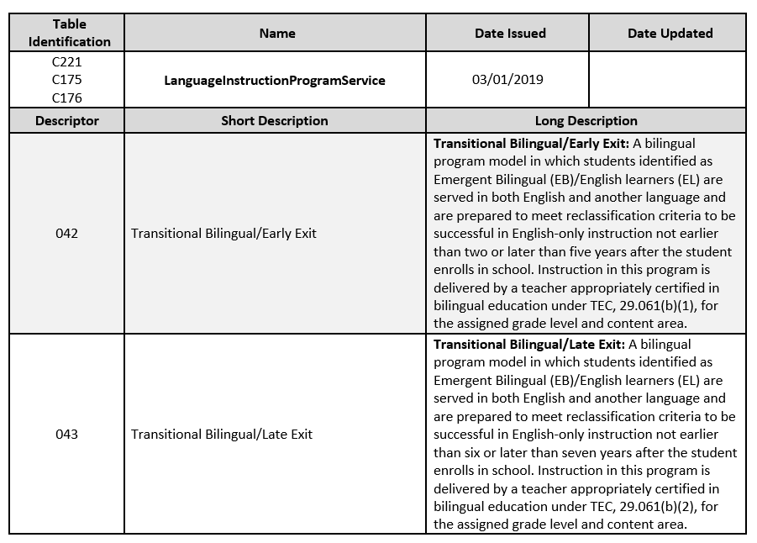
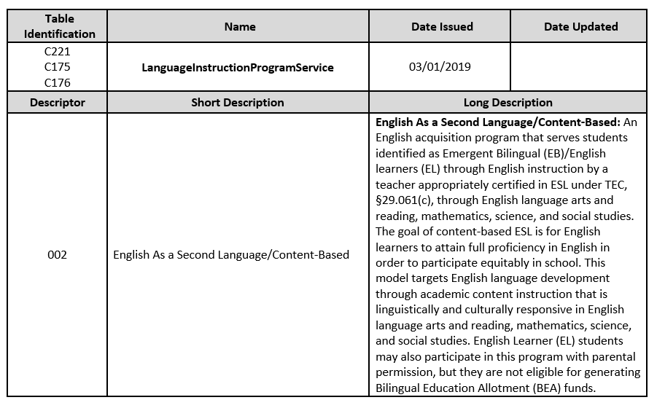
LANGUAGE INSTRUCTION PROGRAM SERVICE DESCRIPTOR TABLE
EXCERPT
NOT FULL DESCRIPTOR TABLE

Slide 38
STUDENT CHARACTERISTIC AND SPECIAL EDUCATION PROGRAM SERVICE
Ed-Fi 3.x has two new concepts that TEA will use to report additional student data elements.
StudentCharacteristic is a descriptor that captures important characteristics of the student’s environment or situation.
SpecialEducationProgramService is a descriptor that defines the services provided by an education organization to populations of students associated with a special education program.

Slide 39
STUDENT CHARACTERISTIC DATA ELEMENT
Data Elements: AT-RISK-INDICATOR-CODE (E0919), IMMIGRANT-INDICATOR-CODE (E0797), MIGRANT-INDICATOR-CODE (E0984), DYSLEXIA-INDICATOR-CODE (E1530), T-STEM-INDICATOR-CODE (E1559), ECHS-INDICATOR-CODE (E1560), P-TECH-INDICATOR-CODE (E1612), NEW-TECH-INDICATOR-CODE (E1647), IEP-CONTINUER-INDICATOR-CODE (E1564), STAR-OF-TEXAS-INDICATOR-CODE (E1601), PK-ELIGIBLE-PREVIOUS-YEAR-INDICATOR-CODE (E1649), SECTION-504-INDICATOR-CODE (E1603), INTERVENTION-STRATEGY-INDICATOR-CODE (E1602), PREGNANCY-RELATED-SERVICES (E1432), GIFTED-TALENTED-INDICATOR-CODE (E0034), ADULT-PREVIOUS-ATTENDANCE-INDICATOR-CODE (E1660), GENERAL-EDUCATION-HOMEBOUND-INDICATOR (E1730), PARENT-REQUEST-RETENTION-INDICATOR (E1729), BILINGUAL/ESL-SUMMER-SCHOOL-INDICATOR-CODE (E1028) , ADDITIONAL-DAYS-PROGRAM-PARTICIPATION-INDICATOR-CODE (E1672)

Slide 40
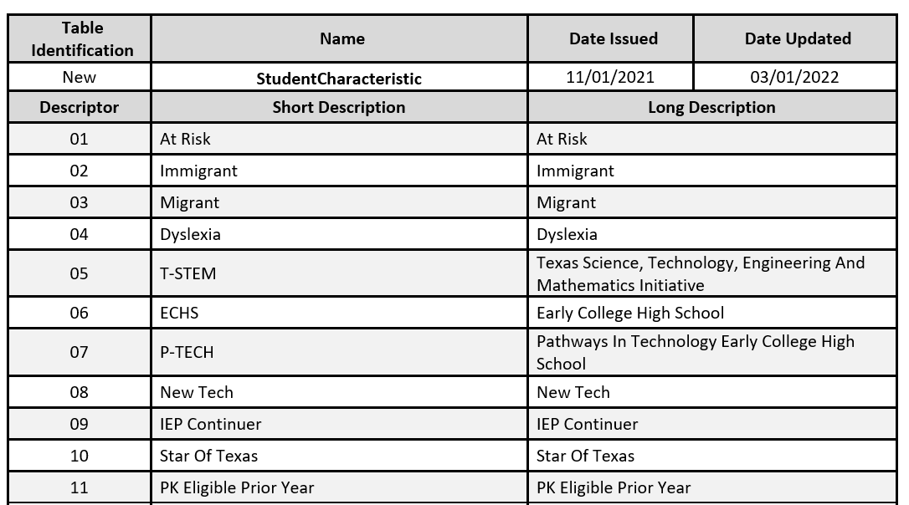
STUDENT CHARACTERISTIC DESCRIPTOR TABLE

Slide 41
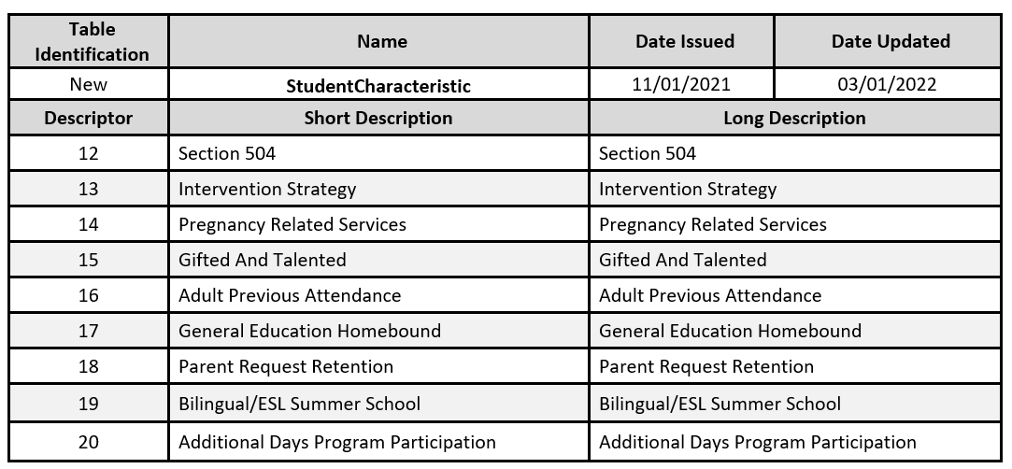
STUDENT CHARACTERISTIC DESCRIPTOR TABLE CONT

Slide 42
SPECIAL EDUCATION PROGRAM SERVICE DATA ELEMENT
Data Elements: REG-DAY-SCH-PROG-DEAF-CODE (E0833), AUDIOLOGICAL-SERV-IND-CODE (E0838), COUNSELING-SERVICES-IND-CODE (E0840), MEDICAL-DIAGNOSTIC-SERV-IND-CODE (E0841), OCCUPATIONAL-THERAPY-IND-CODE (E0843), ORIENT-MOBILITY-TRNG-IND-CODE (E0844), PHYSICAL-THERAPY-IND-CODE (E0845), PSYCHOLOGICAL-SERVICES-IND-CODE (E0846), RECREATION-IND-CODE (E0847), SCHOOL-HEALTH-SERVICES-IND-CODE (E0848), SOCIAL-WORK-SERVICES-IND-CODE (E0849), TRANSPORTATION-INDICATOR-CODE (E0851), SPEECH-THERAPY-INDICATOR-CODE (E0857), PRESCHL-PROG-CHLDRN-WITH-DISAB-IND-CD (E0899), EARLY-CHILDHOOD-INTERV-IND-CODE (E0900), ASSISTIVE-TECH-INDICATOR-CODE (E0997), INTERPRETING-SERVICES-TYPE-CODE (E1040)

Slide 43
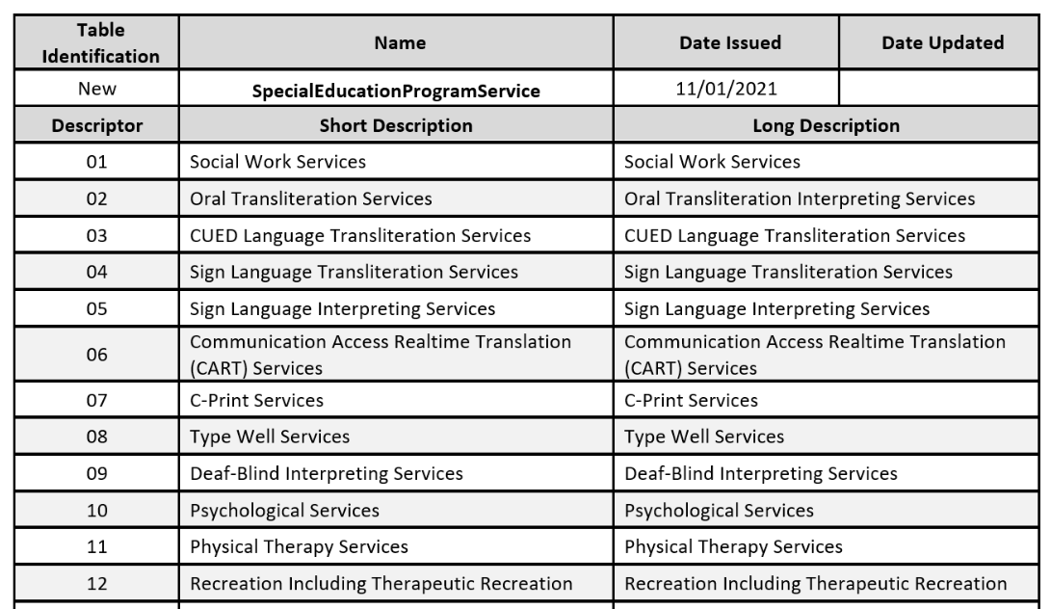
STUDENT EDUCATION PROGRAM SERVICE DESCRIPTOR TABLE

Slide 44
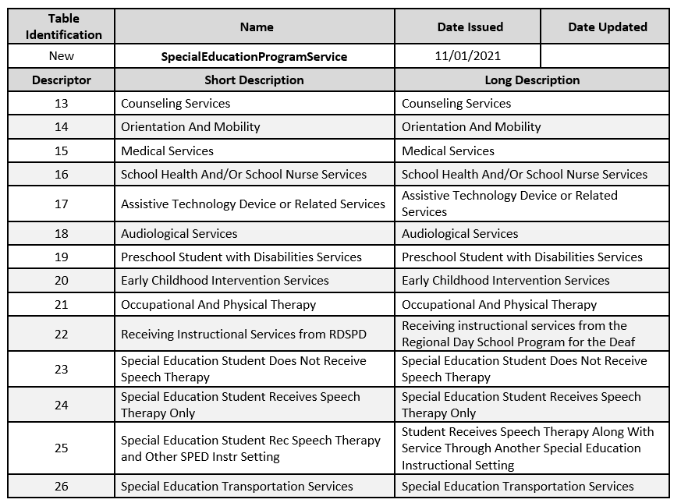
SPECIAL EDUCATION PROGRAM SERVICE DESCRIPTOR TABLE CONT

Slide 45
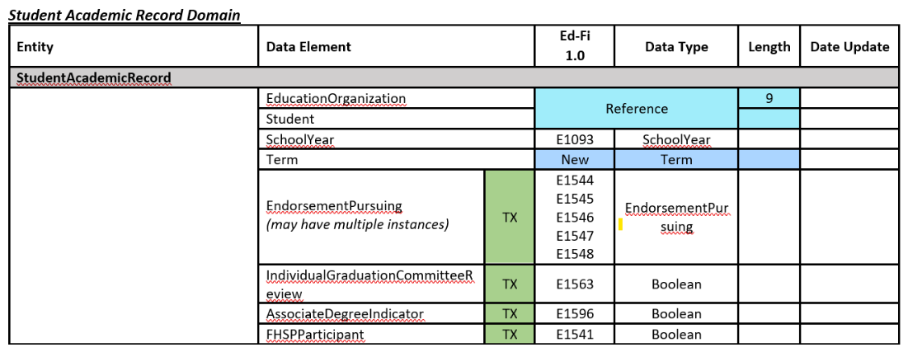
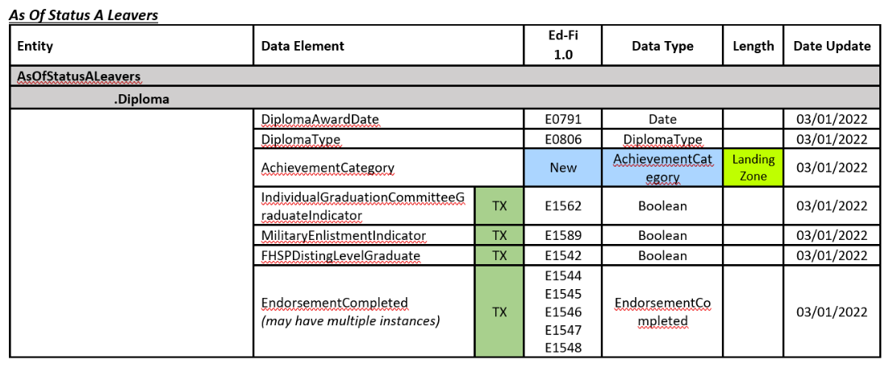
ENDORSEMENT DATA ELEMENTS
Data Elements: STEM-ENDORSEMENT-INDICATOR-CODE (E1544) BUSINESS-AND-INDUSTRY-ENDORSEMENT-INDICATOR-CODE (E1545) PUBLIC-SERVICES-ENDORSEMENT-INDICATOR-CODE (E1546) ARTS-AND-HUMANITIES-INDICATOR-CODE (E1547) MULTI-DISCIPLINARY-STUDIES-ENDORSEMENT-INDICATOR-CODE (E1548)

Slide 46
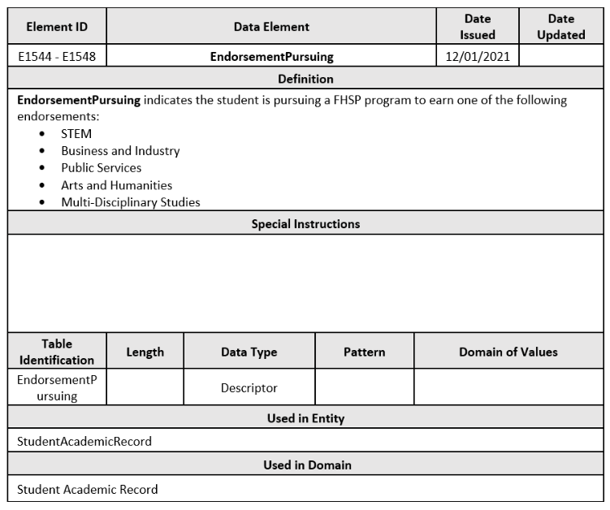
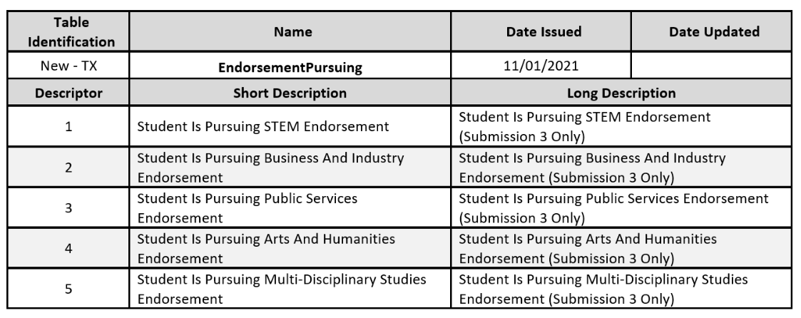
ENDORSEMENT PURSUING

Slide 47
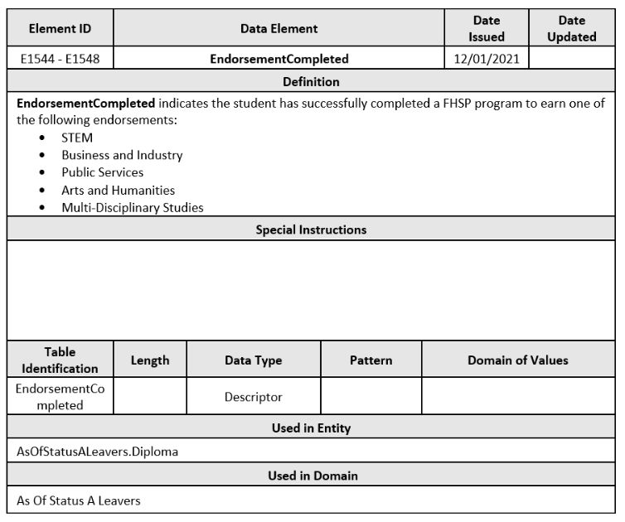
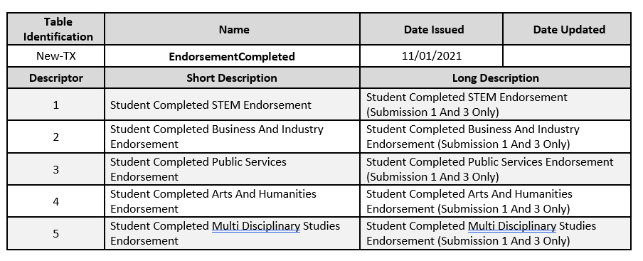
ENDORSEMENT COMPLETED

Slide 48
Begin Date Guidance

Slide 49
BEGIN AND END DATES
In order to “effective date” some data elements, TEA will begin collecting begin and end date.
The begin date will be specific to one or more data elements and will be required to be reported with the data element.
The end date will only be reported when the data element becomes false of the student, staff, or program.

Slide 50
BEGIN DATE GUIDANCE
 | Current School Year Only | Current or Prior​ School Year
StudentCensusBlockGroup | X
CrisisEvent | X
EmergentBilingualIndicator |  | X
Truancy | X
DyslexiaServices | X
EconomicDisadvantage | X
FosterCareType | X
HomelessStatus | X
UnaccompaniedYouth | X
UnschooledAsyleeRefugee |  | X
EarlyReadingIndicator | X
 | Current School Year Only | Current or Prior​ School Year
MilitaryConnectedStudent |  | X
DyslexiaRisk | X
PKProgramType | X
PKFundingSourceSet | X
LanguageUse |  | X
StudentCharacteristic |  | X
Responsibility |  | X
StaffType |  | X
ParaprofessionalCertification |  | X
StaffClassification |  | X
StaffService |  | X

Slide 51
BEGIN DATE GUIDANCE cont
 | Current School Year Only | Current or Prior​ School Year
AuxiliaryRoleId |  | X
HireDate |  | X
CampusEnrollmentType |  | X
NSLPType | X
CharterAdmissionWaitlist | X
ELOType | X
CTEProgramService | X
TitleIPartAParticipant | X
SPEDProgram |  | X
SpecialEducationSetting |  | X
Disability |  | X
 | Current School Year Only | Current or Prior​ School Year
ParentalPermission |  | X
LanguageInstructionProgram Service |  | X
Section | X
StaffSection | X
StudentSection | X
IndustryBasedCertification | X | X
General Student Program |  | X
StaffCohortAssociation | X
StudentCohortAssociation | X

Slide 52
QUESTIONS

