Slide 1
State Performance Plan Indicator (SPPI)-14

Slide 2
PLEASE NOTE:
The focus of this presentation is on the changes for the official XML data submissions during the 2022-2023 school year.

Slide 3
AGENDA
SPPI-14
2021-2022
Submission Updates
2022-2023 Changes
Application Updates
Data Element Updates
Report Updates
Business Rule Updates
Code Table Updates
Reminders
Current Known Issues
Timeline
Frequently Asked Questions
Technical Resources
Questions

Slide 4
2021-2022: SUBMISSION UPDATES
The 2021-2022 SPPI-14 data collection closed on February 17, 2022.
Final Submission Count: 1,035
The promotion logic was updated prior to the 2021-2022 submission to include students reported as special education in the prior year PEIMS Fall submission that were not reported as special education in the prior year PEIMS Summer.
This change resulted in an additional 341 students reported.

Slide 5
2022-2023

Slide 6
2022-2023: APPLICATION UPDATES
The SPPI-14 data collection will be updated to include the following existing PEIMS element:
HOME-LANGUAGE-CODE (E0895)
This data element will be optional in the TSDS StudentExtension complex type but required for all students reported in SPPI-14.

Slide 7
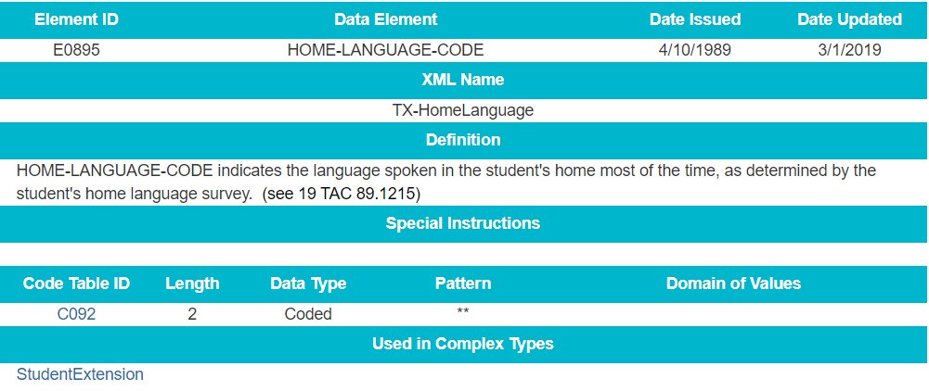
2022-2023: DATA ELEMENT UPDATES

Slide 8
2022-2023: REPORT UPDATES
The following report will be updated to include the new data element HOME-LANGUAGE-CODE (E0895):
SPP0-000-001: TSDS SPPI-14 Student Roster Report
More information, including the updated report mockup, will be shared prior to the start of the 2022-2023 school year.

Slide 9
2022-2023: BUSINESS RULE UPDATES
The following rule, 40203-0023, will be updated to include HOME-LANGUAGE-CODE:

Slide 10
2022-2023 CODE TABLE UPDATES
2022-2023
No New Code Tables
No Updated Code Tables
No Deleted Code Tables

Slide 11
2022-2023 REMINDERS
Report SPP0-000-002 can be run by ESC staff any time prior to the close of the SPPI-14 data collection.
This report will show ESC staff their LEA’s current SPPI-14 submission status and the LEA’s expected count of students to report.
The expected count of students is based off the current year PEIMS Fall leaver data and the prior year PEIMS Summer (or Fall) special education data.
The expected count on the report should match the number of students the LEA promotes to their data mart.

Slide 12
2022-2023 REMINDERS
As the submission deadline approaches, ESCs are encouraged to run the report and reach out to their LEAs that have not completed the submission but show a count of students that need to be reported.
The LEA’s expected student count will show zero (0) if the LEA has not loaded their current year PEIMS Fall leaver data to the ODS.

Slide 13
2022-2023 TIMELINE
State Performance Plan Indicator 14 (SPPI-14) Collection | Date
TSDS ready to load data to eDM | August 1, 2022
SPPI-14 ready for users to promote data | September 12, 2022
SPPI-14 ready for users to complete | October 31, 2022
SPPI-14 submission due date for LEAs | February 16, 2023

Slide 14
FREQUENTLY ASKED QUESTIONS
Which primary disability and instructional setting codes are promoted to SPPI-14?
The primary disability and instructional setting codes that are promoted to the SPPI-14 data mart are those that are associated with the latest EFFECTIVE-DATE (E1632) for the student from the prior year PEIMS Summer (or Fall) submission.

Slide 15
FREQUENTLY ASKED QUESTIONS
How does SPPI-14 determine if a student was special education in the prior school year?
The SPPI-14 promotion logic determines if a student was special education by looking at data reported in the PEIMS Fall and Summer in the prior school year. Students reported with SPECIAL-ED-INDICATOR-CODE (E0794) = ‘1’ in either collection are considered for SPPI-14.

Slide 16
TECHNICAL RESOURCES
Technical Support:
TSDSCustomerSupport@tea.texas.gov
SPPI-14 Program Area
spp@tea.texas.gov
TIMS Knowledge Base Articles
TSDSKB-585 General FAQs for State Performance Plan Indicator 14
TSDSKB-592 State Performance Plan Indicator 14 (SPPI-14) Promotion Questions

Slide 17
Questions

