Slide 1
Child Find

Slide 2
PLEASE NOTE:
The focus of this presentation is on the changes for the official XML data submissions during the 2022-2023 school year.

Slide 3
AGENDA
Child Find
  Program Area Updates & Guidance
  2021-2022
    Submission Updates
    Overview of the Data Collection
    Current Known Issues
  2022-2023 Changes
    Application Updates
    Data Element Updates
    Report Updates
    Business Rule Updates
    Code Table Updates
  Timeline
  Frequently Asked Questions
  Technical Resources
  Questions

Slide 4
PROGRAM AREA UPDATES & GUIDANCE
Division of Special Education Program Reporting
  Zane Wubbenna Data Analyst; Department of Monitoring, Reporting, and Support
  Tammy Pearcy Director; Department of Monitoring, Reporting, and Support

Slide 5
2021-2022: SUBMISSION UPDATES
The 2021-2022 Child Find data collection is due on July 28, 2022.
  The application will be ready for users to complete on June 6, 2022.

Slide 6
Overview of the Data Collection
Child Find combines the following two State Performance Plan (SPP) Indicators in TSDS:
  SPPI-11
    Refers to the timely evaluation of students, ages 3-21, for special education services under Part B of IDEA.
  SPPI-12
    Refers to children who are referred from Part C of IDEA prior to age 3, found eligible for Part B of IDEA, and have an individualized education plan (IEP) developed and implemented by their third birthday to receive early childhood special education (ECSE) services from a local education agency (LEA).

Slide 7
Overview of the Data Collection
The data collection includes students for whom the special education evaluation process was completed.
  In some cases, this may include non-enrolled students such as homeschooled students, private school students, or children who received Early Childhood Intervention services through another state agency.
For the 2021-2022 submission, the completed evaluation/eligibility process is based on an eligibility determination date on or between July 1, 2021 – June 30, 2022.
  This includes “holdover students”, whose parental consent was obtained in the 2020-2021 school year and the evaluation/eligibility process was completed in the current school year.

Slide 8
Overview of the Data Collection
All students reported in TSDS must be reported with a Unique ID, including non-enrolled students.
LEAs should make every effort to find a non-enrolled student’s existing Unique ID, just as they do for enrolled students, in the event one was previously created by another LEA.
  Search the Unique ID application for the student.
  Rely on any information provided by the parents or previous LEAs.
  Students who already have a Unique ID should not be assigned a new one.
LEAs should fill in all fields to the best of their ability for any new Unique ID that must be created for a non-enrolled student.
  The LEA may use S-numbers in place of SSNs and utilize alternative field options (such as ‘TEA Use Only’ for Ethnicity/Race), where applicable.
  Additionally, LEAs can utilize ‘NA’ for Grade Level or estimate the child’s approximate grade based on their age.

Slide 9
Overview of the Data Collection
Child Find promotes data from the following TSDS interchanges:
  InterchangeEducationOrganizationExtension
  InterchangeEducationOrgCalendar
  InterchangeStudentParentExtension
  InterchangeStudentEnrollmentExtension
  InterchangeStudentProgramExtension

Slide 10
Overview of the Data Collection
Student Program data elements reported for both SPPI-11 and SPPI-12 students:
  E1710 CAMPUS-ID-OF-EVALUATION
  E0975 INSTRUCTIONAL-TRACK-INDICATOR-CODE
  E1711 STUDENT-ABSENCES-WITHIN-TIMEFRAME
  E1714 PARENTAL-CONSENT-DATE
    Report the first instructional day following the date on which the LEA received written consent for the full individual and initial evaluation (FIIE) from the student’s parent.
  E1715 INITIAL-EVALUATION-DATE
  E1716 SPED-ELIGIBILITY-DETERMINATION-DATE
  E1717 SPED-ELIGIBILITY-DETERMINATION-CODE
  E1718 EVALUATION-DELAY-REASON

Slide 11
Overview of the Data Collection
Additional Student Program data elements reported only for SPPI-12 students:
  E1632 EFFECTIVE-DATE (TX-EffectiveDateServices)
  E0900 EARLY-CHILDHOOD-INTERV-IND-CODE
  E1712 ECI-NOTIFICATION-DATE
  E1713 ECI-TRANSITION-CONFERENCE-DATE

Slide 12
Overview of the Data Collection
For students where E1714 PARENTAL-CONSENT-DATE is in the prior school year – “holdover students” – Child Find also uses the following calendar data from the prior year’s PEIMS Summer Accepted data:
  CalendarDateExtension
  ReportingPeriodExtension
The Core application will retrieve this certified data automatically. LEAs do not need to reload any of this PEIMS data for the Child Find data collection.

Slide 13
Overview of the Data Collection
The Core application also performs calculations based on the data elements being reported.
The calculated data includes:
  The Initial Evaluation and SPED Eligibility Determination compliance for each student.
  The overall SPPI-11 and SPPI-12 compliance for each student, based on which indicator applies to them.
  The number of days beyond timeframe to complete the initial evaluation/eligibility determination process for non-compliance students.
These calculations display on reports and appear in data validation rules.

Slide 14
Overview of the Data Collection
Students for whom non-compliance is calculated must have an evaluation delay reason reported from the DC164 code table.
A student that is reported with either of the following delay reasons will be considered “in compliance”.
  05 – Parent Delay (Detailed Records Maintained by LEA Regarding a Parent of a Child who Repeatedly Fails or Refuses to Produce the Child for the Evaluation)
  07 – LEA Agreement with Parent to Timeframe (Detailed Records Maintained by LEA)

Slide 15
Overview of the Data Collection
The following subcategories of data are used in Child Find:
  Education Organization
    Local Education Agency
    Campus
    Calendar
  Student
    Student Basic Information
    Enrollment (School Association)
    Special Education Program
Due to the interdependency and complexity of the calculations being performed, users are only able to promote data by ALL CATEGORIES.

Slide 16
Overview of the Data Collection
The following criteria logic will be applied when promoting students to the Child Find data mart:
  21 years of age or younger on September 1, 2021.
  Reported with a value for data element E1716 SPED-ELIGIBILITY-DETERMINATION-DATE between July 1, 2021 – June 30, 2022.

Slide 17
Overview of the Data Collection
There are four reports at the LEA and ESC levels; two each for SPPI-11 and SPPI-12.
  CHF0-000-001: TSDS SPPI-11 Student Compliance Report
  CHF0-000-002: TSDS SPPI-12 Student Compliance Report
  CHF0-000-003: TSDS SPPI-11 Aggregate Report
  CHF0-000-004: TSDS SPPI-12 Aggregate Report

Slide 18
CURRENT KNOWN ISSUES
The spacing on some of the column headers is not aligned properly on the two Child Find reports listed below. This is a cosmetic issue and does not affect the contents of the report.
  CHF0-000-001: TSDS SPPI-11 Student Compliance Report
  CHF0-000-002: TSDS SPPI-12 Student Compliance Report
This issue will be re-evaluated in the 2022-2023 school year.

Slide 19
2022-2023

Slide 20
2022-2023: APPLICATION UPDATES
The Child Find data collection will be updated to collect the following new element:
  ELIGIBILITY-DELAY-REASON (E1731)
This optional data element will be collected in the TX-DelayReason sub-complex type in the InterchangeStudentProgramExtension.

Slide 21
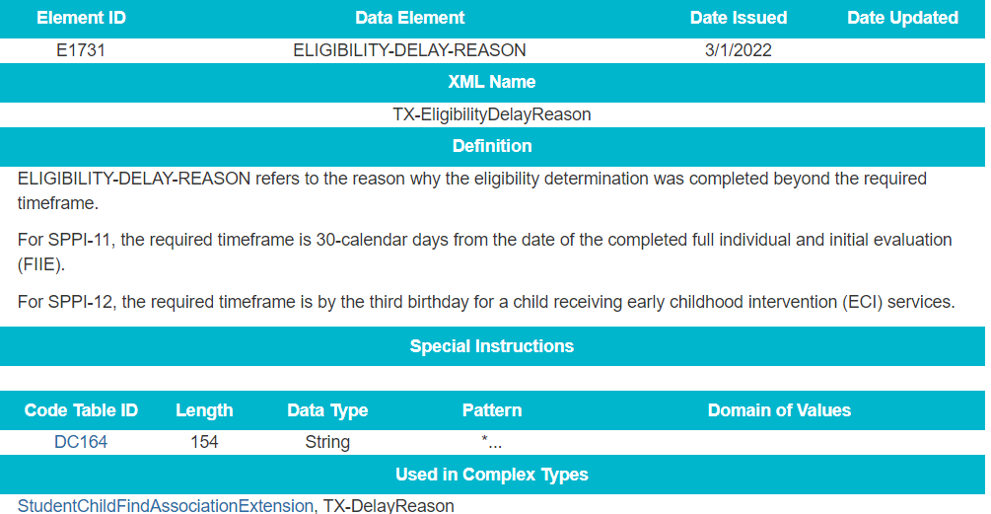
2022-2023: DATA ELEMENT UPDATES

Slide 22
2022-2023: DATA ELEMENT UPDATES

Slide 23
2022-2023: REPORT UPDATES
The following reports will be updated to add a column for the new element ELIGIBILITY-DELAY-REASON (E1731).
  CHF0-000-001: TSDS SPPI-11 Student Compliance Report
  CHF0-000-002: TSDS SPPI-12 Student Compliance Report
More information, including updated report mockups, will be shared prior to the start of the 2022-2023 school year.

Slide 24
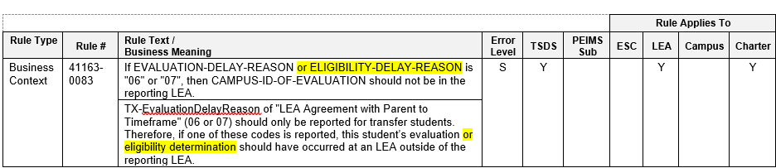
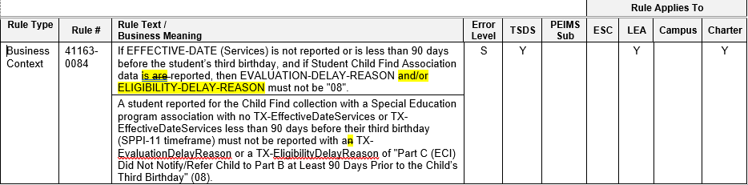
2022-2023: BUSINESS RULE UPDATES
Updated Business Rules

Slide 25
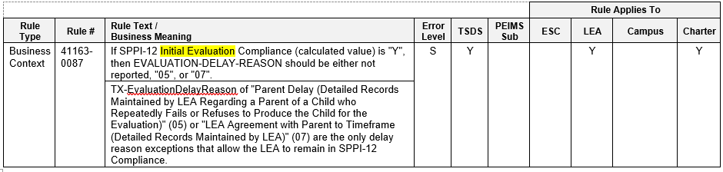
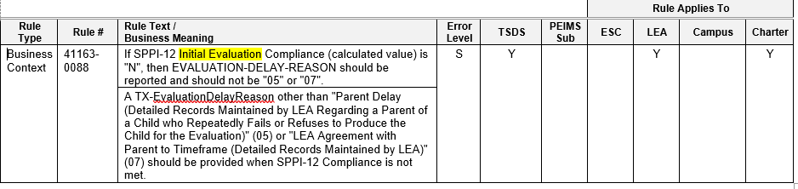
2022-2023: BUSINESS RULE UPDATES

Slide 26
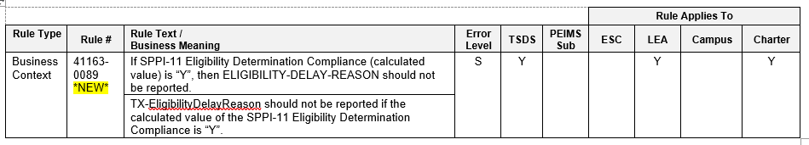
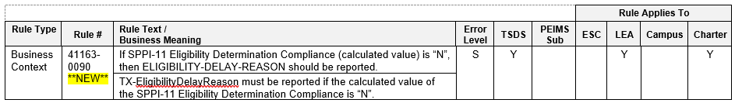
2022-2023: BUSINESS RULE UPDATES
New Business Rules

Slide 27
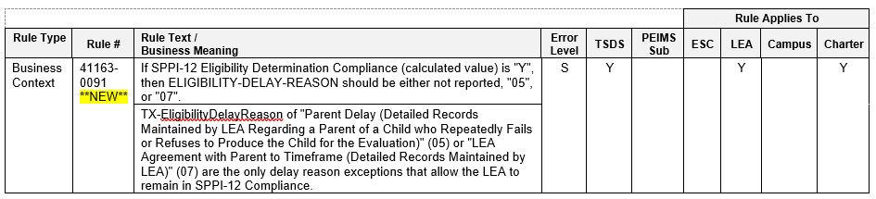
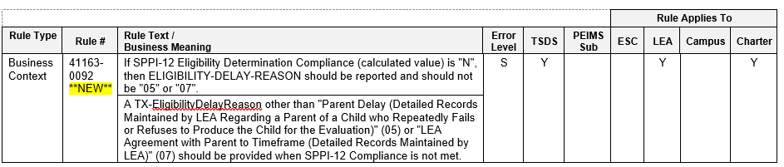
2022-2023: BUSINESS RULE UPDATES

Slide 28
2022-2023: CODE TABLE UPDATES
Renamed EVALUATION-DELAY-REASON-CODE (DC164) to DELAY-REASON-CODE (DC164)
  There are several code definitions that refer to detailed records. Added additional information in the code table related to “Detailed Records”.
    Detailed Records may include, but are not limited to, certified letters, detailed physician’s letters, comprehensive records of phone calls made or attempted along with the results of those calls, copies of correspondence sent to parents and any responses received, records of visits made to the parent’s home or place of employment and the results of those visits, a log of multiple attempts to contact parents or guardians.
    Detailed records should be collected and maintained for each student as evidentiary support for the selected delay reason. The records maintained by the LEA are subject to inspection for auditing and data validation purposes by the Department of Review and Support at the Texas Education Agency (TEA).

Slide 29
2022-2023 TIMELINE
Child Find Collection | Date
TSDS ready to load data to eDM | August 1, 2022
Child Find ready for users to promote data | September 12, 2022
Child Find ready for users to complete | May 15, 2023
Child Find submission due date for LEAs | July 27, 2023

Slide 30
FREQUENTLY ASKED QUESTIONS
Which students are reported for Child Find?
Only students for whom the special education evaluation/eligibility process has been completed shall be reported. This is indicated by data element E1716 SPED-ELIGIBILITY-DETERMINATION-DATE with a date between July 1, 20XX – June 30, 20XY in the current school year. For the 2021-2022 submission, this date must fall between July 1, 2021 – June 30, 2022.

Slide 31
FREQUENTLY ASKED QUESTIONS
Should the actual day the parent provides consent for evaluation be reported for E1714 PARENTAL-CONSENT-DATE?
No. The data element E1714 PARENTAL-CONSENT-DATE represents the first instructional day following the day the LEA receives written consent for the full individual and initial evaluation (FIIE) from the student’s parent.

Slide 32
FREQUENTLY ASKED QUESTIONS
How should E1718 EVALUATION-DELAY-REASON be reported for students whose eligibility determination is delayed but not their evaluation? Why is there no data element to track the eligibility delay?
For SPPI-11 students, LEAs shall only report delays related to the initial evaluation using element E1718 EVALUATION-DELAY-REASON. If the student does not have an evaluation delay but does have an eligibility delay, no delay reason shall be reported.
For SPPI-12 students, the LEA shall use E1718 to report the delay for either the evaluation or the eligibility determination, whichever one was delayed, as both must be completed prior to the child’s 3rd birthday.
In the 2022-2023 school year and going forward, Child Find will collect a new data element, ELIGIBILITY-DELAY-REASON, to track delays related to the eligibility determination for both SPPI-11 and SPPI-12 students.

Slide 33
FREQUENTLY ASKED QUESTIONS
How should the data be reported for non-enrolled students?
In general, both enrolled and non-enrolled students will be reported the same in Child Find. However, the StudentSchoolAssociation data in the InterchangeStudentEnrollmentExtension will not be reported for non-enrolled students. Additionally, optional data elements such as INSTRUCTIONAL-TRACK-INDICATOR-CODE and STUDENT-ABSENCES-WITHIN-TIMEFRAME may not apply to non-enrolled students and are not required to be reported.
LEAs must obtain and report a Unique ID for all non-enrolled students reported in Child Find.

Slide 34
FREQUENTLY ASKED QUESTIONS
How does the data collection account for school closures related to Covid-19 or bad weather days? Are those days included in the 45-day initial evaluation timeline?
Child Find uses the calendar data that is reported in the LEA’s InterchangeEducationOrgCalendar to determine which days are instructional vs non-instructional. Any SCHOOL-DAY-EVENT-CODE marked with code 01 – Student Instructional Day (whole or partial day) is counted toward the 45-day initial evaluation timeline.

Slide 35
TECHNICAL RESOURCES
Technical Support:
  TSDSCustomerSupport@tea.texas.gov
Child Find Program Area
  spp@tea.texas.gov
TAA Letters
  Child Find (SPPI-11 & SPPI-12) in the Texas Student Data System
    Published July 8, 2021
  TSDS Child Find Eligibility Delay Reason (TBD)
TIMS Knowledge Base Articles
  TSDSKB-620: SPPI-11 Compliance Flow Chart
  TSDSKB-621: SPPI-12 Compliance Flow Chart
  TSDSKB-622: Child Find Frequently Asked Questions

Slide 36
Questions

