Slide 1
PEIMS

Slide 2
PLEASE NOTE:
The focus of this presentation is on the changes for the official XML data submissions during the 2022-2023 school year.

Slide 3
AGENDA
PEIMS
Program Area Updates & Guidance
2021-2022
Submission Updates
Reminders
Current Known Issues
Timeline
2022-2023
Application Updates
Financial Aid Application
Dyslexia Services
Industry Based Certification
Safe and Supportive School Program
Timeline
Technical Resources
Questions

Slide 4
PROGRAM AREA UPDATES & GUIDANCE
Program Area Support:
Amy Copeland – State Funding
Brian Doran – Special Projects (ADSY)
Lacy Freeman – College & Career & Military Prep
Mary Scott – Student Discipline Program
Heather Smalley – Performance Reporting
Hank Weikert – Safe and Supportive Schools
Shane Sexton – Safe and Supportive Schools

Slide 5
2021-2022: SUBMISSION UPDATES
Added a new code to the STUDENT-ATTRIBUTION-CODE (C161) code table:

Slide 6
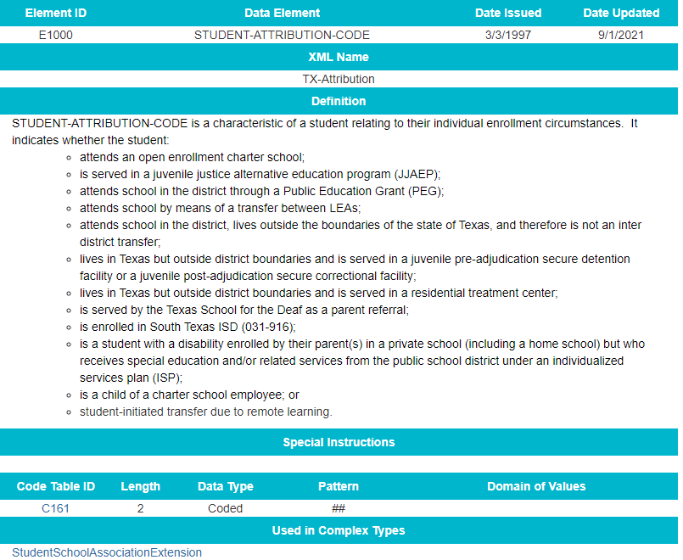
2021-2022: SUBMISSION UPDATES
Updated STUDENT-ATTRIBUTION-CODE (E1000) data element definition and reporting requirements:

Slide 7
2021-2022: SUBMISSION UPDATES
Overview of HB 1525 CTE changes:
During the 2019 legislative session, HB 3 was passed which made changes to Texas school finance. In the 2021 legislative session, HB 1525 was passed to correct some of the unintended consequences of implementing HB 3. HB 1525 implements the following in the Texas Education Code:
Section 48.106, Education code, is amended by increasing the annual allotment to three tier multipliers for full-time equivalent students, in grades 7 through 12, in approved high school career and technology education programs.

Slide 8
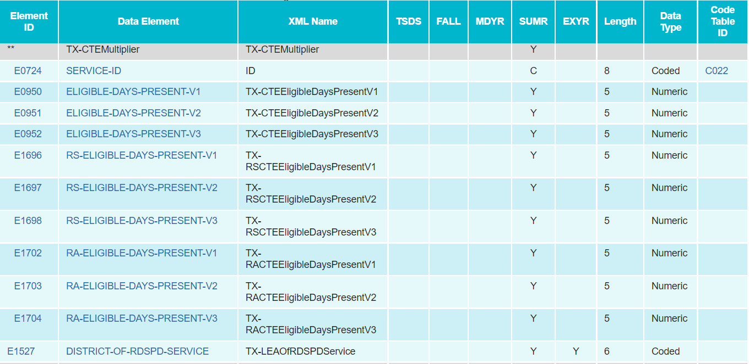
2021-2022: SUBMISSION UPDATES
Added new sub-complex type, TX-CTEMultiplier to the SpecialProgramsReportingPeriodAttendanceExtension with the existing data elements:
SERVICE-ID
ELIGIBLE-DAYS-PRESENT V1-V3

Slide 9
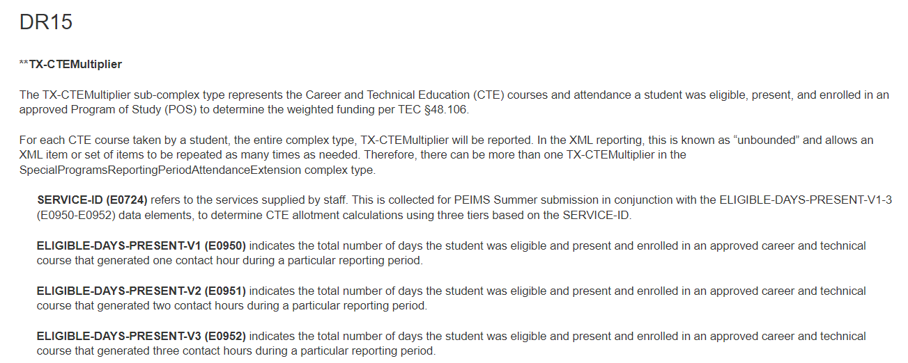
2021-2022: SUBMISSION UPDATES
Updated the general reporting requirements for the SpecialProgramsReportingPeriodAttendanceExtension complex type:

Slide 10
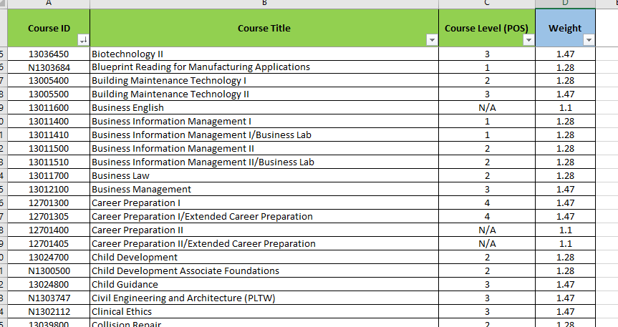
2021-2022: SUBMISSION UPDATES
CTE FTE calculation
All CTE Courses Weighted Tiers Spreadsheet
Notes:
Have program area explain the spreadsheet with the course levels and tiers.
They can use the link to get the entire spreadsheet.

Slide 11
2021-2022: SUBMISSION UPDATES
The CTE FTE calculation
All CTE Courses Weighted Tiers crosswalk will be used for calculating the CTE FTE and it can be located here.
For each campus, perform the following calculations for each instructional track offered at each campus, for each of the six reporting periods, and for each of the three CTE Service ID Tiers.
EXAMPLE SCENARIO:
Campus + track 1 + rep per 1 + CTE Tier 1
Campus + track 1 + rep per 1 + CTE Tier 2
Campus + track 1 + rep per 1 + CTE Tier 3
Campus + track 1 + rep per 2 + CTE Tier 1
Campus + track 1 + rep per 2 + CTE Tier 2
Campus + track 1 + rep per 2 + CTE Tier 3

Slide 12
2021-2022: SUBMISSION UPDATES
CTE FTE calculation updates:
For each permutation of campus, instructional track, six-week reporting period and CTE Service ID Tiers described on the previous slide, find all students with a TOTAL-ELIG- DAYS-PRESENT > 0 who are in regular attendance, remote synchronous attendance, or remote asynchronous attendance:
Sum all the V1 through V3 contact hours together for each track/reporting period/tier permutation.
Add sum from Step a above + (FLEX-ATTEND-TOTAL-CAREER-TECH-MINUTES-PRESENT (E1053) ÷ 60).
Divide the contact hours for each track/reporting period/tier permutation by 6 times the NUMBER-DAYS-TAUGHT (E0935). Round the results to three decimal places.
CTE FTE = Total Track Contact Hours ÷ (NUMBER-DAYS-TAUGHT × 6).
Add together all tracks in each reporting period and tier for each campus. This produces the CTE FTE for each tier, reporting period, and campus.
Add together all reporting periods for each campus.
This produces the IP Regular/Non-Flex/RS/RA + Flex CTE FTE for the campus for each tier.
Sum all tiers for each campus to calculate a grand total of all tiers.
V1 Contact Hrs = | ELIGIBLE-DAYS-PRESENT-V1 (E0950)
V2 Contact Hrs = | ELIGIBLE-DAYS-PRESENT-V2 (E0951) | × 2
V3 Contact Hrs = | ELIGIBLE-DAYS-PRESENT-V3 (E0952) | × 3

Slide 13
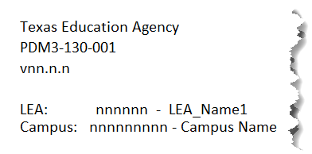
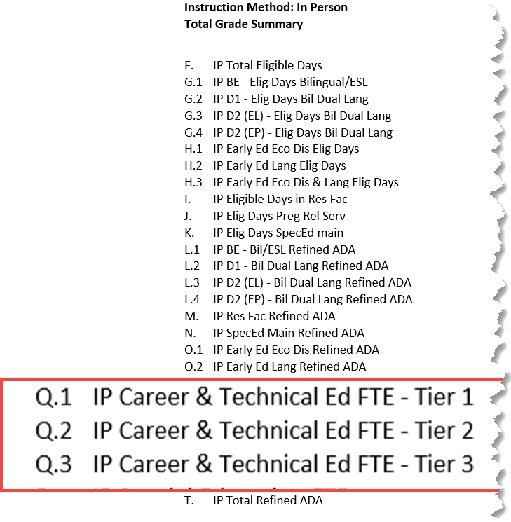
2021-2022: SUBMISSION UPDATES
CTE FTE report updates:
PDM3-130-001 TSDS PEIMS
Principal's Report of Student Attendance

Slide 14
2021-2022: SUBMISSION UPDATES
CTE FTE report updates:
PDM3-130-002 – TSDS PEIMS Superintendent's Report of Career and Technical Education Eligible Days

Slide 15
2021-2022: SUBMISSION UPDATES
The following CTE FTE reports have been updated with the new CTE code requirement changes:
PDM3-120-013 Special Programs Attendance Data
PDM3-130-001 Superintendent's/Principal's Report of Student Attendance
PDM3-130-002 Superintendent's/Principal's Report of Career and Technical Education Eligible Days
PDM3-130-005 Comparison of Current Year and Prior Year Attendance
PDM3-130-006 Campus Attendance Diagnostic Messages
PDM3-130-008 Superintendent's/Principal's Summary Report of Student Attendance
PDM3-130-009 Attendance by District of Residence

Slide 16
2021-2022: SUBMISSION UPDATES
CTE FTE report updates
PDM3-131-001 Roster of Pregnancy Related Services
PDM3-131-003 Roster of Homebound, Hospital Class, & State School Students Earning Career & technical Contact Hours
PDM3-131-007 Roster of 7th & 8th Grade Students Generating More Than One Career & Technical Contact Hour Per Day
PDM3-131-008 Roster of Students Reporting More Than Three Excess Contact Hours Per Day
PDM3-231-001 Percent Change from the Previous Year
These reports are tentatively scheduled to be updated in the May 6, 2022 software release.

Slide 17
2021-2022: SUBMISSION UPDATES
Overview of Extended Year CTE data collection:
The Summer CTE Education Grant requires LEAs to offer CTE courses during the summer months to encourage the completion of programs of study for students unable to schedule courses during the regular school year. The grant also encourages course completion through summer bridge programs for students entering or completing a program of study. This grant program increases the number of CTE courses completed during the summer months.

Slide 18
2021-2022: SUBMISSION UPDATES
Extended Year CTE data collection
Updated the general reporting requirements for the StudentExtension complex type:
Updated the general reporting requirements for the StudentSectionAssociation complex type:
PEIMS Extended Year Submission (4): Reporting students that completed courses during the summer (between school years) for:
a high school Career and Technical Education (CTE) course, or
a dual credit course, or
College Preparatory Course English Language Arts (CP110100), or
College Preparatory Course Mathematics (CP111200).

Slide 19
2021-2022: SUBMISSION UPDATES
Updated the general reporting requirements for the StudentSectionAssociation complex type (Cont.):
Updated the general reporting requirements for the CourseTranscriptExtension complex type (Cont.):

Slide 20
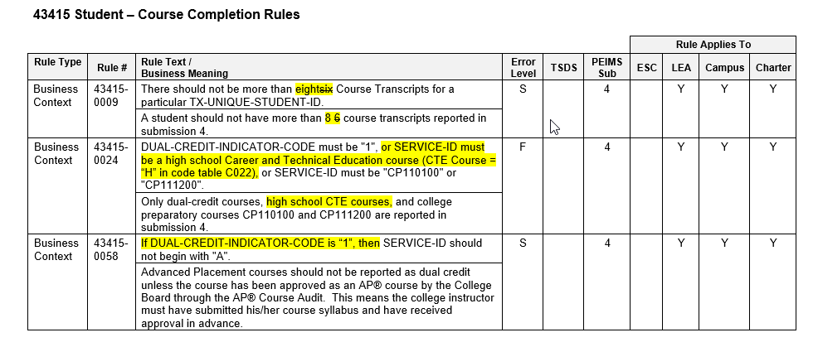
2021-2022: SUBMISSION UPDATES
Updated the following data validation rules:

Slide 21
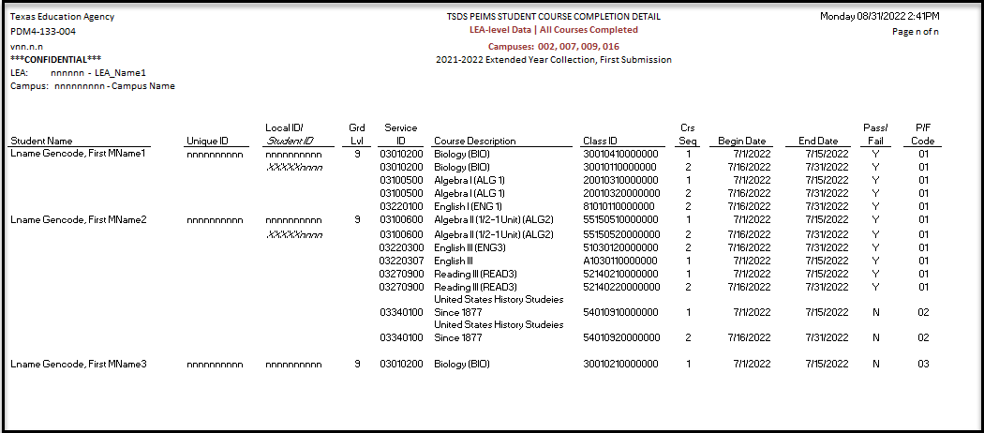
2021-2022: SUBMISSION UPDATES
New TSDS Report PDM4-133-004 – Student Course Completion Detail

Slide 22
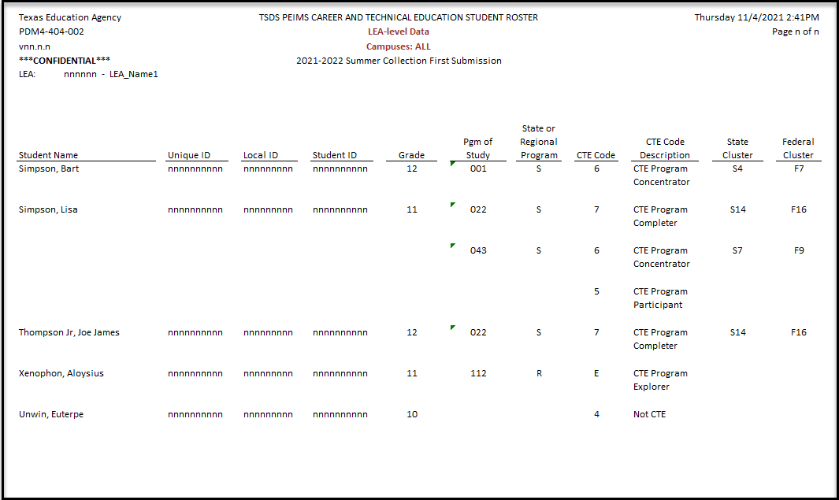
2021-2022: SUBMISSION UPDATES
New TSDS Report PDM4-404-002 – Career and Technical Education Student Roster

Slide 23
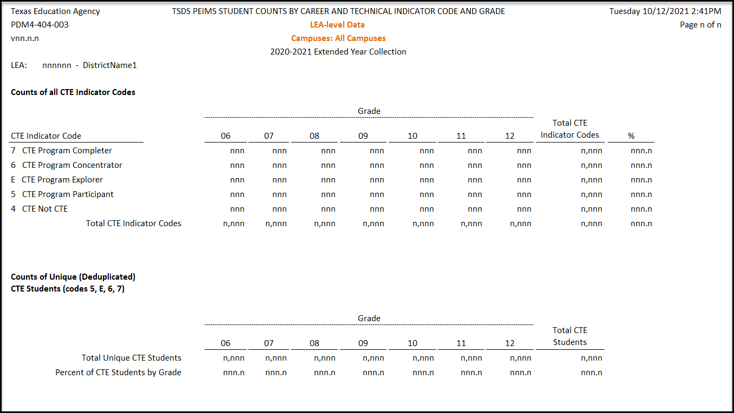
2021-2022: SUBMISSION UPDATES
New TSDS Report PDM4-404-003 – Student Counts by Career and Technical Indicator Code and Grade

Slide 24
2021-2022: SUBMISSION UPDATES
Funding for ADSY was based on legislative intent that the program would be for 30 additional days. If a district operated for fewer than 30 days (i.e., 20 days) and TEA used 20 days as the denominator, then that district would receive the same amount of funding as another district that operated ADSY for 30 days. The result would be that the district that operated 20 days would be overfunded. See Texas Education Code, Section 48.0051(c).ee Texas Education Code, Section 48.0051(c).
Additional Days School Year program
ADSY ADA/FTE calculation update
ADA Calculation Example:
Total Refined ADA = Total Eligible Days / 30 Days Taught
FTE Calculation Example:
Special Education FTE = Total Contact Hours / (30 Days Taught * 6)

Slide 25
2021-2022: SUBMISSION UPDATES
Overview of Funding for Remote Instruction:
Local education agencies (LEAs) have the authority to provide full-time funded remote instruction to students under Senate Bill (SB) 15 signed during the 87th Legislature Second Called Session. Therefore, LEAs will report attendance using the remote synchronous and remote asynchronous data elements during the PEIMS Summer submission.
The Performance Reporting Division at the Texas Education Agency will use the attendance information to determine which students participated in a full-time funded remote program.
Crisis Code indicators 10A and 10B will be used to identify students who were not eligible for ADA but participated in a remote program. This information will be used for virtual program A-F accountability ratings this fall.

Slide 26
2021-2022: SUBMISSION UPDATES
Updated the CRISIS-CODE (C178) code table:
Added Codes 10A and 10B

Slide 27
2021-2022: SUBMISSION UPDATES
Updated general reporting requirements for StudentExtension complex type.
DR45
** TX-CrisisImpacts Complex Type
The TX-CrisisImpacts Complex Type represents which health or weather-related event(s) have impacted this student during the school year. If a student is not affected by a declared crisis, then this complex type does not need to be reported.
CRISIS-CODE (E1054) indicates a state health or weather-related event that impacts a group of students, and may require additional funding, educational, or social services. The event may or may not cause the student to leave the LEA or campus of residence. A crisis event is designated by the Commissioner of Education.
This data is reported based on code table C178, which is populated as events occur that will require state reporting. If the commissioner of education declares a crisis, then this data must be reported for the affected students based on the guidance from TEA. Otherwise, if a student is not affected by a declared crisis, then this field may be left blank. This data may be used for determining special funding and/or accountability measures.
A student with a CRISIS-CODE should be reported with that code for the remainder of the school year.
More than one CRISIS-CODE may be reported for each student. The CRISIS-CODE data element is an unbounded data element within the TX-CrisisImpacts sub-complex type. Therefore, the CRISIS-CODE data element can be repeated within the TX-CrisisImpacts sub-complex type as shown:
<TX-CrisisImpacts>
<TX-CrisisIndicator>###</TX-CrisisIndicator>
<TX-CrisisIndicator>###</TX-CrisisIndicator>
</TX-CrisisImpacts>
The LEA should report each relevant CRISIS-CODE for each student.
For the 2021-2022 PEIMS Summer Submission (3):
CRISIS-CODE 10A would be reported in the 2021-2022 PEIMS Summer Submission for a student enrolled, not in membership due to virtual learning (ADA-ELIGIBILITY-CODE (E0787) value of "9") on January 14, 2022.
CRISIS-CODE 10B would be reported in the 2021-2022 PEIMS Summer Submission for a student enrolled, not in membership due to virtual learning (ADA-ELIGIBILITY-CODE (E0787) value of "9") on May 13, 2022.
Crisis Code Examples:
1. On January 14, 2022, student A was ADA-ELIGIBILITY-CODE 1. On May 13, 2022, student A was ADA-ELIGIBILITY-CODE 9.
PEIMS Summer Submission CRISIS-CODE: 10B
2. On January 14, 2022, student B was ADA-ELIGIBILITY-CODE 9. On May 13, 2022, student B was ADA-ELIGIBILITY-CODE 9.
PEIMS Summer Submission CRISIS-CODE: 10A and 10B
3. On January 14, 2022, student C was ADA-ELIGIBILITY-CODE 9. On May 13, 2022, student C was ADA-ELIGIBILITY-CODE 3.
PEIMS Summer Submission CRISIS-CODE: 10A

Slide 28
2021-2022: SUBMISSION UPDATES
Updated and added data validation rules 40100-0175 and 40100-0229:

Slide 29
2021-2022: SUBMISSION UPDATES
Overview of Bullying and Cyberbullying:
SB 2050 passed during the 87th legislative session amends Texas Education Code (TEC) §37.0832, to require Local Education Agencies (LEAs) to update policies and procedures related to bullying and cyberbullying. Additionally, SB 2050 amends TEC §48.009, to require LEAs to report annually through the Public Education Information Management System (PEIMS), the aggregated numbers, per campus, of:
reported incidents of bullying, and
the number of incidents of bullying that included cyberbullying.

Slide 30
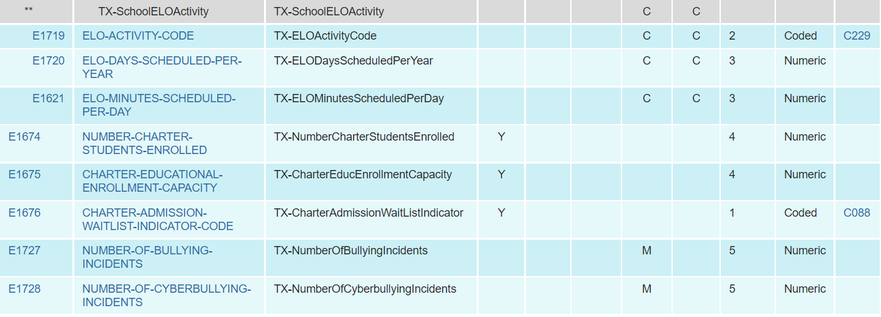
2021-2022: SUBMISSION UPDATES
Added two new data elements to the SchoolExtension complex type to be reported in the PEIMS Summer Submission:

Slide 31
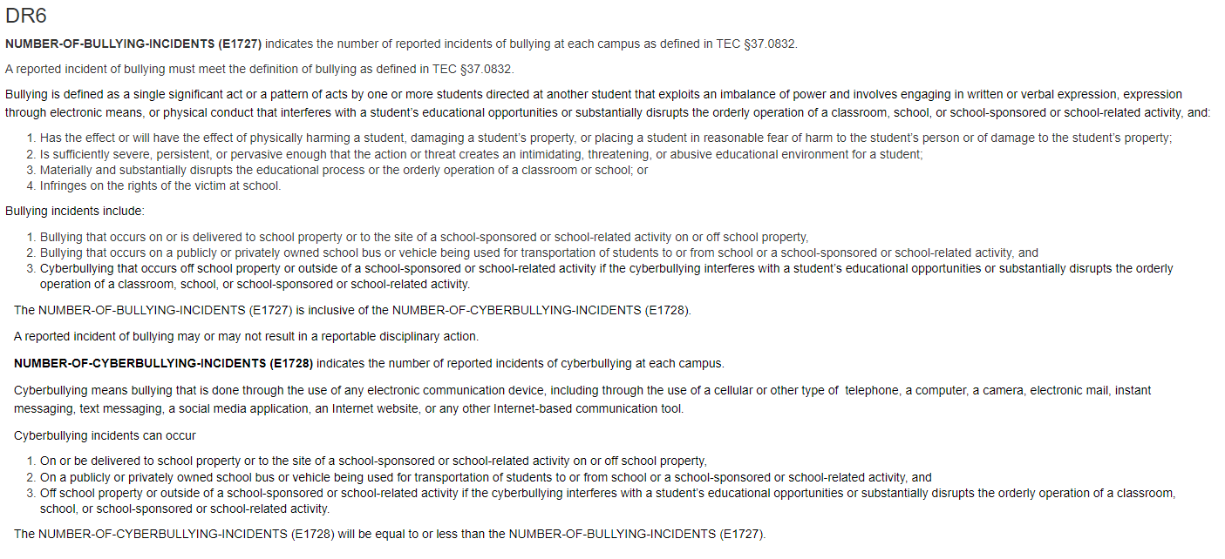
2021-2022: SUBMISSION UPDATES
Updated data element reporting requirements.

Slide 32
2021-2022: SUBMISSION UPDATES
Updated data validation rule 10020-000D to include NUMBER-OF-BULLYING-INCIDENTS and NUMBER-OF-CYBERBULLYING-INCIDENTS:
Added new validation rule 10020-0067:

Slide 33
2021-2022: SUBMISSION UPDATES
New TSDS Report PDM3-116-009 Organization Campus-Level Bullying Incidents

Slide 34
2021-2022: SUBMISSION UPDATES
The following reports were updated to include RA and RS:
PDM3-120-013 Special Program Attendance Data
PDM3-131-001 Roster of Pregnancy Related Services
PDM3-131-002 Roster of Kindergarten Students Under Age Five
PDM3-131-003 Roster of Homebound, Hospital Class, & State School Students Earning Career & Technical Contact Hours
PDM3-131-004 Roster of Full Day Prekindergarten Students with a Special Education Setting of Speech Therapy Only
PDM3-131-005 Roster of Students with Perfect Attendance and No Course Completion Indicator
PDM3-131-007 Roster of 7th & 8th Grade Students Generating More Than One Career & Technical Contact Hour Per Day

Slide 35
2021-2022: SUBMISSION UPDATES
The following reports were updated to include RA and RS:
PDM3-131-008 Roster of Students Reporting More Than Three Contact Hours Per Day
PDM3-131-009 Roster of Students Age 21 Not in Special Education or Over Age 21 with Eligible Days Present
PDM3-131-010 Roster of Possible School Leavers
PDM3-131-011 Students with a Mandatory Expulsion to JJAEP with Attendance in that Reporting Period
PDM3-231-001 Percent Change from the Previous Year
These reports are tentatively scheduled to be updated in the May 6, 2022 software release.

Slide 36
2021-2022: REMINDERS
Unique ID Birthdate and Demographic Reminders
Please ensure birthdates are valid in the Unique ID application. For example, age 00 on September 1st is not a correct birthdate.
TEA is working with their vendor on an enhancement request to provide a warning message to the user if the year of birth in the birthdate matches the current calendar year. The birthyear will be accepted if verified by the user.
Refer to TSDS PEIMS report PDM1-600-002 Statement of Unique ID Student Discrepancies to verify date of birth.
Utilize the PEIMS UID Discrepancy Reports to identify any demographic data in the Unique ID application that does not match your PEIMS data.

Slide 37
CURRENT KNOWN ISSUES
The following known issues are tentatively scheduled to be updated in the May 6, 2022 software release.
Application
The ADA Elig column is being displayed for PEIMS SUMR and EXYR submissions in the Access Data>Search Submission Data. This data element is not collected for these submissions and should not be displayed.

Slide 38
CURRENT KNOWN ISSUES
The following known issues are tentatively scheduled to be updated in the May 6, 2022 software release.
Reports
PDM3-120-004 Disaggregation of PEIMS Summer Attendance Data is not displaying CTE data on this report.
PDM3-120-010 Student Advanced Academic Roster by Grade report when run by LEA and selecting multiple campuses, this report shows ‘no data to report’ for each campus selected.
PDM3-125-002 Student Disciplinary Action Detail Report for Students with Restraint Events is not displaying the Primary Disability and Multiply Disabled data on the report.

Slide 39
CURRENT KNOWN ISSUES
The following known issues are tentatively scheduled to be updated in the May 6, 2022 software release.
Reports (continued)
PDM3-130-001 - Superintendent’s/Principal’s Report of Student Attendance is displaying ‘Row U Percent in Attendance’ on the individual instruction method reports for the total grade summary pages. This row should only be displayed on all methods (combined) report.
PDM3-130-0010 - Superintendent’s/Principal’s Report of Student Attendance is not correctly calculating the Career & Technical Ed FTE for In Person attendance method. This will be fixed with the update of the CTE FTE Tier Calculations.
Users should utilize report PDM3-130-008 Superintendent’s/Principal’s Report of Student Attendance for the correct Career & Technical Ed FTE.

Slide 40
CURRENT KNOWN ISSUES
The following known issues are tentatively scheduled to be updated in the May 6, 2022 software release.
Reports (continued)
PDM3-130-005 Comparison of Current and Prior Year Student Attendance is counting eligible days for students who are not LEP in rows BE - Biling/ESL Refined ADA and D1 - Bil Dual Lang Refined ADA.
PDM3-130-008 Superintendent’s/Principal’s Summary Report of Student Attendance is counting eligible days for students who are not LEP in rows BE - Biling/ESL Refined ADA and D1 - Bil Dual Lang Refined ADA.

Slide 41
CURRENT KNOWN ISSUES
The following known issues are tentatively scheduled to be updated in the May 6, 2022 software release.
Rules
SUMR rule 42400-0047 is misfiring for a student that has changed campuses and is displaying their data incorrectly for ‘sum of TOTAL-DAYS-ABSENT’.
SUMR rule 42400-0048 is displaying error data at the student level instead of the Campus/LEA level.
SUMR rule 42400-0013 validation error data should indicate the ‘Sum of TOTAL-ELIG-BILINGUAL/ESL-DAYS-PRESENT’ instead of the label ‘Sum of FLEX-ATTEND-TOTAL-BILINGUAL/ESL-DAYS-ELIGIBLE’. The rule is firing correctly based on TEDS.
SUMR rule 42400-0067 is displaying identifying information for the Campus instead of the LEA.
SUMR rule 10020-0057 is misfiring for each campus registered as a New Tech campus. The rule is looking for the CAMPUS-ID-OF-ENROLLMENT in the Student School Association data, which is not reported in that complex type in the Summer submission.

Slide 42
CURRENT KNOWN ISSUES
The following known issues are tentatively scheduled to be updated in the June 24, 2022 software release.
Reports
SUMR Bundle Reports option for Superintendent Reports does not include all the Superintendent PEIMS Summer reports.
PDM3-131-001 Roster of Pregnancy Related Services is displaying ‘no date to report’ when choosing selection parameters ‘By LEA’ and ‘*All Campuses’. This issue applies to Accepted submission data only.
Select ‘By LEA’ and ‘Add All’ to select all campuses and the report will print correctly.

Slide 43
CURRENT KNOWN ISSUES
The following known issues are tentatively scheduled to be updated in the June 24, 2022 software release.
Reports (continued)
PDM3-404-002 Career and Technical Education Student Roster
When a student has attended multiple LEAs within a school year, the student is appearing on the career and tech reports for each LEA. The student should only appear on the career and tech reports for the LEA with the latest course completion begin date for the student.
PDM3-404-003 Student Counts by Career and Technical Indicator Code and Grade
The report is taking over four (4) hours to complete.
When a student has attended multiple LEAs within a school year, the student is appearing on the career and tech reports for each LEA. The student should only appear on the career and tech reports for the LEA with the latest course completion begin date for the student.
PDM3-231-001 Percent Change from the Previous Year report is only counting students with mainstream attendance and should be counting students with mainstream and special education attendance. This information is displayed in the Special Education Membership section of the report.

Slide 44
CURRENT KNOWN ISSUES
The following known issues will be updated in a future software release.
Rules
SUMR rule 48011-0023 is currently not firing at the campus level. The LEA version is firing correctly.
SUMR rule 48011-0029 is currently not firing at the campus level. The LEA version is firing correctly.
Reports
PDM3-600-002 Statement of Unique ID Discrepancies is printing no data when the ‘All Reports’ option is selected.
Users should select each individual report type.

Slide 45
PEIMS 2021-2022 SUBMISSION TIMELINE
Summer Submission Timeline
PEIMS Summer Submission (Sub 3)​
PEIMS Summer submission ready for users to promote data​ | February 28, 2022​
TSDS PEIMS ready for users to complete, approve, and accept submissions​ | May 16, 2022​
Requests to retire Unique IDs due at TEA​ | June 10, 2022​
PEIMS Summer first submission due date for LEAs​ | June 16, 2022​
Requests to retire Unique IDs due at TEA​ | July 15, 2022​
PEIMS Summer resubmission due date for LEAs​ | July 21, 2022​

Slide 46
PEIMS 2021-2022 SUBMISSION TIMELINE
Extended Year Submission Timeline
PEIMS Extended Year Submission (Sub 4)​
PEIMS Extended Year submission ready for users to promote data​ | March 28, 2022​
TSDS PEIMS ready for users to complete, approve, and accept submissions​ | July 25, 2022​
Requests to retire Unique IDs due at TEA​ | August 19, 2022​
PEIMS Extended Year first submission due date for LEAs​ | August 25, 2022​
Requests to retire Unique IDs due at TEA​ | September 9, 2022​
PEIMS Extended Year resubmission due date for LEAs​ | September 15, 2022​

Slide 47
2022-2023

Slide 48
2022-2023: APPLICATION UPDATES
The following PEIMS application functionality will be updated to include new data elements:
Data Search
Data Element Summary
Data Retrieval

Slide 49
2022-2023: FINANCIAL AID APPLICATION
Overview of Financial Aid Application:
The Texas Commission on Public School Finance identified that many Texas students are not applying for financial aid and as a result there has been a drop in college enrollment. House Bill 3 (HB3) added to Texas Education Code (TEC §28.0256) the requirement that prior to graduating from high school, all students must complete and submit either a free application for federal student aid (FAFSA), a Texas application for state financial aid (TASFA) or opt out of the requirement.
To align with this legislative mandate, the Standards and Support Division in collaboration with the Curriculum Division and Beyond Grad Support team requested the addition of new data elements and code tables in both the PEIMS Fall submission and the Texas Records Exchange (TREx) to support this reporting requirement.

Slide 50
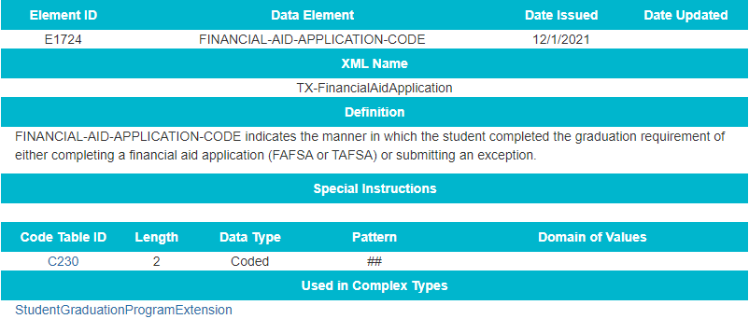
2022-2023: FINANCIAL AID APPLICATION-DATA ELEMENTS
Added a new data element for the*FINANCIAL-AID-APPLICATION-CODE (E1724) to the StudentGraduationProgramExtension complex type to be reported in the PEIMS Fall Submission.
*Data element will be included in the TREx application

Slide 51
2022-2023: FINANCIAL AID APPLICATION-CODE TABLES
Added a new FINANCIAL-AID-APPLICATION-CODE table:

Slide 52
2022-2023: FINANCIAL AID APPLICATION-BUSINESS RULES
Updated field validation rule 48011-000B:

Slide 53
2022-2023: FINANCIAL AID APPLICATION-REPORTS
Added new data element FINANCIAL-AID-APPLICATION-CODE (E1724) to the following PEIMS Fall Graduate reports:
PDM1-120-018 Foundation High School Program Graduate Roster
PDM1-124-007 Graduate Roster by Graduation Type

Slide 54
2022-2023: DYSLEXIA SERVICES
Overview of Dyslexia Services Updates and Additions:
The Texas Education Agency (TEA) currently collects dyslexia related services information during the PEIMS Summer submission. During the PEIMS Fall submission, TEA collects data indicating if a student is identified as dyslexic under TEC 48.009.
During the PEIMS Summer submission, TEA collects the type of dyslexia or related services, if any, a student identified with dyslexia or related disorder under TEC 48.009 has received at any time during the school year. However, TEA does not collect an indicator to validate that each student identified as dyslexic has been reported with the services received.
Additionally, Local Education Agencies (LEAs) are required to screen students in kindergarten and first grade for dyslexia or related disorders. Currently, when an LEA does not screen a student, TEA cannot identify why the screening did not take place.
The division of special education has requested changes to what is collected for dyslexic students.

Slide 55
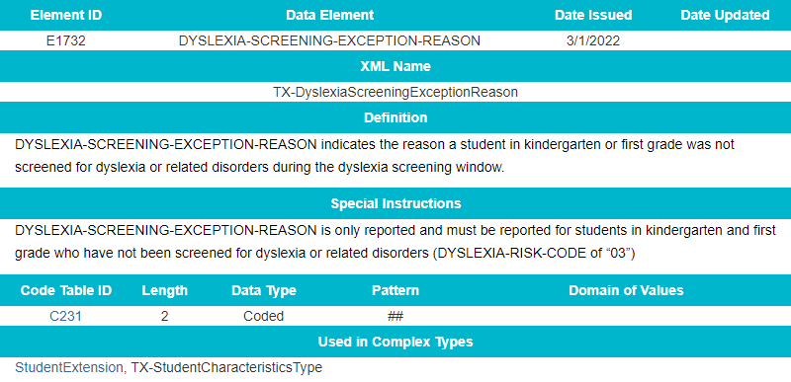
2022-2023: DYSLEXIA SERVICES-DATA ELEMENTS
Added a new data element DYSLEXIA-SCREENING-EXCEPTION-REASON:

Slide 56
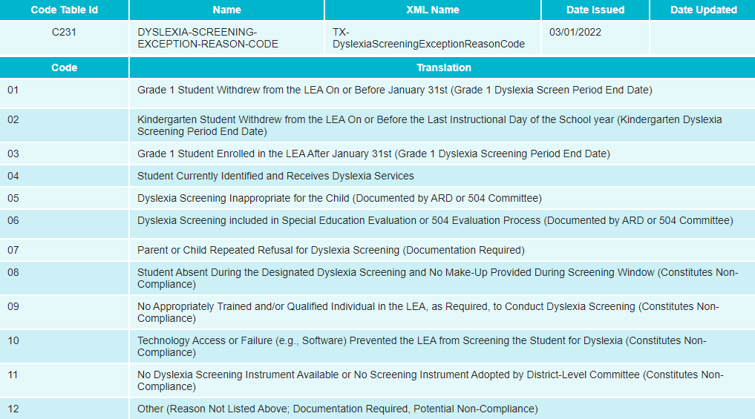
2022-2023: DYSLEXIA SERVICES-CODE TABLES
Added a new code table DYSLEXIA-SCREENING-EXCEPTION-REASON-CODE:

Slide 57
2022-2023: DYSLEXIA SERVICES-Guidance
Updated the General Reporting requirements
DYSLEXIA-SCREENING-EXCEPTION-REASON (E1732) indicates the reason a student in kindergarten or first grade was not screened for dyslexia or related disorders.
DYSLEXIA-SCREENING-EXCEPTION-REASON is only reported and must be reported for students in kindergarten and first grade who have not been screened for dyslexia or related disorders (DYSLEXIA-RISK-CODE of “03”).
Some reason codes provide an acceptable reason a student was not screened during the dyslexia screening window, whereas other reason codes provide an unacceptable reason a student was not screened during the dyslexia screening window. The dyslexia screening window for kindergarten falls between the first and last instructional days of the school year, and for first grade students the dyslexia screening window starts the first instructional day of the school year and ends on January 31st.
See TEC §42.006 Public Education Information Management System (PEIMS)
See 19 TAC §97.1071 Special Program Performance; Monitoring, Review, and Supports

Slide 58
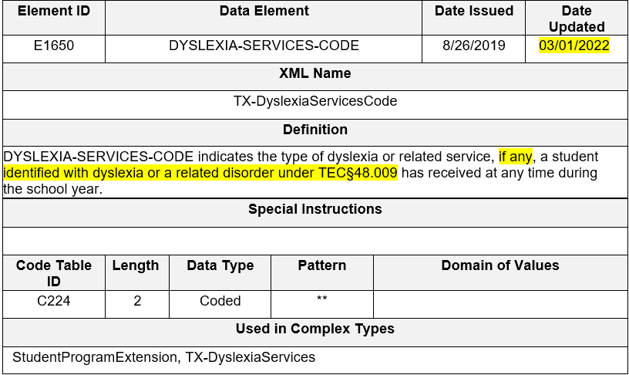
2022-2023: DYSLEXIA SERVICES-DATA ELEMENTS
Revised the data element definition and data element reporting requirements for DYSLEXIA-SERVICES-CODE (E1650):

Slide 59
2022-2023: DYSLEXIA SERVICES-Guidance
Updated the General Reporting requirements

Slide 60
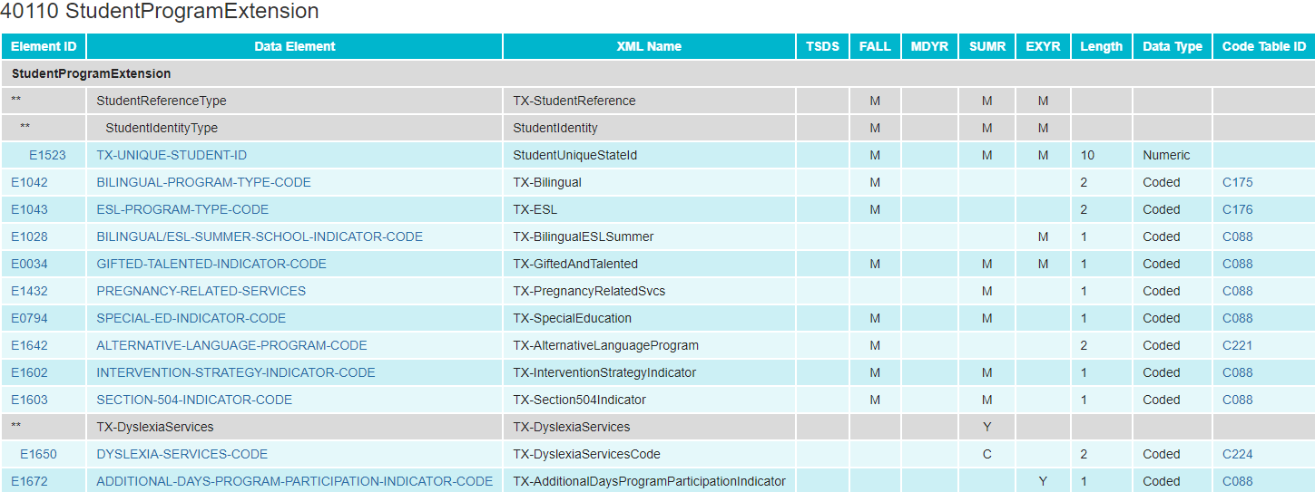
2022-2023: DYSLEXIA SERVICES-DATA ELEMENTS
Updated the data element DYSLEXIA-SERVICES-CODE (E1650) from “mandatory” to “conditionally mandatory”:

Slide 61
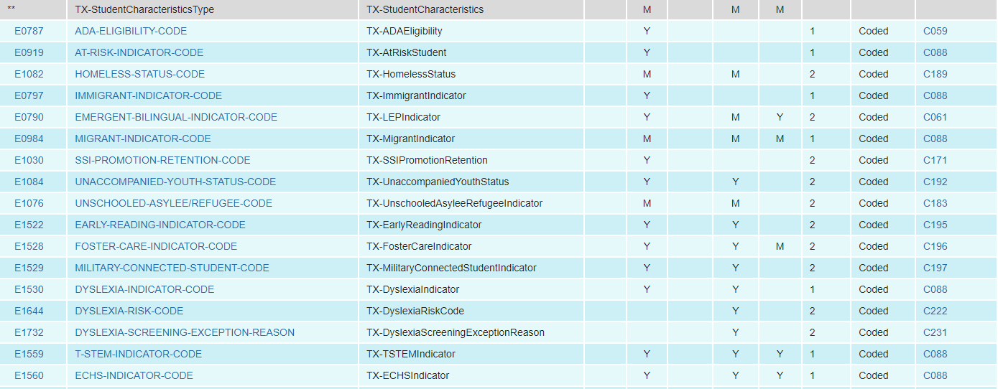
2022-2023: DYSLEXIA SERVICES-DATA ELEMENTS
Added new and existing data elements to the StudentExtension complex type as “Optional” for the PEIMS Summer Submission:
DYSLEXIA-INDICATOR-CODE
DYSLEXIA-SCREENING-EXCEPTION-REASON

Slide 62
2022-2023: DYSLEXIA SERVICES-CODE TABLES
Revised the code translation for ‘00’ in the DYSLEXIA-SERVICES-CODE table:

Slide 63
2022-2023: DYSLEXIA SERVICES-BUSINESS RULES
Added new validation rules 40100-0232, 40100-0233, and 40100-0234:

Slide 64
2022-2023: DYSLEXIA SERVICES-BUSINESS RULES
New validation rules (cont.):

Slide 65
2022-2023: DYSLEXIA SERVICES-REPORTS
The following reports will be reviewed to determine if any modifications are needed.
PDM3-120-007 Student Indicator Report by Grade
PDM3-120-018 Student Dyslexia and/or Related Services Roster

Slide 66
2022-2023: INDUSTRY BASED CERTIFICATION
Overview of Industry Based Certification Changes:
House Bill 22 (HB 22), passed during the 85th legislative session, established the A-F accountability system. Per Texas Education Code section 39.053, students can earn College, Career, and Military Readiness (CCMR) credit for earning an approved industry-based certification (IBC). Additionally, House Bill 3 (HB 3), passed during the 86th legislative session, entitles local education agencies (LEAs) to one IBC reimbursement per student to help defray the cost of the exams passed.
Currently, LEAs use the data element, POST-SECONDARY-LICENSURE-CERTIFICATION-CODE (E1640) to report IBCs earned for CCMR credit (students have earned the certification) and IBCs passed (students have passed all or a portion of a multileveled certification). The Texas Education Agency (TEA) uses this data element to determine whether a student has met the threshold to earn the CCMR indicator, and data element IBC-EXAM-FEE-AMOUNT (E1654) to determine if the LEA is requesting reimbursement. LEAs may request reimbursement for a portion of an IBC exam a student passed, even if the student has not completed all of the requirements to earn the certification.
Additionally, the 2018-2019 school year was the last year TEA collected when a student failed an IBC exam. While the LEA cannot request reimbursement for those students who fail to pass an IBC exam, TEA must collect this information for reporting purposes.

Slide 67
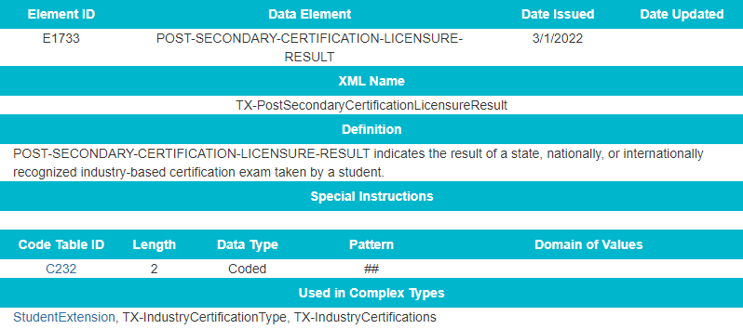
2022-2023: INDUSTRY BASED CERTIFICATION-DATA ELEMENTS
Added a new data element *POST-SECONDARY-CERTIFICATION-LICENSURE-RESULT to TX-IndustryCertifications sub-complex:
*data element will be included in the TREx application

Slide 68
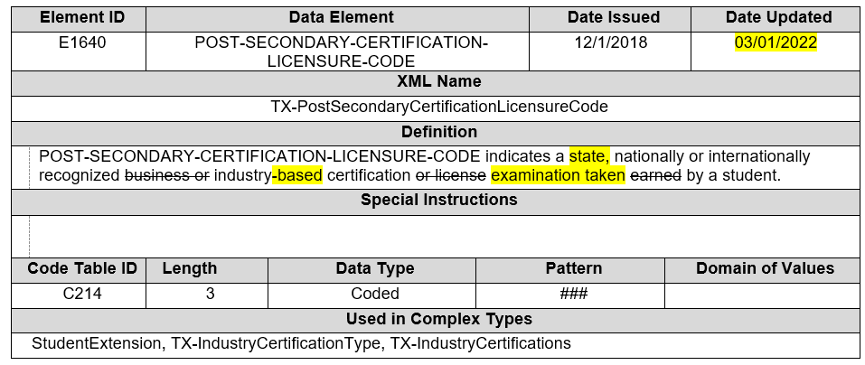
2022-2023: INDUSTRY BASED CERTIFICATION-DATA ELEMENTS
Revised the data element definition for *POST-SECONDARY-CERTIFICATION-LICENSURE-CODE (E1640):
*data element will be included in the TREx application

Slide 69
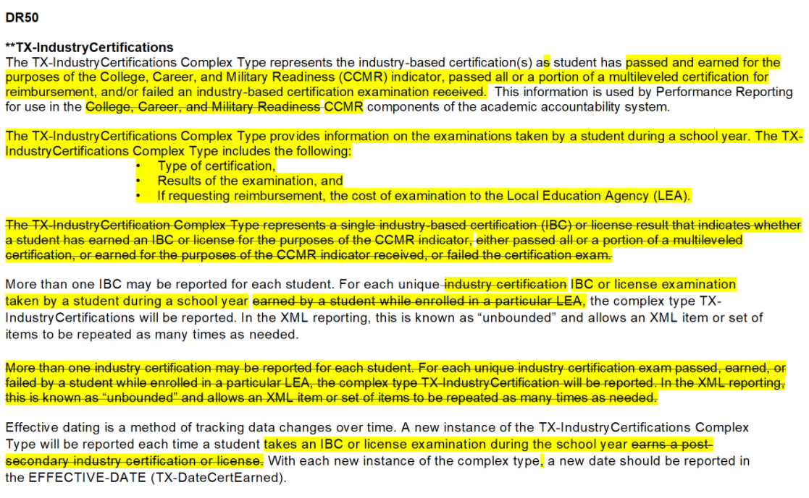
2022-2023: INDUSTRY BASED CERTIFICATION-Guidance
Updated general reporting requirements for Post-Secondary Certification Licensure:

Slide 70
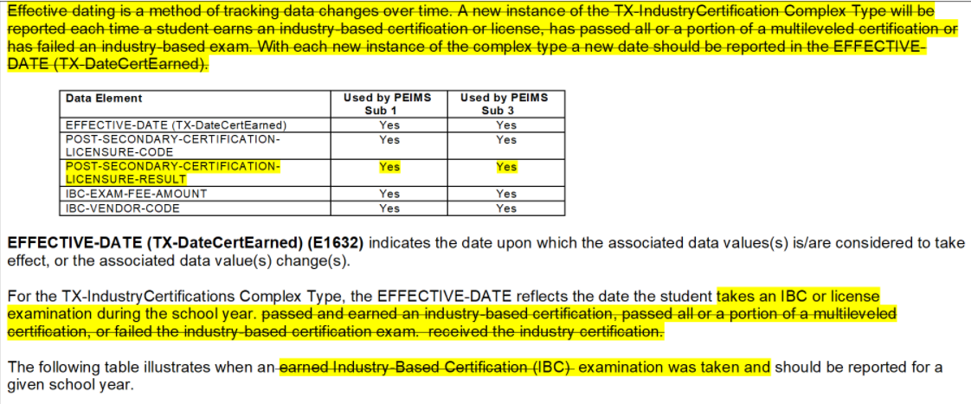
2022-2023: INDUSTRY BASED CERTIFICATION-Guidance
Updated general reporting requirements for Post-Secondary Certification Licensure(continued):
(cont.):

Slide 71
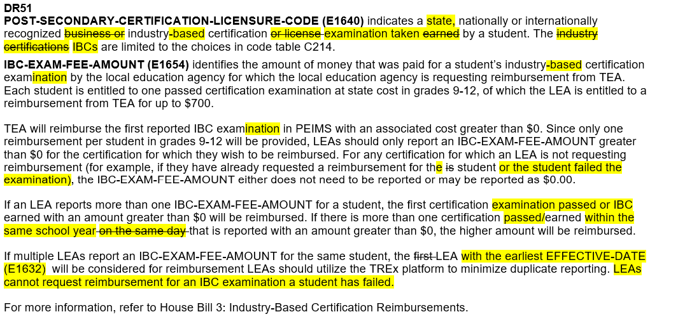
2022-2023: INDUSTRY BASED CERTIFICATION-Guidance
Updated general reporting requirements for Post-Secondary Certification Licensure(continued):
(cont.):

Slide 72
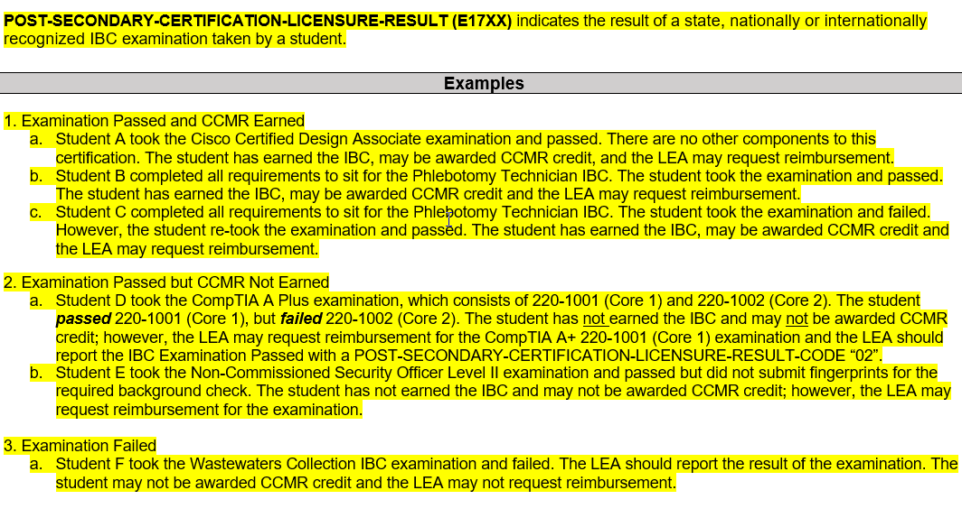
2022-2023: INDUSTRY BASED CERTIFICATION-Guidance
Added general reporting requirements for Post-Secondary Certification Licensure(continued):
:

Slide 73
2022-2023: INDUSTRY BASED CERTIFICATION-CODE TABLES
Added a new code table *POST-SECONDARY-CERTIFICATION-LICENSURE-RESULT-CODE:
*data element will be included in the TREx application

Slide 74
2022-2023: INDUSTRY BASED CERTIFICATION-BUSINESS RULES
Added a new data validation rule 40100-0231:

Slide 75
2022-2023: INDUSTRY BASED CERTIFICATION-REPORTS
Added a new data element POST-SECONDARY-CERTIFICATION-LICENSURE-RESULT (E1733) to the following PEIMS Fall and Summer reports:
PDM1-120-021 Industry-Based Certification Roster (Fall)
PDM3-120-019 Industry-Based Certification Roster (Summer)

Slide 76
2022-2023: SAFE AND SUPPORTIVE SCHOOL PROGRAM
Overview of Safe and Supportive School Program Team:
During the 86th legislative session, SB 11 was passed, which amended Subchapter D, Chapter 37, Education Code by adding §37.115. This new section requires the board of trustees for each local education agency (LEA) to establish a safe and supportive school program (SSSP) team to serve at each campus to conduct threat assessments. The SSSP team must report to the agency, through guidelines developed by the agency, the following information regarding the team's activities and other information for each LEA campus the team serves, the outcome of each assessment made by the team, including:
any disciplinary action taken, including a change in school placement (§37.115(k)(3)(A));
changes in school placement, including placement in a juvenile justice alternative education program or disciplinary alternative education program (§37.115(k)(4)(D));
placements in in-school suspension or out-of-school suspension and incidents of expulsion (§37.115(k)(3)(F));
Through an annual data collection/survey, LEAs must report discipline incidents that included an SSSP team review and the resulting number of changes in school placement that occurred after the SSSP team review was conducted.

Slide 77
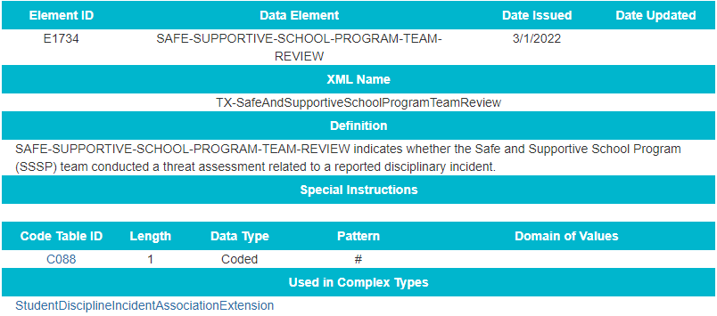
2022-2023: SSSP-DATA ELEMENTS
Added a new data element SAFE-SUPPORTIVE-SCHOOL-PROGRAM-TEAM-REVIEW to the StudentDisciplineIncidentAssociationExtension complex type:

Slide 78
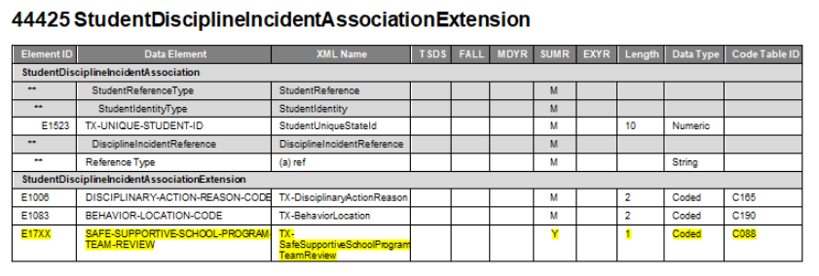
2022-2023: SSSP-DATA ELEMENTS
Added new data element to the StudentDisciplineIncidentAssociationExtension complex type:

Slide 79
2022-2023: SSSP-DATA ELEMENTS
Added new data element reporting requirements
SAFE-SUPPORTIVE-SCHOOL-PROGRAM-TEAM-REVIEW (E1734) indicates whether the Safe and Supportive School Program (SSSP) team conducted a threat assessment related to a reported disciplinary incident.

Slide 80
2022-2023: SSSP-CODE TABLES
No New Code Tables
No Updated Code Tables
No Deleted Code Tables

Slide 81
2022-2023: SSSP-BUSINESS RULES
No New Business Rules
No Updated Business Rules
No Deleted Business Rules

Slide 82
2022-2023: SSSP-REPORTS
Added a new data element SAFE-SUPPORTIVE-SCHOOL-PROGRAM-TEAM-REVIEW (E1734) to the following PEIMS Summer Disciplinary reports:
PDM3-132-001 Student Disciplinary Action Roster
PDM3-132-002 Student Disciplinary Action Detail by Reason
PDM3-132-004 Student Disciplinary Action Detail by Incident Number

Slide 83
2022-2023: SSSP-REPORTS
Added a new PEIMS Summer Disciplinary report:
PDM3-132-xxx Student Disciplinary Action Summary by SSSP Team Review
This report will be at the LEA and Campus level and will display the total number of incidents reviewed by the SSSP team broken out by Action Code (JJAEP, DAEP, ISS, OSS).

Slide 84
PEIMS 2022-2023 SUBMISSION TIMELINE
PEIMS Fall Submission (Sub 1)
TSDS PEIMS ready to load data to eDM | August 1, 2022
PEIMS Fall submission ready for users to promote data | September 12, 2022
Close of school-start window - Last Friday in September | September 30, 2022
PEIMS Fall snapshot date | October 28, 2022
TSDS PEIMS Fall ready for users to complete, approve, and accept submissions | October 31, 2022
Requests to retire Unique IDs due at TEA for PEIMS Fall first submission | December 2, 2022
PEIMS Fall first submission due date for LEAs and ESCs | December 8, 2022
Requests to retire Unique IDs due at TEA for PEIMS Fall resubmission | January 13, 2023
PEIMS Fall resubmission due date for LEAs and ESCs | January 19, 2023

Slide 85
PEIMS 2022-2023 SUBMISSION TIMELINE
PEIMS Mid-Year Submission (Sub 2)
PEIMS Mid-Year submission ready for users to promote data | November 14, 2022
TSDS PEIMS Mid-Year ready for users to complete, approve, and accept submissions | December 19, 2022
PEIMS Mid-Year first submission due date for LEAs and ESCs | January 26, 2023
PEIMS Mid-Year resubmission due date for LEAs and ESCs | February 9, 2023

Slide 86
PEIMS 2022-2023 SUBMISSION TIMELINE
PEIMS Summer Submission (Sub 3)
PEIMS Summer submission ready for users to promote data | February 27, 2023
TSDS PEIMS Summer ready for users to complete, approve, and accept submissions | May 15, 2023
Requests to retire Unique IDs due at TEA for PEIMS Summer first submission | June 9, 2023
PEIMS Summer first submission due date for LEAs | June 15, 2023
Requests to retire Unique IDs due at TEA for PEIMS Summer resubmission | July 14, 2023
PEIMS Summer resubmission due date for LEAs LEAs registered with TEA with year-round tracks ending later than June 15, 2023 may delay PEIMS Summer resubmission until two weeks following completion of the latest year-round track or August 17, 2023, whichever comes first. However, the initial data delivery for submission 3 must still be made by June 15, 2023, for all LEAs. In no case will any resubmission be processed after August 17, 2023. Data corrections made after August 17, 2023 will be processed by State Funding. | July 20, 2023

Slide 87
PEIMS 2022-2023 SUBMISSION TIMELINE
PEIMS Extended Year Submission (Sub 4) if applicable
PEIMS Extended Year submission ready for users to promote data | March 27, 2023
TSDS PEIMS Extended Year ready for users to complete, approve, and accept submissions | July 31, 2023
Requests to retire Unique IDs due at TEA for PEIMS Extended Year first submission | August 18, 2023
PEIMS Extended Year first submission due date for LEAs | August 31, 2023
Requests to retire Unique IDs due at TEA for PEIMS Extended Year resubmission | September 8, 2023
PEIMS Extended Year resubmission due date for LEAs | September 21, 2023

Slide 88
TECHNICAL RESOURCES
Technical Specifications
TSDS Web-Enabled Data Standards (TWEDS)​
Technical Support
TSDSCustomerSupport@tea.texas.gov

Slide 89
Questions

