Slide 1
Residential Facility Tracker

Slide 2
PLEASE NOTE:
The focus of this presentation is on the changes for the official XML data submissions during the 2022-2023 school year.

Slide 3
AGENDA
Residential Facility (RF) Tracker
Program Area Updates & Guidance
2021-2022
Submission Updates
Reminders
Current Known Issues
2022-2023 Changes
Application Updates
Data Element Updates
Report Updates
Business Rule Updates
Code Table Updates
Reminders
Timeline
Frequently Asked Questions
Technical Resources
Questions

Slide 4
PROGRAM AREA UPDATES & GUIDANCE
Office of Special Populations and Monitoring
Ramonda Olaloye Director; Department of Review and Support

Slide 5
2021-2022: SUBMISSION UPDATES
The 2021-2022 RF Tracker data collection is due on July 21, 2022.
The application will be ready for users to complete on May 16, 2022

Slide 6
2021-2022: REMINDERS
Students enrolled not in membership (ADA code 0) should be loaded to the ODS for PEIMS Summer and the students will be promoted to RF Tracker.
The students must have the RESIDENTIAL-FACILITY-INDICATOR (E1629) equal to 'true’.
The LEAs will no longer need to report these students by entering them into a spreadsheet and uploading the spreadsheet.

Slide 7
CURRENT KNOWN ISSUES
If an LEA has an extension and reactivates a residential facility after the submission due date, fatal rule 10025-0001 fires incorrectly.
Users will need to enter a TIMS ticket to correct the effective date for the residential facility.
This issue is tentatively scheduled to be fixed in the June 24, 2022, software release

Slide 8
2022-2023

Slide 9
2022-2023: APPLICATION UPDATES
2022-2023
No Application Updates

Slide 10
2022-2023 DATA ELEMENT UPDATES
2022-2023
No New Data Elements
No Updated Data Elements
No Deleted Data Elements

Slide 11
2022-2023 REPORT UPDATES
2022-2023
No New Reports
No Updated Reports
No Deleted Reports

Slide 12
2022-2023 BUSINESS RULES UPDATES
2022-2023
No New Business Rules
No Updated Business Rules
No Deleted Business Rules

Slide 13
2022-2023 CODE TABLE UPDATES
2022-2023
No New Code Tables
No Updated Code Tables
No Deleted Code Tables

Slide 14
2022-2023: REMINDERS
RF Tracker uses the following PEIMS Summer interchanges:
Education Organization
Student Extension
Student Program (Student Special Education Program Complex and StudentProgram Extension Complex)
These interchanges must be updated with the 2022-2023 TEDS changes by the RF Tracker data checkpoint deadline of December 9, 2022. This enables the LEAs to load their RF Tracker data by the data checkpoint deadline.

Slide 15
2022-2023: REMINDERS CONTINUED - 2
Any new data elements that are mandatory for a complex type in one of the PEIMS Summer interchanges will need to be included.
Mandatory data elements must be reported even if they are not required for the RF Tracker submission in order to pass file/batch edits in the ODS.
If a sub complex type is optional but data related to that sub complex type is reported for a student, then any new data elements that are mandatory for that sub complex type will need to be included.

Slide 16
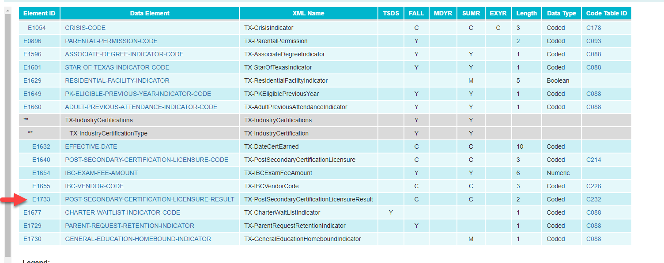
2022-2023: REMINDERS CONTINUED - 3
New Mandatory IBC Data Element on StudentExtension Complex Type
As of TEDS 2023.1.0, this is the only mandatory change.
Notes:
We will use post secondary certification licensure result as example
If IBC data reported for a student, then the sub complex type must be updated with the new mandatory data element.
OR
The IBC data could be excluded for the students

Slide 17
2022-2023 TIMELINE
Residential Facility Tracker (RFT) Collection | Date
TSDS ready to load data to eDM | August 1, 2022
RF Tracker ready for users to promote data | September 12, 2022
All RF Tracker data up to this point must be promoted, validated and fatal free LEA will continue to report RF Tracker data as students enter and exit residential facilities or on a monthly basis throughout the school year. | December 9, 2022
RF Tracker ready for users to complete | May 15, 2023
RF Tracker submission due date for LEAs | July 20, 2023
RF Tracker data available to customers | August 3, 2023

Slide 18
FREQUENTLY ASKED QUESTIONS
Why is the residential facility inactive?
Once the RF Tracker submission is closed, if a residential facility has no students reported for the current school year, then the residential facility is set to inactive for the next school year. The process checks the data from the Student Residential Facility Association for all LEAs.

Slide 19
TECHNICAL RESOURCES
Technical Support:
TSDSCustomerSupport@tea.texas.gov
RF Tracker Program Area:
ReviewandSupport@tea.texas.gov
TIMS Knowledge Based Articles:
TSDSKB-586 - Frequently Asked Questions
TSDSKB-589 - Process for adding or updating the Residential Facilities IDs

Slide 20
Questions

