Slide 1

TSDS ODS 3.x Data Standards

Slide 2
AGENDA
Texas Education Data Standards
Domain Deep Dive
  Attendance
  Leavers
  Charter School Waitlist
  Child Find
Data Element Changes
Begin Date Guidance
Key Takeaways
Questions

Slide 3

TEXAS EDUCATION DATA STANDARDS
Pilot ODS 3.x Data Standards
TEA will maintain both the 3.x TEDS version and the current TEDS version (available in the TSDS Web-Enabled Data Standards (TWEDS)) throughout the ODS 3.x project. The 3.x TEDS version should be available in TWEDS in December 2022.

Slide 4
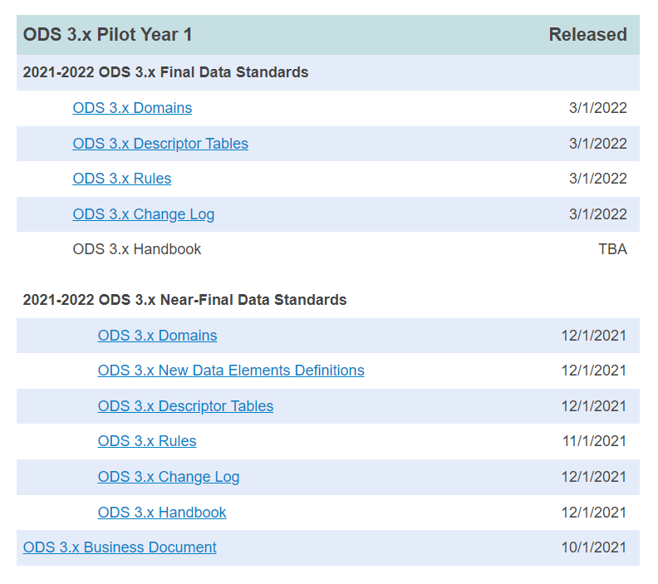
TEXAS EDUCATION DATA STANDARDS – PILOT 1
10/01/2021: ODS 3.x Business Document
12/01/2021: Near-Final Data Standards – ODS 3.x Domains, New Data Element Definitions, Descriptor Tables, Rules, Change Log and Handbook
03/01/2022: Final Data Standards – ODS 3.x Domains, Descriptor Tables, Rules, and Change Log
4/DD/2022: Final Data Standards – ODS 3.x Domains (any corrections needed after the 03/01/2022 publication.

Slide 5
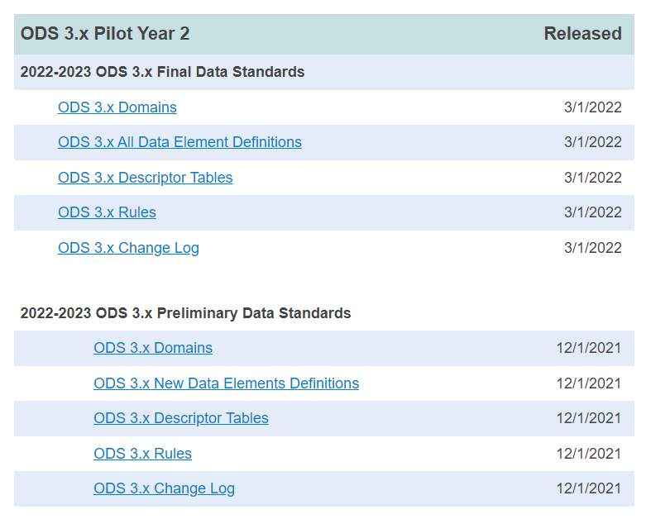
TEXAS EDUCATION DATA STANDARDS – PILOT 2
12/01/2021: Preliminary Data Standards – ODS 3.x Domains, New Data Element Definitions, Descriptor Tables, Rules, and Change Log
03/01/2022: Final Data Standards – ODS 3.x Domains, All Data Element Definitions, Descriptor Tables, Rules, and Change Log
4/DD/2022: Final Data Standards – ODS 3.x Domains (Including Attendance), All Data Element Definitions, Descriptor Tables, Rules, and Change Log

Slide 6
TERMINOLOGY REVIEW
Current TSDS Terminology | ODS 3.x Terminology
Interchanges | Domains/Domain Entities
Complex Type | Entity
Data Element | Data Element
Code Table | Descriptor Table

Slide 7
DOMAIN OVERVIEW – Part 1
Based on Ed-Fi 3.2.0-c Version
Domains/Domain Entities Collected
  Student Identification & Demographics Extension Domain – provides the characteristics and demographics of a student and the education organization associated with the student.
  Enrollment Extension Domain – provides the enrollment and withdrawal information for a student and the relationship between a particular education organization.
  School Calendar Extension Domain – provides the specific calendar information for a particular school. A new entity Session is generally a unit of time into which courses are scheduled similar to a reporting period.
  Staff Extension Domain – provides the general staff information for a local education agency.

Slide 8
DOMAIN OVERVIEW – Part 2
Based on Ed-Fi 3.2.0-c Version
Domains/Domain Entities Collected
  Education Organization Extension Domain – provides information about any public, charter, education service center, organization or agency.
  Alternative & Supplemental Services Extension Domain – provides program information such as Title I, Special Education, and Emergent Bilingual.
  Discipline Extension Domain – provides the discipline incidents, the student associated to the incident, and any actions that were taken against the student.
  Restraint Event Domain Entity Extension – provides the restraint information and the student associated to the restraint.
  Teaching & Learning Extension Domain – provides the course information, the students assigned to a course offered on a particular campus and the staff member that provides instruction for the course.

Slide 9
DOMAIN OVERVIEW – Part 4
Based on Ed-Fi 3.2.0-c Version
Domains/Domain Entities Collected
  Student Academic Record Extension Domain – provides the cumulative record of academic achievement for a student and the final record of a student’s performance in their course at the end of a semester or school year.
  Finance Extension Domain – provides the financial information captured in accounts (both actuals and budgeted).
  Assessment Extension Domain – provides the assessments given to students and the results.
  Student Cohort Domain – provides the cohort information for which a student is designated.
  Student Attendance Extension Domain – provides the daily attendance information for students.

Slide 10
DOMAIN OVERVIEW – Part 3
Based on Ed-Fi 3.2.0-c Version
Domains/Domain Entities Collected
  As Of Status A Leavers Domain Entity – represent the leaver information for students enrolled in the LEA during the prior school year but has never enrolled in the LEA during the current school year.
  Student Application Domain Entity – represents the data for students who have applied but are not enrolled in a charter school and who are on a waitlist for the current school year.
  Student Special Education Program Eligibility Association Domain Entity – represents the data needed to meet federal compliance reporting requirements related to special education Child Find (SPPI-11 and SPPI-12) Child Find activities.

Slide 11
ODS 3.x DOMAINS/DOMAIN ENTITIES
Based on Ed-Fi 3.2.0-c Version
Domains NOT Collected
  Bell Schedule – represents the start time and duration of one or more class periods in a day or over a course of days.
  Graduation – captures the credits and coursework required for graduation, and references to required assessment. (TEA will capture this information in the As of Status A Leavers Domain Entity Extension.)
  Intervention – captures educational interventions aimed at improving student’s understanding of concepts, materials or skills necessary for success in school.
  Survey – captures the structure of surveys and survey results.

Slide 12
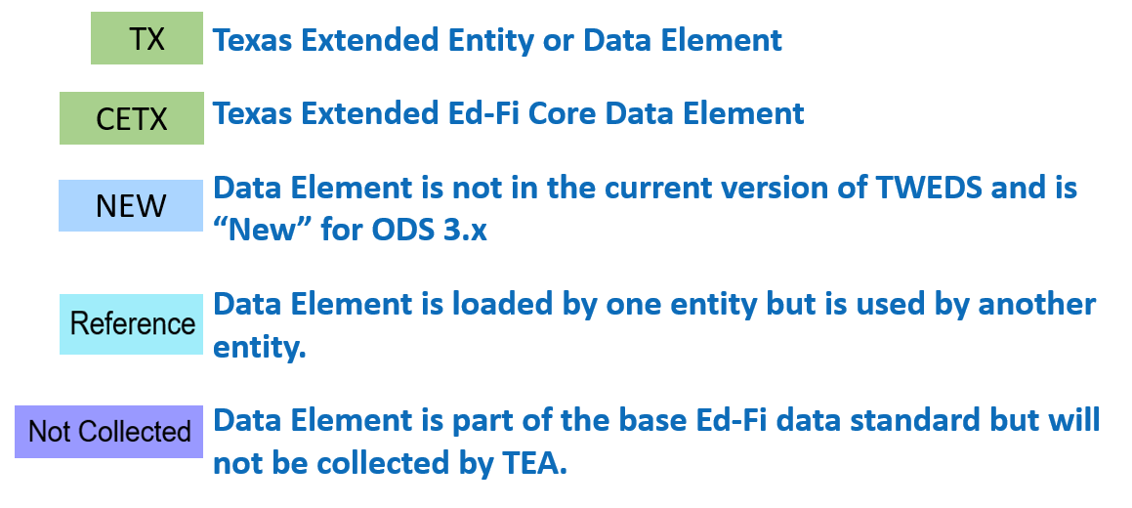
Data Standards Legend

Slide 13
Domain Deep Dive

Slide 14
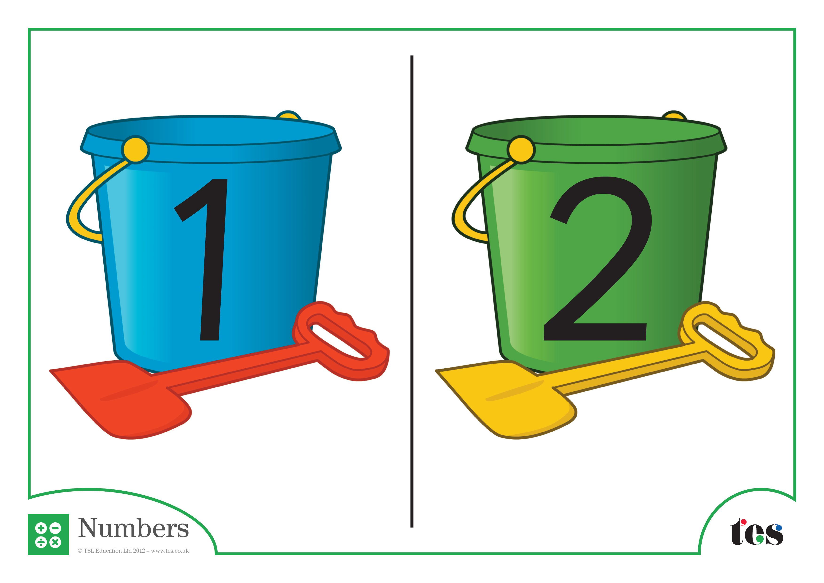
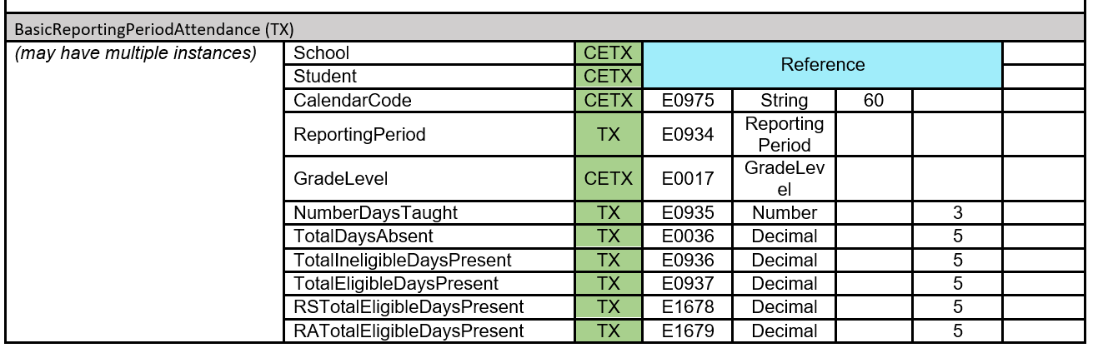
ODS 3.x BASIC ATTENDANCE CUMULATIVE BY STUDENT
TEA will collect attendance two ways.

Slide 15
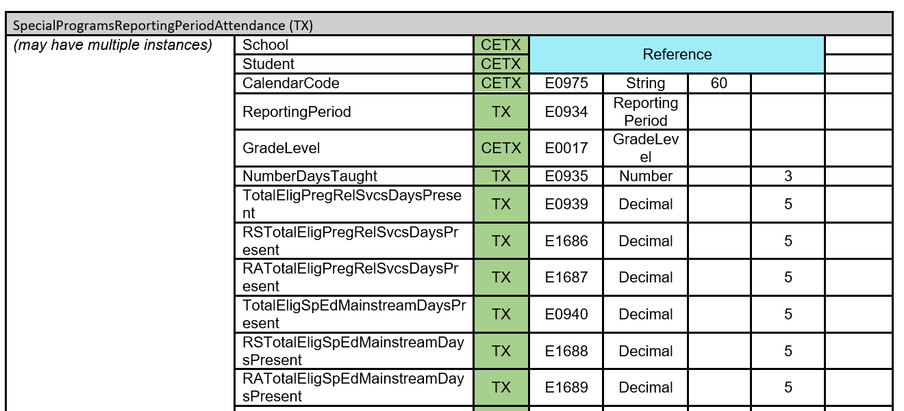
ODS 3.x PROGRAM ATTENDANCE CUMULATIVE BY STUDENT
TEA will collect attendance two ways.

Slide 16
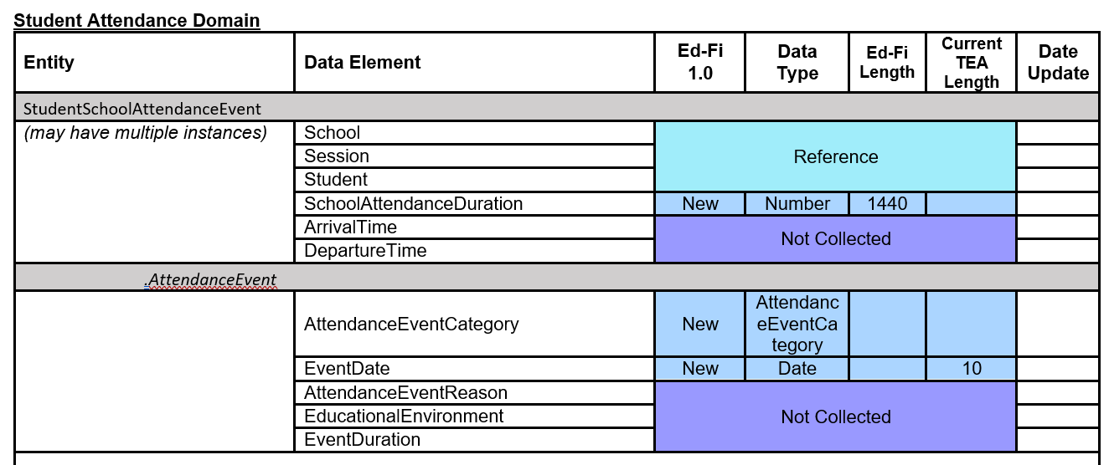
ODS 3.x BASIC GRANULAR ATTENDANCE BY STUDENT

Slide 17
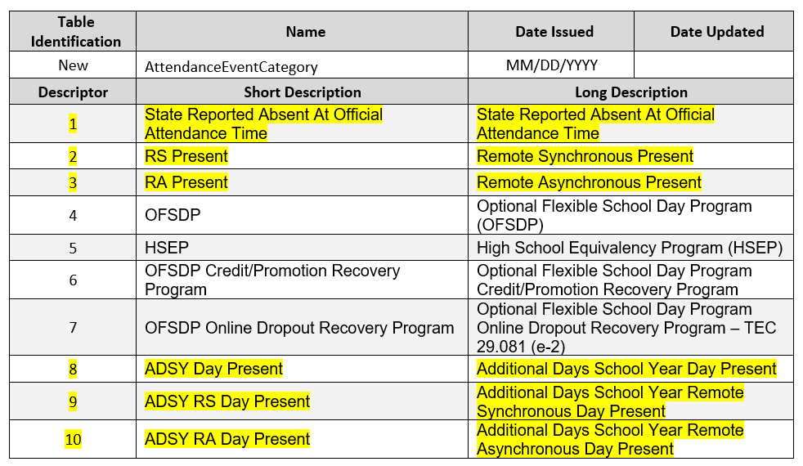
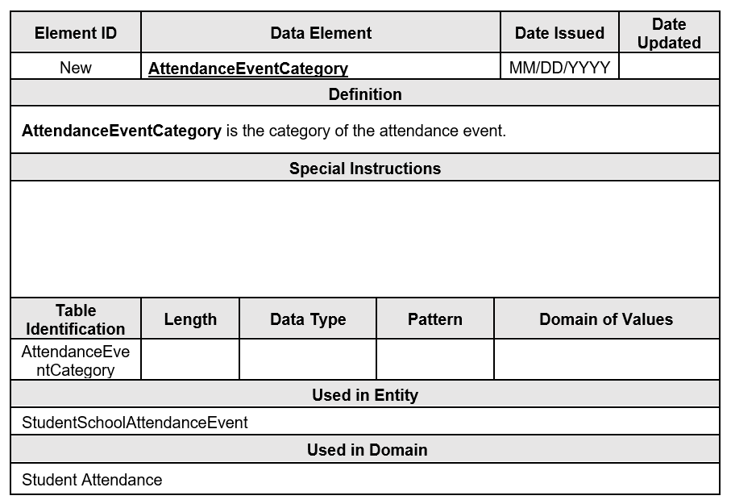
ODS 3.x ATTENDANCE EVENT CATEGORY - BASIC

Slide 18
ODS 3.x FLEXIBLE GRANULAR ATTENDANCE BY STUDENT

Slide 19
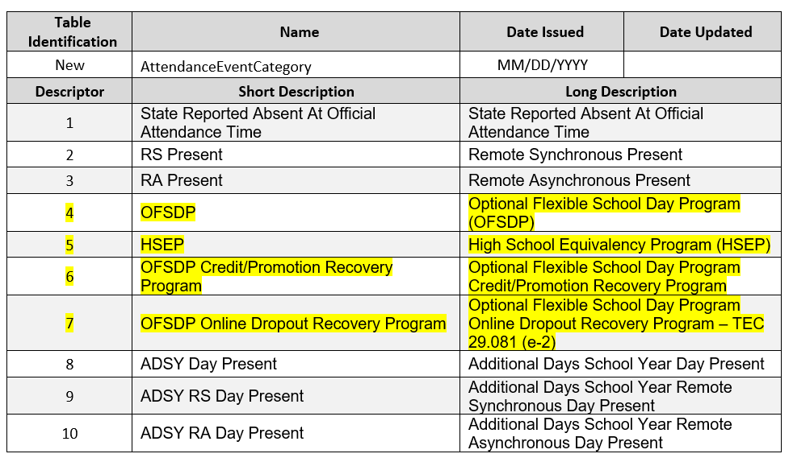
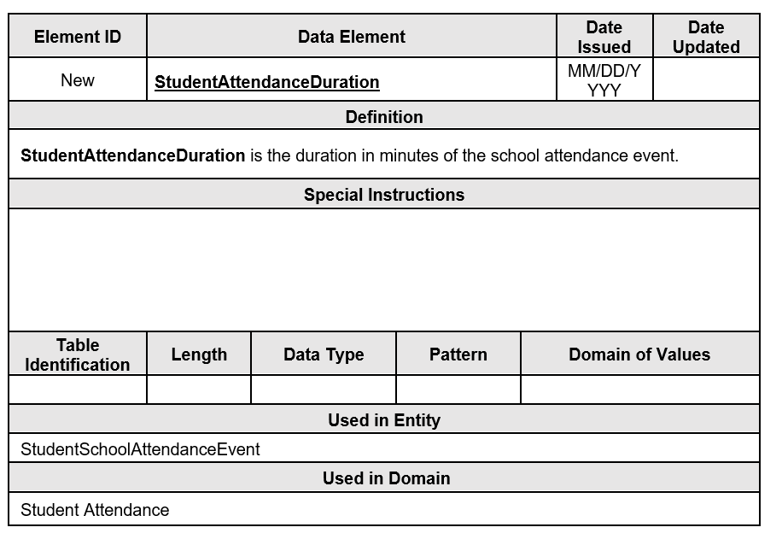
ODS 3.x ATTENDANCE EVENT CATEGORY - FLEXIBLE

Slide 20












ATTENDANCE EVENT CATEGORIES
State Reported Absence
OAT
If no AttendanceEventCategory look at ADA Code:
ADA = 1, 2, 3, or 6:
Eligible Day Present
ADA = 4 or 5
Ineligible Day
Present
RS
Present
RA
Present
OFSDP
HSEP
Eligible
Day
Present
OFSDP
Credit
Promotion
Recovery
OFSDP
Online
Dropout
Recovery
ADSY
RS
Present
ADSY
RA
Present
ADSY
Present
Ineligible
Day
Present

Slide 21
ODS 3.x LEAVERS – CURRENT vs ODS 3.x
Current:
  Local Education Agencies (LEAs) report a calculated AS-OF-STATUS-CODE (E1002) in the PEIMS Fall and Summer submissions. The AS-OF-STATUS-CODE indicates the student’s current status in the LEA on the Submission 1 as-of date and the Submission 3 as-of date. LEAs report the calculated code using the AS-OF-STATUS-CODE (C163) table.
ODS 3.x:
  For the first two years, TEA will ask the LEAs to report two new data elements, AsOfStatusLastFridayOctober and AsOfStatusLastDayEnrollment, in the Student entity.
  Beginning in the 2025-2026 school year, the Texas Education Agency (TEA) plans to calculate the AsOfStatus values using data reported in both the current and prior year.

Slide 22
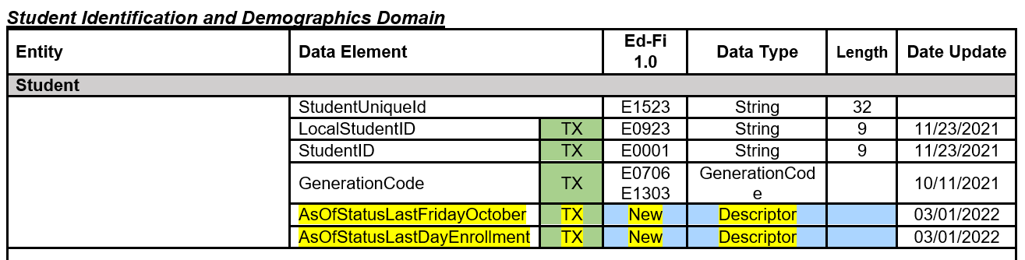
ODS 3.x LEAVERS – INITIAL COLLECTION

Slide 23
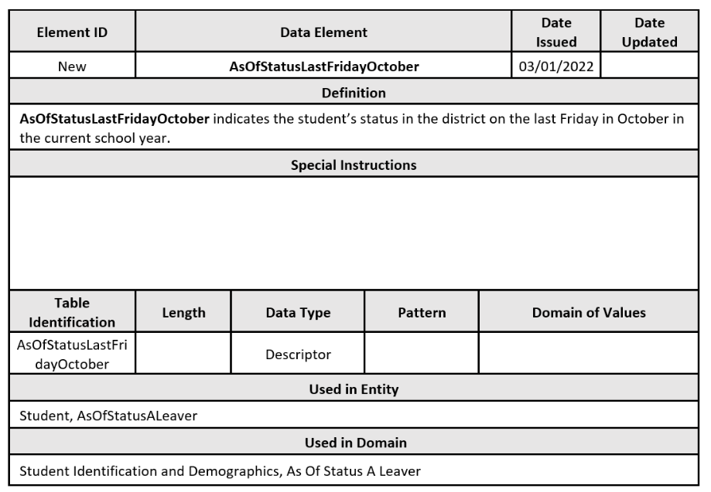
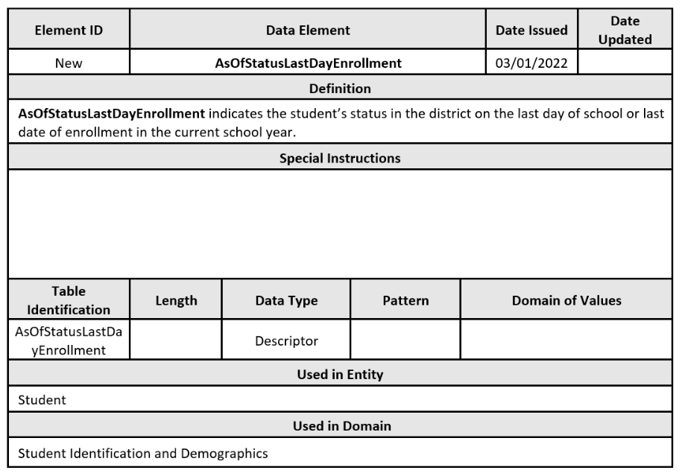
ODS 3.x LEAVERS - DEFINITIONS

Slide 24
ODS 3.x AS OF STATUS A LEAVERS
Current:
  AS-OF-STATUS-CODE “A” is defined as “student was enrolled in the LEA during the prior school year but has never enrolled in the LEA during the current year.” This code is reported for all LEA graduates in addition to specific non-graduate leavers.
ODS 3.x:
  Initially, TEA will need to develop a way to collect specific data elements for students enrolled in the LEA during the prior school year but never enrolled in the LEA during the current year. In the first year of collecting data through ODS 3.x, TEA will not have access to prior year data. TEA will collect this through a Texas extended entity called AsOfStatusCodeALeaverExtension. The new entity will contain new data elements. The new data elements will be reflective of the prior year.
  TEA is only planning to collect this new entity and new data elements until the 2025-2026 school year. The necessary data elements for AsOfStatusLastFridayOctober descriptor “A” students will be available to TEA using the data in the prior year LEA operational data store.

Slide 25
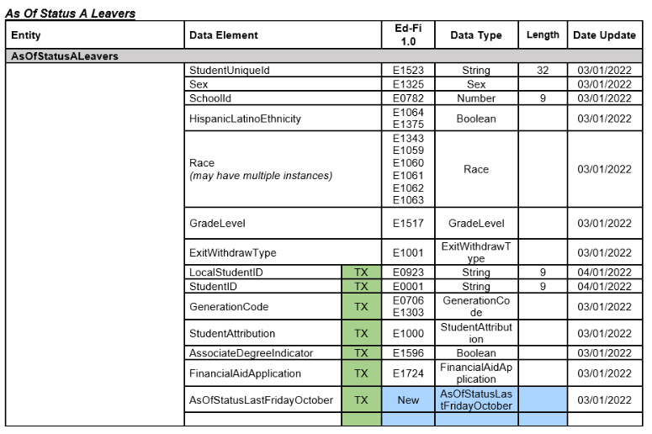
ODS 3.x AS OF STATUS A LEAVERS DOMAIN ENTITY PT1

Slide 26
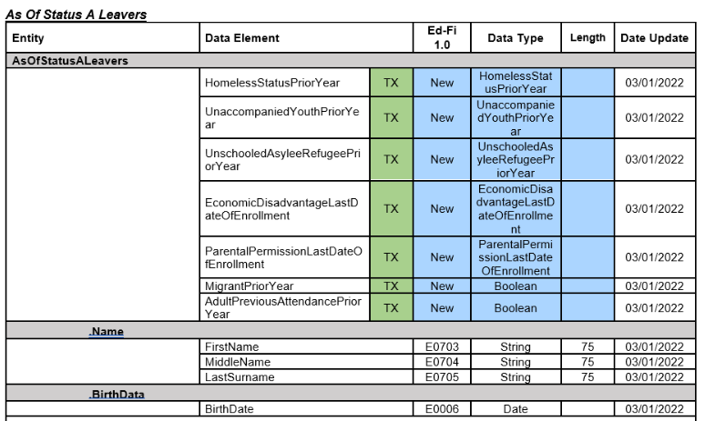
ODS 3.x AS OF STATUS A LEAVERS DOMAIN ENTITY PT2

Slide 27
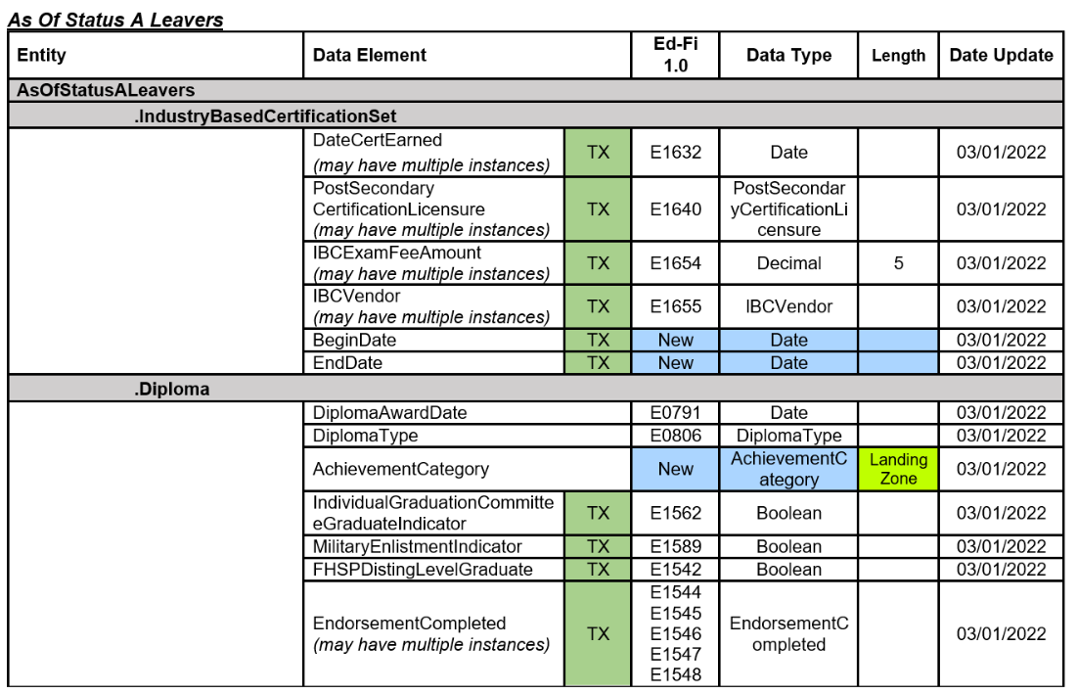
ODS 3.x AS OF STATUS A LEAVERS DOMAIN ENTITY PT3

Slide 28
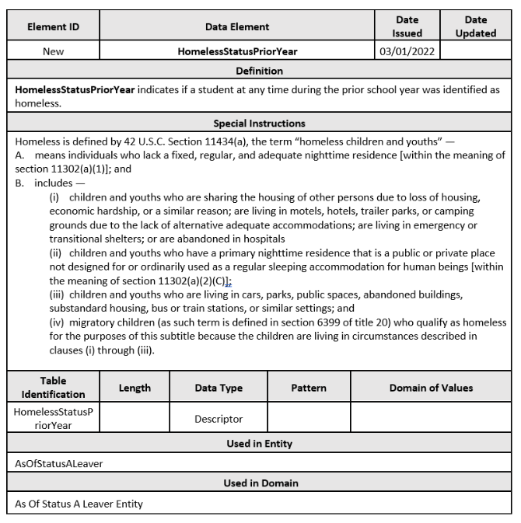
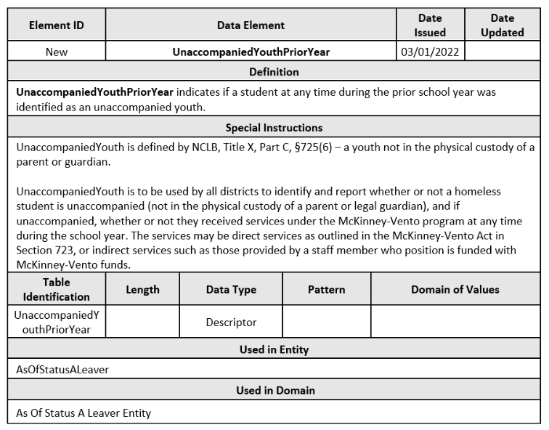
TEDS: AS OF STATUS A LEAVER ENTITY PT1

Slide 29
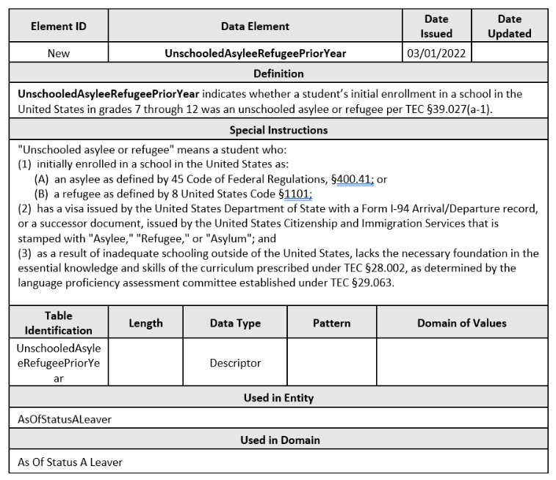
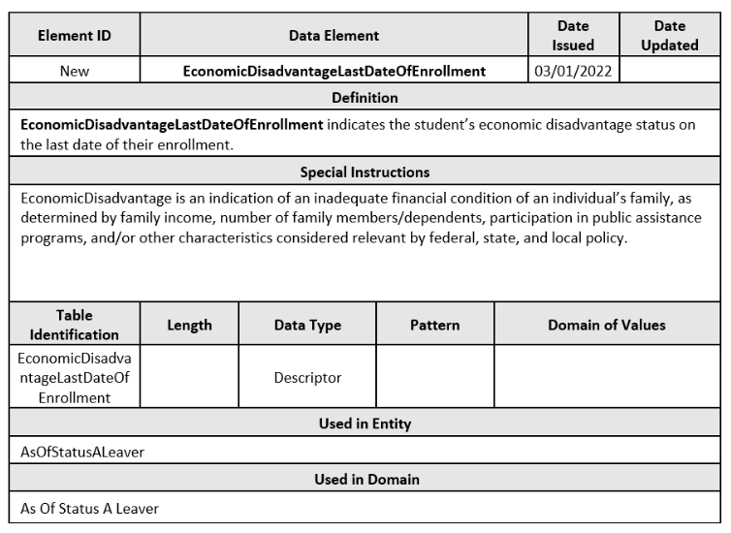
TEDS: AS OF STATUS A LEAVER ENTITY PT2

Slide 30
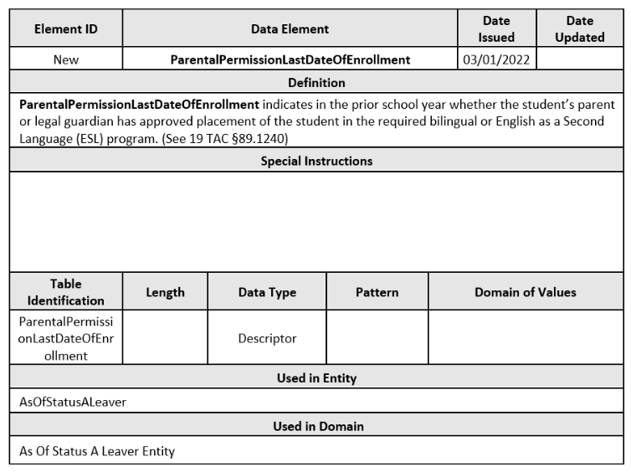
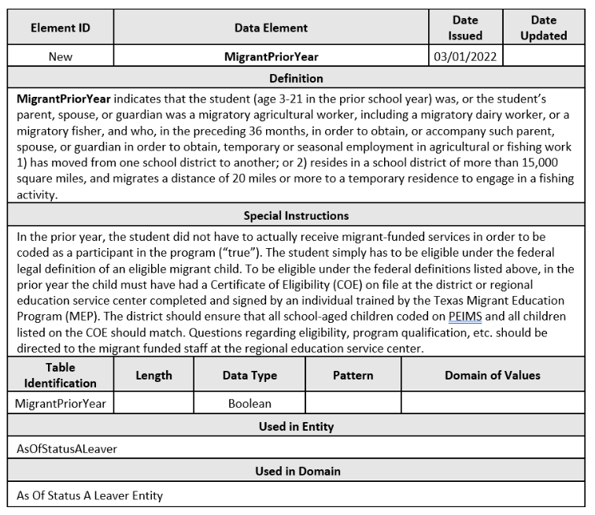
TEDS: AS OF STATUS A LEAVER ENTITY PT3

Slide 31
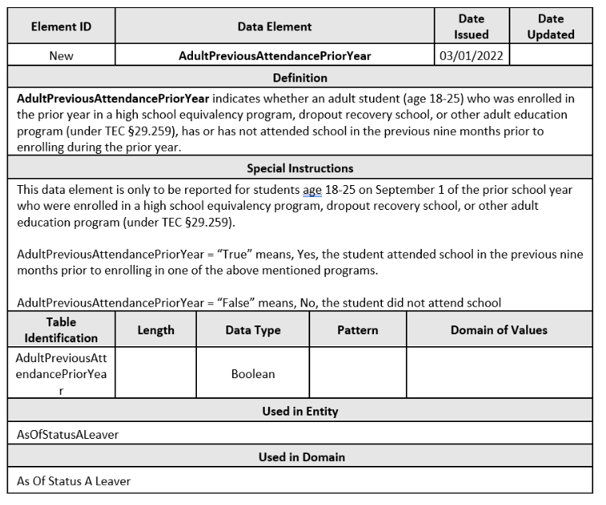
TEDS: AS OF STATUS A LEAVER ENTITY PT4

Slide 32
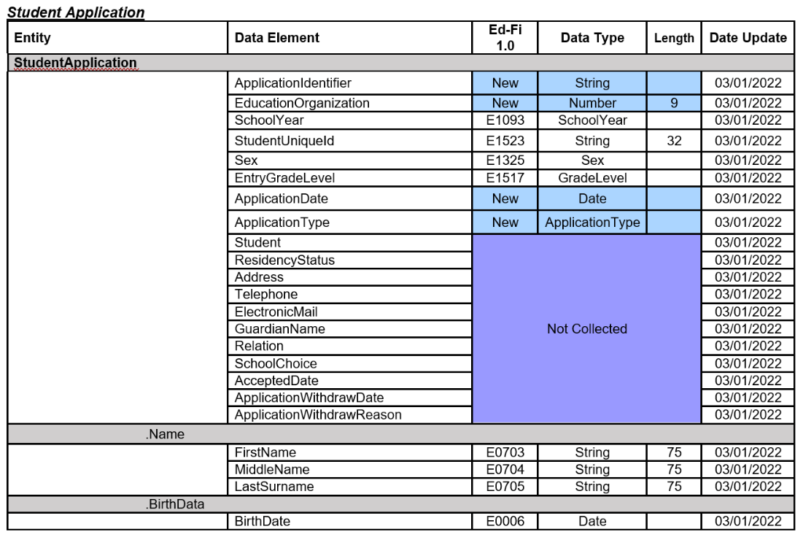
ODS 3.x STUDENT APPLICATION – CHARTER SCHOOL WAITLIST

Slide 33
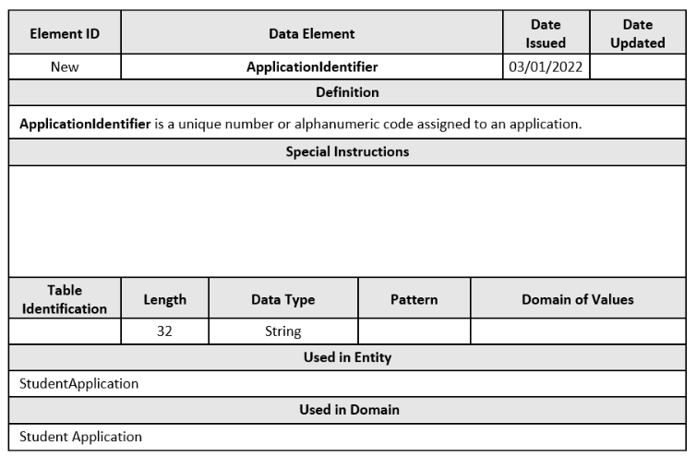
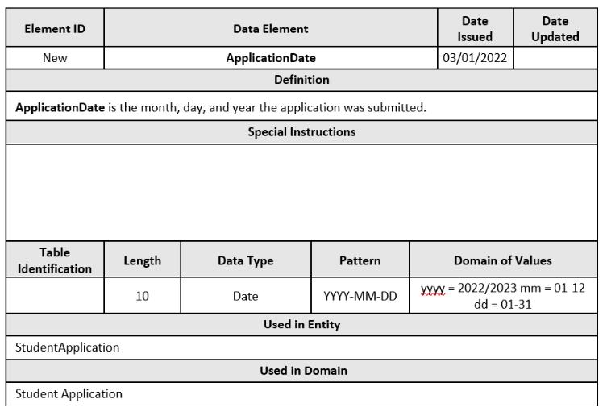
ODS 3.x STUDENT APPLICATION – NEW DATA ELEMENTS

Slide 34
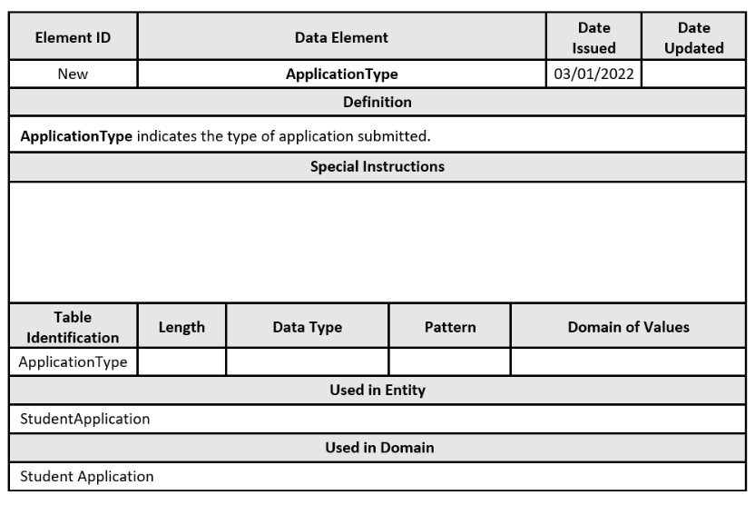
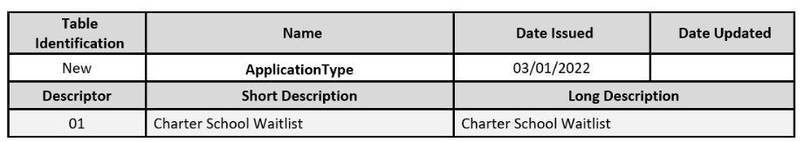
ODS 3.x STUDENT APPLICATION – NEW DATA ELEMENT

Slide 35
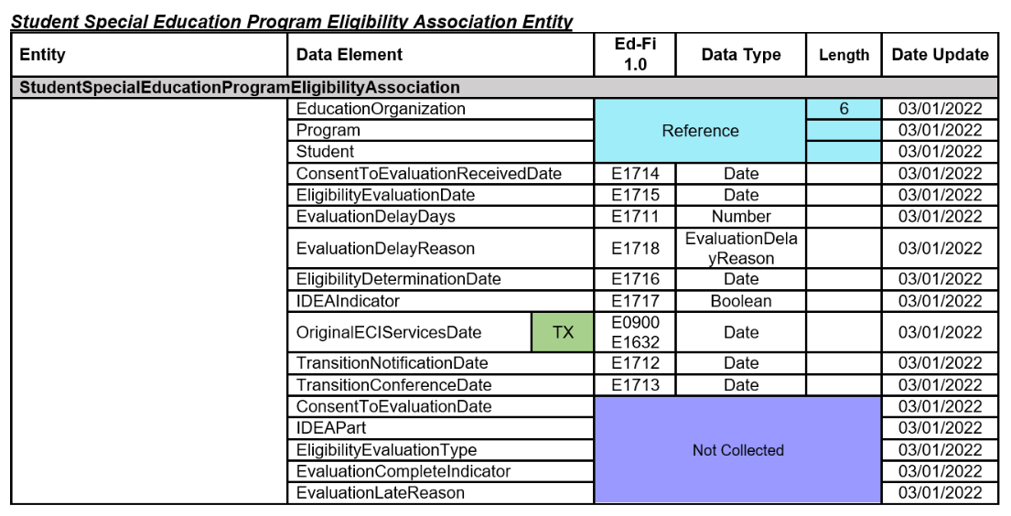
ODS 3.x STUDENT SPECIAL EDUCATION PROGRAM ELIGIBLITY ASSOCIATION – CHILD FIND

Slide 36
ODS 3.x STUDENT SPECIAL EDUCATION PROGRAM ELIGIBLITY ASSOCIATION – DATA ELEMENT NAME CHANGES
Date Element ID | Old Data Element Name | New Data Element Name
E1711 | STUDENT-ABSENCES-WITHIN-TIMEFRAME | EvaluationDelayDays
E1712 | ECI-NOTIFICATION-DATE | TransitionNotificationDate
E1713 | ECI-TRANSITION-CONFERENCE-DATE | TransitionConferenceDate
E1714 | PARENTAL-CONSENT-DATE | ConsentToEvaluationReceivedDate
E1715 | INITIAL-EVALUATION-DATE | EligibilityEvaluationDate
E1716 | SPED-ELIGIBILITY-DETERMINATION-DATE | EligibilityDeterminationDate
E1717 | SPED-ELIGIBILITY-DETERMINATION-CODE | IDEAIndicator

Slide 37
Data Element Changes

Slide 38
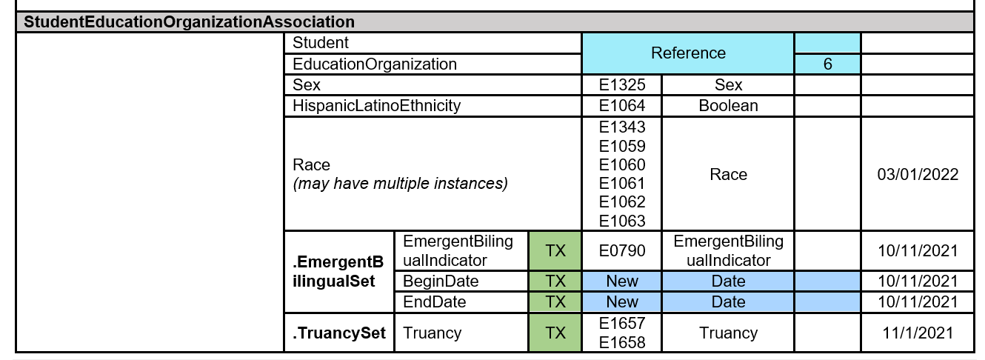
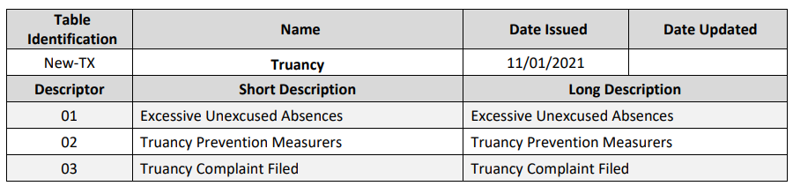
TRUANCY SET
Data Elements:
EXCESSIVE-UNEXCUSED-ABSENCE-INDICATOR-CODE (E1657),
TRUANCY-PREVENTION-MEASURE-INDICATOR-CODE (E1658), TRUANCY-COMPLAINT-FILED-INDICATOR-CODE (E1658)

Slide 39
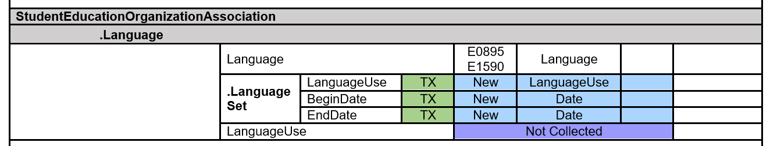
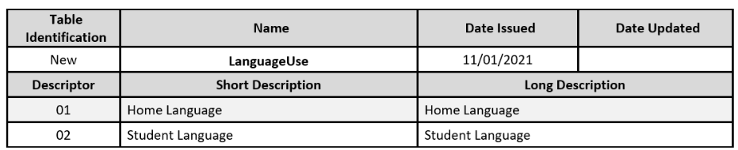
LANGUAGE SET
Data Elements:
HOME-LANGUAGE-CODE (E0895),
STUDENT-LANGUAGE-CODE (E1590)

Slide 40
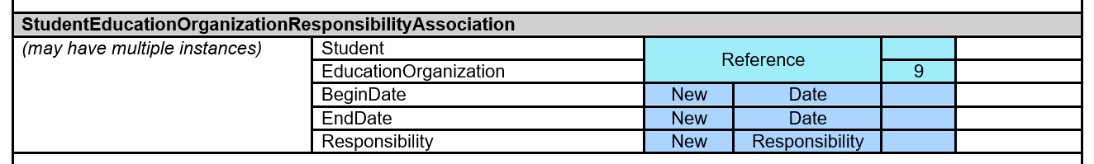
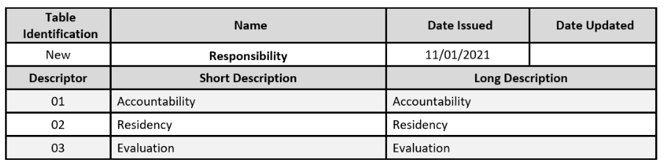
STUDENT EDUCATION ORGANIZATION RESPONSIBILITY ASSOCIATION
Data Elements:
CAMPUS-ID-OF-ACCOUNTABILITY (E1027),
CAMPUS-ID-OF-RESIDENCE (E0903), CAMPUS-ID-OF-EVALUATION (E1710)

Slide 41
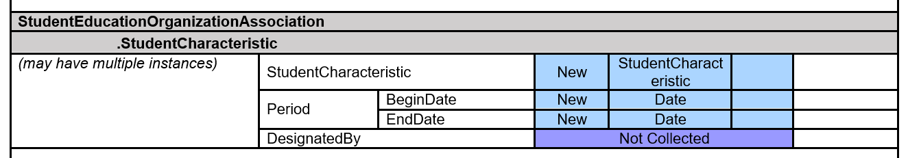
STUDENT CHARACTERISTIC DATA ELEMENT
Data Elements: AT-RISK-INDICATOR-CODE (E0919), IMMIGRANT-INDICATOR-CODE (E0797), MIGRANT-INDICATOR-CODE (E0984), DYSLEXIA-INDICATOR-CODE (E1530), T-STEM-INDICATOR-CODE (E1559), ECHS-INDICATOR-CODE (E1560), P-TECH-INDICATOR-CODE (E1612), NEW-TECH-INDICATOR-CODE (E1647), IEP-CONTINUER-INDICATOR-CODE (E1564), STAR-OF-TEXAS-INDICATOR-CODE (E1601), PK-ELIGIBLE-PREVIOUS-YEAR-INDICATOR-CODE (E1649), SECTION-504-INDICATOR-CODE (E1603), INTERVENTION-STRATEGY-INDICATOR-CODE (E1602), PREGNANCY-RELATED-SERVICES (E1432), GIFTED-TALENTED-INDICATOR-CODE (E0034), ADULT-PREVIOUS-ATTENDANCE-INDICATOR-CODE (E1660), GENERAL-EDUCATION-HOMEBOUND-INDICATOR (E1730), PARENT-REQUEST-RETENTION-INDICATOR (E1729), BILINGUAL/ESL-SUMMER-SCHOOL-INDICATOR-CODE (E1028) , ADDITIONAL-DAYS-PROGRAM-PARTICIPATION-INDICATOR-CODE (E1672)

Slide 42
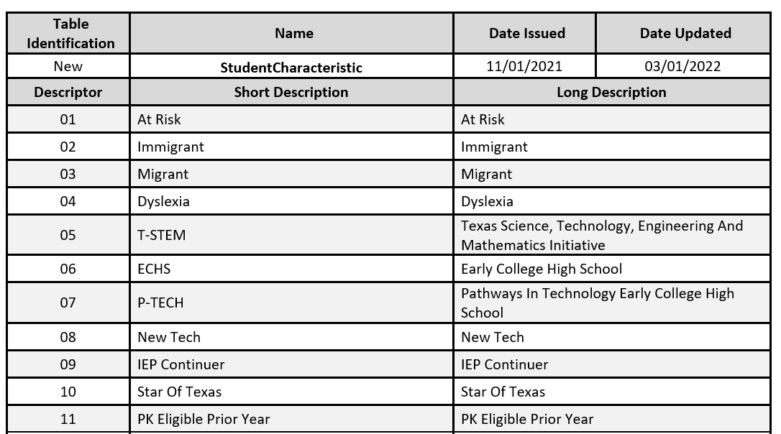
STUDENT CHARACTERISTIC DESCRIPTOR TABLE

Slide 43
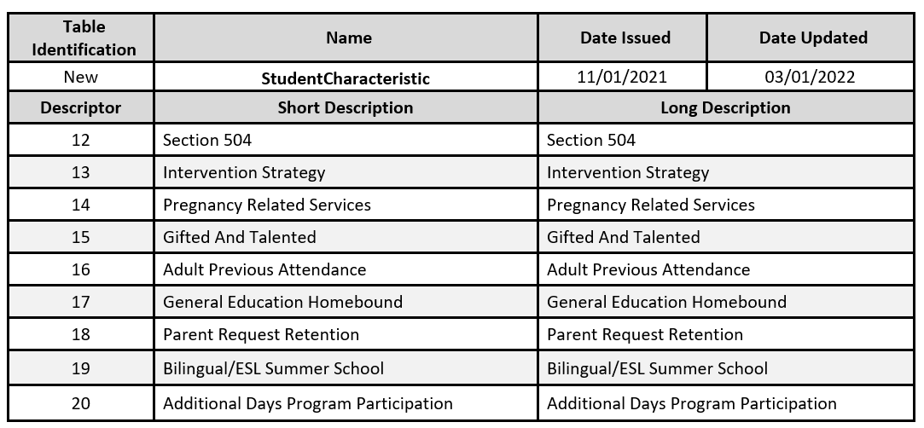
STUDENT CHARACTERISTIC DESCRIPTOR TABLE CONT

Slide 44
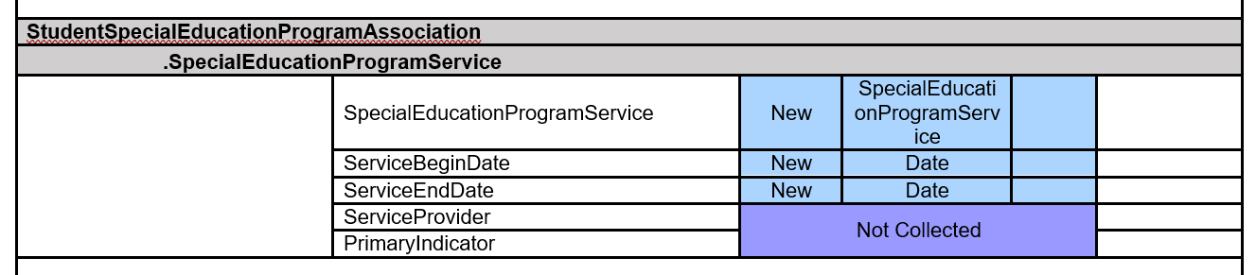
SPECIAL EDUCATION PROGRAM SERVICE DATA ELEMENT
Data Elements: REG-DAY-SCH-PROG-DEAF-CODE (E0833), AUDIOLOGICAL-SERV-IND-CODE (E0838), COUNSELING-SERVICES-IND-CODE (E0840), MEDICAL-DIAGNOSTIC-SERV-IND-CODE (E0841), OCCUPATIONAL-THERAPY-IND-CODE (E0843), ORIENT-MOBILITY-TRNG-IND-CODE (E0844), PHYSICAL-THERAPY-IND-CODE (E0845), PSYCHOLOGICAL-SERVICES-IND-CODE (E0846), RECREATION-IND-CODE (E0847), SCHOOL-HEALTH-SERVICES-IND-CODE (E0848), SOCIAL-WORK-SERVICES-IND-CODE (E0849), TRANSPORTATION-INDICATOR-CODE (E0851), SPEECH-THERAPY-INDICATOR-CODE (E0857), PRESCHL-PROG-CHLDRN-WITH-DISAB-IND-CD (E0899), EARLY-CHILDHOOD-INTERV-IND-CODE (E0900), ASSISTIVE-TECH-INDICATOR-CODE (E0997), INTERPRETING-SERVICES-TYPE-CODE (E1040)

Slide 45
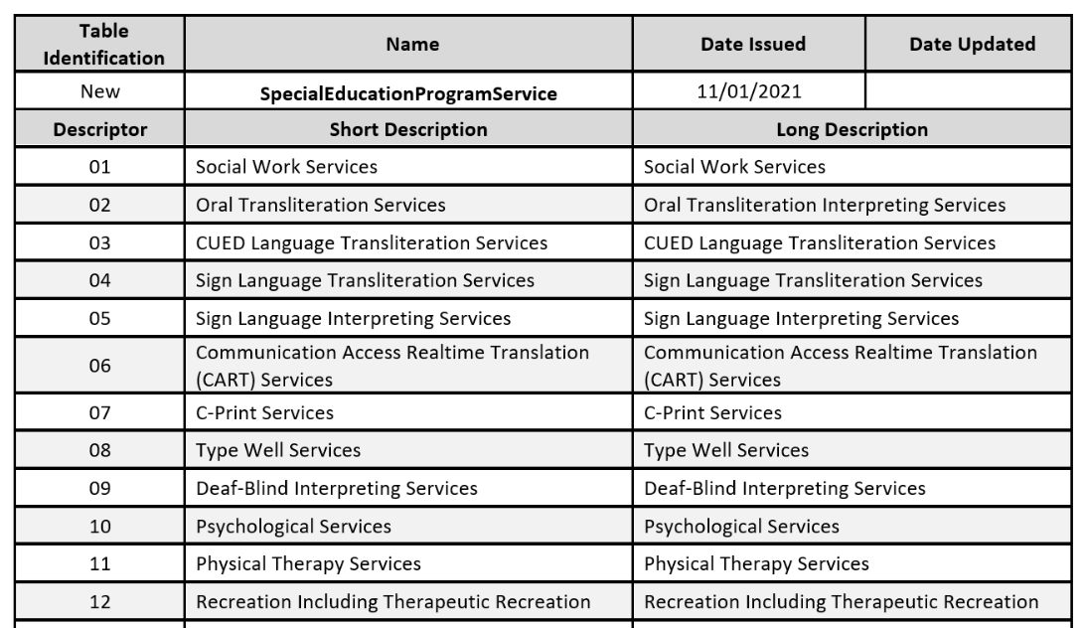
STUDENT EDUCATION PROGRAM SERVICE DESCRIPTOR TABLE

Slide 46
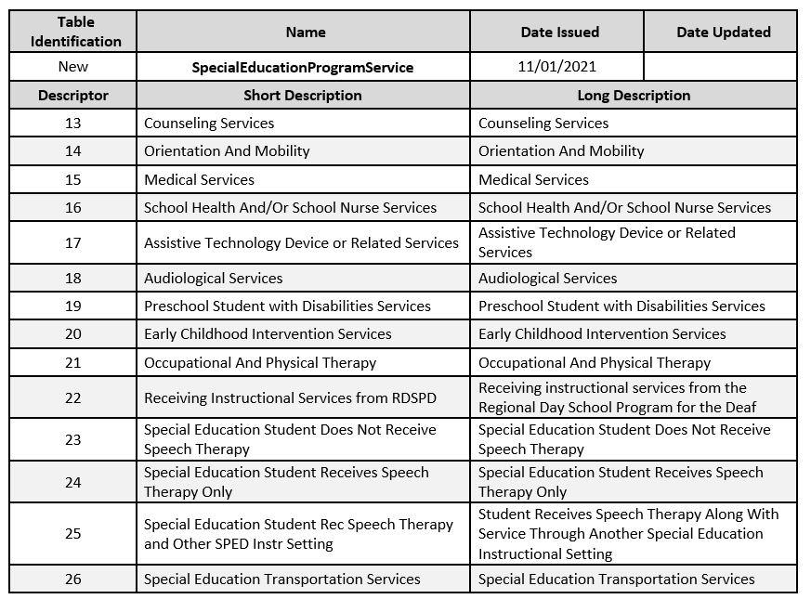
SPECIAL EDUCATION PROGRAM SERVICE DESCRIPTOR TABLE CONT

Slide 47
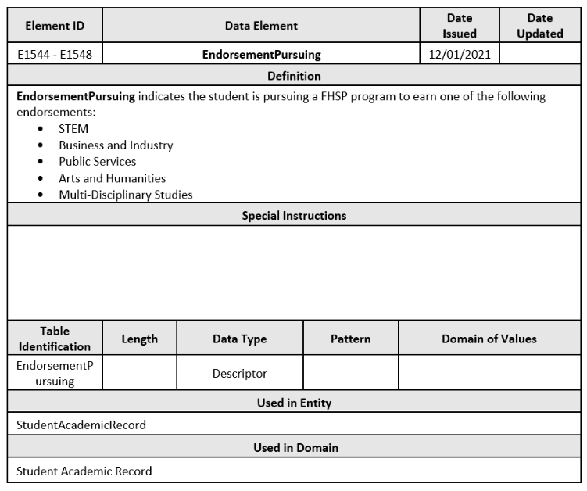
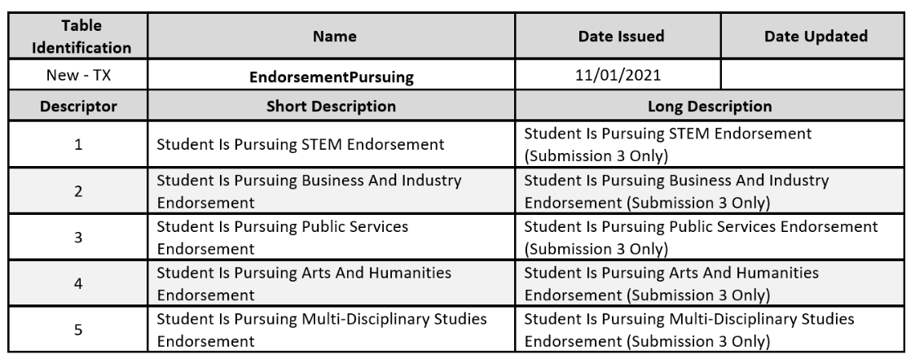
ENDORSEMENT PURSUING

Slide 48
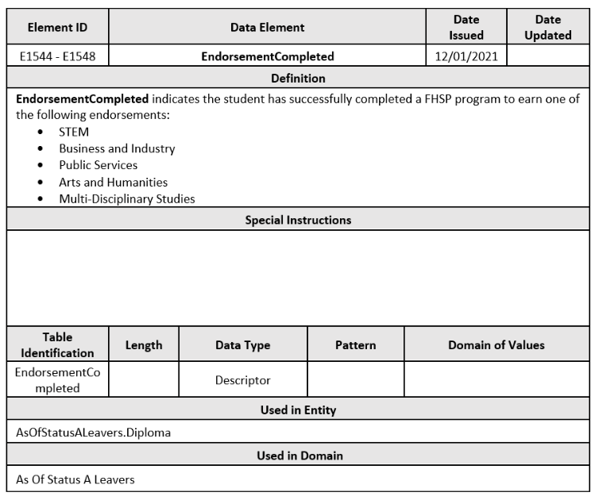
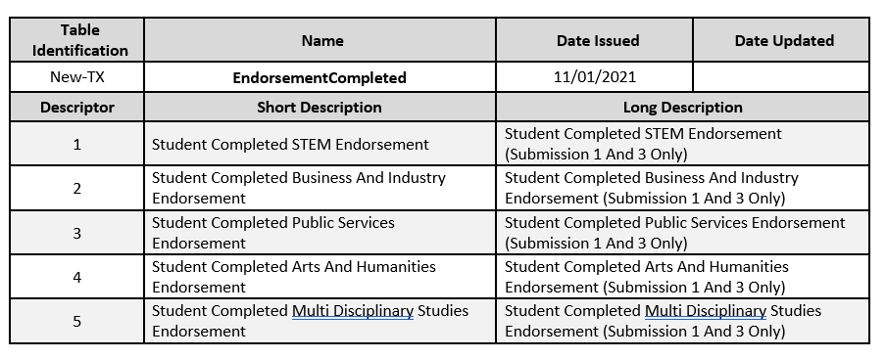
ENDORSEMENT COMPLETED

Slide 49
Begin Date Guidance

Slide 50
BEGIN DATE GUIDANCE
 | Current School Year Only | Current or Prior School Year
StudentCensusBlockGroup | X
CrisisEvent | X
EmergentBilingualIndicator |  | X
Truancy | X
DyslexiaServices | X
EconomicDisadvantage | X
FosterCareType | X
HomelessStatus | X
UnaccompaniedYouth | X
UnschooledAsyleeRefugee |  | X
EarlyReadingIndicator | X
 | Current School Year Only | Current or Prior School Year
MilitaryConnectedStudent |  | X
DyslexiaRisk | X
PKProgramType | X
PKFundingSourceSet | X
LanguageUse |  | X
StudentCharacteristic |  | X
Responsibility |  | X
StaffType |  | X
ParaprofessionalCertification |  | X
StaffClassification |  | X
StaffService |  | X

Slide 51
BEGIN DATE GUIDANCE cont
 | Current School Year Only | Current or Prior School Year
AuxiliaryRoleId |  | X
HireDate |  | X
CampusEnrollmentType |  | X
NSLPType | X
CharterAdmissionWaitlist | X
ELOType | X
CTEProgramService | X
TitleIPartAParticipant | X
SPEDProgram |  | X
SpecialEducationSetting |  | X
Disability |  | X
 | Current School Year Only | Current or Prior School Year
ParentalPermission |  | X
LanguageInstructionProgram Service |  | X
Section | X
StaffSection | X
StudentSection | X
IndustryBasedCertification | X | X
General Student Program |  | X
StaffCohortAssociation | X
StudentCohortAssociation | X

Slide 52
KEY TAKEAWAYS
The transition to ODS 3.x does not change what data TEA collects only how TEA collects the data.
Initially, As of Status A student leaver data will be collected in a separate domain entity, AsOfStatusALeavers extension.
Initially, cumulative and granular attendance will be collected by student.
DATA STANDARDS
  In April 2022, 2022-2023 data standards will be updated to include the Student Attendance Domain.

Slide 53

QUESTIONS

