Slide 1
TITLE SLIDE: TSDS ODS 3.x Project Updates
TSDS ODS 3.x PROJECT UPDATES FOR ESC CHAMPIONS
August 3, 2022

Slide 2
SESSION AGENDA
PROJECT UPDATE
Purpose & Project Extension
PROJECT TIMELINE
Pilot Program & Milestones
Parallel Submission & Go-Live
PROJECT ARCHITECTURE
Diagram & Components
ODS & Key Changes
UPCOMING EVENTS
Software Development Kit (SDK)
TSDS ODS 3.x Training
CLOSEOUT
Key Takeaways & FAQs

Slide 3
OFFICE OF INFORMATION TECHNOLOGY
Customer Relationship Management & Data Standards Department
Information Technology
A multi-year initiative to upgrade the Operational Data Store (ODS) and Texas Education Data Standards (TEDS) to a current version of Ed-FI.

Slide 4
PROJECT TIMELINE EXTENSION
Announced on May 18, 2022
RATIONAL & REASONING
PILOT PROGRAM
Extending provides a more comprehensive testing period for LEAs to validate their vendor product solution(s).
ARCHITECTURE & TECHNOLOGY
Extending allows TEA to take ownership of the architecture and in developing application(s) to meet our LEAs’ needs.
VENDOR READINESS
Extending grants vendors more time to develop their solution(s) in ensuring readiness for parallel submission.

Slide 5
LEA COMMUNICATIONS
Published To the Administrator Addressed (TAA) on September 30, 2021
Published To the Administrator Addressed (TAA) on May 19, 2022

Slide 6
PROJECT TIMELINE
Pilot
Parallel
Go Live
September 2021 – August 2023
Optional: TSDS vendors can participate in pilot program to develop and test their product solutions.
Optional: LEAs can partner with their vendors to conduct end-to-end testing in preparation to parallel submission.
August 2023 – August 2024
Required: All TSDS vendors test their product solutions.
Optional: LEAs will submit both API transactions and XML submissions and compare results to ensure vendor readiness.
August 2024 – August 2025
Required: All LEAs will submit their TSDS official data through API transactions.
XML submissions no longer accepted for TSDS.
EXTENDED

Slide 7
2021-2023: PILOT PROGRAM
2021-2022: Cohort of six (6) vendors conducted initial vetting of the integration and data out phases.
Software Development Kit (SDK) was provided to all vendors.
2022-2023: Pilot program will continue for any interested vendor.
LEAs and ESCs will begin End-to-End testing starting in January 2023.
Extended into 2022-2023
January - August 2023
Integration
Data Output
End-to-End
PEIMS Fall
Child Find
Class Roster
September 2022: Online form available for LEAs to submit their interest in the pilot program.

Slide 8
PILOT PROGRAM: KEY MILESTONES
SEPTEMBER 2022
2022-2023 SDK Released
CET Training (ODS 3.x)
JANUARY 2023
Parallel Environment
PEIMS Fall, Class Roster, Child Find
JULY 2023
LEA Analysis & Feedback
Training & Resource Updates
OCTOBER 2022
New User Training
LATE WINTER 2023
Initial LEA/ESC Training
RESOURCES
ESC/LEA KICKOFF
START END-TO-END
PILOT TRAINING
STOP END-TO-END
AUGUST 2022
TEDS Post-Addendum
Pilot Vendors Cohort
DECEMBER 2022
System Configuration
Guidance & Process for Testing
SPRING 2023
Advanced LEA/ESC Training
Continuous & On-Demand

Slide 9
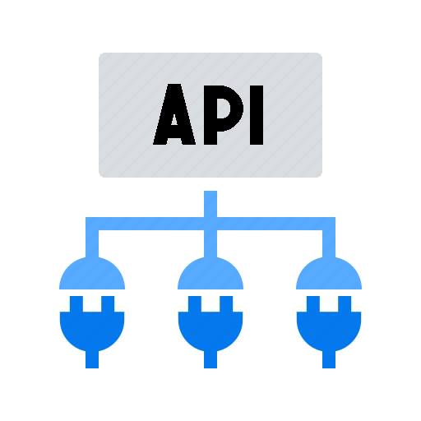
2023-2024: PARALLEL SUBMISSION
REQUIRED For All Vendors
OPTIONAL For LEAs & ESCs
LEAs will compare XML data against API transactions through TSDS reports and validations.
All TSDS submissions are expected to be compared by the submission due dates.
XML will be used for official TSDS reporting.
LEAs will be nominated, selected, and approved to participate
in the parallel submission. Recommending 250+ LEAs.

Slide 10
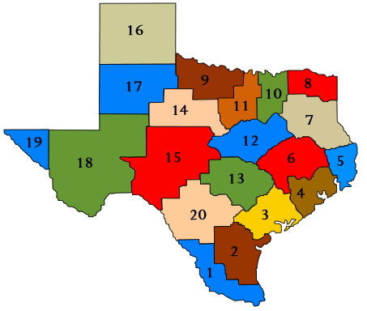
2024-2025: GO-LIVE
REQUIRED For All Vendors
REQUIRED For All LEAs & ESCs
Only API transactions will be accepted for TSDS.
XML data loads will not be available or permitted.
All ESCs will be trained and ready to support their LEAs.

Slide 11
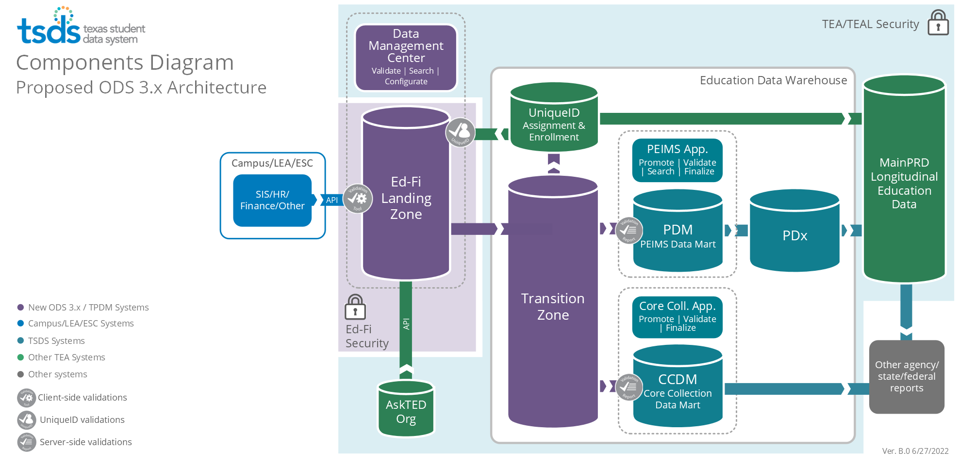
UPDATED ARCHITECTURE

Slide 12
UPDATED ARCHITECTURE
Data
Landing Zone
Each LEA will be provided a local Ed-Fi Operational Data Store (ODS).
Source system vendors will publish data via API transactions at near real-time.

Slide 13
UPDATED ARCHITECTURE
Application
LEAs will be able to view data loads and run validations on local ODS data.
Data

Slide 14
UPDATED ARCHITECTURE
Data
Transition Zone
TEA will automatically retrieve data from the Landing Zone.
Data will be filtered to ensure only TSDS mandated data is loaded to the Transition Zone.
LEAs will promote and complete submissions as they do now.

Slide 15
OPERATIONAL DATA STORE (ODS)
Each LEA will be provided an Ed-Fi Operational Data Store (ODS) to utilize for state reporting and local use. LEAs will need to provide security credentials to vendors through the Data Management Center for API transactions.
Source system vendors will publish transactional data to an LEA’s Ed-Fi ODS irrespective of specific TSDS data submissions along with appropriate effective dating.
Additional data can be published beyond the reporting requirements of TSDS for an LEA’s local use.
LEAs will be able to verify and validate API transactional data in the Data Management Center.
Logic will be implemented in the LEA’s Landing Zone to ensure only the TSDS state mandated data is reported to TEA’s Transition Zone (ODS) and utilized for TSDS data submissions.

Slide 16
KEY CHANGES TO DATA COLLECTION
Attendance
1. Granular negative attendance by student which will eliminate the requirement for SIS vendors to calculate attendance by six-weeks.
2. Cumulative attendance by six-weeks by student (no change from the way attendance is currently collected).
Enrollment
TEA plans to collect attendance data two ways in the 2024-2025 (Go-Live) school year:
Enrollment and withdrawal data will be collected at the student level through source system vendor API transactions to the LEA’s ODS.
This data will be automatically loaded to the Unique ID Enrollment Tracking application. LEAs will no longer need to load this data in the Unique ID system directly.
Note: TEA will discontinue collecting cumulative attendance after confirming attendance calculations in future year(s) beyond 2024-2025.

Slide 17
WHAT IS REMAINING THE SAME?
All processes that occur from the Transition Zone (ODS) to the data mart will remain as-is.
Reports and business rule validations will remain in downstream TSDS applications.
TEAL will continue to be utilized for authentication.
Unique ID application will continue to be utilized for assignment for staff and students.
TSDS Web-Enabled Data Standards (TWEDS) will continue to be utilized to provide specifications and guidance.

Slide 18
SOFTWARE DEVELOPMENT KIT (SDK)
PURPOSE
The SDK will provide vendors with a fully functional set of EdFi ODS, WebApi, Swagger, and
VENDOR RESOURCE
TEA will release the 2022-2023 SDK to all source system vendors in September 2022. Vendors
The ODS and WebApi will contain all the TEA defined extensions, as well as will come with
pre-populated TEA Descriptors, Education Organizations (ESCs, LEAs, and Campuses), and
Courses.
not participating in the pilot program will be encouraged to utilize the SDK for local
development to ensure product readiness for the 2023-2024 parallel submission.
Admin App that can be easily installed in their local systems for development purposes.

Slide 19
TSDS ODS 3.x TRAINING
TSDS ODS 3.x Overview Training
September 7, 13 & 20, 2022
For currently certified Champions
New User Training
October 3-14, 2022
Includes ODS 3.x training from September
Pilot Program Kickoff
December 2022 (tentative)
Guidance & process for End-to-End testing
Pilot Program Trainings
Winter 2023 – Spring 2023
Continuous & on-demand training for ESCs & LEAs

Slide 20
KEY TAKEAWAYS
2021-2023 Pilot Program (extended)
2023-2024 Parallel Year
2024-2025 Go-Live
TEA will provide all vendors with the SDK for local development and planning.
TEA will provide an online form in September 2022 to collect information for LEAs interested in the pilot program.
TEA will offer trainings throughout 2022-2023. Specific pilot program training will be made available.
FUTURE COMMUNICATIONS
TEA will begin to utilize the Field Coordination Network webinars for timely topics on the TSDS ODS 3.x project.
TEA will resume dedicated vendor coordination and support in September 2022.
TEA will provide more in-depth project updates, guidance, and information during the Spring TSDS ESC training.

Slide 21
FREQUENTLY ASKED QUESTIONS
How can interested LEAs participate in the pilot program?
TEA will be providing an online form in September 2022 for interested LEAs to fill out the necessary information for nomination. ESCs are encouraged to solicit interest and capture any initial information in the meantime.
Throughout Fall 2022, TEA will be coordinating with the source system vendors of nominated LEAs to determine product readiness and their ability to support partner LEAs. Any LEA accepted to the pilot program will be able to begin end-to-end testing as early as January 2023 but may start later at their convenience through July 2023.
TEA will be reaching out to those ESCs and/or LEAs who have previously provided interest in the pilot program during the 2021-2022 school year.

Slide 22
FREQUENTLY ASKED QUESTIONS
How many LEAs can participate in the pilot program?
This will be based upon several factors, including the number of nominations received, vendor readiness and capability, and regional considerations.
TEA encourages all interested LEAs to submit a nomination with the necessary information for consideration.

Slide 23
FREQUENTLY ASKED QUESTIONS
How will ESC Champions be informed of LEAs accepted to participate in the pilot program?
TEA will be directly communicating and coordinating with ESCs to inform them of any LEA(s) interested prior to acceptance to ensure adequate support capacity.
ESCs will be provided the necessary training, guidance, and materials to effectively support their participating LEAs.

Slide 24
FREQUENTLY ASKED QUESTIONS
Will ESCs be able to participate in the pilot program?
Beyond supporting LEAs accepted to the pilot program, ESCs may be able to join the pilot program to develop and test any solution(s) in terms of submitting their PEIMS Fall data.
Their acceptance will be determined on a case-by-case basis and more information will be provided through the Field Coordination Network.
Please contact TSDSDeployment@tea.texas.gov with any questions.

Slide 25
FREQUENTLY ASKED QUESTIONS
When will the TSDS Training Advisory Group (TTAG) resume the review and feedback on TSDS ODS 3.x training materials?
These efforts have been postponed with the extension of the pilot program. The TTAG review is tentatively scheduled to resume in Spring 2023.
Please contact TSDS_Training@tea.texas.gov with any questions.

Slide 26
QUESTIONS

