Slide 1
ODS 3.x ATTENDANCE

Slide 2
AGENDA
Terminology
Data Standards
Calculations
Frequently Asked Questions
Closeout
Key Takeaways
Questions

Slide 3
TERMINOLOGY
Code Table
Current
Descriptor Table
Upgrade
Complex Type
Entity
Data Elements
Data Elements
Interchange
Domain

Slide 4
DATA STANDARDS

Slide 5
ATTENDANCE cont
Initially, TEA will collect attendance two ways. First, the granular attendance will be collected and used by TEA to calculate attendance. Second, cumulative attendance will be calculated by the LEA and sent to TEA.

Slide 6
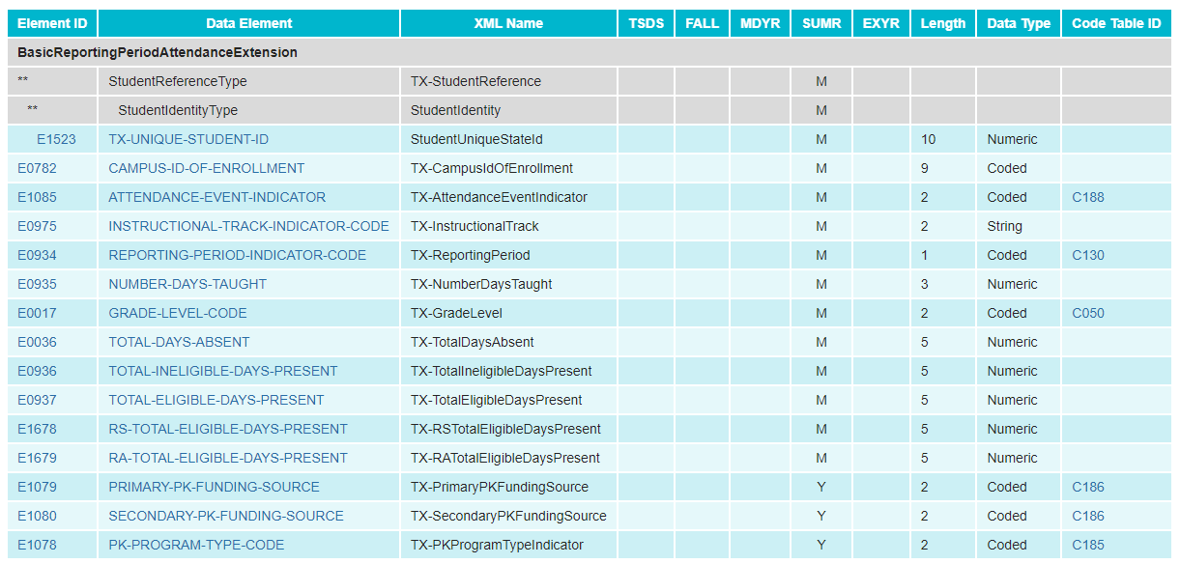
CUMULATIVE BASIC ATTENDANCE – CURRENT
Cumulative attendance is collected through the BasicReportingPeriodAttendanceExtension.

Slide 7
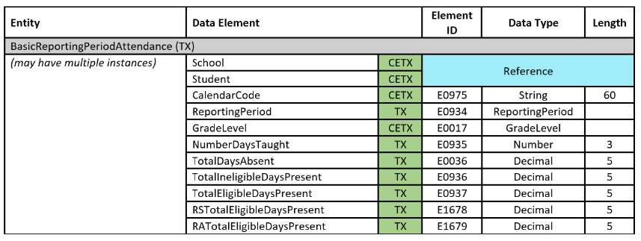
CUMULATIVE BASIC ATTENDANCE – UPGRADED
Cumulative attendance will still be collected through the BasicReportingPeriodAttendance entity.

Slide 8
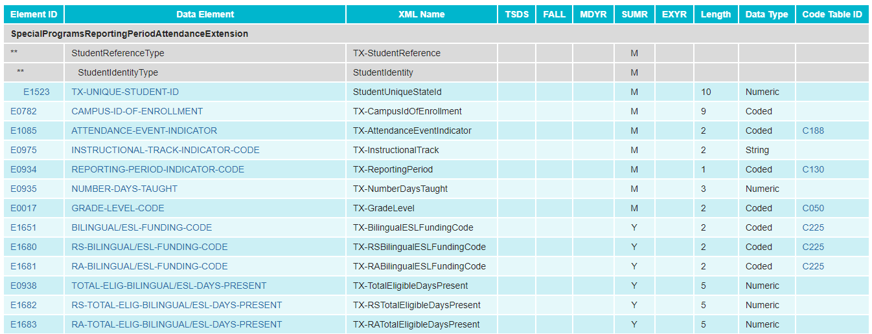
SPECIAL PROGRAMS ATTENDANCE - CURRENT
Cumulative special program attendance is collected through the SpecialProgramsReportingPeriodAttendanceExtension.

Slide 9
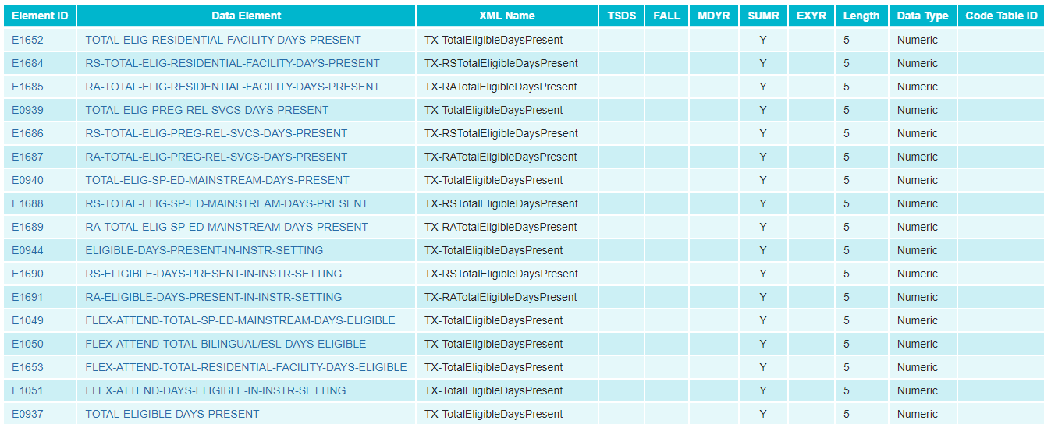
SPECIAL PROGRAMS ATTENDANCE – CURRENT CONT1
SpecialProgramsReportingPeriodAttendanceExtension cont.

Slide 10
SPECIAL PROGRAMS ATTENDANCE – CURRENT CONT2
SpecialProgramsReportingPeriodAttendanceExtension cont.

Slide 11
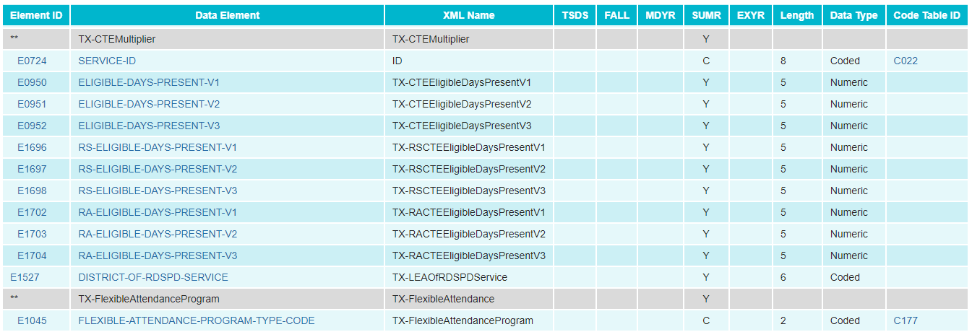
SPECIAL PROGRAMS ATTENDANCE – CURRENT CONT3
SpecialProgramsReportingPeriodAttendanceExtension cont.

Slide 12
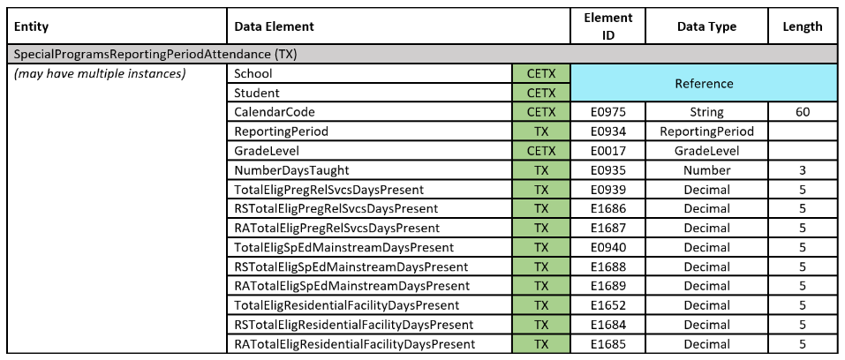
SPECIAL PROGRAMS ATTENDANCE – UPGRADED cont.
TEA will break down the special program attendance into eight entities.
SpecialProgramsReportingPeriodAttendance

Slide 13
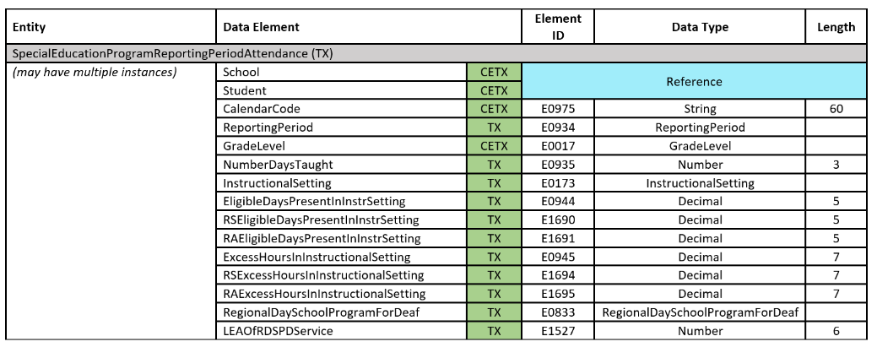
SPECIAL PROGRAMS ATTENDANCE – UPGRADED NT2
SpecialEducationProgramReportingPeriodAttendance

Slide 14
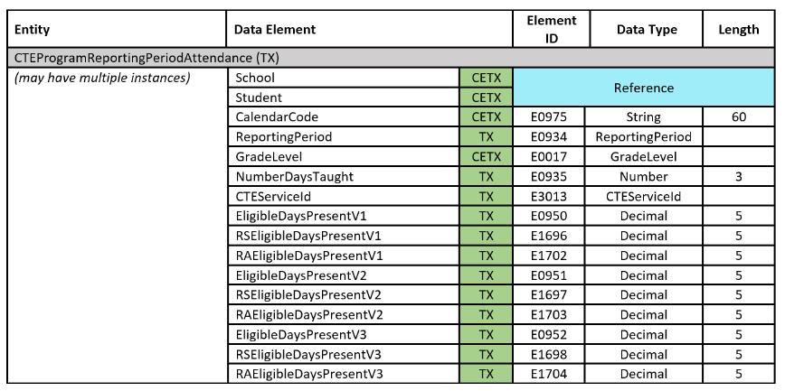
SPECIAL PROGRAMS ATTENDANCE – UPGRADEDNT3
CTEProgramReportingPeriodAttendance

Slide 15
SPECIAL PROGRAMS ATTENDANCE – UPGRADED CONT4
BilingualESLProgramReportingPeriodAttendance

Slide 16
SPECIAL PROGRAMS ATTENDANCE – UPGRADEDCONT6
FlexibleRegularProgramReportingPeriodAttendance

Slide 17
SPECIAL PROGRAMS ATTENDANCE – UPGRADEDont1.
FlexibleSpecialEducationProgramReportingPeriodAttendance

Slide 18
SPECIAL PROGRAMS ATTENDANCE – UPGRADED ONT7
FlexibleCTEProgramReportingPeriodAttendance

Slide 19
SPECIAL PROGRAMS ATTENDANCE – UPGRADED ONT8
FlexibleBilingualESLProgramReportingPeriodAttendance

Slide 20
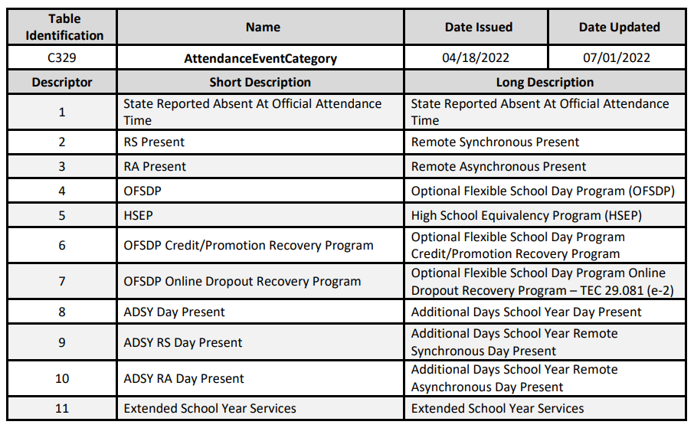
GRANULAR ATTENDANCE – UPGRADED
Daily attendance will be collected for the descriptors listed in the AttendanceEventCategory table.

Slide 21
GRANULAR ATTENDANCE CONT1
TEA will use the StudentSchoolAttendanceEvent entity and student enrollment information reported in the StudentSchoolAssociation entity to determine days present and absent for a student. (If no StudentSchoolAttendanceEvent is reported for a day the student was enrolled, the student is considered in-person present.)

Slide 22
GRANULAR FLEXIBLE ATTENDANCE
TEA will also use the StudentSchoolAttendanceEvent entity reported using descriptors 4-7 and include a SchoolAttendanceDuration.

Slide 23
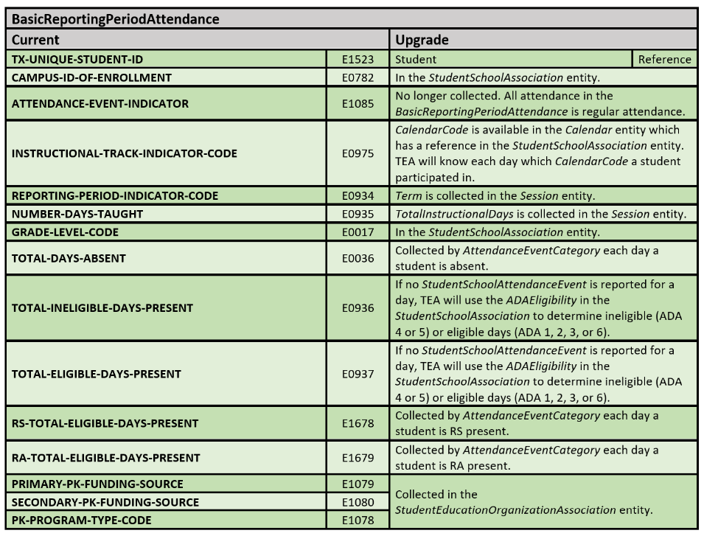
BASIC REPORTING PERIOD ATTENDANCE
Where to find the Current BasicReportingPeriodAttendance data elements in the upgrade:

Slide 24
CALCULATIONS

Slide 25
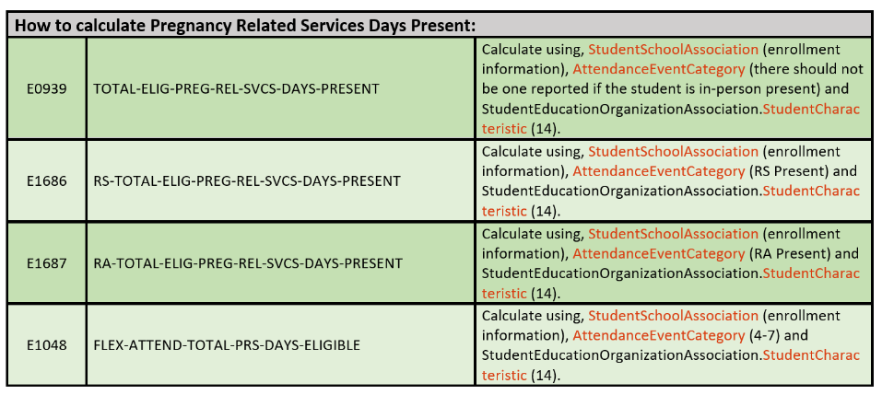
PREGNANCY RELATED SERVICES DAYS PRESENT

Slide 26
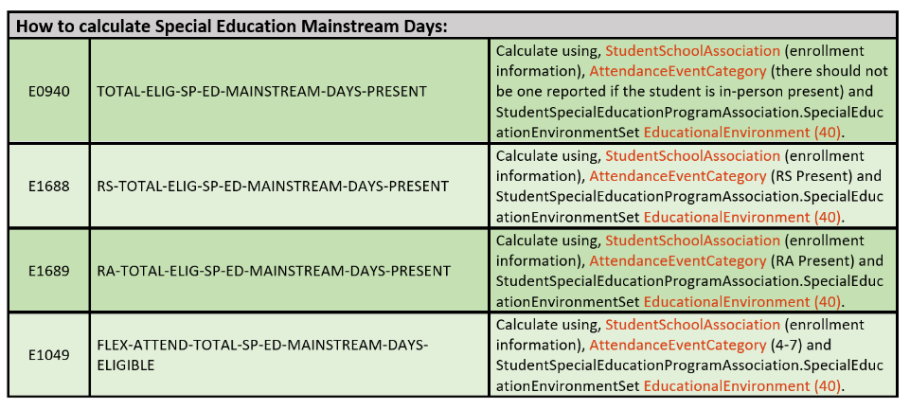
MAINSTREAM ELIGIBLE DAYS PRESENT

Slide 27
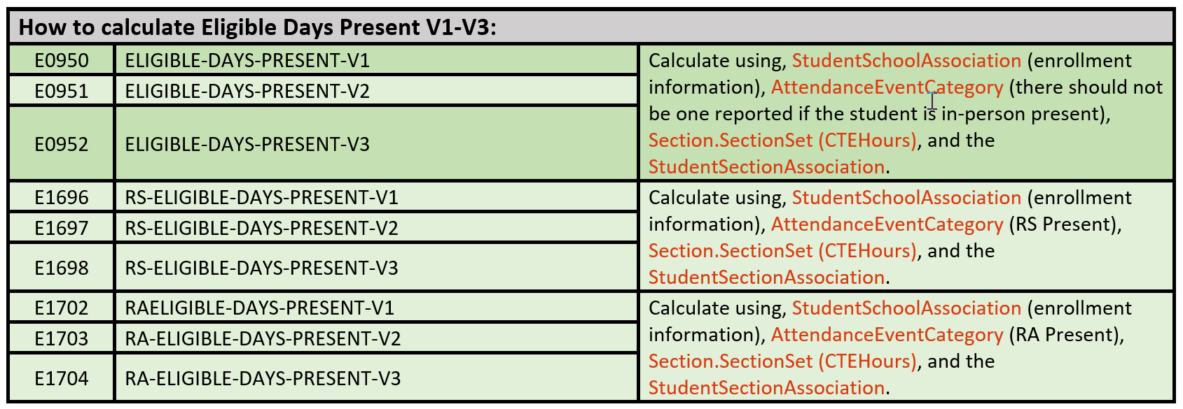
ELIGIBLE DAYS PRESENT V1-V3

Slide 28
FREQUENTLY ASKED QUESTIONS

Slide 29
FREQUENTLY ASKED QUESTIONS cont2
Is there a difference between the data elements ReportingPeriod and Term?
No, the data element ReportingPeriod will be used for the Texas extended entities in the Student Attendance domain. When TEA no longer collects cumulative attendance, ReportingPeriod will no longer be collected. The data element Term replaces ReportingPeriod and is in the Session entity in the School Calendar domain. The Session entity is referenced in the StudentSchoolAttendanceEvent entity. The descriptor table for Term is identical to the descriptor table for ReportingPeriod.

Slide 30
FREQUENTLY ASKED QUESTIONS cont.
How long will TEA collect the cumulative attendance? Will the cumulative or granular attendance be the official attendance record for the LEA?
Cumulative and granular attendance will both be collected until the calculations and reports for the granular attendance are determined to be accurate. During this time, the cumulative attendance reported by the LEA will be the official attendance record.

Slide 31
CLOSEOUT

Slide 32
KEY TAKEAWAYS
Attendance will be collected two ways, granular and cumulative.
Link to Current Upgraded Data Standards:
2022-2023 TEDS Pilot Year 2 Data Standards
When collected, the cumulative attendance will be the official record for the LEA.
If a student is in-person present, a StudentSchoolAttendanceEvent will not be reported. The StudentSchoolAssociation will be used to determine if the student is in-person eligible or ineligible.

Slide 33
QUESTIONS

