Slide 1
ODS 3.x PRIOR YEAR LEAVERS & SPPI-14

Slide 2
AGENDA
Terminology
Data Standards
Leaver/Graduate
SPPI-14
Frequently Asked Questions
Closeout
Key Takeaways
Questions

Slide 3
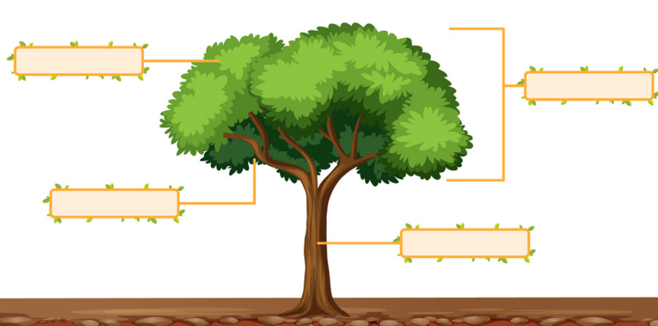
TERMINOLOGY
Code Table
Current
Descriptor Table
Upgrade
Complex Type
Entity
Data Elements
Data Elements
Interchange
Domain

Slide 4
DATA STANDARDS LEAVER/GRADUATE

Slide 5
AS-OF-STATUS-CODE - CURRENT
Local Education Agencies (LEAs) report a calculated AS-OF-STATUS-CODE (E1002) in the StudentExtension in the PEIMS Fall and Summer submissions. In the PEIMS Fall submission, the AS-OF-STATUS-CODE indicates the student’s status as of the last Friday in October. In the PEIMS Summer submission, the AS-OF-STATUS-CODE indicates the student’s status as of their last day of enrollment (or last day of the school year). LEAs report the calculated code using the AS-OF-STATUS-CODE (C163) table.

Slide 6
AS-OF-STATUS-CODE – UPGRADED
In the beginning, TEA will have the LEAs report two new data elements, AsOfStatusLastFridayOctober and AsOfStatusLastDayEnrollment, in the Student entity. In the future, TEA will calculate the two data elements.

Slide 7
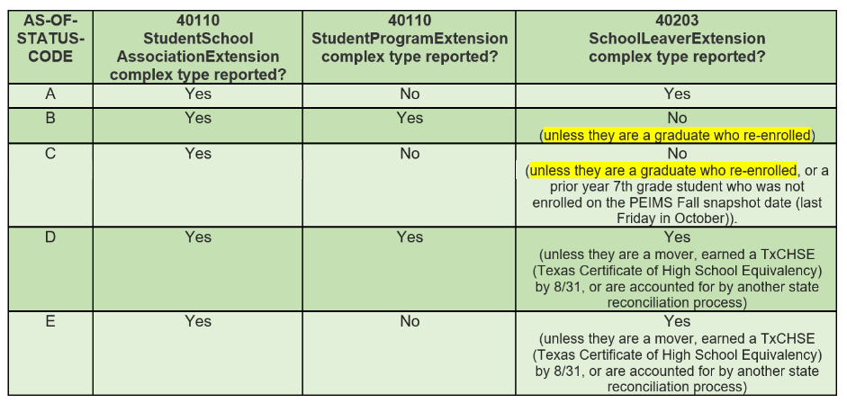
SCHOOL LEAVER GUIDANCE – CURRENT
The StudentExtension provides the following Data Element Reporting Requirements by AS-OF-STATUS-CODE:

Slide 8
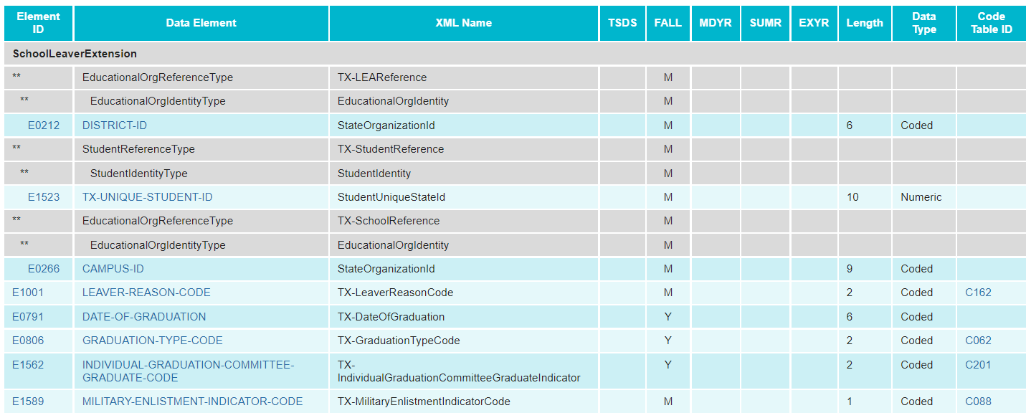
SCHOOL LEAVER – CURRENT
School Leaver data is collected through the SchoolLeaverExtension.

Slide 9
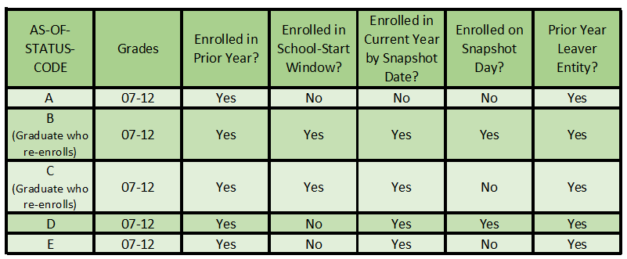
PRIOR YEAR LEAVER AND AS-OF-STATUS – UPGRADED
In the beginning, the PriorYearLeaver entity will need to be collected for the following AS-OF-STATUS-CODE students:

Slide 10
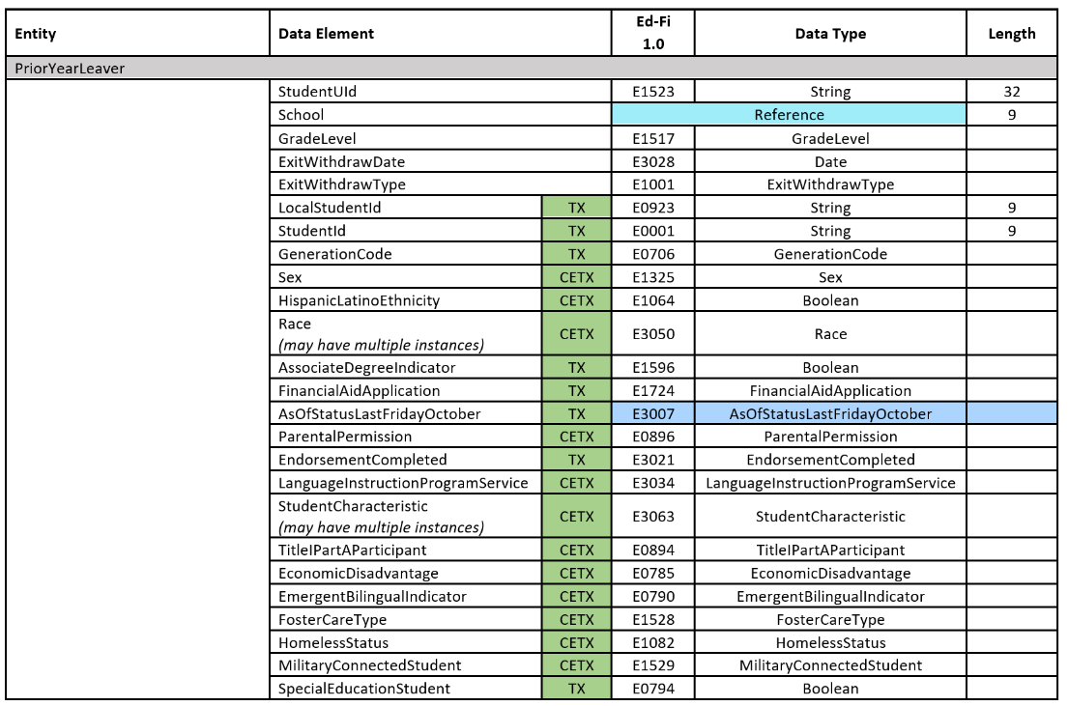
LEAVER COLLECTION - UPGRADED
Leaver and graduate data collected through PEIMS is used to create the annual Completion, Graduation, and Dropout Report.

Slide 11
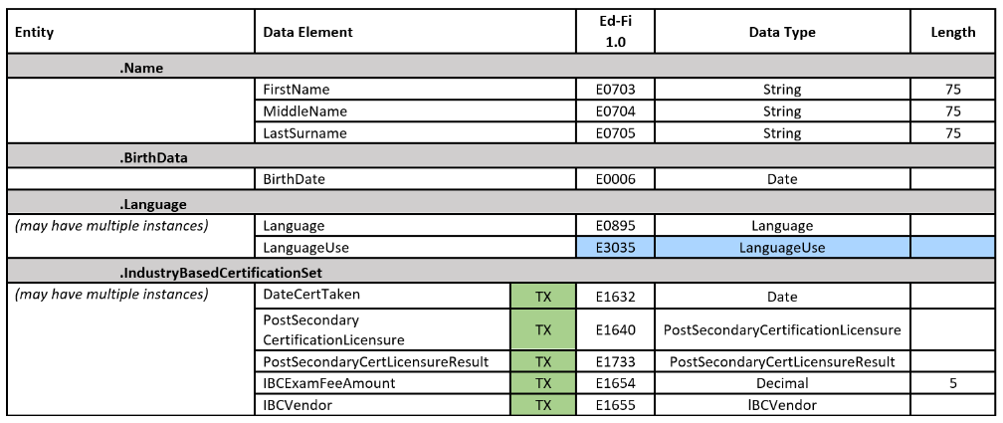
LEAVER COLLECTION – UPGRADED CONT

Slide 12
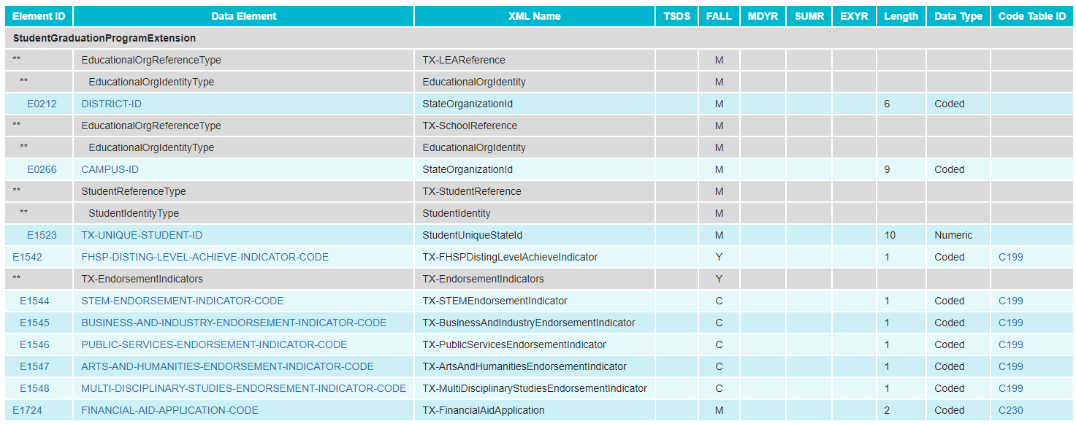
GRADUATE COLLECTION - CURRENT
Graduate data is collected through the StudentGraduationProgramExtension.

Slide 13
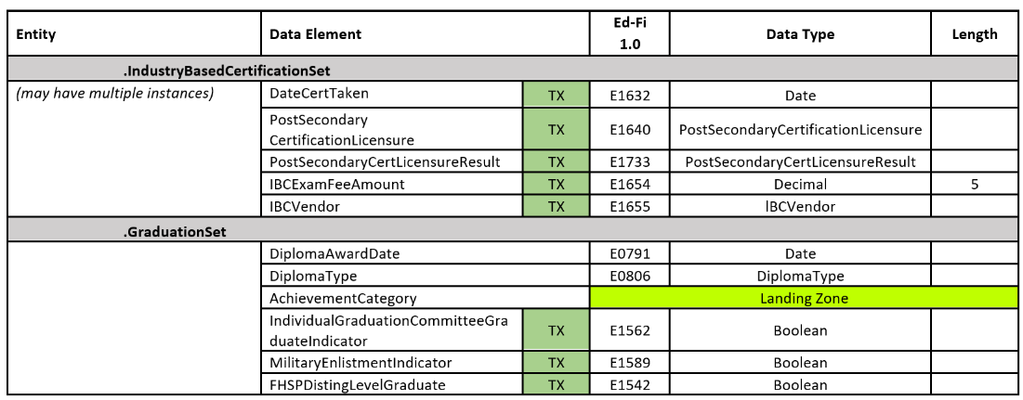
GRADUATE COLLECTION - UPGRADED
To begin, graduate data will be collected in the PriorYearLeaver entity.

Slide 14
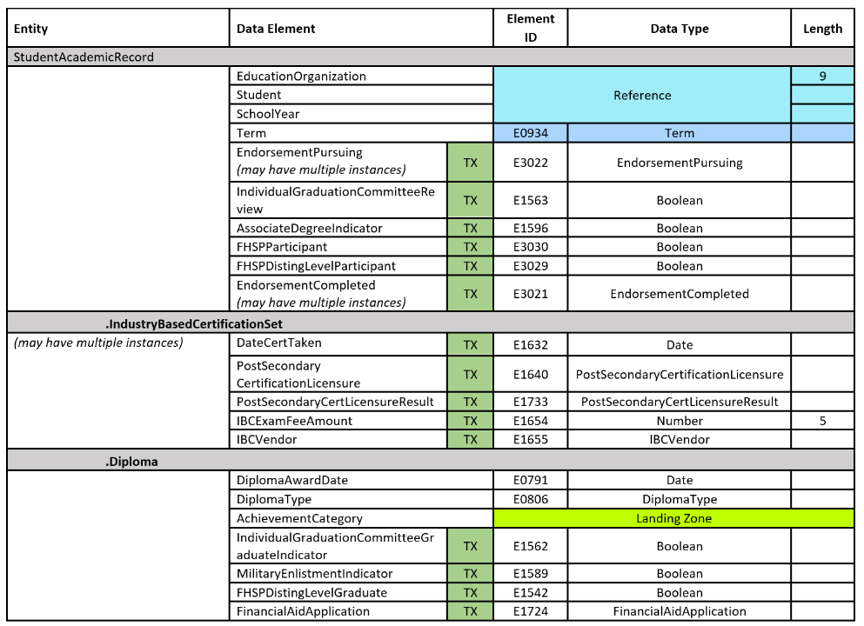
GRADUATE COLLECTION - UPGRADED PT2
TEA will transition to collecting graduate data in the StudentAcademicRecord entity.

Slide 15
DATA STANDARDS SPPI-14

Slide 16
SPPI-14 – CURRENT
Currently, TEA collects student and parent contact information through the SPPI-14 collection to send the Post-School Outcomes Survey to a random sample of recipients. Special Education leavers with one of the following LEAVER-REASON-CODES are collected for SPPI-14 purposes:

Slide 17
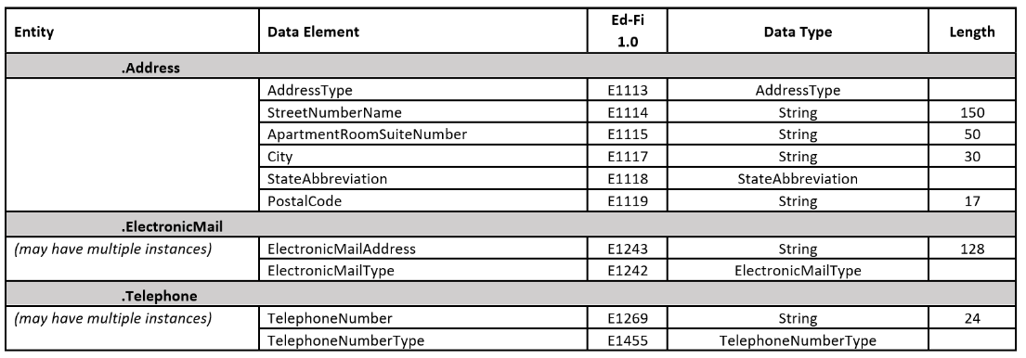
SPPI-14 - UPGRADED
TEA has added student and parent contact information to the PriorYearLeaver entity to collect the necessary data elements for the SPPI-14 collection:

Slide 18
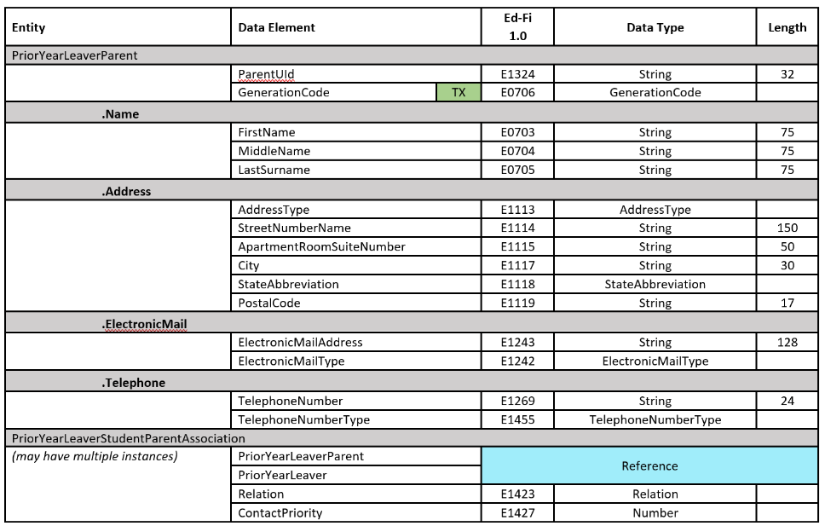
SPPI-14 – UPGRADED CONT

Slide 19
FREQUENTLY ASKED QUESTIONS

Slide 20
FREQUENTLY ASKED QUESTIONS pt1
Will every student reported with a PriorYearLeaver entity also need to report a PriorYearLeaverParent entity?
No, only special education students with one of the following ExitWithdrawTypes should be reported with a PriorYearLeaverParent entity. TEA will develop rules to prevent the PriorYearLeaverParent entity from reporting with any other ExitWithdrawTypes.

Slide 21
CLOSEOUT

Slide 22
KEY TAKEAWAYS
The PriorYearLeaver domain will only be collected during the parallel year and first year of implementation.
Link to Current Upgraded Data Standards:
2022-2023 TEDS Pilot Year 2 Data Standards
SPPI-14 data elements will be collected in the PriorYearLeaver domain only for special education students with certain ExitWithdrawTypes.
Beginning in the first year of implementation, graduation data elements will be collected in the StudentAcademicRecord and the PriorYearLeaver entity for leavers.

Slide 23
QUESTIONS

