Slide 1
ODS 3.x STAFF RESPONSIBILITIES

Slide 2
AGENDA
Terminology
Data Standards
Examples
Frequently Asked Questions
Closeout
Key Takeaways
Questions

Slide 3
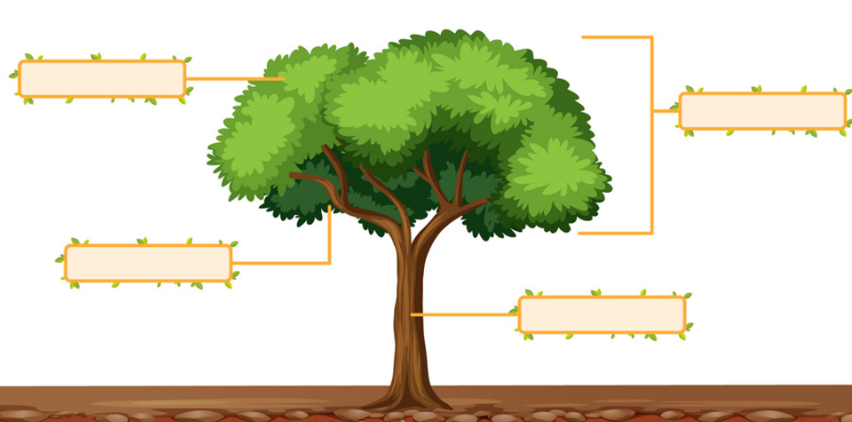
TERMINOLOGY
Code Table
Current
Descriptor Table
Upgrade
Complex Type
Entity
Data Elements
Data Elements
Interchange
Domain

Slide 4
DATA STANDARDS

Slide 5
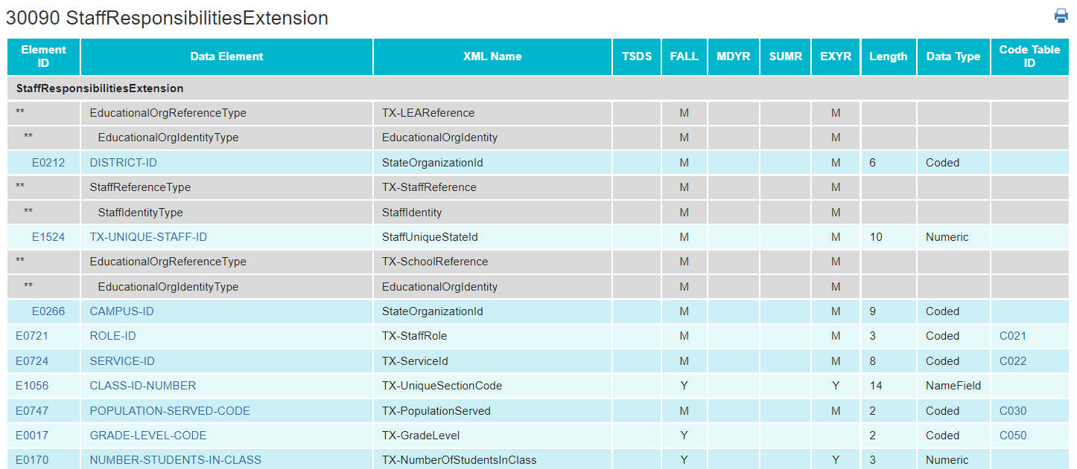
STAFF RESPONSIBILITIES – CURRENT Pt1
Currently Staff Responsibilities are collected through the StaffResponsibilitiesExtension.

Slide 6
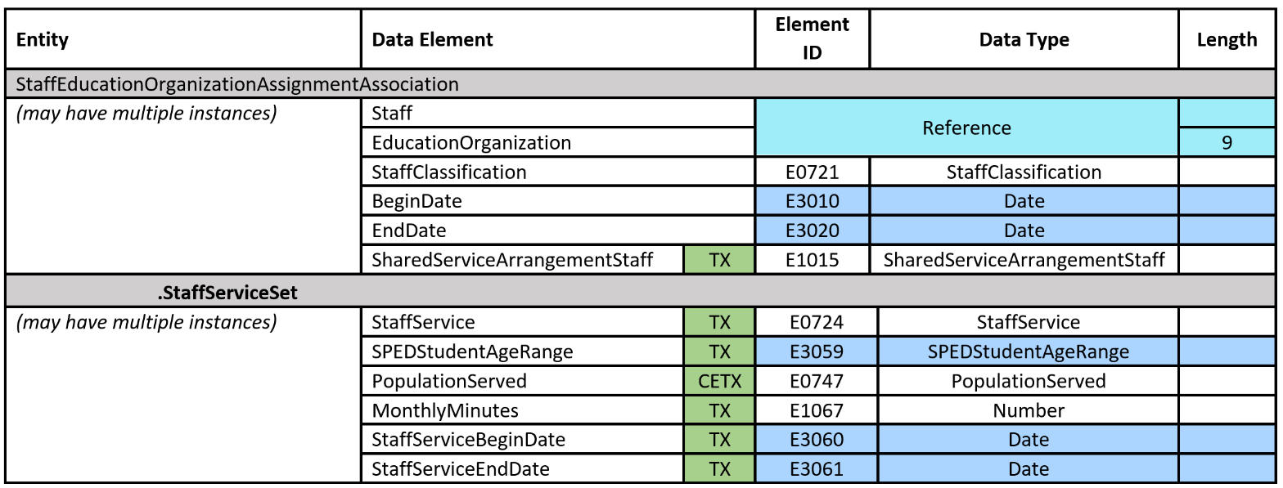
STAFF RESPONSIBILITIES – UPGRADED PT1
For non-instructional staff responsibilities, the necessary data elements will be reported using the StaffEducationOrganizationAssignmentAssociation entity in the Staff domain.

Slide 7
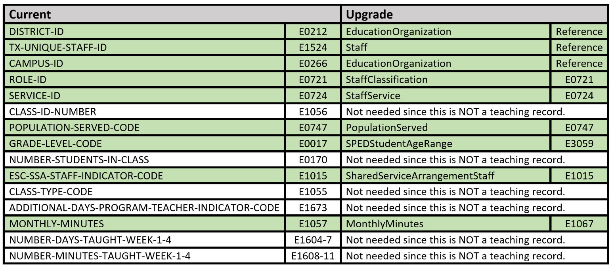
STAFF RESPONSIBILITIES – UPGRADED pt2
Non-Instructional Staff Responsibility

Slide 8
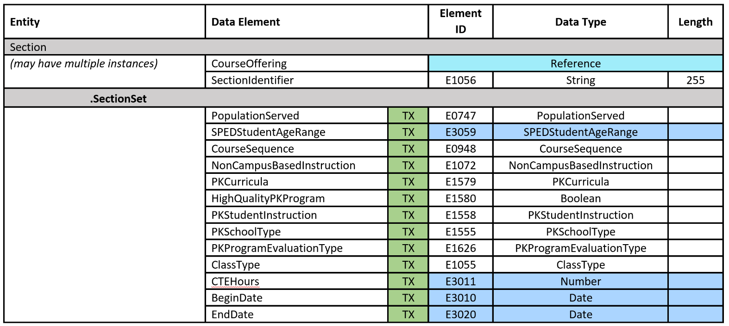
STAFF RESPONSIBILITIES – UPGRADED pt3
For instructional staff responsibilities, the necessary data elements will be reported using the Section and the StaffSectionAssociation entities in the Teaching and Learning domain.

Slide 9
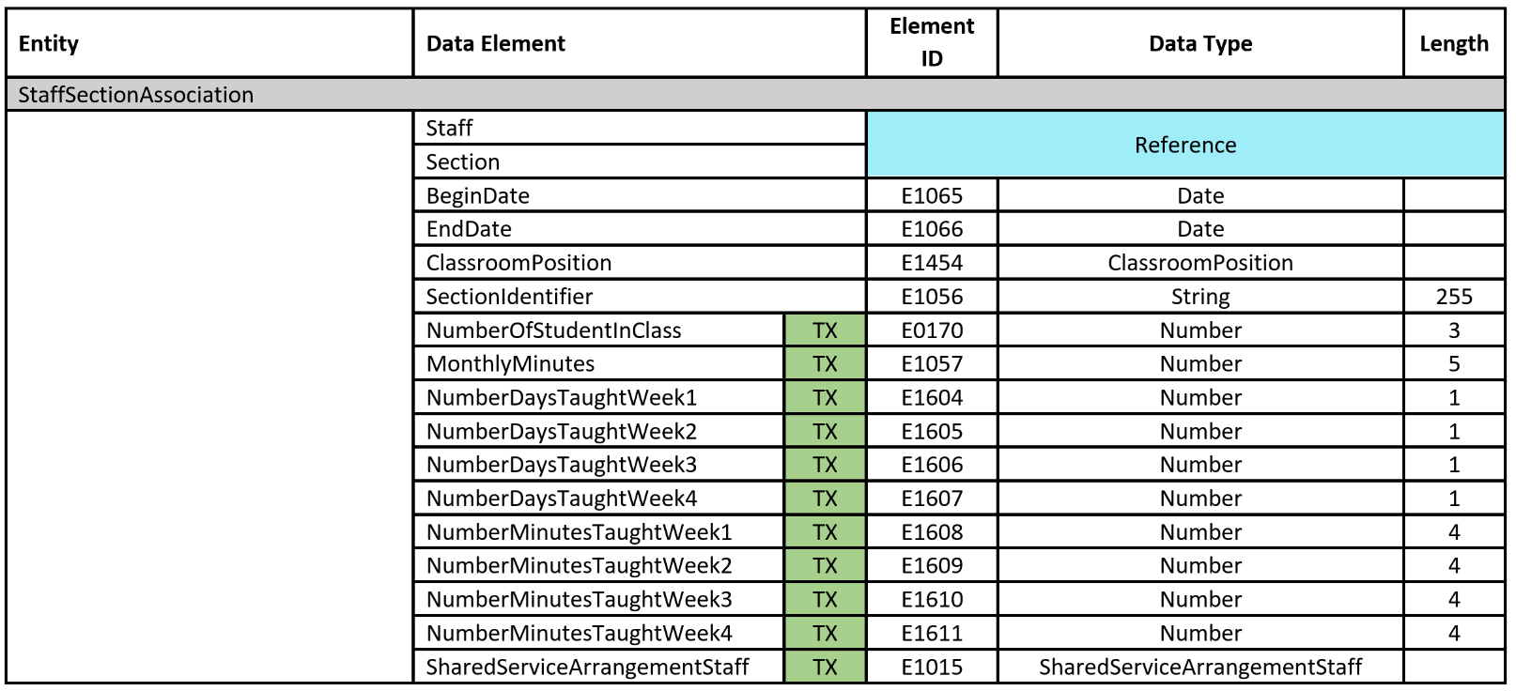
STAFF RESPONSIBILITIES – UPGRADED pt4
For instructional staff responsibilities, the necessary data elements will be reported using the Section and the StaffSectionAssociation entities in the Teaching and Learning domain.

Slide 10
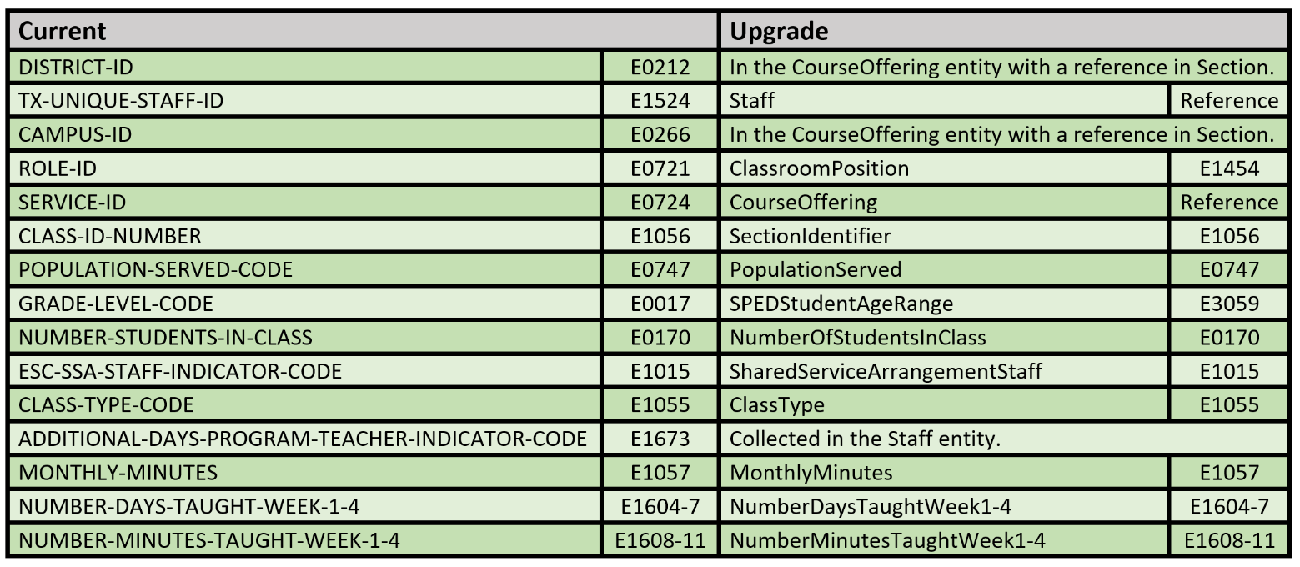
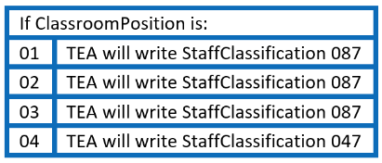
STAFF RESPONSIBILITIES – UPGRADED pt5
Instructional Staff Responsibility

Slide 11
EXAMPLES

Slide 12
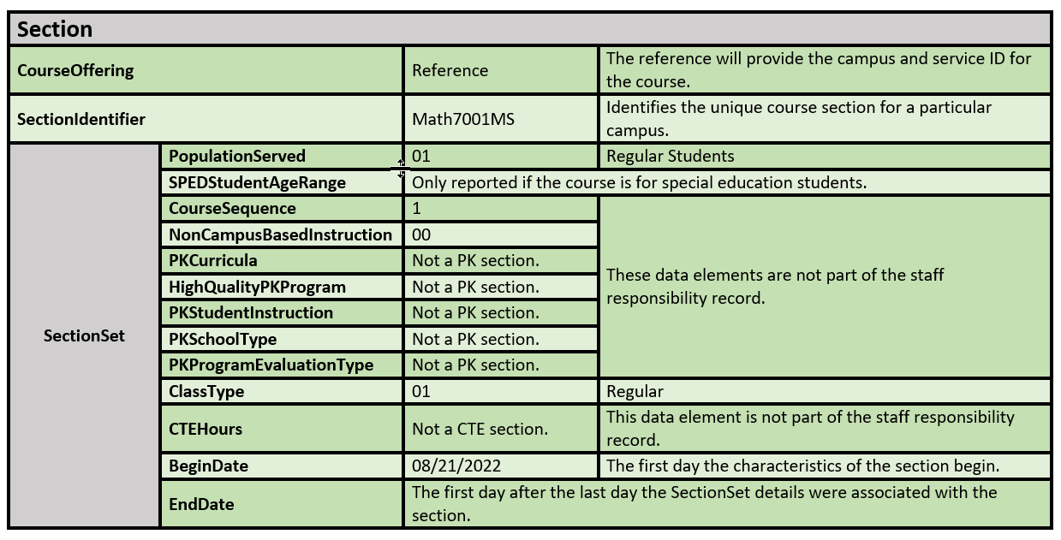
INSTRUCTIONAL STAFF RESPONSIBILITY
Ms. Elizabeth Zot is a teacher. She teaches 7th grade math to regular education students. She began teaching section 001 on August 21, 2022.

Slide 13
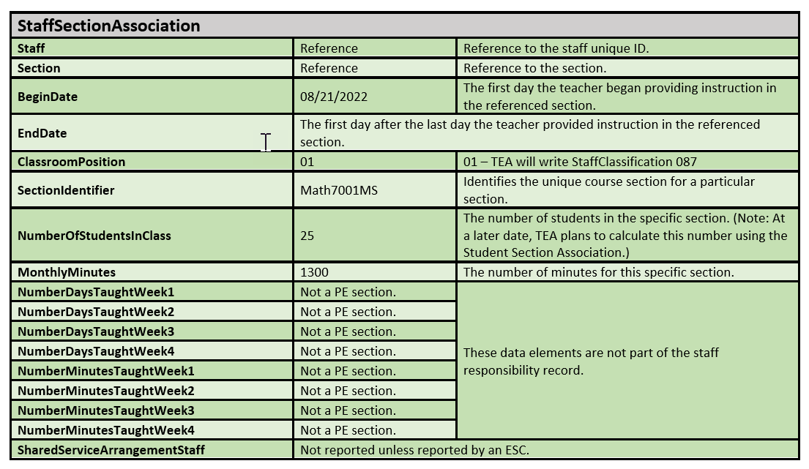
INSTRUCTIONAL STAFF RESPONSIBILITY – cont.

Slide 14
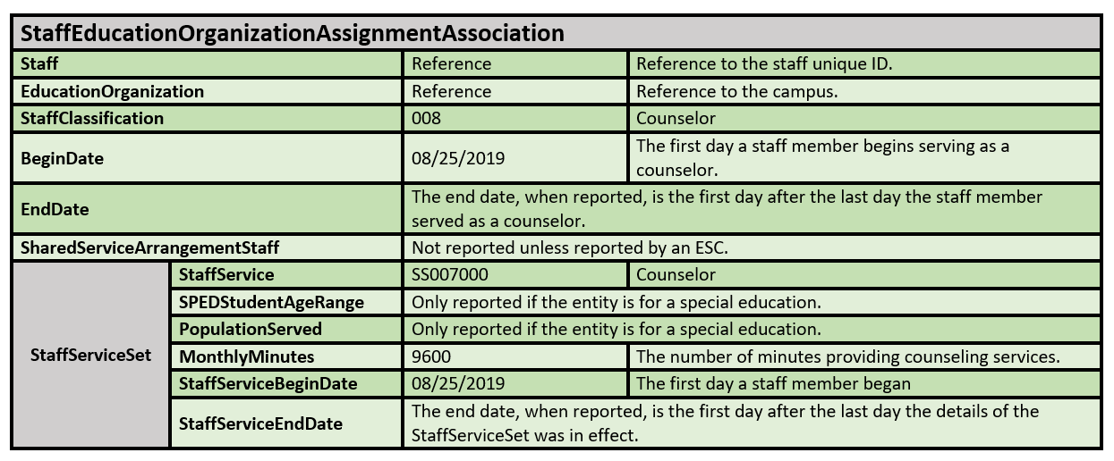
NON-INSTRUCTIONAL STAFF RESPONSIBILITY
Ms. Bernadette is a Counselor beginning on August 25, 2019. She has been a counselor providing the same number of monthly minutes since August 25, 2019.

Slide 15
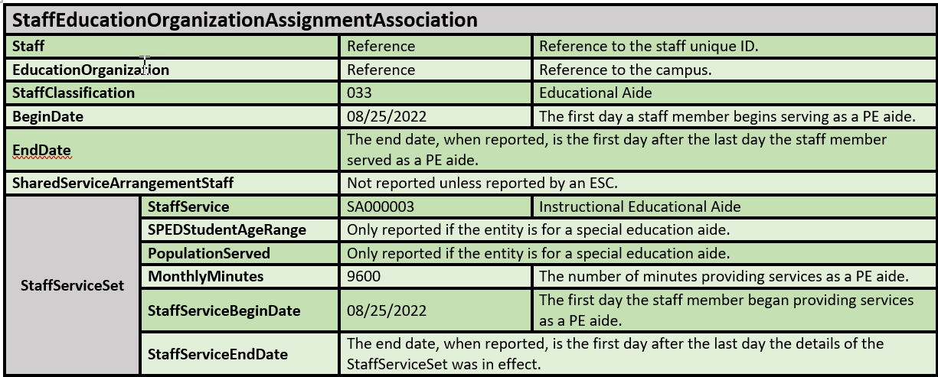
PHYSICAL EDUCATION AIDE
Mr. Conor is a PE Aide beginning on August 25, 2022.

Slide 16
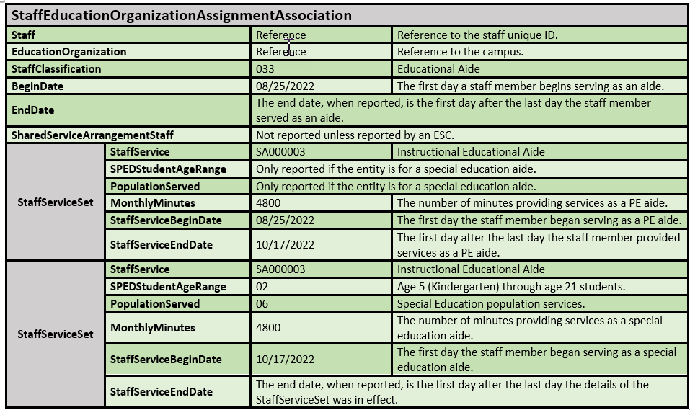
PE AIDE CHANGE TO SPED AIDE
Mrs. Penny is a PE aide beginning on August 25, 2022. Her last day as a PE aide is on October 16, 2022. On October 17, 2022, Mrs. Penny becomes a special education aide for 3rd and 4th grade students.

Slide 17
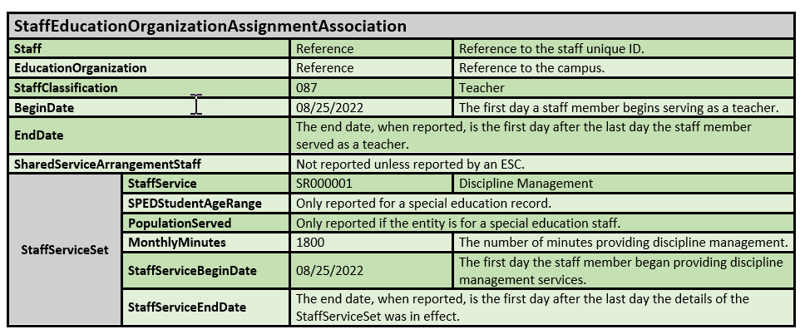
ADDITIONAL STAFF RESPONSIBILITY FOR TEACHER
Mr. Cooper provides discipline management for one class period per day beginning on August 25, 2022.

Slide 18
FREQUENTLY ASKED QUESTIONS

Slide 19
FREQUENTLY ASKED QUESTIONS #1
When we send Staff domain data, specifically the StaffEducationOrganizationAssignmentAssociation, will every employee (professional and auxiliary) have a record?
No, the only staff reported with a StaffEducationOrganizationAssignmentAssociation will be professional staff members with a StaffClassification listed in the StaffClassification descriptor table. StaffClassification 087 (teacher) will only be reported in the StaffEducationOrganizationAssignmentAssociation to report additional responsibilities of teachers.
Auxiliary staff members are reported in the StaffEducationOrganizationEmploymentAssociation with an Auxiliary RoleId.

Slide 20
FREQUENTLY ASKED QUESTIONS #2
Does the StaffServiceBeginDate need to be the same as the BeginDate for the StaffEducationOrganizationAssignmentAssociation?
No, the StaffServiceBeginDate does not need to be the same as the BeginDate for the StaffEducationOrganizationAssignmentAssociation. However, the BeginDate for the StaffEducationOrganizationAssignmentAssociation should be equal to or earlier than the StaffServiceBeginDate. (Example on Slide 17)

Slide 21
FREQUENTLY ASKED QUESTIONS #3
What is the definition of EndDate in the StaffSectionAssociation?
For the StaffSectionAssociation, the end date is the first day after the last day the teacher provided instruction in the referenced section in the current school year.

Slide 22
CLOSEOUT

Slide 23
KEY TAKEAWAYS
Non-Instructional Staff Responsibilities will be collected through the StaffEducationOrganizationAssignmentAssociation entity.
Link to Current Upgraded Data Standards:
2022-2023 TEDS Pilot Year 2 Data Standards
Instructional Staff Responsibilities will be collected through the Section and StaffSectionAssociation entities.
The ClassroomPosition will be used to determine the StaffClassification (role) of a staff member in the StaffSectionAssociation.

Slide 24
QUESTIONS

