Slide 1
PEIMS

Slide 2
PLEASE NOTE:
The focus of this presentation is on the changes for the official XML data submissions during the 2022-2023 school year.

Slide 3
AGENDA
PEIMS
Program Area Support
2021-2022
Submission Updates
Current Known Issues
Reminders
Timeline
2022-2023
Application Updates
Additional Days School Year Program Updates
Financial Aid Application
Dyslexia Services
Industry Based Certification
Expand IBC Field Length
Safe and Supportive School Program
Virtual Student Indicator
P-Tech Continuer
Charter Partner Staff Type Code
Guidance & Reminders
Timeline
Technical Resources
Questions

Slide 4
PROGRAM AREA SUPPORT
Program Area Support:
Sara Kohn – State Funding
Les Hudson – College & Career & Military Prep
Jonathon Delgado – Performance Reporting

Slide 5
2021-2022: SUBMISSION UPDATES
Overview of Extended Year CTE data collection:
The Summer CTE Education Grant requires LEAs to offer CTE courses during the summer months to encourage the completion of programs of study for students unable to schedule courses during the regular school year. The grant also encourages course completion through summer bridge programs for students entering or completing a program of study. This grant program increases the number of CTE courses completed during the summer months.

Slide 6
2021-2022: SUBMISSION UPDATES
Extended Year CTE data collection
Updated the general reporting requirements for the StudentExtension complex type:
Updated the general reporting requirements for the StudentSectionAssociation complex type:

Slide 7
2021-2022: SUBMISSION UPDATES
Updated the general reporting requirements for the StudentSectionAssociation complex type (Cont.):
Updated the general reporting requirements for the CourseTranscriptExtension: complex type (Cont.):

Slide 8
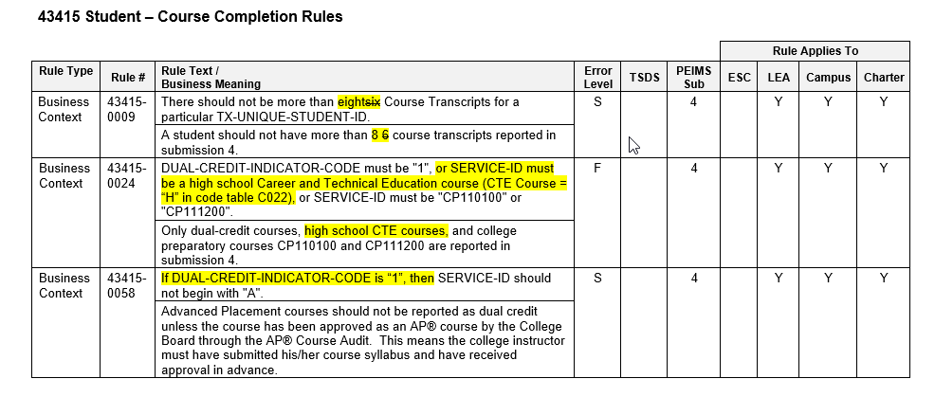
2021-2022: SUBMISSION UPDATES
Updated the following data validation rules:

Slide 9
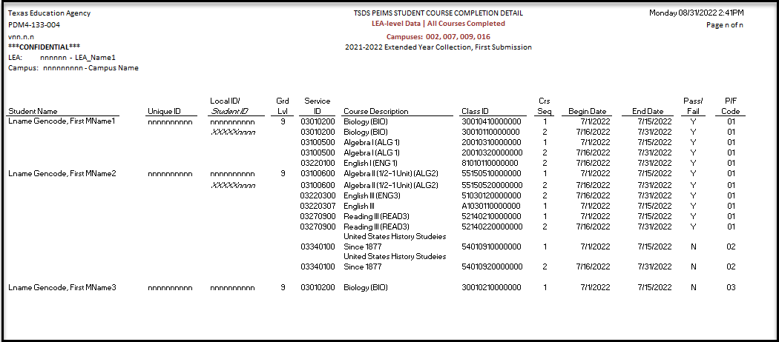
2021-2022: SUBMISSION UPDATES
New TSDS Report PDM4-133-004 – Student Course Completion Detail:

Slide 10
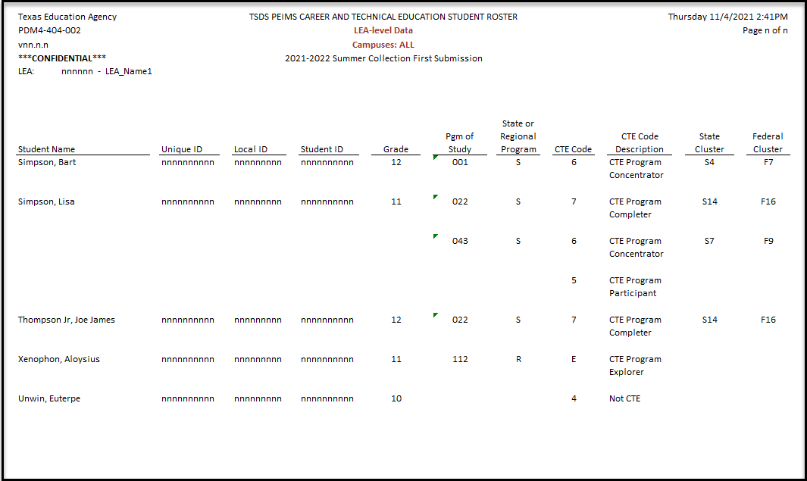
2021-2022: SUBMISSION UPDATES
New TSDS Report PDM4-404-002 – Career and Technical Education Student Roster:

Slide 11
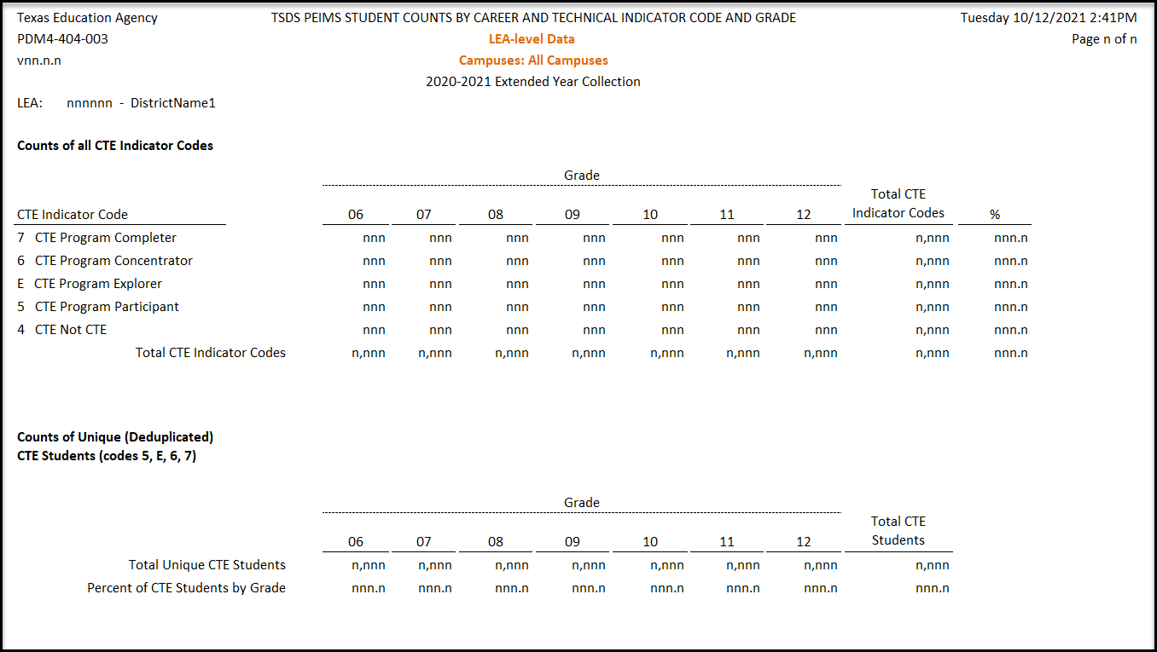
2021-2022: SUBMISSION UPDATES
New TSDS Report PDM4-404-003 – Student Counts by Career and Technical Indicator Code and Grade:

Slide 12
FREQUENTLY ASKED QUESTIONS
When is the CTE Indicator Code calculated?
The CTE Indicator Code is calculated a total of four times. The CTE auto-calculation process is run after the close of the PEIMS Summer 1st submission, resubmission and year-round schools' submission. It is then calculated again after the close of PEIMS Extended Year 1st submission and resubmission.
Are students with a CTE Indicator Code Calculation of ‘5’ or ‘E’ included in the CTE tier calculation for weighted funding?
All CTE courses for high school credit will have an assigned tier. The CTE Indicator does not impact the tier calculations for weighted funding.
Notes:
Be sure to highlight CTE calculations during summer submission include processing after year-round schools complete

Slide 13
FREQUENTLY ASKED QUESTIONS
When will the CTE auto-calculation look-up tables be updated to include new CTE courses for high school credit SERVICE-IDs (E0724) for the upcoming school year?
The CTE auto-calculation look-up tables are updated for the current school year at the beginning of April. For example, the 2022-2023 CTE auto-calculation look-up table will be updated in April 2023.
How will TEA know when the LEA offers a particular Program of Study (POS) when a student takes a course?
The program of study associated to courses are defined on the CTE website. TEA gets the data from Course Completion and matches the POS to the completion of a course.
Please note, while the program of study is used in the CTE auto-calculation, it does not impact the CTE FTE calculation.

Slide 14
FREQUENTLY ASKED QUESTIONS
Did LEAs have to apply for the Summer CTE Grant to receive grant money?
Yes. The College, Career, and Military Preparation Division has stated that only LEAs that applied for the Summer CTE Grant received funds.

Slide 15
2021-2022: SUBMISSION UPDATES
The CTE FTE calculation Extended Year Flexible (Non-ADSY)
For each campus, perform the following calculations for each instructional track offered at each campus, and for each of the six reporting periods
EXAMPLE SCENARIO:
Campus + track 1 + rep per 7
Campus + track 1 + rep per 8
Campus + track 2 + rep per 7
Campus + track 2 + rep per 8

Slide 16
2021-2022: SUBMISSION UPDATES
CTE FTE calculation updates:
For all students in CTE FTE flexible attendance, perform the following calculation:
For each permutation of campus, instructional track, and sixweek reporting period sum all FLEX-ATTEND-TOTAL-CAREER-TECH-MINUTES-PRESENT (E1053) and divide by 60 to find the Flex contact hours.
Divide the Flex contact hours for each track/reporting period permutation by 6 times NUMBER-DAYS-TAUGHT (E0935).
Flex CTE FTE = Total Track Flex Contact Hours ÷ (NUMBER-DAYS-TAUGHT x 6)
Add together all tracks in each reporting period for each campus.
This produces the Tier 2 Flex CTE FTE for each reporting period and campus.
Add together all reporting periods for each campus.
This produces the IP Flex CTE FTE for the campus for Tier 2.
Notes:
Flexible attendance during summer and extended year are only calculated using tier 2 once the data is at TEA.

Slide 17
2021-2022: SUBMISSION UPDATES
Funding for ADSY was based on legislative intent that the program would be for 30 additional days. If a district operated for fewer than 30 days (i.e., 20 days) and TEA used 20 days as the denominator, then that district would receive the same amount of funding as another district that operated ADSY for 30 days. The result would be that the district that operated 20 days would be overfunded. See Texas Education Code, Section 48.0051(c).ee Texas Education Code, Section 48.0051(c).
Additional Days School Year program
ADSY ADA/FTE calculation update
ADA Calculation Example:
Total Refined ADA = Total Eligible Days / 30 Days Taught
FTE Calculation Example:
Special Education FTE = Total Contact Hours / (30 Days Taught * 6)

Slide 18
FREQUENTLY ASKED QUESTIONS
How should an LEA report a student who received ADSY program instruction during the summer of 2022 and withdrew prior to August 1, 2022?
The student would still be eligible for ADSY and reported in the same manner as all other ADSY students.
Will LEAs see an adjustment in their Summary of Finance (SOF) in cases where an LEA was overfunded for the Additional Days School Year (ADSY) Program?
Yes. LEAs are paid based on the legislative payment estimate (LPE) of average daily attendance (ADA), including ADSY ADA. At near-final settle up in September, TEA incorporates ADA into the SOF reports from the PEIMS Summer submission, which does not include ADSY ADA.
As a result, the LEA may see a reduction in foundation school program (FSP) funding or an increase in recapture, if applicable. In November, TEA settles up with LEAs based on actual ADSY ADA from the PEIMS Extended Year submission, so at this point TEA is adding any ADSY ADA, which results in an increase in FSP funding or decrease in recapture, if applicable.

Slide 19
2021-2022: CURRENT KNOWN ISSUES
The following application known issues are tentatively scheduled to be updated in the September 9, 2022 software release.
Data Retrieval function for PEIMS Summer submission:
Prior year CTE attendance data retrieval failing
Add Special Education attendance data elements for Remote Synchronous (RS) and Remote Asynchronous (RA)
Add Bilingual/ESL attendance data elements for RS and RA
Attendance data promotions failing for prior years.

Slide 20
2021-2022: CURRENT KNOWN ISSUES
The following report known issues are tentatively scheduled to be updated in the September 9, 2022 software release.
PDM1-111-001 Individual Staff Profiles
Report is not including staff with role IDs 115, 116, 117, 118 119, and 120 when selecting report parameter ‘Professional’.
PDM1-121-001 Special Education Students by Grade and Instructional Setting and Funding Type
‘Speech Therapy Only’ counts by grade level are not being calculated correctly on this report.
PDM1-230-004 Staff Summary by Sex and Ethnicity
Report is not including staff with role IDs 032, 100, 101, 102, 103, 104, 105, 106, 107, 108, 109, 100, 111, 112, 113, 114, 115 , 116, 117, 118, 119, 120 when selecting report parameter ‘Professional’.

Slide 21
2021-2022: CURRENT KNOWN ISSUES
The following report known issues are tentatively scheduled to be updated in the September 9, 2022 software release.
The following reports will be updated to include program intent code ’43’.
PDM1-100-009 Budget Data Review
PDM2-100-006 Actual Expenditures by Program and Object within Function
PDM2-100-011 Actual Expenditures by Program & Object within Detail Function
PDM2-101-001 Actual Allocation Matrices
PDM2-101-002 Actual Compliance Report
PDM2-101-005 Actual Compliance Report – ESSER Unallocated

Slide 22
2021-2022: CURRENT KNOWN ISSUES
Summer reports are not displaying data for students with no attendance and crisis codes 10A or 10B in the following scenarios:
If the reports contain campus ID.
If the reports are run by campus.
If the reports include attendance data.
For 2022-2023, a new student indicator is being added for virtual students not in membership that should resolve these issues.

Slide 23
2021-2022: REMINDERS
Unique ID Birthdate and Demographic Reminders:
There were several occurrences this past school year where the year value in the Date of Birth on the Master Record was the same as the current calendar year. This may result in an incorrect September 1 age and requires TEA outreach to the LEA to verify and correct as needed.
TEA is working with their vendor to update the application and provide a warning message if the year in the Date of Birth matches the current calendar year. The birthyear will be accepted if verified by the user.​
Refer to TSDS PEIMS report PDM1-600-002 Statement of Unique ID Student Discrepancies to verify date of birth.
Utilize the PEIMS UID Discrepancy Reports to identify any demographic data in the Unique ID application that does not match your PEIMS data.

Slide 24
2021-2022: SUBMISSION TIMELINE
Extended Year Submission Timeline
PEIMS Extended Year Submission (Sub 4)​
PEIMS Extended Year submission ready for users to promote data​ | March 28, 2022​
TSDS PEIMS ready for users to complete, approve, and accept submissions​ | July 25, 2022​
Requests to retire Unique IDs due at TEA​ | August 19, 2022​
PEIMS Extended Year first submission due date for LEAs​ | August 25, 2022​
Requests to retire Unique IDs due at TEA​ | September 9, 2022​
PEIMS Extended Year resubmission due date for LEAs​ | September 15, 2022​

Slide 25
2022-2023

Slide 26
2022-2023 APPLICATION UPDATES
The following PEIMS application functionality will be updated to include new data elements:
Data Search
Data Element Summary
Data Retrieval

Slide 27
2022-2023: ADDITIONAL DAYS SCHOOL YEAR UPDATES
Overview of Additional Days School Year (ADSY) program:
TEA removed the following data elements from the PEIMS Extended Year Submission:
TOTAL-DAYS-ABSENT (E0036)
ESC-SSA-STAFF-INDICATOR-CODE (E1015)
EXCESS-HOURS-IN-INSTRUCTIONAL-SETTING (E0945).
Additionally, TEA has modified the Special Reporting Requirements and Data Element Reporting Requirements in the BasicReportingPeriodAttendanceExtension and the Special Reporting Requirements in the SpecialProgramsReportingPeriodAttendanceExtension complex types to clarify the ADSY program further.
References related to the removed data elements have been removed from four identified business rules. One report will be updated to remove the Total Days Absent row.

Slide 28
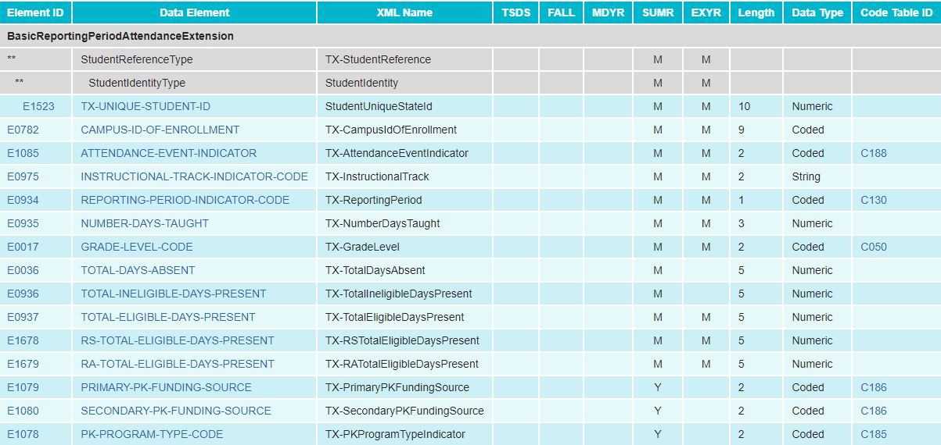
2022-2023: ADDITIONAL DAYS SCHOOL YEAR UPDATES
Modified the BasicReportingPeriodAttendanceExtension complex type for the PEIMS Extended Year Submission:
Removed TOTAL-DAYS-ABSENT (E0036)

Slide 29
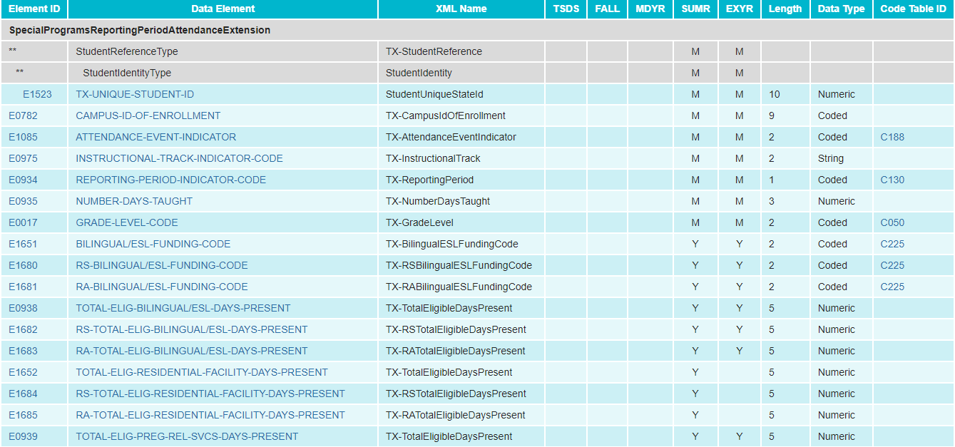
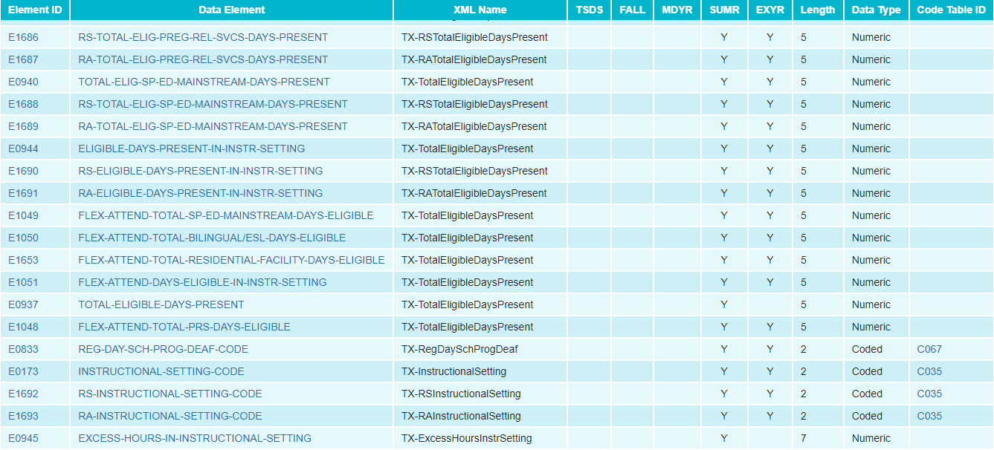
2022-2023: ADDITIONAL DAYS SCHOOL YEAR UPDATES
Modified the SpecialProgramsReportingPeriodAttendanceExtension complex type for the PEIMS Extended Year Submission:
Removed EXCESS-HOURS-IN-INSTRUCTIONAL-SETTING (E0945)

Slide 30
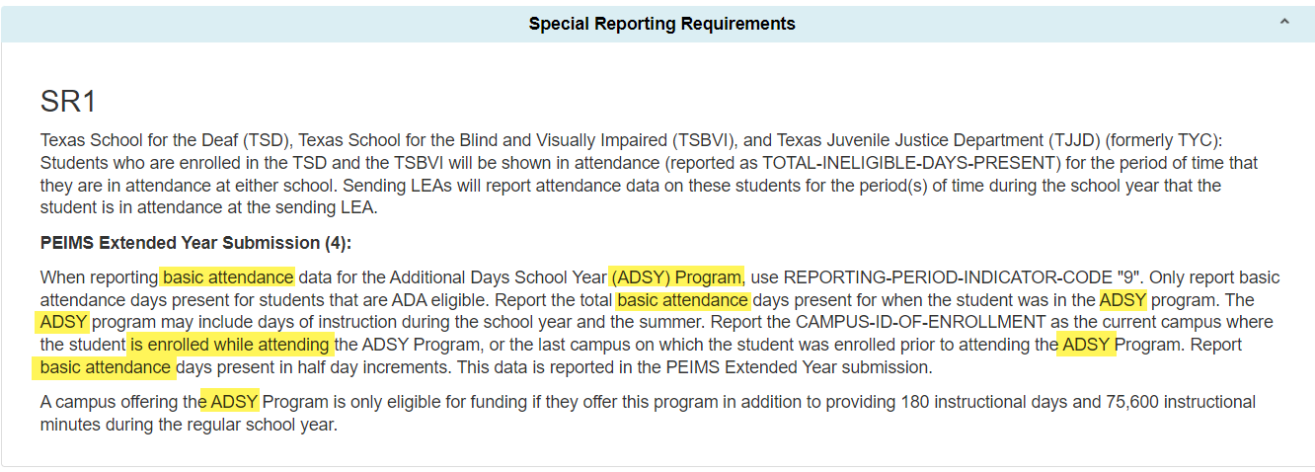
2022-2023: ADDITIONAL DAYS SCHOOL YEAR UPDATES
Updated the Special Reporting and Data Element Reporting Requirements in both the basic and special program attendance complex types for the ADSY Program:
Notes:
Strikethrough items have been removed
PEIMS Extended Year Submission (4):
When reporting basic attendance data for the Additional Days School Year Program (ADSY) Program, use REPORTING-PERIOD-INDICATOR-CODE "9". Only report absences and basic attendance days present for students that are ADA eligible. Report the total basic attendance days present and days absent for when the student was in the ADSY program. The ADSY program may include days of instruction during the school year and the summer. Report the CAMPUS-ID-OF-ENROLLMENT as the current campus where on which the student is enrolled while attending attended the ADSY Additional Days School Year Program, or the last campus on which the student was enrolled prior to attending the ADSY Program. Report basic attendance days absent and days present in half day increments. This data is reported in the PEIMS Extended Year submission.
A campus offering the ADSY an Additional Days School Year Program is only eligible for funding if they offer this program in addition to providing 180 instructional days and 75,600 instructional minutes during the regular school year.

Slide 31
2022-2023: ADDITIONAL DAYS SCHOOL YEAR UPDATES
Updated the Special Reporting and Data Element Reporting Requirements in both the basic and special program attendance complex types for the ADSY Program:
Notes:
Strikethrough is what was deleted
CAMPUS-ID-OF-ENROLLMENT (E0782) indicates the unique campus identification number of the campus in which the student is enrolled.
For the PEIMS Extended Year Submission (4), this is the current campus where in which the student is enrolled while attending the ADSY Additional Days School Year Program, or the last campus on which the student was enrolled prior to attending the ADSY Program.
The instruction for an ADSY program can be provided on a campus that is different from the campus in which a student is enrolled. The campus in which the student is enrolled during the current school year, or the last campus in which the student was enrolled prior to attending the ADSY Program, is required to meet the ADSY calendar requirements of 180 days and 75,600 minutes.
TOTAL-DAYS-ABSENT (E0036) indicates the total number of days the student was absent during a particular reporting period.
For the PEIMS Extended Year Submission (4), TOTAL-DAYS-ABSENT should be reported as half-day absences in the Additional Day School Year Program.

Slide 32
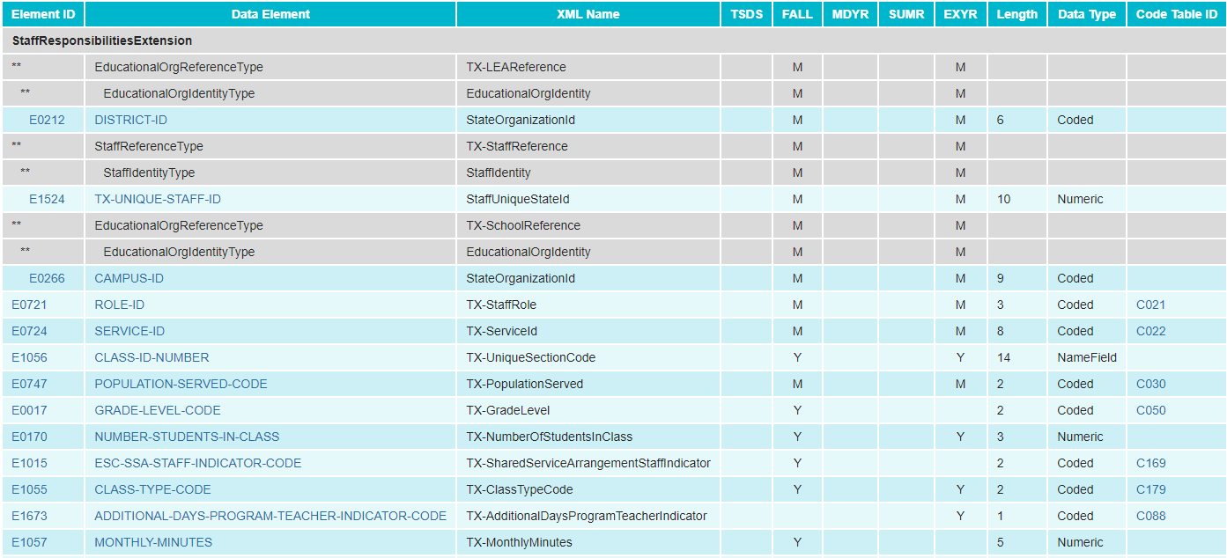
2022-2023: ADDITIONAL DAYS SCHOOL YEAR UPDATES
Modified the StaffResponsibilitiesExtension complex type for the PEIMS Extended Year Submission:
Removed ESC-SSA-STAFF-INDICATOR-CODE (E1015)

Slide 33
2022-2023: ADDITIONAL DAYS SCHOOL YEAR UPDATES
Updated PDM4-130-003 Superintendent’s/Principal’s Report of ADSY Attendance:
Removed row ‘Total Days Absent’
LEA level
Campus level report

Slide 34
2022-2023: ADDITIONAL DAYS SCHOOL YEAR UPDATES
Updated PDM4-130-003 Superintendent’s/Principal’s Report of ADSY Attendance:
Removed row for ‘Total Days Absent’
Grade Summary

Slide 35
2022-2023: ADDITIONAL DAYS SCHOOL YEAR UPDATES
Revised three business validation rules to remove TOTAL-DAYS-ABSENT:

Slide 36
2022-2023: ADDITIONAL DAYS SCHOOL YEAR UPDATES
Removed one rule from the PEIMS Extended Year Submission:

Slide 37
2022-2023: FINANCIAL AID APPLICATION
Overview of Financial Aid Application:
The Texas Commission on Public School Finance identified that many Texas students are not applying for financial aid and as a result there has been a drop in college enrollment. House Bill 3 (HB3) added to Texas Education Code (TEC §28.0256) the requirement that prior to graduating from high school, all students must complete and submit either a free application for federal student aid (FAFSA), a Texas application for state financial aid (TASFA) or opt out of the requirement.
To align with this legislative mandate, the Standards and Support Division in collaboration with the Curriculum Division and Beyond Grad Support team requested the addition of new data elements and code tables in both the PEIMS Fall submission and the Texas Records Exchange (TREx) to support this reporting requirement.

Slide 38
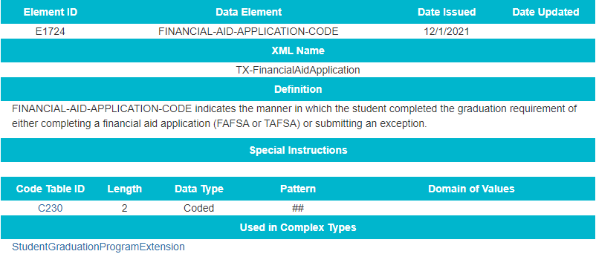
2022-2023: FINANCIAL AID APPLICATION DATA ELEMENTS
Added a new data element for the*FINANCIAL-AID-APPLICATION-CODE (E1724) to the StudentGraduationProgramExtension complex type to be reported in the PEIMS Fall Submission:
*Data element will be included in the TREx application

Slide 39
2022-2023: FINANCIAL AID APPLICATION CODE TABLES
Added a new FINANCIAL-AID-APPLICATION-CODE (C230) code table:

Slide 40
2022-2023: FINANCIAL AID APPLICATION BUSINESS RULES
Updated field validation rule 48011-000B to include FINANCIAL-AID-APPLICATION-CODE:

Slide 41
2022-2023: FINANCIAL AID APPLICATION REPORTS
Added new data element FINANCIAL-AID-APPLICATION-CODE (E1724) to the following PEIMS Fall Graduate reports:
PDM1-120-018 Foundation High School Program Graduate Roster
PDM1-124-007 Graduate Roster by Graduation Type

Slide 42
FREQUENTLY ASKED QUESTIONS
LEAs are using one date to populate the FINANCIAL-AID-APPLICATION-CODE (E1724) for all students to indicate they completed the graduation requirements. Is this acceptable, or should the LEA code each student when the student completes the financial aid application?
TEA will not be collecting the date the student completed the financial aid application. However, the date must appear on a student’s transcript, so an LEA will need to determine if they plan to use the same date locally. Additionally, the Texas Records Exchange (TREx) application transmits the FINANCIAL-AID-APPLICATION-MET-DATE (TE140).
Should the FINANCIAL-AID-APPLICATION-CODE (E1724) be reported on the student transcript when sent to a university? Is there a difference in the reporting of the FINANCIAL-AIDAPPLICATION-CODE for the Free Application for Federal Student Aid (FAFSA) or the Texas Application for State Financial Aid (TASFA)?
The FINANCIAL-AID-APPLICATION-CODE (E1724) is the same code (01) for either the FAFSA or TASFA. The FINANCIAL-AID-APPLICATION-CODE (E1724) may be part of the students’ academic record but is not required to appear on the transcript.

Slide 43
2022-2023: DYSLEXIA SERVICES
Overview of Dyslexia Services Updates and Additions:
The Texas Education Agency (TEA) currently collects dyslexia related services information during the PEIMS Summer submission. During the PEIMS Fall submission, TEA collects data indicating if a student is identified as dyslexic under TEC 48.009.
During the PEIMS Summer submission, TEA collects the type of dyslexia or related services, if any, a student identified with dyslexia or related disorder under TEC 48.009 has received at any time during the school year. However, TEA does not collect an indicator to validate that each student identified as dyslexic has been reported with the services received.
Additionally, Local Education Agencies (LEAs) are required to screen students in kindergarten and first grade for dyslexia or related disorders. Currently, when an LEA does not screen a student, TEA cannot identify why the screening did not take place.
The division of special education has requested changes to what is collected for dyslexic students.

Slide 44
2022-2023: DYSLEXIA SERVICES
Updates to the complex type StudentExtension.
Added DYSLEXIA-INDICATOR-CODE (E1530) to PEIMS Summer Submission as optional
Added new data element DYSLEXIA-SCREENING-EXCEPTION-REASON (E1732) as “optional”.
Added Data Element Reporting requirements for DYSLEXIA-SCREENING-EXCEPTION-REASON (E1732) reported in the PEIMS Summer submission.
Added new code table DYSLEXIA-SCREENING-EXCEPTION-REASON-CODE (C231) with 12 codes.

Slide 45
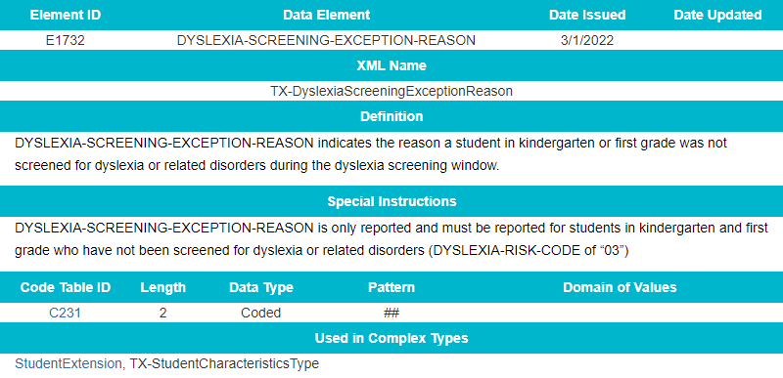
2022-2023: DYSLEXIA SERVICES DATA ELEMENTS
Added a new data element DYSLEXIA-SCREENING-EXCEPTION-REASON:

Slide 46
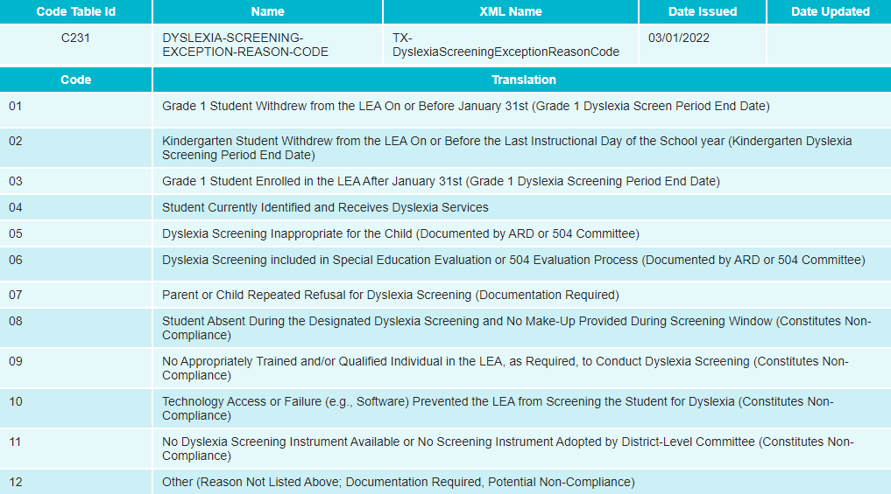
2022-2023: DYSLEXIA SERVICES CODE TABLES
Added a new code table DYSLEXIA-SCREENING-EXCEPTION-REASON-CODE (C231):

Slide 47
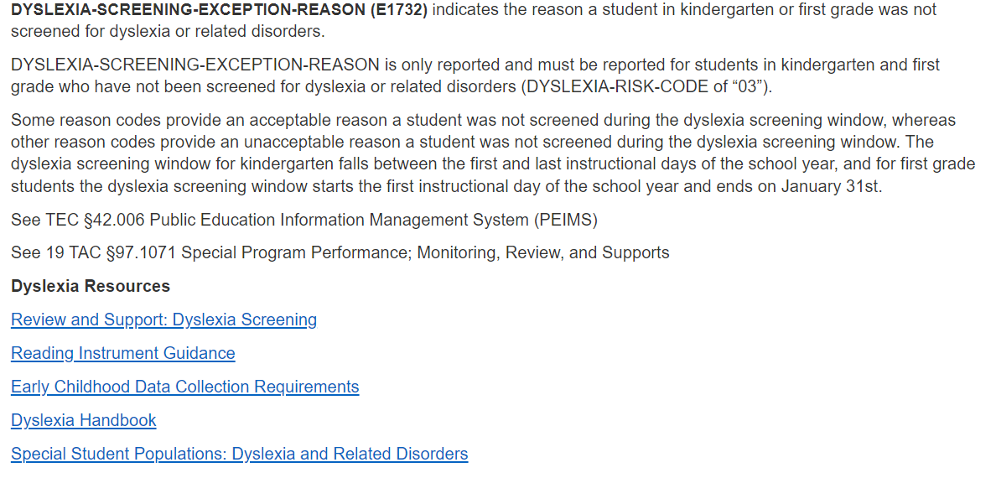
2022-2023: DYSLEXIA SERVICES GUIDANCE
Added new Data Element Reporting Requirements:

Slide 48
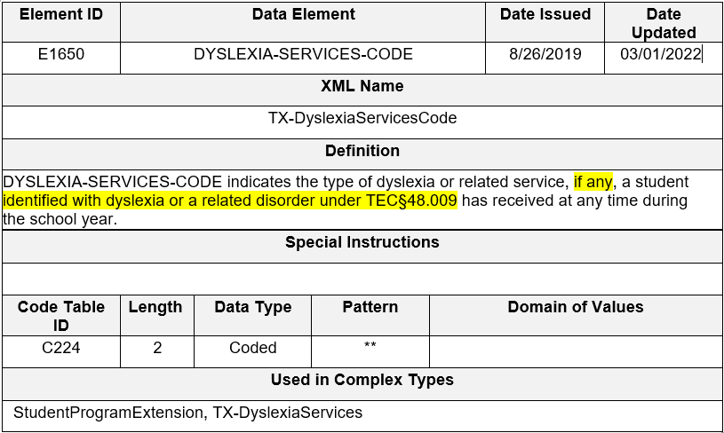
2022-2023: DYSLEXIA SERVICES DATA ELEMENTS
Revised the data element definition and data element reporting requirements for DYSLEXIA-SERVICES-CODE (E1650):

Slide 49
2022-2023: DYSLEXIA SERVICES GUIDANCE
Updated the Data Element Reporting Requirements:

Slide 50
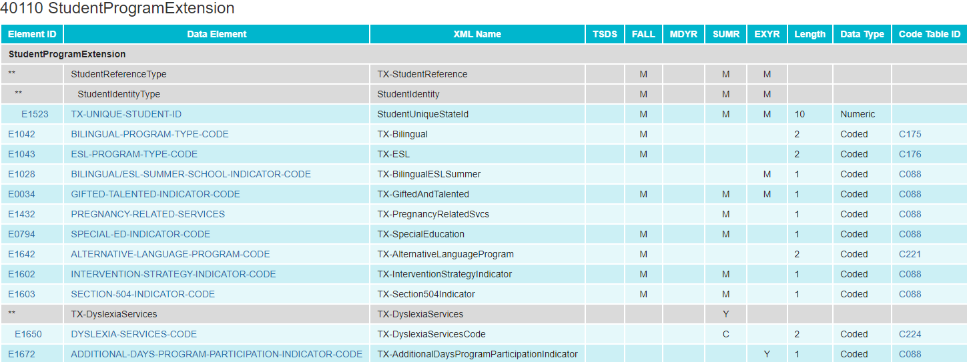
2022-2023: DYSLEXIA SERVICES DATA ELEMENTS
Updated the data element DYSLEXIA-SERVICES-CODE (E1650) from “mandatory” to “conditionally mandatory”:

Slide 51
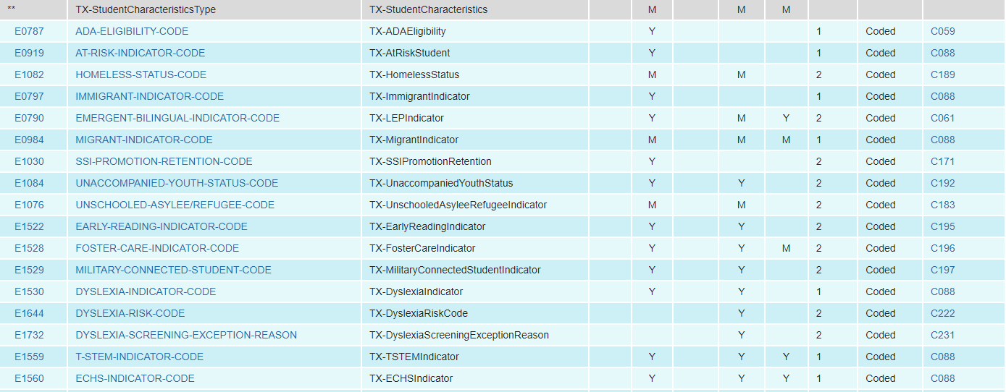
2022-2023: DYSLEXIA SERVICES DATA ELEMENTS
Added new and existing data elements to the StudentExtension complex type as “Optional” for the PEIMS Summer Submission:
DYSLEXIA-INDICATOR-CODE
DYSLEXIA-SCREENING-EXCEPTION-REASON

Slide 52
2022-2023: DYSLEXIA SERVICES CODE TABLES
Revised the code translation for ‘00’ in the DYSLEXIA-SERVICES-CODE table:

Slide 53
2022-2023: DYSLEXIA SERVICES BUSINESS RULES
New validation rules:

Slide 54
2022-2023: DYSLEXIA SERVICES BUSINESS RULES
New validation rules (cont.):

Slide 55
2022-2023: DYSLEXIA SERVICES REPORTS
The following reports will be reviewed to determine if any modifications are needed.
PDM3-120-007 Student Indicator Report by Grade
PDM3-120-018 Student Dyslexia and/or Related Services Roster

Slide 56
FREQUENTLY ASKED QUESTIONS
Should an LEA still screen a kindergarten student for dyslexia who enrolled in an LEA after January 31st of a given year?
Screening for each kindergarten student should be completed by the end of the year. If the LEA determines the student was not previously screened, the LEA should screen the student. Ultimately, it is essential to know if the student needs additional support.

Slide 57
2022-2023: INDUSTRY BASED CERTIFICATION
Overview of Industry Based Certification Changes:
House Bill 22 (HB 22), passed during the 85th legislative session, established the A-F accountability system. Per Texas Education Code section 39.053, students can earn College, Career, and Military Readiness (CCMR) credit for earning an approved industry-based certification (IBC). Additionally, House Bill 3 (HB 3), passed during the 86th legislative session, entitles local education agencies (LEAs) to one IBC reimbursement per student to help defray the cost of the exams passed.
Currently, LEAs use the data element, POST-SECONDARY-LICENSURE-CERTIFICATION-CODE (E1640) to report IBCs earned for CCMR credit (students have earned the certification) and IBCs passed (students have passed all or a portion of a multileveled certification). The Texas Education Agency (TEA) uses this data element to determine whether a student has met the threshold to earn the CCMR indicator, and data element IBC-EXAM-FEE-AMOUNT (E1654) to determine if the LEA is requesting reimbursement. LEAs may request reimbursement for a portion of an IBC exam a student passed, even if the student has not completed all of the requirements to earn the certification.
Additionally, the 2018-2019 school year was the last year TEA collected when a student failed an IBC exam. While the LEA cannot request reimbursement for those students who fail to pass an IBC exam, TEA must collect this information for reporting purposes.

Slide 58
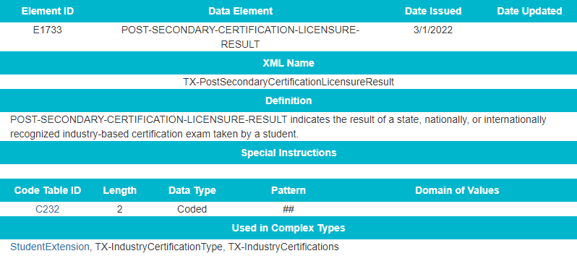
2022-2023: INDUSTRY BASED CERTIFICATION DATA ELEMENTS
Added a new data element *POST-SECONDARY-CERTIFICATION-LICENSURE-RESULT to TX-IndustryCertifications sub-complex type:
*data element will be included in the TREx application

Slide 59
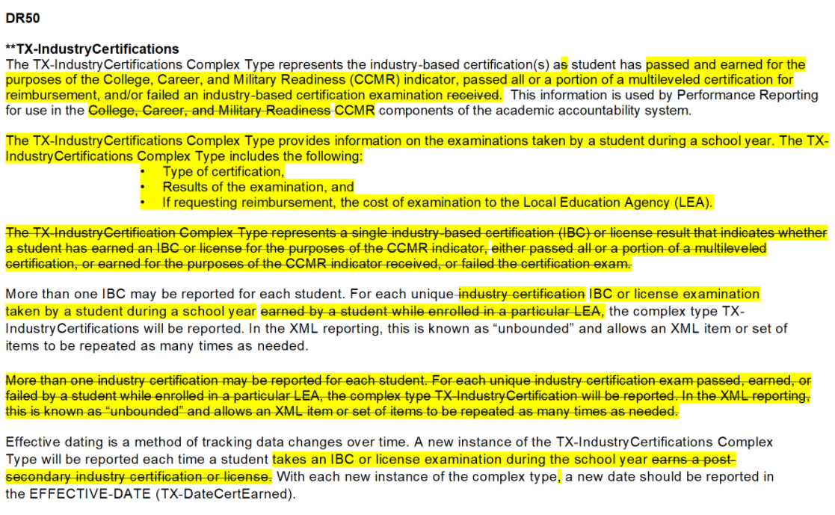
2022-2023: INDUSTRY BASED CERTIFICATION GUIDANCE
Updated Data Element Reporting Requirements for the TX-IndustryCertifications sub-complex type:

Slide 60
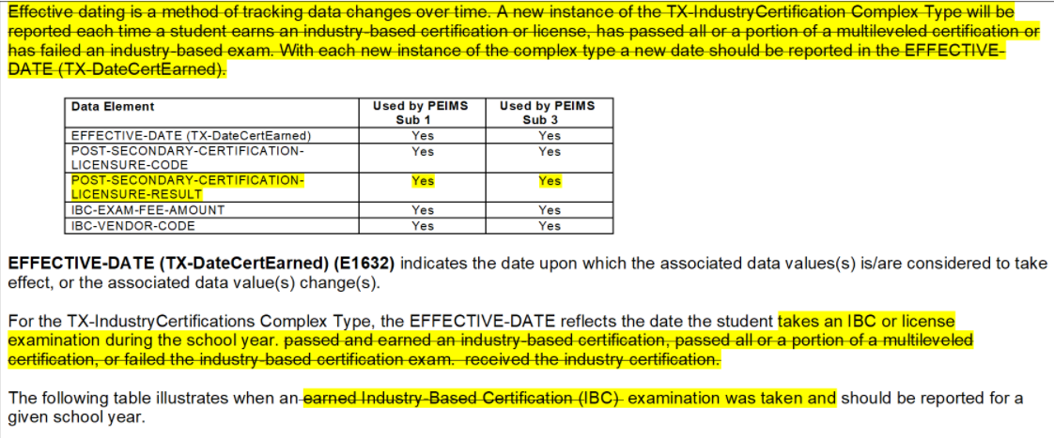
2022-2023: INDUSTRY BASED CERTIFICATION GUIDANCE
Updated Data Element Reporting Requirements the TX-IndustryCertifications sub-complex type (cont.):
(cont.):

Slide 61
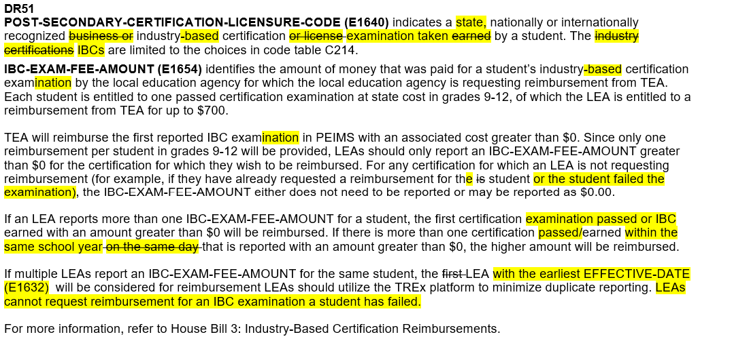
2022-2023: INDUSTRY BASED CERTIFICATION GUIDANCE
Updated Data Element Reporting Requirements the TX-IndustryCertifications sub-complex type (cont.):

Slide 62
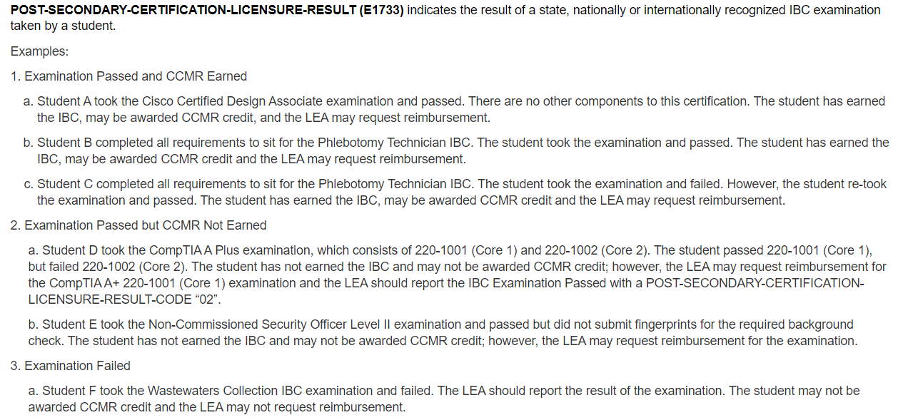
2022-2023: INDUSTRY BASED CERTIFICATION GUIDANCE
Added new Data Element Reporting Requirements for new data element, POST-SECONDARY-CERTIFICATION-LICENSURE-RESULT (E1733):

Slide 63
2022-2023: INDUSTRY BASED CERTIFICATION CODE TABLES
Added a new code table *POST-SECONDARY-CERTIFICATION-LICENSURE-RESULT-CODE (C232):
*data element will be included in the TREx application

Slide 64
2022-2023: INDUSTRY BASED CERTIFICATION BUSINESS RULES
Added a new data validation rule:

Slide 65
2022-2023: INDUSTRY BASED CERTIFICATION REPORTS
Added a new data element POST-SECONDARY-CERTIFICATION-LICENSURE-RESULT (E1733) to the following PEIMS Fall and Summer reports:
PDM1-120-021 Industry-Based Certification Roster (Fall)
PDM3-120-019 Industry-Based Certification Roster (Summer)

Slide 66
2022-2023: EXPAND IBC DATA ELEMENT FIELD LENGTH
Overview Expand IBC Data Element Field Length:
TEA increased the length of the data elements, POST-SECONDARY-CERTIFICATION-LICENSURE-CODE (E1640) and IBC-VENDOR-CODE (E1655) from three to four digits. This change allows for the addition of new codes to the code tables. As a result, reports have been updated to allow three-or-four digit codes to be displayed for the affected data elements. There are no rule impacts as a result of this change.
TEA is also proposing to increase the length of the TREx data element, POST-SECONDARY-CERTIFICATION-LICENSURE-CODE (TE133) from three to four digits.

Slide 67
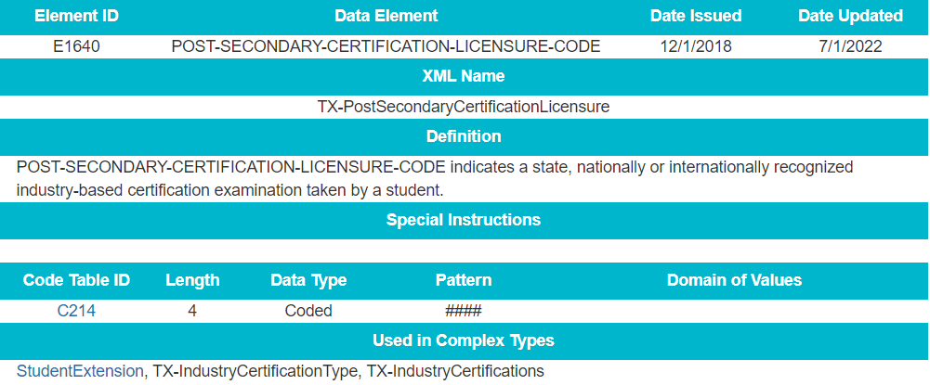
2022-2023: EXPAND IBC DATA ELEMENT FIELD LENGTH
Increased the length from three to four digits for the following data element:
*POST-SECONDARY-CERTIFICATION-LICENSURE-CODE (E1640)
*data element length will be updated in the TREx application as well

Slide 68
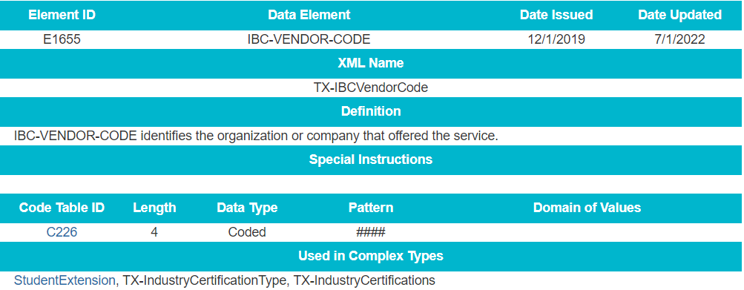
2022-2023: EXPAND IBC DATA ELEMENT FIELD LENGTH
Increased the length from three to four digits for the following data element:
*IBC-VENDOR-CODE (E1655)
*data element length will be updated in the TREx application as well

Slide 69
2022-2023: EXPAND IBC DATA ELEMENT FIELD LENGTH
Update Existing TSDS reports:
PDM1-120-016 – Student Advanced Academic Roster by Grade
PDM1-120-018 – Student Foundation High School Program Graduate Roster
PDM1-120-021 – Industry-Based Certification Roster
PDM1-124-004 – School Leaver Roster
PDM1-124-007 – Graduate Roster by Graduation Type
PDM3-120-010 – Student Advanced Academic Roster by Grade
PDM3-120-019 – Industry-Based Certification Roster

Slide 70
FREQUENTLY ASKED QUESTIONS
When will TEA publish the updated VENDOR-CODEs (C226) and INDUSTRY-CERTIFICATION-LICENSURE-CODEs (C214) for the 2022-2023 school year? TEA will publish a Post-Addendum Version after August 15, 2022 which will include additions to the C226 and C214 tables. At that time, no codes will be removed from the code tables.

Slide 71
2022-2023: SAFE AND SUPPORTIVE SCHOOL PROGRAM
Overview of Safe and Supportive School Program Team:
During the 86th legislative session, SB 11 was passed, which amended Subchapter D, Chapter 37, Education Code by adding §37.115. This new section requires the board of trustees for each local education agency (LEA) to establish a safe and supportive school program (SSSP) team to serve at each campus to conduct threat assessments. The SSSP team must report to the agency, through guidelines developed by the agency, the following information regarding the team's activities and other information for each LEA campus the team serves, the outcome of each assessment made by the team, including:
any disciplinary action taken, including a change in school placement (§37.115(k)(3)(A));
changes in school placement, including placement in a juvenile justice alternative education program or disciplinary alternative education program (§37.115(k)(4)(D));
placements in in-school suspension or out-of-school suspension and incidents of expulsion (§37.115(k)(3)(F));
Through an annual data collection/survey, LEAs must report discipline incidents that included an SSSP team review and the resulting number of changes in school placement that occurred after the SSSP team review was conducted.

Slide 72
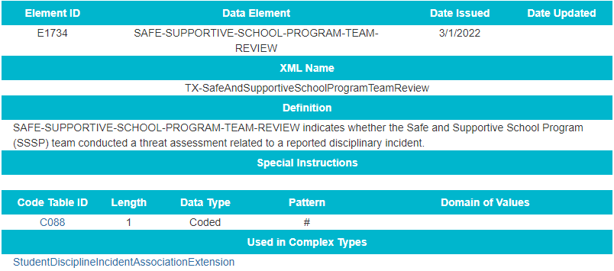
2022-2023: SSSP DATA ELEMENTS
Added a new data element SAFE-SUPPORTIVE-SCHOOL-PROGRAM-TEAM-REVIEW to the StudentDisciplineIncidentAssociationExtension complex type:

Slide 73
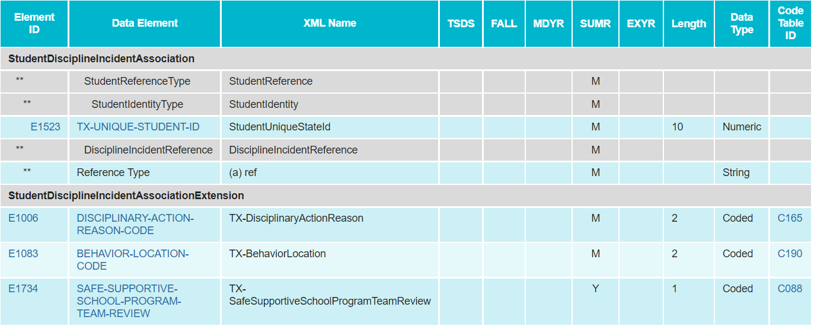
2022-2023: SSSP DATA ELEMENTS
Added new data element to the StudentDisciplineIncidentAssociationExtension complex type:

Slide 74
2022-2023: SSSP DATA ELEMENTS
Added new data element reporting requirements:

Slide 75
2022-2023: SSSP CODE TABLES
No New Code Tables
No Updated Code Tables
No Deleted Code Tables

Slide 76
2022-2023: SSSP BUSINESS RULES
No New Business Rules
No Updated Business Rules
No Deleted Business Rules

Slide 77
2022-2023: SSSP REPORTS
Added a new data element SAFE-SUPPORTIVE-SCHOOL-PROGRAM-TEAM-REVIEW (E1734) to the following PEIMS Summer Disciplinary reports:
PDM3-132-001 Student Disciplinary Action Roster
PDM3-132-002 Student Disciplinary Action Detail by Reason
PDM3-132-004 Student Disciplinary Action Detail by Incident Number

Slide 78
2022-2023: SSSP REPORTS
Add a new PEIMS Summer Disciplinary report:
PDM3-132-007 Student Disciplinary Action Summary by SSSP Team Review
This report will be at the LEA and Campus level and will display the total number of incidents reviewed by the SSSP team broken out by Action Code (JJAEP, DAEP, ISS, OSS).

Slide 79
FREQUENTLY ASKED QUESTIONS
Should the SSSP team conduct a threat assessment every time a student is sent to ISS, OSS, DAEP, or JJAEP?
No. A threat assessment occurs each time an individual “makes threats of violence or exhibits harmful, threatening, or violent behavior,” as outlined in TEC 37.115 (f)(1)(A). However, a threat assessment may result in those placements.
Do LEAs currently have an SSSP team or is this a new requirement that LEAs must implement?
LEAs are aware as the legislation resulting from SB11 includes the SSSP team requirement. The legislation went into effect in September 2019. Since then, TEA has released additional guidance through TAAs.

Slide 80
FREQUENTLY ASKED QUESTIONS
What is involved or evaluated in a threat assessment? Where can LEAs find more details about the threat assessment process?
Anytime there is a report of a threat, the SSSP team meets to conduct a threat assessment to identify threatening behaviors. SSSP teams undergo specific training to accomplish these assessments. Once a threat assessment is conducted, if the outcome is a disciplinary action resulting in ISS, OSS, DAEP, and JJAEP, the indicator would be reported through PEIMS.
Please email the SSSP Division at safeandsupportiveschoolprogram@tea.texas.gov to find additional resources on the threat assessment process.
If the SSSP team conducted a review that resulted in a change in school placement, how will the resulting number of changes in school placement be reported to meet the SB11 Subchapter D, Chapter 37 TEC §37.115 legislative requirements?
The approval of the new data element, SAFESUPPORTIVE-SCHOOL-PROGRAM-TEAM-REVIEW (E1734), for the 2022-2023 school year allows campuses the ability to indicate the incident that resulted in a disciplinary placement was reviewed by the behavioral threat assessment team. TEA will aggregate that data to meet the SB11 reporting requirements.

Slide 81
2022-2023: VIRTUAL STUDENT INDICATOR
Virtual Student Indicator Overview:
TEA added a new indicator, VIRTUAL-STUDENT-NOT-IN-MEMBERSHIP (E1735) to the PEIMS Summer submission for use by an LEA when a student spends at least half of their instructional time enrolled in virtual courses without the benefit of funding under ADA.
Reports and rules will be updated to include the new indicator.
During 2021-2022, these students may have been identified with crisis codes 10A and 10B.
These students may be reported with attendance in the PEIMS Summer submission if some of their time was spent outside of the virtual program and they are eligible for ADA.
Additional information regarding Remote Learning can be found at https://tea.texas.gov/academics/learning-support-and-programs/remote-learning

Slide 82
2022-2023: VIRTUAL STUDENT INDICATOR
Scenario #1
A student enrolled in virtual learning from the first day of school until the student withdrew February 15, 2022.
During the 2021-2022 school year, the student would have been reported with a CRISIS-CODE 10A and an ADA-ELIGIBILITY-CODE 9.
No attendance would be reported for this student.
During the 2022-2023 school year, the same scenario, the student would be reported with a VIRTUAL-STUDENT-NOT-IN-MEMBERSHIP 1 and an ADA-ELIGIBILITY-CODE 9.
Scenario #2
A student enrolled in virtual learning from the first day of school until December 20, 2021 at which time the student returned to school and then was eligible for ADA funding.
During the 2021-2022 school year, the student would have been reported with no CRISIS-CODE and an ADA-ELIGIBILITY-CODE 9 since the eligibility was changed after the PEIMS Fall Snapshot date.
Attendance would be reported for this student.
During the 2022-2023 school year, the same scenario, the student would be reported with a VIRTUAL-STUDENT-NOT-IN-MEMBERSHIP 0 and an ADA-ELIGIBILITY-CODE 9.

Slide 83
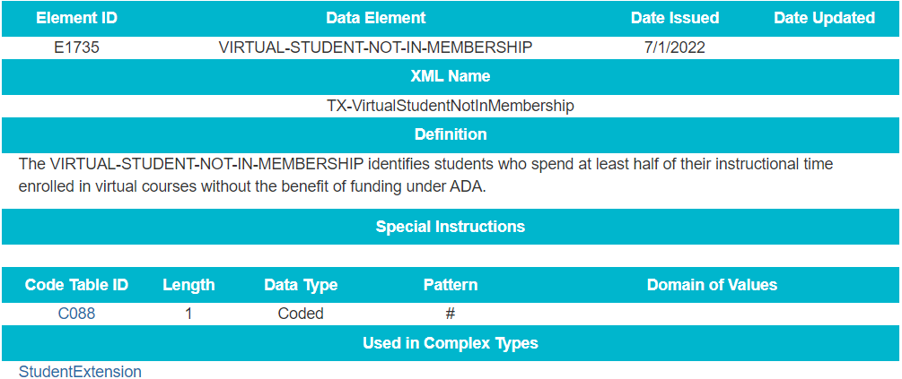
2022-2023: VIRTUAL STUDENT INDICATOR DATA ELEMENTS
Added new indicator VIRTUAL-STUDENT-NOT-IN-MEMBERSHIP (E1735) to the StudentExtension complex type to be reported in the PEIMS Summer Submission:

Slide 84
2022-2023: VIRTUAL STUDENT INDICATOR REPORTS
Update existing TSDS reports to include the new Virtual Student Indicator data element.
Reports will be reviewed to determine if any new reports will need to be developed or modified as a result of the new Virtual Student Indicator data element.

Slide 85
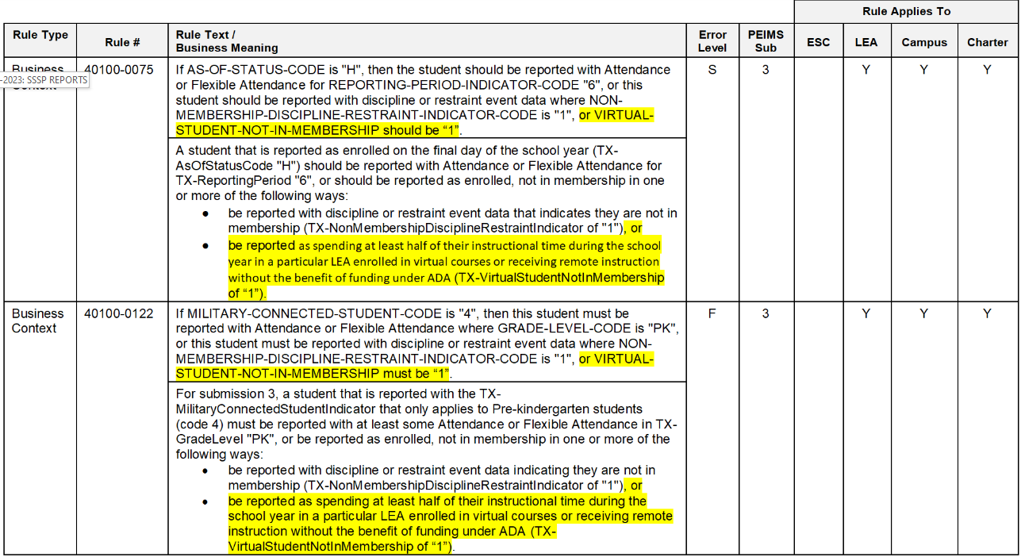
2022-2023: VIRTUAL STUDENT INDICATOR BUSINESS RULES
Updated data validation rules:

Slide 86
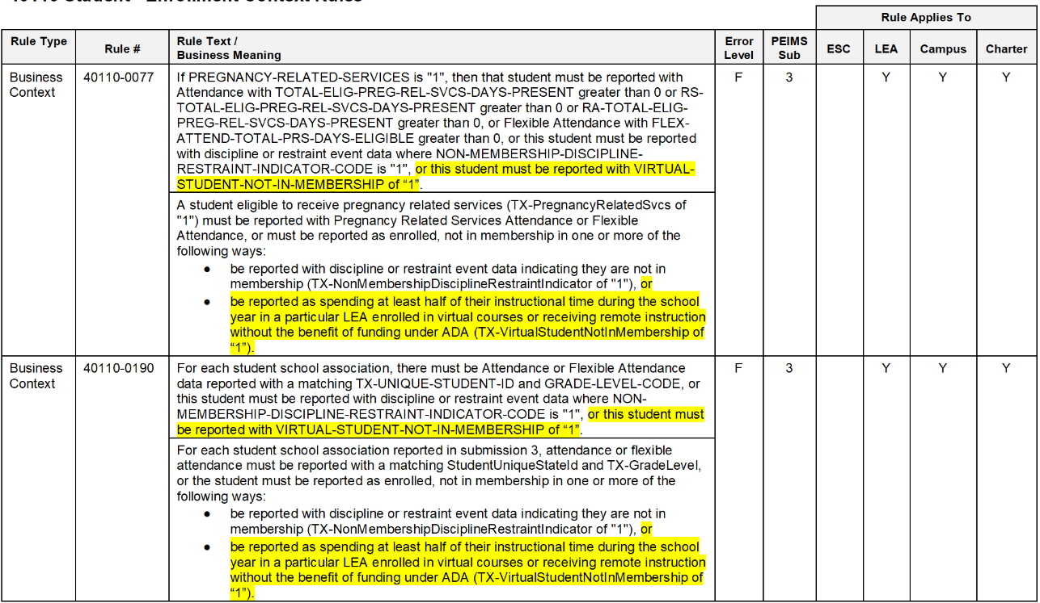
2022-2023: VIRTUAL STUDENT INDICATOR BUSINESS RULES
Updated data validation rules (cont.):

Slide 87
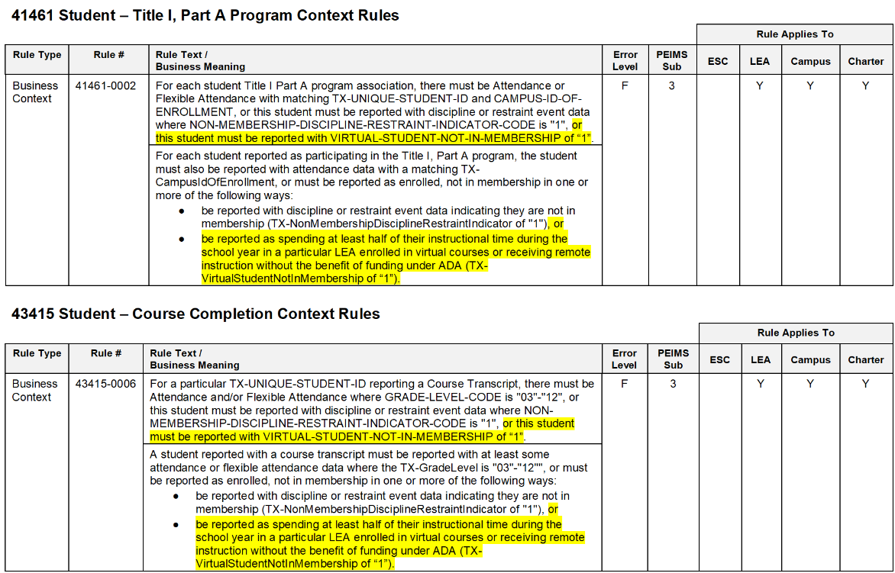
2022-2023: VIRTUAL STUDENT INDICATOR BUSINESS RULES
Updated data validation rules(cont.):

Slide 88
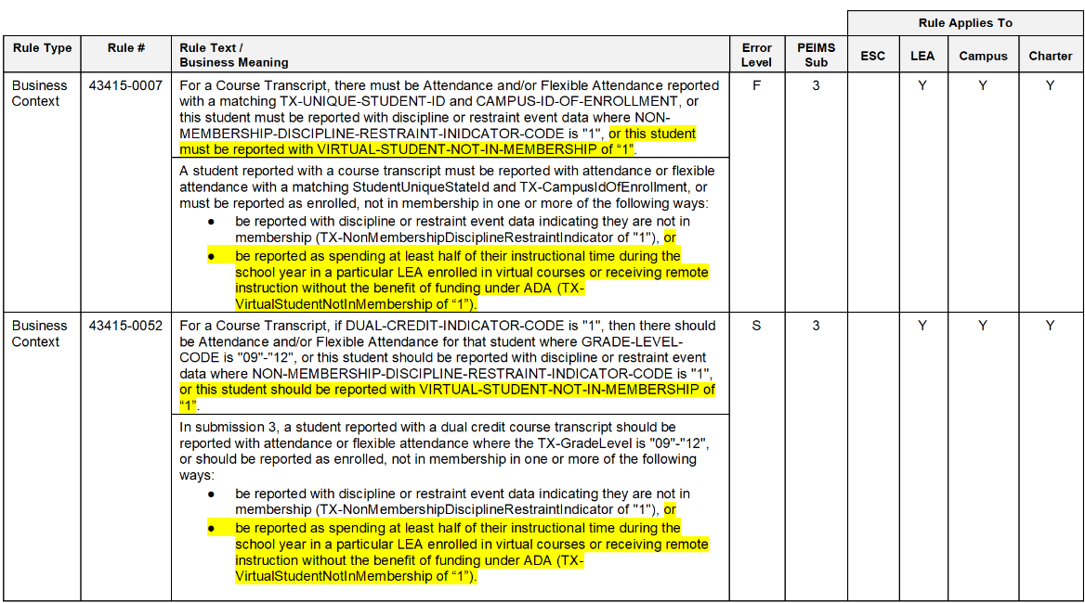
2022-2023: VIRTUAL STUDENT INDICATOR BUSINESS RULES
Added and updated data validation rules(cont.):

Slide 89
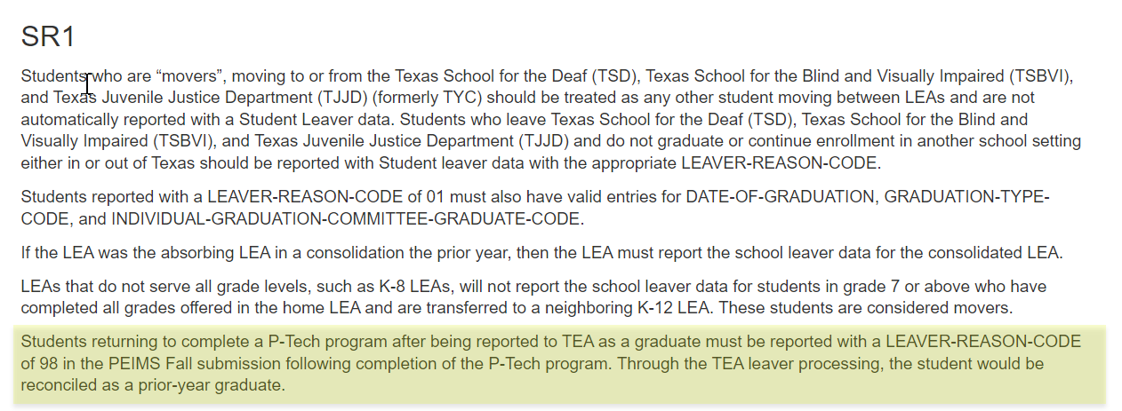
2022-2023: P-TECH CONTINUER
Updated reporting guidance for in SchoolLeaverExtension for the P-Tech continuers:

Slide 90
2022-2023: CHARTER PARTNER STAFF TYPE CODE
Overview:
TEA updated the data element definition for STAFF-TYPE-CODE (E1073) to allow LEAs to report teachers employed at an in-district charter campus by an organization that has been granted a charter under TEC Chapter 12, Subchapter C. These teachers will be reported in the PEIMS Fall submission for employment verification, and the Class Roster Winter submission for TIA purposes. TEA also updated the general reporting and data element reporting requirements for the StaffExtension complex type. Additionally, TEA added a new code to the STAFF-TYPE-CODE (C181) table. Reports and rules will be updated to include the new STAFF-TYPE-CODE.

Slide 91
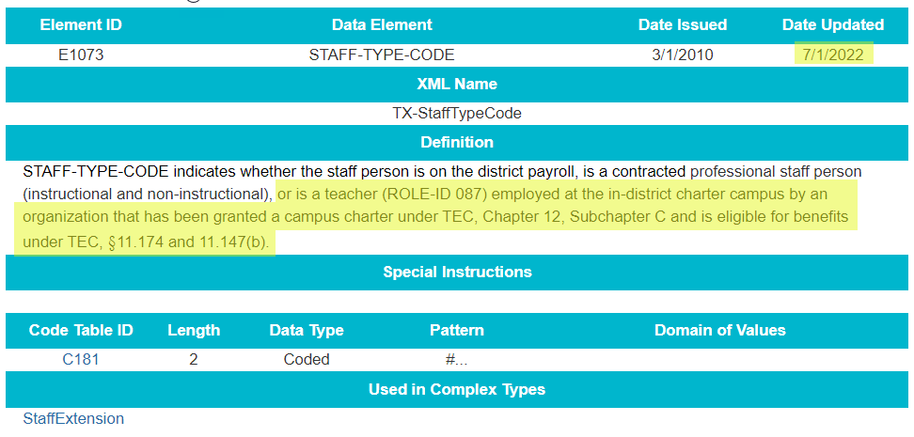
2022-2023: CHARTER PARTNER STAFF TYPE CODE DATA ELEMENTS
Revised data element definition for STAFF-TYPE-CODE (E1073).

Slide 92
2022-2023: CHARTER PARTNER STAFF TYPE CODE TABLES
Added new code to the STAFF-TYPE-CODE (C181) code table.

Slide 93
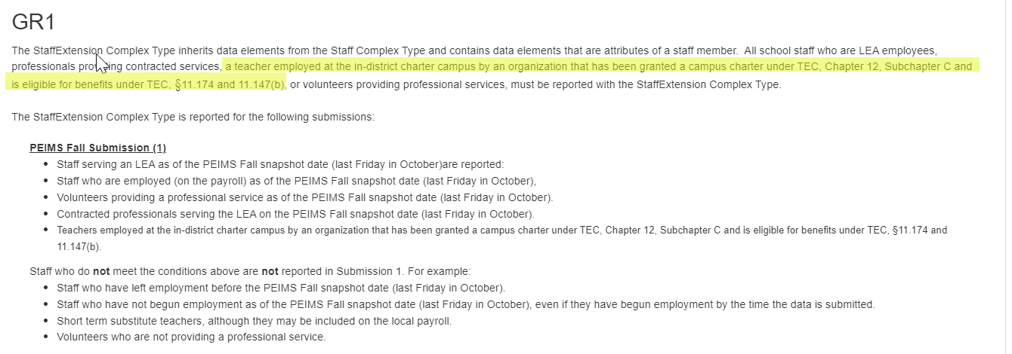
2022-2023: CHARTER PARTNER STAFF TYPE CODE GUIDANCE
Updated the General Reporting and Data Element Reporting Requirements for the StaffExtension complex type.

Slide 94
2022-2023: CHARTER PARTNER STAFF TYPE CODE GUIDANCE
Updated the General Reporting and Data Element Reporting Requirements for the StaffExtension complex type.

Slide 95
2022-2023: CHARTER PARTNER STAFF TYPE CODE GUIDANCE
Updated the General Reporting and Data Element Reporting Requirements for the StaffExtension complex type.

Slide 96
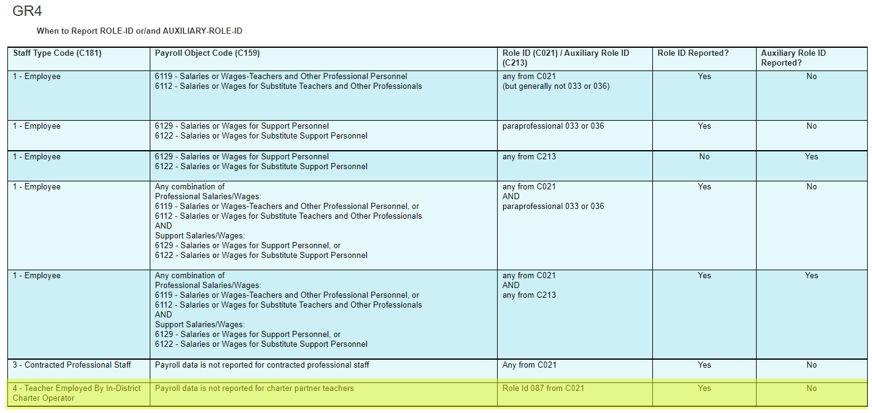
2022-2023: CHARTER PARTNER STAFF TYPE CODE GUIDANCE
Updated the General Reporting and Data Element Reporting Requirements for the StaffExtension complex type.

Slide 97
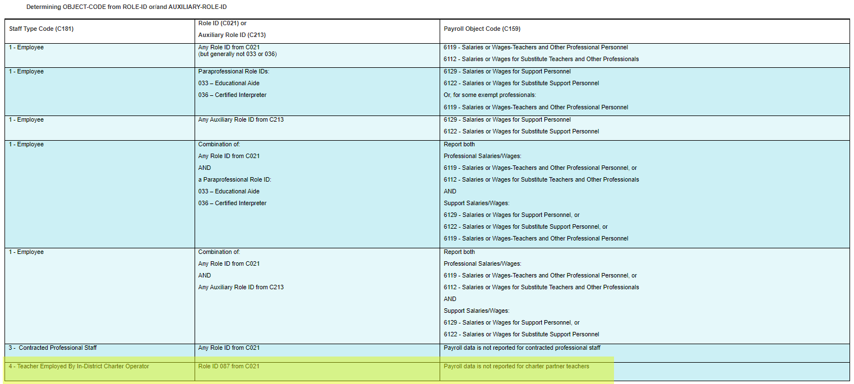
2022-2023: CHARTER PARTNER STAFF TYPE CODE GUIDANCE
Updated the General Reporting and Data Element Reporting Requirements for the StaffExtension complex type.

Slide 98
2022-2023: CHARTER PARTNER STAFF TYPE CODE GUIDANCE
Updated the General Reporting and Data Element Reporting Requirements for the StaffExtension complex type.

Slide 99
2022-2023: CHARTER PARTNER STAFF TYPE CODE GUIDANCE
Updated the General Reporting and Data Element Reporting Requirements for the StaffExtension complex type.

Slide 100
2022-2023: CHARTER PARTNER STAFF TYPE CODE REPORTS
The following TEDS reports may be updated to reflect the new code 4 when STAFF-TYPE-CODE is reported in the 2022-2023 PEIMS Fall Submission:
PDM1-110-001 –Staff Counts and Totals
PDM1-110-004 –Staff FTE Summary
PDM1-110-005 –Student and Staff Counts by Service ID
PDM1-110-006 –Staff FTE by Role
PDM1-111-001 – Individual Staff Profiles
PDM1-111-002 –Staff Roster
PDM1-111-003 –Class Size by Staff and Service ID

Slide 101
2022-2023: CHARTER PARTNER STAFF TYPE CODE BUSINESS RULES
Updated data validation rules to reflect the change for STAFF-TYPE-CODE:

Slide 102
2022-2023: GUIDANCE & REMINDERS
The CTE FTE non-flexible attendance calculation
All CTE Courses Weighted Tiers crosswalk will be used for calculating the CTE FTE and it can be located here.
For each campus, perform the following calculations for each instructional track offered at each campus, and for each of the six reporting periods and for each of the three CTE Service ID Tiers.
In order to determine tiers, add together all of the contact hours reported for any Service IDs coded as "Tier 1" in the “all CTE courses weighted tiers” spreadsheet for the reporting year: Calc Sources - CTE Tier Crosswalks. Then repeat for Tier 2 and Tier 3.
EXAMPLE SCENARIO:
Campus + track 1 + rep per 1 + CTE Tier 1
Campus + track 1 + rep per 1 + CTE Tier 2
Campus + track 1 + rep per 1 + CTE Tier 3
Campus + track 1 + rep per 2 + CTE Tier 1
Campus + track 1 + rep per 2 + CTE Tier 2
Campus + track 1 + rep per 2 + CTE Tier 3

Slide 103
2022-2023: GUIDANCE & REMINDERS
For each permutation of campus, instructional track, sixweek reporting period and CTE Service ID Tiers:
Sum all the V1 through V3 contact hours together for each track/reporting period/tier permutation.
Divide the contact hours for each track/reporting period/tier permutation by 6 times the NUMBER-DAYS-TAUGHT (E0935). Round the results to three decimal places.
CTE FTE = Total Track Contact Hours ÷ (NUMBER-DAYS-TAUGHT × 6).
Add together all tracks in each reporting period and tier for each campus.
This produces the CTE FTE for each tier, reporting period and campus.
Add together all reporting periods in each tier for each campus.
This produces the Regular/Non-Flex CTE FTE for the campus and each tier.
V1 Contact Hrs = | ELIGIBLE-DAYS-PRESENT-V1 (E0950)
V2 Contact Hrs = | ELIGIBLE-DAYS-PRESENT-V2 (E0951) | × 2
V3 Contact Hrs = | ELIGIBLE-DAYS-PRESENT-V3 (E0952) | × 3
Notes:
RA & RS attendance is calculated the same as regular In Person attendance

Slide 104
2022-2023: GUIDANCE AND REMINDERS
Service ID 13024500 is taught for 45 minutes a day and is a V1, is in a POS, and the CTE Funding Tier is 2.
Service ID 13000300 is taught for 140 minutes a day and is a V3, is in a POS, and the CTE Funding Tier is 3.
This example is for two students participating in these two courses in 1st sixweeks.
One student was absent for 5 days so their eligible days present is 25 while the other student was present for all days so their eligible days present is 30.

Slide 105
2022-2023: GUIDANCE AND REMINDERS
Calculating CTE Contact Hours
Course Service ID 13024500
Eligible Days Present Student1: 25 + Student2: 30 | 55
V1 Course Multiplier = 1 | × 1
CTE Tier 2 Contact Hours | 55

Slide 106
2022-2023: GUIDANCE AND REMINDERS
Calculating CTE Contact Hours
Course Service ID 13000300
Eligible Days Present Student1: 25 + Student2: 30 | 55
V3 Course Multiplier = 3 | × 3
CTE Tier 3 Contact Hours | 165

Slide 107
2022-2023: GUIDANCE AND REMINDERS
Calculating CTE FTE
Course Service ID 13024500
CTE Contact Hours | 55
Contact Hours ÷ (Days taught × 6 hours) | 55 ÷ (30 × 6) 55 ÷ 180 = 0.3055
Total CTE Tier 2 FTE | 0.306

Slide 108
2022-2023: GUIDANCE AND REMINDERS
Calculating CTE FTE
Course Service ID 13000300
CTE Contact Hours | 165
Contact Hours ÷ (Days taught × 6 hours) | 165 ÷ (30 × 6) 165 ÷ 180 = 0.9166
Total CTE Tier 3 FTE | 0.917

Slide 109
2022-2023: GUIDANCE & REMINDERS
AB Block Schedule Course Guidance from Student Accounting Attendance Handbook:
5.5.1 Special Instructions for Districts Operating Block Schedules
If your district operates block schedules in which class periods are not in equal length increments, use the chart above to determine the CTE code to assign to each CTE course.
Career and Technical Education 2021–2022 Student Attendance Accounting Handbook
Each CTE course must be reviewed separately to determine the average minutes per day students attend that course. Average minutes per day must be computed by reviewing a complete cycle of courses.
For example, if a course meets on even numbered days of the month, district personnel must review a two-week cycle. (One week, the course will meet on Monday, Wednesday, and Friday, and the next week, the course will meet on Tuesday and Thursday.) District personnel divide the total number of CTE minutes for the course, for a complete cycle of courses, by the total number of school days during the cycle. Once district personnel have determined average minutes, they assign the applicable code to each CTE course. They then assign all students attending that CTE course the corresponding CTE code.
CTE Course’s Average Minutes per Day | CTE Codes
45-89 | V1
90-134 | V2
135-180+ | V3

Slide 110
2022-2023: GUIDANCE & REMINDERS
AB Block Schedule Course Scenario:
A classes meet in week one on M, W, F and in week two on T, Th
B classes meet in week one on T, Th and in week two on M, W, F
Advanced Animal Science meets on A days for 90 minutes
Accounting I meets on B days for 95 minutes
The student was enrolled and present in both classes for 30 days.
Course | Week 1 Minutes | Week 2 Minutes | Total minutes for 2 week | Average minutes for two week cycle (10 days) | V Code
Adv Animal Science | 270 | 180 | 450 | 45 | V1 (45-89 minutes per day)
Accounting I | 190 | 285 | 475 | 47.5 | V1 (45-89 minutes per day)
Start Date | End Date | Service ID | Course | Section | Contact Hours | Elig Days Pres V1 | Elig Days Pres V2 | Elig Days Pres V3
8/12/2021 | 9/23/2021 | 13000700 | Adv Animal Science | 001 | 1 | 30
8/12/2021 | 9/23/2021 | 13016600 | Accounting I | 002 | 1 | 30

Slide 111
2022-2023: GUIDANCE & REMINDERS
The CTE FTE flexible attendance calculation
Campus Sixweek + Track IP REGULAR/NON-FLEX + FLEX Tier 2 Calculation
For each permutation of campus, instructional track, and sixweek reporting period in flexible attendance, perform the following calculation:
Sum all FLEX-ATTEND-TOTAL-CAREER-TECH-MINUTES-PRESENT (E1053) and divide by 60 to find the Flex contact hours.
Divide the Flex contact hours for each track/reporting period permutation by 6 times the NUMBER-DAYS-TAUGHT (E0935).
Flex CTE FTE = Total Track Flex Contact Hours ÷ (NUMBER-DAYS-TAUGHT x 6)
Add together all tracks in each reporting period for each campus. This produces the CTE FTE for each reporting period and campus
Add together all reporting periods for each campus.
This produces the IP Regular/Non-Flex + Flex CTE FTE for the campus for Tier 2.
Note: All reported flexible attendance will only be included in the IP Tier 2 calculation.

Slide 112
FREQUENTLY ASKED QUESTIONS
Does the Career and Technology Education (CTE) weighted funding impact the auto-calculation of the CTE Indicator?
No. CTE FTE calculations do not impact CTE Indicator auto-calculations.
Should the data elements ELIGIBLE-DAYSPRESENT-V1 through V3 (E0950-0952) represent attendance from the Official Attendance Time (OAT)?
Yes. ELIGIBLE-DAYS-PRESENT-V1 through V3 (E0950- 0952), including RS-ELIGIBLE-DAYS-PRESENT-V1 through V3 (E1696-1698) and RA-ELIGIBLE-DAYSPRESENT-V1 through V3 (E1702-1704) should represent attendance from the Official Attendance Time.

Slide 113
FREQUENTLY ASKED QUESTIONS
Should an LEA use the TSDS PEIMS Report, PDM3-130-002 Superintendents Report of Career and Technical Education Eligible Days, to confirm totals by tier and then multiply by the weight to determine the CTE weighted funding?
Yes, LEAs can use the TSDS PEIMS Report, PDM3-130- 002 Superintendents Report of Career and Technical Education Eligible Days, to obtain the CTE FTE for each tier
How are days reported under the CTE FTE Tier calculation after converting the FLEX-ATTENDTOTAL-CAREER-TECH-MINUTES-PRESENT (E1053) to equivalent days present?
CTE Flexible attendance is reported the same as in prior years and TEA will continue to convert the minutes to contact hours and calculate the FTE as usual.
Total FLEX-ATTEND-TOTAL-CAREER-TECH-MINUTESPRESENT / 60 = Flex CTE Contact Hours
The CTE Flexible Attendance FTE is included in the Tier 2 FTE calculation

Slide 114
FREQUENTLY ASKED QUESTIONS
Can a SERVICE-ID (C022) be in multiple programs of study? Would the tier be different, and if so, would the higher tier be used in the weighted funding calculation?
Yes. SERVICE-ID (C022) can be in more than one program of study. Each SERVICE-ID belongs to one tier and that one tier will be used in the CTE FTE tier calculation.

Slide 115
2022-2023: GUIDANCE & REMINDERS
CTE Auto-calculation guide Documentation: https://www.texasstudentdatasystem.org/tsds/education-data-warehouse/peims-calculations-tech-tips
Identify the student population to evaluate for the Summer CTE calculation.
Include all students who: completed one or more courses (of any kind—not necessarily CTE) in grades 6 –12 in the current year’s PEIMS SUMR data OR
did not have course completion data in SUMR but were in attendance at any time in the current school year.
Identify any students who do not have any Course Sequence Code of 0, 2, 5, 9, D0, D2, D5,or D9 for any CTE Service ID. Students without the specified course sequence codes are assigned a CTE value of “4”.
Notes:
Mention that we can’t close resubmission until after Year-Rounds schools complete which is why the report is not available in resubmission at this time. Run the PDM3-404-002 & 003 in 1st submission until we close resubmission.

Slide 116
2022-2023: TIMELINE (FALL)
PEIMS Fall Submission (Sub 1)
TSDS PEIMS ready to load data to eDM | August 1, 2022
PEIMS Fall submission ready for users to promote data | September 12, 2022
Close of school-start window - Last Friday in September | September 30, 2022
PEIMS Fall snapshot date | October 28, 2022
TSDS PEIMS Fall ready for users to complete, approve, and accept submissions | October 31, 2022
Requests to retire Unique IDs due at TEA for PEIMS Fall first submission | December 2, 2022
PEIMS Fall first submission due date for LEAs and ESCs | December 8, 2022
Requests to retire Unique IDs due at TEA for PEIMS Fall resubmission | January 13, 2023
PEIMS Fall resubmission due date for LEAs and ESCs | January 19, 2023

Slide 117
2022-2023: TIMELINE (MID-YEAR)
PEIMS Mid-Year Submission (Sub 2)
PEIMS Mid-Year submission ready for users to promote data | November 14, 2022
TSDS PEIMS Mid-Year ready for users to complete, approve, and accept submissions | December 19, 2022
PEIMS Mid-Year first submission due date for LEAs and ESCs | January 26, 2023
PEIMS Mid-Year resubmission due date for LEAs and ESCs | February 9, 2023

Slide 118
2022-2023: TIMELINE (SUMMER)
PEIMS Summer Submission (Sub 3)
PEIMS Summer submission ready for users to promote data | February 27, 2023
TSDS PEIMS Summer ready for users to complete, approve, and accept submissions | May 15, 2023
Requests to retire Unique IDs due at TEA for PEIMS Summer first submission | June 9, 2023
PEIMS Summer first submission due date for LEAs | June 15, 2023
Requests to retire Unique IDs due at TEA for PEIMS Summer resubmission | July 14, 2023
PEIMS Summer resubmission due date for LEAs LEAs registered with TEA with year-round tracks ending later than June 15, 2023 may delay PEIMS Summer resubmission until two weeks following completion of the latest year-round track or August 17, 2023, whichever comes first. However, the initial data delivery for submission 3 must still be made by June 15, 2023, for all LEAs. In no case will any resubmission be processed after August 17, 2023. Data corrections made after August 17, 2023 will be processed by State Funding. | July 20, 2023

Slide 119
2022-2023: TIMELINE (EXTENDED YEAR)
PEIMS Extended Year Submission (Sub 4) if applicable
PEIMS Extended Year submission ready for users to promote data | March 27, 2023
TSDS PEIMS Extended Year ready for users to complete, approve, and accept submissions | July 31, 2023
Requests to retire Unique IDs due at TEA for PEIMS Extended Year first submission | August 18, 2023
PEIMS Extended Year first submission due date for LEAs | August 31, 2023
Requests to retire Unique IDs due at TEA for PEIMS Extended Year resubmission | September 8, 2023
PEIMS Extended Year resubmission due date for LEAs | September 21, 2023

Slide 120
TECHNICAL RESOURCES
Technical Specifications
TSDS Web-Enabled Data Standards (TWEDS)​
Technical Support
TSDSCustomerSupport@tea.texas.gov

Slide 121
Questions

