Slide 1
TITLE SLIDE: TSDS ODS 3.x Project Updates
TSDS ODS 3.x PROJECT UPDATES FOR VENDORS
August 4, 2022

Slide 2
SESSION AGENDA
PROJECT UPDATE
Purpose & Project Extension
PROJECT TIMELINE
Pilot Program & Milestones
Parallel Submission & Go-Live
PROJECT ARCHITECTURE
Diagram & Components
ODS & Key Changes
UPCOMING EVENTS
Software Development Kit (SDK)
Vendor Communications & Support
CLOSEOUT
Key Takeaways & FAQs

Slide 3
OFFICE OF INFORMATION TECHNOLOGY
Customer Relationship Management & Data Standards Department
Information Technology
A multi-year initiative to upgrade the Operational Data Store (ODS) and Texas Education Data Standards (TEDS) to a current version of Ed-FI.

Slide 4
PROJECT TIMELINE EXTENSION
Announced on May 18, 2022
RATIONAL & REASONING
PILOT PROGRAM
Extending provides a more extensive End-to-End testing period for LEAs to validate their vendor product solutions.
TECHNOLOGY & ARCHITECTURE
Extending allows TEA to have ownership of the architecture and control in developing application(s) to meet LEA needs.
VENDOR READINESS
Extending grants vendors more time to develop their solution(s) in ensuring readiness for parallel submission.

Slide 5
LEA COMMUNICATIONS
Published To the Administrator Addressed (TAA) on September 30, 2021
Published To the Administrator Addressed (TAA) on May 19, 2022

Slide 6
PROJECT TIMELINE
Pilot
Parallel
Go Live
September 2021 – August 2023
Optional: TSDS vendors can participate in pilot program to develop and test their product solutions.
Optional: LEAs can partner with their vendors to conduct end-to-end testing in preparation to parallel year.
August 2023 – August 2024
Required: All TSDS vendors test their product solutions.
Optional: LEAs will submit both API transactions and XML submissions and compare results to ensure vendor readiness.
August 2024 – August 2025
Required: All LEAs will submit their TSDS official data through API transactions.
XML submissions no longer accepted for TSDS.
EXTENDED

Slide 7
2021-2023: PILOT PROGRAM
2021-2022: Cohort of six (6) vendors conducted initial vetting of the integration and data out phases.
Software Development Kit (SDK) was provided to all vendors.
2022-2023: Pilot program will continue for any interested vendor.
LEAs and ESCs will begin End-to-End testing starting in January 2023.
Extended into 2022-2023
January - August 2023
Integration
Data Output
End-to-End
PEIMS Fall
Child Find
Class Roster
September 2022: Online form available for LEAs to submit their interest in the pilot program.

Slide 8
PILOT PROGRAM: KEY MILESTONES
SEPTEMBER 2022
2022-2023 SDK Released
Vendor Coordination Resumes
JANUARY 2023
Parallel Environment
PEIMS Fall, Class Roster, Child Find
JULY 2023
LEA Analysis & Feedback
Training & Resource Updates
OCTOBER 2022
Hosted Staging Environment
LATE WINTER 2023
Initial LEA/ESC Training
RESOURCES
ESC/LEA KICKOFF
START END-TO-END
PILOT TRAINING
STOP END-TO-END
AUGUST 2022
TEDS Post-Addendum
Pilot Vendor Cohort
DECEMBER 2022
System Configuration
Guidance & Process for Testing
SPRING 2023
Advanced LEA/ESC Training
Continuous & On-Demand

Slide 9
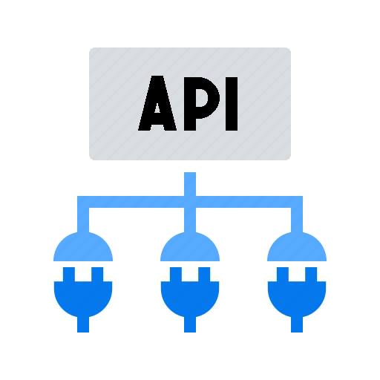
2023-2024: PARALLEL SUBMISSION
REQUIRED For All Vendors
OPTIONAL For LEAs & ESCs
LEAs will compare XML data against API transactions through TSDS reports and validations.
All TSDS submissions are expected to be compared by the submission due dates.
XML data will be used for official TSDS reporting.
LEAs will be nominated, selected, and approved to participate
in the parallel submission. Recommending 250+ LEAs.

Slide 10
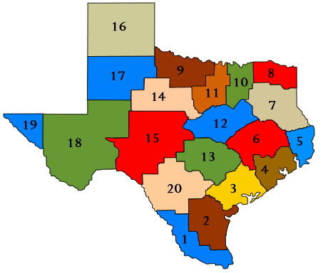
2024-2025: GO-LIVE
REQUIRED For All Vendors
REQUIRED For All LEAs & ESCs
Only API transactions will be accepted for TSDS
XML data loads will not be available or permitted
Training & support based upon API transactions

Slide 11
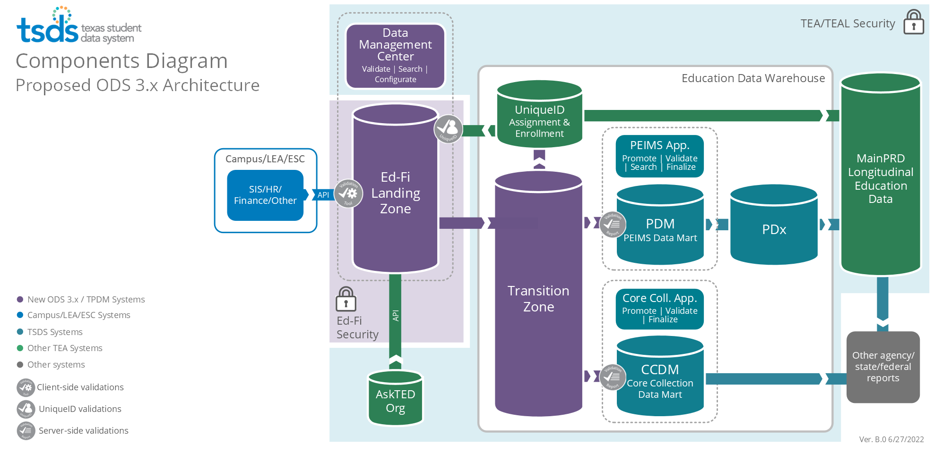
UPDATED ARCHITECTURE

Slide 12
UPDATED ARCHITECTURE
Data
Landing Zone
Each LEA will be provided a local Ed-Fi Operational Data Store (ODS)
Source system vendors will publish data via API transactions at near real-time

Slide 13
UPDATED ARCHITECTURE
Application
LEAs will be able to view data loads and run validations on local ODS data.
Data

Slide 14
UPDATED ARCHITECTURE
Data
Transition Zone
TEA will automatically retrieve data from Landing Zone
Data will be filtered to ensure only TSDS mandated data is loaded to Transition Zone
LEAs will promote and complete submissions as they do now

Slide 15
OPERATIONAL DATA STORE (ODS)
Each LEA will be provided an Ed-Fi Operational Data Store (ODS) to utilize for state reporting and local use. LEAs will need to provide security credentials to vendors through the Data Management Center for API transactions.
Source system vendors will publish transactional data to an LEA’s Ed-Fi ODS irrespective of specific TSDS data submissions along with appropriate effective dating.
Additional data can be published beyond the reporting requirements of TSDS for an LEA’s local use.
LEAs will be able to verify and validate API transactional data in the Data Management Center.
Logic will be implemented in the LEA’s Landing Zone to ensure only the TSDS state mandated data is reported to TEA’s Transition Zone (ODS) and utilized for TSDS data submissions.

Slide 16
KEY CHANGES TO DATA COLLECTION
Attendance
1. Granular negative attendance by student which will eliminate the requirement for SIS vendors to calculate attendance by six-weeks.
2. Cumulative attendance by six-weeks by student (no change from the way attendance is currently collected).
Enrollment
TEA plans to collect attendance data two ways in the 2024-2025 (Go-Live) school year:
Enrollment and withdrawal data will be collected at the student level through source system vendor API transactions to the LEA’s ODS.
This data will be automatically loaded to the Unique ID Enrollment Tracking application. LEAs will no longer need to load this data in the Unique ID system directly.
Note: TEA will discontinue collecting cumulative attendance after confirming attendance calculations in future year(s) beyond 2024-2025.

Slide 17
WHAT IS REMAINING THE SAME?
All processes that occur from the Transition Zone (ODS) to the data mart will remain as-is.
Reports and business rule validations will remain in downstream TSDS applications.
TEAL will continue to be utilized for authentication.
Unique ID application will continue to be utilized for assignment for staff and students.
TSDS Web-Enabled Data Standards (TWEDS) will continue to be utilized to provide specifications and guidance.

Slide 18
SOFTWARE DEVELOPMENT KIT (SDK)
PURPOSE
The SDK will provide vendors with a fully functional set of EdFi ODS, WebApi, Swagger, and
TECHNICAL APPROACH
TEA will create a “Docker Compose File” that will create all the required containers for all the
components in a local system running a Docker engine. All container images referenced in the
Docker Compose File will be owned and managed by TEA.
The ODS and WebApi will contain all the TEA defined extensions, as well as will come with
pre-populated TEA Descriptors, Education Organizations (ESCs, LEAs, and Campuses), and
Courses.
Admin App that can be easily installed in their local systems for development purposes.

Slide 19
SDK: KEY CHANGES & DIFFERENCES
MS SQL Server Express instead of PostgreSQL
API mode is “DistrictSpecific” instead of ShareInstance
Admin App will be included
Create more ODSs for different districts
Configure claim-sets
Dependency on Docker
Texas extensions and pre-populated data
ODS and API versions
What will be different?
What remains the same?

Slide 20
SDK: DEMONSTRATION
Ed-Fi Admin App
Create ODS Instances
Manage Claim Sets
Create Key/Secrets
List Descriptors
District user
Software Development Kit
Run Docker Compose File
Show containers in Docker Desktop
Open API and Swagger in the browser
Login to Swagger
Query Pre-loaded data
DEMO
TIME

Slide 21
VENDOR COMMUNICATIONS & SUPPORT
Statewide Vendor Webinars
TEA will resume the statewide webinars for all vendors starting in September 2022.
Meeting invitations for our next webinar will be sent to our vendor distribution list in August 2022.
Please contact the following mailbox to be added to the distribution list:
TSDSDeployment@tea.Texas.gov
Vendor Coordination
TEA is still in the process of hiring a dedicated TSDS ODS 3.x vendor coordinator.
Support guidance and process will be provided during the statewide vendor webinar in September 2022.
Pilot vendors can continue to utilize the Microsoft TEAMS channels previously established.

Slide 22
KEY TAKEAWAYS
2021-2023 Pilot Program (extended)
2023-2024 Parallel Year
2024-2025 Go-Live
Any interested vendor can join the optional pilot program being extended into the 2022-2023 school year.
The Software Development Kit (SDK) for 2022-2023 will be provided in September 2022.
Partner LEAs will be able to test in TEA’s parallel environment in starting in January 2023.
PILOT END-TO-END TESTING
Vendors will need to partner with LEAs to complete end-to-end testing.
TEA will coordinate with vendors to ensure product readiness and support capacity.
Vendors will need to provide any necessary training on their product solutions.
TEA will provide training and support to LEAs and ESCs on the TEA environments and applications.

Slide 23
FREQUENTLY ASKED QUESTIONS
Can vendors join pilot program in 2022-2023 if they were not a pilot vendor in 2021-2022?
Yes. The pilot program is open to any interested vendor, regardless if they were a pilot vendor last year. TEA strongly encourages vendors to participate in this optional opportunity.
Vendors do not need to meet any criteria requirements to be accepted. Please contact TSDSDeployment@tea.texas.gov for any questions or to be added to the pilot program for 2022-2023.

Slide 24
FREQUENTLY ASKED QUESTIONS
What TEDS publication will the upcoming SDK be built upon?
The Software Development Kit (SDK) scheduled to be released in September 2022 will be built upon the ODS 3.x TEDS post addendum published on August 1, 2022.
TEA will continue to release additional SDK updates, as necessary, based upon any TEDS changes or vendor feedback.

Slide 25
FREQUENTLY ASKED QUESTIONS
What support and assistance is available to vendors now?
While TEA is still in the process of hiring a dedicated TSDS ODS 3.x Vendor Coordinator, vendors can still reach out to TSDSDeployment@tea.texas.gov for assistance.
Pilot vendors with previously established Microsoft TEAMS channels can also utilize that platform to reach out with any questions.
TEA will be establishing a new support process for all vendors in the coming months. Information and guidance will be shared during the upcoming vendor webinar expected in September 2022.

Slide 26
FREQUENTLY ASKED QUESTIONS
How do pilot vendors prepare for End-to-End testing by LEAs?
TEA will be providing additional guidance and support regarding End-to-End testing in the coming months through the scheduled statewide vendor webinars.
Pilot vendors will need to plan for any necessary documentation and/or training that an LEA partner will need in order to integrate and utilize their product solution(s).
TEA will assist pilot vendors and partner LEAs with the applicable security credentials needed to publish data needed for End-to-End testing.

Slide 27
QUESTIONS

