Slide 1
Census Block Group Tools

Slide 2
PLEASE NOTE:
The focus of this presentation is on the changes for the official XML data submissions during the 2022-2023 school year.

Slide 3
AGENDA
Census Block Group Tools
Program Area Updates & Guidance
2022-2023 Changes
Application Updates
Data Element Updates
Report Updates
Business Rule Updates
Code Table Updates
Reminders
Timeline
Frequently Asked Questions
Technical Resources
Questions

Slide 4
PROGRAM AREA UPDATES & GUIDANCE
Census Block Tier Mapping for 2023:
What is the American Community Survey (ACS) and how does it relate to LEAs?
Will the Census Block Group IDs be based on 2020 Census data?
The Census’ 2016-2020 American Community Survey data has not been released. The tentative release date is March 31, 2022.

Slide 5
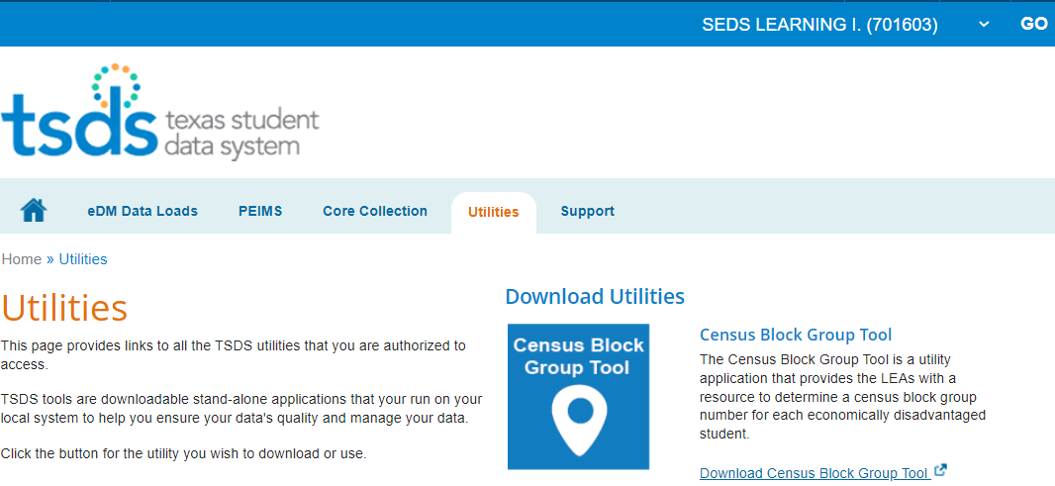
2022-2023: APPLICATION UPDATES
Census Block Group Tool
Available as a downloadable utility for the 2022-2023 school year.

Slide 6
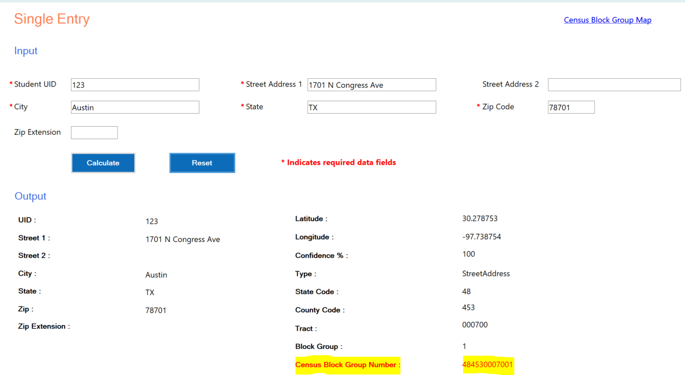
2022-2023: APPLICATION UPDATES - Continued
Census Block Group Tool
Obtain the Census Block Group Number for an individual student.

Slide 7
2022-2023: APPLICATION UPDATES – Continued 2
Census Block Group Tool
Access with the ‘Census Block Group Tool (CBGT)’ privilege under the following TEAL Roles:
PEIMS Data Completer
ODS Data Loader
ODS Campus Data Loader
Users that have the existing TEAL roles above will not need to request the ‘Census Block Group Tool (CBGT)’ privilege. It will be granted automatically prior to the start of the 2022-2023 school year.

Slide 8
2022-2023: APPLICATION UPDATES – Continued 3
Census Block Group Tool
Obtain the Census Block Group Number for multiple students by uploading a .csv file with the students’ address information.
File naming convention:
Example: 701603_999_CCYYCBGT_CCYYMMDDHHMM_CensusBlockGroupToolFile.csv
Position | 1-6 | 7 | 8-10 | 11 | 12-20 | 21 | 22-33 | 34 | 35
Description | District Code | _ | Campus ID | _ | Collection Code | _ | Timestamp | _ | Interchange

Slide 9
2022-2023 DATA ELEMENT UPDATES
2022-2023
No New Data Elements
No Updated Data Elements
No Deleted Data Elements

Slide 10
2022-2023 REPORT UPDATES
2022-2023
No New Reports
No Updated Reports
No Deleted Reports

Slide 11
2022-2023 BUSINESS RULES UPDATES
2022-2023
No New Business Rules
No Updated Business Rules
No Deleted Business Rules

Slide 12
2022-2023 CODE TABLE UPDATES
2022-2023
No New Code Tables
No Updated Code Tables
No Deleted Code Tables

Slide 13
2022-2023 REMINDERS
The census block group number is collected in the PEIMS Fall submission on the StudentExtension complex type

Slide 14
2022-2023 TIMELINE
PEIMS Fall Submission (Sub 1) | Date
TSDS ready to load data to eDM | August 1, 2022
PEIMS Fall submission ready for users to promote data | September 12, 2022
Close of school-start window - Last Friday in September | September 30, 2022
PEIMS Fall snapshot date | October 28, 2022
TSDS PEIMS Fall ready for users to complete, approve, and accept submissions | October 31, 2022
PEIMS Fall first submission due date for LEAs and ESCs | December 8, 2022
PEIMS Fall resubmission due date for LEAs and ESC | January 19, 2023

Slide 15
FREQUENTLY ASKED QUESTIONS
Will the existing Census Block Group Calculator spreadsheet be replaced by this new Census Block Group Tool application?
LEAs will use the downloadable TSDS Census Block Calculator Tool to obtain their Student Census Block Group numbers. The Census Block Group Calculator spreadsheet that is currently available on the TEA Census Block Group Tools website will be removed.

Slide 16
FREQUENTLY ASKED QUESTIONS - Continued
Will there be training provided on the new Census Block Group Tool application prior to the start of the 2022-2023 school year?
Yes. LEAs will be provided training through an e-learning module provided by the TSDS Training team on how to use the new Census Block Calculator Tool. Please refer to upcoming FCN communications on training details.

Slide 17
TECHNICAL RESOURCES
Technical Support:​
TSDSCustomerSupport@tea.texas.gov ​
Instructions/Documentation:
Census Block Group Tools
Knowledge Base Articles:
TSDSKB-595 Census Block Group Number Information / FAQs

Slide 18
Questions

