Slide 1
TEXAS RECORDS EXCHANGE (TREx) UPDATE

Slide 2
AGENDA
Texas Records Exchange (TREx) Updates
2021-2022 Changes
Data Element Updates
Code Table Updates
Known Issues
2022-2023 Changes
Data Element Updates
Code Table Updates
Current Known Issues
Frequently Asked Questions

Slide 3
2021-2022: DATA ELEMENT UPDATES
Updated Data Elements
AT-RISK-INDICATOR-CODE (TE008)
Limited English Proficient – English Learner Terminology
Elements TE057, TE037 and TE009
FOSTER-CARE-INDICATOR-CODE (TE100)

Slide 4
AT-RISK-INDICATOR-CODE: DATA ELEMENT
AT-RISK-INDICATOR-CODE (TE008)
House Bill 572
TEC §29.081(d)
87th Texas Legislative session added a new reason for students to be considered at-risk of not meeting standards or dropping out of school. A student under 26 years of age and who is enrolled in a school district or open-enrollment charter school, or campus of a school district or open-enrollment charter school designated as a dropout recovery school under TEC §39.0548 should now be considered at-risk.
Updated made to element definition #15

Slide 5
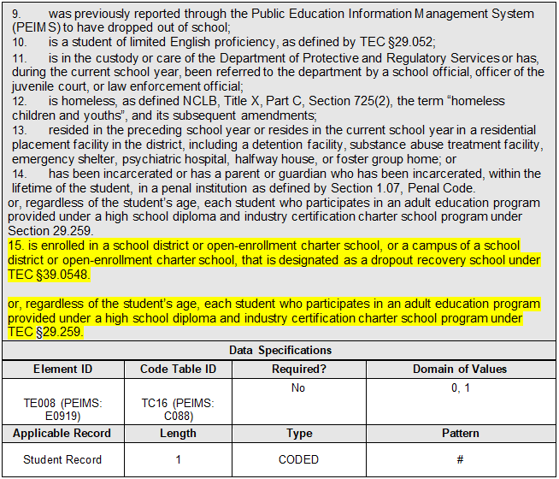
AT-RISK-INDICATOR-CODE: DATA ELEMENT Continued

Slide 6
LIMITED ENGLISH PROFICIENT-ENGLISH LEARNER
Senate Bill 2066
The 87th Texas Legislative session amended Texas Education Code (TEC) §29.060(a) and (d) and §29.066(a) and (b), to replace the term, “limited English proficient (LEP)” with “emergent bilingual (EB)”
Updated data elements and supporting code tables

Slide 7
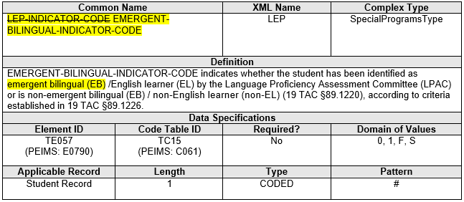
LIMITED ENGLISH PROFICIENT-ENGLISH LEARNER Continued
Element Name and Definition
LEP-INDICATOR-CODE to EMERGENT-BILINGUAL-INDICATOR-CODE (TE057)

Slide 8
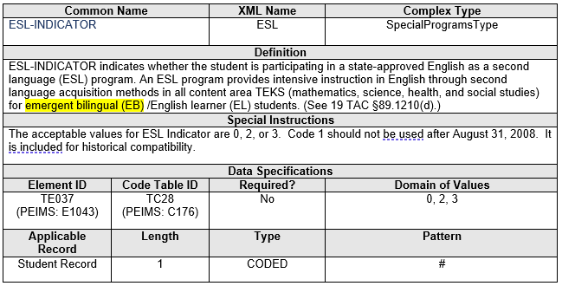
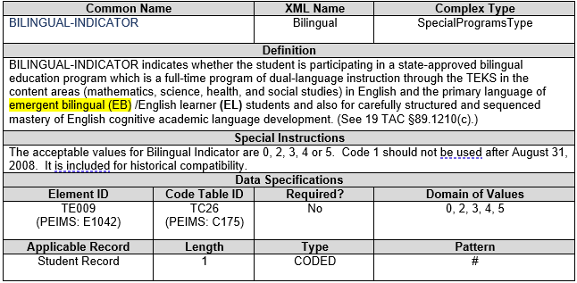
LIMITED ENGLISH PROFICIENT- ENGLISH LEARNER Continued - 2
Element Definition
ESL-INDICATOR (TE037)
Element Definition
BILINGUAL-INDICATOR (TE009)

Slide 9
FOSTER CARE UPDATES
FOSTER-CARE-INDICATOR-CODE (TE100)
House Bill 725
The 87th Texas Legislative session, amended TEC, §29.153(b) to add prekindergarten eligibility for Texas children who are currently or were previously in foster care in another state or territory, if the child resides in this state (Texas).
Updated data element and supporting code table

Slide 10
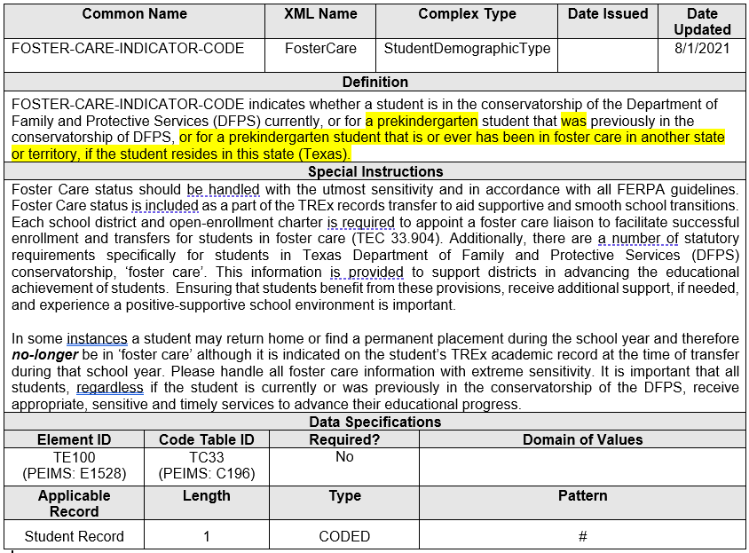
FOSTER CARE UPDATES Continued
Update the data element definition for FOSTER-CARE-INDICATOR-CODE (TE100).

Slide 11
2021-2022: CODE TABLE CHANGES
Updated Code Tables
ESL-PROGRAM-TYPE-CODE (TC28)
BILINGUAL-PROGRAM-TYPE-CODE (TC26)
FOSTER-CARE-INDICATOR-CODE (TC33)
CAREER-TECH-ED-INDICATOR (CTE) (TC03)
CRISIS-CODES (TC45)
DICIPLINARY-ACTION-REASON (TC07)

Slide 12
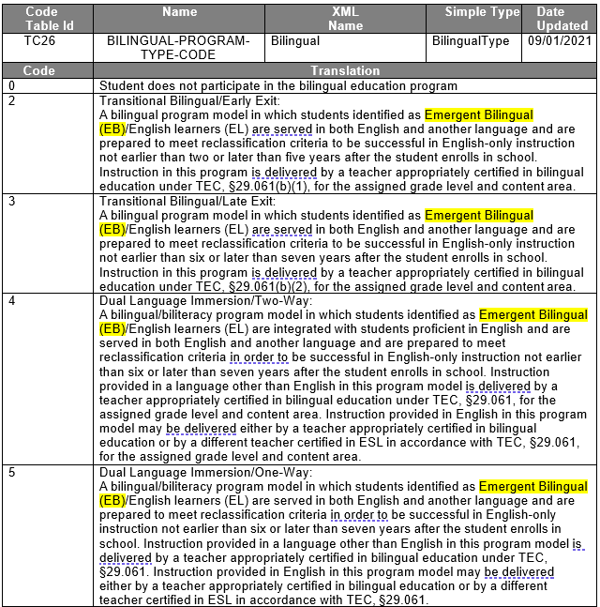
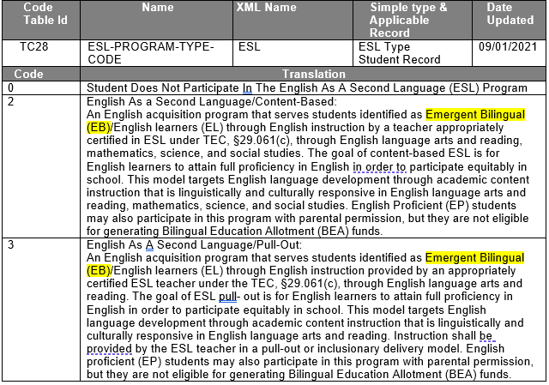
LIMITED ENGLISH PROFICIENT- ENGLISH LEARNER
Updated Code Table Translations
ESL-PROGRAM-TYPE-CODE (TC28)
Updated Code Table Translations
BILINGUAL-PROGRAM-TYPE-CODE (TC26)

Slide 13
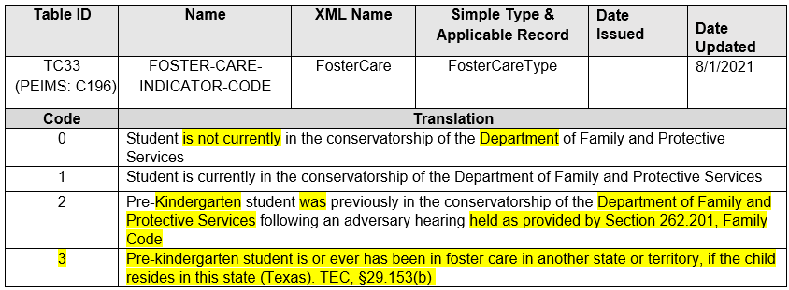
FOSTER CARE UPDATE
Added a new code to FOSTER-CARE-INDICATOR-CODE (TC33) code table and update code translations to match the C196 code table.

Slide 14
CAREER-TECH-ED-INDICATOR (CTE)
CAREER-TECH-ED-INDICATOR (CTE) (TC03)
Updated translation for Code 5 – CTE Participant to match PEIMS.

Slide 15
CAREER-TECH-ED-INDICATOR (CTE) Continued

Slide 16
CRISIS CODES
Added two new codes to the to the CRISIS-CODE (TC45) to provide information on students that were enrolled, not in membership due to virtual learning on January 14, 2022, and May 13, 2022.
Removed code 10.

Slide 17
TSDS STUDENT DISCIPLINE
DISCIPLINARY-ACTION-REASON (TC07)
House Bill 375
The 87th Texas Legislature passed House Bill 375 that updated the reference to §21.02, Penal Code found in §37.007(a), Education Code, to clarify a person who engages in an offense against a disabled individual as defined in §21.02(a)(2), Penal Code, shall be expelled.
Updated the Penal Code reference

Slide 18
TSDS STUDENT DISCIPLINE Continued
Updated code translation “57” in DISCIPLINARY-ACTION-REASON (TC07) code table.

Slide 19
2022-2023

Slide 20
2022-2023: DATA ELEMENT CHANGES
Updated Data Elements
PK-ELIGIBLE-PREVIOUS-YEAR-INDICATOR-CODE (TE138)
POST-SECONDARY-CERTIFICATION-LICENSURE-EARNED (TE133)
PERSONAL-GRADUATION-PLAN (TE063)
Added New Element
POST-SECONDARY-CERTIFICATION-LICENSURE-RESULT (TE142)

Slide 21
PK-ELIGIBLE-PREVIOUS-YEAR-INDICATOR-CODE
PK-ELIGIBLE-PREVIOUS-YEAR-INDICATOR-CODE (TE138).
The definition for the data element, PK-ELIGIBLE-PREVIOUS-YEAR-INDICATOR-CODE (TE138), indicated it was to be used only for four-year-old students. TREx updated the data element definition to include five-year-old students as eligible for prekindergarten if a parent chooses to retain the student.
Updated Data Element

Slide 22
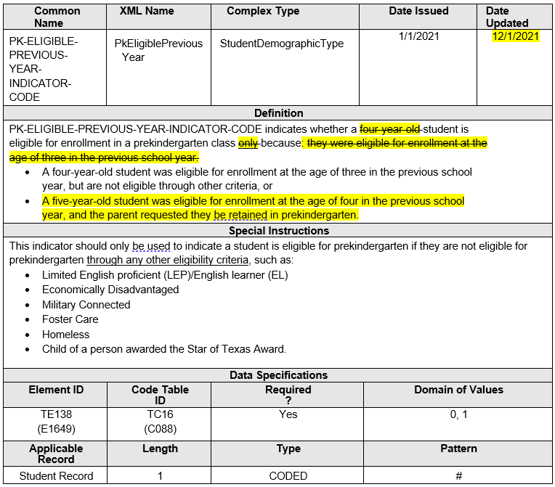
PK-ELIGIBLE-PREVIOUS-YEAR-INDICATOR-CODE Continued
Updated data element PK-ELIGIBLE-PREVIOUS-YEAR-INDICATOR-CODE (TE138) definition.

Slide 23
IBC UPDATES AND EXAM RESULTS
TEA must collect and report information for those students who fail to pass an IBC exam. To align with PEIMS, TREx added one new data element, POST-SECONDARY-LICENSURE-RESULT (TE142), with a corresponding code table, POST-SECONDARY-LICENSURE-RESULT-CODE (TC47). The data element definition for POST-SECONDARY-LICENSURE-CERTIFICATION-CODE (TE133) was updated from indicating an exam earned by a student to an exam taken by a student.
Changed the data element name POST-SECONDARY-CERTIFICATION-LICENSURE-EARNED (TE133) to POST-SECONDARY-CERTIFICATION-LICENSURE-CODE.
Added new data element POST-SECONDARY-CERTIFICATION-LICENSURE-RESULT (TE142).
Added new code table POST-SECONDARY-CERTIFICATION-LICENSURE-RESULT-CODE (TC47).

Slide 24
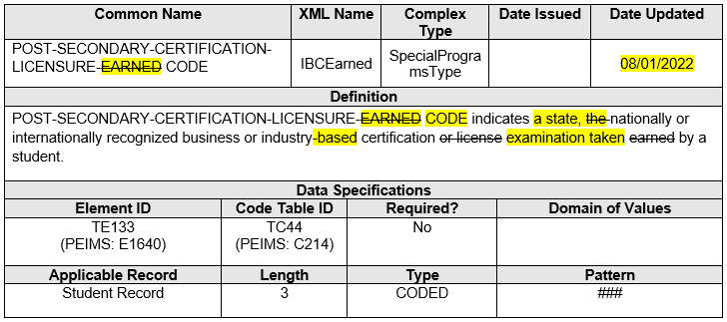
POST-SECONDARY-CERTIFICATION-LICENSURE-CODE
Changed the data element name POST-SECONDARY-CERTIFICATION-LICENSURE-EARNED (TE133) to POST-SECONDARY-CERTIFICATION-LICENSURE-CODE.

Slide 25
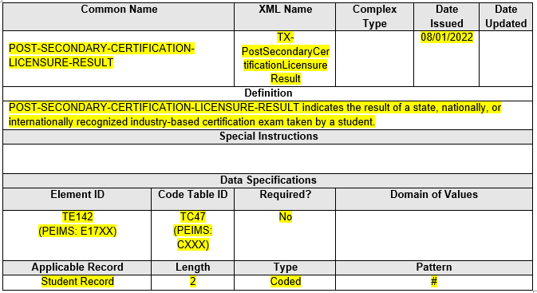
POST-SECONDARY-CERTIFICATION-LICENSURE-RESULT
Added new data element POST-SECONDARY-CERTIFICATION-LICENSURE-RESULT (TE142).

Slide 26
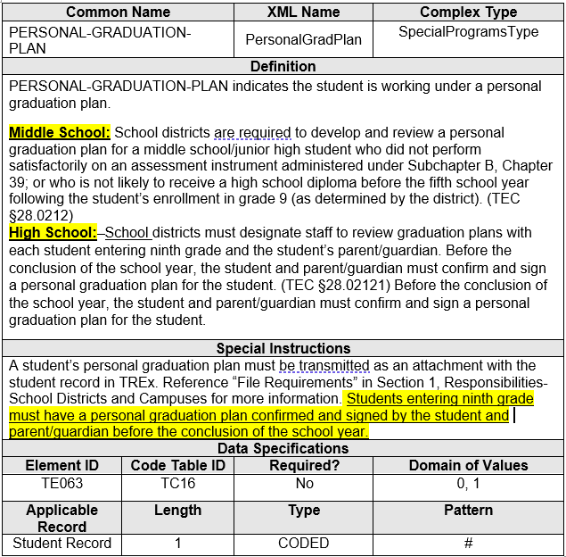
PERSONAL-GRADUATION-PLAN
Updated data element Definition and Special Instructions for PERSONAL-GRADUATION-PLAN (TE063)

Slide 27
2022-2023: CODE TABLE CHANGES
Updated Code Tables
POST-SECONDARY-CERTIFICATION-LICENSURE-RESULT-CODE (TC47)
FINANCIAL-AID- APPLICATION-CODE (TC46)

Slide 28
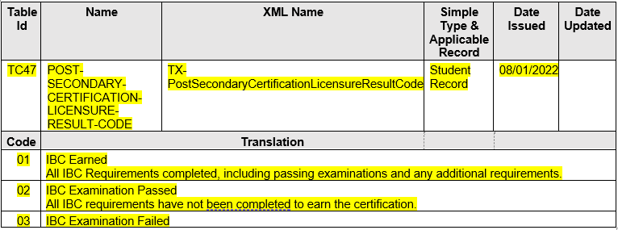
POST-SECONDARY-CERTIFICATION-LICENSURE-RESULT-CODE
Added new code table POST-SECONDARY-CERTIFICATION-LICENSURE-RESULT-CODE (TC47).

Slide 29
FINANCIAL-AID- APPLICATION-CODE
FINANCIAL-AID- APPLICATION-CODE (TC46)
The Curriculum Standards and Student Support division determined that the code “02” translation needed further clarification.
Updated Code Table

Slide 30
FINANCIAL-AID- APPLICATION-CODE Continued
Updated code “02” to “Exception submitted/Opt-Out” for the 2022-2023 school year.

Slide 31
FREQUENTLY ASKED QUESTIONS
Crisis Codes 10A, 10B added to TREx
Question: Do districts need to report previous years’ Crisis Codes?
Answer: Districts need to report current year Crisis Codes. Prior year Crisis Codes remain in the data standards if an LEA wants to send the Crisis Code to a new district. It is not required to send prior year Crisis Codes but can be optionally sent.
TREx Publication
Question: When will the TREx Data Standards be published?
Answer: The TREx Data Standards will be published in August 2022.

Slide 32
TEXAS RECORDS EXCHANGE (TREx)
Portal Demo

Slide 33
Questions

