Slide 1
Additional Days School Year Overview August 3, 2022

Slide 2
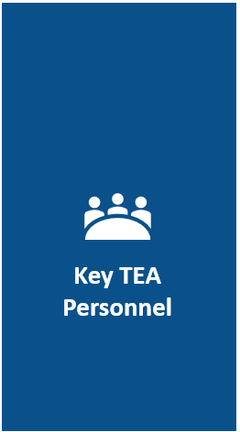
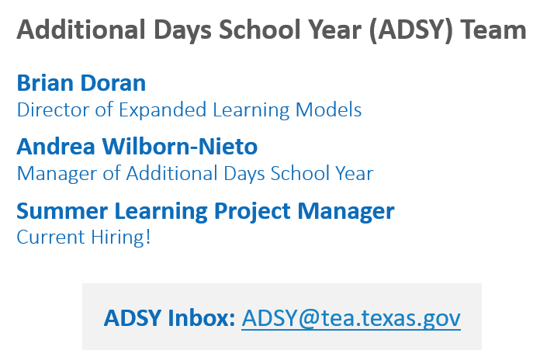
Key TEA Personnel

Slide 3
Agenda
Additional Days School Year Overview
Design Considerations
Option 1: Volunteer Summer Learning
Option 2: Intersessional Calendar
Option 3: Full Year Redesign
ADSY Planning and Execution Program
Budgeting Considerations
Observed and Anticipated Implementation
Q&A

Slide 4
Declining Achievement During Summer Breaks
Student achievement levels drop during the summer months, commonly referred to as the “summer slide”.

Slide 5
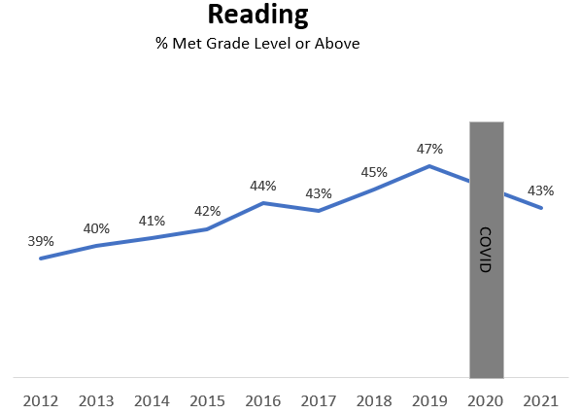
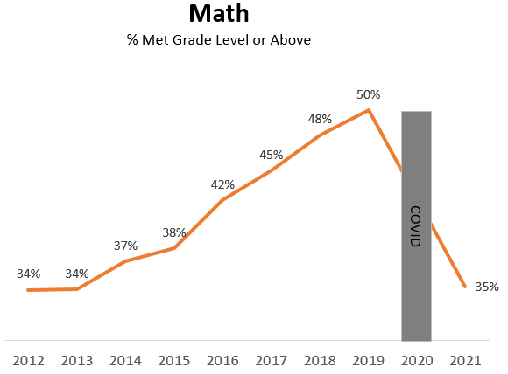
COVID-19 Erased Years of Academic Gains

Slide 6
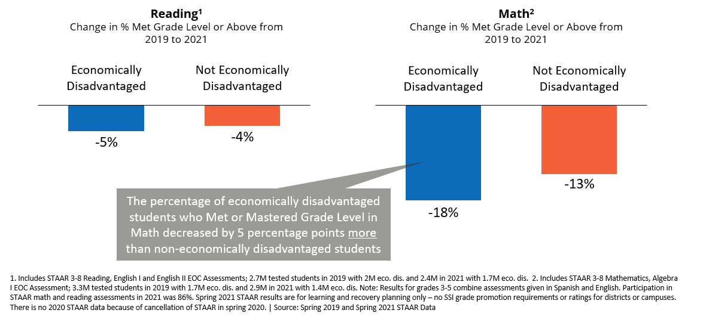
Economically disadvantaged students experienced greater learning loss in both reading and math

Slide 7
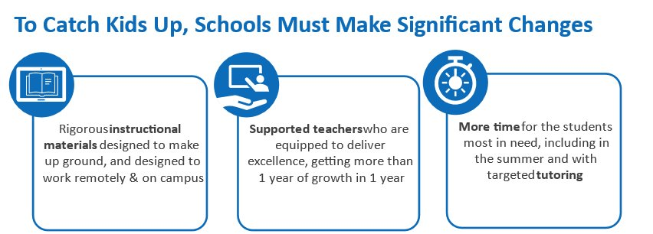
The Additional Days School Year program is a key resource for COVID response

Slide 8
Additional Days School Year (ADSY)
HB 3 added half-day formula funding for school systems that want to
add instructional days (beyond a minimum 180 days, up to 210 days)
to any of their elementary schools (grades PK-5).
Minimum 180 Instructional Days
Up to 30 Additional Days
Half-day formula funding

Slide 9
ADSY Eligibility
Serve at least one grade level within grades PreK-5
Ensure the campus academic calendar will have at least 180 instructional days, not including staff development waivers; ideal calendars also have two bad-weather make-up days identified
Have a campus academic calendar with at least 75,600 operational minutes
Be willing to add up to 30 additional half days of instruction (ADSY days) to the 180 instructional days in a campus’s academic calendar
Have a certified teacher deliver at least two hours of instruction on dedicated ADSY days
Host ADSY days on separate days from regular instructional calendar days

Slide 10
ADSY Design Considerations
Option 1: Summer Learning
Purpose: Summer Enrichment
Think: 180-day traditional calendar, and up to 30 days for something additional
Option 2: Intersessional Calendar
Purpose: Targeted Remediation
Think: 180 days spaced out over the full year, with intermittent breaks for targeted remediation with a subset of students
Option 3: Full Year Redesign
Purpose: Rethinking the School Day
Think: A revamped 7x6-weeks calendar, daily schedule changes to increase teacher planning time and student play

Slide 11
Summer Program Example
Snyder ISD – 2021-2022 Calendar
30 Additional Days through Summer Program
Last Day of Academic Year: June 11, 2021
Summer Dates: June 14 – July 30, 2021
Program follows evidence-based practices from RAND Getting to Work on Summer Learning (minimum of 25 six-hour days)
Start of Following Year: August 11, 2021
Length of Summer Break: 1.5 weeks for students in Summer Intersession, 8.5 weeks for others
bit.ly/snyder-summer-schedule

Slide 12
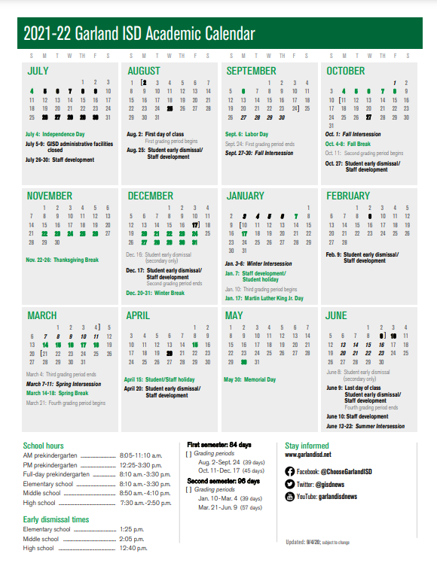
Intersessional Calendar Example
Garland ISD – 2021-2022 Calendar
22 Additional Days through Intersessions
Start Date: August 2, 2021
Intersessions:
9/27 – 10/1 – Fall Intersession
1/3 – 1/6 – Winter Intersession
3/7 – 3/11 – Spring Intersession
6/13 – 6/23 – Summer Intersession
End Date: 6/9/22 for all students, 6/23/22 for students in Summer Intersession
Length of Summer Break: 7 weeks for students in Summer Intersession, 9 weeks for others
bit.ly/garland-isd-calendar

Slide 13
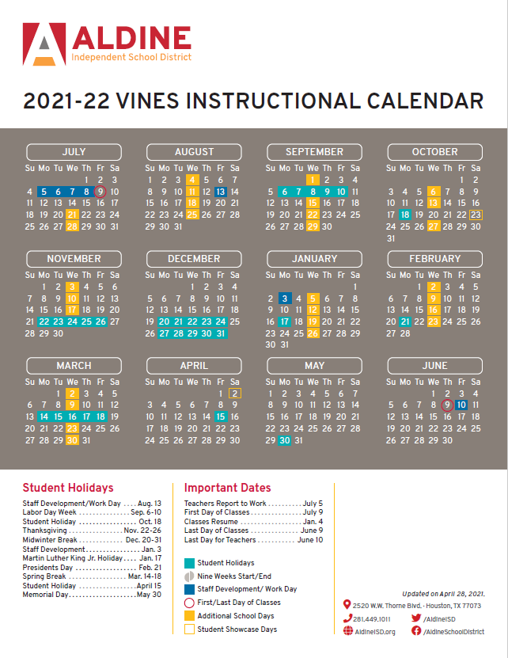
Full Year Redesign Calendar Example
Aldine ISD – 2021-2022 Calendar
30 Additional Days through Full Year Redesign
Start Date: July 9, 2021
Additional Days: Wednesdays throughout the school year (minimizes attendance risks for non-compulsory ADSY funding)
End Date: 6/9/22
Length of Summer Break: 4 weeks for all students
bit.ly/aldine-isd-calendar

Slide 14
ADSY Planning and Execution Program

Slide 15
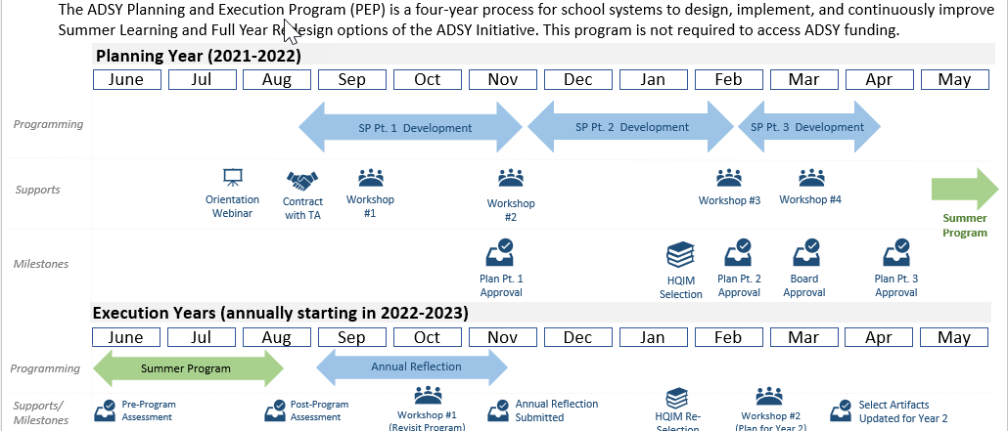
ADSY Planning and Execution Program cont.

Slide 16
ADSY PEP Components
Program Benefits Involving Use of Grant Funds
Additional Program Benefits
ADSY Project Manager and Steering Committee
ADSY Strategic Plan Development (Parts 1 and 2); Annual Reflection and Revision
Approved Technical Assistance Vendors
ADSY Planning and Execution Resources
ADSY Kickoff Summit and Cohort Learning Community Workshops
Ongoing Performance Management Framework

Slide 17
Budgeting for Summer Learning

Slide 18
Budgeting Tools - Most Common Sources of Summer Funding
Funding Source | Federal vs. State | Type of Funding | Funding Delivery Method | Timing for Receiving Funds | Fund Flexibility Level
21st CCLC | Federal | Competitive Grant | New grants are awarded in grant cycles every 2-3 years | One grant cycle is five years long | HIGH: Funds can be used for academics or enrichment
Additional Days School Year | State | Formula Funding | Foundation School Program | State funding cycle (including settle-up) | HIGH: Funds are dispersed as general revenue
Early Education Allotment | State | Formula Funding | Foundation School Program | State funding cycle | HIGH: Funds must go toward improving student performance
English Learner Summer Program | Federal | Formula Funding | EL units are reimbursed on a prorated basis | Annually | LOW: Funds must be used on instruction
State Compensatory Education | State | Formula Funding | Foundation School Program | State funding cycle | HIGH: Funds must go toward increasing academic achievement and reducing dropout rates
Teacher Incentive Allotment | State | Formula Funding | Foundation School Program | Annually | LOW: Only TIA districts are eligible for this funding. Funds must go toward teacher compensation
Title Funds | Federal | Formula Funding | Drawdowns determined by districts | Drawdowns determined by districts | VARIES: Fund use is determined by Title Fund

Slide 19
Example: Stacking ADSY with 21st CCLC Funds
ADSY funds can be ‘stacked’ with 21st Century/ACE funds in the same day if they are used as a supplemental aspect to the program.
ADSY has a minimum instruction requirement of two hours per day
21st CCLC requires a four-hour summer day

Slide 20
Fiscal Timeline Considerations
There are fiscal considerations around timing of funds (ADSY) or extending use of ESSER funds. It is critical to bring your finance team along as a core member of the planning committee.
ADSY Attendance Projections – Attendance is projected on a biennial basis. If you did not project ADSY attendance for 2021-2022 or 2022-2023 in the winter of 2020, you can still receive ADSY funds, however it would be in the settle-up process after the year is over.
Fiscal Year Considerations – Districts with a September 1 fiscal year start date who shift to an earlier staff start date may face a doubled-up salary payment scenario. Switching fiscal year start dates to July 1 can help minimize impact if you are experiencing insufficient cash flow.
Attaching to Associated School Year – Summer ADSY days can be associated with either the previous school year or the following school year. This impacts the grade levels a campus/LEA would invite to the summer program.

Slide 21
Implementation Trends

Slide 22
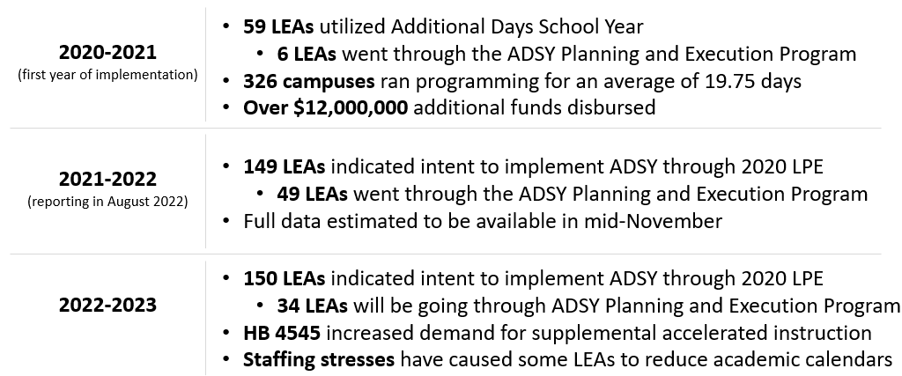
Current ADSY Implementation Trends and Projections

Slide 23
Q&A
For additional questions please visit https://tea.texas.gov/adsy or e-mail adsy@tea.texas.gov

