Slide 1
Census Block Group Tools

Slide 2
AGENDA
Census Block Group Tools
Program Area Updates & Guidance
2022-2023 Changes
Website Updates
Application Updates
Report Updates
Business Rule Updates
Reminders
Timeline
Frequently Asked Questions
Technical Resources
Questions

Slide 3
PROGRAM AREA UPDATES & GUIDANCE
Census Block Tier Mapping for 2023:
How are the Tiers determined in the mapping document?
Are the Census Block Group IDs currently based on 2020 Census data?
Census Block Tier data and Foundation School Programs (FSP):
State Compensatory Education (SCE) Allotment Calculation:
Provides supplemental funding to LEAs to serve the extra needs of students categorized as educationally disadvantaged.
Based on 3 factors and 3 entities:
Federal: Defines a Census Block Group for a specified area based on boundaries determined by the 2020 census.
State/TEA: Tiers are assigned to each of the GEOID Census Block Groups based on annually published statistics.
Local/LEA: For each economically disadvantaged student’s record, as reported on the PEIMS Fall snapshot, the district includes the student’s GEOID based on their home address.

Slide 4
PROGRAM AREA UPDATES & GUIDANCE CONTINUED
Census Block Tier data and Foundation School Programs (FSP):
Teacher Incentive Allotment (TIA)
Provides extra compensation to LEAs for employing a designated teacher.
Allotment calculation is based on the campus’ student point value average as determined by the census block group. The census block group is based on the Census Block Tier Calculation where a student resides.
Students at rural campuses are assigned a point value that is two tiers higher than the one determined by the census block group.

Slide 5
2022-2023: WEBSITE UPDATES
The Census Block Group Tools webpage was updated on July 29, 2022, for the following:
Census Block Group Calculator:​
The spreadsheet and instructions were removed from the website. Users will need to download and utilize the new TSDS Census Block Group tool from the TSDS Portal. ​ ​
Census Block Group Map:​
The map was updated to reference the 2020 US Census data. ​ ​
API Instructions:​
The instructions were updated with the URL for the 2020 US Census data.
The Census Block Group Tier Mapping for 2023 spreadsheet is now available.

Slide 6
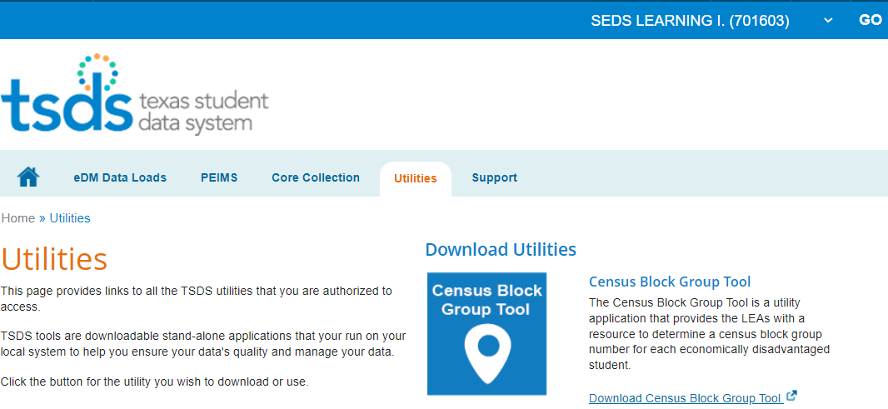
2022-2023: APPLICATION UPDATES
Census Block Group Tool
TEAL Roles/Privileges:
Access with ‘Census Block Group Tool (CBGT)’ privilege under the following TEAL Roles:
PEIMS Data Completer
ODS Data Loader
ODS Campus Data Loader
Users that have an existing TEAL role above will not need to request the ‘Census Block Group Tool (CBGT)’ privilege.
The Census Block Group Tool is now available to download under Utilities tab.

Slide 7
2022-2023: APPLICATION UPDATES CONTINUED 1
Information and Guidance:
Documentation and Training:
Users can access the .pdf help documentation within the downloadable Census Block Group Tool application.
An e-learning video link is now available for users to access that provides a detailed walkthrough of the TSDS Census Block Group Tool.
Improvements:
Previous stability issues with the Census Block Group Tool calculator spreadsheet are expected to be improved with the new Census Block Group Tool application.
The 2020 U.S. Census data will be retrieved from a TEA local server to provide improved performance.

Slide 8
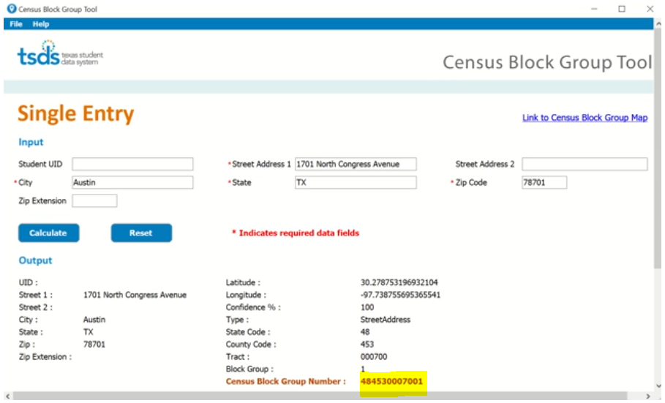
2022-2023: APPLICATION UPDATES CONTINUED 2
Census Block Group Tool (Single Entry Method)
Allows users to quickly obtain/confirm a Census Block Group Number for an individual student.

Slide 9
2022-2023: APPLICATION UPDATES CONTINUED 3
Census Block Group Tool (File Upload Method)
Allows users to obtain the Census Block Group Number for multiple students by uploading a .csv file with the students’ address information.
Information is provided on the number of records and time taken to process.
The Student Census Block Group numbers are listed in the .csv output file.

Slide 10
2022-2023: APPLICATION UPDATES CONTINUED 4
Census Block Group Tool (File Upload Method)
An error message and file is provided when issues are detected within the .csv file.
Users can easily identify the line number and description of the error.

Slide 11
2022-2023: REPORT UPDATES
2022-2023
No New Reports
No Updated Reports
No Deleted Reports

Slide 12
2022-2023: BUSINESS RULES UPDATES
Updated Business Rule Meaning
40100-0224: For students with an invalid Student-Census-Block-Group code, that does not match a Census Block group Code listed in the Census Tier Mapping spreadsheet for 2022-2023, the student would be assigned to ‘Tier 5’ which is the lowest Tier.

Slide 13
2022-2023: REMINDERS
The census block group number is collected in the PEIMS Fall submission on the StudentExtension complex type

Slide 14
2022-2023: TIMELINE
PEIMS Fall Submission (Sub 1) | Date
TSDS ready to load data to eDM | August 1, 2022
PEIMS Fall submission ready for users to promote data | September 12, 2022
Close of school-start window - Last Friday in September | September 30, 2022
PEIMS Fall snapshot date | October 28, 2022
TSDS PEIMS Fall ready for users to complete, approve, and accept submissions | October 31, 2022
PEIMS Fall first submission due date for LEAs and ESCs | December 8, 2022
PEIMS Fall resubmission due date for LEAs and ESC | January 19, 2023

Slide 15
FREQUENTLY ASKED QUESTIONS
Will the existing Census Block Group Calculator spreadsheet be replaced by this new Census Block Group Tool application?
LEAs will use the downloadable TSDS Census Block Calculator Tool to obtain their Student Census Block Group numbers. The Census Block Group Calculator spreadsheet that is currently available on the TEA Census Block Group Tools website was removed on July 29th.

Slide 16
FREQUENTLY ASKED QUESTIONS CONTINUED
Will the new Downloadable CBGT work if the link to the US Census Data Servers are down?
Yes. The new TSDS Census Block Group Tool utility will retrieve 2020 U.S. Census data from a local server at TEA. This will allow users to quickly retrieve Census Block Group data and avoid being reliant on connecting directly to the US Census Data Servers to retrieve information.

Slide 17
TECHNICAL RESOURCES
Technical Support:​
TSDSCustomerSupport@tea.texas.gov ​
Instructions/Documentation:
Census Block Group Tools
Training:
Census Block Group Tools e-learning video link
Knowledge Base Articles:
TSDSKB-595 Census Block Group Number Information / FAQs

Slide 18
Questions

