Slide 1
Early Childhood Data System

Slide 2
PLEASE NOTE:
The focus of this presentation is on the changes for the official XML data submissions during the 2022-2023 school year.

Slide 3
AGENDA
Early Childhood Data System (ECDS)
Program Area Updates & Guidance
2021-2022
Submission Updates
Reminders
Current Known Issue
2022-2023 Changes
Application Updates
Data Element Updates
Business Rule Updates
Report Updates
Code Table Updates
Timeline
Frequently Asked Questions
Technical Resources
Questions

Slide 4
PROGRAM AREA UPDATES & GUIDANCE
ECDS KG Assessment Data Submission
Support issues with ECDS assessment vendors.
Mid-Year checkpoint on ECDS submission before holidays.
Assessment Support
Our assessment support grantee (Region 4) will begin making touchpoints with LEAs to aid and/or support throughout the submission window process.
ECDS Commissioner Approved Assessment List Updates
TEA is currently working on a deeper analysis of the current tools to make informed decisions and processes on updating the list.

Slide 5
PROGRAM AREA UPDATES & GUIDANCE - Continued
PK partnership updates:
Preliminary data from 2021-2022 shows more LEAs reporting partnership classrooms and with greater accuracy using the updated school type codes definitions.
LEAs should remember that when submitting for Head Start partnerships (school type code 07), some will have operation numbers to report while others will not.
A Head Start partnership housed on a LEA campus, or if the LEA is the grantee, will NOT have an operation number. The data field for the operation number will be left blank.
A Head Start partnership housed at a “stand alone” childcare site will have an operation number.
The data field for the operation number contains space for eight digits but most operation numbers contain six or seven digits. When the number is entered, zeros should precede to fill extra spaces.
For example, 123456 should be entered as 00123456 to fill the data field.

Slide 6
2021-2022: SUBMISSION UPDATES
The 2021-2022 ECDS Prekindergarten data collection closed on June 23, 2022.​
Final Submission Count: 1,081

Slide 7
2021-2022: REMINDERS
Reports:
ESCs and LEAs can run the ECD0-000-003 Assessment Pre-K Sources report for 2020-2021 to see 2021-2022 KG assessment readiness results compared to same students enrolled in a pre-K program for 2020-2021.
ESCs and LEAs will not be able to see the KG readiness information on the ECD0-000-003 report for 2021-2022 until Kindergarten assessment results are promoted for the 2022-2023 ECDS Kindergarten submission.
Assessment Specifications:
The 2022-2023 ECDS ‘Assessment Specifications’ link is tentatively scheduled to be posted to TWEDS on August 15th.

Slide 8
CURRENT KNOWN ISSUE
ECD0-000-006​ Early Childhood PK Data Submission report
The 'Date of Birth' and 'Administration Date' are displaying '0' values on the .csv version of the report.
LEAs can use the .pdf version to verify 'Date of Birth' and 'Administration Date' for pre-K students.
This issue is scheduled to be resolved in the September 9, 2022 software release.

Slide 9
2022-2023

Slide 10
2022-2023 CHANGES
2022-2023
No Application Updates
No Data Element Updates
No Business Rules Updates

Slide 11
2022-2023: REPORT UPDATES
ECDS Kindergarten assessment updates
The Kindergarten readiness information for the reports below will be updated to reflect the updates listed in the ‘Assessment Specifications’ link in TWEDS for the BOY KG TX-KEA English/Spanish assessments:
ECDS KG reports impacted:
ECD0-000-002 Early Childhood Assessment Summary
ECD0-000-004 Early Childhood KG Data Submission
ECDS PK reports impacted:
ECD0-000-003 Early Childhood Assessment With PK Sources

Slide 12
2022-2023: REPORT UPDATES CONTINUED 1
ECDS Prekindergarten assessment updates
The “% BOY/EOY Proficiency Score” information for the reports below will be updated to reflect the updates listed in the ‘Assessment Specifications’ in TWEDS for the following prekindergarten assessments:
BOY/EOY PK GOLD English/Spanish
BOY/EOY PK ISIP - Early Reading English
BOY PK Frog Street Assessment Spanish
EOY PK Frog Street Assessment English/Spanish
EOY PK CIRCLE CLI Spanish
ECDS PK Reports Impacted:
ECD0-000-008 Early Childhood PK Proficiency Summary

Slide 13
2022-2023: REPORT UPDATES CONTINUED 2
ECD0-000-010: Early Childhood High Quality PK Components Completion (ESC level)
The Early Childhood Education (ECE) program area has requested the addition of one column, "Number HQ PK Classes“, to help the ESCs better discern if their LEAs' section data is correct for HQ PK.
This update is scheduled for the November 4, 2022 software release.

Slide 14
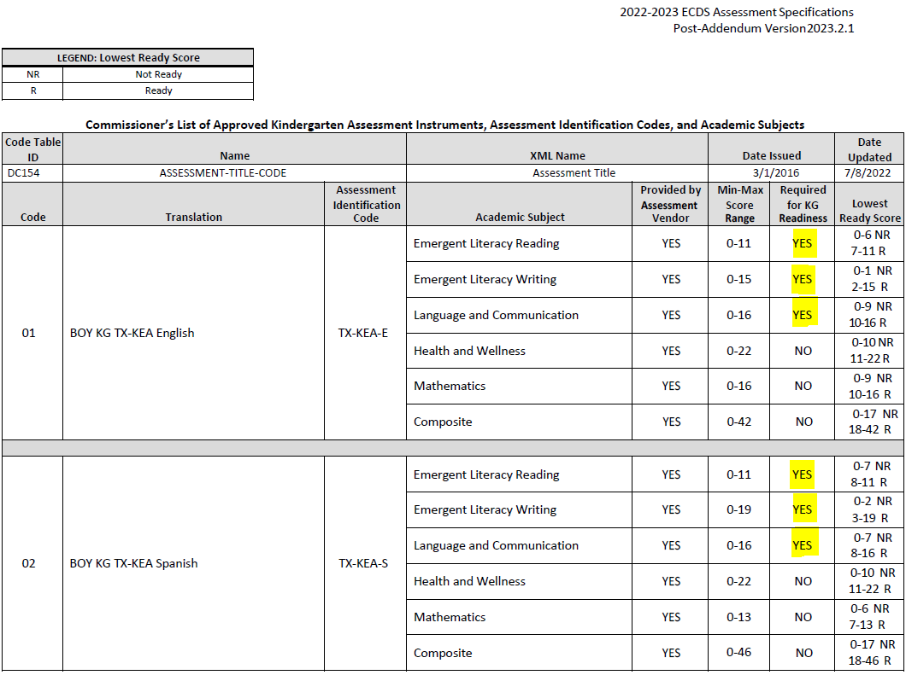
2022-2023: REPORT UPDATES CONTINUED 3
ECDS Kindergarten assessment updates
BOY KG TX-KEA English/Spanish
The ‘Required for KG Readiness’ will be calculated based on ‘Lowest Ready Score’ for the following academic subjects listed in the ‘Assessment Specifications’ link in TWEDS:
Emergent Literacy Reading, Emergent Literacy Writing, Language and Communication

Slide 15
2022-2023: CODE TABLE UPDATES
2022-2023 (Kindergarten Assessments)
DC154 - ASSESEMENT-TITLE-CODE

Slide 16
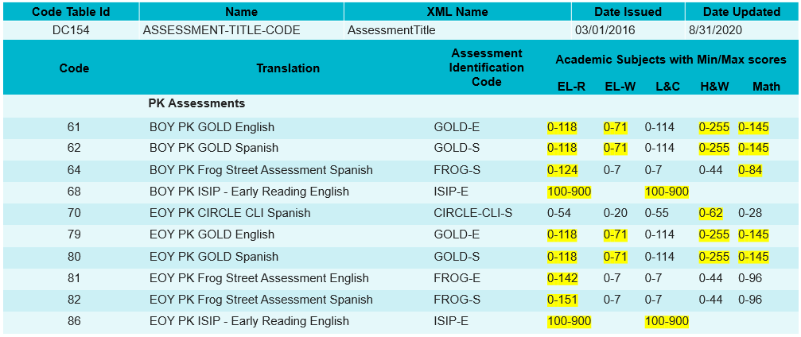
2022-2023: CODE TABLE UPDATES CONTINUED
2022-2023 (Prekindergarten Assessments)
DC154 - ASSESEMENT-TITLE-CODE

Slide 17
2022-2023: TIMELINE
Early Childhood Data System Collection (ECDS) - KG | Date
TSDS ready to load data to eDM | August 1, 2022
ECDS Kindergarten ready for users to promote data | November 7, 2022
ECDS Kindergarten submission due date for LEAs | January 26, 2023
ECDS Kindergarten data available to customers | February 9, 2023

Slide 18
2022-2023: TIMELINE - Continued
Early Childhood Data System Collection (ECDS) - PK | Date
TSDS ready to load data to eDM | August 1, 2022
ECDS Prekindergarten ready for users to promote data | November 7, 2022
Private Prekindergarten application deadline for BPD (Business Partner Directory) Org number | May 25, 2023
ECDS Prekindergarten submission due date for LEAs and Private Prekindergarten Organizations | June 22, 2023
ECDS Prekindergarten data available to customers | July 6, 2023

Slide 19
FREQUENTLY ASKED QUESTIONS
Will the ECDS pre-K assessment vendors be sending their assessment data to TEA on behalf of the LEAs for the 2022-2023 school year?
The prekindergarten process will remain the same for 2022-2023 as it was for 2021-2022. LEAs are expected to obtain their assessment results directly from their ECDS vendor and are responsible for loading their assessment data into the ODS. Prekindergarten assessment results will NOT be provided directly to TEA.

Slide 20
FREQUENTLY ASKED QUESTIONS CONTINUED
Will the frequency of ECDS KG assessment data sent to TEA by the ECDS assessment vendors be increased for the 2022-2023 school year?
The ECE program area is working with CLI and Amplify to review the frequency of assessment updates that are sent to TEA for the 2022-2023 school year.

Slide 21
TECHNICAL RESOURCES
Technical Support:
TSDSCustomerSupport@tea.texas.gov
ECDS Program Area:
Early Childhood Education Website
ECDS Quick Support Guide
Knowledge Base Articles:
TSDSKB-249 ECDS: General FAQs
TSDSKB-508 ECDS: Assessment Specifications

Slide 22
Questions

